Slide 1
Michael W. Johnson
NSSGA President & CEO

Slide 2
NSSGA Mission
NSSGA is the leading voice and advocate for the aggregates industry. We advance public policies that protect and expand the safe and environmentally-responsible use of aggregates that build America’s infrastructure and economy.

Slide 3
Advocacy is Job #1
Infrastructure Investment
Regulatory Reform
Industrial Health
Workforce
Access to Aggregates

Slide 4
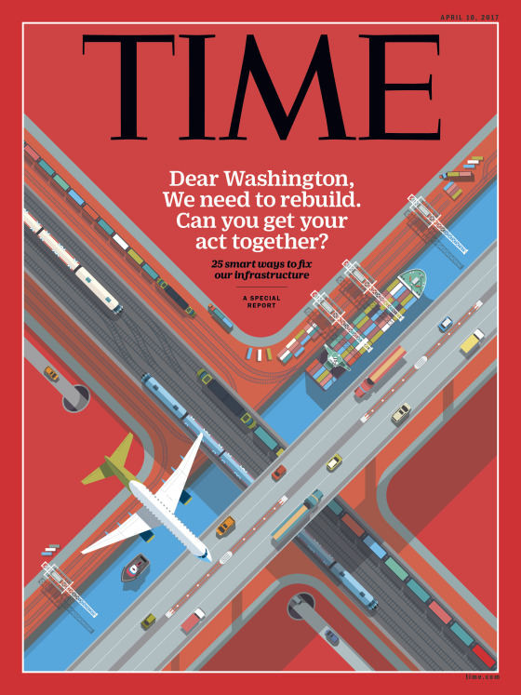
Infrastructure Investment
Robust Funding at the Federal Level
Multi-year Authorizations
Annual Appropriations – Not CR’s
Replenishing the Highway Trust Fund
Shortfall, 2020 cliff
Long-term funding solution
No one time shot – NEED RELIABLE

Slide 5
ASCE Infrastructure Report Card
Notes:
Roads: D
6.9 billion hours of delayed in traffic, 42 hours per driver
Wasted 3.1 billion gallons of fuel
TOTAL COST: $160 billion
Fallen to 28th in spending as % of GDP: behind Ireland, Greece and the former Soviet Republics
By 2030: - 25% increase in overall vehicle travel and -64% increase in travel by large commercial trucks
Aviation: D
US airports serve 2 million passengers daily, $562 billion in cargo annually in addition, that will double by 2040
$22 billion estimated by FAA as cost of congestion and delays
If flat federal funding
$34 billion in 2020
$63 billion by 2040
Rail B
$27 billion in improvements in one year by the freight railroads
Railroads are experiencing resurgence
Freight transportation
City-to-city passenger service
2012 – Amtrak – highest ridership 31.2 million passengers (double 2000)
Railroads transport 43% of the nation’s intercity freight and about one-third of U.S. exports, such as wheat and coal.
Congestions (near Chicago & Northeast Corridor) costing U.S. economy
$200 billion a year, or 1.6% of U.S. economic output
Railroad freight tonnage growth is estimated to grow by 22% by 2035, rising from 12.5 billion tons to 15.3 billion tons.
Both freight and passenger rail investing thru Public-Private-Partnerships
Rails, bridges and tunnels
2009 – Investment (duing Great Recession) exceeded $75 bil
2010 – 3,100 miles of freight rail renewed (equivalent to going coast to coast)
Ports C-
95% of America’s overseas trade passes through ports
Approximately 76 % of America’s international exports accessed global markets by water in 2010, valued at over $460 billion
Approximately 70 % (by tonnage) of U.S. imports arrived to the U.S. by water in 2010, valued at over $940 billion
Capital investments (2012 – 2020)
75% of funds needed for maintenance and upgrades
25% of the capital investment needed for expansion
Inadequate connections from the port terminals to the surrounding roads and rail lines is an even bigger problem
Port connecting roads twice as deficient as non-Interstate routes
Nonexistent shoulders
Narrow road widths and turn lanes

Slide 6
The World Economic Forum Global Competitiveness Report 2015-2016
Japan
Switzerland
Hong Kong SAR
Spain
Finland
France
Netherlands
Singapore
Germany
Korea, Rep.
Chinese Taipei
Austria
Malaysia
Luxembourg
United States
Notes:
Railroads are experiencing resurgence
Freight transportation
City-to-city passenger service
2012 – Amtrak – highest ridership 31.2 million passengers (double 2000)
Railroads transport 43% of the nation’s intercity freight and about one-third of U.S. exports, such as wheat and coal.
Congestions (near Chicago & Northeast Corridor) costing U.S. economy
$200 billion a year, or 1.6% of U.S. economic output
Railroad freight tonnage growth is estimated to grow by 22% by 2035, rising from 12.5 billion tons to 15.3 billion tons.
Both freight and passenger rail investing thru Public-Private-Partnerships
Rails, bridges and tunnels
2009 – Investment (duing Great Recession) exceeded $75 bil
2010 – 3,100 miles of freight rail renewed (equivalent to going coast to coast)

Slide 7
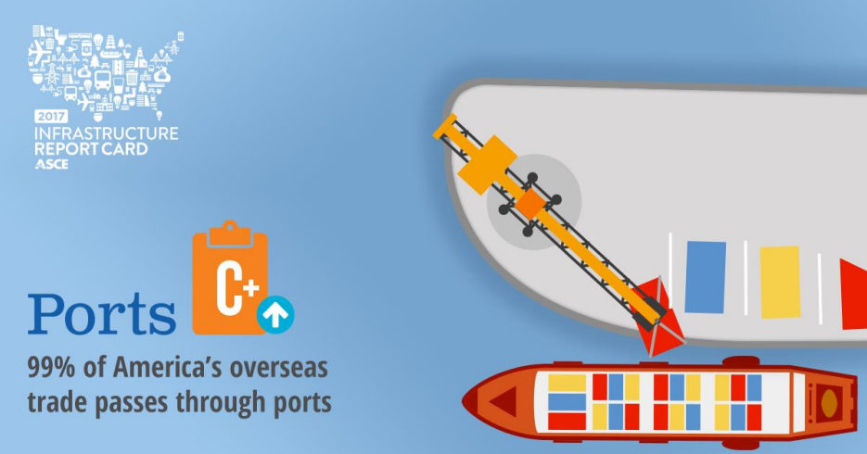
The World Economic Forum
Global Competitiveness Report 2015-2016
Netherlands
Singapore
United Arab Emirates
Finland
Hong Kong SAR
Belgium
Panama
Iceland
Denmark
United States
United Kingdom
Spain
Sweden
Notes:
95% (by volume) of overseas trade (import and export) moves thru U.S. ports
Approximately 76 % of America’s international exports accessed global markets by water in 2010, valued at over $460 billion
Approximately 70 % (by tonnage) of U.S. imports arrived to the U.S. by water in 2010, valued at over $940 billion
Capital investments (2012 – 2020)
75% of funds needed for maintenance and upgrades
25% of the capital investment needed for expansion
Inadequate connections from the port terminals to the surrounding roads and rail lines is an even bigger problem
Port connecting roads twice as deficient as non-Interstate routes
Nonexistent shoulders
Narrow road widths and turn lanes

Slide 8
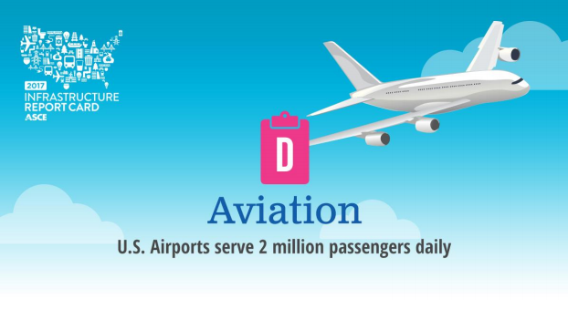
The World Economic Forum
Global Competitiveness Report 2015-2016
Singapore
United Arab Emirates
Hong Kong SAR
Netherlands
United States
Panama
Qatar
Switzerland
Finland
Norway
Germany
Spain
Iceland
South Africa
France
Notes:
Today U.S. Airports carry
$562 billion in cargo annually in addition
To double by 2040
728 million passengers enplanements
Rise to 1 bil by 2040
$22 billion estimated by FAA as cost of congestion and delays
If flat federal funding
$34 billion in 2020
$63 billion by 2040

Slide 9
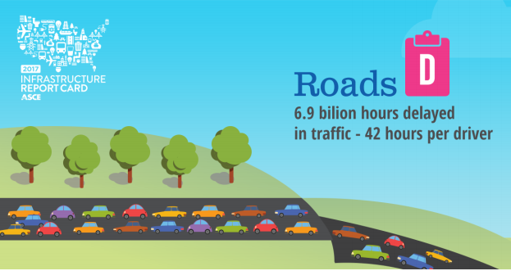
The World Economic Forum
Global Competitiveness Report 2015-2016
United Arab Emirates
Netherlands
Singapore
Portugal
Hong Kong SAR
Austria
France
Japan
Switzerland
Chinese Taipei
Spain
Finland
Germany
United States
Malaysia
Notes:
CONGESTION
6.9 billion hours delayed in traffic
42 hours per driver.
Wasted 3.1 billion gallons of fuel
TOTAL COST: $160 billion
Fallen to 28th in spending as % of GDP
Behind powerhouses
Ireland
Greece
Former Soviet Republics
By 2030:
-25% increase in overall vehicle travel
-64% increase in travel by large commercial trucks

Slide 10
Michigan Report Card
Notes:
Michigan:
it costs each driver $645 per year due to driving on roads in need of repair
10% of bridges are rated structurally deficient; and
172 dams are considered to be high-hazard potential

Slide 11
$4.6 Trillion
Notes:
System needs (2016-2025)
-$4.6 trillion total
-$2.5 trillion expected estimated funding
- NSSGA advocacy a big part of getting that $2.5 into the steam and keeping it!
- $2.1 trillion shortfall over the next 5 years!

Slide 12
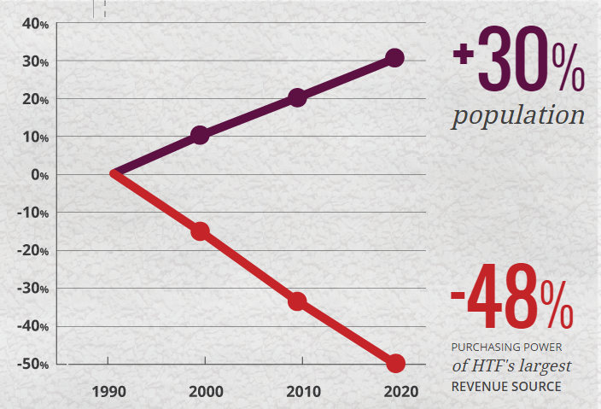
Investment hasn’t kept up
Notes:
We are here because
U.S population grown, and
Demands on the system has increased, yet
Investment has NOT kept up

Slide 13
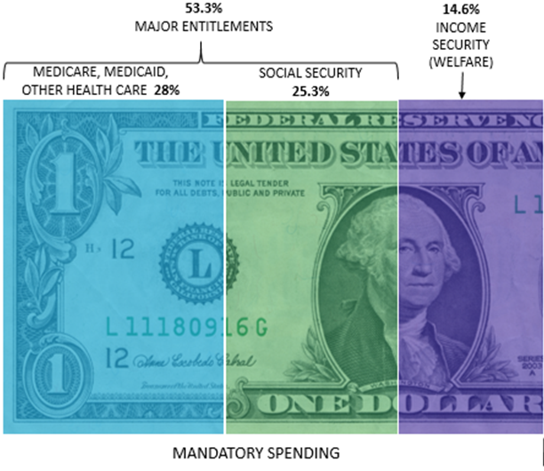
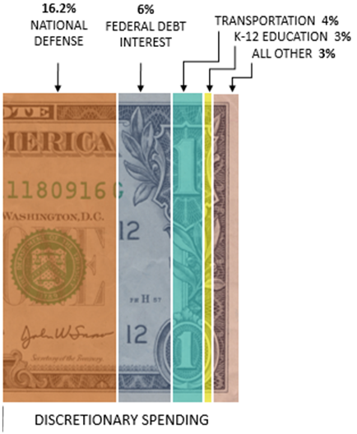
Notes:
53.3% - Major Entitlements
(Medicare, Medicaid, Social Security)
14.6% - Poverty programs (welfare)
16.2% - Defense
6% - National debt
TOTAL: 90%
10% left
4% transportation
3% education
3% everything else

Slide 14
$3 Trillion in New Debt
Trump Inaug.
Notes:
Since Trump:
$1.5 trillion tax-cut package
$400 billion FY18 budget
By 2028:
National Debt $29.4 trillion (101% of GDP)

Slide 15
Meeting the Demand…
A Good Problem to Have!

Slide 16
New WOTUS Rule Announced
Federally regulated under the Clean Water Act = Navigable Waters and those immediately connected
New Navigable Waters Rule (WOTUS) announced – includes much of what we advocated for to fix the previous rule
Notes:
We continue to work with EPA to limit overregulation.
In April, 12 federal agencies agreed to limit National Environmental Policy Act (NEPA) reviews to two years and assign a specific agency to lead the review.
New Navigable Waters rule (definition of WOTUS) was announced Jan. 23 by EPA. This is a big win for our industry and a result of the engagement and advocacy of our members and staff over the past several years.

Slide 17
MSHA
“Historically … MSHA has been typically viewed as a coal-centric organization. As we move forward, it has to be viewed as more of a mining-centric organization.”

Slide 18
Safety is a Top Priority!
ONE MSHA Initiative
Powered Haulage Comments
MSHA Alliance
SEAT BELTS!
Notes:
One MSHA effort: should impact members regionally – if you are in a coal area, you will have coal inspectors coming to your facility. MSHA has done extensive training and has done 86 aggregates operations, with no complaints we know of; MSHA is also internally reorganizing to blur the lines between coal and non coal sectors
MSHA alliance partnership continues to improve safety
NSSGA provided comments to MSHA on powered haulage in December

Slide 19
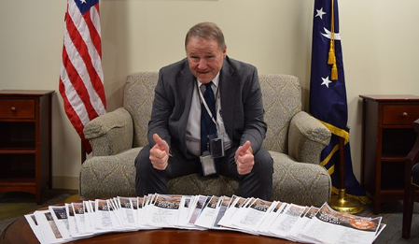
Why Risk It? Just Click It!
Notes:
NSSGA offered to provide breakroom posters and helmet stickers to all producer member companies
We heard from 46 producer member companies.
We produced and supplied over 1,200 breakroom posters and 18,000 helmet stickers for those member companies
Pledge sheets were presented to Assistant Secretary Zatezalo at our Legislative & Policy Forum in November.

Slide 20
Industrial Health - Silica
Notes:
March 2016 – OSHA releases final rule that halves the workplace exposure limit for general industry, from 100 to 50 (micrograms of respirable crystalline silica per cubic meter of air, measured over an 8-hour shift).
“General industry” includes ready-mixed and asphaltic concrete production facilities, and off-site aggregates sales yards.
For the construction industry, the limit drops from 250 to 50.
NSSGA filed formal comments with OSHA and challenged the rule in federal court:
OSHA cherry-picked the science in support of the rule
OSHA’s economic analysis was substantially flawed
The existing limit (100) protects workers when fully complied with.
Many labs cannot reliably test at the new limit (50).
December 2017 – Circuit Court challenge goes in favor of OSHA
NSSGA holds that OSHA ignored a substantial body of science-based evidence—including studies by the U.S. Centers for Disease Control and Prevention—that full compliance with the 1972 workplace exposure limit protects worker health.

Slide 21
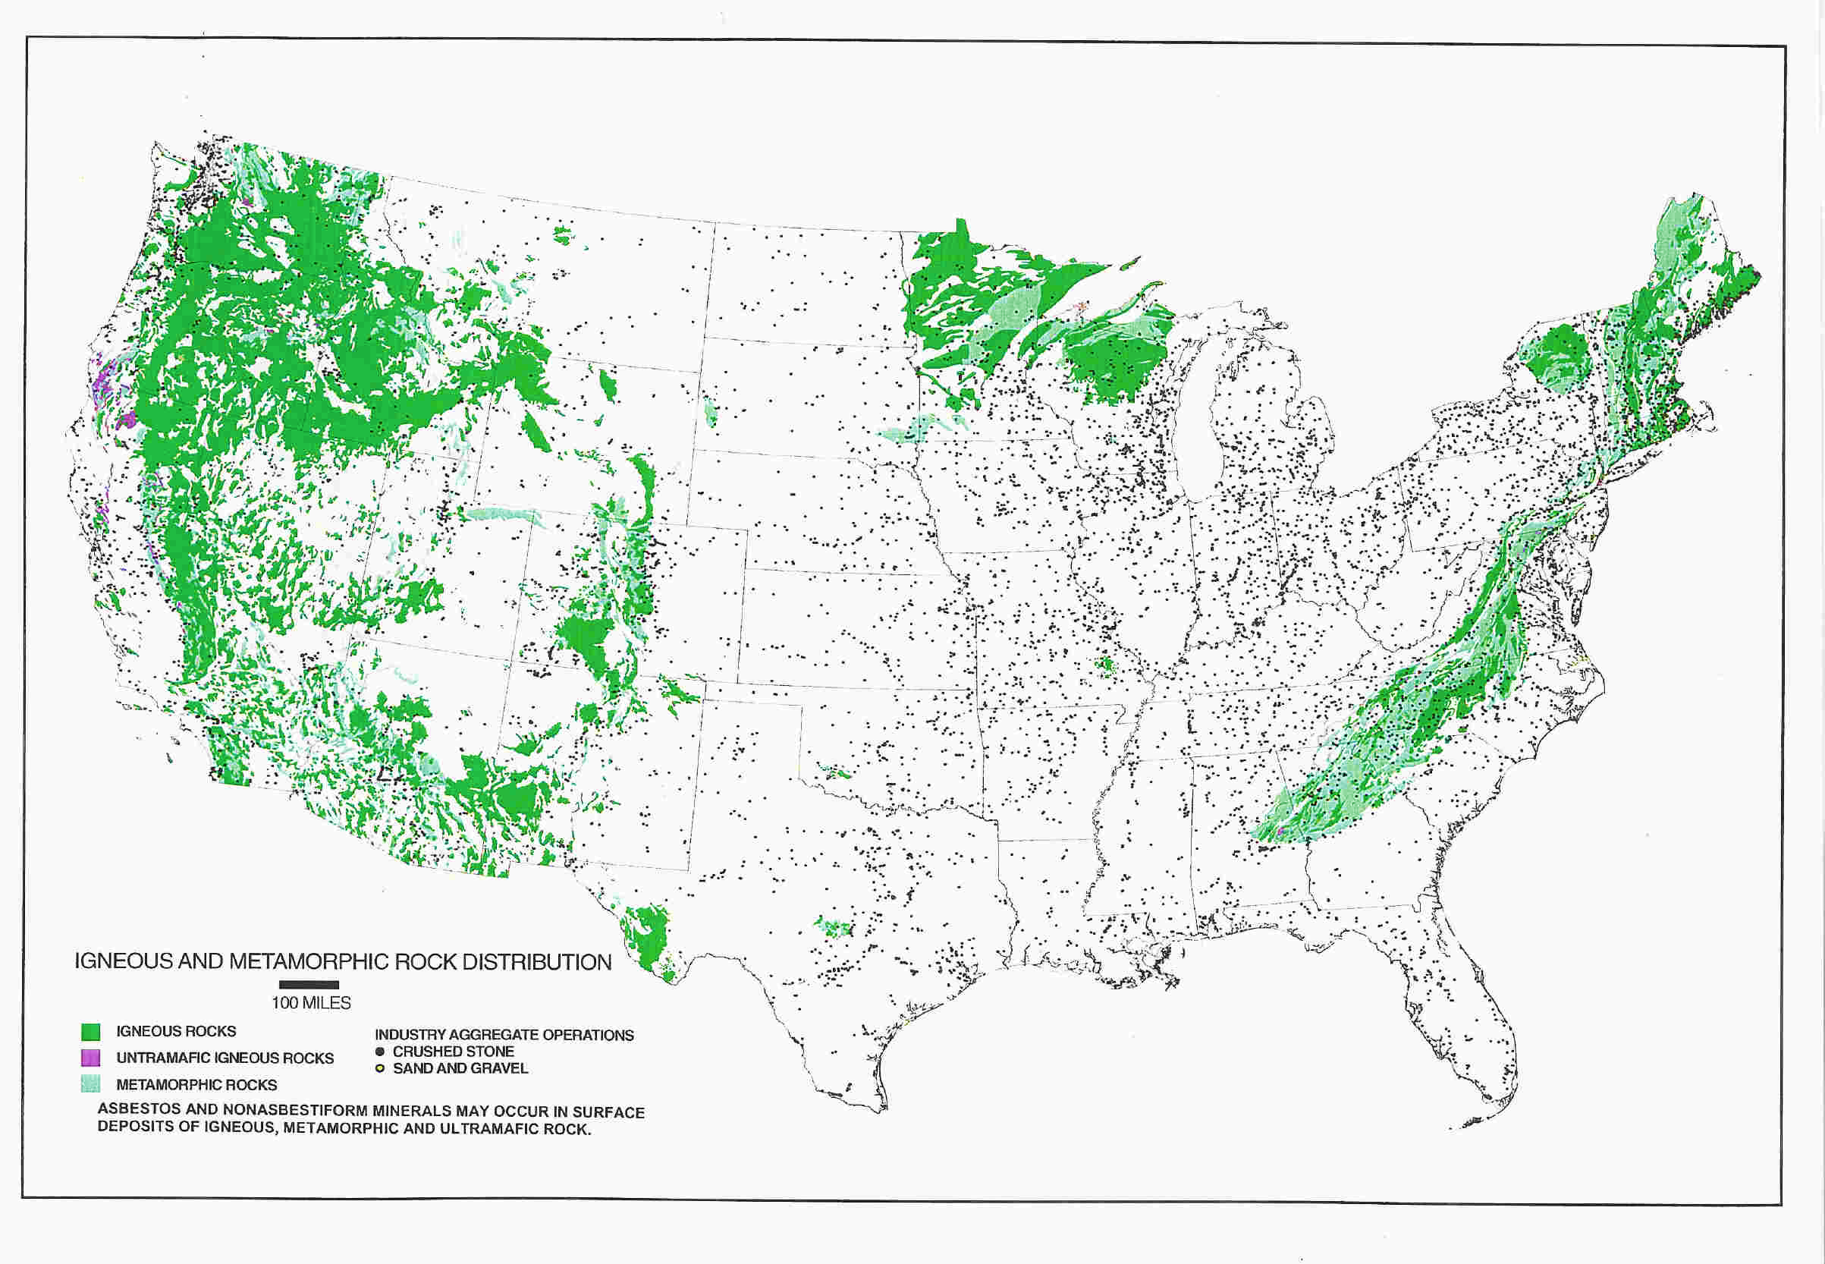
Industrial Health - NOA
>EPA Risk Assessment for Asbestos
>HR 1603: Ban Asbestos Now Act
>0% Bills in the States
Notes:
Goals:
EPA: De minimis levels of NOA an insignificant hazard
EPA retains accurate definitions and 1 percent limit
EPA agrees OSHA/MSHA regs protective
Continuing science-based research
Educating stakeholders
Will oppose regulations not supported by sound science

Slide 22
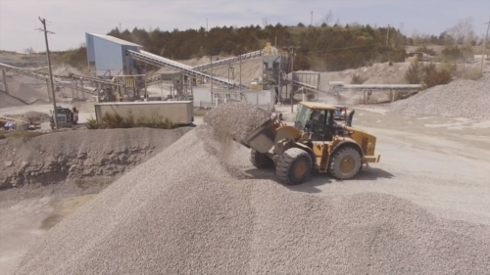
Workforce & Innovative Materials
Workforce Development
Innovative Materials
Notes:
Ensuring availability to quality aggregates for our members
Including mining bans and NIMBY issues
Advocate for updating the Endangered Species Act
NSSGA has formed a task force within our Government Affairs Committee to address Innovative Materials from aggregates perspective
Continue to foster relations with FAA/FHWA
Provide forum for our members to explore how to best acquire talent in the workforce

Slide 23
The ROCKS Act
Rebuilding Our Communities by Keeping aggregates Sustainable
Notes:
introduced by U.S. Reps. Greg Stanton (AZ-09) and Troy Balderson (OH-12)
establish a working group of federal, state and local stakeholders to examine the use of aggregates
institute a federal policy to ensure continued access to this critical resource
Part of our efforts to ensure access to aggregates

Slide 24
#1
Everybody Wants What You Got!

Slide 25
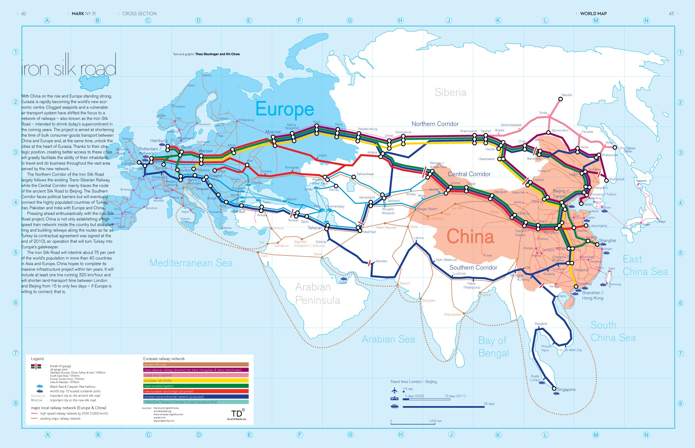
The New Silk Road
Notes:
More than 2,000 years ago, China’s Han Dynasty launched the Silk Road.
A sprawling network of commerce that linked South and Central Asia with the Middle East and Europe.
Today, there is a new Silk Road. The Chinese government will build infrastructure in exchange for access to new markets and trade benefits.
They’re playing chess and we’re playing checkers.

Slide 26
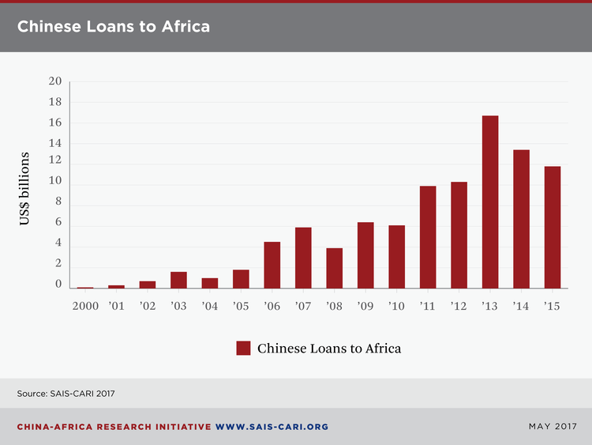
2001 – 2011
49 countries
$175 billion
Notes:
A study by the Rand Corporation used media reports and an expansive definition of “aid” (all Chinese government-related flows, including foreign direct investment) to estimate that “between 2001 and 2011, 49 countries in Africa received approximately $175 billion.”

Slide 27
Better Together…
for Commitment!
for Engagement!
for ADVOCACY!
You are Your Own
Best Advocate!

Slide 28
2020 NSSGA Annual Convention
Notes:
NSSGA’s 2020 Annual Convention will take place in Las Vegas, March 8-10.
This is one of the two times each year, our members gather together – along with the Legislative & Policy Forum.
At our Annual Convention, we will conduct the business of the association and look to lay out our strategic direction for the future.

Slide 29
Michael W. Johnson
NSSGA President & CEO

