Slide 1


UPDATE
Acting Director, Brad Wieferich, P.E.
February 9, 2023
ANNUAL CONFERENCE

Slide 2
Today’s Topics
Program & Accomplishments
Work Zone Safety Task Force Initiatives
IIJA Impact and Plans

Slide 3
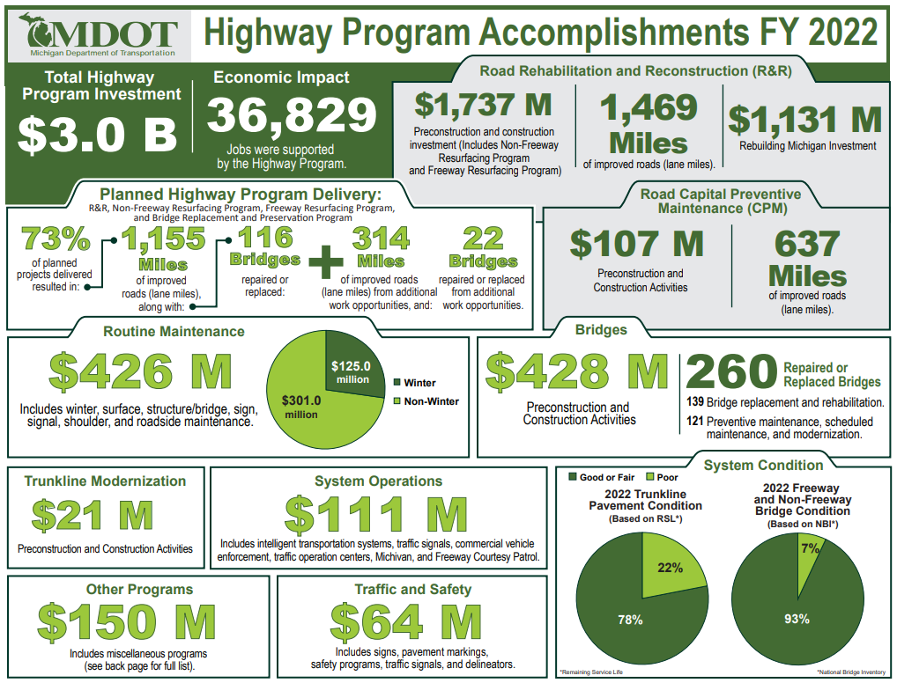

Slide 4
2023 Construction Program
(Trunkline Only)
*This information represents the total number of projects and dollars scheduled to be let in a given month. Therefore, the sum of values will not directly correlate to program year budgets, and this information is always subject to change.
Report Date: Jan. 3, 2023

Slide 5
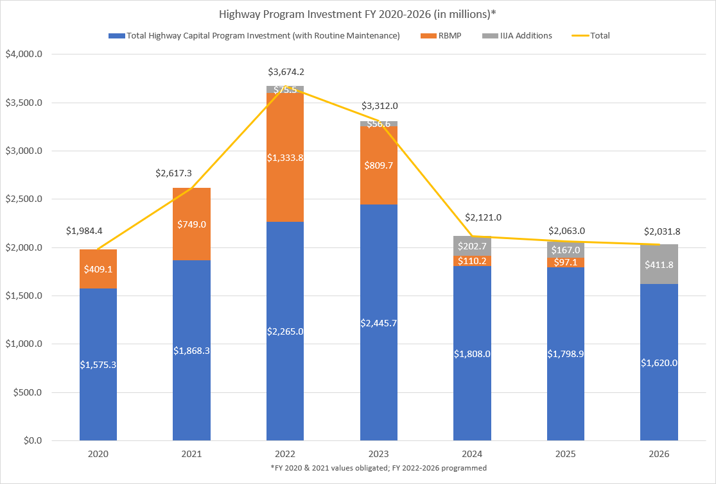

Slide 6
Quantity Values
This information is draft and may change as the program is developed.

Slide 7
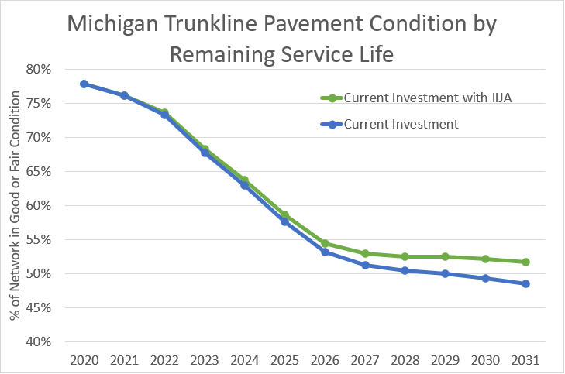

Slide 8

Working together, MDOT and the heavy construction industry are advancing our culture and practices to put SAFETY FIRST in Michigan’s work zones.

Slide 9
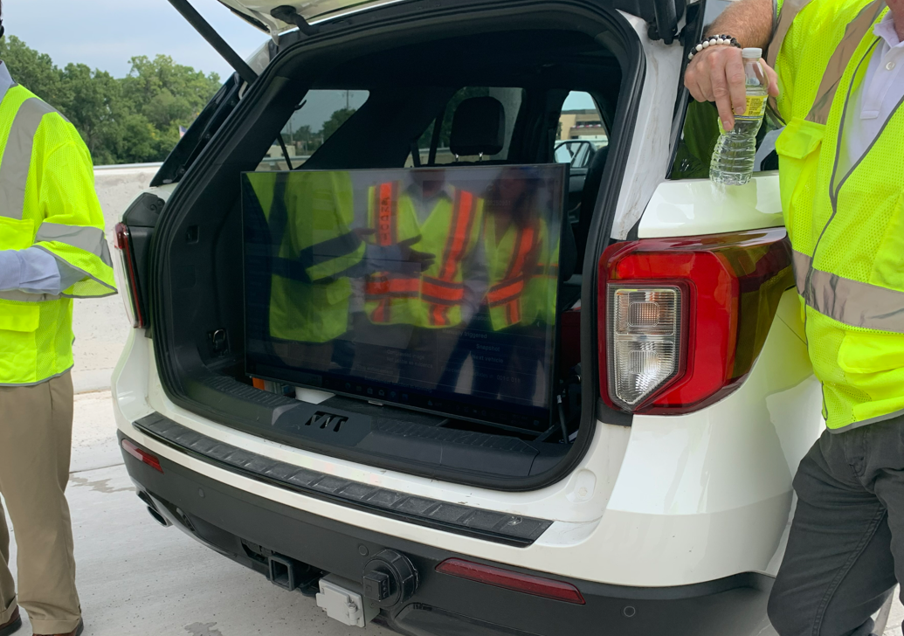
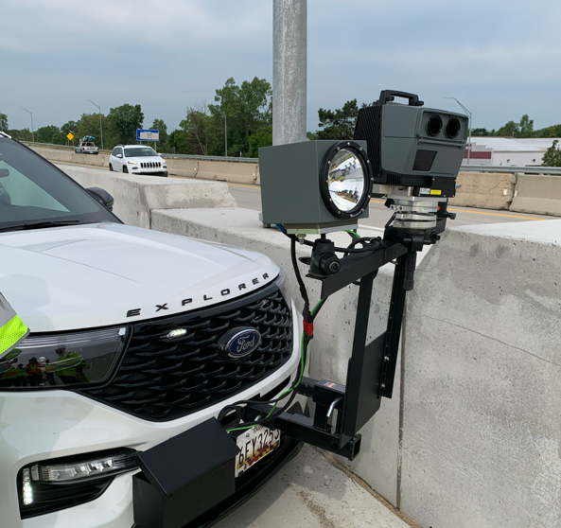
Automated Work Zone Enforcement Pilots
House Bill 5750 introduces the definition of an Automated Speed Enforcement System to MI Vehicle Code
Piloted Automated WZ Enforcement in 2 locations this summer
Supported by a joint effort of industry, MDOT and Michigan State Police

Slide 10
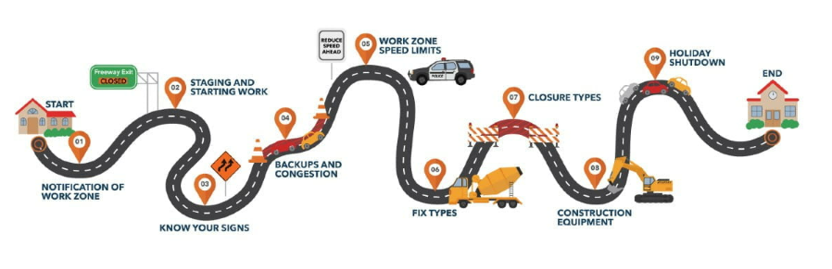
Education via
Work Zones 101-page
Users can take themselves on a self paced Intro to Work Zones.
This includes knowing your signs, your equipment, the process, speed limits and closure types

Slide 11
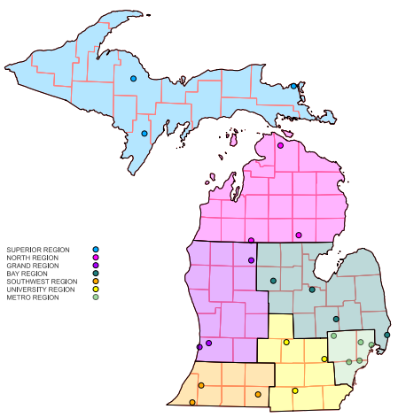
Safety Collaboration Special Provision
Previously approved Special Provision may be destined to be a Frequently Used Special Provision in 2024
Honors commitment to collaborate on necessary safety improvements

Slide 12
IIJA Impact
& Plans

Slide 13
IIJA Funding Overview
$1.2 Trillion in Total Infrastructure Investment
$550 Billion in new federal money
  Road, Bridges, & Major Projects - $110 Billion
  Passenger and Freight Rail - $66 Billion
  Power and Grid - $65 Billion
  Broadband - $65 Billion
  Water Infrastructure - $55 Billion
  Resiliency - $47.2 Billion
  Public Transit - $39.2 Billion
  Airports - $25 Billion
  Addressing Legacy Pollution - $21 Billion
  Ports and Waterways - $17 Billion
  Safety - $11 Billion
  Western Water Infrastructure - $8.3 Billion
  Clean School Buses and Ferries - $7.5 Billion
  Electric Vehicle Charging - $7.5 Billion
  Reconnecting Communities - $1 Billion
* Sectors with new Highway Program Funding Bolded

Slide 14
High Points of IIJA Highway Provisions
Funds highway programs for five years (FY 22-26)
$350.8 B (FY 22-26) for highway programs
$303.5 B in Contract Authority (CA) from the Highway Trust Fund (HTF)
+$47.3 B in advance appropriations from the General Fund (GF)
More than a dozen new highway programs, including:
Formula: resilience, carbon reduction, bridges and electric vehicle (EV) charging infrastructure
Discretionary: bridges, EV charging infrastructure, rural projects, resilience, wildlife crossings, and reconnecting communities
Focus on safety, bridges, climate change, resilience, and project delivery
More opportunities for local governments and other non-traditional entities to access new funding
$90 B transfer (GF->HTF) to keep the HTF Highway Account solvent for years

Slide 15
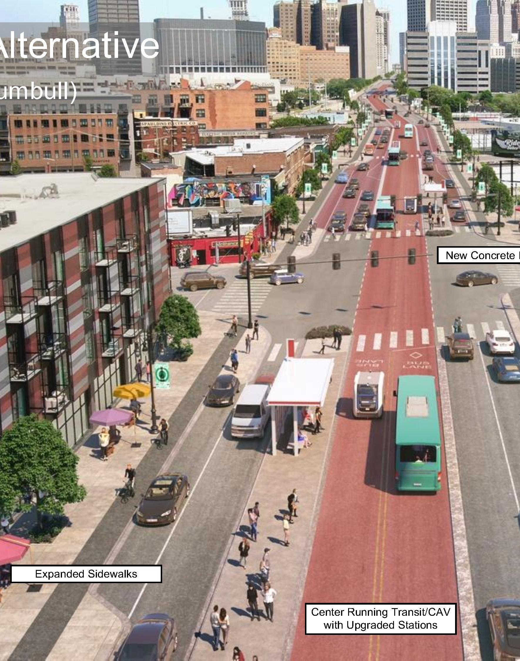
Michigan Main
Streets Approach
Safety and Access for All Users
Dig Once Approach
Drinking Water Systems
Storm Water/Climate Change Resiliency
Broadband
Electrification
Leverage IIJA Discretionary Grants & Other Infrastructure Funding Categories

Slide 16
Funding Available to a Range of Recipients
Program Examples | State | MPO | Local | Tribe | PA* | Territory | FLMA*
Apportioned programs (formula) | ✓
Bridge Program (formula) | ✓ |  |  | ✓
National Electric Vehicle Formula Program | ✓ |  | ✓
Safe Streets and Roads for All program |  | ✓ | ✓ | ✓
PROTECT Grants (discretionary) | ✓ | ✓ | ✓ | ✓ | ✓ |  | ✓
Charging and Fueling Infrastructure Program | ✓ | ✓ | ✓ | ✓ | ✓ | ✓
Congestion Relief Program | ✓ | ✓ | ✓
Bridge Investment Program (discretionary) | ✓ | ✓ | ✓ | ✓ | ✓ |  | ✓
Reconnecting Communities Pilot Program | ✓ | ✓ | ✓ | ✓
Rural Surface Transportation Grants | ✓ |  | ✓ | ✓
INFRA | ✓ | ✓ | ✓ | ✓ | ✓ |  | ✓
Nat’l Infra. Project Assistance | ✓ | ✓ | ✓ | ✓ | ✓
Local and Regional Project Assistance | ✓ | ✓ | ✓ | ✓ | ✓ | ✓
Note: This table does not include all IIJA programs or eligible entities, and there are additional nuances not represented in this table.
* ”PA” means a special purpose district or public authority with a transportation function; FLMA means Federal Land Management Agency

Slide 17



Carbon Reduction
Program Purpose
Reduce transportation emissions through the development of state carbon reduction strategies
Funding projects designed to reduce transportation emissions

Slide 18
PROTECT Program Purpose
Enhance the resiliency of infrastructure assets, including projects to improve the resilience of surface transportation assets and evacuation routes
1
Ensure continuity of operations and/or rapid recovery of communities where a natural disaster has occurred
2
Utilize and improve natural coastal infrastructure
3

Slide 19
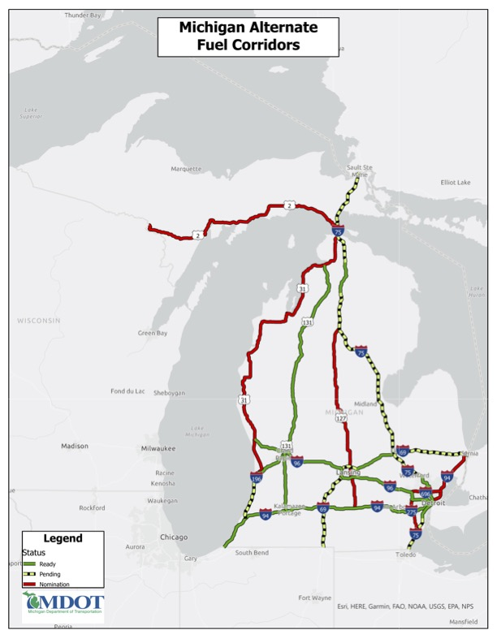
MI NEVI Plan
Completed and Approved
Requires substantial Stakeholder Engagement
Includes AFC nominations
Initial funding focused on AFC Corridors
Remaining funds could be used for communities
Partnership with MDOT/EGLE/OFME

Slide 20
Thank You
Questions?

