Slide 1


UPDATE
Director Bradley Wieferich, PE
Michigan Aggregates Association Annual Conference February 12, 2025

Slide 2
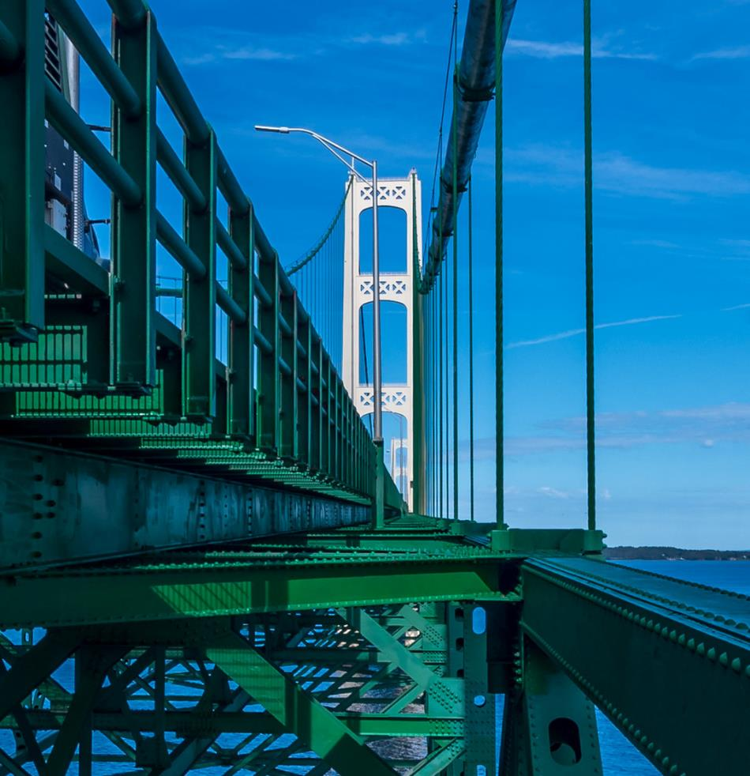

Today’s Topics
2024 Accomplishments
Program & Budget Status
Rebuilding Michigan Projects
Safety Update
Contract Issues

Slide 3
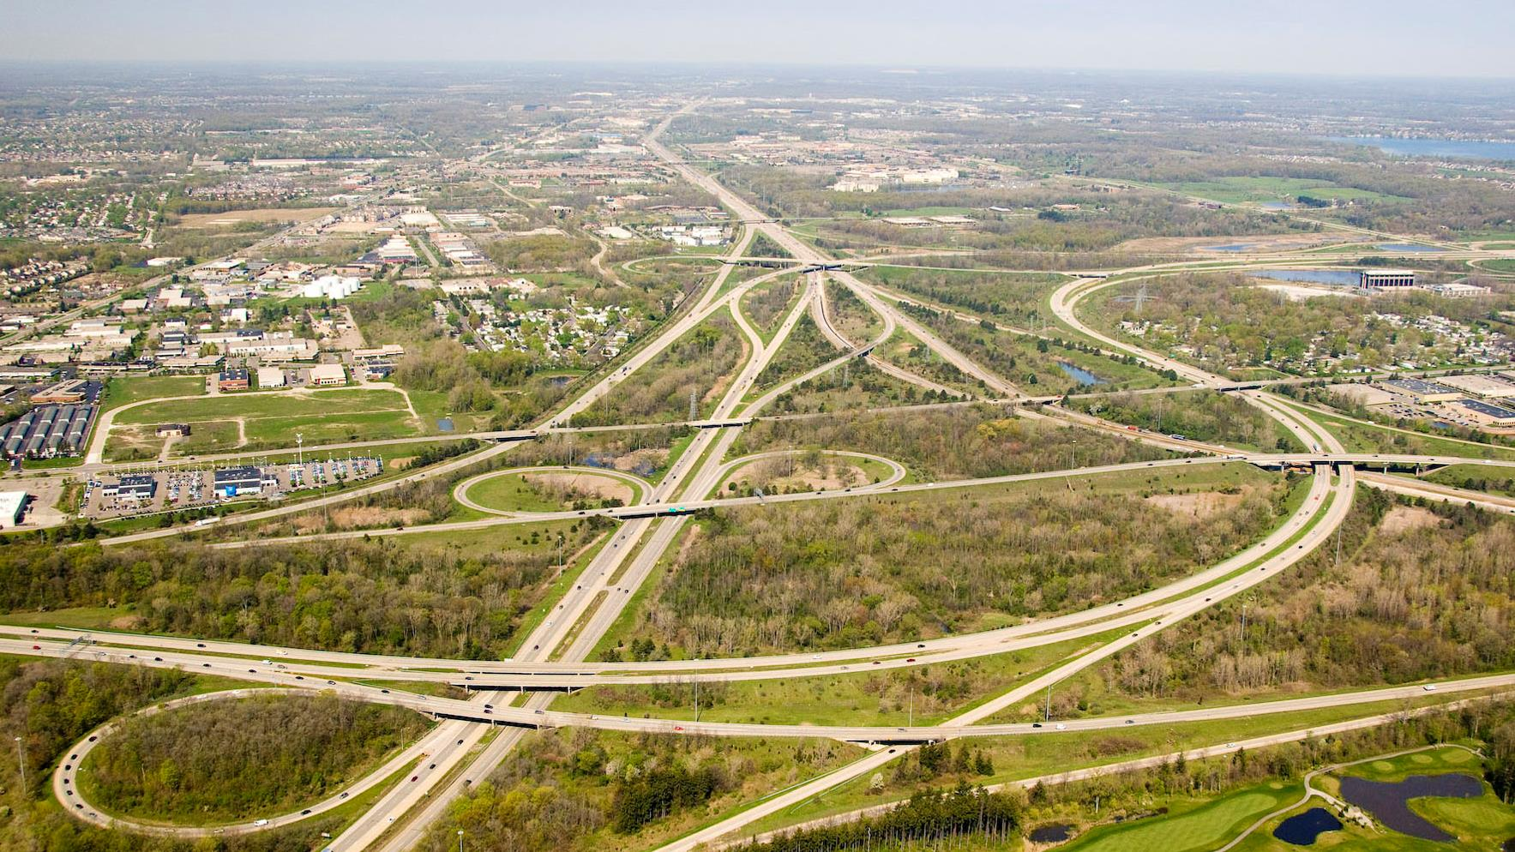
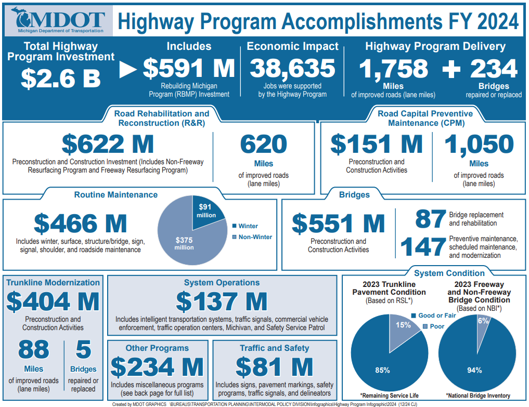

Slide 4

2025
Construction Projects
Trunkline Only
*This Information Represents the Total Number of Projects and Dollars scheduled to be let in each month
Therefore, the sum of values will not directly correlate to program year budgets, and this information is always subject to change.

Slide 5
2026
Construction Projects
Trunkline Only
*This Information Represents the Total Number of Projects and Dollars scheduled to be let in each month
Therefore, the sum of values will not directly correlate to program year budgets, and this information is always subject to change.

Slide 6
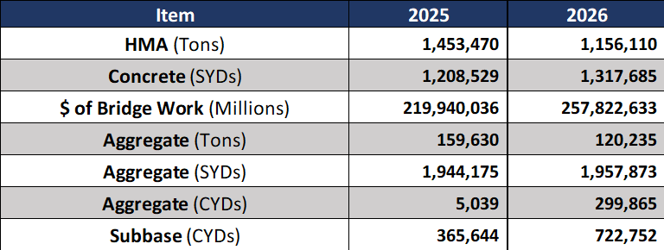
Quantity Values
*This information is draft and may change as the program is developed.
The year listed represents July 1st of the previous year to June 30th of the year listed

Slide 7
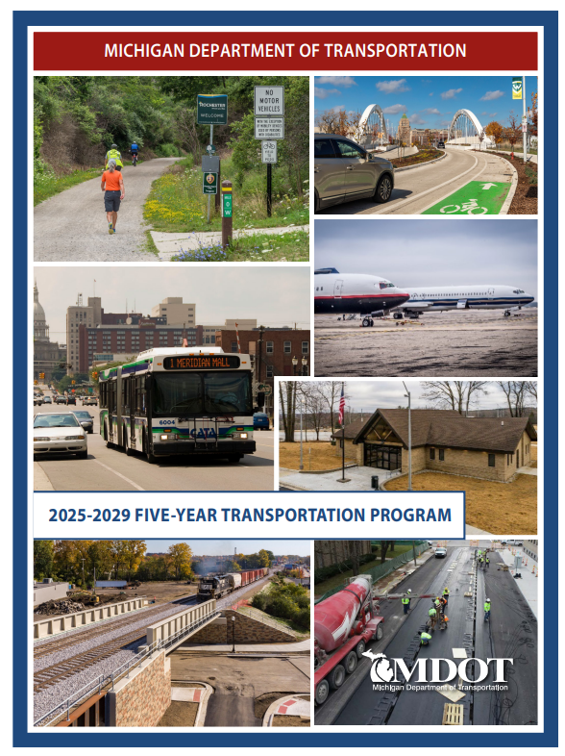
Five-Year
Transportation
Program
Webpage Link https://www.michigan.gov/mdot/programs/planning/five-year-transportation-program

Slide 8
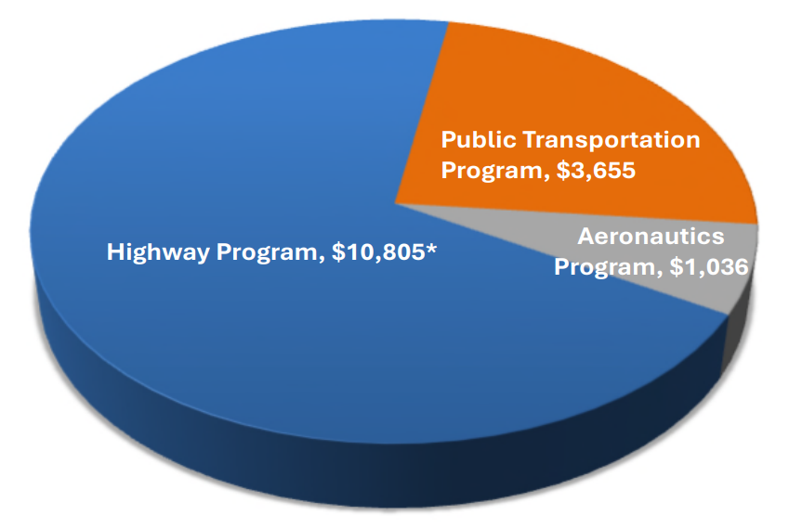
2025-2029 MDOT Transportation Program Investment
$15.5 Billion (in millions)
*Does not include other program costs estimated at $1.9 billion

Slide 9
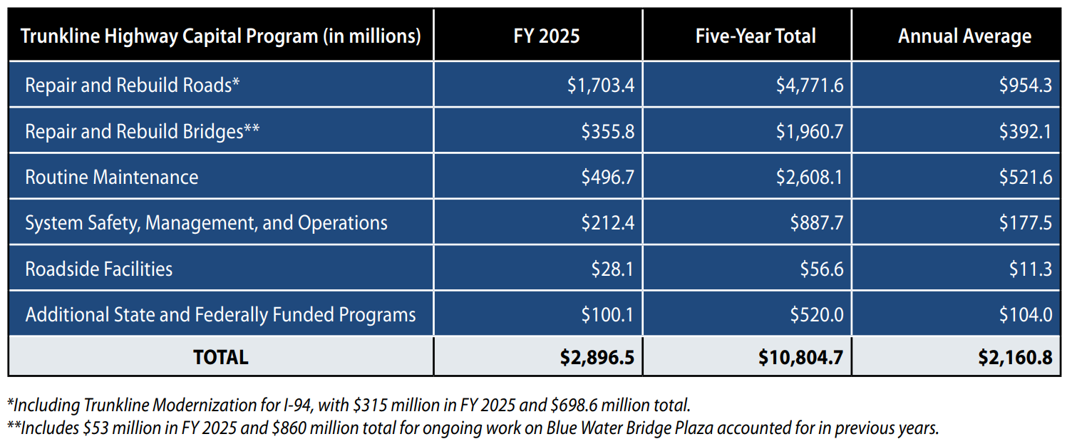
2025-2029 Five-Year Transportation Program Investment

Slide 10
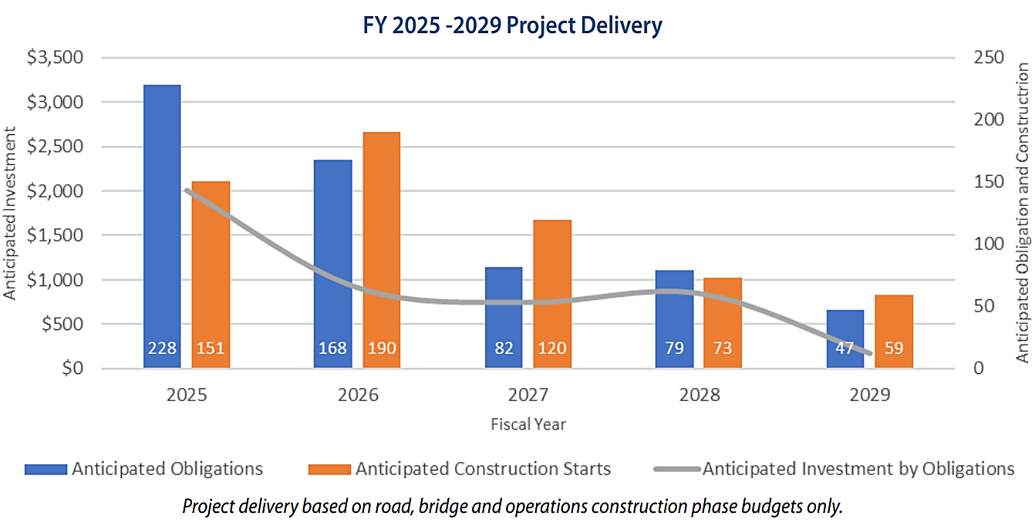
Fiscal Year 2025-2029 Project Delivery

Slide 11
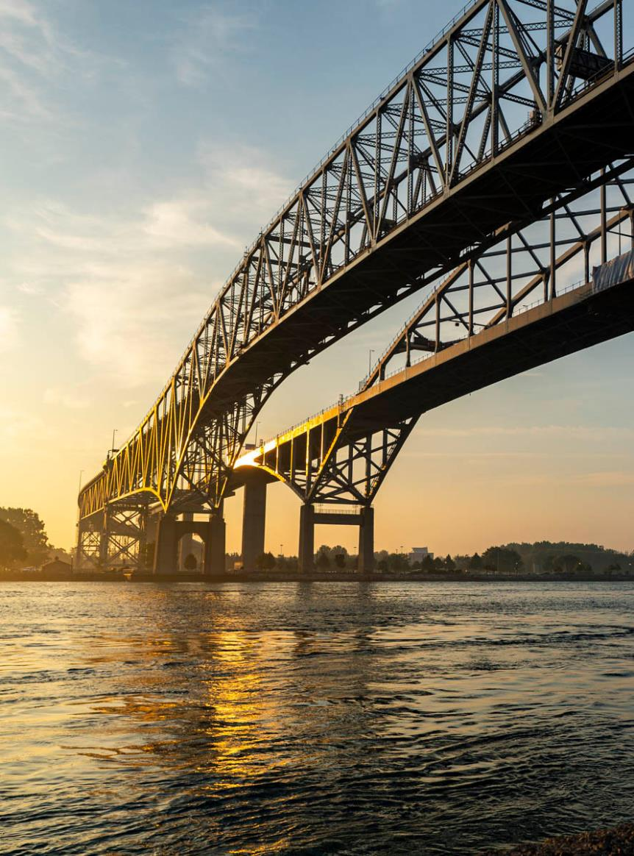
Rebuilding
Michigan

Slide 12
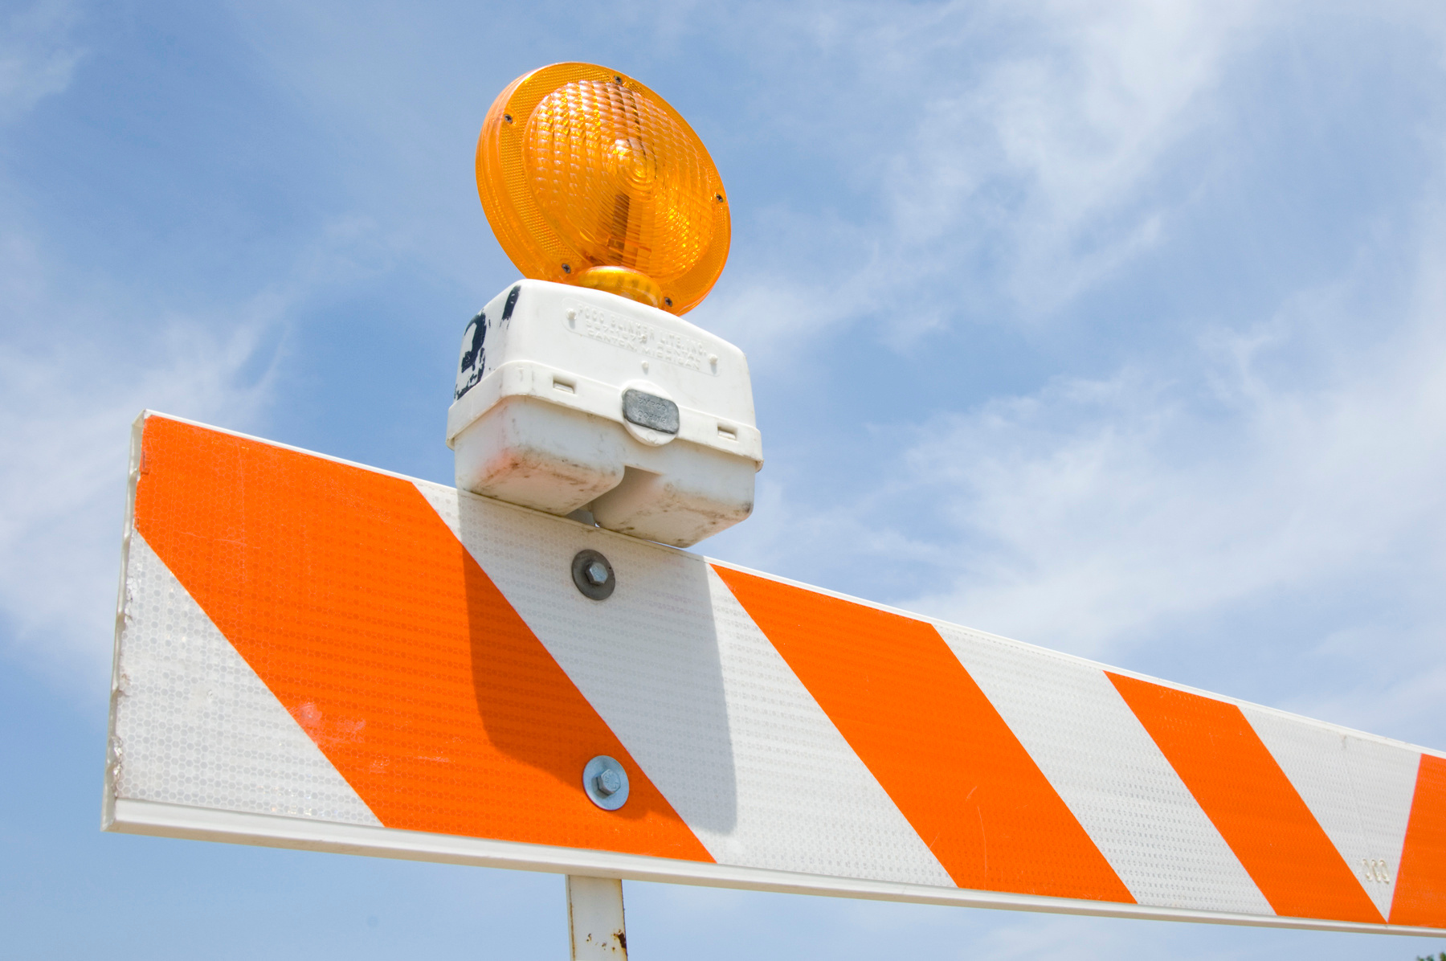
Rebuilding Michigan
Status
62 % of the RBMP are 90% or more complete - 26 projects
32% of the RBMP are in progress - 13 projects
375 PDB
696 in Oakland Co
RBMP let contracts total 3.968 B
Have not yet issued the 4th tranche
approx. $706M

Slide 13

Two RBMP Projects Remaining
Route | Location | Let Date
I-94 | Wayne Road to Middlebelt Road | Aug 2025
I-475 | Thread Creek to Flint River | Aug/Sept 2025
 | Bristol Road to Thread Creek | Aug/Sept 2025

Slide 14
FY 2026 Governor’s Recommended Budget
Appropriations
Total: $6,841,109,700

Slide 15
FY 2026 Governor’s Recommended Budget

Slide 16
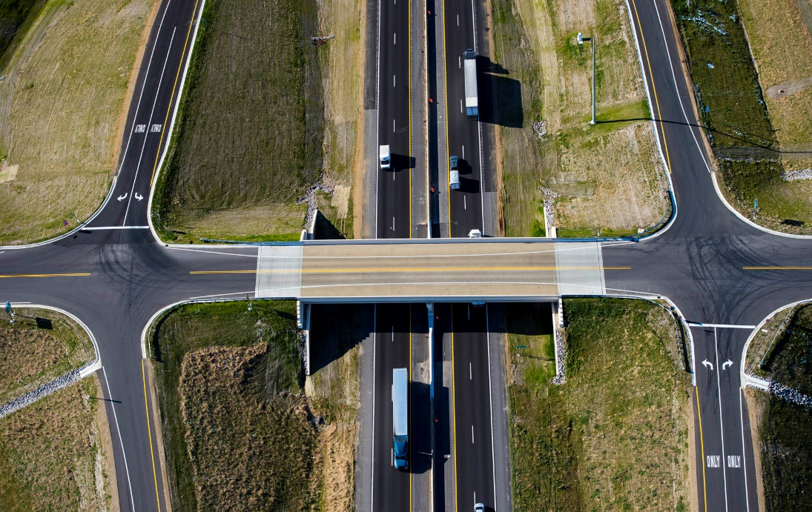
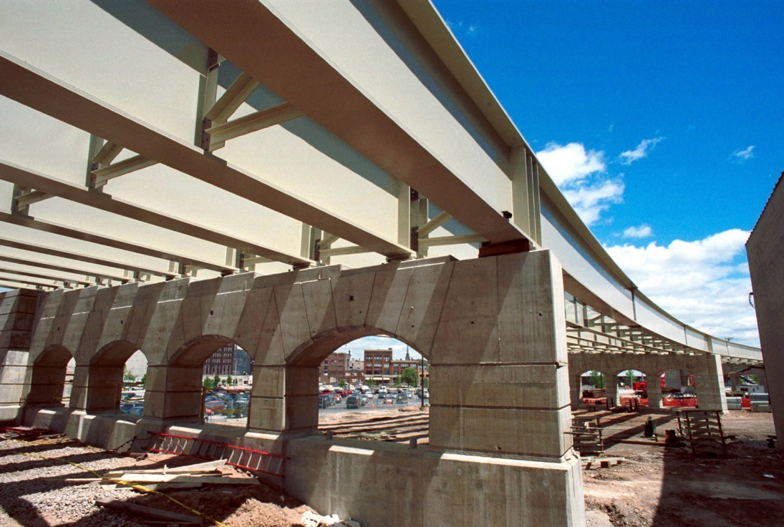
FY 2026 Governor’s Recommended Budget
Road and Bridge Program Highlights
Road and Bridge Programs increased by $98.3 million
    State R&B increased by $53.6 million
    (Federal & BWB increases; STF decrease)
    Local R&B increased by $17.8 million (Federal)
  Counties increased by $17.5 million
  Cities and Villages increased by $9.8 million
  Local Bridge Fund decreased by $497,600
  Moveable Bridge Program increased by $141,900 (inflation)
  Blue Water Bridge increased by $104,100

Slide 17
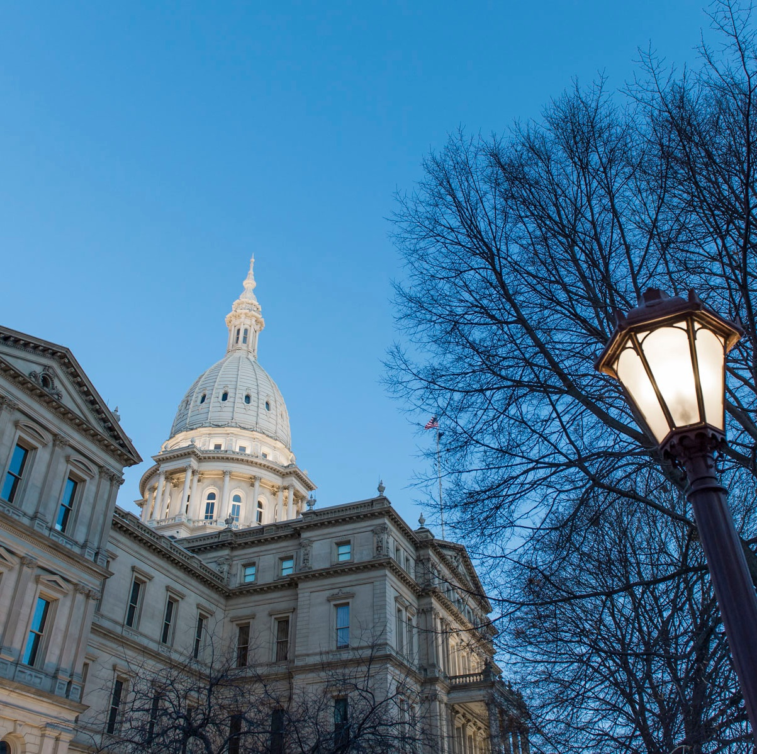
FY 2026 Governor’s Recommended Budget
Other Budget Highlights
Recreational Marijuana excise tax - $123.2 million
One-Time Appropriations - $119.8 million
    One-Time General Funds - $112.2 million
          Federal Aid Match
    One-Time MTF Funds - $7.65 million
          Road User Charge Study

Slide 18
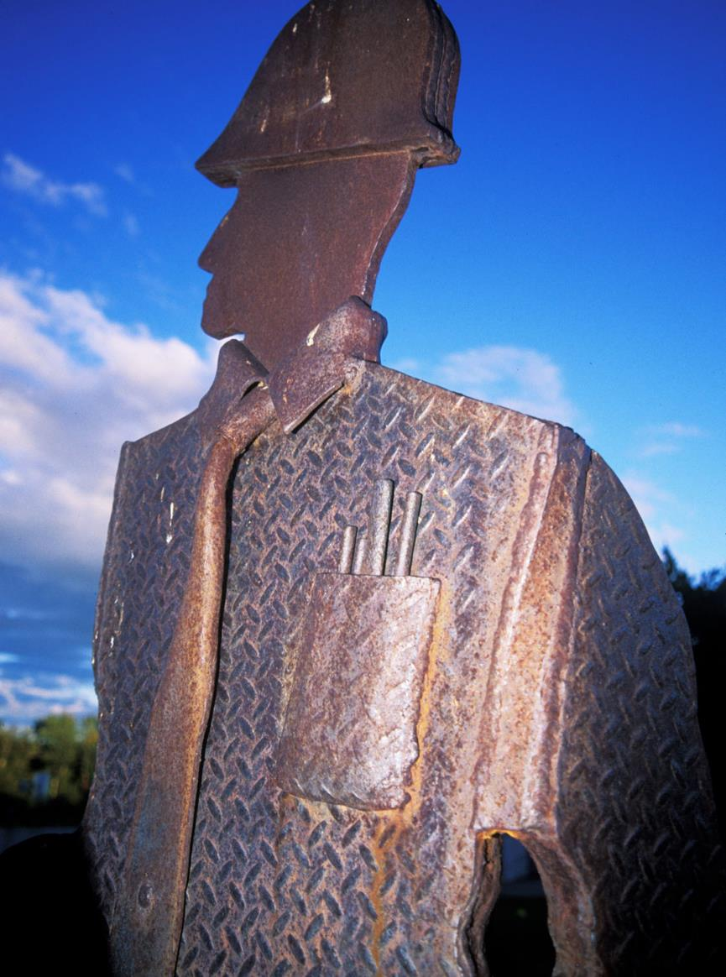
Safety
Update

Slide 19

Toward Zero Deaths
2024 Michigan Traffic Fatalities as of 01/01/2025
 | 2024 | 2023 | Change | % Change
Total Fatalities** | 1022 | 1028 | -6 | 1%⬇️
Person Types**
Pedestrian | 152 | 184 | -32 | 25%⬇️
Bicycle | 24 | 24 | 0 | 0%⏹️
Crash Types**
Lane Departure | 654 | 676 | -22 | 3%⬇️
Lane Departure on a Curve | 102 | 115 | -13 | 11%⬇️
Speed Limits >45 mph | 593 | 653 | -60 | 9%⬇️
Wrong Way | 16 | 25 | -9 | 36%⬇️
Work Zone | 21 | 24 | -3 | 13%⬇️
Seat Belt Not Used | 265 | 293 | -28 | 10%⬇️
*Data Disclaimer: All crash data pulled from Mi-CAT (Michigan Crash Analysis Tool). Mi-CAT receives up-to-date traffic crash data and statistics for all crashes that have occurred in Michigan.

Slide 20
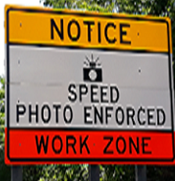
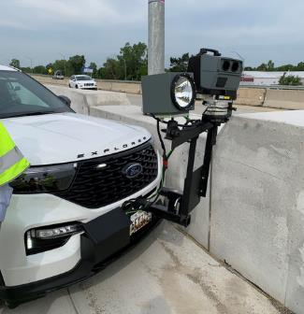
Work Zone
Safety Cameras: Law
Signed into law December 2025 as PA 164 and 165 of 2024
Considerations moving forward:
  To make violations enforceable: signs must be as prescribed, covers on existing speed limits, ensure system is off when no workers present

Slide 21
Work Zone
Safety Cameras
Required Signage and Work Zone Application Criteria
Limits 4 Systems Per MDOT Region
Speeding Threshold 10 mph or greater
  First Violation – Written Warning
  Second Violation - $150 civil fine
  Third Violation and Subsequent – Civil Infraction and fine no greater than $300
Annual Reporting Requirements (March 1)
Creates Work Zone Safety Fund at Treasury

Slide 22
Work Zone
Safety Cameras: Status
Discussing best practices with other states
Develop vendor contract request for proposals
Coordinate with other state agencies
  MSP
  Treasury
  Secretary of State
Develop plans, typicals, special provision and use criteria

Slide 23
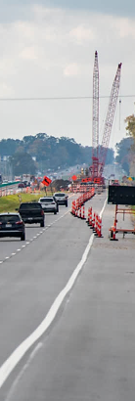
Work
Zones
Connected Arrow Boards
    20RC812(A820) Compensation for Type C Lighted Arrow Boards meeting Materials and Construction requirements
    Must furnish secure access to Work Zone Data Exchange (WZDx) Device Feed with reporting requirements
  Frequently Used Special Provision with April 2025 letting
    Use in all trunkline projects calling for a Type C Arrow Board. Optional for Local Agency Projects.

Slide 24

Work Zone
Awareness Week
Press Event:
  Monday, April 28, 11am
  Dow Diamond, Midland

Slide 25
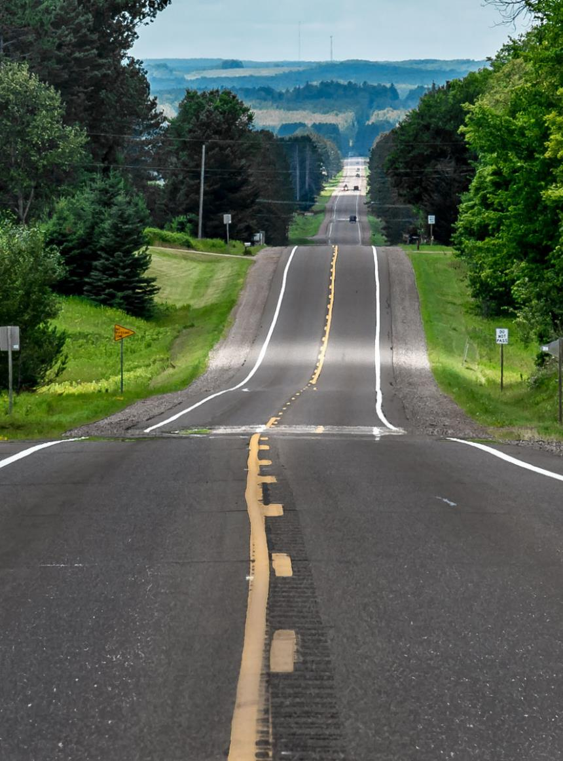
Contract
Issues

Slide 26
Buy America – Final Rule
Effective March 17, 2025
Terminates FHWA’s General Waiver for manufactured products from 1983
Current General Waiver will expire on October 1, 2025
New 55 percent domestic content requirement will begin on October 1, 2026
MDOT will work with FHWA on revising special provisions for Buy America and Construction Materials

Slide 27
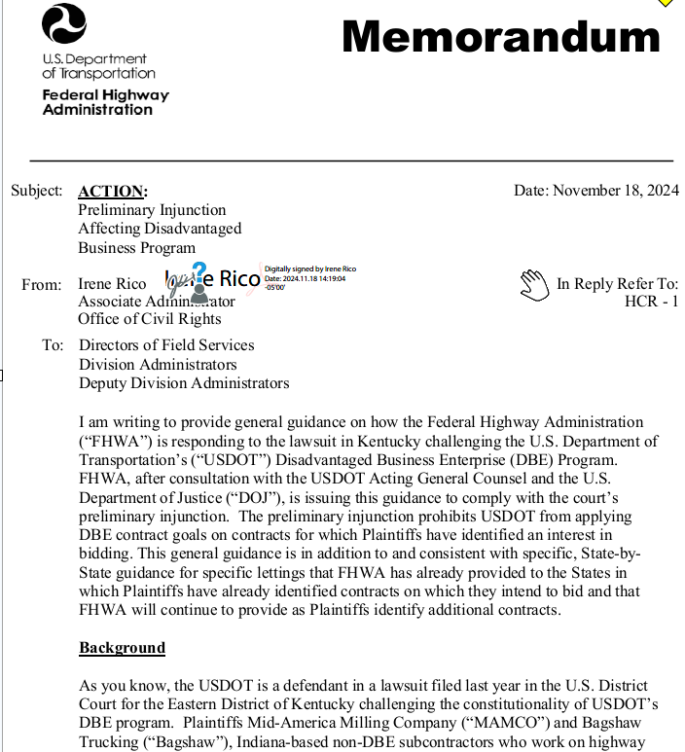
Preliminary Injunction
​Plaintiffs are two Indiana based non-DBE contractors, claiming program unlawfully discriminates on race and gender.
On specific contracts which plaintiffs intend to submit a quote, DBE goal is set to zero.
Except for any such contracts that are identified by the Plaintiffs, the DBE Program will continue to operate pursuant to the applicable DBE regulations at 49 CFR part 26 and approved DBE programs

Slide 28
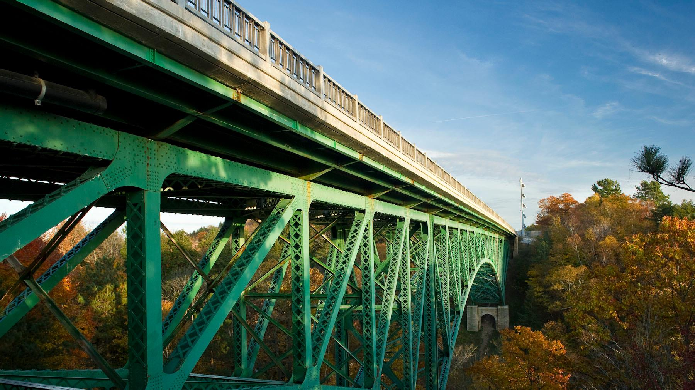

THANK YOU
Questions?

