Slide 1
Evaluating Workers’ Learning Derived From Active Safety Training
Michigan Aggregates Association
Annual Convention
February 7-9, 2023
Battle Creek, MI

Slide 2
What I Hear….I Forget
What I See….I Remember
What I Do….I Understand

Slide 3
Advantages and challenges of current training tools
Passive: PowerPoints, Videos and Lectures
Virtual: Zoom or Other On-line Platforms
Active: Discussion Groups, Activities and Games

Slide 4
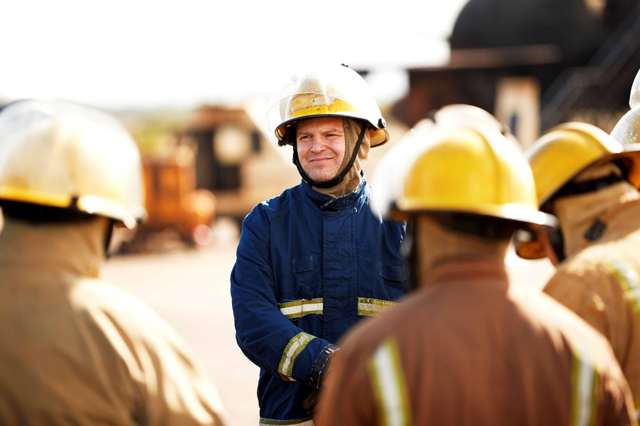
Improving the Effectiveness of Safety Training
Stop: the “Same Old Stuff,” teaching people what they already know
Workers: Know the safety rules, regulations and company policies
Millennials and Gen Z’ers : Want to know the “why”

Slide 5
Robert Mager’s Rules of Learning
Rule 1: Training is only appropriate when two conditions exist
There is something people do not know how to do
They need to be able to do it
Rule 2: If they already know how to do it, more training will not help
Rule 3: Skill alone is not enough to guarantee performance
Rule 4: You cannot store training…use it or lose it

Slide 6
Malcom Knowles: Assumptions of Adult Learners
Self-Concept: As adults move through life, they become more self-directed
Learner Experience: Adult learners bring a wealth of knowledge to the learning process
Readiness to Learn: Adults want to learn things that help them accomplish relevant tasks. They will learn what they want to learn and reject the rest
Orientation to Learning: Adult learners want to solve problems

Slide 7
Research on Retained Learning

Slide 8
Survey Results from 4,000 Front-line Workers 2014-2022
On using passive learning delivery processes
89% do not believe they learned from training delivered using passive processes
On learning delivery preferences
95% preferred to be involved and active during training events
On having training delivered using active processes
93% liked participating in discussions, participating in learning activities/games or using training aids

Slide 9
1,377 Written Comments
71%: Positive about the active learning processes
24%: Administrative comments about chairs, length of class, food, not liking to talk in front of others, constructive criticism or keeping them awake.
5%: Specifically expressed a dislike for PowerPoints, lectures and same old movies
100%: In 2022, 325 front-line workers were asked “as adults, what is your preferred way of learning or how do you learn best”?

Slide 10
Harvard Research-2019 (Deslauriers)
Two physics classes using the same curriculum
One delivered using “passive” processes
One delivered using “active” processes
Students were given surveys/tests to measure from which class they “felt” they learned as compared to retaining the materials covered

Slide 11
Active Learning
Relies on team activities and group discussions
Encourages participants to get involved and become more engaged
Helps frontline workers gain information needed to do jobs, resolve problems and attain safety related goals

Slide 12
Active Learning Strategies and Tools
Engage: Allow people to “see” value in their participation
Use Art: Encourage people to think using different parts of their brain
Give Ownership: Give people the autonomy to speak and be a part of the decision and solution in their own learning
Make it Relevant: Engagement comes from learning things that are relevant to work and/or personal lives

Slide 13
Active Learning Strategies and Tools
Move Around: Use activities or learning stations gets people moving around and increases creativity
Use Games: Encourages students to become involved and collaborate
Create Visuals: Use charts and graphs to elicit comments/discussions
Stop and Write: After discussing a topic, stop and have students write down what they remember. Thinking is important to discussions and information retention.
Warm-ups: Working in pairs, have them discuss a question. Then join another group and continue to build until there is one large group.

Slide 14
Barriers to Transition from Passive to Active Learning
Active learning means there is more than one right answer.
Active learning is too risky.
Active learning doesn’t feel like learning.
Active learning requires a different kind of effort.

Slide 15
Complacency
Often talked about in relation to front-line workers
Not talked about in relation to trainers or instructors
“Complacency on the part of teachers tends to foster complacency toward learning in students. Teachers will not promote active learning if teachers rely solely on lecture methods.”

Slide 16
Questions and Thoughts
Do we train for compliance or worker development?
Do we ask our front-line workers what they want or need to learn?
Understanding what motivates adults can help guide the learning process.
If workers have a little fun in training, they are probably more engaged and retain more information.

Slide 17
Questions?
Thoughts?
Suggestions?
Thank you…..

