Slide 1
2020 Forecast: Moving Michigan Forward

Slide 2
Who is the Chamber?
Over 5,000 members
Located in all 83 Counties…Spanning all industries
Mission: Help our members solve their business problems and prosper.
We work everyday to be the leading voice of business in Michigan.

Slide 3
Economic Impact Starts at Kitchen Table
Median Household Income as of December 2018
US $ 63,688 Michigan $ 56,697
* American Community Survey of Census Data
Unemployment
US 3.5% Michigan 3.9%
Historic lows for Hispanics (3.9%) and African Americans (5.5%) and Women (3.1%)
Consumer Confidence is high as people feel confident about job prospects.
49% say jobs plentiful 11.6% say jobs hard to find

Slide 4
Average Citizens Benefit From Strong Market

Slide 5
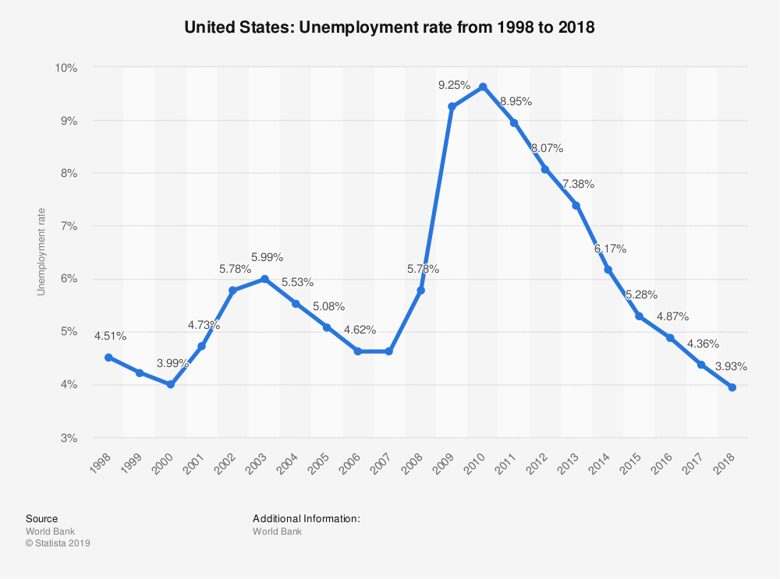
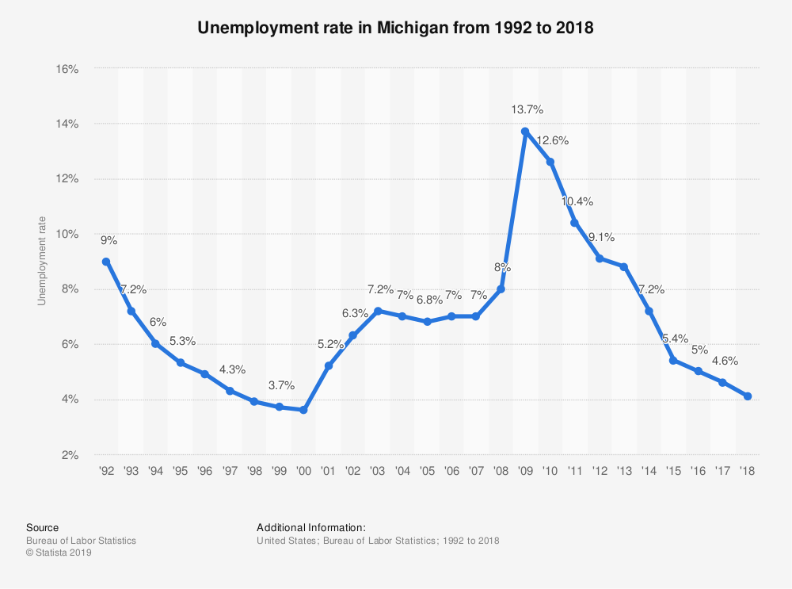
What’s Propelling the Economy
Low Unemployment
Low Interest Rates
Strong Housing Market
Steady Auto Sales

Slide 6
Consumer Confidence is King
Consumer Confidence Is Strong
Consumer expenditures make up approximately 2/3 of overall economy.
Consumers remain ready to spend.
Holiday sales were strong
3.4% Increase in 2019 18.8% Increase in online shopping

Slide 7
Points of Impact
Positive Actions
Predictability and stability are beneficial to job providers as they navigate economic realities
Passage of USMCA
Progress on Trade Agreements
Negative Possibilities
Trade agreements fail
Conflicts around the globe
Political Fights (in DC and Lansing)

Slide 8
Opinions Within the Business Community
Michigan Chamber of Commerce Economic Survey

Slide 9
Michigan Chamber of Commerce Economic Survey
Do you believe a road funding increase is important to keeping Michigan’s economy growing?
Yes
No
0% 10% 20% 30% 40% 50% 60% 70% 80% 90% 100%
Answer Choices Responses
Yes 63.12%
No 36.88%

Slide 10
Michigan Chamber of Commerce Economic Survey
Production worker wages have increased, but overall growth in wages has decreased in Michigan. In the next year, what do you expect to happen with wages for your business?
Wages are expected to increase…
Wages are expected to stay…
Wages are expected to decrease…
Other…
0% 10% 20% 30% 40% 50% 60% 70% 80% 90% 100%
Answer Choices Responses
Wages are expected to increase in the next year 63.12%
Wages are expected to stay the same 33.33%
Wages are expected to decrease 1.42%
Other 2.13%

Slide 11
Michigan Chamber of Commerce Economic Survey
Michigan’s unemployment rate during 2020 is likely to:
Drop
Rise
Stay about the same
0% 10% 20% 30% 40% 50% 60% 70% 80% 90% 100%
Answer Choices Responses
Drop 14.18%
Rise 14.18%
Stay about… 71.63%

Slide 12
Michigan Chamber of Commerce Economic Survey
In the next year, what do you expect employment to look like for your business?
No change in employment
We are at full employment
We are having challenges
We expect layoff
Other
0% 10% 20% 30% 40% 50% 60% 70% 80% 90% 100%
Answer Choices Responses
No Change in employment 27.46%
We are at full employment 17.61%
We are having challenges filling talent gaps 48.59%
We expect layoffs in the next year 2.82%
Other 3.52%

Slide 13
Michigan Chamber of Commerce Economic Survey
In 2020, do you expect Michigan to experience a recession?
Yes
No
0% 10% 20% 30% 40% 50% 60% 70% 80% 90% 100%
Answer Choices Responses
Yes 15.60%
No 84.40%

Slide 14
Michigan Chamber of Commerce Economic Survey
Are you optimistic about the overall direction of Michigan’s economy in 2020?
Yes
No
Unclear
0% 10% 20% 30% 40% 50% 60% 70% 80% 90% 100%
Answer Choices Responses
Yes 61.27%
No 14.08%
Unclear 24.65%

Slide 15
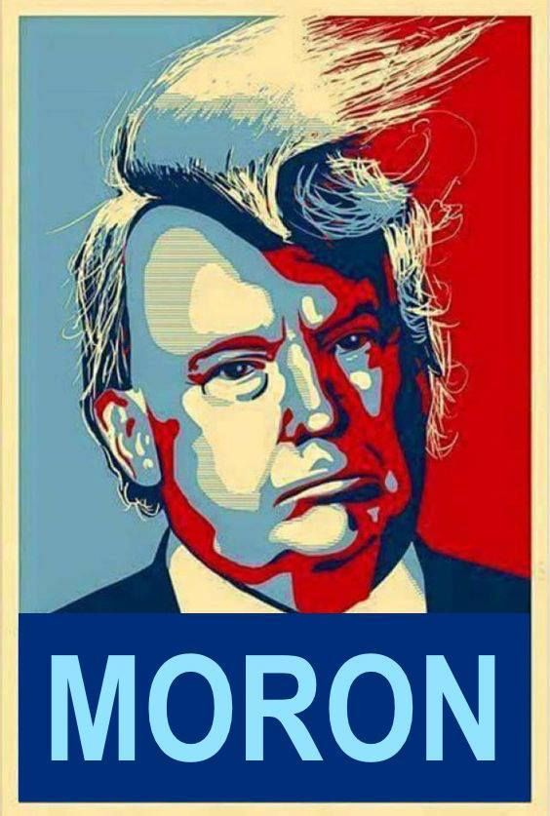
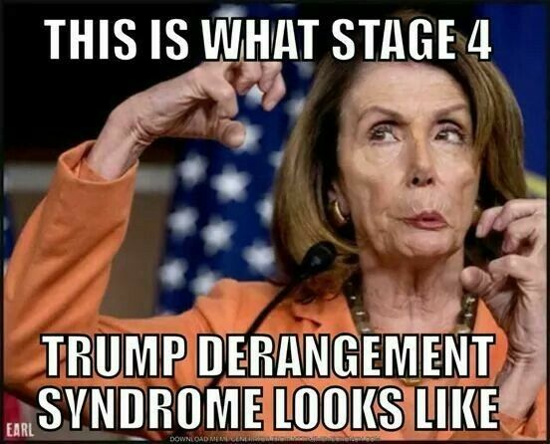
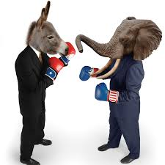
Negative Impact of Politics on Economy
Public Very Divided
Favorable / Unfavorable Ratings
44 / 53 36 / 51 23 / 72
Election season is now constant
Medical problems on arise in the public
Families battle….Friends lost

Slide 16
Elections Have Consequences
Voter Enthusiasm is High
88% of Registered Voters Enthusiastic (in 2016 46%)
Get out the vote is crucial for major political parties
Type of voter who will decide this election?
Independent Women
Blue Collar
Do those voters stay with Trump agenda?
Traditional Coalitions
Some splintering is evident on both sides of the isle

Slide 17
State House Up For Grabs
All 110 Seats Up for Grabs
Current GOP Majority 58-52
22 Term Limited Seats (12 D / 10 R)
Fundraising has been stronger for GOP
Candidates are working hard to localize races
Trump effect
Majority party legislative agenda can have big impact

Slide 18
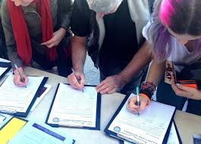
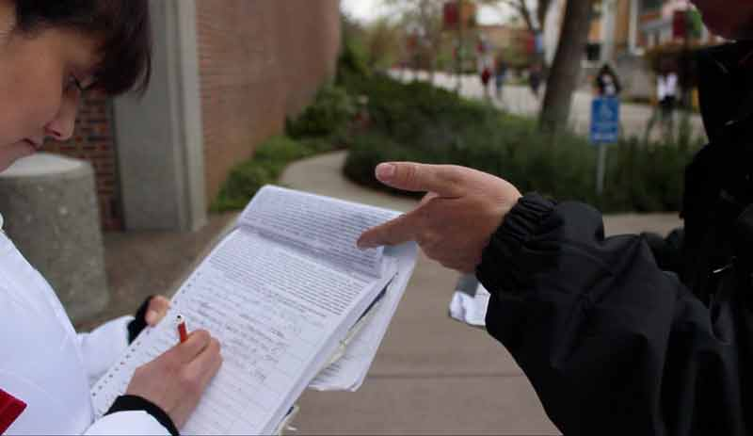
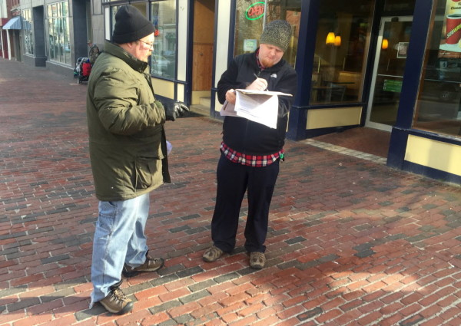
Ballot Proposals Michigan is one of only 15 states to provide citizens all three tools: ✓ Initiated Laws ✓ Referendum ✓ Constitutional Amendment

Slide 19
Less Drama More Action
Fix Michigan’s Roads and Bridges
Build the Great Lakes Tunnel
Address the Talent Shortage
Focus on Stable Growth
Keep Politics Where it Belongs

Slide 20
General View
Barring a major negative event we should not see a recession in 2020.
Most economists predict at least the first six months on 2020 will look a lot like the last six months of 2019.
Expectation is for the economy to grow but possibly at a slightly slower pace.

