Slide 1
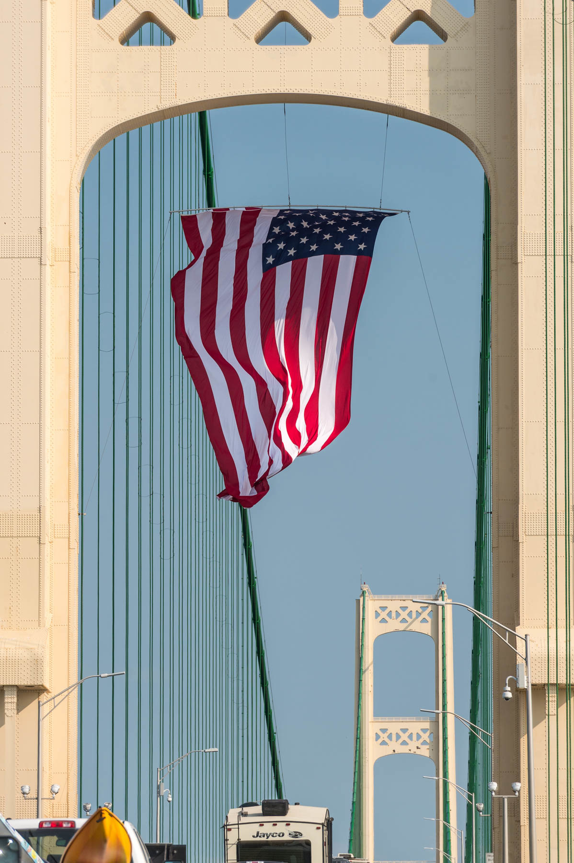
2020 MDOT UPDATE
Michigan Aggregates Association
February 5, 2020
Tony Kratofil, PE
Chief Operations Officer & Chief Engineer
Michigan Department of Transportation
Notes:
MAA Conference
Wednesday, February 5, 2020
9:30 – 10:00 a.m.
Firekeepers Casino Hotel
11177 East Michigan Avenue
Emmet, MI

Slide 2

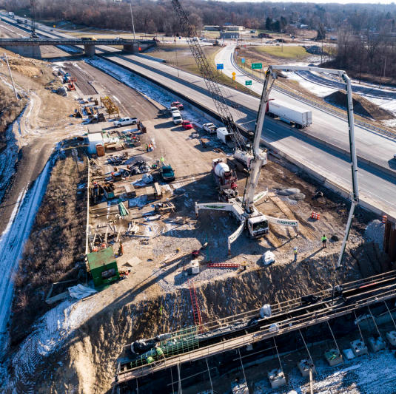
Today’s Topics
Budget & Program Summaries
Concrete, HMA & Aggregate Quantity Estimates
Rebuilding Michigan
2020 Standard Specifications For Construction
Work Zone Safety Task Force

Slide 3
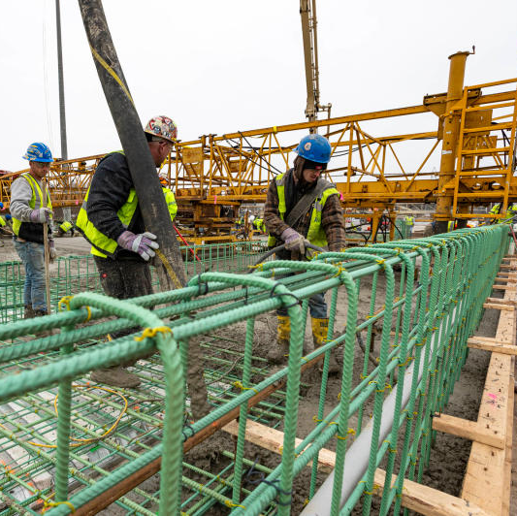
FY 2020 Enacted Budget Highlights
FY20 Enacted Budget is $5.3 Billion
Includes Funding for Various Road & Bridge Investments
  Local Federal Aid $278 M
  Cities & Villages $621.2 M
  Counties $1.1 B
  State Trunkline $1.3 B
  Local Bridge Program $29.1 M
  Grants to Local Programs $33 M
  Rail Grade Crossing & $6 M Surface Improvements

Slide 4
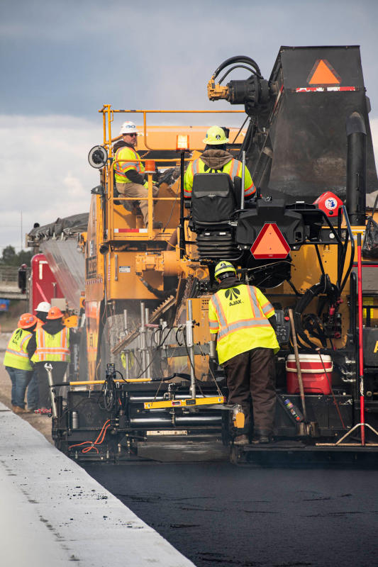
FY 2020 Enacted Budget Maintenance Investments
Maintenance Increase - $66.5 M
Investment will Support:
  Maintenance Material Increase $7.4 M
  Ancillary Structures $10 M
  Non-Winter Deferred Maintenance $51.2 M

Slide 5
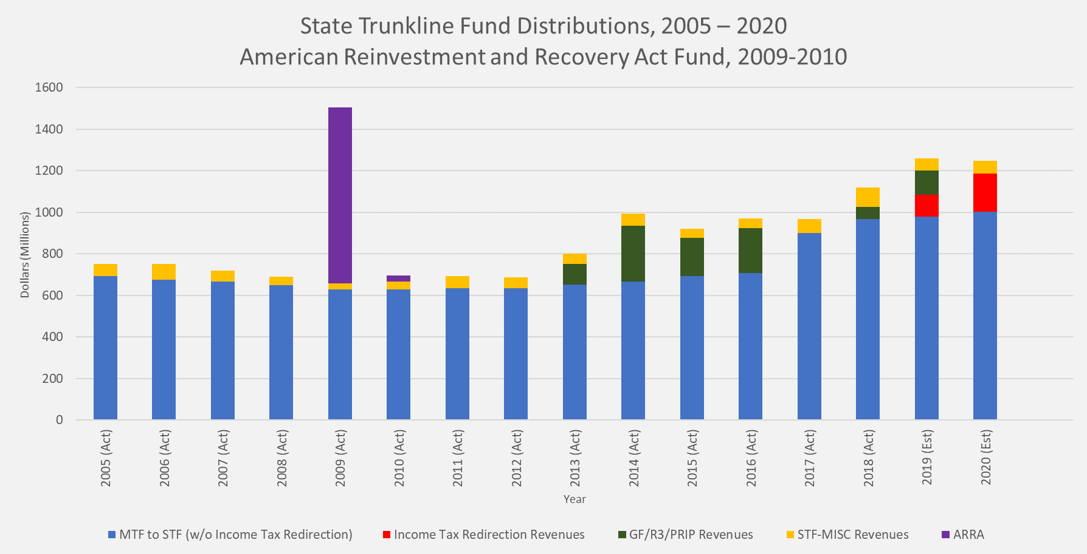

Slide 6

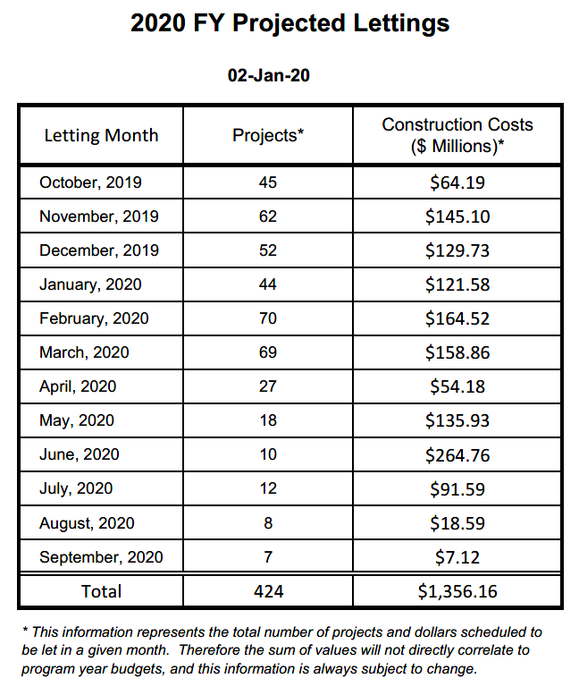

Slide 7
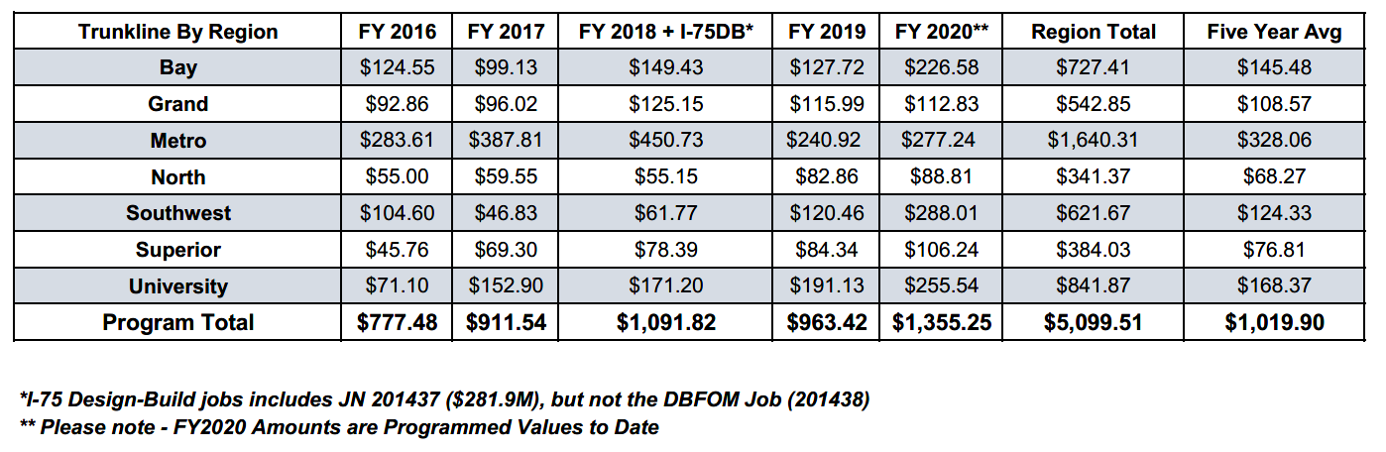
Lettings by Region
(values in millions)

Slide 8
Quantity Values
Item | 2019 | 2020 | 2021
HMA (Tons) | 2,758,731 | 2,754,244 | 1,056,576
Concrete (SYDs) | 1,327,153 | 1,243,481 | 2,541,268
$ of Bridge Work (Millions) | $130.05 | $158.07 | $350.63
Aggregate (Tons) | N/A | 108,151 | 69,507
Aggregate (SYDs) | N/A | 1,050,358 | 626,956
Aggregate (CYDs) | N/A | 45,701 | 69,380
Subbase (CYDs) | N/A | 467,032 | 372,824
This information is draft & may change as program is developed.

Slide 9
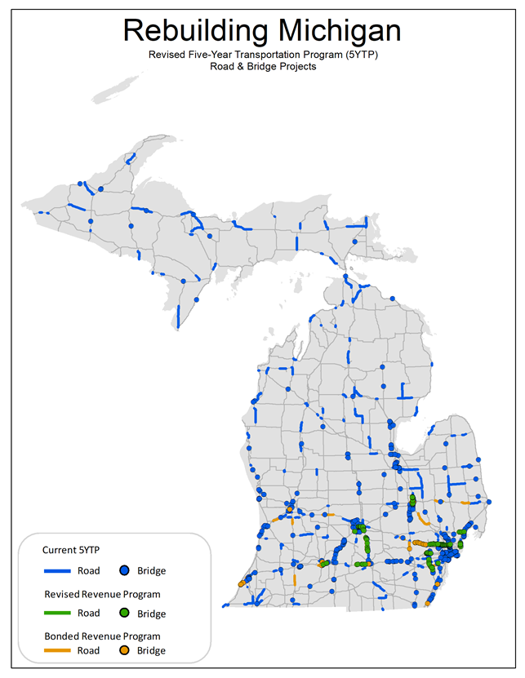

Expands investment in the state trunkline system in the near-term using bond financing.
5 Year Program construction increases $3.515 B (almost doubling), from $3.785 B to $7.300 B.
Invests bond financing in long-term fixes, a fiscally responsible approach.
User Driven - focuses investment on the highest travelled parts of Michigan’s highway network.

Slide 10
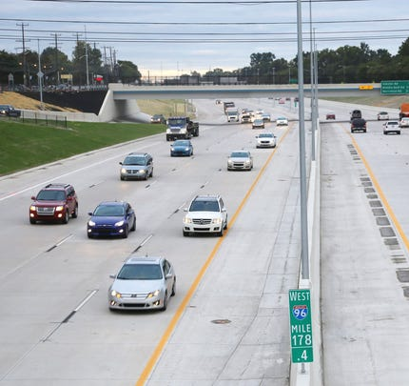
Invests bond financing in 49 long-term fix projects in 3 main categories:
  Finances 5 long-term fix projects already in the 5 Year Program.
  Increases the scope of 18 existing projects in the 5 Year Program to long-term fixes.
  Adds 26 new, long-term fix projects to the 5 Year Program

Slide 11
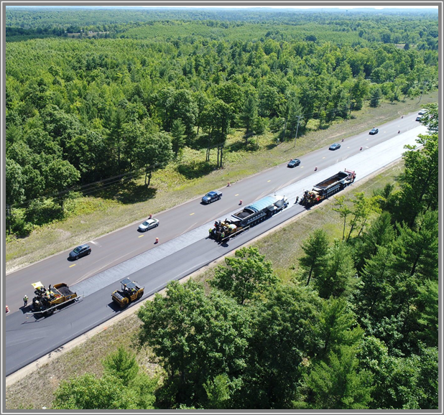
The bond financing of existing 5 Year Program Projects (categories 1 & 2) creates a backfill opportunity of $1.026 B
  Covers as many miles as possible, mostly resurfacing projects
    Addresses condition goals & federal performance measures
    Aligns with MDOT’s asset management plan
  Adds 73 new projects on high volume roads
  Aligns bridge work with bond projects to maximize our corridor approach

Slide 13
Region | Average Vehicles Per Day
 |  | Original 5 Year Program | Bond Program
Bay |  | 20,310 | 45,582
Grand |  | 23,731 | 24,257
North |  | 12,139
Metro |  | 88,127 | 137,500
Southwest |  | 31,829 | 44,550
Superior |  | 6,975
University |  | 38,506 | 45,204
Total |  | 35,878 | 62,213

Slide 14
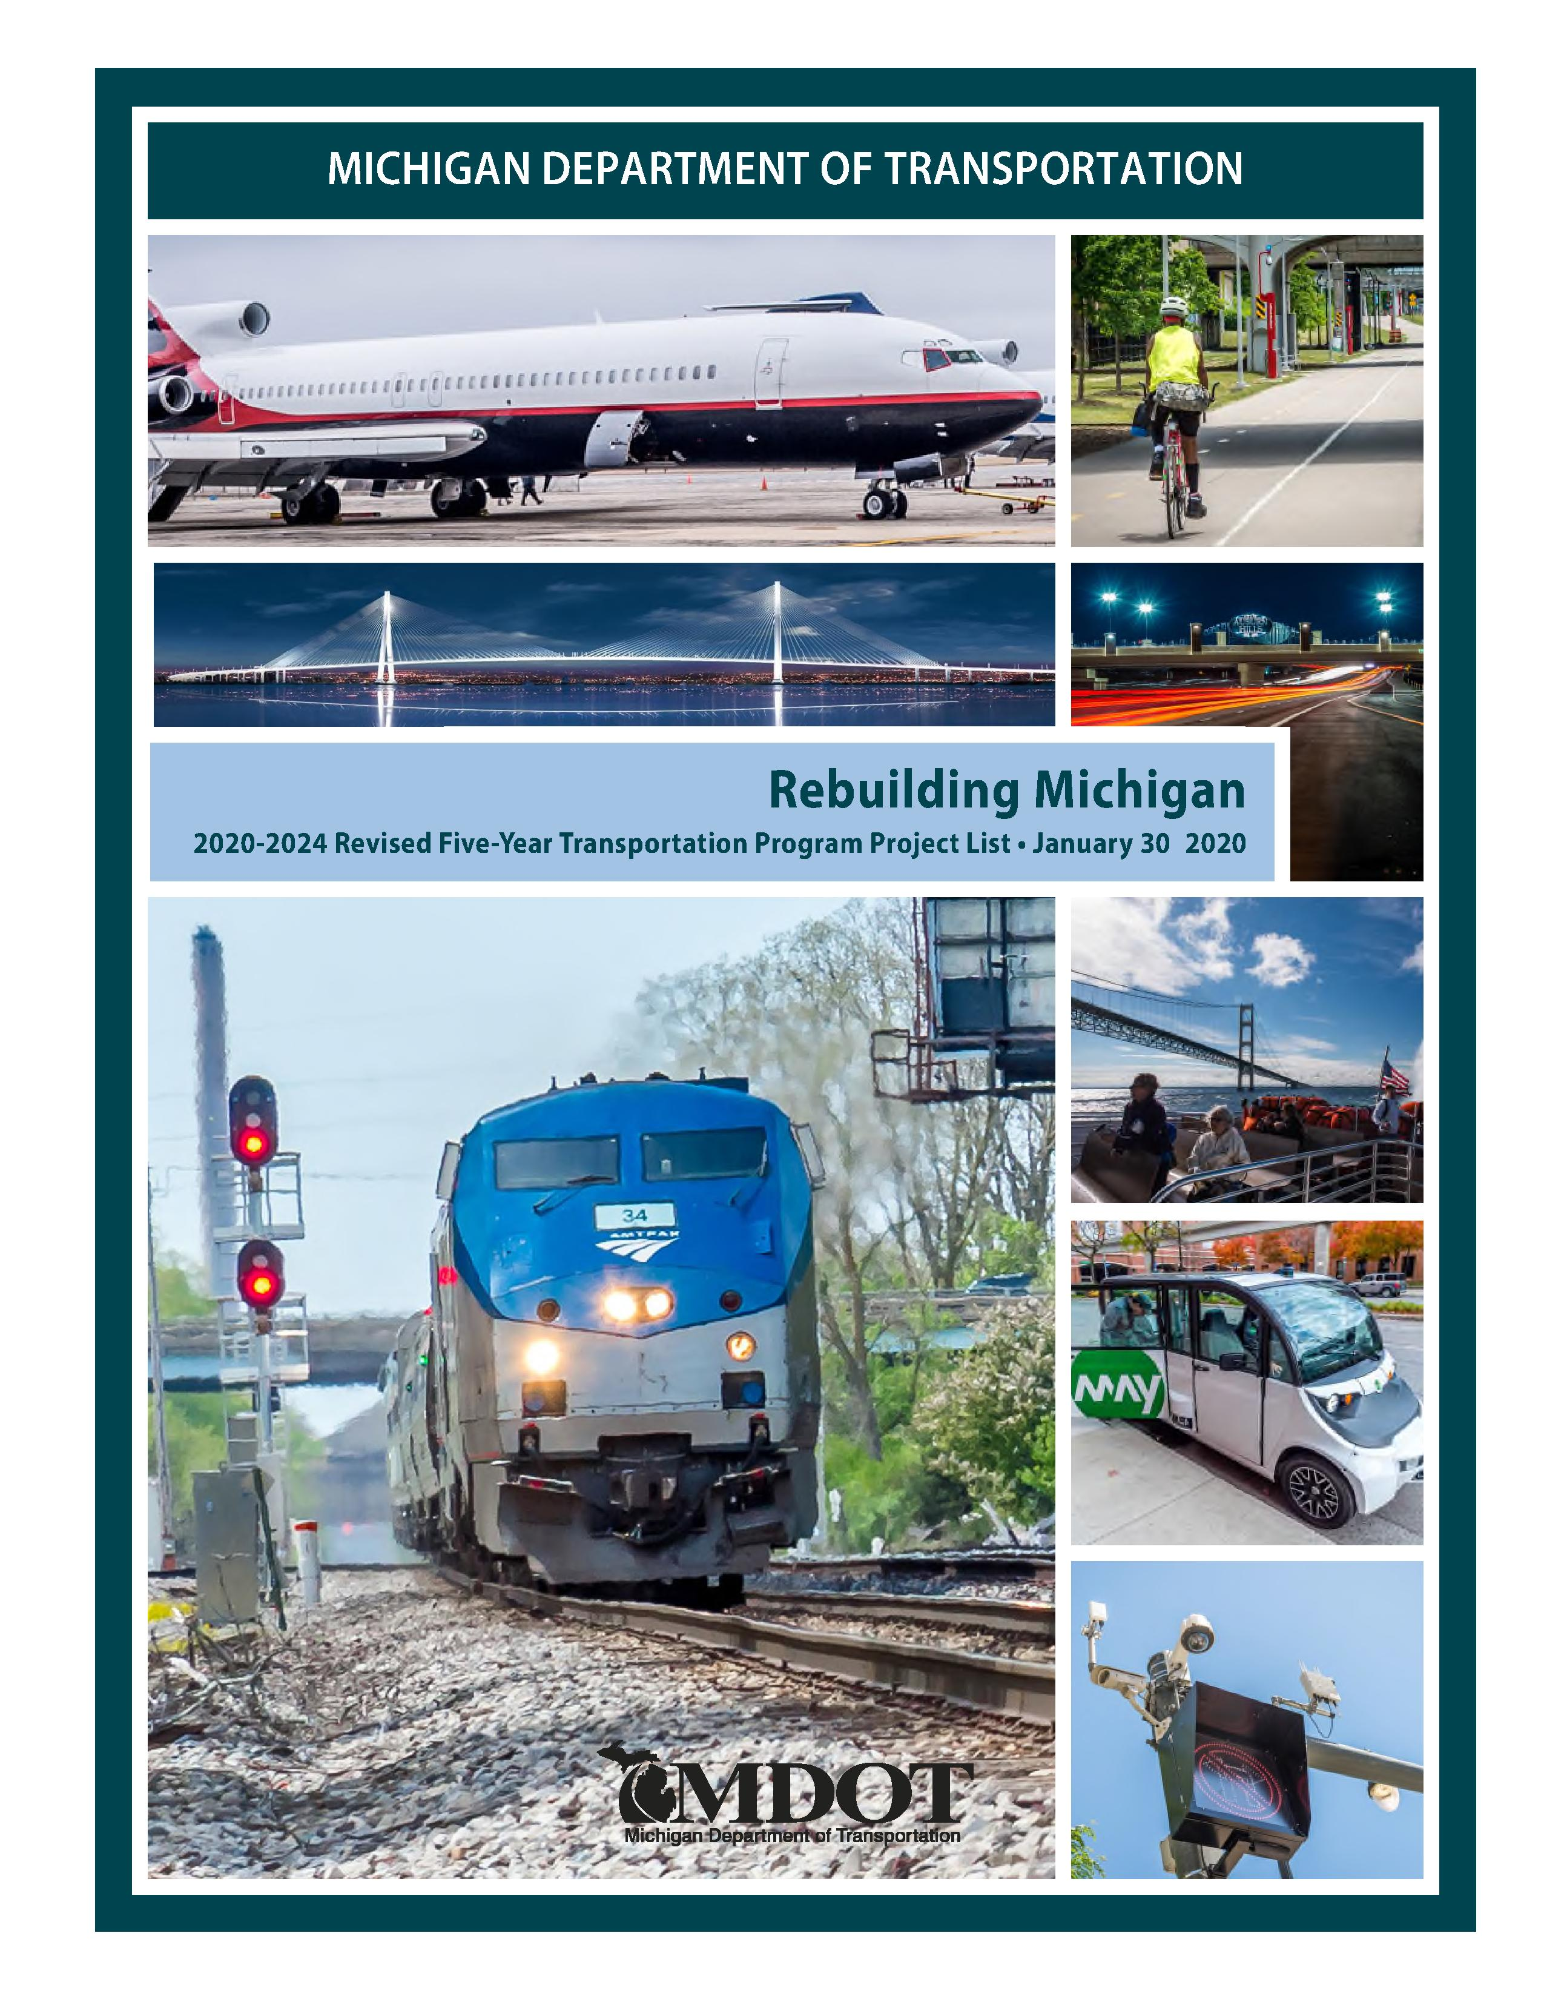
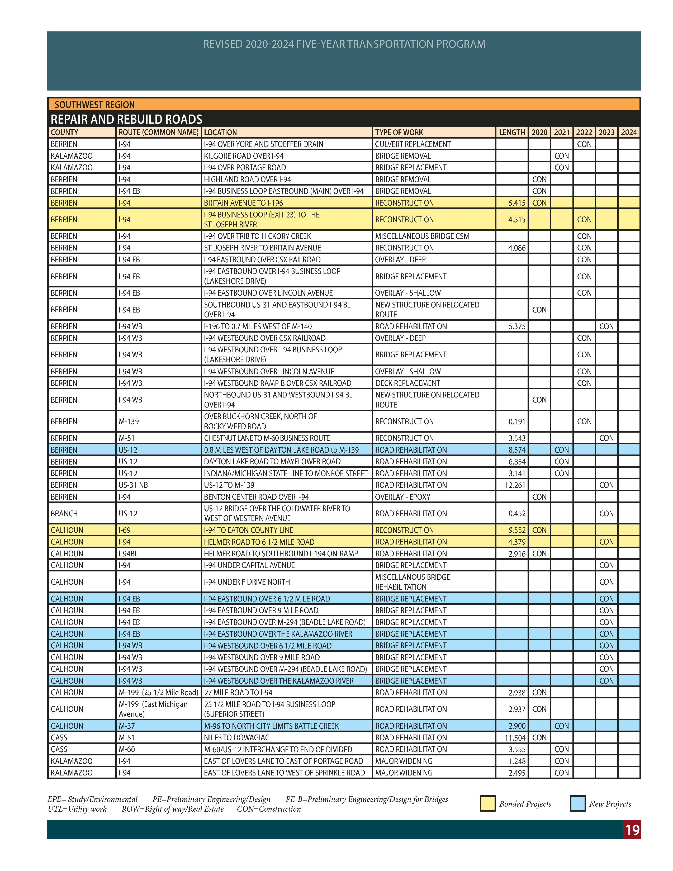

Slide 15
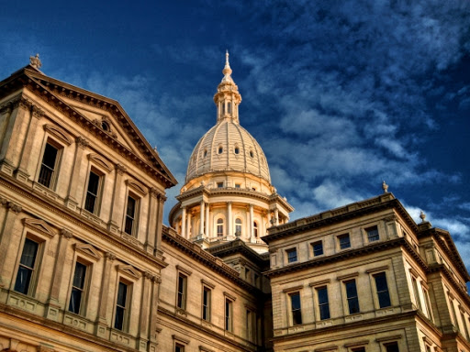
What the Rebuilding Michigan Plan does NOT do:
It does not fix everything nor completely address state trunkline condition needs.
It does not generate any new revenue to address the chronic underinvestment in transportation in Michigan.
It does not address the needs of other transportation modes or the local road and bridge systems.

Slide 16
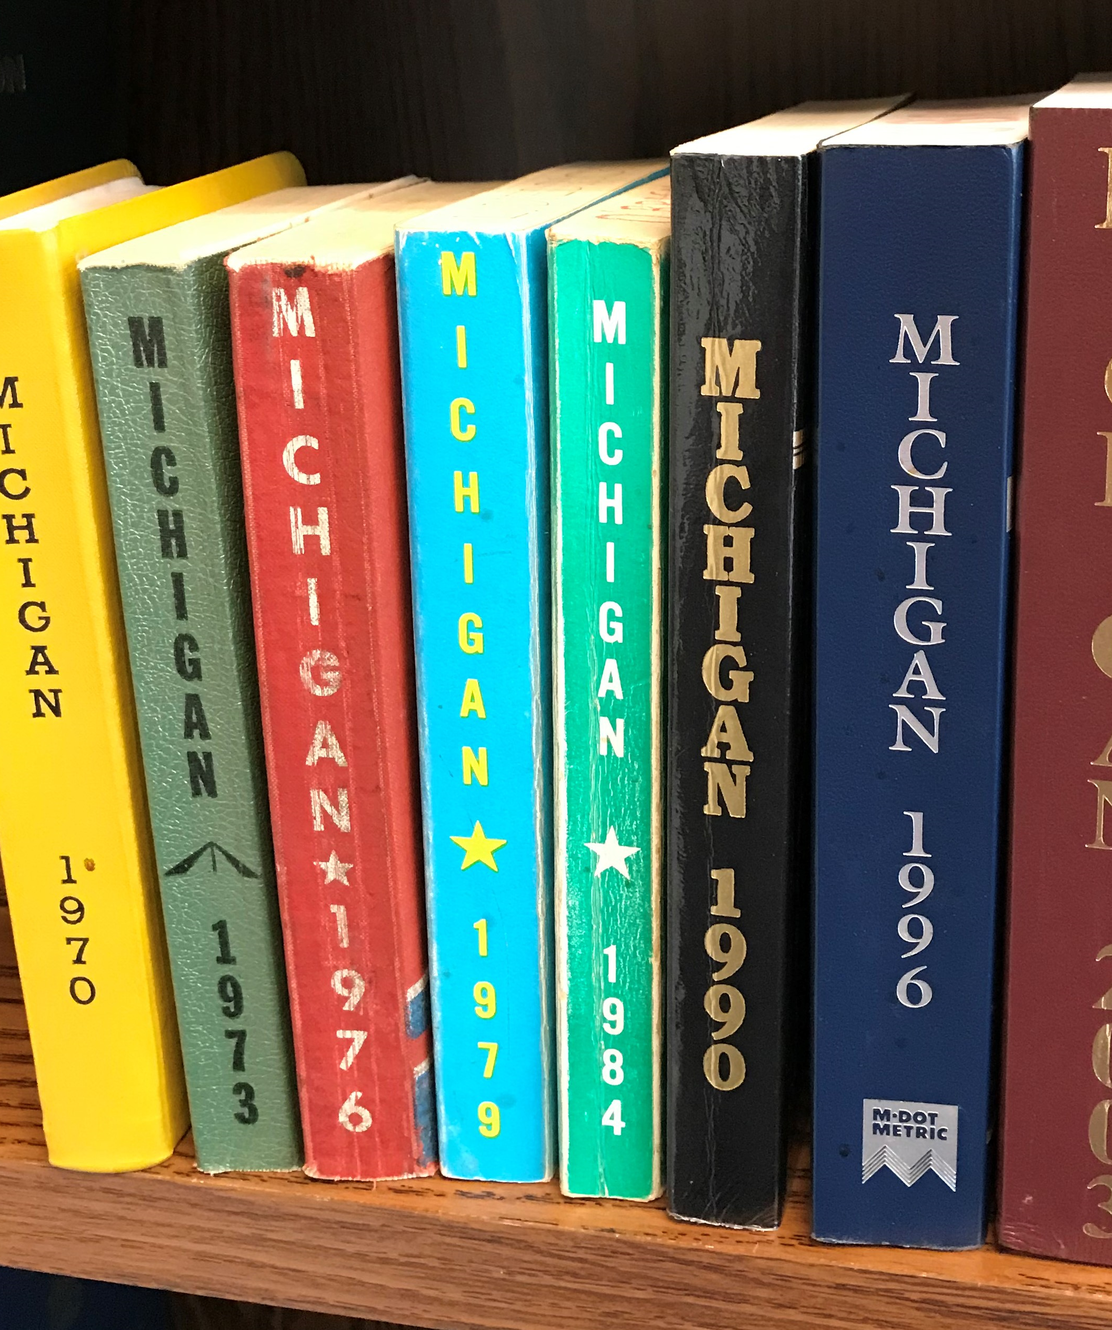
2020 Standard Specifications for Construction
Final Review December 2019 – February 2020
Electronic Publication March 2020
Printed Release Mid-2020
Effective October 2020 Letting
2021 Construction Season

Slide 17
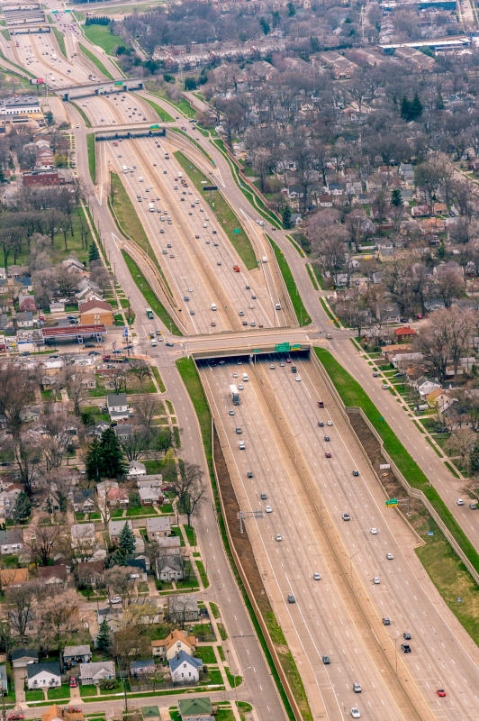
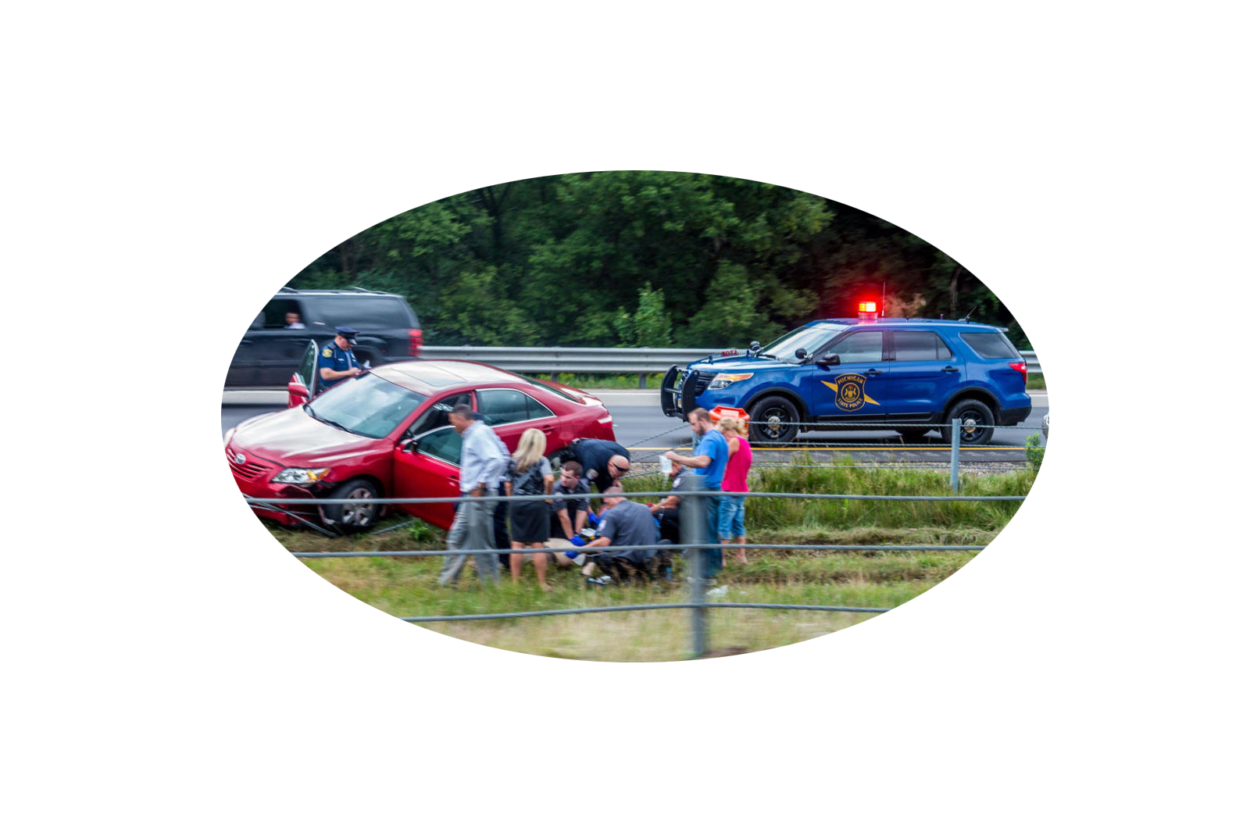
SAFETY ON OUR ROADS
1
WORK ZONE
CRASH
OCCURS EVERY
5.4 MINUTES
1682
WORK ZONE
CRASHES
ON MI ROADWAYS
IN 2017
4838
WORK ZONE
CRASHES
ON MI ROADWAYS
IN 2018
5411*
WORK ZONE
CRASHES
ON MI ROADWAYS
IN 2019
**Preliminary numbers. All crash data has yet to be included and are not finalized.

Slide 18

Enforcement
Flexibility to Implement Safety
Culture
Technology
Education
Marketing
Balancing Mobility & Safety

Slide 19
Significant 2019 Accomplishments
Established dialogue & relationship with Prosecutors’ Association | Proposed process of early industry review on constructability & safety to be piloted in 2020
Improvements to MDOT Work Zone Safety & Mobility Manual & plan development process | Initiated design & procurement of Work Zone Safety awareness trailer for education efforts
Expanded use of Alternate Technical Concepts (ATC) for Maintenance of Traffic concepts | Established social media presence & #WorkZoneWednesday industry-wide messaging
Proposed concept for Safety Contingency Fund to be piloted in 2020 | Held first-ever industry-wide work zone safety technology forum
Completed first-ever industry-wide Work Zone Safety Perception Survey | Encouraged safety moments in all project meetings
Developed “use statements” for high value safety technology/devices

Slide 20
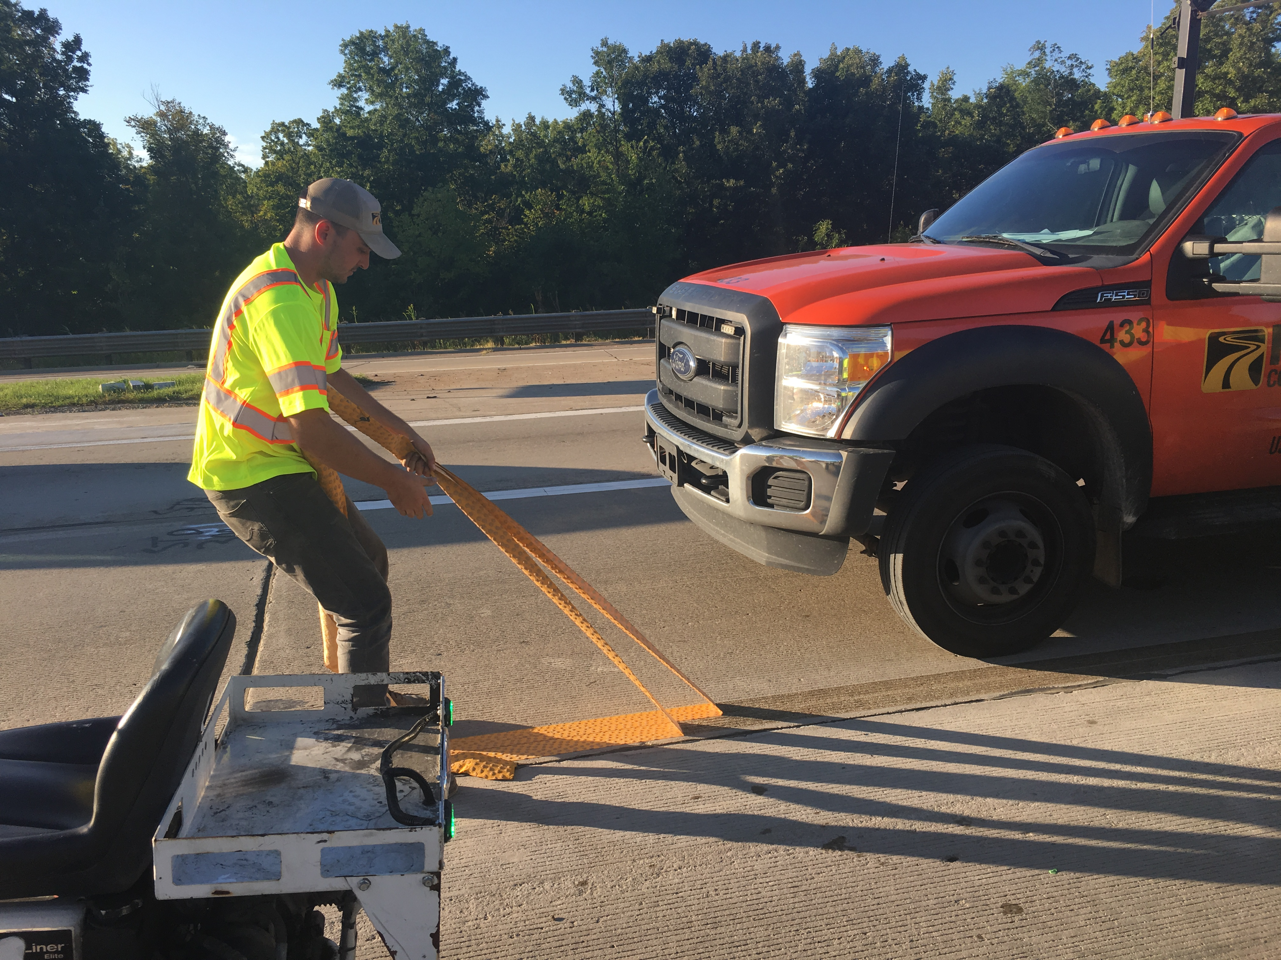
Temporary Pavement Marking Tape
3 test locations in 2019 with promising results:
  Less breakage
  3 times faster removal
  Safer removal
  Reduced worker & motorist exposure during traffic switches
  Reduced duration (user delay & confusion) of traffic switches

Slide 21

National Work Zone Safety Awareness Week
APRIL 21st
American Center for Mobility
Ypsilanti, MI

Slide 22
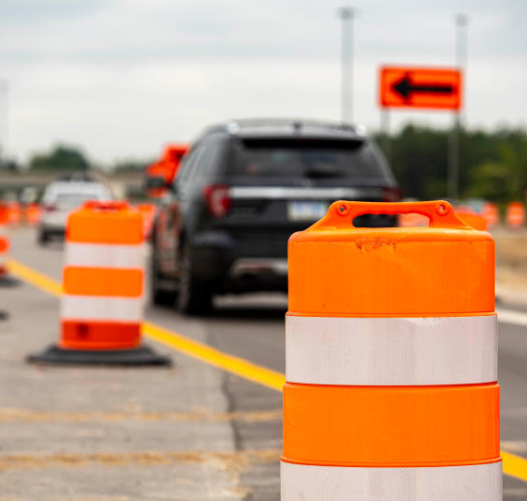

Questions?

