Slide 1

Jason Gutting, PE
February 14, 2024
2024 Michigan Aggregates Association
Annual Conference

Slide 2


Today’s Topics
2023 Program Accomplishments
Future Program
2024 and 2025 Numbers
MDOT Team
Integrated Program Management
Work Zone Safety Task Force

Slide 3
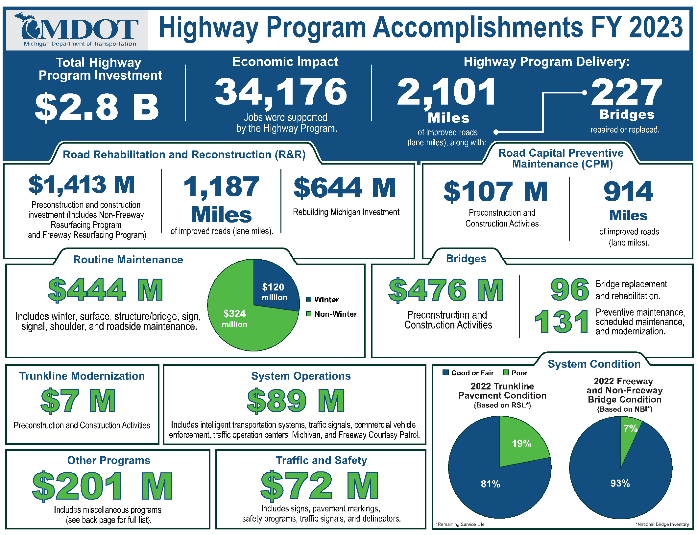


Slide 4

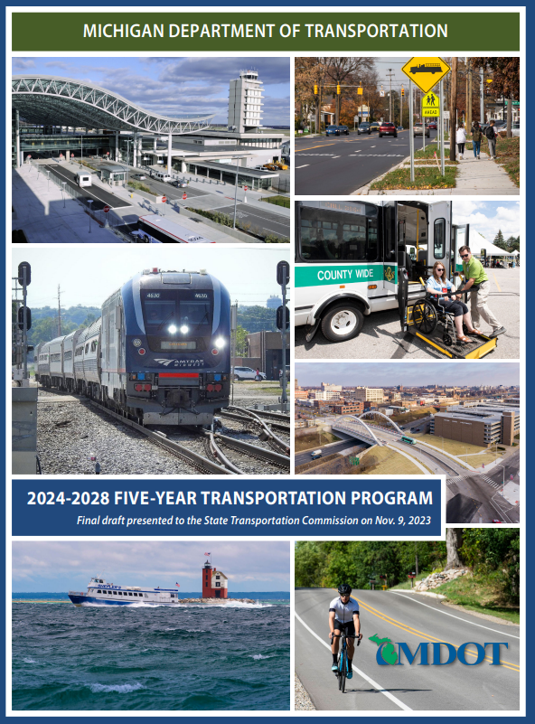
Five-Year Transportation Program
Webpage Link https://www.michigan.gov/mdot/programs/planning/five-year-transportation-program

Slide 5

Five-Year Transportation Program (5YTP) 2024-2028
FY 2024-2028 MDOT Multimodal Transportation Program
$15.86 Billion (in millions)

Slide 6
Five-Year Transportation Program (5YTP) 2024-2028
Estimated Highway Program Revenue for 2024-2028 After Pre-Capital Uses $10.2 billion

Slide 7
Draft Five-Year Transportation Program (5YTP) 2024-2028

Slide 8
Five-Year Transportation Program (5YTP) 2024-2028
FY 2024-2028 MDOT Highway Program (in millions)
$11.15 Billion Total
Program | FY 2024 | Five-Year Total | Annual Avg.
Repair and Rebuild Roads* | $1,577 | $5,192 | $1,038
Repair and Rebuild Bridges** | $558 | $1,963 | $393
Routine Maintenance | $476 | $2,499 | $500
Safety and System Operations | $239 | $949 | $190
Additional State and Federally Funded Programs | $111 | $547 | $109
Total Five-Year Trunkline Program | $2,961 | $11,150 | $2,230
*Including Trunkline Modernization
**Includes $40 million in FY24 and $600 million total from FY24 to 2028 for ongoing Blue Water Bridge (BWB) Plaza work accounted for in previous years.

Slide 9
Rehab & Reconstruct

Slide 10
FY 2024 Budget
Program Description | FY 2024 Amount
Road and Bridge Programs ** | $ 3,903,573,600.00
Modal Programs | $ 706,132,400.00
Trunkline Programs | $ 510,661,100.00
Highway Maintenance | $ 466,088,700.00
Other Capital Outlay | $ 289,354,000.00
Debt Service | $ 343,740,100.00
One Time Funding | $ 407,000,000.00
Gross Appropriations | $ 6,219,549,900.00
**This line item includes Act 51 Distribution payments

Slide 11
2024 Construction Projects
Trunkline Only *This information represents the total number of projects and dollars scheduled to be let in each month.
Therefore, the sum of values will not directly correlate to program year budgets, and this information is always subject to change.

Slide 12
2025 Construction Projects
Trunkline Only *This information represents the total number of projects and dollars scheduled to be let in each month.
Therefore, the sum of values will not directly correlate to program year budgets, and this information is always subject to change.

Slide 13
Quantity Values
This information is draft and may change as the program is developed.
*2024 & 2025 amounts are programmed values to date. The 2024 year encompasses data from July 2023 to June 2024 and the 2025 year encompasses data from July 2024 to June 2025 to align with construction year emphasis.

Slide 14
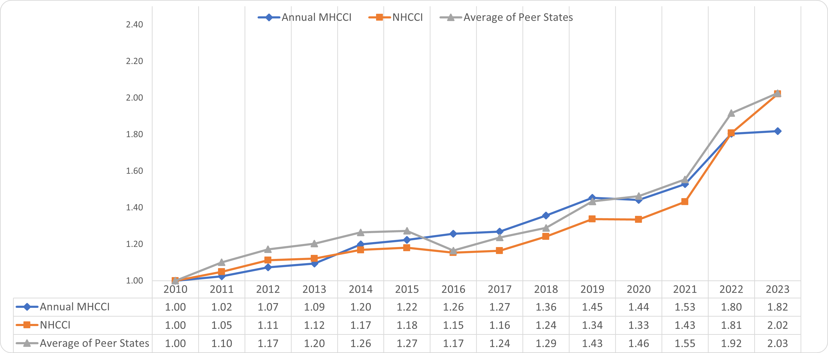
Michigan Highway Construction Cost Index (MHCCI) Comparison with Peer States & National Highway Index 2010-2023
*2023 NHCCI calculations based on Qtr. 1 & 2 data only (calendar year).

Slide 15
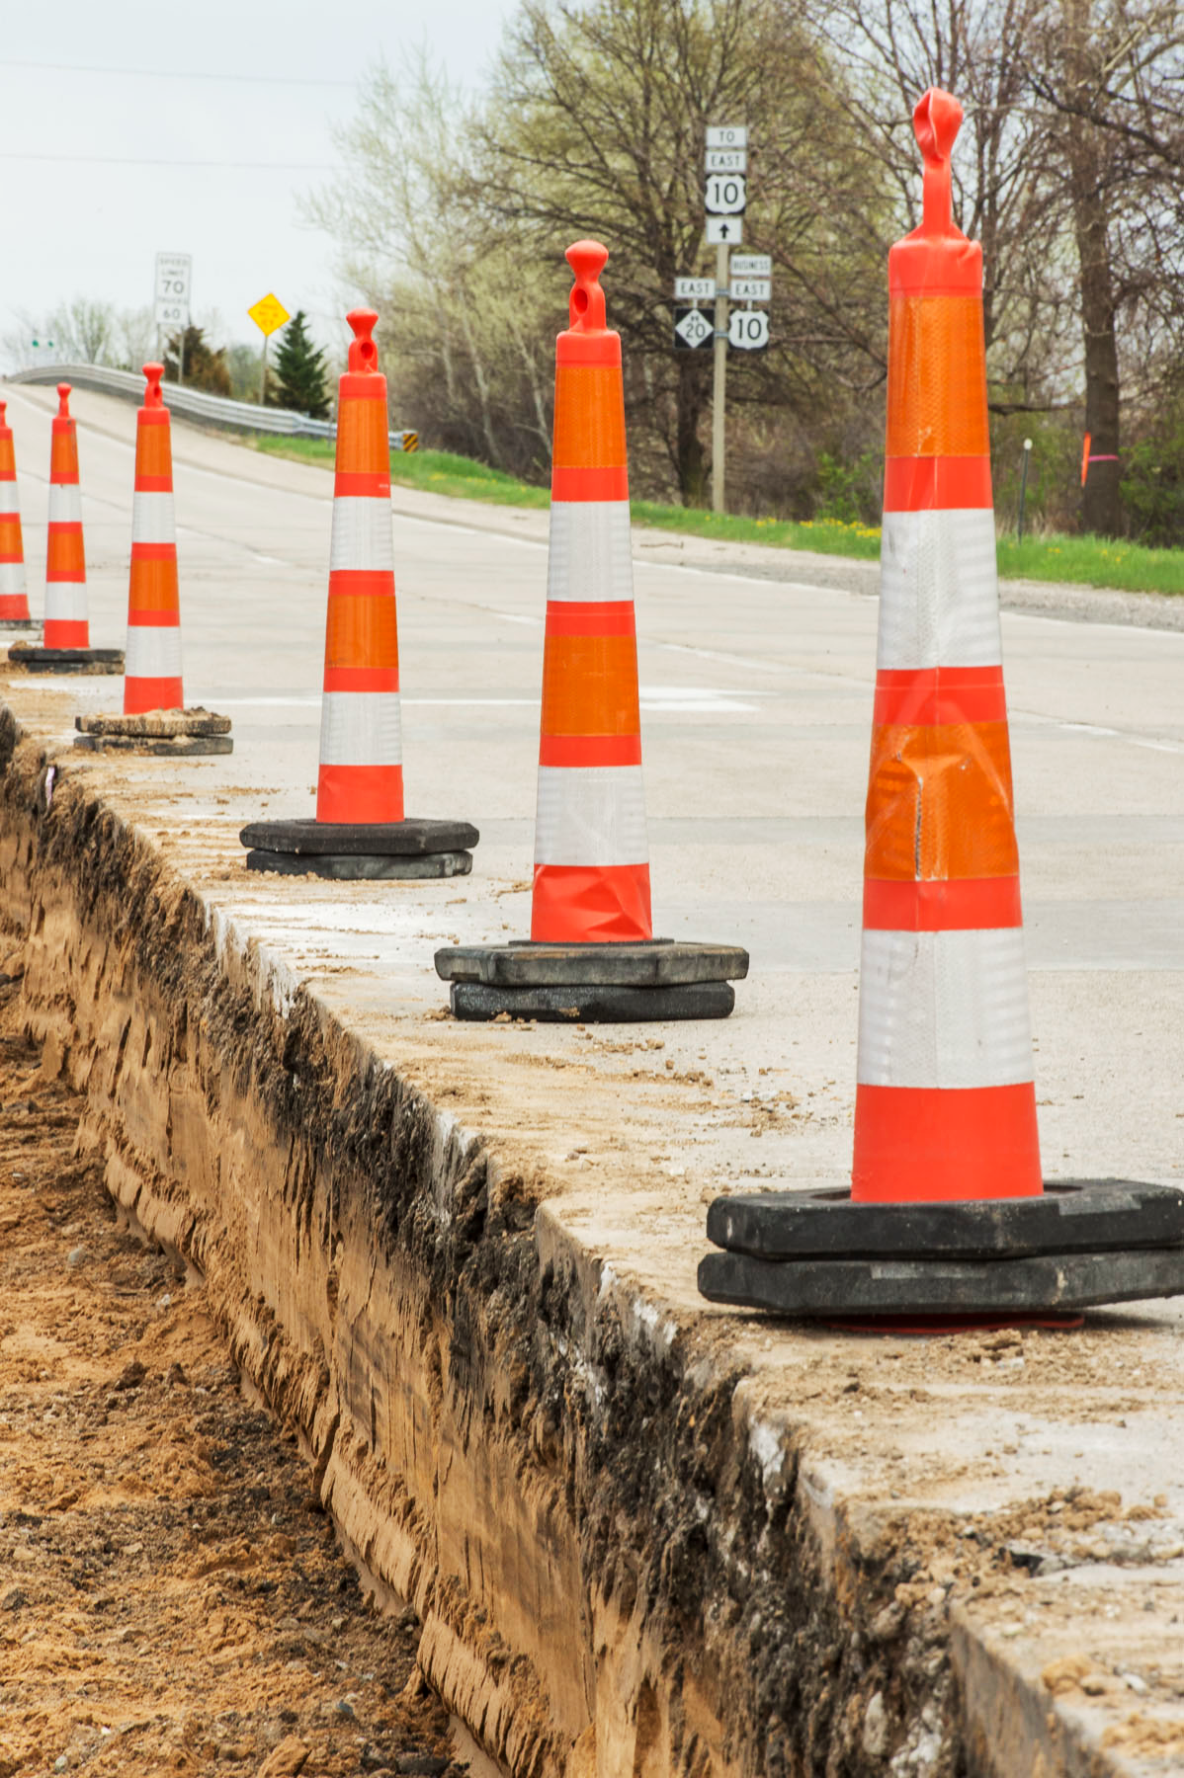
Rebuilding Michigan
Program Status
Authorized - $3.5 Billion
Issued @ Par - $2.8 Billion
Cash Proceeds from Issuance - $3.3 Billion
Obligated for Construction - $3.0 Billion
7 Projects remaining to be awarded in 2024 and 2025

Slide 16

Ryan Mitchell
Office of Major Projects Administrator
For the past 13 years, Ryan has focused solely on developing and delivering successful alternative delivery projects and programs across the United States, many of them major projects, totaling more than $500 million.
Ryan led MDOT's Innovative Contracting Unit, overseeing project identification, selection, development, procurement, implementation, and performance monitoring on all MDOT alternative delivery projects.
Ryan chairs MDOT's Innovative Contracting Committee and serves as a voting member of MDOT's Engineering Operations Committee.

Slide 17

Jason Gutting
Bureau Director of Field Services
Gutting has served as the engineer of Construction Field Services since February 2016 and brings more than 24 years of experience and leadership with the State of Michigan to his new role.
Gutting has a Bachelor of Science in civil engineering from Michigan State University and is a licensed professional engineer with the state of Michigan.

Slide 18

Lindsey Renner
Construction Field Services Division Administrator
Lindsey brings with her more than 18 years of experience and leadership from her time at MDOT and the consultant industry, previously serving as the Construction Operations engineer and Field Operations engineer prior to that.
Lindsey possesses a Bachelor of Science in civil engineering from Michigan State University. She is a licensed professional engineer with the state of Michigan.

Slide 19

Jason Bodell
ITS & Signals Program Office Engineering Manager
Jason previously held the role of TSMO Maintenance Unit Engineer. Prior to coming to TSMO - Maintenance, Jason held the position of Statewide Transportation Operations Center (STOC) Engineer. Additionally, Jason has held the roles of Gaylord TSC Traffic & Safety Engineer, and Gaylord TSC Design Engineer.
Jason possesses a Bachelor of Science in Civil Engineering from U of M and is a licensed professional engineer with the states of Michigan and Hawaii.

Slide 20




What is Integrated Program Management?
Project Controls expertise for effective program and project delivery and management.
Project Controls is data gathering, data management and analytical processes used to predict, understand and constructively influence the time and cost outcomes of a project and/or program;
Communication of that information and data to assist effective management and more informed decision making.

Slide 21

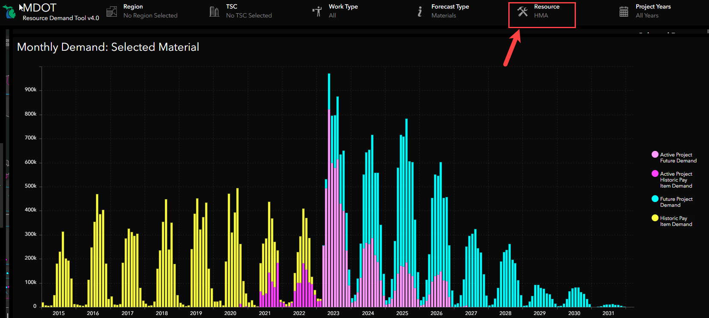
Material Demand Example for HMA (tons)

Slide 22



OK, but what does this really mean?
Setting Our Program AND Projects Up For Success…in Development, Design, and CONSTRUCTION
Mitigate surprises as much as possible, ADAPT to new information and EXTERNAL FACTORS

Slide 23

IPM Program Planner
(still in development)
Forecast future material, spending, labor demand based off historical averages
Scenario planning
Model impacts of shifted projects
Allow for more insight to help “balance” lettings and overall program

Slide 24
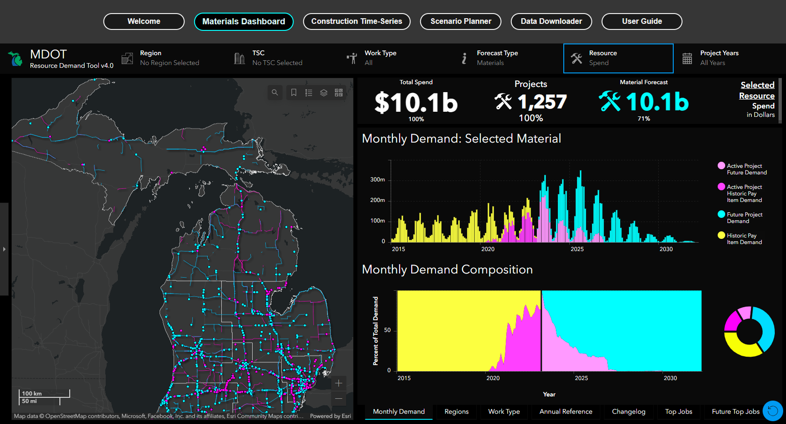

Slide 25


Work Zone Safety
Task Force
New Focus of Task Force
Focus on a few key topics
New Positive Protection Team
Work Zone Enforcement/Presence
Implement New Technology
Continued use of Special Provisions
Work Zone Safety Contingency Fund
Work Zone Collaboration

Slide 26

Work Zone Safety
Task Force Members
Trevor Block
Chris Brookes
Gregg Brunner
Deven Rau
Aaron Johnson
Mike DeFinis
Mike Malloure
Rob Coppersmith
Ryan O’Donnell
Kim Zimmer
Jason Gutting
Justin Peyerk

Slide 27


