Slide 1
2024 MAA Annual Conference 02/15/2024
Amy Z. Jackson, Supervisor
Lansing, MI. Field Office
Jackson.amy@dol.gov

Slide 2
Fatals 2023
As of 12/31/2023:
There have been 40 Fatal accidents; 1st occurred on Jan 4th; Latest on Dec 14th.
8-underground, 32-Surface
31-MNM, 9-Coal
Classifications of Accidents
3-Electrical
2-Fall/Slide of materials
2-Fall of face/Rib/Highwall
1-Fall of roof or Back
10-Powered Haulage
16-Machinery
3-Slip/Fall of person
2-Other
1-Handling of Materials

Slide 3
Fatals 2024
As of 02/14/2024:
There has been 2 Fatal accidents
2-Surface
1-MNM
1-COAL
Classifications of Accidents
2-Powered Haulage

Slide 4
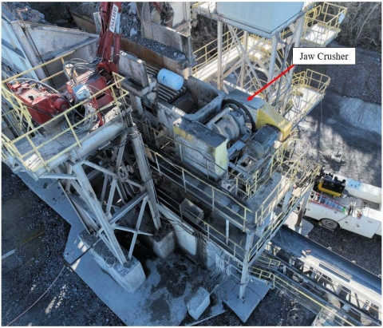
Let’s look at some details… Repair & Maintenance
January 4, 2023: Fatality #1 – Machinery
Tennessee; Two Years of Task Experience
MINE FATALITY – On January 4, 2023, a miner was fatally injured while performing maintenance inside a jaw crusher. The pitman assembly (moving jaw) rotated, pinning the miner against the crusher housing.

Slide 5
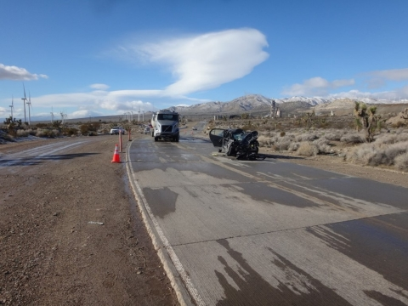
Let’s look at some details… Weather Conditions
January 17, 2023: Fatality #2 – Powered Haulage
California; 19 Years of Task Experience
MINE FATALITY – On January 17, 2023, a miner was fatally injured when his personal car collided with a customer truck. Both vehicles were traveling toward each other in opposite directions on an icy mine access road.

Slide 6
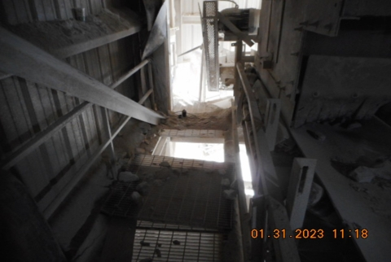
Let’s look at some details… Clean up
January 30, 2023: Fatality #6 – Fall of Person
Missouri; Half a Year of Task Experience
MINE FATALITY – On January 30, 2023, a miner died while troubleshooting a belt conveyor when he fell through a 37-inch-long by 34-inch-wide hole created by the removal of a section of grating. The miner fell approximately 35 feet from the catwalk to the ground below.

Slide 7
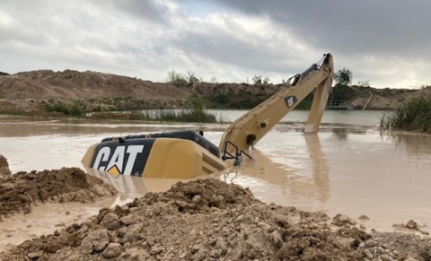
Let’s look at some details… Berm Maintenance
February 25, 2023: Fatality #8 – Drowning
Texas; Five Days Task Experience
MINE FATALITY – On February 25, 2023, a miner drowned when his excavator traveled over a berm into a sediment pond.

Slide 8
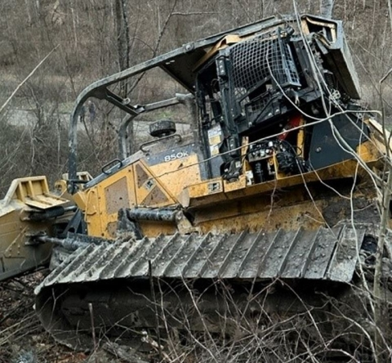
Let’s look at some details… Seat Belts
February 26, 2023: Fatality #9 – Machinery
West Virginia; 53 Years Task Experience
MINE FATALITY – On February 26, 2023, a contract miner died while operating a bulldozer. The bulldozer traveled over the edge of an access road and rolled 375 feet down an embankment, ejecting the miner from the operator’s cab. The miner was not wearing a seatbelt.

Slide 9
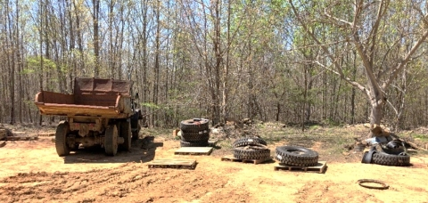
Let’s look at some details… Tire Maintenance
April 9, 2023: Fatality #15 – Machinery
Tennessee; 20 Years Years Task Experience
MINE FATALITY – On April 9, 2023, a miner died while mounting off road truck tires on rims. The miner was in the process of mounting a tire on its rim when another tire’s outer lock ring dislodged, became airborne and struck the victim in the head.

Slide 10
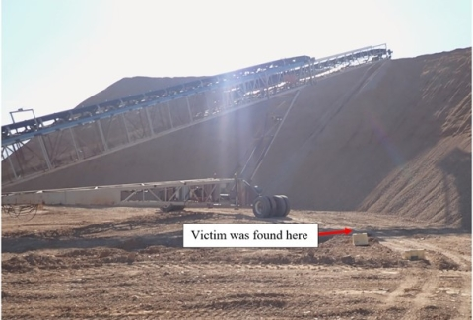
Let’s look at some details… Automatic Equipment
May 2, 2023: Fatality #18 – Powered Haulage
South Dakota; 11 Weeks Task Experience
MINE FATALITY – On May 2, 2023, a miner died when he was struck by a mobile radial stacker conveyor.

Slide 11
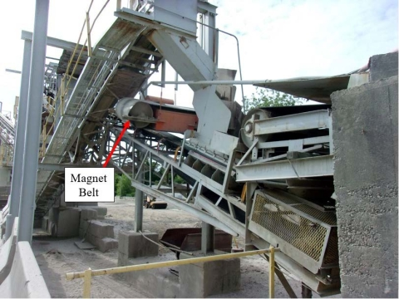
Let’s look at some details… LOTO
June 8, 2023: Fatality #22 – Fall of Person
Massachusetts; 29 Years Task Experience
MINE FATALITY – On June 8, 2023, a miner died after climbing over the handrail onto a conveyor belt to gain access to a magnet belt that needed adjustment. When the miner stepped onto the magnet belt, the belt started, throwing the miner 16 feet to the ground below.

Slide 12
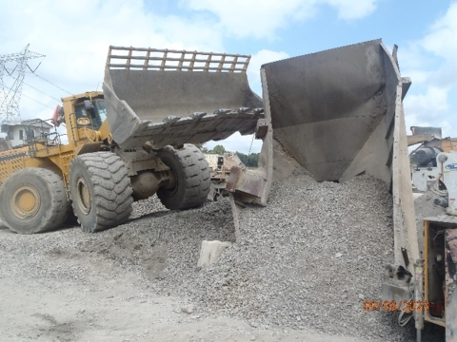
Let’s look at some details… Blocking Access
September 8, 2023: Fatality #31 – Powered Haulage
Pennsylvania; One and a Half Years Task Experience
MINE FATALITY – A miner died while he was working inside a hopper after a front-end loader dumped stone into the hopper.

Slide 13
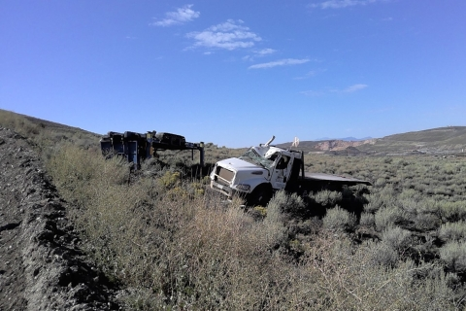
Let’s look at some details… Seat Belts
September 17, 2023: Fatality #33 – Powered Haulage
Nevada; One Year Task Experience
MINE FATALITY – A miner died after the service truck he was operating rolled over and he was ejected. The passenger was wearing his seat belt and received injuries but was treated and released from the hospital.

Slide 14
Let’s look at some details… Prevention!!
Operators should:
Block machinery components against motion before beginning maintenance or repairs
Develop procedures for working safely in confined spaces
Maintain control of equipment while it is in operation
Lock out, tag out, and block equipment from movement before performing maintenance or repairs.
Replace guarding/grating that protects temporary access openings as soon as completing work.
Always wear a seatbelt when operating mobile equipment. Monitor work activities routinely to ensure miners wear seatbelts and follow safe work procedures.
Provide fall protection where there is a danger of falling and train miners on its proper use.

Slide 15
Let’s look at some details… Prevention!!
Workplace Exams
Conduct workplace examinations and immediately correct any unsafe conditions.
Examine ground conditions before beginning work and remain alert as conditions change throughout the shift.
Training…Training…Training…
Task train equipment operators on the operation of machinery
Train miners on the equipment they operate, including safe work procedures, and to identify and report hazards.
Train miners in the safe performance of their tasks
Review and train miners on new and changes to regular tasks

Slide 16
The Mining Industry in State
Top 10 Regulations Cited by Lansing Field Office
% OF TOTAL CITATIONS | 30 CFR | REGULATIONS
6.90% | 56.20003(a) | Workplaces, passageways, storerooms, and service rooms shall be kept clean and orderly
5.20% | 56.14112(b) | Guards securely in place while machine is operated except when testing, adjusting can’t do with guard in place
5% | 56.12004 | Electrical conductors’ sufficient size & current carrying capacity - exposed to mechanical damage protected
5% | 56.14107(a) | Moving machine parts guarded to protect persons from contacting moving machine parts that can cause injury
2.90% | 50.30(a) | Submission of 7000-2 form - Quarterly Employment Form within 15 days after end of each calendar quarter
2.80% | 56.14132(a) | Manually operated horns other audible warning devices provided on self- propelled mobile equip - maintained
2.60% | 56.14100(b) | Defects on any equipment, machinery, & tools that affect safety - corrected in a timely manner
2.30% | 56.16005 | Compressed and liquid gas cylinders shall be secured in a safe manner
2.00% | 56.12032 | Inspection & cover plates on electric equip & junction boxes kept in place all times except during testing & repairs
1.90% | 56.11012 | Protection for openings around travel ways

Slide 17
HQ updates
Waiting on possible info from HQ on activity updates – Slides will be added as needed.

Slide 18
MSHA

Slide 19
Questions
Thank you!
For additional information please go to:
www.msha.gov

