Slide 1
Conveyor Components
Our Newest Technology

Slide 2
Conveyor Components I Sales Contact
Vince Schlatter
Territory Sales Manager
Conveyor Components Division
15-year anniversary at Superior!
Father to four boys!
Married 23 years
Cell Phone: (616) 502-4050
vince.schlatter@superior-ind.com

Slide 3
Conveyor Idlers I SpinGuard® Seal Technology
New & Improved SpinGuard Seal
Previous Seal (2005 - 2020)
NEW

Slide 4
Conveyor Idlers I SpinGuard® Seal Technology
NEW
Protected gap keeps shields labyrinth
Like impeller blade, paddle ejects material
Enhanced triple labyrinth
Contact seal locks against shaft (Not on B)
Retaining ring protected behind seal
Fully sealed ball bearing
1
1
2
3
3
6
4
5
5
4
6
2

Slide 5
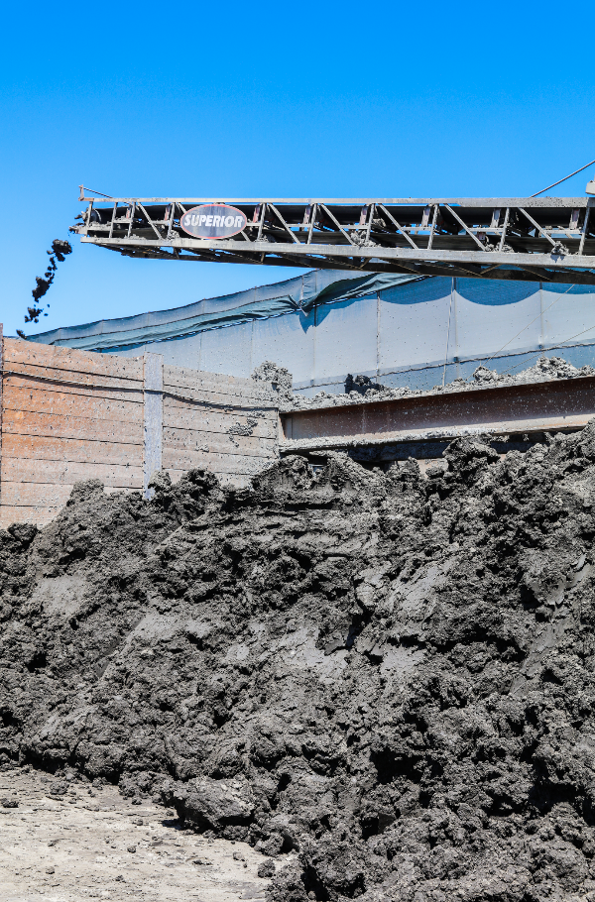
Conveyor Idlers I Application-Specific Seals
Wet Seal
Dust Seal
Eco Seal
Titanium™ Seal
NEW

Slide 6
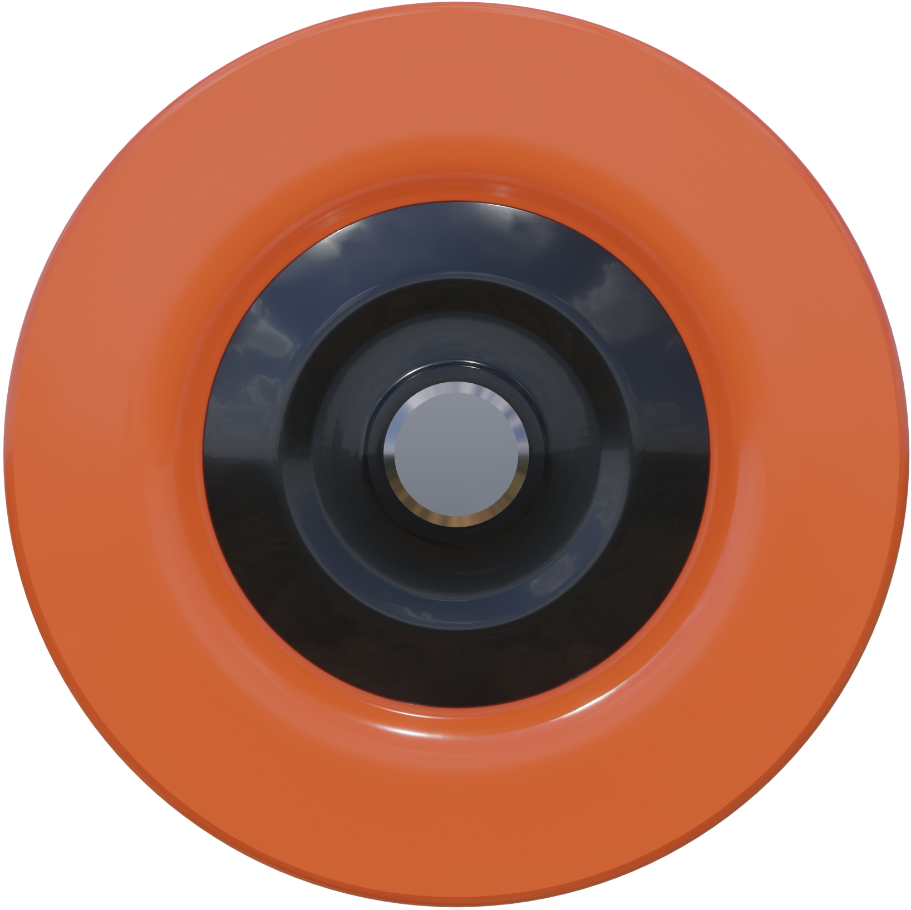
Conveyor Idlers I Application-Specific Seals
NEW
Color | Name | Common Applications |  | Benefits
 | Wet Seal | Wash or dredge process. Frequent plant washdowns. |  | Special double contact seal defends bearing from moisture penetration.
 | Dust Seal | Crushing, screening, coal, grain or frac sand. Covered or indoor conveyors. |  | Oiled and contact seal protects bearing from dry particles and grit.
 | Eco Seal | Overland or long distance material handling where energy is a factor. |  | Seal reduces drag and roll resistance for less horsepower at startup/operation.
 | Titanium Seal | Washed sand, fines removal, dredging. Extreme conditions. Stainless hardware. |  | Combination of wet and dry design for ultimate bearing protection.
 | Standard Seal | Traditional conveying not described above. 80% of applications. |  | Extreme bearing protection from water, particles and grit.
NEW
NEW
NEW
NEW
NEW

Slide 7
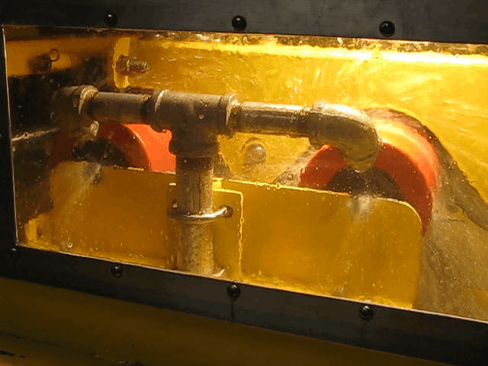
Conveyor Idlers I Application-Specific Seals
NEW
Slurry Application Test
Slurry mixture directed to seal
Flow rate of 1,500 GPM
Roll weights taken daily
Lasts until water penetrates roll
Dismantled seal and roll inspected

Slide 8
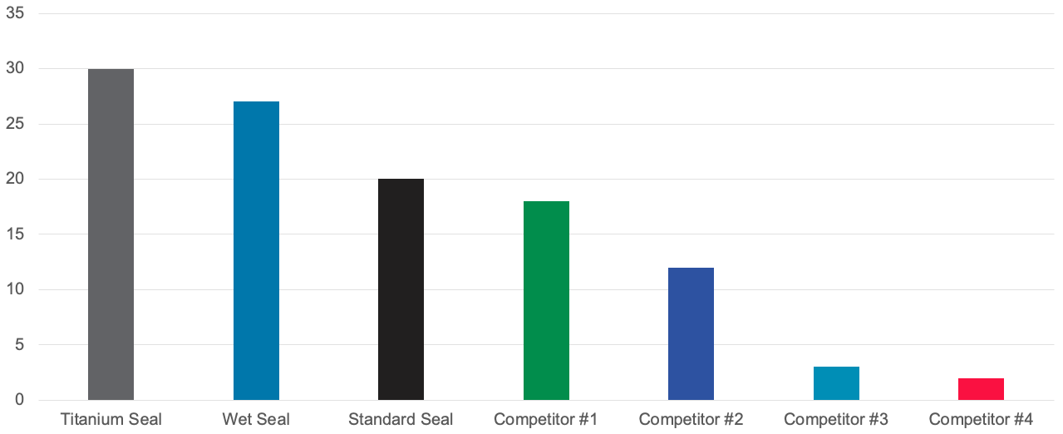
Conveyor Idlers I Application-Specific Seals
NEW
Slurry Test Results Days to Failure

Slide 9
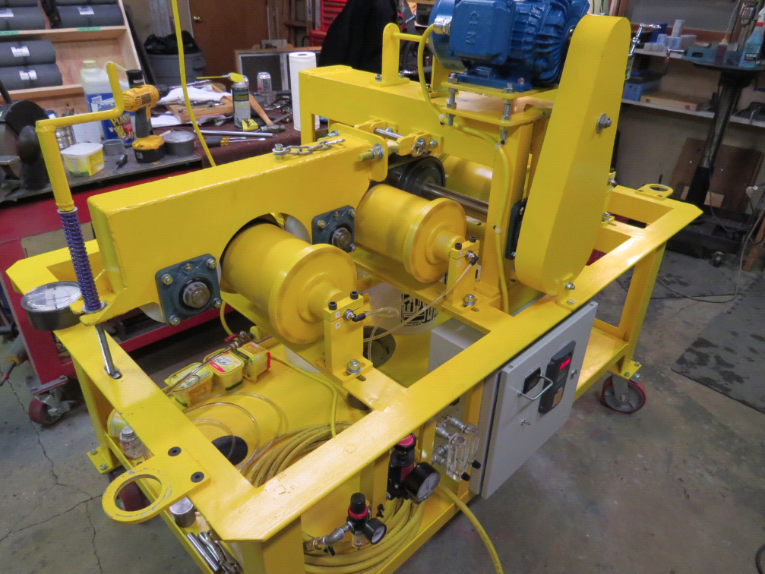
Conveyor Idlers I Application-Specific Seals
NEW
Dust Application Test
Rolls encapsulated in dust cans
Paddle constantly agitates dust.
Rolls rotate 2,100,000 (145 RPM)

Slide 10
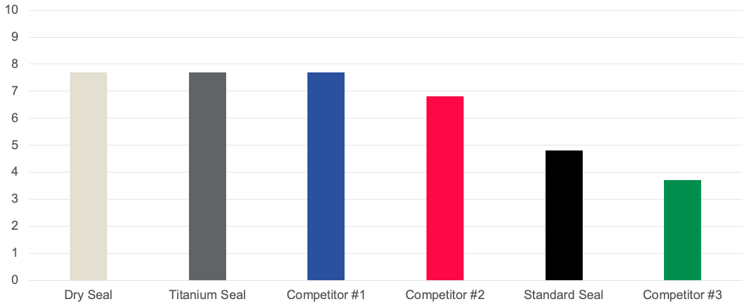
Conveyor Idlers I Application-Specific Seals
NEW
Dry Test Results Evaluation Grade

Slide 11
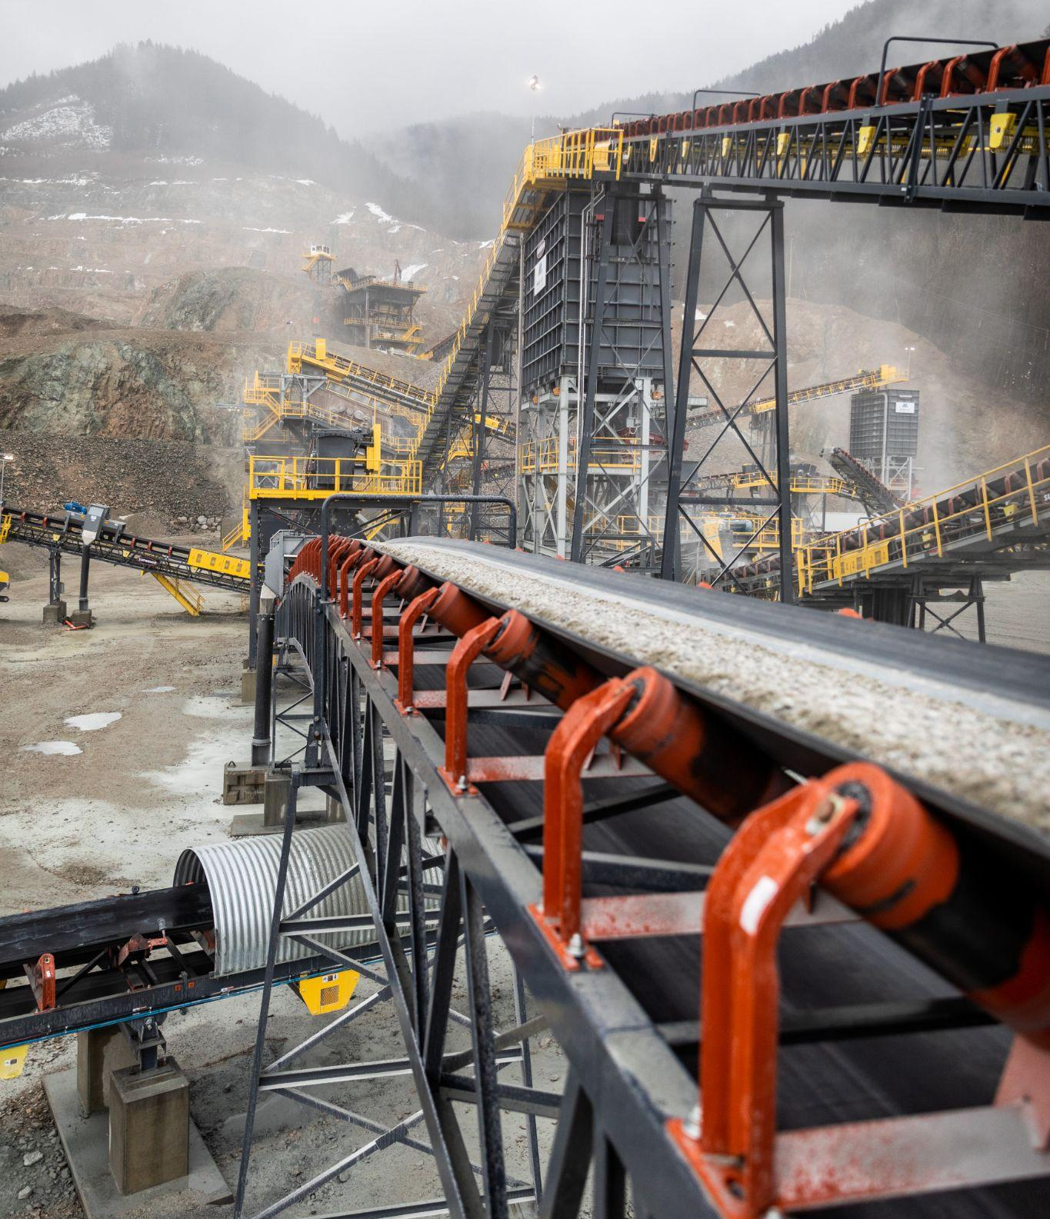
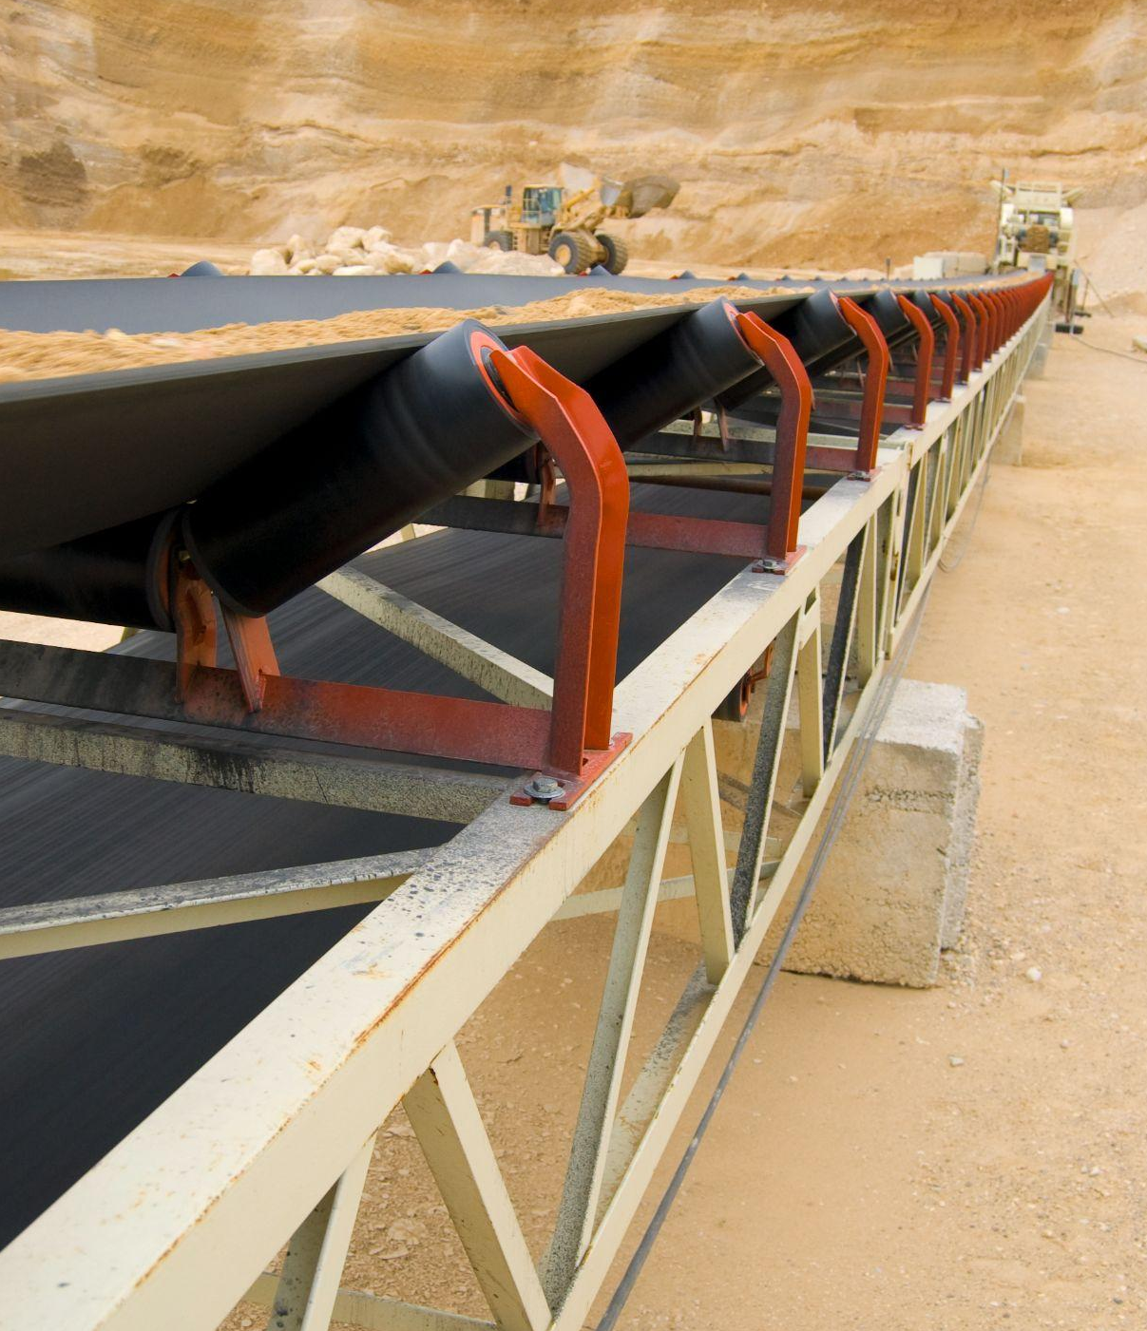
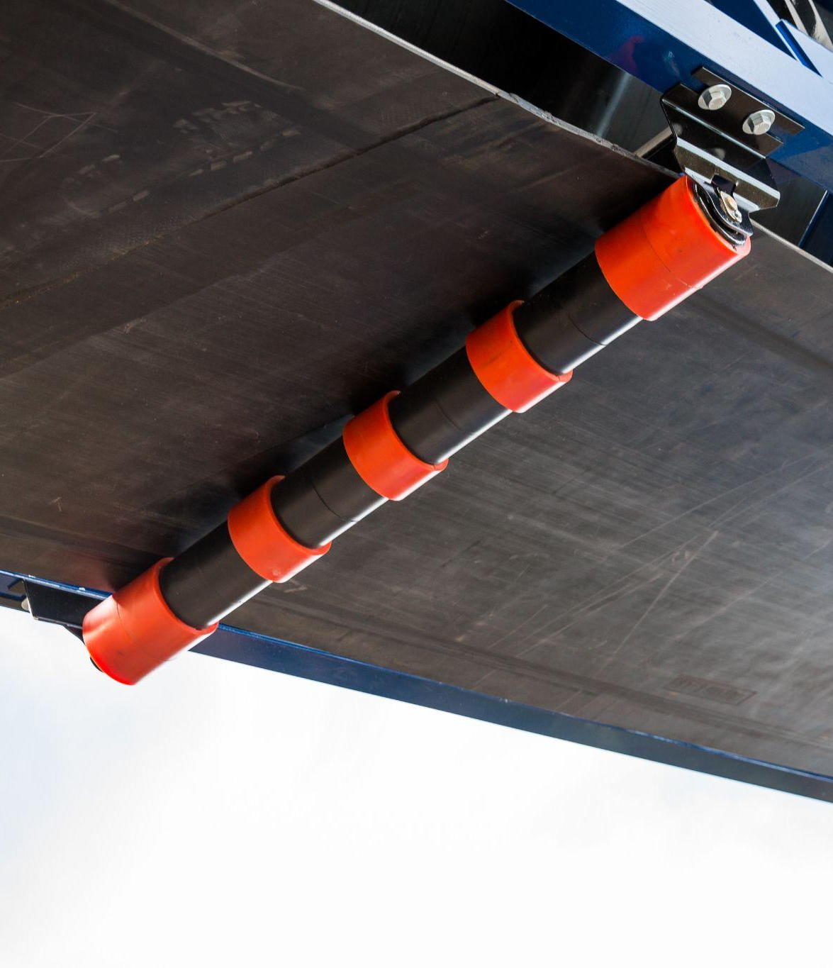
Conveyor Idlers I Multiple Material Solutions
Steel Rolls
Moxie® Rolls
Urathon® Rolls

Slide 12
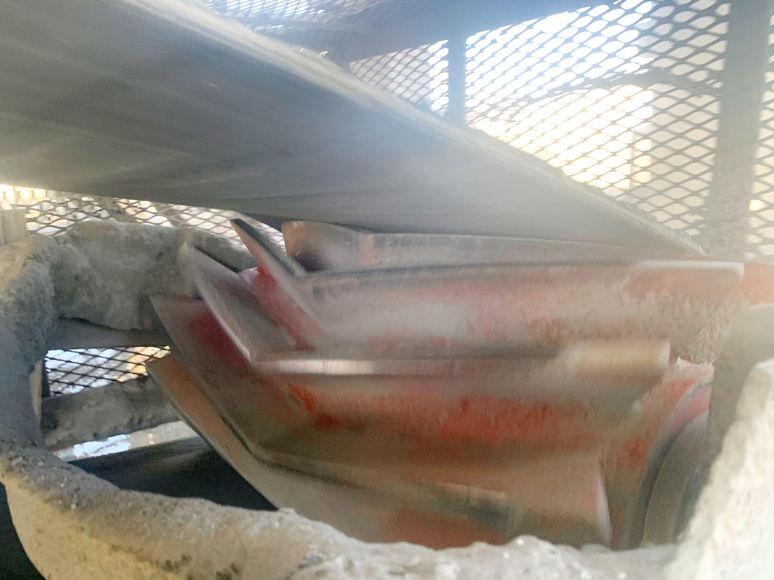
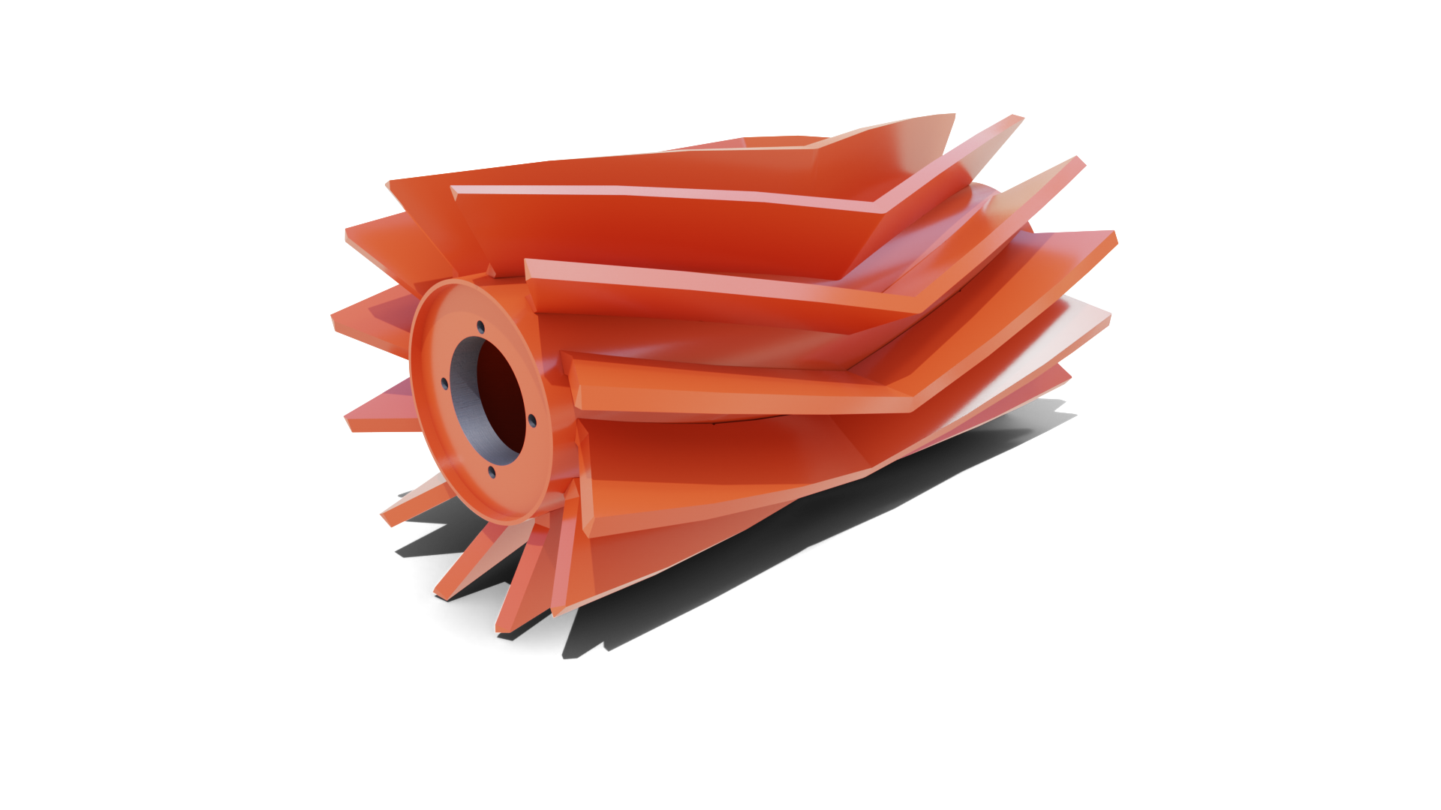
Conveyor Pulleys I Chevron® Wing Pulley
NEW
New CEMA Duty Design
No more rounded cap on the wings
Same benefits of the original design
Increased service life
Wings have more wearable material

Slide 13
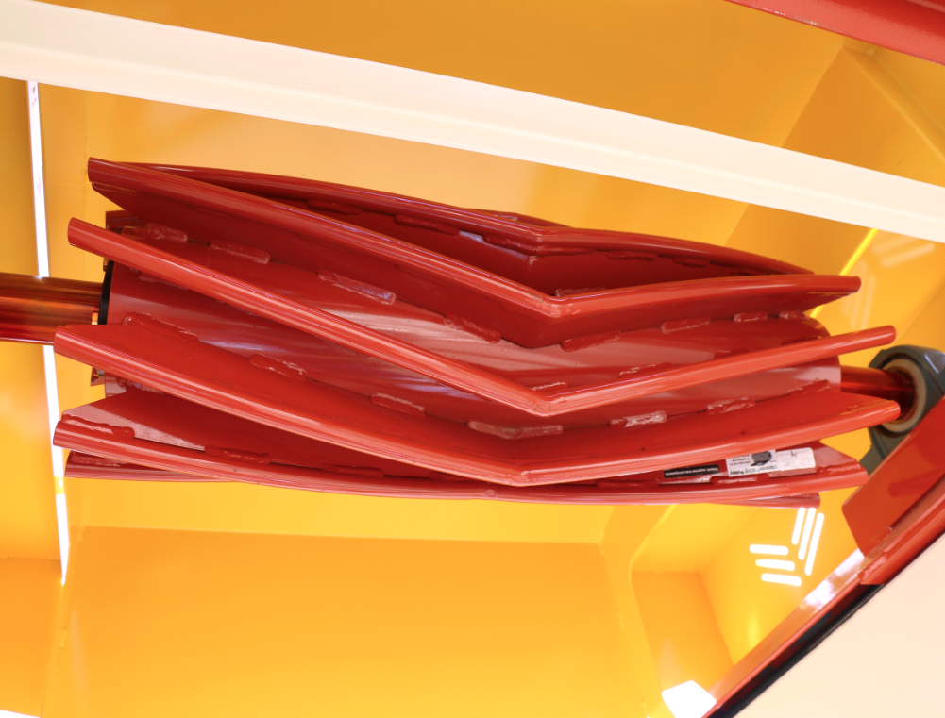
Conveyor Pulleys I Chevron® Wing Pulley
Advanced material shedding
Rare entrapment between wings
Longer lasting belts
Resists wing bending
Heavy-duty wings
Better belt tracking
Constant pulley and belt contact
50 decibels quieter
Friendlier to your neighbors
Tolerant of mechanical splices

Slide 14
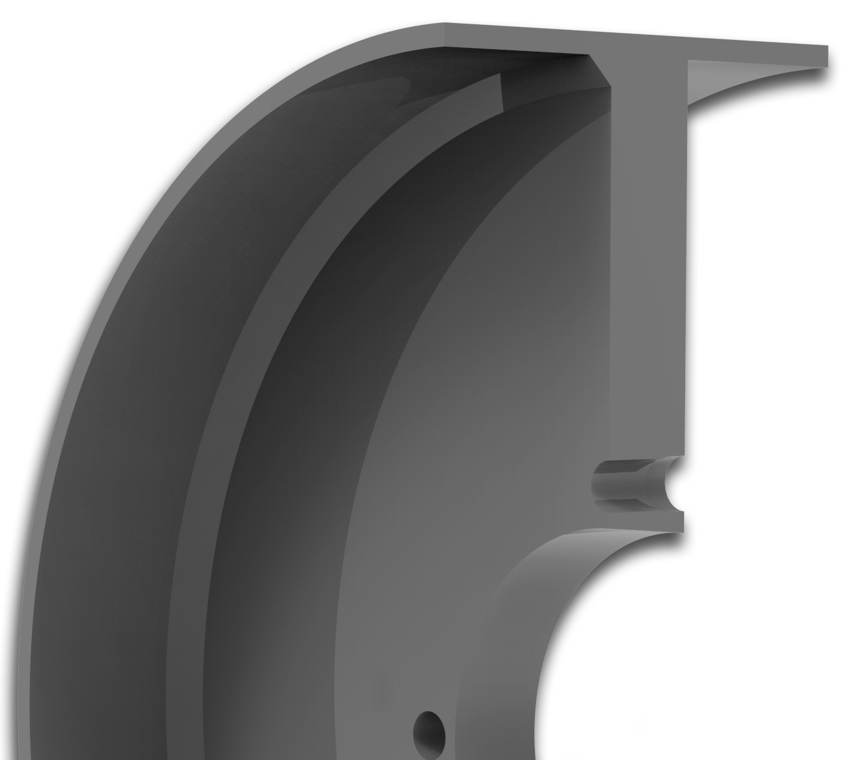
Conveyor Pulleys I Prime® Drum Pulley
NEW
Integral Hub Standard
Already an option, now standard
Eliminate perceived failure
Up to 30” and XT70
No end disk cooling (fast produce)
Weld-in hub still available
Weld

Slide 15
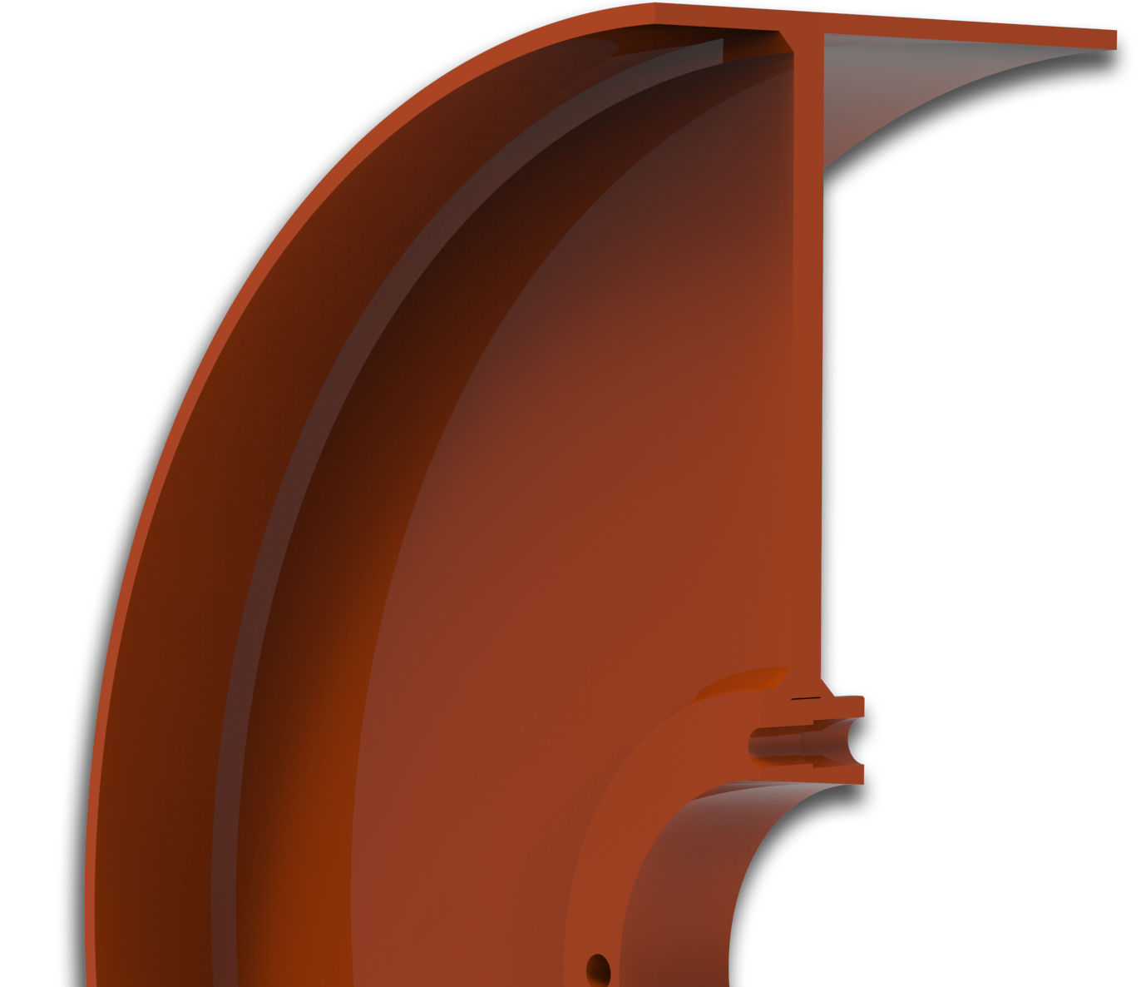
Old Standard
Welded Hub
Prime® Pulley
Integral Hub
Weld

Slide 16
Conveyor Pulleys I Prime® Drum Pulley
NEW
Compared to MD 2.0
Equal or greater than performance
Lower weight
USA steel
Control over quality
Better lead times
Competitive play for distributors
Decreases weld issues < 30"

Slide 17
Exterra® Belt Cleaners I Models
Aggregate Duty
Primary
Aggregate Duty
SFL Primary
Aggregate Duty
Secondary
Aggregate Duty
SFL Dual
Mine Duty
SFL Primary

Slide 18
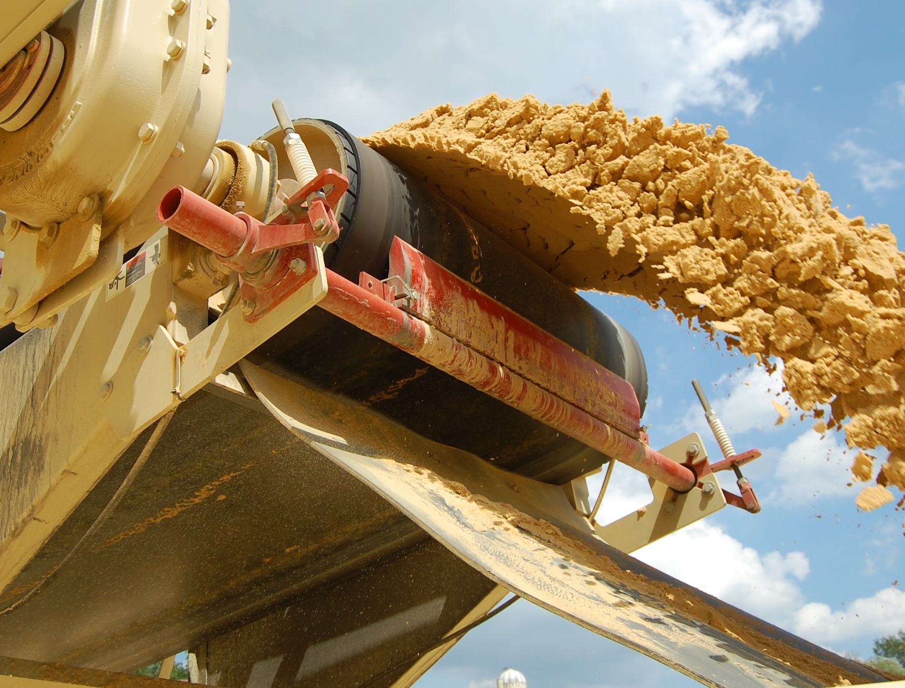
Exterra Belt Cleaners I Aggregate Duty Primary
Beefy blade is larger than competitors
Thicker tip for longer-lasting blade
Inhouse urethane improves quality
NEW
Optional SFL Technology
Optional Click Tensioner

Slide 19
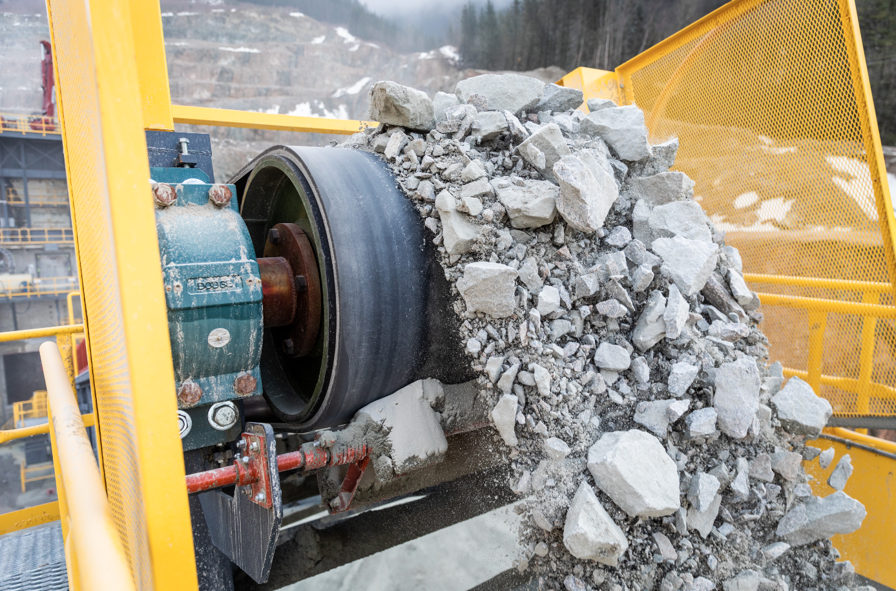
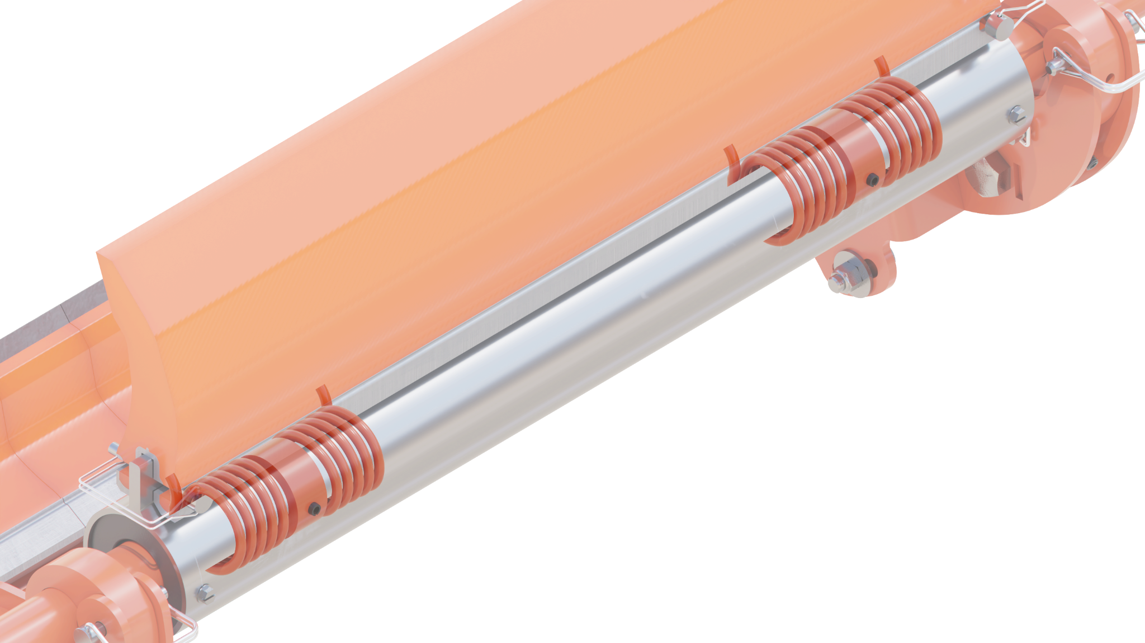
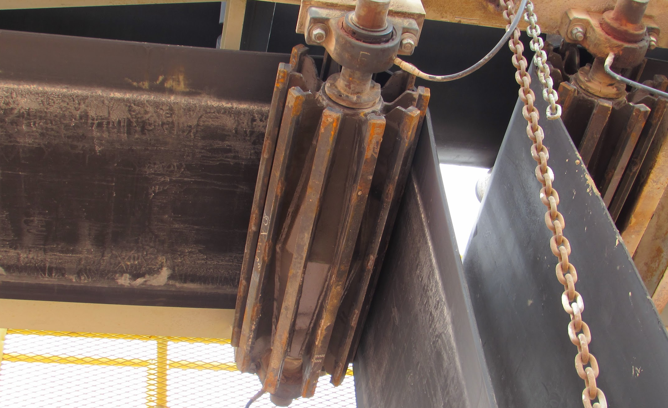
Exterra Belt Cleaners I Options
Set For Life (SFL) Technology
Tension is set at installation of new blade
Pressure maintained automatically
Click Tensioning System
Simply twist to set proper force
Click count instructions labeled on housing
NEW

Slide 20
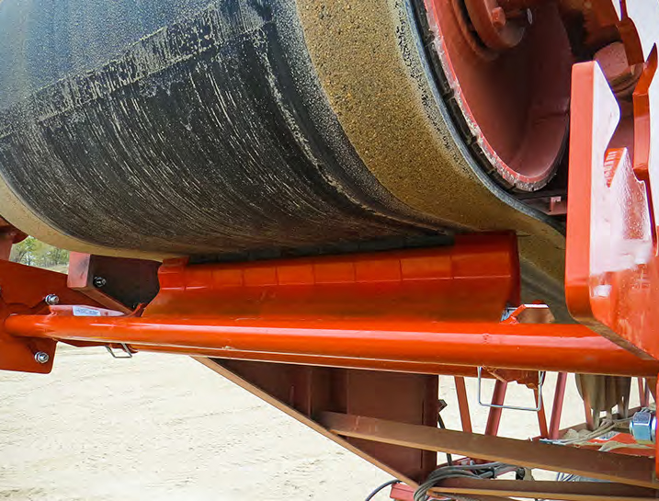
Exterra Belt Cleaners I Aggregate Duty Secondary
Removes leftovers passed by primary
Adjustable angle for different belt splices
Segments individually conform to belting
Tungsten carbide tip for better scraping
Simplified positioner pin eases install
NEW
Optional Click Tensioner

Slide 21
Exterra Belt Cleaners I Aggregate Duty SFL Dual
Primary and secondary on one pole
No structure needed for secondary
Automatically maintains proper tension
Eliminate daily tension maintenance
Set tension at installation of blade(s)
Segmented secondary contours to belt

Slide 22
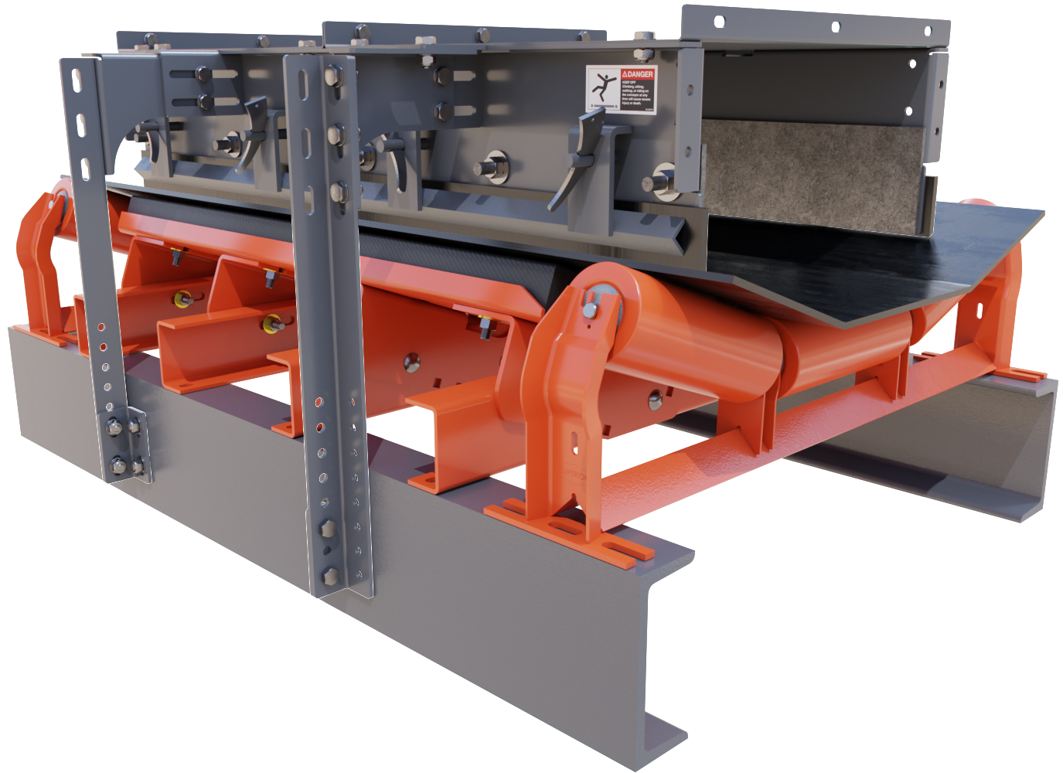
Load Zone Solutions I Skirting System
NEW
Controls dust and stops spillage
Improve health and wellness of site
Modular 5-foot sections
Retrofits to existing conveyor structures
Adjustable legs for universal installation
Clamping system versus nuts and bolts
Available for belts up to 72”
Canoe liner or AR liner plus skirt rubber

Slide 23
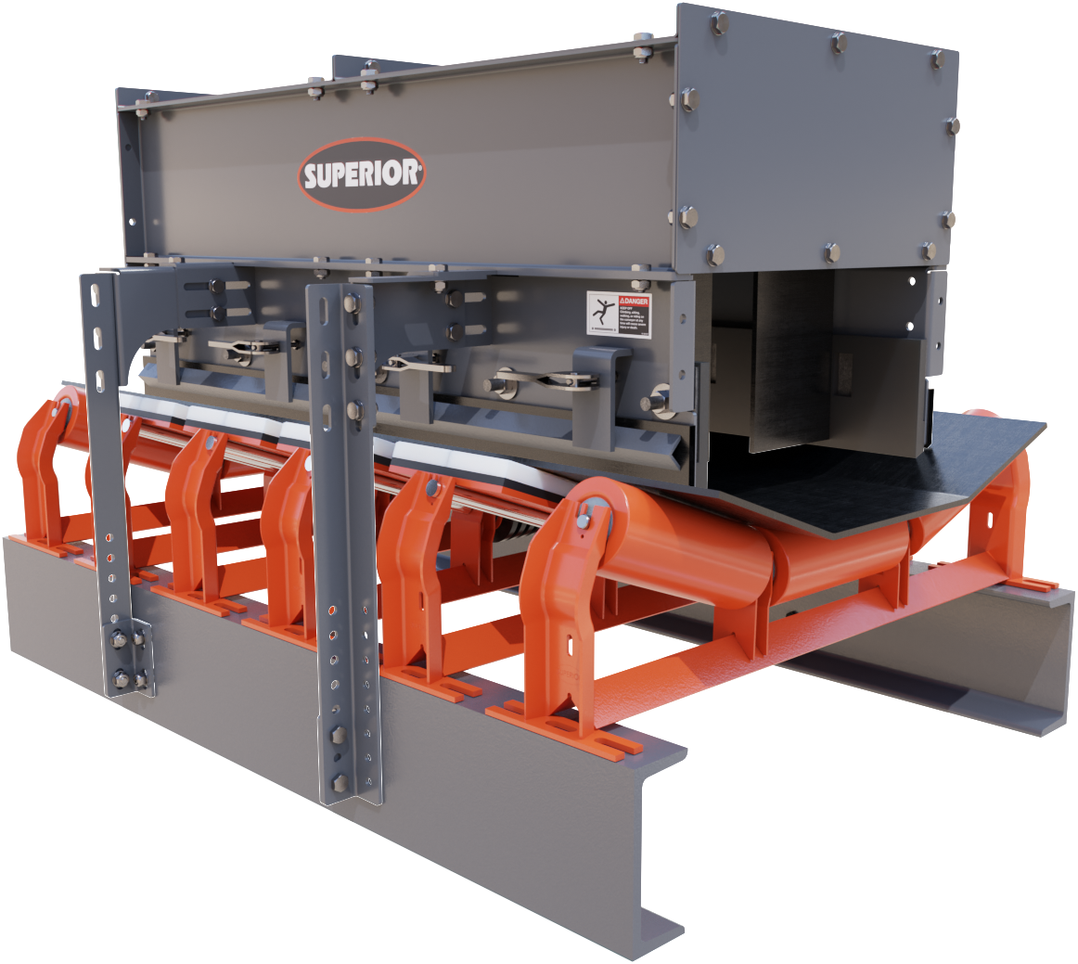
Load Zone Solutions I Skirting System
NEW
Stilling Section
Allows more time for dust to settle
Internal baffles encourage settling
Retrofits to main skirting structure
Modular design
Induced air flow area, ie under a crusher or screen, review of conveyor specs required.

Slide 24
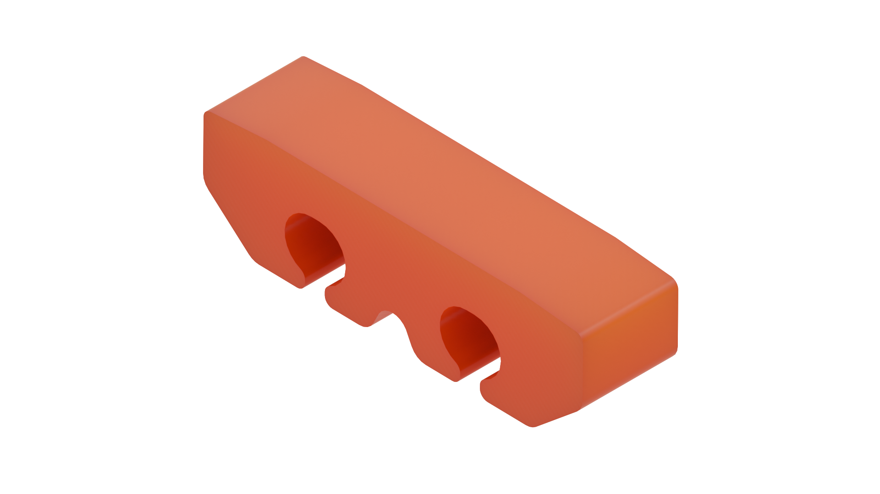
Load Zone Solutions I Skirting System
NEW
SPECIFICATIONS
CEMA Class | Bed Length | Diameter | Belt Width
C | 12’ | 5” or 6” | 24” - 60”
D | 12’ | 5” or 6” | 24” - 72”
E | 12’ | 6” or 7” | 36” - 84”
Pad Segment

Slide 25
Thank You for Attending!
New Conveyor Components Technology

