Slide 1
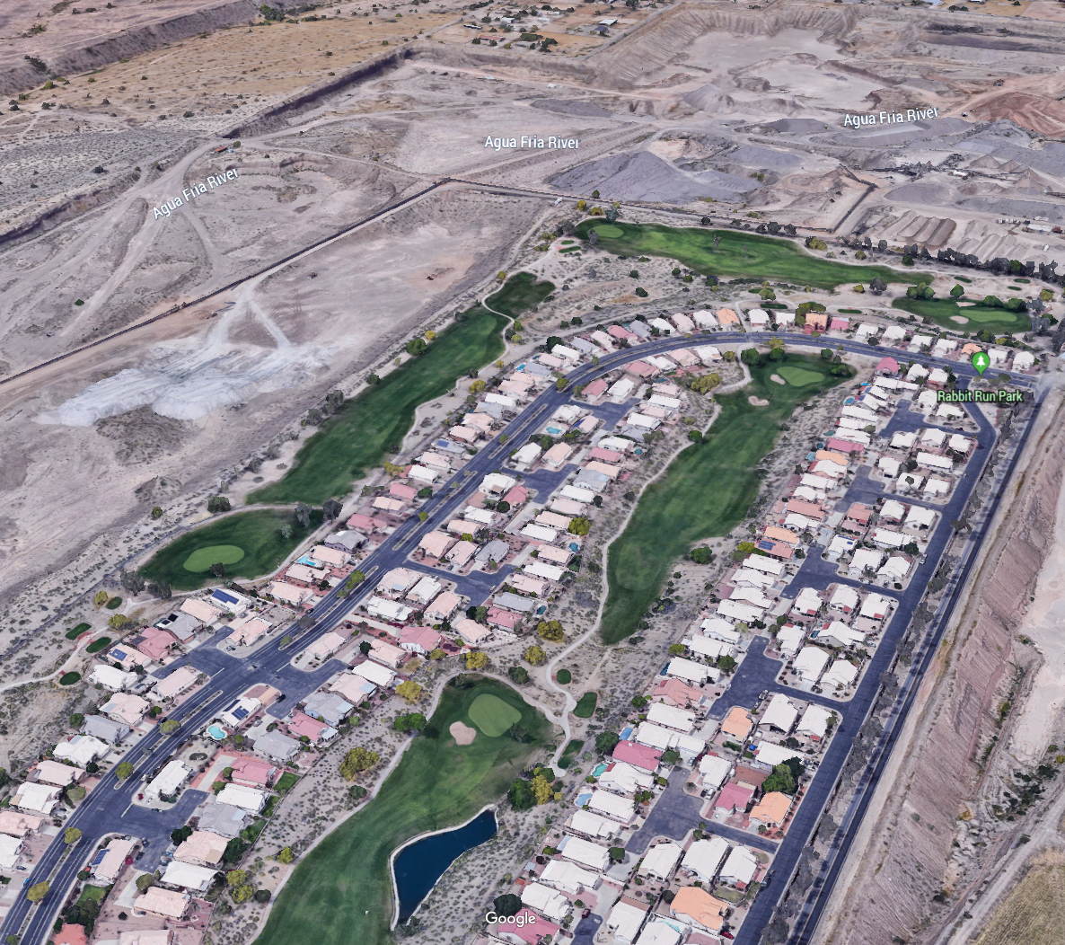

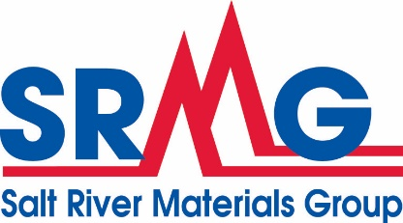
Aggregate Protection: Avoiding Resource Sterilization Through Productive Collaboration with Lawmakers and Public Agencies
Eric Mears R.G.
Vice President, Mining Services
Notes:
SRMG logo on all slides
A different power plant pic with better resolution needed.

Slide 2
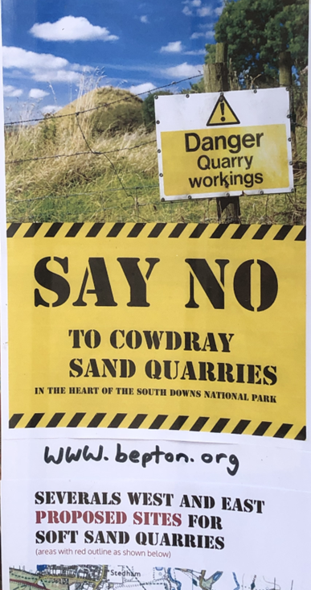
Topics for today's discussion
What is sterilization and how is it happening?
What are the tools available to combat sterilization?
Recent success stories and how can they be locally adapted?
Should we be optimistic about the future?

Slide 3
How is sterilization happening?
Direct causes:
Indirect causes:
Absolute and targeted prohibitions on mining
  Mineral withdrawals
Local zoning decisions
  Requirements for special use permits
  Zoning overlays that result in development or land preservation
Poor planning and lack of aggregate resource information
Unintended outcomes relating to other permitting requirements
  Reclamation planning
  Floodplain use permitting
  NEPA style processes
  Wetland or watershed preservation

Slide 4

Cycles of rapid growth and development often sets the stage for significant resource and land use conflicts
Rapid encroachment around aggregate production areas
Sterilization of known high-quality aggregate resources
Planners unprepared to make informed decisions regarding growth
Growing conflicts with active mines regarding dust, noise, and health concerns
Notes:
Need a better picture housing construction

Slide 5
The California aggregate market is a great example of what we desperately need to avoid
Despite having abundant aggregate deposits:
  Many large cities have less than 10 years of available reserves
  Permitting new mines takes longer than 10 years with no guarantee of favorable outcome
  San Diego, Los Angeles, and San Francisco are importing materials from Canada and Mexico and “local” travel distances often exceed 80 miles
  Aggregate prices are 6 to 10 times greater than surrounding states due to transportation, environmental, and regulatory factors
  2019 Caltrans Aggregate Resource Policy: “… Caltrans will work with local and state agencies to help gain approval of new aggregate mining sites throughout the state…”

Slide 6
What are the basic tools for preventing sterilization
Legislative Processes
  Create new laws that support mining
  Change or discourage laws that prohibit or restrict mining
Agency Collaboration
  Cultivate agency relationships that support mining
  Be open to unlikely partnerships
Planner Outreach
  Educate planners on the value of local aggregate supplies
Legislative
Outreach
Regulatory

Slide 7
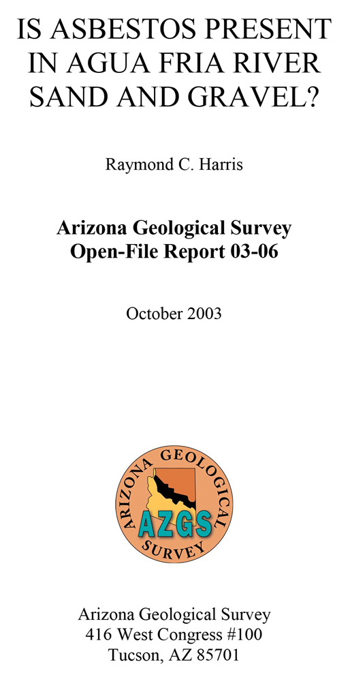
Regional conflict foreshadows the value of agency relationships and scientific independence
Residents near Agua Fria River aggregate operations frustrated
Rapidly spread allegations of asbestos in aggregates
Sampling results (conducted by industry) distrusted
by community
2003 AZGS study effectively resolves issue
Key learnings:
  AZGS was agile and responsive
  Results were credible and convincing
  Independent science highly valued

Slide 8
2005 Aggregate Mined Land Reclamation Act (MLRA)
  Requires all aggregate mines on private lands to obtain an Arizona State Mine Inspector (ASMI) approved reclamation plan (Plan)
  Legislation promulgated by industry in response to a proliferation of local reclamation requirements
  Established uniform reclamation standards across AZ and eliminated duplicative local standards and bonding efforts
  Plan approval involves public and local communities to encourage dialog and long-range planning
  Mandates ASMI approval of all administratively and technically complete plans

Slide 9
ARS 11-812: County Mining Exemption
Counties cannot prevent, restrict, or otherwise regulate the use or occupation of land or improvements for mining or metallurgical purposes
Aggregate mining broadly defined as all activities needed for aggregate development and production purposes
Covers ancillary activities including ready mix and HMA operations

Slide 10
Aggregate Mining Operations Zoning Districts
Can establish an aggregate mining district (District) in areas with known reserves or existing aggregate mining operations
The District committee can recommend reasonable aggregate mining operations standards regarding permitted uses, property development plans, and site development standards including reclamation
Districts cannot impose duplicative standards for facilities already subject to federal, state, or local regulation or a governmental obligation
Committees consist of up to 7 operators and an equal number of private citizens
  Open meeting rules and majority votes
  Established enduring lines of communication and collaboration in the community

Slide 11
Regulatory Bill of Rights
Passed in 2011, amended ARS to require municipalities to establish licensing time frames and well-defined application requirements.
Agency cannot base a licensing decision in whole or part on licensing conditions not specifically authorized in statute or rule.
Unless specifically authorized by statute, agencies must avoid dual permitting requirements or duplication of laws that do not enhance regulatory clarity
Allows for appeal of any agency decision and reimbursement of costs

Slide 12
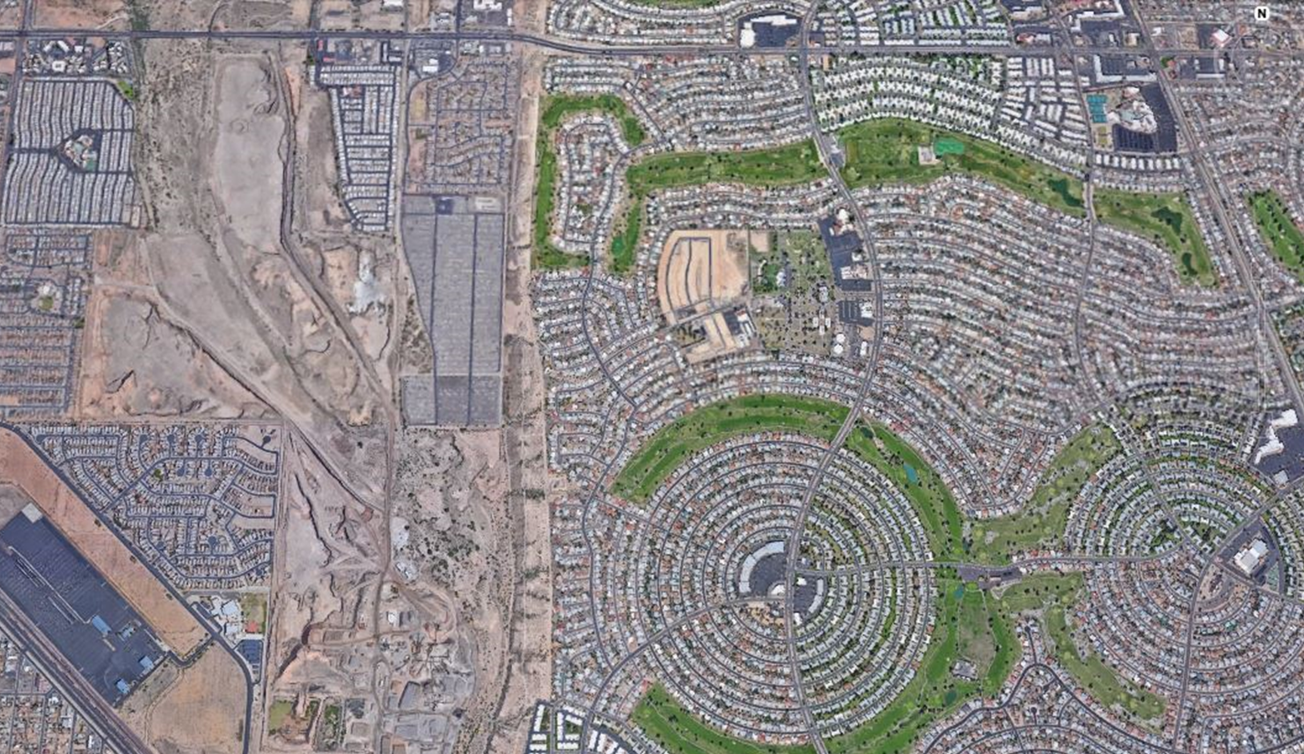
Arizona’s Growing Smarter Act (GSA) was an important tool in addressing aggregate supply in planning decisions
GSA passed in 1998 and amended in 2000 to assist towns, cities, and counties in developing strategies for dealing with population growth.
GSA requires General Plans to address land use, open space, growth areas, environmental planning, and water resources.
Requires each city, town, and county to update or re-approve their general plan every 10 years.
Unfortunately, the GSA did not address source or protection of aggregates.

Slide 13



Passed in 2011, the Arizona Aggregate Protection Act (APA) had lofty goals of helping to prevent Land Use Conflicts
SB-1598 amends GSA to require Planning Agencies to address sources of aggregates in their General Plans by:
Including sources of currently identified aggregates from existing mapping
Enacting measures to preserve currently identified aggregates for future development
Enacting policies to avoid incompatible land uses

Slide 14

After reviewing compliance in 2018:
Did we declare mission accomplished?
Have municipalities generally complied with APA?
Do we need to do more?
Has the APA changed the regulatory landscape?
What have we learned?
14

Slide 15
5 years later, reviewed General Plans of the largest
28 municipalities in Arizona
Only 13 of 28 municipalities
have any substantive compliance with APA
Only 9 have identified aggregate sources and implemented policies protecting those resources
At least 8 municipalities (notably Casa Grande, Marana, Queen Creek, and Kingman) basically failed to comply

Slide 16
Top reasons for APA non-compliance
5.
  General Plans identify active operations but enacted no goals or policies
  to protect them
4.
  Failed to identify existing aggregate operations
3.
  Cite that aggregates maps are not available for the area
2.
  Ignored APA requirements
1.
  Have not updated General Plans since enactment

Slide 17

USGS STATEMAP Program
Invested over $150 million in matching money to complete critical geologic mapping projects in U.S.
Cooperative agreements support State surveys in meeting their mapping priorities
Focus on areas of high significance for a variety of issues including land-use planning and mineral, energy, and water resource development
Used in AZ to map aggregates in Phoenix and Tucson (pending) metropolitan areas
STATE Mapping Advisory Committees can include mining representatives

Slide 18
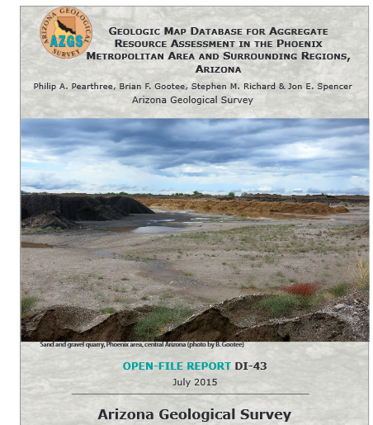
Best-in-class compliance with APA highly correlative with AZGS Aggregate Resource Assessment
STATEMAP product recommended by the AZGS Mapping Advisory Committee
Largely a compilation of existing mapping products with some field verification
Highly collaborative effort with rock products industry
Assisted planners by clearly identifying areas with proven aggregate resources

Slide 19
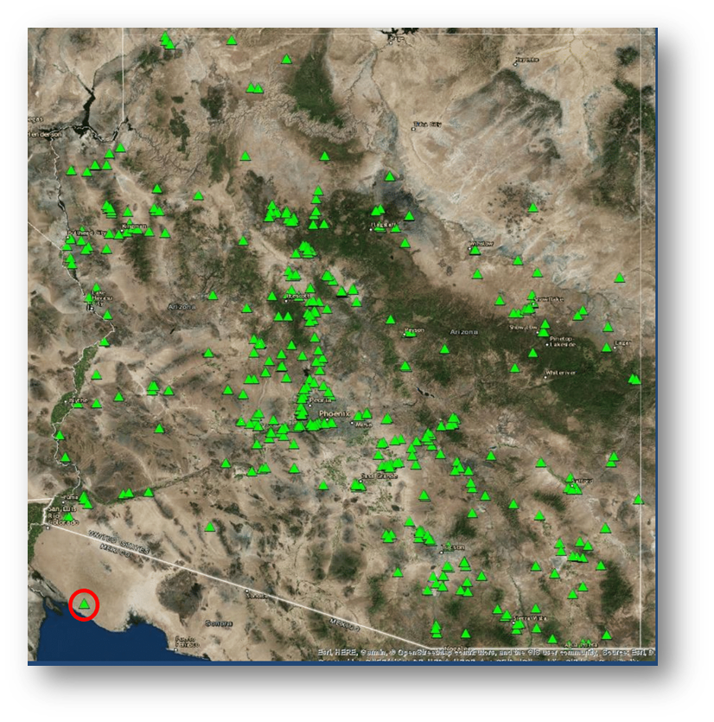
ARPA amends APA in 2019 to improve General Plan compliance with the assistance of AZGS
H2453 amends APA and GSA to include the identification of active mines in planning areas
Passed unanimously in both House and Senate
Makes it more difficult to use lack of mapping to ignore APA requirements
AZGS will compile and maintain free database of active mines in Arizona

Slide 20

Best practices: City of Avondale
Identified current aggregate operations from ASMI database, general areas with the potential for future aggregate development, and described active mines in Land Use Element text.
The owners of potential aggregate resources may apply for the Special Use District (SUD) Overlay with no guarantee that approval of aggregate mining facilities through the SUD will be granted.
For future aggregate sites, the City will work proactively with the ASMI, the property owners, and the operators to develop their operation and reclamation plans that minimizes undesirable land-use conflicts and maximizes the post-mining land use.

Slide 21
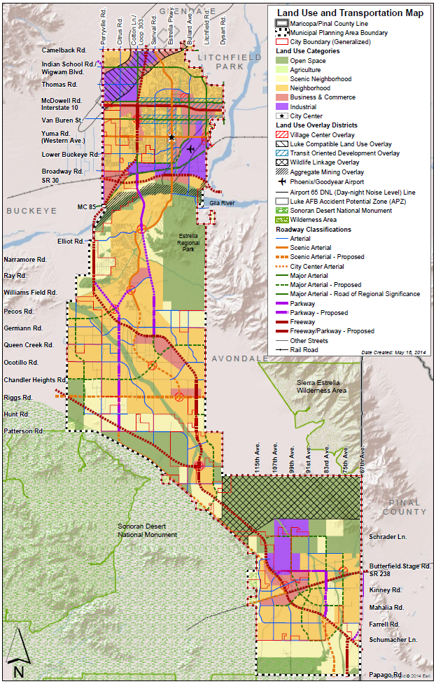
Best practices: City of Goodyear
Created an Aggregate Mining Overlay that denotes sources of aggregates and identifies general areas with the potential for future aggregate development.
The purpose is to disclose to adjoining owners the presence of this resource and the potential for development.
Identification of these areas does not mean that they may be developed as aggregate mining operations by right. The property must obtain the proper zoning, permits, and other required permissions.
Transportation of materials through the City are restricted to truck routes and may be further limited to protect existing uses.

Slide 22
Best practices: City of Phoenix
GOAL:
To provide equal protection for residential development and
aggregate mining operations by promoting compatible land
uses near existing or planned aggregate and mineral mining operations.
POLICIES:
Discourage new residential zoning where future residences
would be adjacent to an existing or planned aggregate/mineral
mining operation.
Discourage new mining operations adjacent to or in close proximity to
existing residential development, schools, or existing or planned city
recreation areas.
Promote non-residential development such as business parks and
industrial uses adjacent to existing mining operations.
Update the General Plan to recognize existing mining
sites and as needed when new potential mining sites are identiﬁed.
“A report prepared for the Arizona Rock Products Association estimates that In 2006, Arizona produced 109 million tons of aggregates and crushed stone. Transportation of these materials generated 8.73 million truck trips traveling more than 174 million miles. This required more than 26.7 million gallons of diesel fuel and generated over 506.9 tons of truck emissions.”
Click here to read the report.

Slide 23
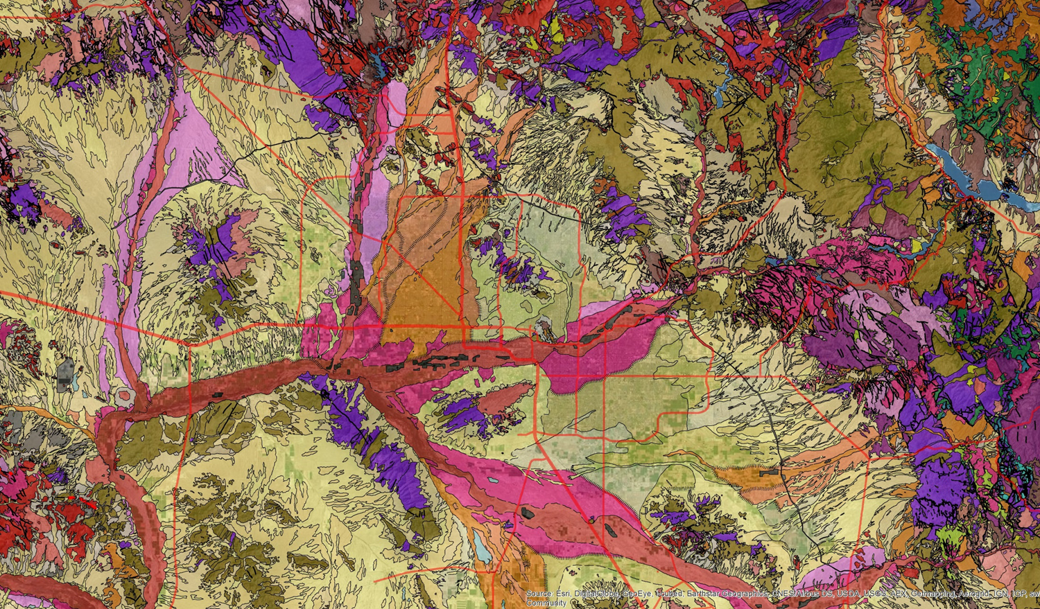
What was the real impact of the STATEMAP product?
Influenced policies and future development actions of:
  The largest metropolitan area (and aggregate consumers) in Arizona
  Four of the most populous cities in Arizona (Phoenix, Surprise, Peoria, and Glendale)
  The fastest growing city in the United States (Phoenix)
More importantly, it weakens arguments of others that aggregate protection can’t be done
General area of AZGS resource mapping

Slide 24
Although some progress had been made, our 2018 study suggested that significant issues remained
Aggregate resources still commonly conflict with many greenbelt, wildlife corridor, and open space designations in General Plans
Zoning Overlays are great, but not as great as overlays with conforming use designations
Many entities used lack of mapping to avoid APA requirements and many areas lack adequate resource mapping
AZGS mapping was extremely effective, but additional STATEMAP funding uncertain
Many planning entities not taking the APA seriously, unaware of active mining or
sources of construction materials

Slide 25
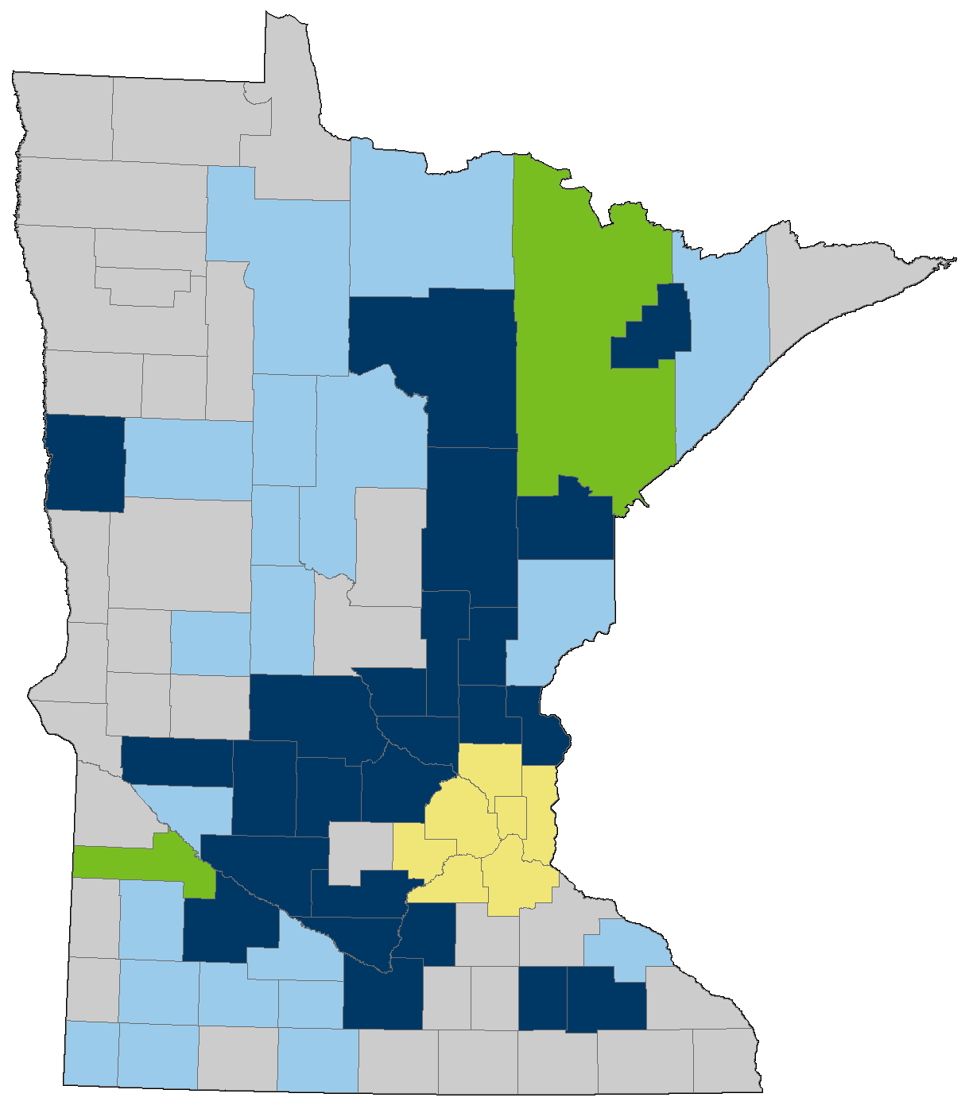
Minnesota Aggregate Resource Mapping Program (ARMP)
Minnesota Departments of Natural Resources Program and Transportation
Aggregate resources are essential to Minnesota's infrastructure and economy.
By knowing the location of aggregates, local and state governments can do a better job preserving and conserving natural resources.
ARMP provides mapping that helps local governments and stakeholders balance stewardship of mineral resources, the environment, and local economies.
GIS mapping and pit information available via Aggregate Source Information System Map

Slide 26

Michigan Aggregates Association: Natural Resources and Environmental Protection Act Revision
Standardizes mine and reclamation permitting through state agencies
Preempts counties, townships, or municipalities from prohibiting or regulating mining
Prevents duplicative, conflicting, or revisions to the state mining regulation
Doesn’t change post-mining land use identified in local General Plans
Allows for mutually-agreed changes to operations or reclamation

Slide 27
The ROCKS Act (H.R. 611) ensures that building materials are sourced in a cost-effective and sustainable way.
The ROCKS Act builds on a model created in Arizona and is an important first step in shaping federal building practices
Requires USDOT to convene a commission to study the use of aggregate resources in federal transportation projects
Examines how state, tribal, and local transportation and planning agencies may consider aggregates resources when developing projects
Identifies measures the federal government, state, tribal, and local transportation and planning agencies may take to preserve currently identified aggregate resources for future development
“Now our attention turns to implementing the ROCKS
Act and completing the work laid out under the IIJA. NSSGA
is engaged with the U.S. Department of Transportation and
key members of Congress to plan and establish the ROCKS
Act working group. A critical component of our efforts will be
utilizing the great work that has been done at the state level
by Arizona and Minnesota, specifically, to promote aggregates
development and protection....”
Austin Bone, NSSGA Director of Government Affairs
Notes:
Rebuilding Our Communities by Keeping Aggregates Sustainable (ROCKS) Act,
Currently included in the pending Federal Infrastructure bill

Slide 28
Conclusion: Aggregate protection efforts can be highly effective if leveraged with other State resources
Influenced policies and future development actions of:
  The largest metropolitan area in Arizona
  Four of the most populous cities in Arizona (Phoenix, Surprise, Peoria and Glendale)
  The fastest growing city in the United States (Phoenix)
Aggregate Protection legislation can be accomplished by:
  Leveraging existing legislation
  Starting small and build incrementally
  Using credible science to demonstrate needs and effectiveness
State agencies can be a trusted partner
  Independent
  Agile and responsive
  Credible, convincing, and highly-regarded science

Slide 29

Top ten signs your project is in trouble…
1. Erin Brockovich shows up at your community meeting
2. Planner wraps dead fish with your site plans
3. Uncontrollable laughing at your pre-application meeting
4. Council agenda lists your project as “crazy-ass mining proposal”
5. Planner constantly confuses mineral extraction with kidney harvesting
6. Police use Tasers on demonstrators at your public meeting
7. Draft permit lists “when pigs fly” as a permit condition
8. Your project is in Metamora
9. Councilman uses PayPal for kickbacks
10. Run over the mayor’s dog on the way to a project meeting

Slide 30

Your Presenter:
Eric Mears, R.G.
Mining Leader
Over 30 years of mine permitting and entitlement experience
Served on Phoenix Environmental Quality and Village Planning Commissions
Maricopa County Parks and Recreation Commission
Passionate mining advocate and engaged on local, state, and federal rulemaking
Life Director of Arizona Rock Products Association
Chair - Arizona State Mapping Advisory Committee
Notes:
Edit as you see fit

Slide 31

ARPA- Aggregate Protection Guidance

