Slide 1

Fraud Prevention in Construction: Risk Management Insights

Slide 2

Agenda
1
ERM
2
Fraud & Forensics
3
“Traditional” Risks & Fraud Triangle
4
Conclusion

Slide 3

What Does Enterprise Risk Management Look Like?
Not a singular function of a singular department.
It is an organization’s culture, processes, & abilities that intertwine with strategy with the purpose of managing risk and creating and preserving value.
  ERM is more than internal control(s) and considers other areas such as:
  Business strategy
  Risk tolerance/Governance
  Risk data/measures
  Tailored controls
  Measuring/testing performance.
  ERM applies to all levels of the organization and across functions.
  Important for the ERM framework to be embedded throughout the organization.
  ERM culture is dependent upon STRONG organizational leadership!
  Enterprise Risk Management (“ERM”)

Slide 4
Agenda
1
ERM
2
Fraud & Forensics/Stats/Risk Mitigation
3
“Traditional” Risks & Fraud Triangle
4
Conclusion

Slide 5

Questions
How many of you have committed fraud?
*IN FACT ... don't answer that question!
Actually...how many of you/or your companies have been a victim of fraud?
> or you think you have been...
> or you don't have any idea...
> or you have concerns right now...

Slide 6
What is fraud?
A simple definition is an act of intentional deception designed to exploit a victim. (Investopedia)
I prefer to keep it SUPER SIMPLE!
Fraud exists as a result of a or many lie(s)...purposeful lies....
...the purpose of those lies is generally for personal gain by the liar(s)

Slide 7

Forensic Accounting
"Forensic Accounting"
A term used to refer to the specialty practice area of accounting which includes fraud investigation and conducting financial analysis as part of litigation support
It combines accounting, auditing, and investigative skills and may include serving as an expert witness
"Art" not a "science"...a MINDSET...an
…............Investigative Mindset..............

Slide 8

Association of Certified Fraud Examiners (ACFE)
International professional anti-fraud organization of fraud examiners
Mission to reduce the incidence of fraud and white-collar crime and to assist the membership in fraud detection and deterrence
Certified Fraud Examiners Designation earned for combination of experience and passing examinations

Slide 9

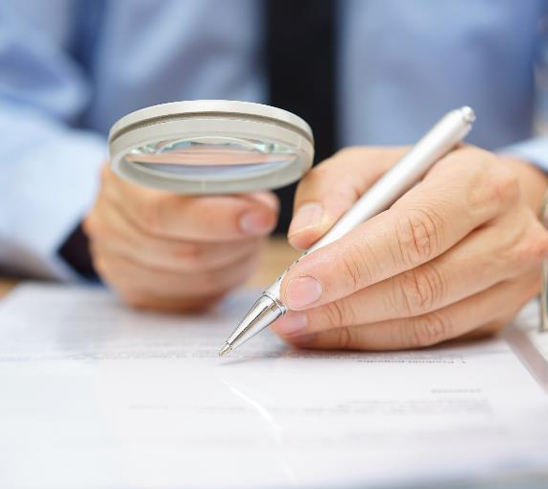


Fraud Won’t Happen to Us - Insights
About 75% of U.S. organizations are affected by employee theft, with three out of every four employees admitting to stealing from their employer at least once
43% of fraud detected is identified by tips
50% of tips from EE
33% of tips by vendors
40% tips rec’d via web-based tools
12 Months – Typical length of time fraud is perpetrated before detection
80% of embezzlements impact Small and Midsize Organizations (< 150 EE)

Slide 10
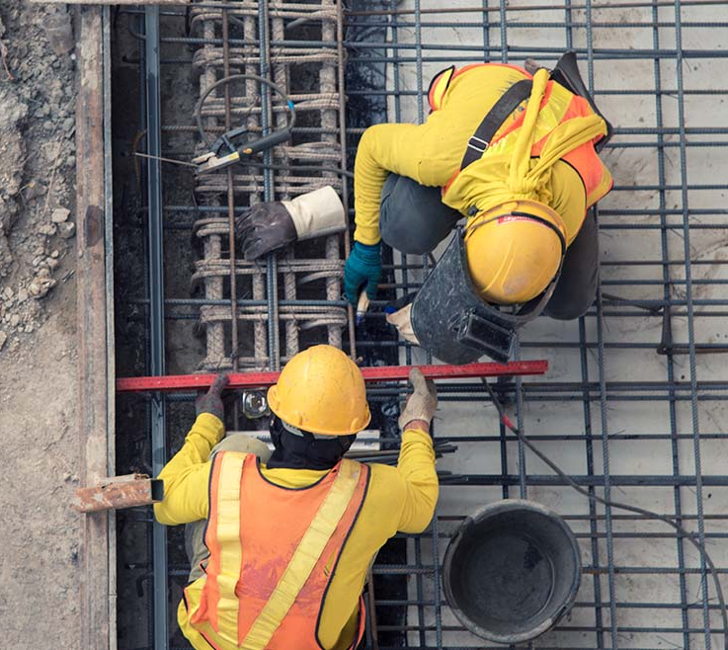
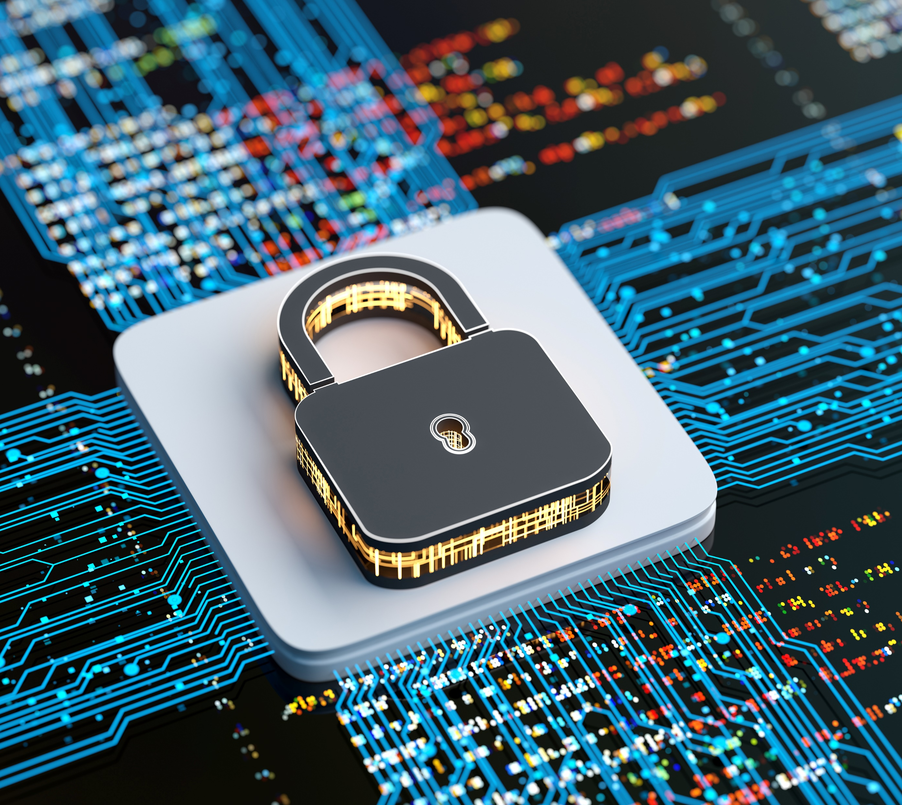
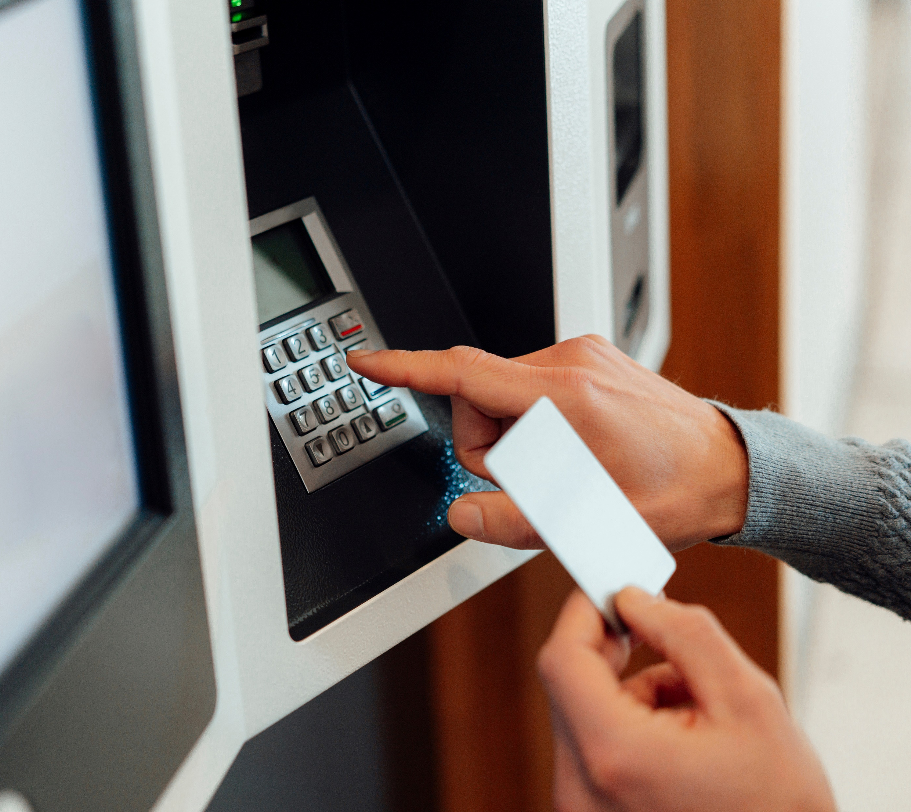

Fraud Won’t Happen to Us - Insights
1/3 with losses exceeding $500,000
Median loss $145K; Avg loss $1.7
48% perps pled guilty; almost twice as many as F/S fraud & corruption
Asset Misappropriation
-Billing schemes-22%
-Theft noncash asset-22%
It is estimated that organizations worldwide lose 5% of their annual Revenues to fraud

Slide 11
Construction Relevant Stats
52% CORRUPTION
> Conflicts of interest
- purchasing schemes
- sales schemes
> Bribery
- invoice kickbacks
- bid rigging
> Illegal gratuities
> Economic extortion
Impactful Anti-Fraud Controls:
- Surprise audits < loss 63%
- Hotlines < loss 50%
- Data monitoring < loss 50%
- Fraud trng < loss 47%
Most common fraud in Construction industry is tied to CORRUPTION
Median Average Loss within Construction industry is $250K per incident

Slide 12
Risk Mitigation & Examples Of Anti-Fraud Controls
Victim Companies:
- 85% Code of Conduct
- 84% Ext. Fin. St. Audit
- 80% Int. Audit Dept.
- 71% Hotlines
- 62% Fraud Trng Prog
- 60% Anti-fraud Policy
- 59% EE Support Prog
Impactful Anti-Fraud Controls:
- Surprise audits < loss 63%
- Hotlines < loss 50%
- Data monitoring < loss 50%
- Fraud trng < loss 47%
- Int. Audit < loss 43%
- Dedicated fraud f(x) < loss 41%
- EE support prog < loss 3

Slide 13
So...is there a Keep It Super Simple method of combating fraud...
Internal controls/Risk Mitigation steps are the first line of defense in combating fraud..
But I hire trusted employees...what about trust?
"Trusting your employee is not an internal control”
— Frank Suponcic, Partner in the Advisory Services group at Marcum Accountants and Advisors

Slide 14
Agenda
1
ERM
2
Fraud & Forensics/Stats/Risk Mitigation
3
“Traditional” Risks & Fraud Triangle
4
Conclusion

Slide 15
Internal Controls
Properly planned...designed...implemented and monitored internal controls are absolutely critical and necessary for any organization
Internal controls should mitigate the OPPORTUNITY for the occurrence of MOST fraud
Dynamic perspective of internal controls – constantly assessing and evolving I/C
Now who has heard the word/descriptor OPPORTUNITY in the context of fraud...

Slide 16
Fraud Triangle*
OPPORTUNITY:
Foundational understanding that exists for prevention....
Mitigate the opportunity through effective internal controls
MITIGATION:
Ensure internal controls are well planned, effectively implemented and more importantly monitored and dynamically adapted to an ever-changing organization environment
Opportunity
*Developed by Donald Cressey

Slide 17
The opportunity to commit
fraud typically results
from weak or ineffective
Internal Controls...such as:
1
Lack of segregation of duties
2
Lack of physical safeguards
3
Proper authorization process ignored or not established
4
The ability to override controls
5
Inadequate accounting system

Slide 18
Fraud Triangle
INCENTIVE, PRESSURE, or MOTIVATION:
Need and greed
Pressures
- Performance pressures
- Vices
- Secret habits/life
- Living beyond one's means
MITIGATION:
Realistic/moderate performance pressures re: performance...what are you incentivizing...performance at all cost?
Know your employees.. invest where it counts...personally
Health and well-being programs for employees...EAP etc.
Incentive, Pressure, or Motivation
Opportunity

Slide 19
Incentives, Pressures or Motivations
Living Beyond One’s Means
Unexpected Financial Needs
Vices
Secret
Life
Personal
Debt
Financial
Losses

Slide 20
Fraud Triangle
RATIONALIZATION:
Fabrication of a "moral" excuse to
justify the fraud committed
Develop reasons as to why it is
ok for the person to commit
the fraud and why doing
so won’t be an issue
- I deserve/victim
- Org won't miss the $
MITIGATION:
Ensure a "buy-in" culture within your org
Open door policies...not just words
Listen
Invest
Employees invest when they:
- Feel impactful
- Are "seen"
- Receive comm/feedback
Incentive, Pressure, or Motivation
Incentive, Pressure, or Motivation
Rationalization
Opportunity

Slide 21
Rationalization to
Commit Fraud:
1
Feeling exploited by employer
2
Believes the company has victimized them
3
Believes if they do not commit the fraud, they may lose their job (performance pressure)
4
The organization will never miss the money/asset(s)
5
Will do whatever the organization needs to succeed (greater good for everyone's sake)

Slide 22
That’s great and all, but...
So...you now know key "buckets" or topics that fundamentally enable and promote fraud activities:
Opportunity
Incentive, Pressure or Motivation
Rationalization
...but what should I be aware of and on the look-out for when it comes to fraudulent accounting transactions and technical topics...
Well...since you asked...

Slide 23
Know the Client Organization!
Accounting Irregularities:
Excessive or unusual voids, credits or over-rides
Document or check sequence irregularities
Unbalanced ledgers or illogical journal entries
Excessive or unusual journal entries at or near period end
Journal entries lacking supporting documentation
Unexplained adjustments to $ on hand, A/P, or expenses
Expense reimbursement requests without supporting documentation or receipts

Slide 24
Know the Client Organization!
Analytical Irregularities:
Skewed payroll compared to staff
Unexpected supply or inventory expenses
Unusual capital account fluctuations
Outliers to years past w/o justification
If balances or fluctuations seem strange, they probably are...employ basic comparative analytics to assess.

Slide 25
Conclusion: Prevention and Awareness
2
Within your power...fraud fortification
Within your power...personnel fortification
Communication and training...it is on leadership's radar...
Be aware and vigilant...

Slide 26

Q & A

Slide 27

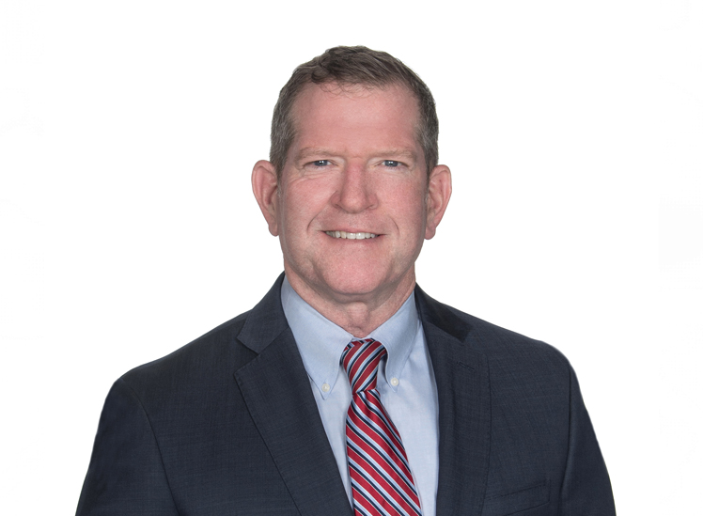
Scan with your phone!
Chuck Story, CPA, CFE
Director of Operations
Corporate Investigative Services
chuck.story@rehmann.com
248.267.8445
Access valuable resources.
Learn more about us.
Get in touch.

Slide 28

Agenda
1
ERM
2
Fraud & Forensics
3
“Traditional” Risks & Fraud Triangle
4
Cyber and Data Security Risks
Notes:
CHUCK -

Slide 29
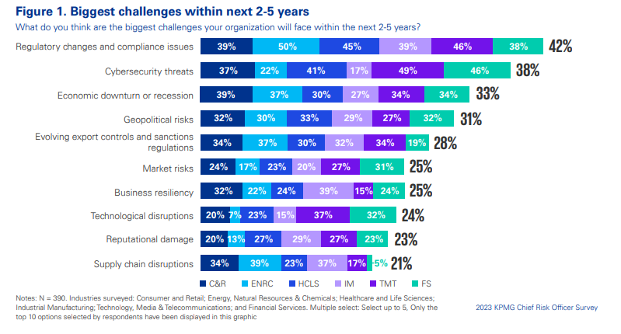
KPMG 2023 Chief Risk Officer Survey
Notes:
And THIS is the tactical level of CYBER….everyone’s a target….rest of ERM discussion will be CYBER centric…..

Slide 30

Incident Stats/Costs
Global Averages
Average total cost of a data breach
$4.45M
Amount of breaches identified by an organization’s own security teams or tools
1 in 3
Average total cost of a ransomware attack
$5.23M
Time to identify and contain a breach
280 days
Highest country average cost
United States
Highest industry average cost ($10.93 million)
Healthcare
Notes:
Paul
Average total cost of a data breach is well over $4 million dollars. While that stat is average across all company sizes, keep in mind that there is a significant small and medium sized business cost disadvantage. The cost of a breach does not scale proportionally to the size of the business.
Time to identify and contain – 287 days - The average time to identify a breach in 2021 was 212 days and the average time to contain a breach was 75 days, for a total of 287 days.

Slide 31
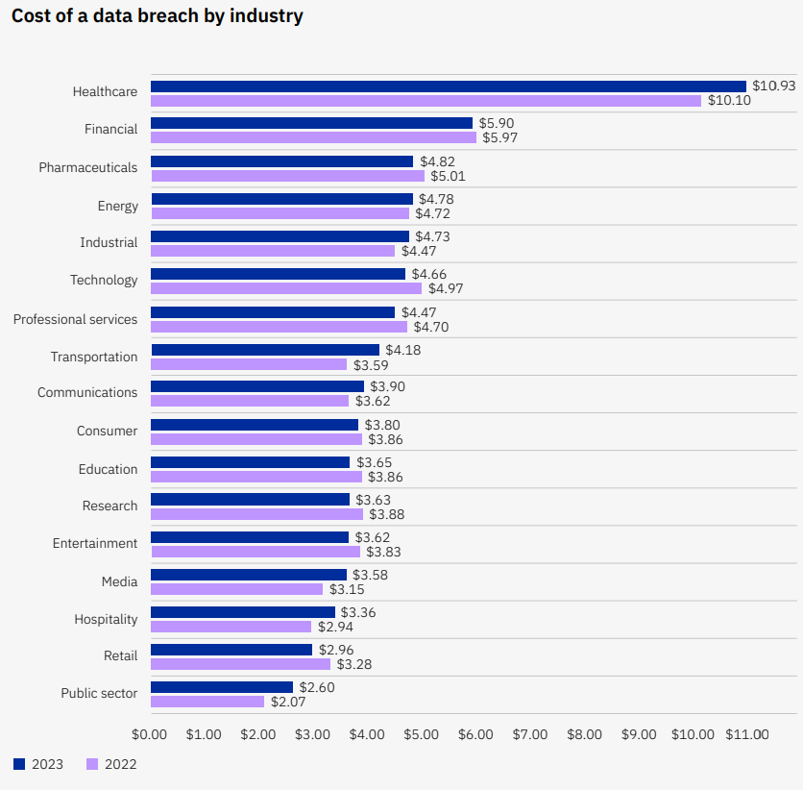
Ponemon – Average Breach Costs
Average total cost of a data breach by industry
Measured in US$ Millions
Notes:
Continue why are we discussing Cyber as an example when we are moving more tactical in this discussion

Slide 32

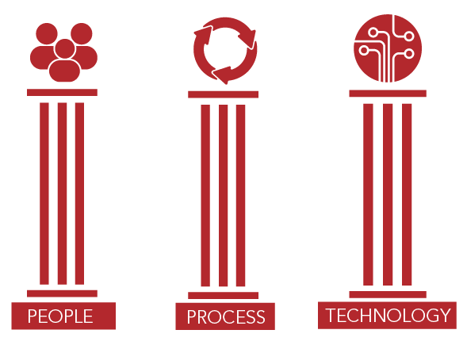
Governance
Governance re: Cybersecurity?
Cybersecurity is a business issue, not just an IT issue!
Notes:
Sooo….really next category in an overall CRM plan is governance….this is where more specific risks come into play and planning around the spec. risks….soooo…we are sticking with Cyber…three areas of governance to consider re: cyber……People/Process/Technology

Slide 33
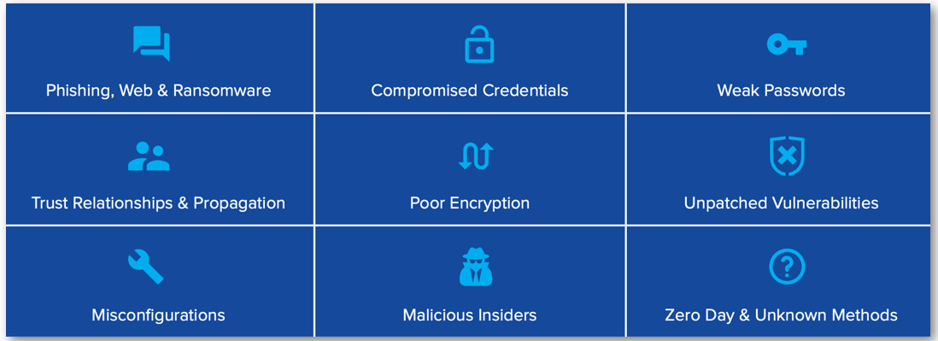
Threat Vectors – How the Bad Guys Get In
Notes:
Whether a big or small business, how are the bad guys getting in? The good news is that most of these threat vectors will be addressed in our training today.

Slide 34
Threat Vectors – How the Bad Guys Get In
Notes:
Whether a big or small business, how are the bad guys getting in? The good news is that most of these threat vectors will be addressed in our training today.

Slide 35
Governance-People
PEOPLE - CULTURE!!!!!
- MAKE IT KNOWN – Security is not convenient!
Feed someone a fish or teach someone to fish-hold accountable?
Educate/Train/Equip/Built in Protection & Risk Mitigation
- Ask…what makes you think it is reasonable to have this behavior at work…with work computers? Would you do this at home? With your own devices? With your own PII?
Notes:
AVI...own this slide and really avoid selling services...transition to how we often address fraud is through forensic accounting techniques...financial analysis typically very specific in scope and nature....and how we approach fraud or anomalie situations is with the investigative mindset....

Slide 36
Employees are the Weakest Link
Sending work
e-mail to personal accounts
Not following corporate policies
Negligent insiders are a leading cause of data breaches
Using data on insecure lines
Clicking on links
or malicious attachments
in e-mails
Not securing mobile devices

Slide 37
Governance-People
Security Awareness Training
Establish Policies & Procedures (Acceptable use/HR etc.)
Multi-factor Authentication
Password Management
Remove admin rights from user workstations
Separate Administrator accounts from base user accounts
Notes:
AVI...own this slide and really avoid selling services...transition to how we often address fraud is through forensic accounting techniques...financial analysis typically very specific in scope and nature....and how we approach fraud or anomalie situations is with the investigative mindset....

Slide 38
Threat Vectors – How the Bad Guys Get In
Notes:
Whether a big or small business, how are the bad guys getting in? The good news is that most of these threat vectors will be addressed in our training today.

Slide 39
Governance-Process & Technology
PROCESS & TECHNOLOGY
- Policies – Risk driven…WHAT/WHY
- Controls in place to combat? Regularly evaluated?
- Procedures – the HOW…
Examples:
- Endpoint Web Content and DNS Filtering
- Vendor and Patch Management
- Cyber Liability & Crime Insurance
- Establish Cyber Risk Ownership & Oversight
- Craft Incident Response & Disaster Recovery
& Business Continuity Plan
Notes:
AVI...own this slide and really avoid selling services...transition to how we often address fraud is through forensic accounting techniques...financial analysis typically very specific in scope and nature....and how we approach fraud or anomalie situations is with the investigative mindset....

Slide 40

Risk Data & Metrics - Cyber
OK…so we checked the box and we have in place a Comprehensive/Enterprise RM program…but is it meaningful? How do we know it is meaningful?
Is the right RM data being collected on the right risks?
Is the data collected organized and analyzed to tell a story; dependent and independent variables?
Is the data integrated into decision making processes?
Whose lap does this land in?

Slide 41
How Factors Increased or Decreased the Total Cost of a Data Breach
Source: IBM Security – Cost of a Data Breach Report

Slide 42
Evaluation
Who is the “story” told to?
- So what? Were the boxes just checked simply that someone was told?
Likelihood of…what if there is a failure? Is this mission critical risk? Are mission critical risks being evaluated?
Impact…put the pen to the paper…what if we have a failure:
What’s the impact?
Since you asked….
Let’s play Battleship…and throw some “challenges” at our system..

Slide 43

Table Top/Testing
Alright awesome…we now have:
- Identified appropriate risks
- Collecting appropriate data
- Measuring/assessing collected data
- Evaluating and telling a “story”
- Decision makers have listened and paid attention
- We are dynamic and agile!
Notes:
AVI – Not for sure how you want to transition this....

Slide 44
Table Top/Testing – cont.
BUT…does the system work? Let’s test it out…
- Vulnerability Assessment & Penetration Testing
- Endpoint Detection & Response
- Verify Backup Position & Ensure Recoverability
- Incident Recovery/Crisis Response – Who’s on first?
Notes:
AVI – Not for sure how you want to transition this....

Slide 45
Table Top/Testing – cont.
So…..are we awesome?
Or are we NOT awesome?
- when things failed/were taken from us…did people really know what to do/how to do what to do/who to call?
- did the people who are supposed to answer…answer?
- so many immediate logistics are required when !!!!! hits the fan…
Notes:
CHUCK

Slide 46
Conclusion: Prevention and Awareness
1
Within your power...fraud fortification
2
Within your power...personnel fortification
3
Communication and training...it is on
leadership's radar...
4
Be aware and vigilant...
Notes:
CHUCK -

Slide 47
Q & A

Slide 48
Contact Info
Chuck Story, CPA, CFE
Director of Operations
Corporate Investigative Services
chuck.story@rehmann.com
248.267.8445

