Slide 1
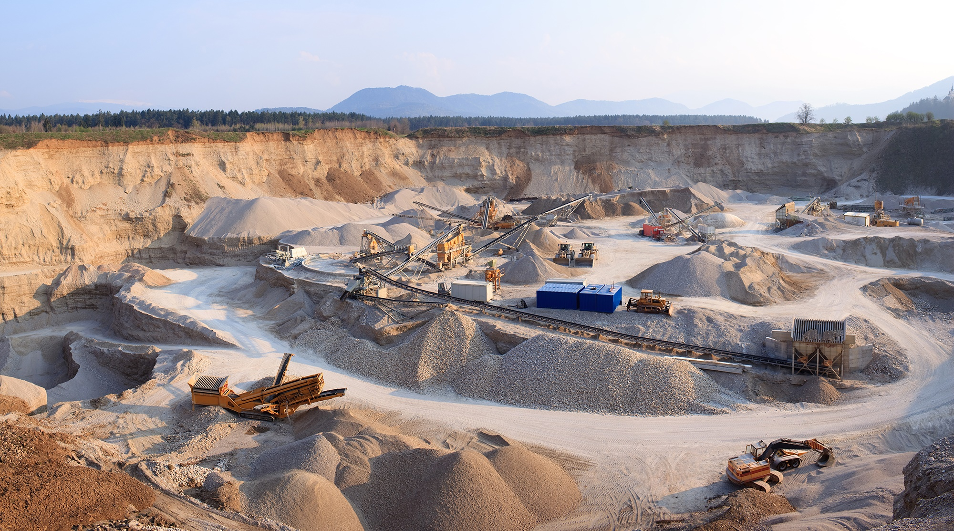

Construction Materials
Outlook
Winter 2024
www.fmicapitaladvisors.com
FMI Capital Advisors, Inc. is a wholly-owned subsidiary of FMI Corporation
Registered Broker / Dealer | Member FINRA
FOR DISCUSSION PURPOSES ONLY

Slide 2





WHO we are
FMI is a leading investment banking and consulting firm dedicated exclusively to the built environment. We serve as the industry’s trusted advisor, providing current market insights, deep industry research, and key relationships that deliver tangible results for our clients.
Industry
Insiders
Capital Advisors
Consulting & Research

Slide 3








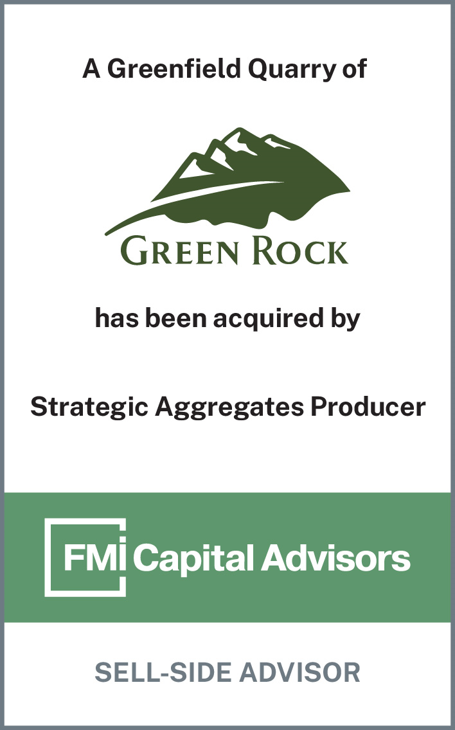
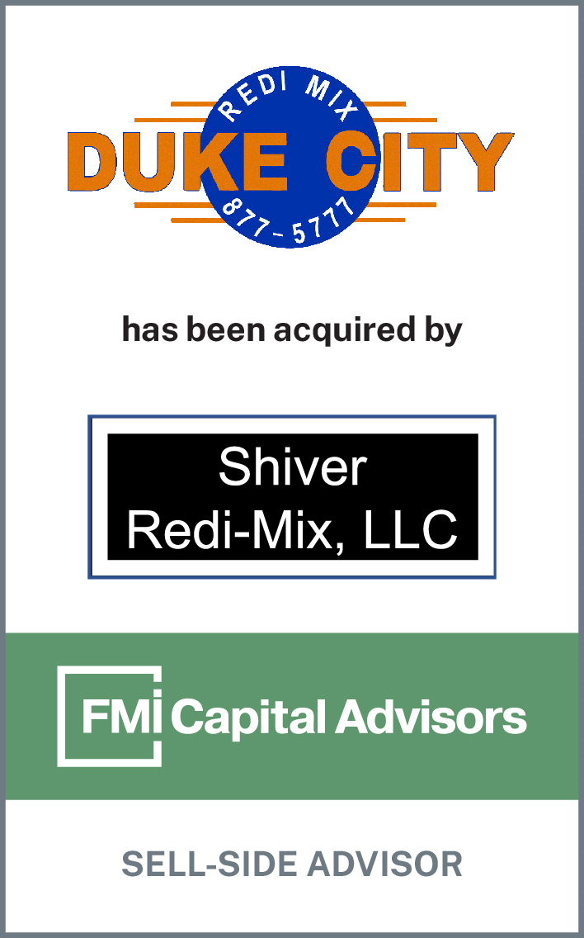
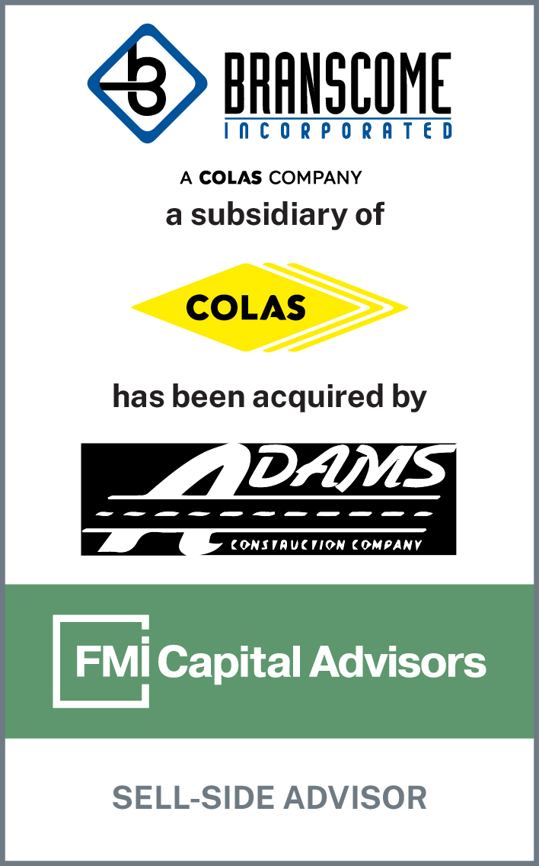



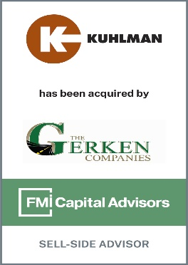
Specializing in CONSTRUCTION MATERIALS
35
100
+
YEARS OF EXPERIENCE
+
TRANSACTIONS
More than any peer advisory group
Servicing All Segments of the Supply Chain
Active Members in Industry Organizations
Aggregates
Crushed Stone | Sand | Gravel
Concrete (RMC) | Asphalt (HMA)
Products
Asphalt Paving | Road Construction |
Paving Maintenance
Construction
Recent Transaction Advisory

Slide 4



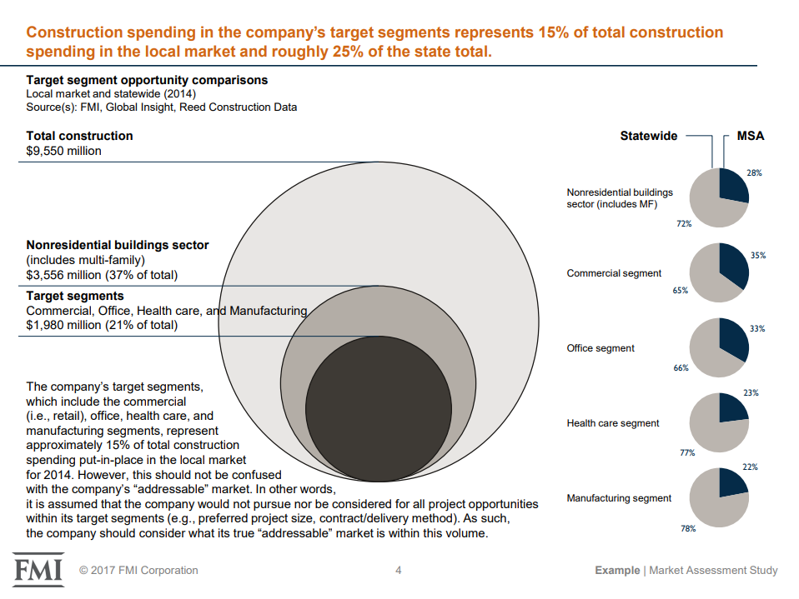



Consulting and Research
CM Focused Consulting
Global Research
Wallace Marshall
Head of Construction Materials,
Management Consulting
O: 919.785.9382
E: wallace.marshall@fmicorp.com
Jay Bowman
Partner,
Research and Analytics
O: 919.785.9336
C: 919.782.6679
E: jay.bowman@fmicorp.com
Jay Bowman
Partner,
Research and Analytics
O: 919.785.9336
C: 919.782.6679
E: jay.bowman@fmicorp.com
Jay Bowman
Partner, Research and Analytics
O: 919.785.9336
C: 919.782.6679
E: jay.bowman@fmicorp.com
Brian Strawberry
Senior Economist
O: 919.785.9246
C: 919.760.5656
E: brian.strawberry@fmicorp.com
Education: B.A. University of Georgia
MBA East Carolina University
Experience: Market Sizing and Forecasting
Education: B.A. Appalachian State University
Education: B.A. University of Georgia
Education: B.A. Elon University
Education: Ph.D. Boston College
Education: MBA East Carolina University
Education: MBA UNC Greensboro
Experience: Construction Materials and Market Research
Experience: Market Sizing and Forecasting
Experience: Market Sizing and Forecasting
Management Consulting Capabilities:
Leadership development
Field productivity improvement
Business strategic planning
Acquisition integration
Compensation analysis
Market studies

Slide 5
Construction Materials Update

Slide 6






Outlook for Construction Materials
Category
Sentiment
Earnings Call Quotes
Demand
"With the layering of federal infrastructure dollars, there is a meaningful runway for construction projects for years to come.”
– Michael Haack: CEO, President & Director
Pricing
“Pricing momentum remains strong across our markets with average organic pricing up high single digits…”
– Gail Peck: CFO
Backlogs
"...there has been a consistent increase in our backlog for 11 quarters. It's very unusual in this business."
– Gregory Hoffman: CFO
Public Funding
“…record state departments of transportation budgets…will provide sustained multiyear demand…”
– Ward Nye: Chairman, CEO & President
"If weather cooperates and the construction season is extended, we could exceed expectations. But as a managerial team, we don't make a habit of predicting Q4 weather."
– Scott Anderson: Executive VP, CFO
Weather
“…we're encouraged by the recent growth in single family permits and starts…over the last 3 months. On the other hand…multifamily starts have now begin to pull back…”
– Tom Hill: President & CEO
Residential
Source: Q3 2023 Earnings Call Transcripts

Slide 7




U.S. Pricing and Volume Dynamics – Q3 2023 vs. Q3 2022
U.S. Sales Volumes – Aggregates, Concrete, Asphalt, & Cement
U.S. Product Pricing
Q3 2022
6.0%
2.6%
Q3 2023 vs. Q3 2022 | Aggs | RMC | HMA | Cement
CEMEX | 9.0% | 16.0% | N/A | 10.0%
Cementos Argos | N/A | 14.3% | N/A | 13.2%
Eagle Materials | 2.6% | 8.3% | N/A | 14.7%
Knife River | 16.2% | 11.6% | 14.9% | N/A
Summit Materials | 14.4% | 8.2% | 16.3% | 13.9%
Martin Marietta | 20.0% | 21.0% | 6.7% | 18.9%
Vulcan Materials | 14.9% | 10.7% | 1.9% | N/A
GCC | N/A | 17.1% | N/A | 12.4%
Avg Increase | 12.8% | 13.4% | 9.9% | 13.8%
Q3 2023
3.6%
3.6%
7.1%
4.4%
Volumes are down, but producers continue to successfully implement price increases
Note: Eagle Materials reporting Q2 2024
Source: Q3 2023 Investor Presentations and Regulatory Filings

Slide 8







Construction Materials Index (CMI) Performance – Q3 2023 vs. Q3 2022
CMI Revenue
($ in Billions)
Q3 2022
Average 9.5%
Aggregate Volumes 3.4%
Q3 2023
3.6%
15.5%
10.1%
4.7%
17.9%
20.9%
-2.0%
2.8%
14.4%
7.3%
5.6%
11.8%
10.7%
CMI EBITDA
($ in Billions)
Q3 2022
26.2%
Q3 2023
Average 33.9%
40.2%
32.3%
18.7%
35.0%
76.0%
-1.5%
8.9%
76.9%
35.8%
12.8%
43.0%
36.2%
Note: Construction Partners reporting Q4 2023, Eagle Materials reporting Q2 2024
Source: CapIQ, USGS, Q3 2023 Investor Presentations and Regulatory Filings

Slide 9
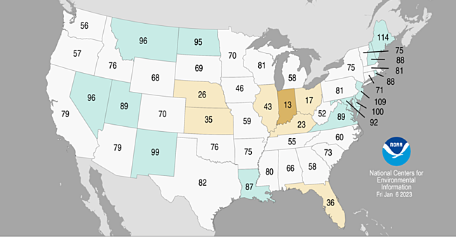
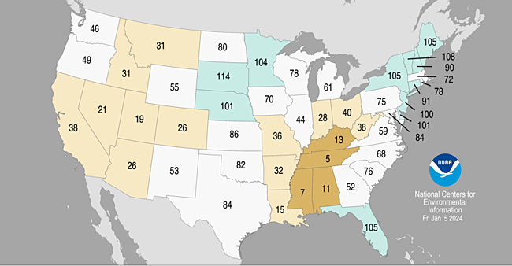
Aggregate Volumes – Region Outperforming U.S.
USGS Aggregate Production Data
YoY % Change | Q1 2022 | Q2 2022 | Q3 2022 | Q4 2022 | Q1 2023 | Q2 2023 | Q3 2023 | TTM
United States | 6.4% | 3.7% | 5.1% | -5.2% | -2.1% | -1.7% | -3.4% | -3.1%
East North-Central Division | 1.7% | 2.6% | 7.1% | 3.5% | 8.3% | 6.9% | -0.9% | 3.6%
Q4 2022 Precipitation by State
Q4 2023 Precipitation by State
Record Wettest
Record Wettest
Below Average
Below Average
Much Above Average
Much Above Average
Much Below Average
Much Below Average
Above Average
Above Average
Record Driest
Record Driest
Near Average
Near Average
Note: USGS aggregate figures are based on a survey of industry participants, Wisconsin sand and gravel figures excluded
Source: National Oceanic and Atmospheric Administration, U.S. Geological Survey

Slide 10



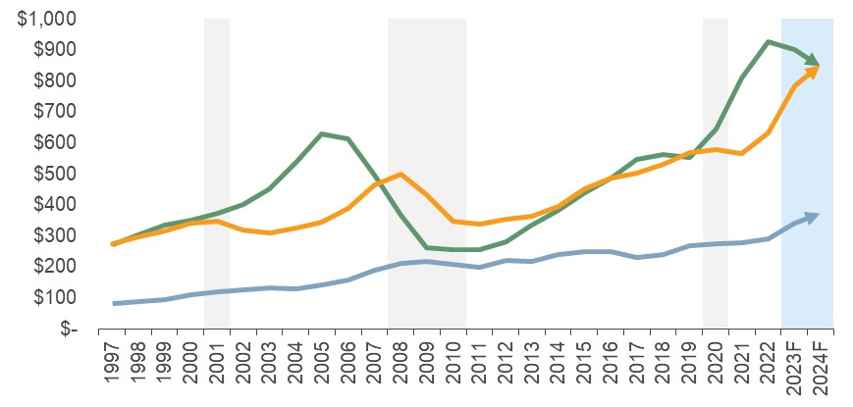
Total U.S. Market – Construction Put-in-Place (CPiP)
Macro uncertainties abound, but strong demand and funding secure the outlook for construction materials
Construction Put-in-Place (1997 – 2024F)
($ in Billions)
Grey bars denote recessions, Blue bars denote forecast
FMI Q1 Outlook Takeaways:
Growth in 2024 for manufacturing, transportation, highway and street, sewage and waste disposal, and water supply
Manufacturing: Government incentives and the onshoring movement (CHIPS, IRA, and IIJA) will continue to fuel growth
Highway and Streets: Spending growth in 2024 will remain above historic levels
All construction is local and your portfolio matters
Residential
Nonresidential
Nonbuilding
1
Residential Buildings
2
Nonresidential Buildings
3
Nonbuilding Structures
Single-Family
Multi-Family
Home Improvements
Commercial
Manufacturing
Transportation
Health Care
Educational
Religious
Public Safety
Office
Communication
Lodging
Recreation
Highway & Street
Sewage & Waste Disposal
Power
Water Supply
Conservation & Development
Note: 1st Quarter 2024 Forecast, Based on 3rd Quarter 2023 Actuals and 4th Quarter 2023 Assumptions; CPiP Segments defined by U.S. Census Bureau
BOLD CATEGORIES DENOTE STRONGEST CONSTRUCTION MATERIAL DRIVERS

Slide 11
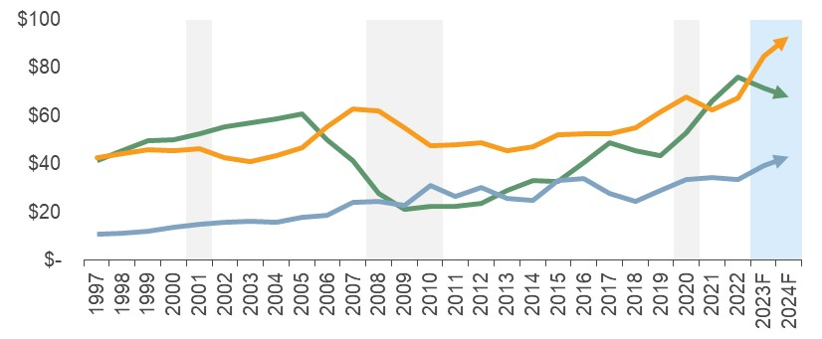
East North-Central Division – Construction Put-in-Place (CPiP)
East North-Central Division
Construction Put-in-Place (1997 – 2024F)
($ in Billions)
Grey bars denote recessions, Blue bars denote forecast
The East North-Central Division is one of nine geographic divisions that FMI Research tracks in its analysis of construction trends
Residential
Nonresidential
Nonbuilding
Note: 1st Quarter 2024 Forecast, Based on 3rd Quarter 2023 Actuals and 4th Quarter 2023 Assumptions; CPiP Segments defined by U.S. Census Bureau

Slide 12

Residential Construction – A Structural Problem in Supply and Demand
There is a fundamental supply - demand disconnect in the residential housing market
Supply: Housing Shortage – Avg. Annual Starts
<
Demand: Increasing Generational Housing Demand
Multi-Family
U.S. Population (1980): 227M
U.S. Population (2023): 335M
Single-Family
Ages of 1st Time Buyers
85.9M
90.9M
83.2M
63.4M
11.5M
-654k
The median age of first-time home buyers has climbed to 35 years old
Continued demand for new housing brought on by:
Homeowners unwilling to give up ~2% mortgage rates
Decade+ period of declining housing starts
Generational demand with growing population of prime homebuying demographic
Source: National Association of Realtors, U.S. Census Bureau

Slide 13
Residential Construction – Single-Family Dynamics
(1) Lack of Supply: Existing Home Sales
(2) Lack of Supply: Housing Starts
(in Millions)
Multi-Family
Home Sales
1995: 3.85M
2023: 4.09M
“The only way to get [home] prices down sustainably is to increase supply.”
– Redfin
28-Year Low
Single-Family
“Existing-home sales slid 19% in 2023 from the prior year to 4.09 million… lower than during the subprime crisis and the lowest full-year level since 1995”
– National Association of Realtors
-14%
-6%
(3) Affordability Issues: Mortgage Rates vs. Home Prices
(4) Current Landscape: Mortgage vs. Lease Payments
(Home Price Index: January 2000=100)
($ in Actuals)
Home Price Index
30-Yr. Mortgage Rate
Avg. Home Payment
Avg. Lease Payment
Average mortgage is 52% more expensive than average rent
Prices continue to climb despite rapid rise in mortgage rates
Note: Mortgage rates shown represent monthly average of weekly data
Source: CBRE, FHFA, Freddie Mac, National Association of Homebuilders, Realtor.com, S&P Global, U.S. Census Bureau, Wall Street Journal

Slide 14
Residential Construction – Multi-Family Dynamics
(1) Overbuilding: Apartment Construction Starts
(2) Oversupply: Apartment Vacancy Rates
(in Thousands; Seasonally Adjusted Annual Rate)
Avg. Jan 2018 – Dec 2023
Increase in interest rates negatively impacting starts
As projects finish supply jumps while demand moderates--vacancy rates begin to climb
Commentary
(3) Demand Indicator: YoY % Change in Monthly Rent
Increased interest rates are leading to a decrease in new starts for multi-family
Recent construction has led to an increase in vacancy rates
Higher vacancy rates have led to a decrease in rents
The combination of these factors has resulted in a decline in multi-family CPiP for 2024
The imbalance between supply and demand is apparent in slowing rent growth
Note: Apartment defined as 5+ units, rent growth representative of all rental unit types
Source: U.S. Bureau of Labor Statistics, U.S. Census Bureau, Wall Street Journal

Slide 15

Residential Construction – Single-Family (Michigan)
Population Migration
Residential Construction – Single-Family
Michigan Population Trends 2008-2023
East North-Central Single-Family Permit Issuance 2008-2022 CAGR
To maintain our quality of life every U.S. citizen annually needs:
Strong long-term permitting trends regionally
+
7,254 lbs of sand & gravel
10,765 lbs of stone
3.7%
<0%
0% - 1%
1.1% - 2.0%
2.1%+
SF Housing start projections 2023 & 2024:
Michigan: (12%) and 6%
United States: (6%) and 5%
Source: National Association of Homebuilders, U.S. Census Bureau, U.S. Geological Survey

Slide 16
Nonresidential Construction – A Mixed Bag
Key Areas of Nonresidential Construction Demand
YoY % Change | 2023F |  | 2024F
 | U.S. | E.N.C. | U.S. | E.N.C.
Manufacturing | 78% | 66% | 18% | 17%
Lodging | 23% | 15% | 12% | 7%
Public Safety | 20% | 24% | 13% | 11%
Religious | 20% | 33% | 5% | 2%
Educational | 18% | 15% | 10% | 8%
Health Care | 15% | 12% | 8% | 14%
Amusement & Recreation | 12% | 18% | 7% | 5%
Transportation | 10% | 12% | 12% | 18%
Office | 10% | 9% | (2%) | 3%
Commercial | 9% | 10% | (4%) | (4%)
Communication | 4% | 14% | 7% | 16%
Total Nonresidential | 24% | 26% | 8% | 10%
Total Put-in-Place | 10% | 11% | 2% | 4%
One bad apple can spoil the barrel; one good egg doesn't make a dozen
E-Commerce: Warehouse & distribution make up >50% of Commercial
Manufacturing & CHIPS Act: CHIPS Act invests ~$53B over the next 5 years
Travel & Entertainment: Post-pandemic life shows tailwinds for lodging and amusement & recreation
U.S. Manufacturing Construction Spending
($ in Billions; Seasonally Adjusted Annual Rate)
Manufacturing spending experiencing explosive growth on the heels of public funding deployment
Source: FMI, U.S. Census Bureau

Slide 17
Nonresidential Construction – CHIPS and Science Act and Relevant Projects
Semiconductor Market Share
CHIPS and Science Act of 2022
Rest of World
The semiconductor industry represents ~$575B globally
The U.S. has been losing market share in the space for decades
COVID-19 exposed faults in the U.S. supply chain as demand for electronics soared while major exporters closed their borders
To incentivize investment in U.S. semiconductor manufacturing, the Federal CHIPS and Science Act was passed, apportioning $53B for U.S. semiconductor manufacturing and R&D
U.S.
Manufacturing CPiP (U.S.)
Local Semiconductor Manufacturing Projects
78%
$204 Billion
2023/2022 Comparison
1
Mersen USA
$81m manufacturing expansion project in Greenville and Bay City
~115 estimated jobs created
2021
UP
9%
$82B
2
Hemlock Semiconductor
$375m manufacturing expansion project in Thomas Township
~170 estimated jobs created
2022
UP
40%
$115B
3
1
2
2023
UP
78%
$204B
3
SK Siltron CSS
$300m manufacturing expansion project in Bay City
~150 estimated jobs created
2024
UP
18%
$241B
Note: Semiconductor manufacturing facilities include new projects and expansions
Source: FMI, Semiconductor Industry Association, The White House

Slide 18
Nonbuilding Construction – Comparison of Highway Authorization Bills
The IIJA is a “once-in-a-generation” infrastructure bill with huge implications for Construction Materials
Federal Road and Bridge Funding
30% - 55% Increase From FAST Act
General Fund Appropriations $62B
ARRA $26B
Extension
ISTEA
TEA-21
SAFTEA-LU
MAP-21
FAST ACT
IIJA
Source: Federal Highway Administration, FMI Research

Slide 19
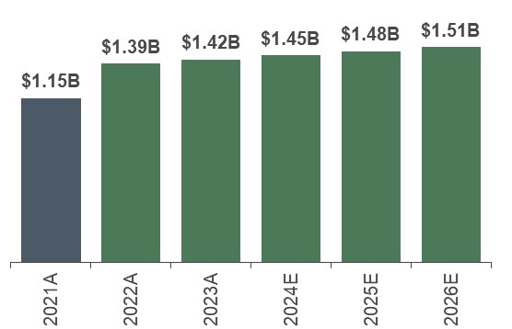
Nonbuilding Construction – State and Federal Funding
Road & Bridge Network
Michigan State Funding
Michigan Federal Funding⁽¹⁾
Miles of Road by State:
East North-Central Division
Michigan Highway Program Investment
FAST Act
IIJA
~$8.6B investment over the next five years
~26% avg. increase over FAST Act
State | Rank
IL | 1
OH | 2
MI | 3
WI | 4
IN | 5
240k
256k
262k
307k
203k
Michigan has the 3rd most roadway based on miles in the East North-Central Division
As of 2023 Michigan had ~1.3k bridges that are structurally deficient
The Michigan Highway Program invests in road and bridge reconstruction and rehabilitation, maintenance, and resurfacing
Over the next five years, MDOT will invest $8.6B in these initiatives
IIJA provides Michigan with ~$7.3B
On average, IIJA funding is 26% greater than 2021 FAST Act funding
(1) Figures only show Federal-Aid Highway Program apportionments
Source: American Road and Transportation Builders Association, Federal Highway Administration, MIDOT

Slide 20
Construction Put-in-Place – Winners and Losers (What’s in Your Portfolio?)
2023 Construction Put-in-Place & Forecast Growth (2022-2024 CAGR)
CAGR 2022-2024 for All Spending
5.8%
($ in Billions)
Note: 1st Quarter 2024 Forecast, Based on 3rd Quarter 2023 Actuals and 4th Quarter 2023 Assumptions;
BOLD CATEGORIES DENOTE STRONGEST CONSTRUCTION MATERIAL DRIVERS

Slide 21







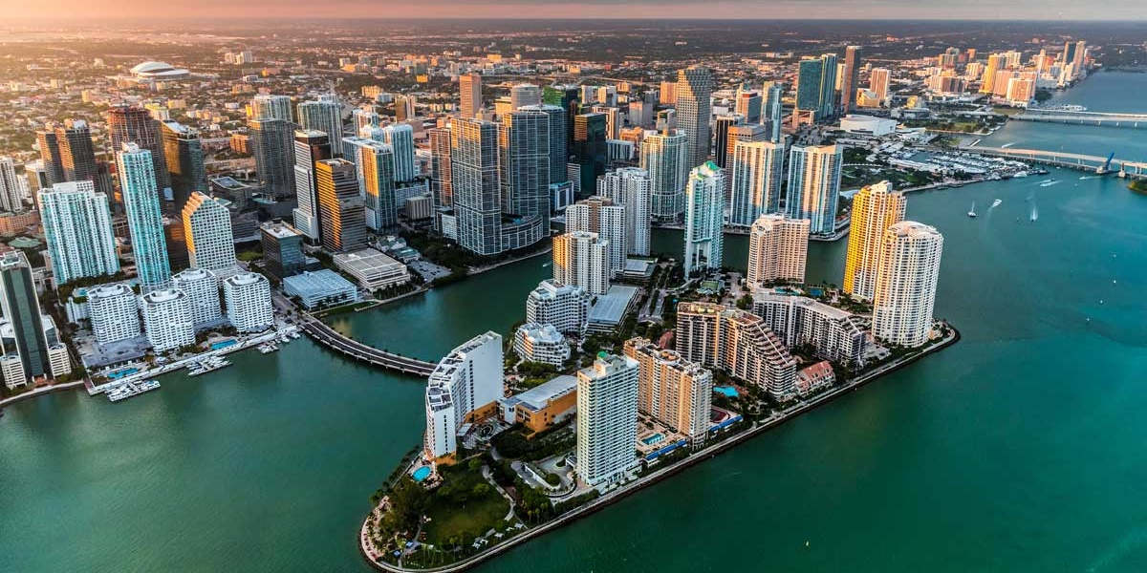




All Construction is Local
More than 1-in-3 Construction Dollars are Spent in just 12 Markets
35% of U.S. CPiP
1. New York
2. Los Angeles
3. Dallas
4. Houston
5. Atlanta
6. Phoenix
7. Washington, DC
8. Miami
9. Chicago
10. Seattle
11. San Francisco
12. Boston
50% of U.S. CPiP
Riverside
Denver
Philadelphia
Minneapolis
Charlotte
Tampa
Orlando
Austin
Nashville
Portland
San Jose
San Diego

Slide 22



Economic Update
Inflation
Recession?
Outlook

Slide 23

Inflation – What is the Fed Watching?
Core PCE
Federal Funds Rate
2.2%
Commentary
Producer Price Index – Construction vs. All
Fed focuses on Core PCE because it accounts for consumer behavior (substituting for lower priced goods)
Many forecasts are calling for 2.2% Core PCE in 2024
At the December FOMC meeting, Chairman Powell noted that the Fed is willing to cut rates even if the U.S. economy avoids recession
Construction PPI, once the highest of the four inflation measurements shown, has declined to <1%
PPI: Construction
Note: PPI figures as of December
PPI: All
CPI
3.1%
0.9%
0.5%
Source: CNBC, FactSet, MSNBC, U.S. Bureau of Economic Analysis, U.S. Bureau of Labor Statistics

Slide 24

Recession? – How Strong is the Economy?
Real GDP Change
Understanding the Components of GDP
(Compounded Annual Rate of Change)
Q4 2023 v Q3 2023
(Billions of Chained 2017 Dollars; Seasonally Adjusted Annual Rate)
C
Personal Expenditures
$108.5B
0.7%
+
I
Gross Private Domestic Investment
$21.0B
0.5%
+
G
Government Expenditures
$31.0B
0.8%
(X–M)
Q1F:
3.0%
+
Net Exports of Goods and Services
$22.5B
2.4%
2024F:
1.5%
GDP
$182.2B
0.8%
A recession is defined as two consecutive quarters of GDP decline, but NBER is the governing body that declares official recessions
Q4 2023 was significantly better than expected
“The economy’s strength in the final months of 2023 was broad based, driven by consumer spending, business investment, government outlays, exports and improvements in housing conditions.”
– CNN
2020
2021
2022
2023
2024F
Note: Q4 GDP and components from U.S. Bureau of Economic Analysis Advance as of 1/25/24
Source: CNN, Federal Reserve Bank of Atlanta, MSNBC, U.S. Bureau of Economic Analysis

Slide 25
Recession? – How Well-Off are Consumers?
Consumer Sentiment Index
Pandemic Era Excess Savings Held by U.S. Households
(Index:1966 Q1=100)
“Consumer sentiment surged 29% from November into January, the biggest two-month increase since 1991.”
- University of Michigan
($ in Trillions)
Pandemic-era cash reserves are being depleted
Consumer Credit Card Debt
Monthly Job Creation
($ in Trillions)
$1T Threshold
(in Millions)
Avg. Jan 2017 – Dec 2019
Credit card debt has surpassed $1T
January 2024 jobs report beat expectations:
353,000 jobs created vs. 185,000 expected
Source: Federal Reserve Bank of San Francisco, Federal Reserve Bank of New York, Federal Reserve Bank of St. Louis, MSNBC, University of Michigan

Slide 26
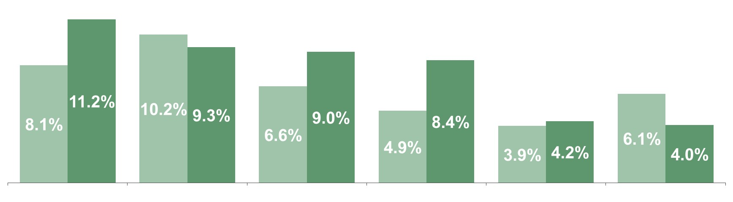



Recession? – Capital Expenditures
Capital Expenditures as a % of Revenue (Select CMI Companies)
YTD Q3 2022
YTD Q3 2023
Average
YTD Q3 2022 | YTD Q3 2023
6.6% | 7.7%
As it relates to Private Investment, CM Companies have generally increased their CapEx spend as a % of revenue
Source: CapIQ

Slide 27
Recession? – Government Spending
Government spending makes up slightly more than 1/3 of GDP. The following categories directly contribute to GDP.
U.S. Government Spending by Category ($ Billions of Dollars) | Q3 2023 | Q4 2023
National Defense | $210B | $238B
Health | $215B | $224B
Commerce and Housing Credit | $49B | $65B
Transportation | $37B | $32B
Total | $511B | $559B
Note: Figures shown representative of federal fiscal Q4 2023 and Q1 2024
Source: fiscaldata.treasury.gov

Slide 28
Recession? – How Confident is the Market?
Heavy Civil Construction Index (HCCI)
Nonresidential Construction Index (NRCI)
Current Reading
52.6
Current Reading
45.9
Previous Reading
56.1
Previous Reading
49.8
NAHB/WF Housing Market Index (HMI)
FMI’s HCCI and NRCI surveys ask one question: “What is the outlook for your business next quarter”
Readings above 50 on all the indexes indicate expansion
Though trending upward, homebuilders & industry experts remain pessimistic on residential
Current Reading
44
Previous Reading
37
Source: FMI, National Association of Homebuilders

Slide 29
Recession? – Backlogs and Employment
As backlogs continue to build, CM firms will be looking to add more employees to perform the work
U.S. Construction Backlog by Quarter
AGC Survey for Hiring Expectations over NTM
(in Months)
Mean (Q4 2017 – Q4 2023): 8.6 months
Expect Headcount to:
Expect it will become / continue to be:
Source: Associated Builders and Contractors, Associated General Contractors of America

Slide 30

Outlook – What the “Experts” Forecasted for 2023 vs. 2024
The “Experts” significantly missed their forecasts for 2023
Forecast for 2023
Forecast for 2024
“JPMorgan’s Jamie Dimon Warns U.S. Likely to tip into Recession in 6 to 9 Months”
- CNBC, Oct. 2022
“Fed Lowers Inflation Forecast for 2024, Seeing Core PCE Falling to 2.4%”
- CNBC, Dec. 2023
“Why a Global Recession is Inevitable in 2023”
- The Economist, Nov. 2022
“‘Everyone got Burned’: Wall Street Missed the Great Stock Rally of 2023”
- Bloomberg, Dec. 2023
“Big Banks Predict Recession, Fed Pivot in 2023”
- Wall Street Journal, Jan. 2023
“For Much of the World, Inflation Will Be Normal in 2024—Finally”
- Wall Street Journal, Dec. 2023
“Wall Street Chorus Grows Louder Warning that 2023 will be Ugly”
- Bloomberg, Dec. 2022
“Charting the Global Economy: U.S. Labor Market Picks Up Steam”
- Bloomberg, Dec. 2023
Economists lowered the probability of a recession within the next year to 39%
- WSJ
Note: WSJ survey as of 1/14/2024

Slide 31





Outlook – Your Portfolio Matters
Your portfolio mix will dictate your success in the event of a downturn
Nonbuilding
Safe – subset of public, IIJA will be a strongpoint for HMA and aggregates producers
Nonbuilding
Nonresidential
Mixed bag – pockets of strength in manufacturing, industrial, and some commercial
Residential
Wild Card – demand is there, but very interest rate dependent
Residential
Nonresidential
Public Sector
Private Sector
Safe – guaranteed government stimulus
More risk – CHIPS Act spending but potential cancellations

Slide 32
Industry Sentiment & Performance

Slide 33
Public CM Company Performance – Last Twelve Months
CMI vs. Major Indexes (February 2023 – February 2024)
Construction Materials has outperformed the broader market in the past ~9 months
Potential Reasons:
46%
Perceived “stability” vs. macroeconomic uncertainty
Strong funding
Demonstrated pricing power
Demonstrated margin recovery
Residential is a “mixed-bag”
21%
13%
CM Index
S&P 500
DJIA
Source: S&P CapIQ as of 2/12/2024
FMI’s CM Index includes: Arcosa, Inc., Buzzi Unicem S.p.A., Cementos Argos S.A., CEMEX, S.A.B. de C.V., Construction Partners, Inc., CRH plc, Eagle Materials, Inc., Granite Construction Incorporated, Grupo Cementos de Chihuahua, S.A.B. de C.V., HeidelbergCement AG, Holcim Ltd, Knife River Corporation, Martin Marietta Materials, Inc., Summit Materials, Inc., The Monarch Cement Company, Titan Cement International S.A., Vulcan Materials Company

Slide 34
Public CM Company Performance – Checking the “Vital Signs” (Positioned for Growth)
CMI Cash vs. Total Debt
CMI Median Net Debt/EBITDA
($ in Billions)
Total Cash
Total Debt
Mean Debt: $64.8B
Healthy Leverage Capacity
Mean: 2.6x
Mean Cash: $14.2B
CMI Average EBITDA Margin
CMI TEV/EBITDA
Stable Performance
Mean: 18.6%
Historically Volatile Valuations
Mean: 9.6x
Source: CapIQ; Total Enterprise Value (TEV) defined as market capitalization plus debt minus cash & cash equivalents; market data as of 2/12/2024

Slide 35



Trends & Takeaways
Mergers & Acquisitions
Growth Trends
Industry Outlook Conclusion

Slide 36











Trends & Takeaways – Mergers and Acquisitions
Construction Materials Deals 2018 – 2023
H1
H2
Sellers want to capitalize on IIJA funding
Buyers “comfortable” given heightened activity in 2021 and 2022
H1 2023 – Uncertainty gives M&A Pause
Sellers want to leave some “bloom on the rose”
Buyers hungry for deals / return of thunderclap transactions
H2 2023 – Market Becomes Comfortable with Macro Environment
Recent activity from “Majors”
Major Buyers
37 RMC plants in CO, TX, & WY
Select Acquisitions
28 RMC plants in NY, NJ, & PA
North America Assets
20 aggregates operations across the Southeast
20 RMC plants and 1 cement plant in TX
82 RMC plants, 11 volumetric locations in TX
Global uncertainty has forced a “flight to safety” for CM buyers, those targets are bolt-on acquisitions
Source: Merger Market, Wallstreet Research; Market data and deals as of 2/12/2024

Slide 37

Trends & Takeaways – Growth is Steady but Modest
U.S. Construction Aggregates Produced
U.S. Ready-Mixed Concrete Produced
Crushed Stone
Sand & Gravel
1.7% CAGR
Metric Tons (millions)
Cubic Yards (millions)
3.0% CAGR
U.S. Asphalt Tons Produced
U.S. Cement Produced (Domestic)
2.4% CAGR
Tons (millions)
2.8% CAGR
Metric Tons (millions)
Source: National Asphalt Pavement Association, National Ready Mixed Concrete Association, U.S. Geological Survey

Slide 38



Trends & Takeaways – Outlook for Construction Materials
Category
Sentiment
Outlook
Demand
Near-term demand remains strong
Pricing
Pricing will continue to improve
Backlogs
Backlogs remain healthy
Committed public funding will sustain the CM Sector
Public Funding
Weather
CM Companies will continue to closely monitor weather patterns in their markets
Industry leaders are cautiously optimistic as slowdowns in residential have been milder than expected
Residential
All construction is local and YOUR portfolio matters
What are your end markets?
What is your public vs. private sector mix?

Slide 39


Scan for industry insights, recent transactions, and an overview of FMI Capital Advisors Construction Materials
George Reddin
Managing Director
919.349.1919
george.reddin@fmicorp.com
Rob Mineo
Managing Director
919.539.6861
rob.mineo@fmicorp.com
Evan Coughlin
Vice President
919.407.0469
evan.coughlin@fmicorp.com
FMI Capital Advisors
223 S. West Street
Suite 1200
Raleigh, NC 27603
Mark Schachte
Associate
919.616.4573
mark.schachte@fmicorp.com
Matt Berendsen
Analyst
919.943.9902
matt.berendsen@fmicorp.com

