Slide 1
Community Engagement
Making A Difference

Slide 2
What You Can Expect:
Who Are We?
Why Is Building Relationships Important?
We Are Here To Inspire Each Other- Not Compete With Each Other!
What Are Our Companies Doing?
Tell YOUR Story
Team Work Makes The Dream Work!
Questions
Naomi

Slide 3
Why Community Outreach is Important
Boosts Brand Loyalty
Cultivates Brand Advocates
Builds Trust
Shows Loyalty to the Community
Grows Employee Relationships
Gives Employees Purpose
Customer Engagement
Emily

Slide 4
Building Relationships
Telling our story within the community
Promote Safety Efforts
Aggregates build communities/infrastructure
Explain why mining is essential - How the material is used.
Promote Quality / Safety Awards
Promote your employees
Local Townships
Attending township meetings
Knowing the support within your company
Being open to the public
Host a community day - allow people to ask questions
Take a Tour
Touch a Truck
Ask The Community What We Can Do
Megan

Slide 5
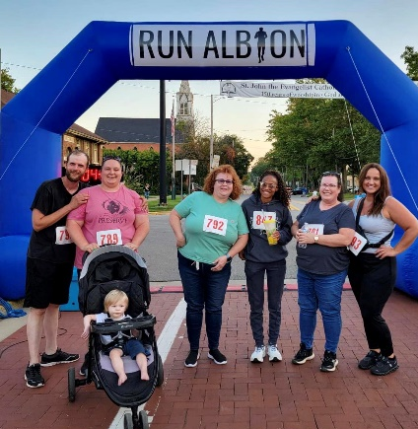
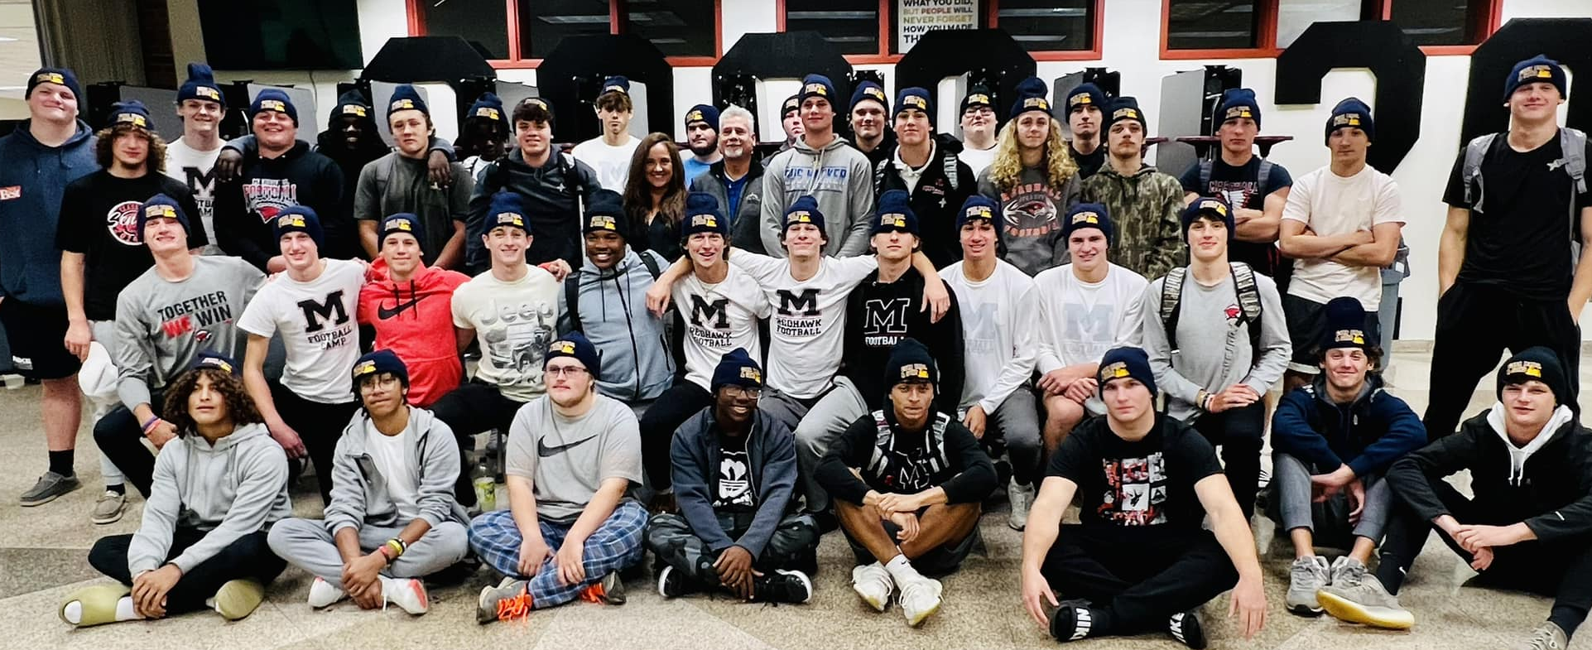
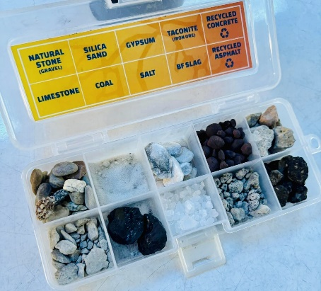
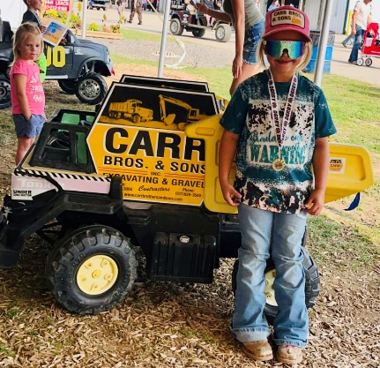
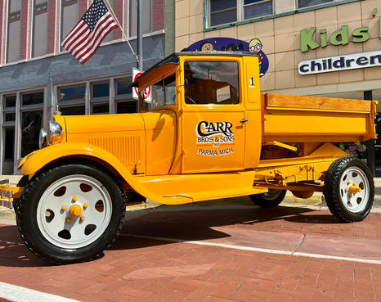
Community Outreach - Carr Brothers
Involvement with the Youth
4H Projects
Purchasing Projects or Sponsoring with an Add-On
Donating Materials to Show Arenas
Power Wheels Derby
Touch a Truck
Local Schools
Little League
Ball Diamonds
Playgrounds
Sports Dinners
MAA Programs
MI Rocks Rock!- Rock Box’s
Toys for Tots- Winter Conference
Community Involvement
5K- Supporting Albion’s Big Read
Holiday Parades
Truck Shows- Albion’s Festival of the Forks
Local Firefighters and Law Enforcement
Storm Response
Tours of our Facilities
Search and Rescue Training

Slide 6
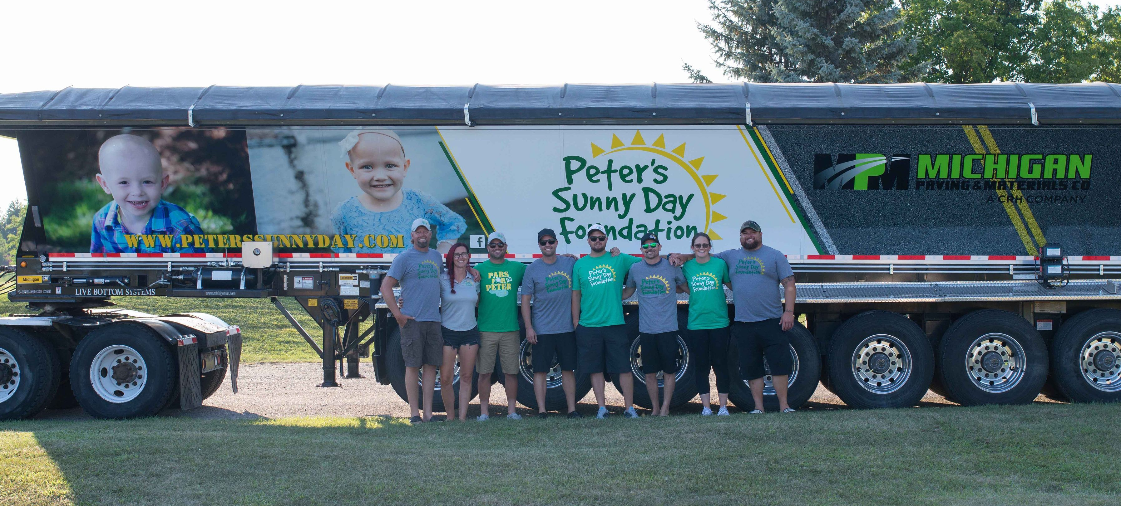
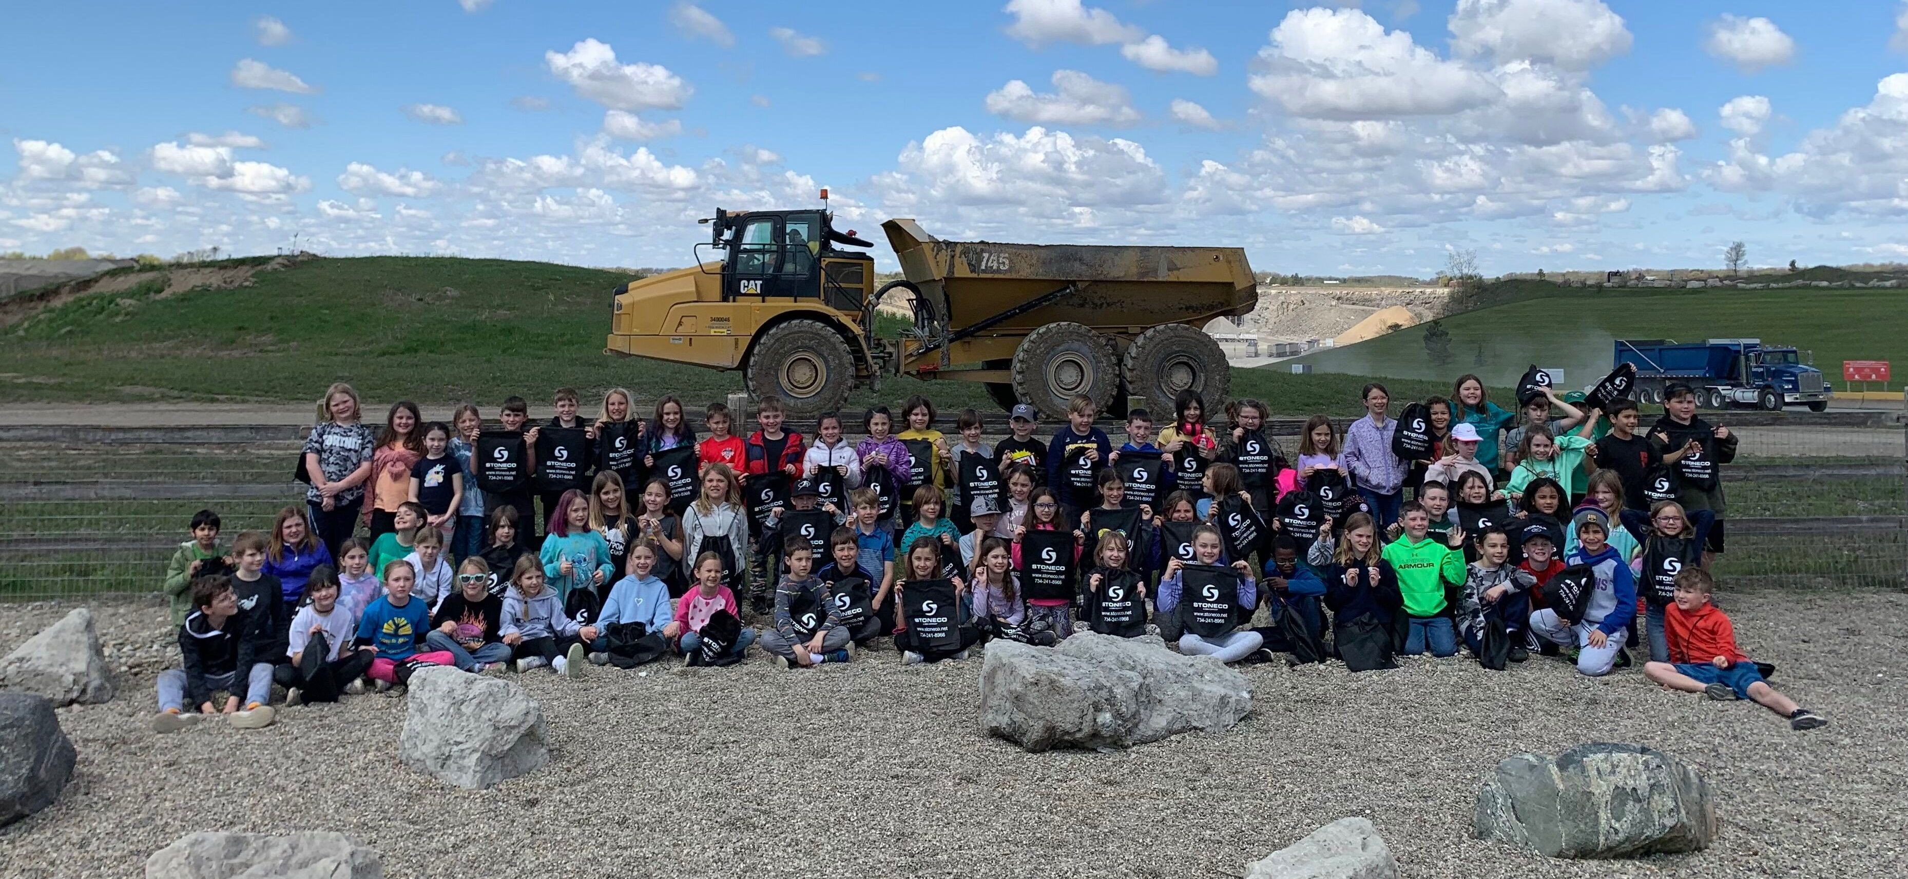
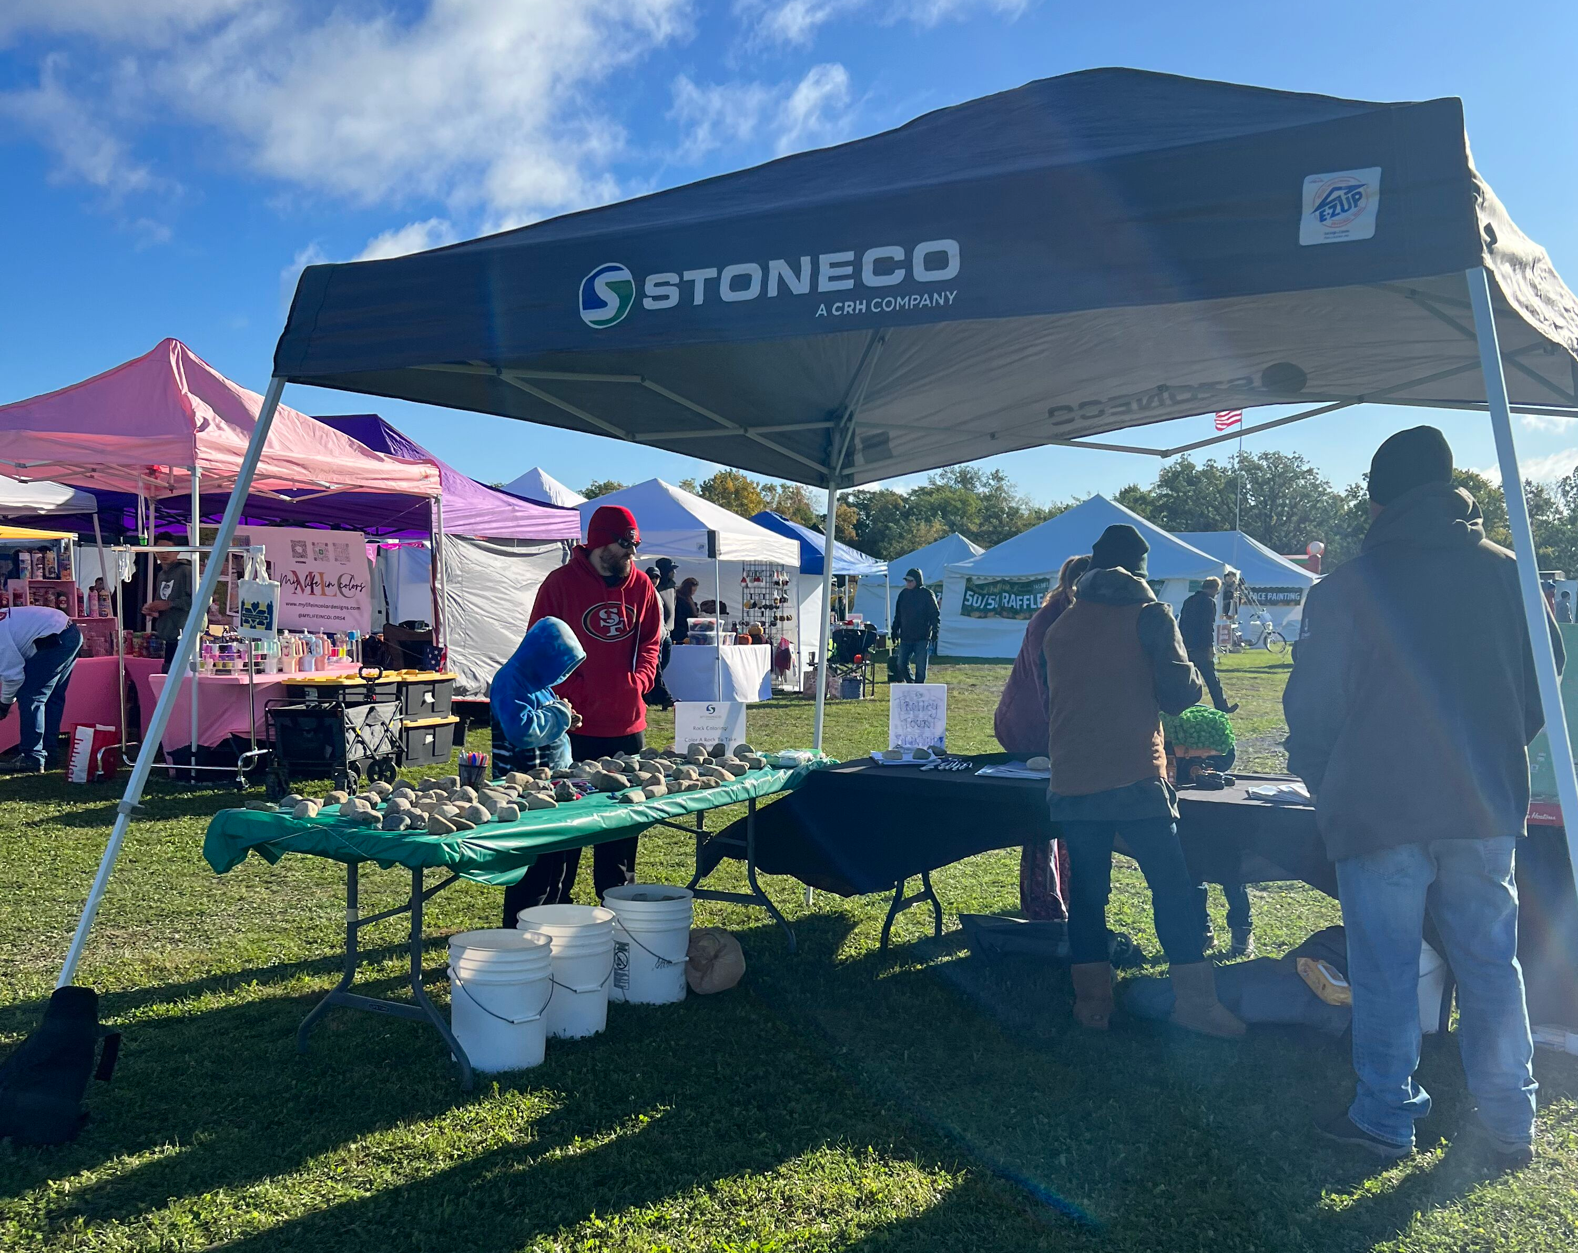
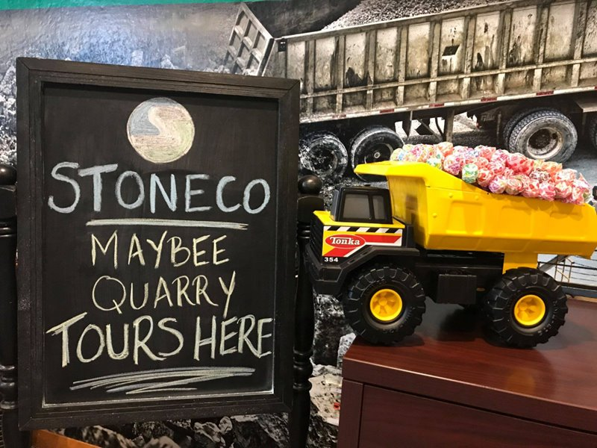
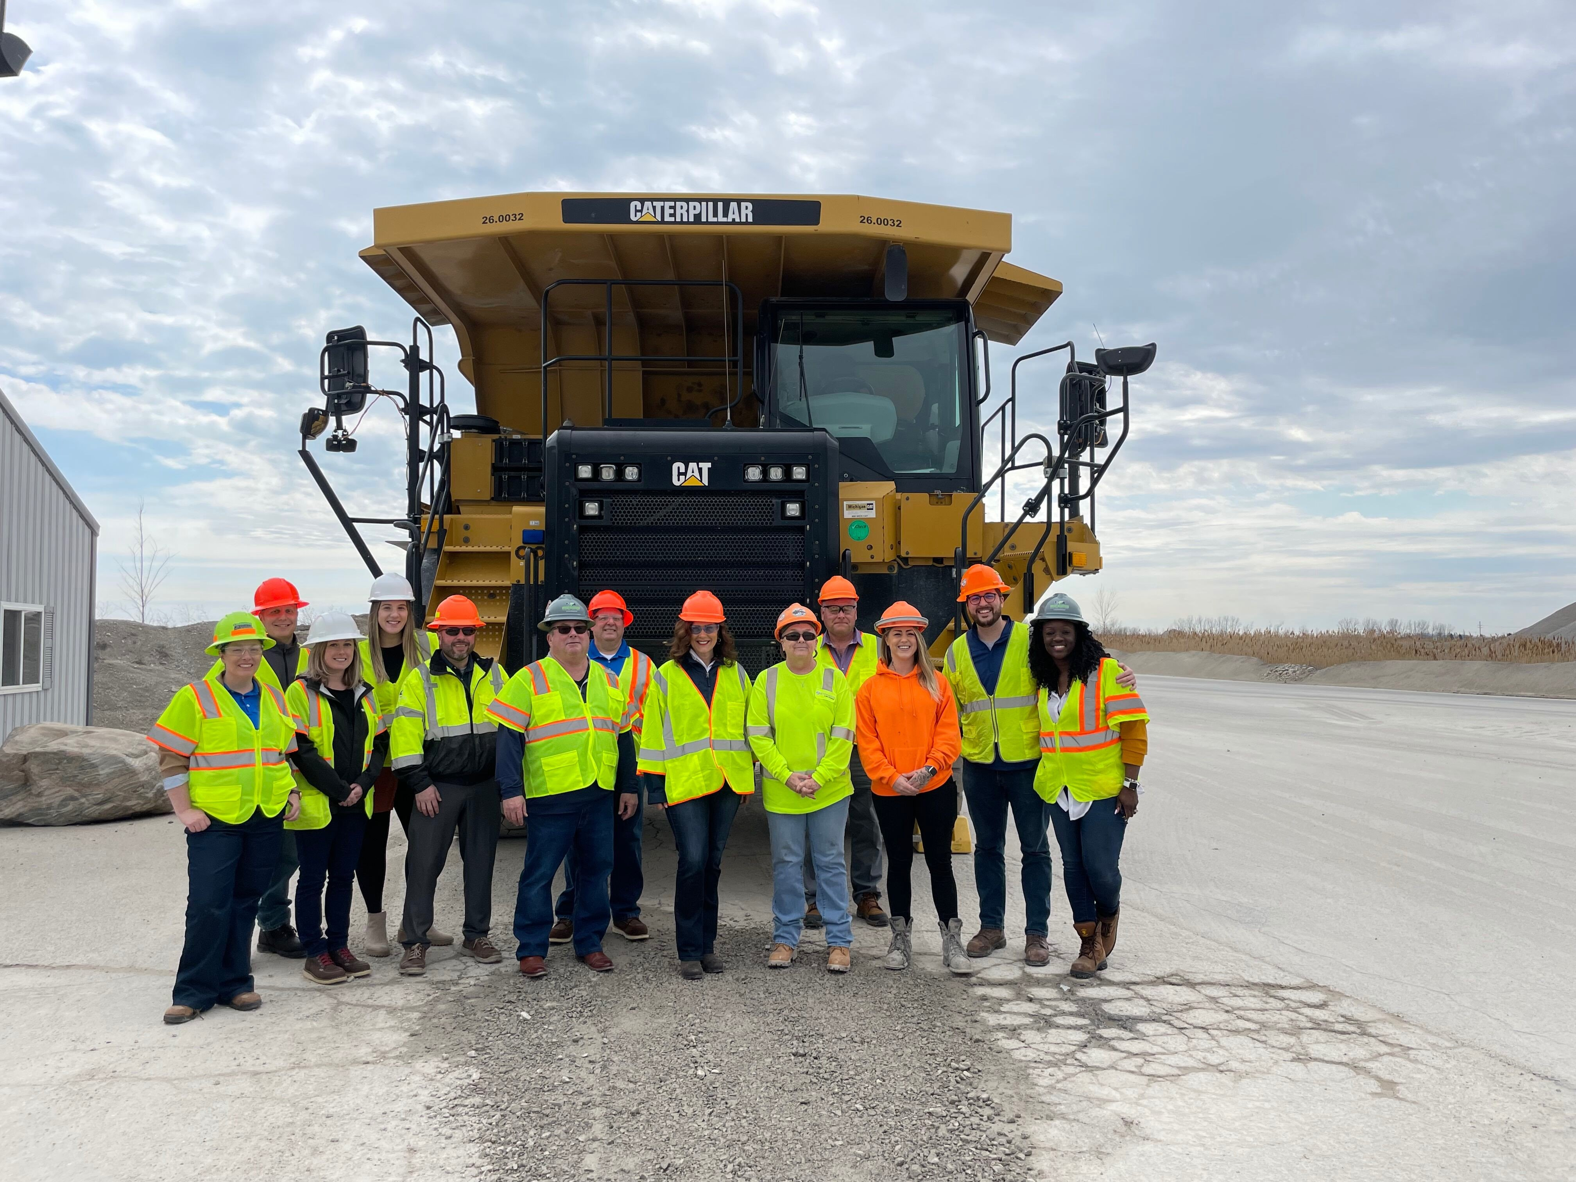
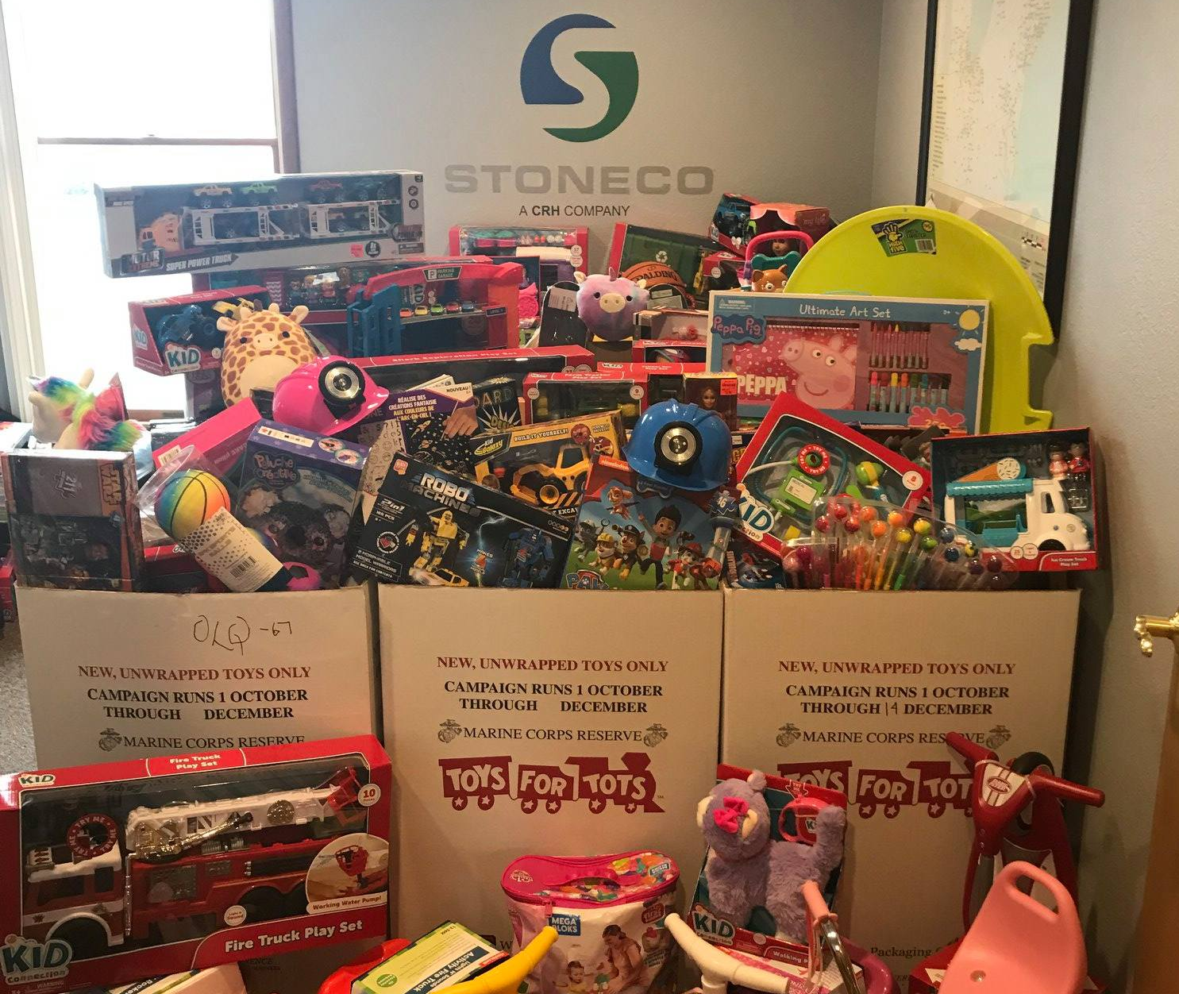
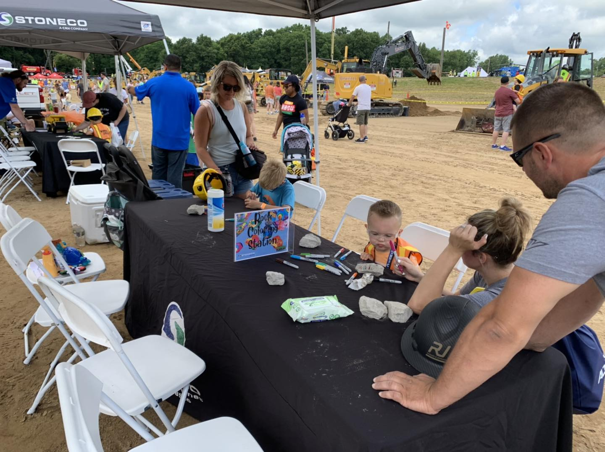
Community Outreach- Stoneco Of Michigan
School Tours:
10 School Every Spring- 1,000 Students
High School Spirit Rocks
Holiday Giving
Toys for Tots
Holiday Dinners
Adopt A Family
Employee Engagement Ideas:
Relay for Life
Truck Wraps
Local Organizations

Slide 7
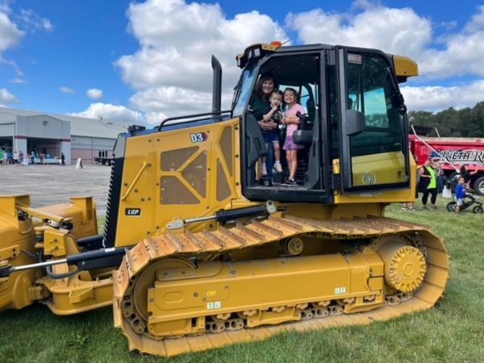
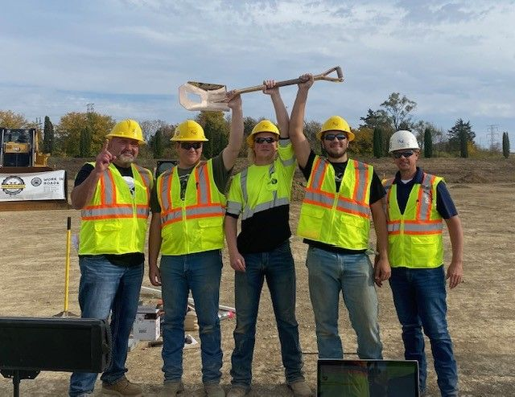
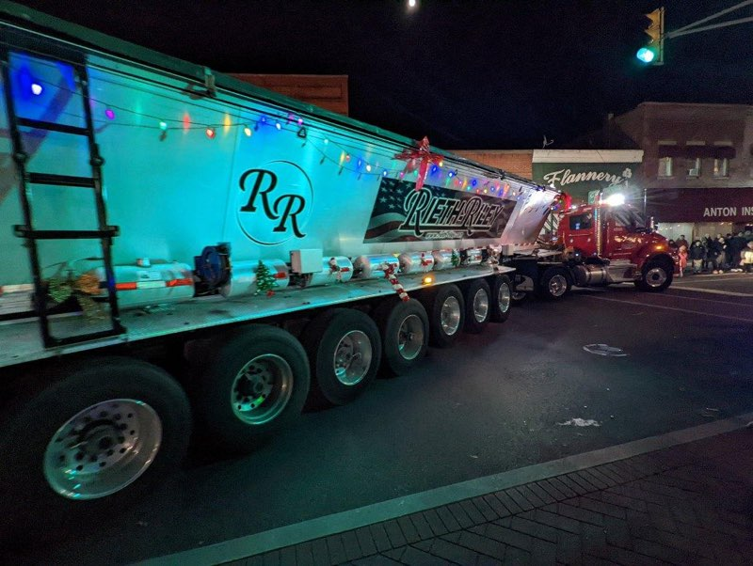
Community Outreach - Rieth-Riley
Community Outreach / Social Media Reach – 89k
Thanksgiving Baskets
Delivered 600 thanksgiving meals to a neighborhood by our Indy office.
Touch A Truck
Holiday Parades
Little League
Food Drives
Workforce Development / Social Media Reach – 205k
Donate PPE to Civil Pathway Construction High School Students
Plant / Project Tours
Class Presentations
Meet the Parents
MiCareer Quest
Total Reach 2023 – 1.6 Million

Slide 8
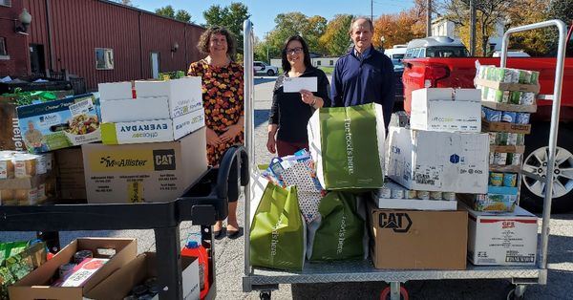
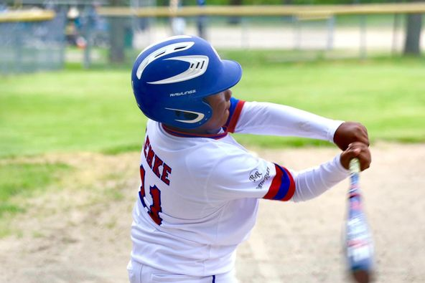
Teamwork Makes the Dream Work!
Work as a Team
Review Photos / Content
Utilize Your Employees
They live and work in the communities you serve.
Create a contest for submissions- get creative!
Create a Plan
Sports team sponsorships
Holiday Giving
Food Drives
Raise money for charitable donations
Football Boards
Pay to wear jeans
Emily

Slide 9
Tell YOUR Story!
Use your Websites
Add A Community Page- a Blog Page
Use local Papers
When Sponsoring-Donating, Ask For A Share/Follow
Social Media
Facebook, LinkedIn, Instagram, Twitter, TikTok
Change the Way People Feel and Think About the Industry!
Telling OUR story together
Megan

Slide 10
Questions?
Naomi

