Slide 2
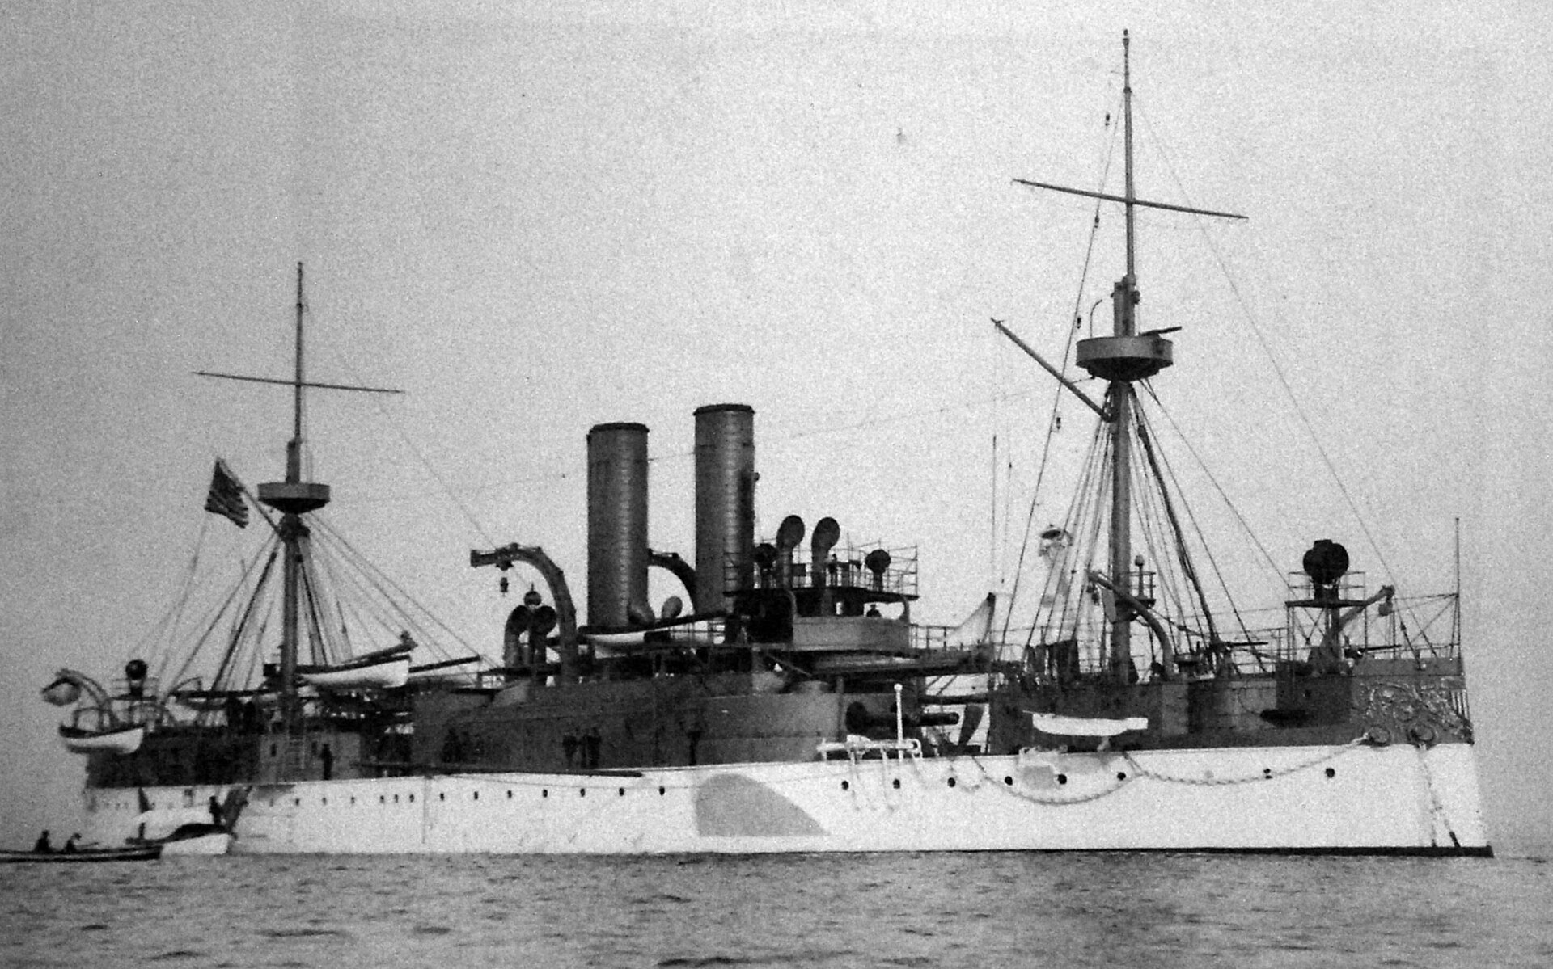

Slide 3
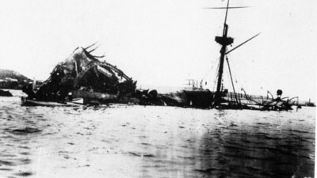

Slide 5
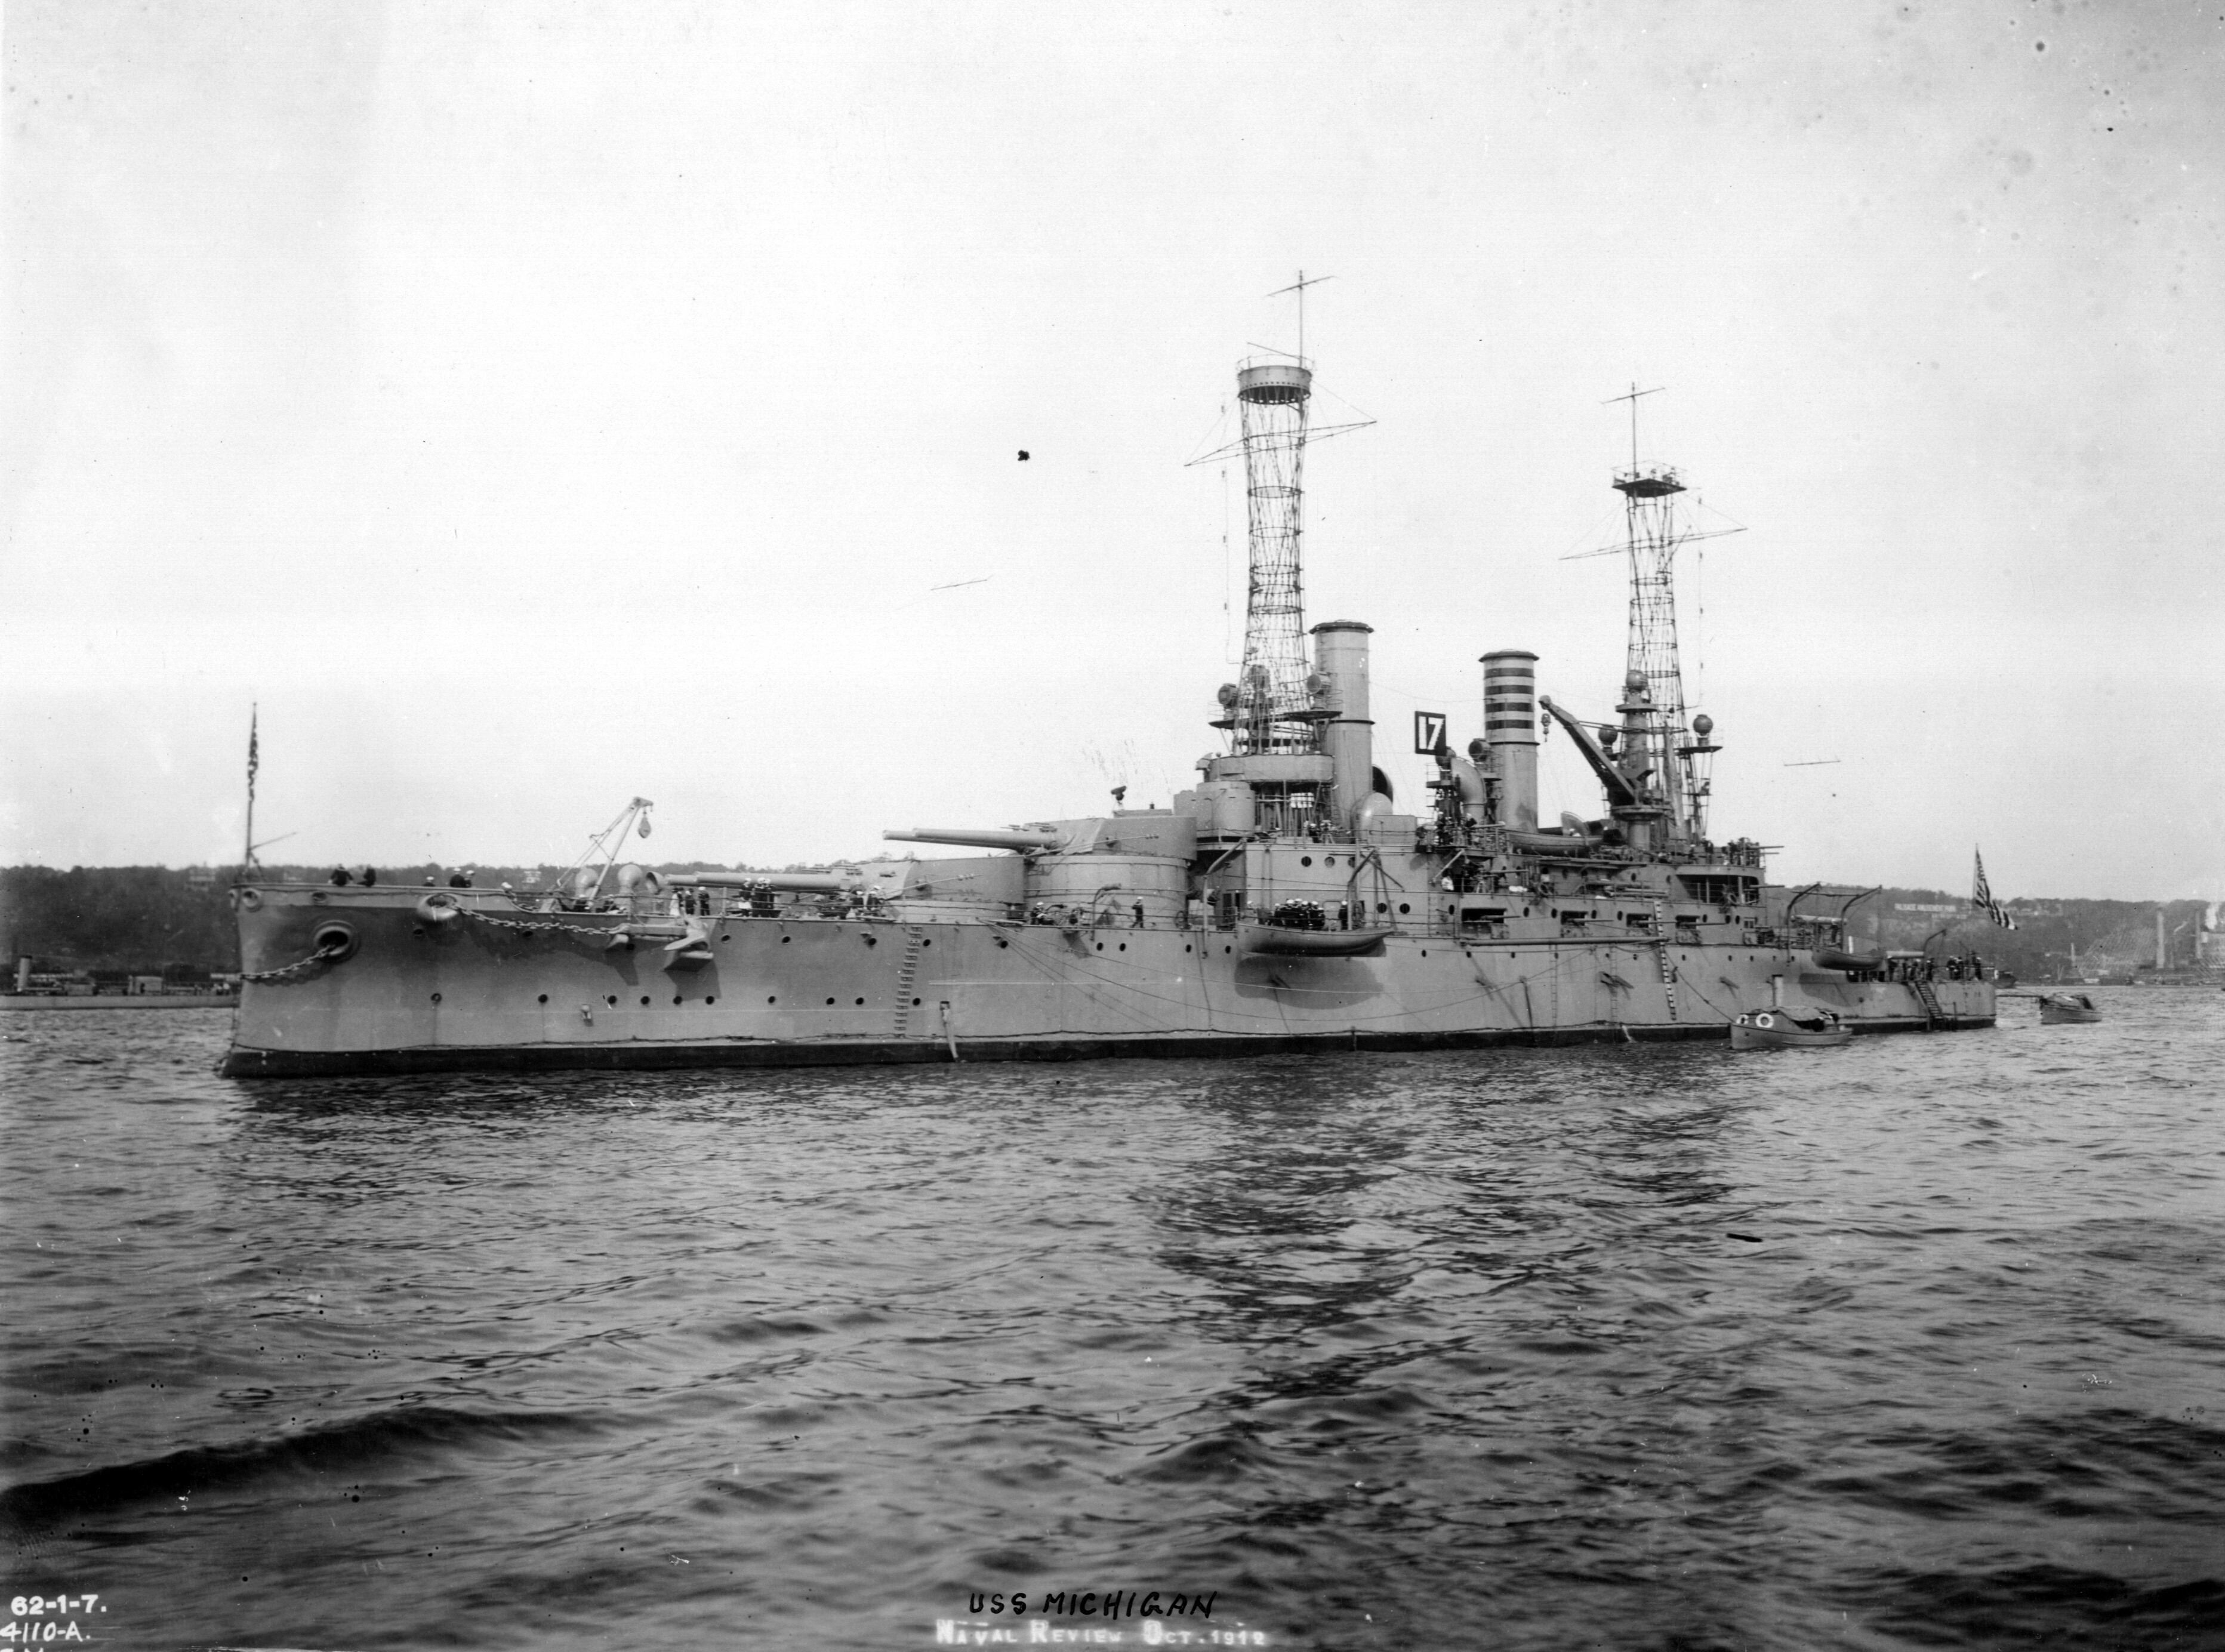

Slide 6
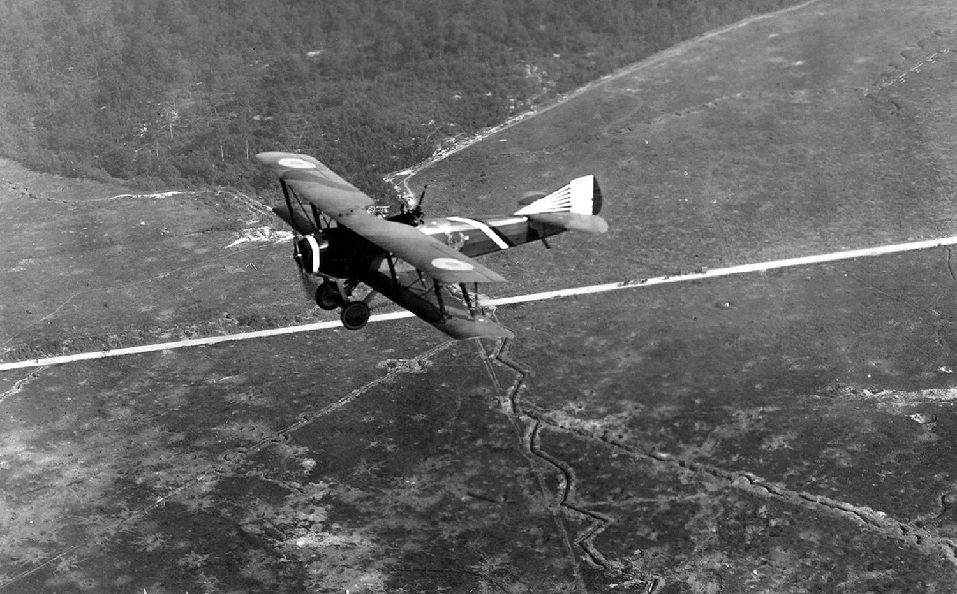
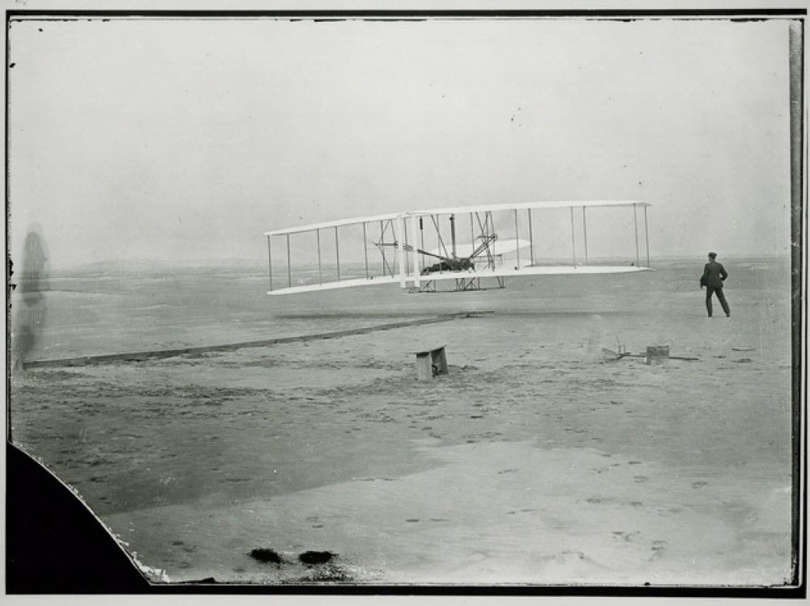
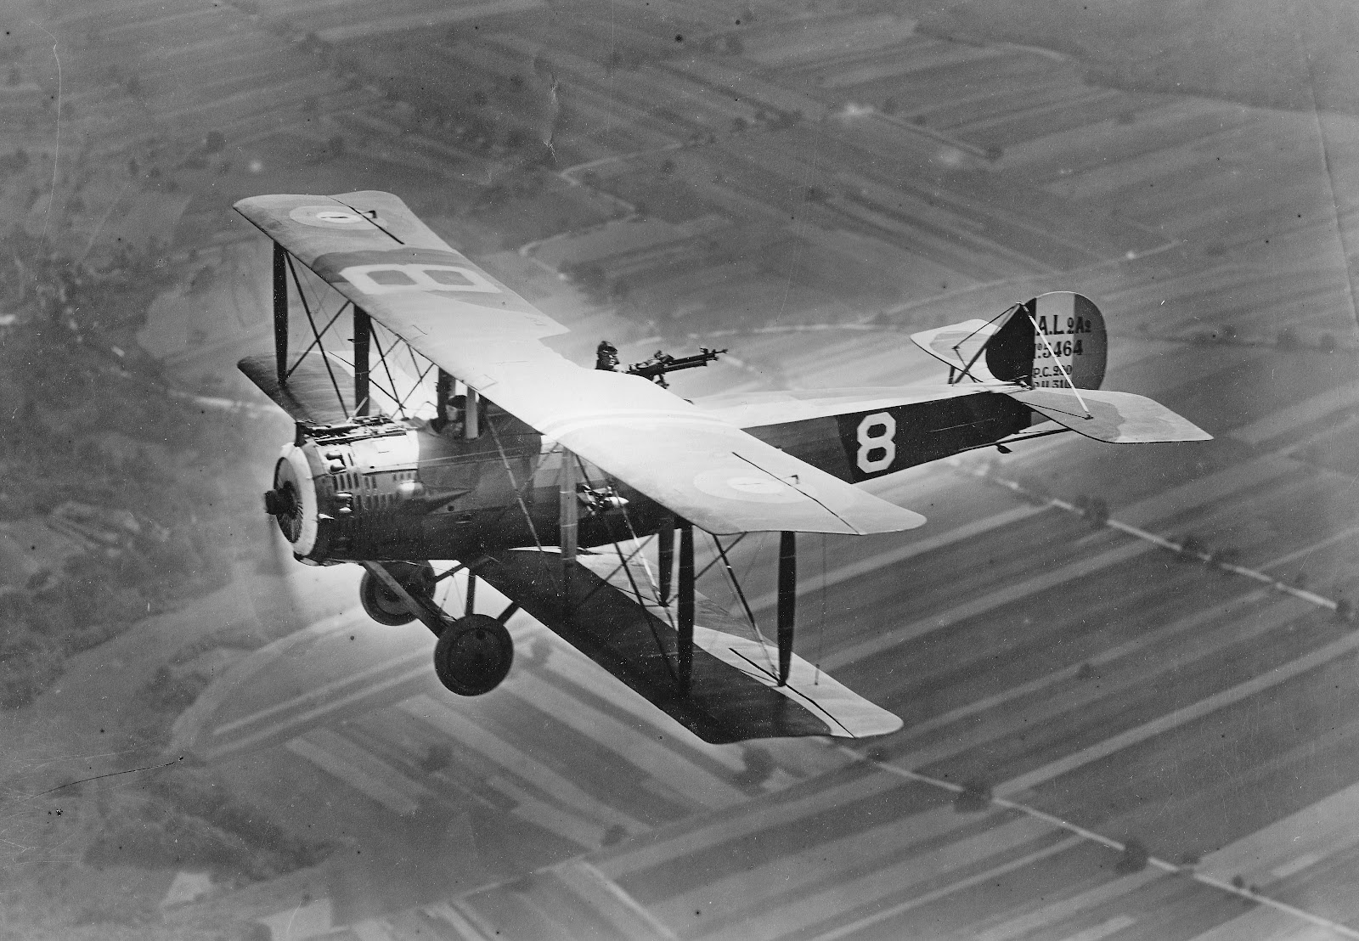
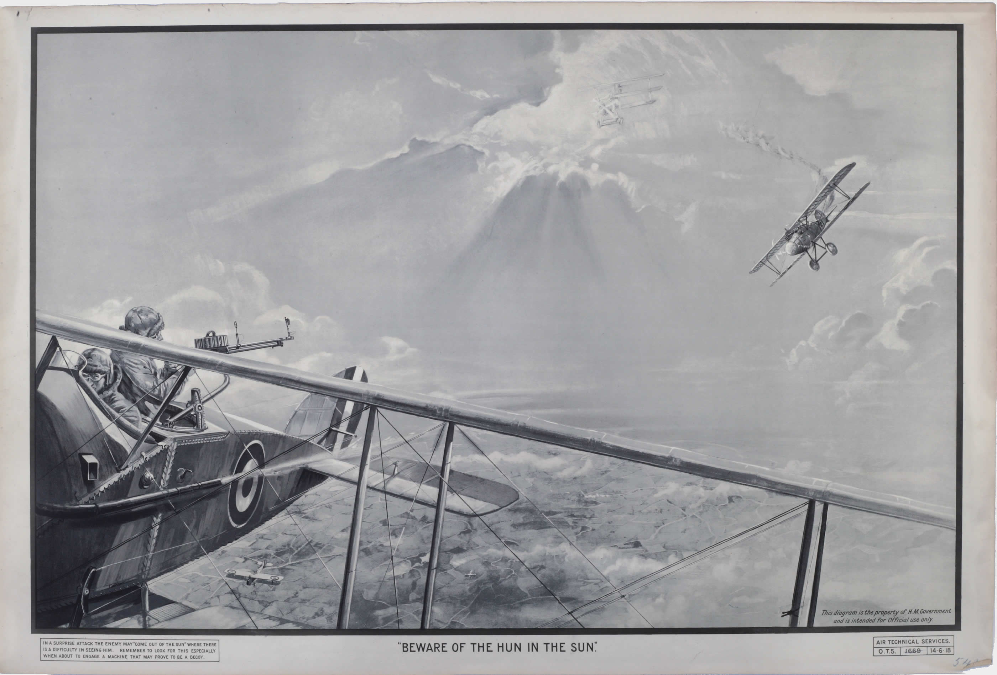

Slide 7
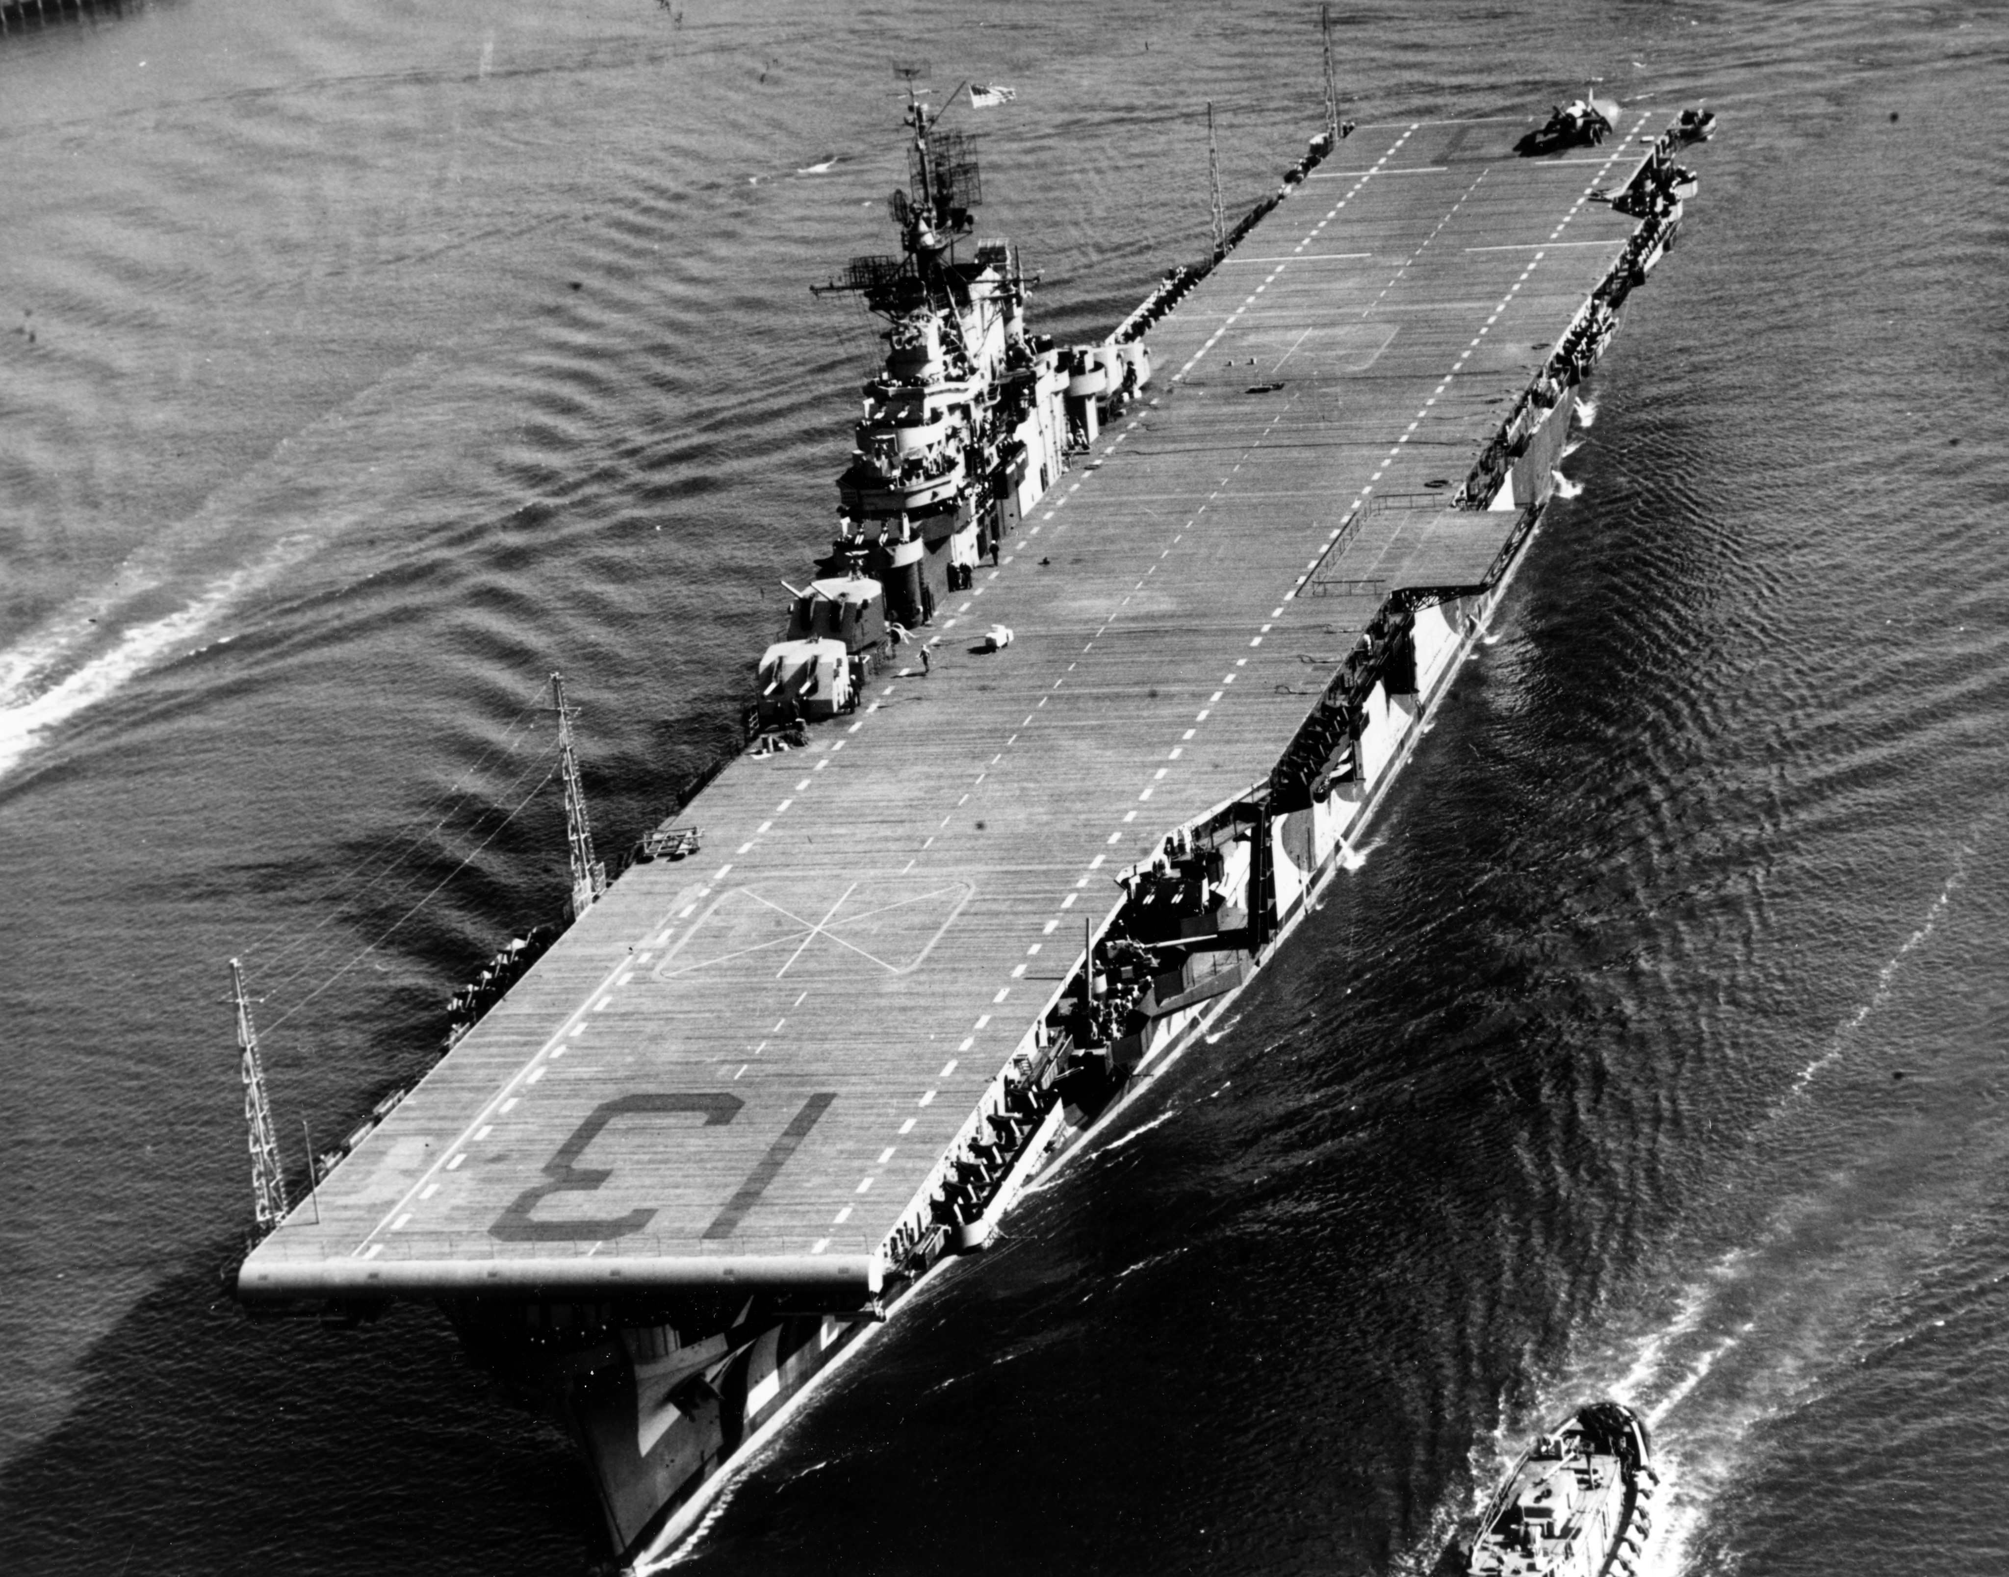
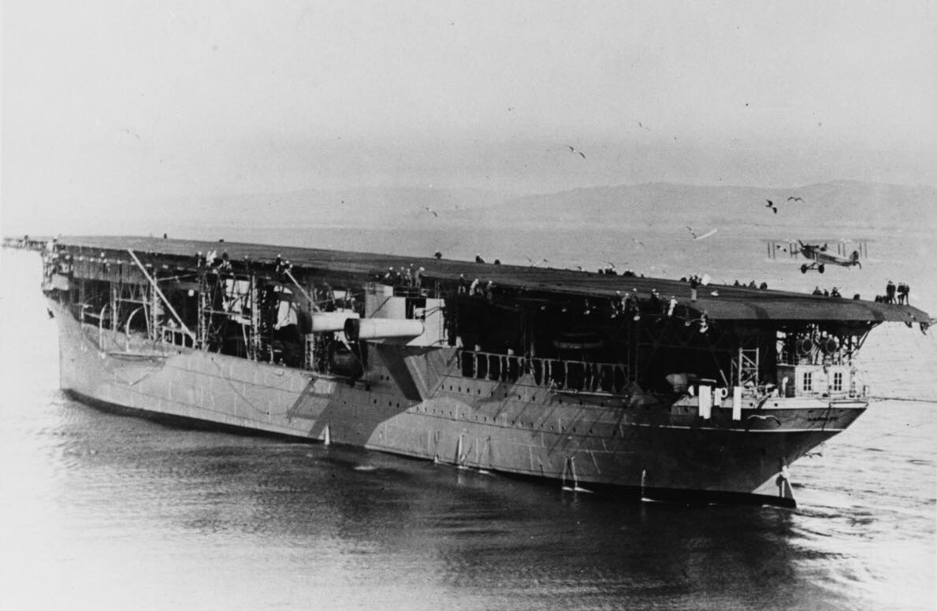

Slide 8
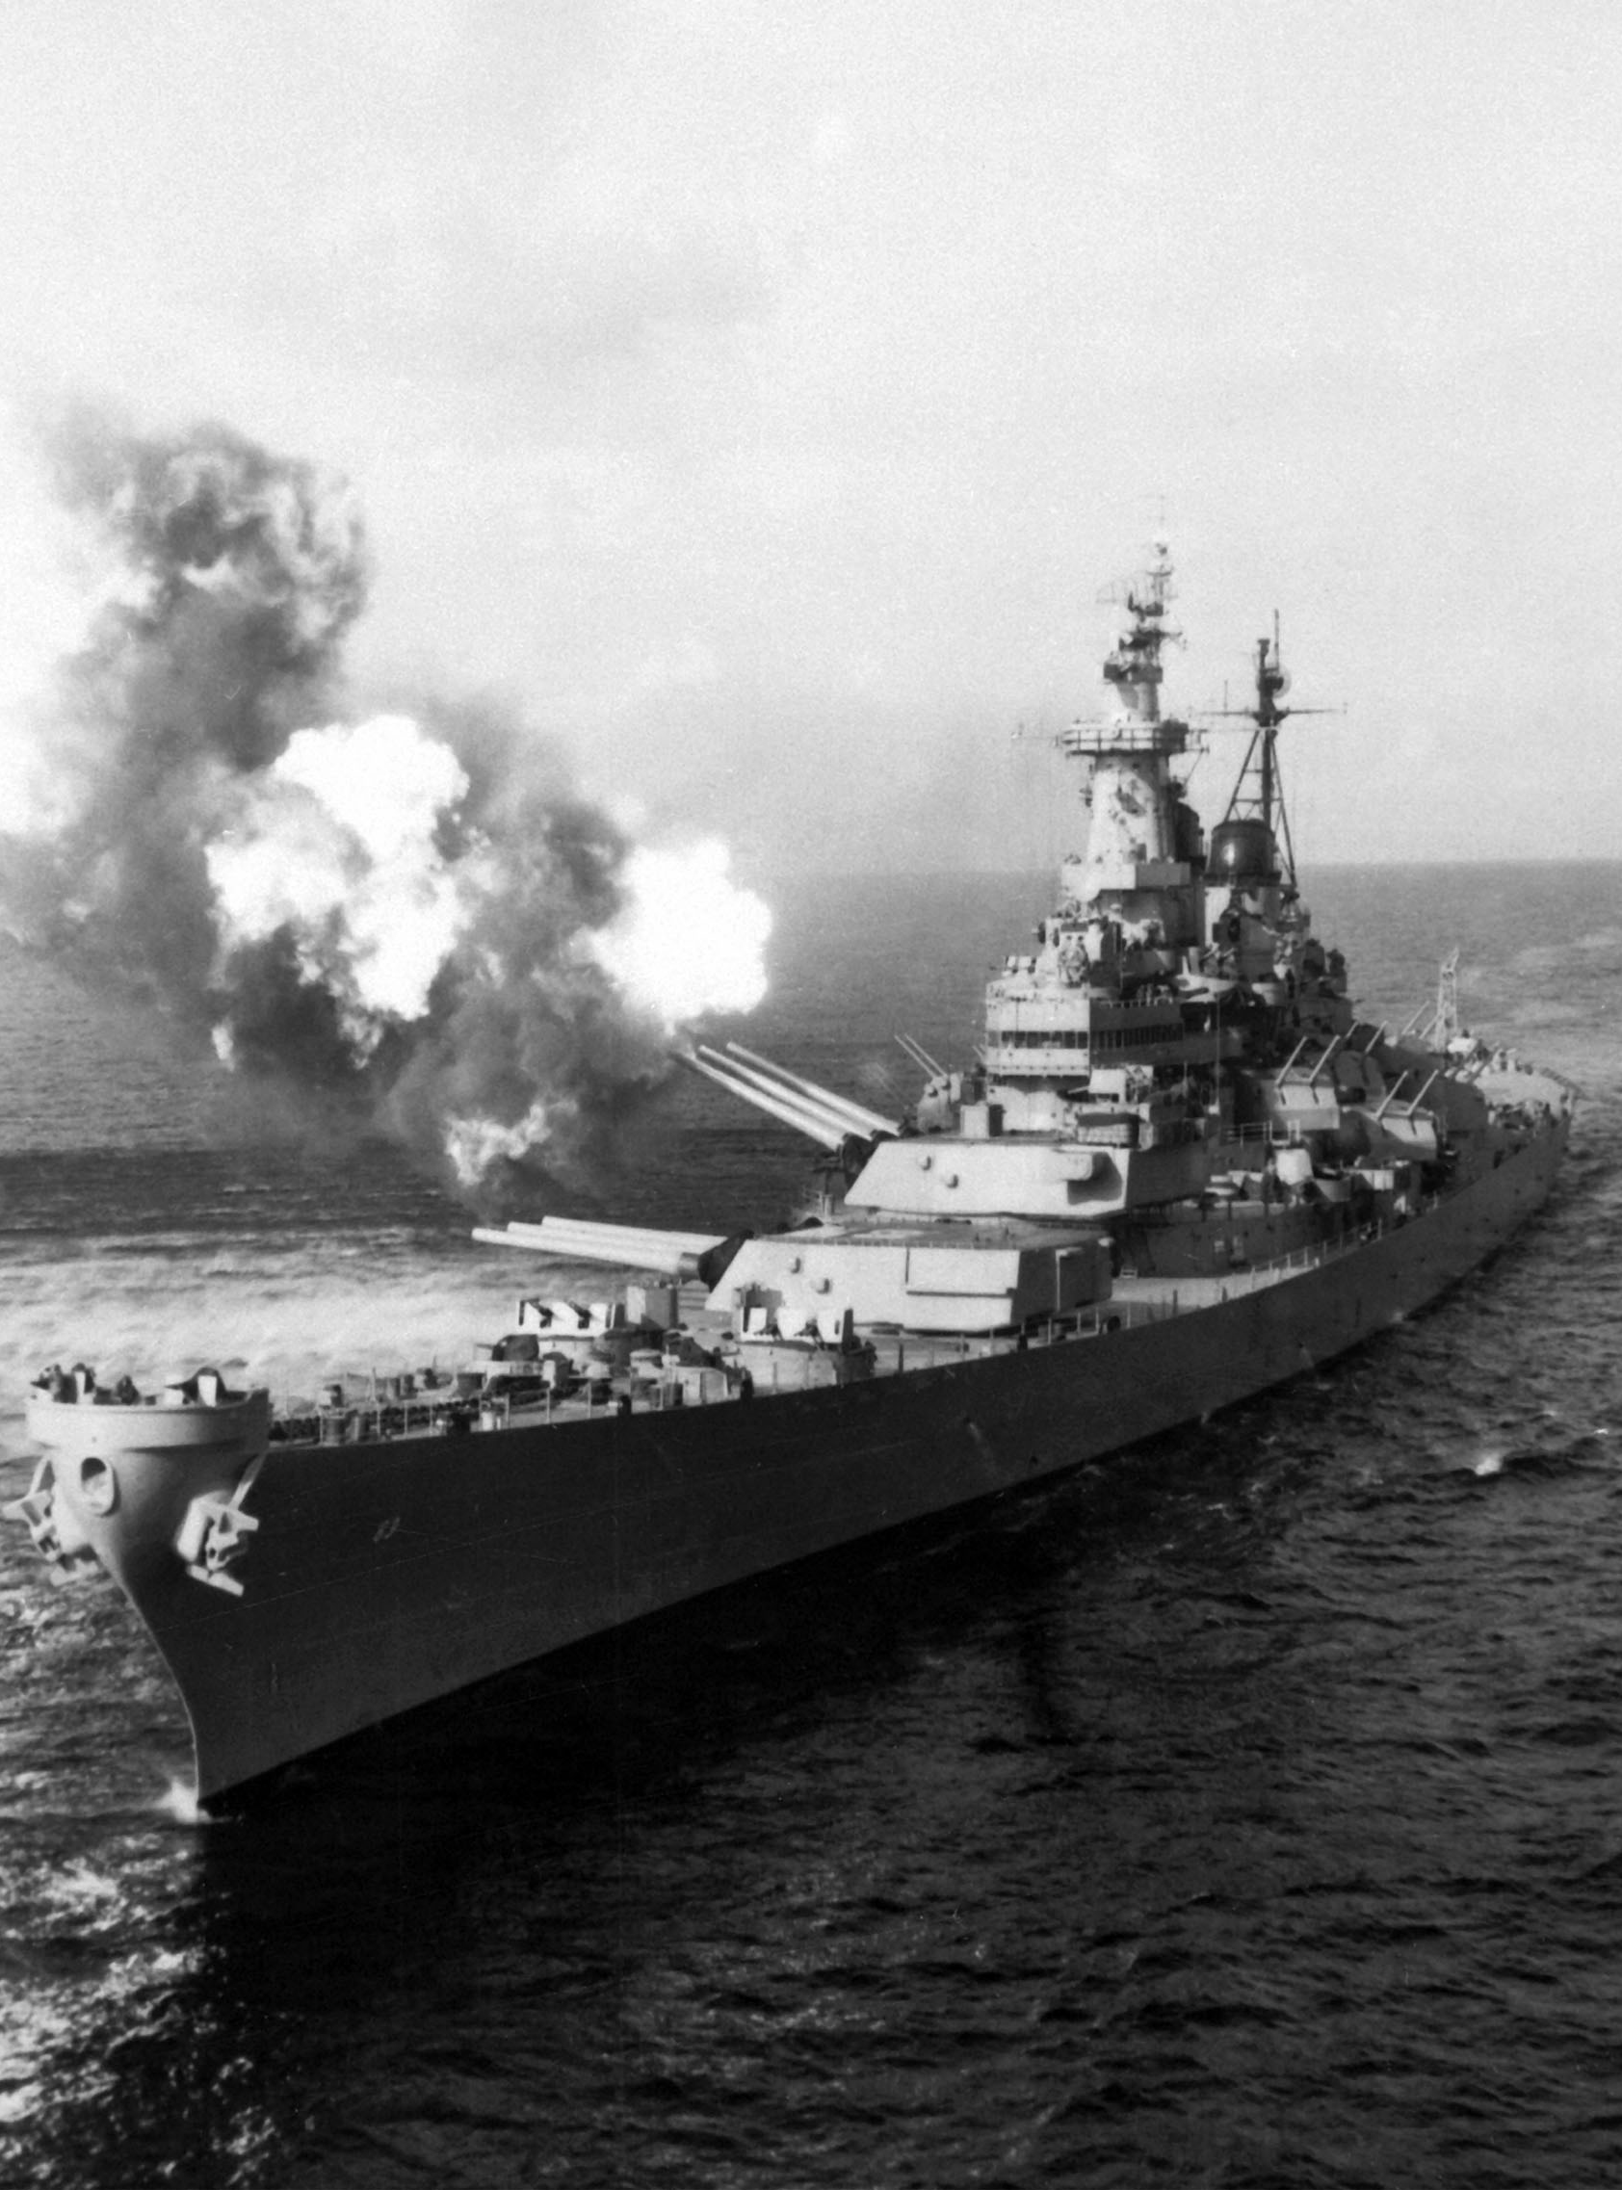
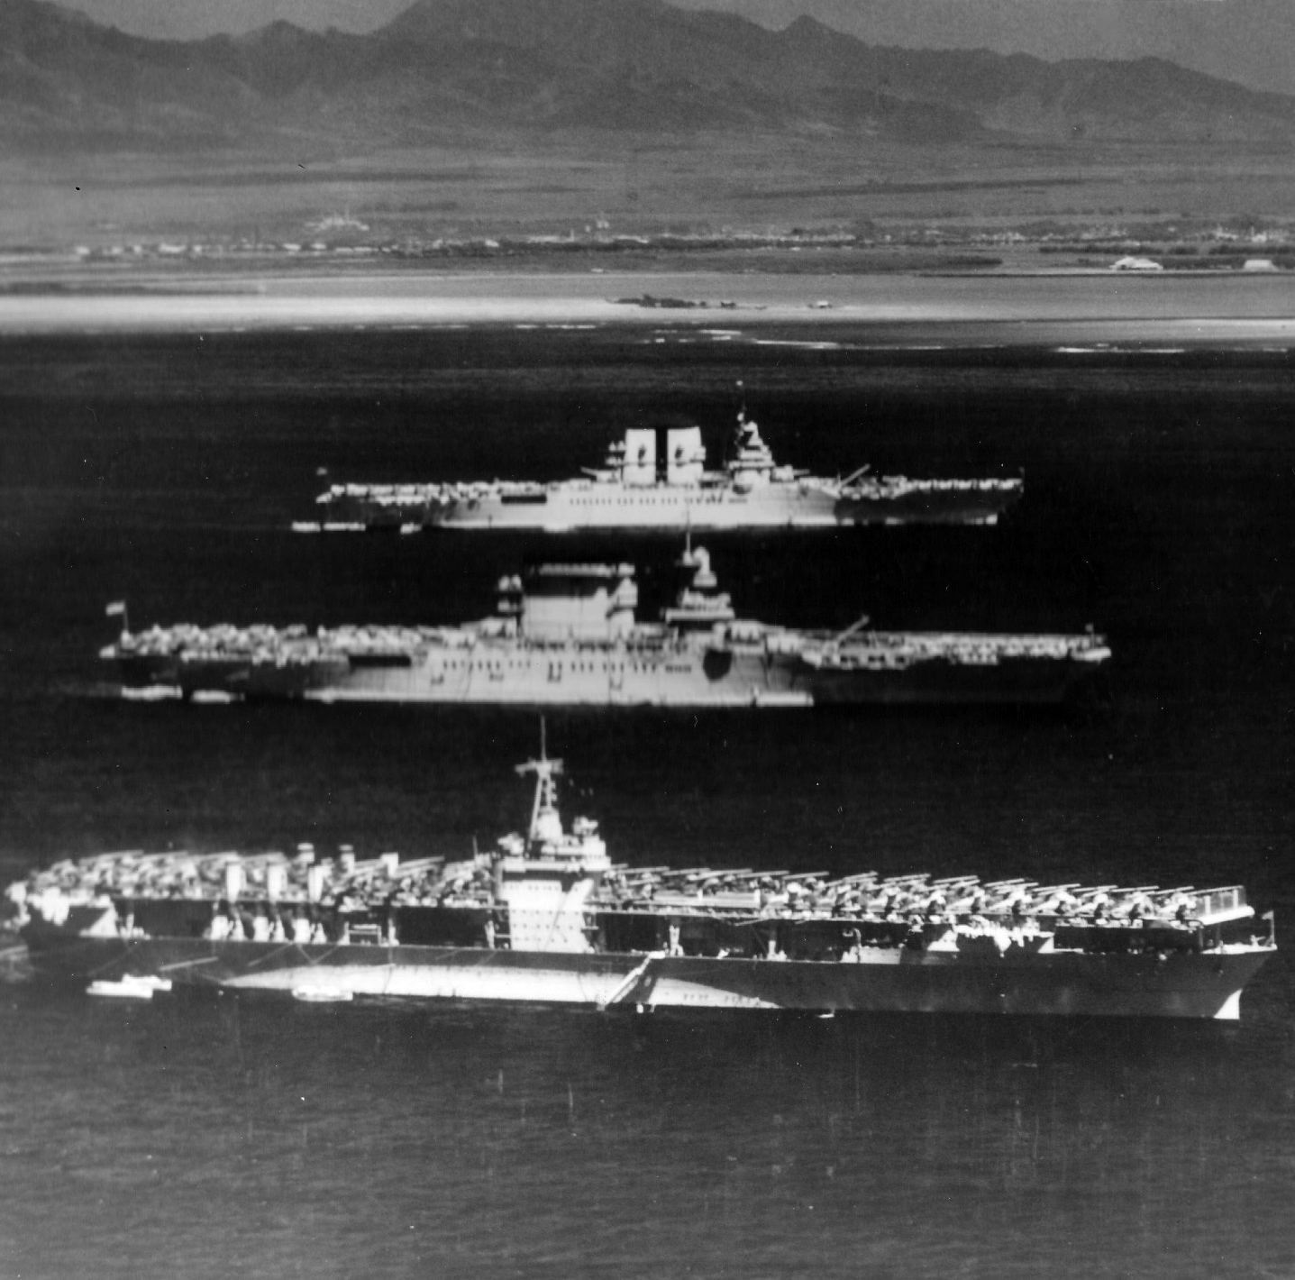

Slide 9
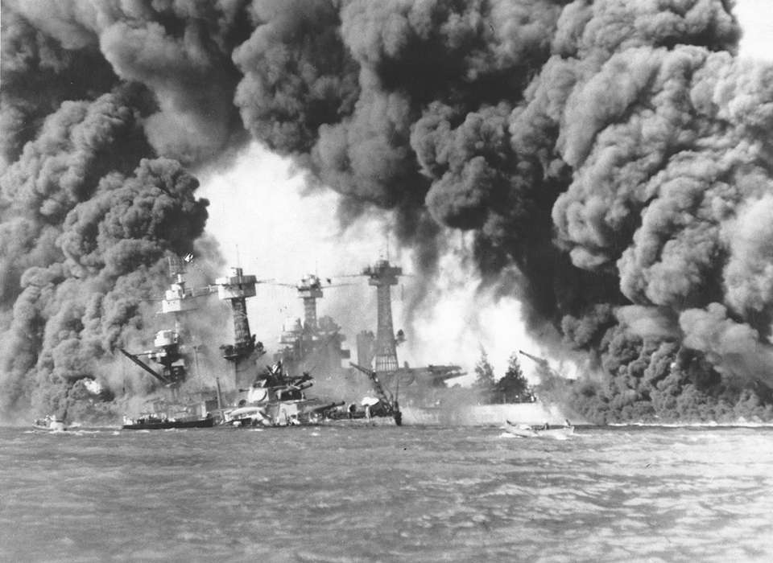

Slide 11
There is nothing permanent except change.
- Heraclitus

Slide 12
Driving Change Successfully
Understanding the environment
Customers, competitors, vendors, obstacles
Understanding your organization
People, processes, locations, communication
Understanding yourself
Same for your people
Strategic, Operational, Tactical

Slide 13
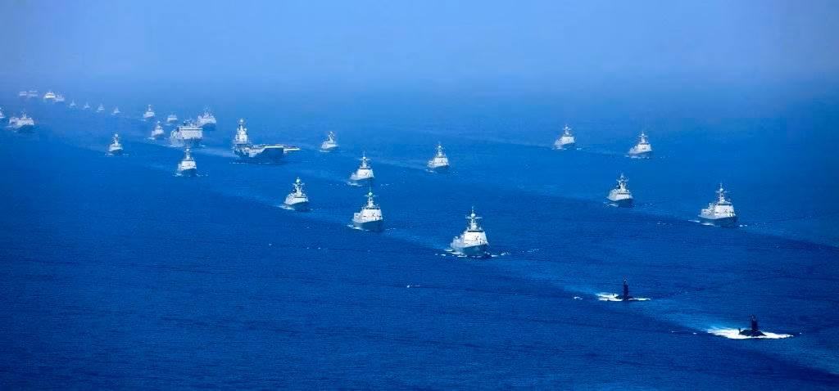
Understanding the Environment
VUCA
Volatile
Uncertain
Complex
Ambiguous
Margin for error is small, and the competition is always changing
We want to set the pace

Slide 15
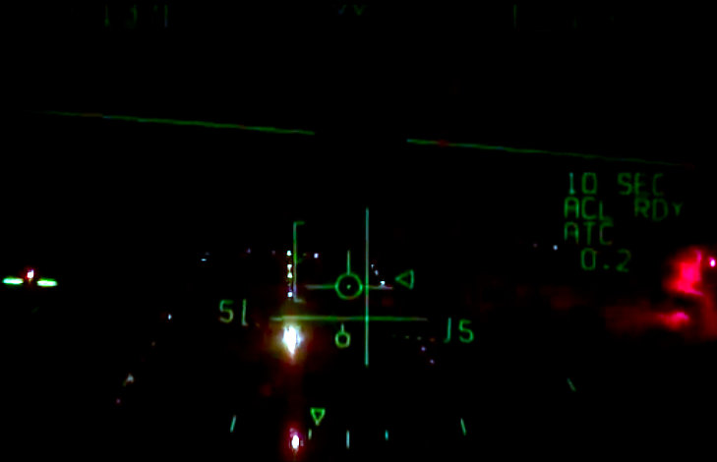

Slide 16
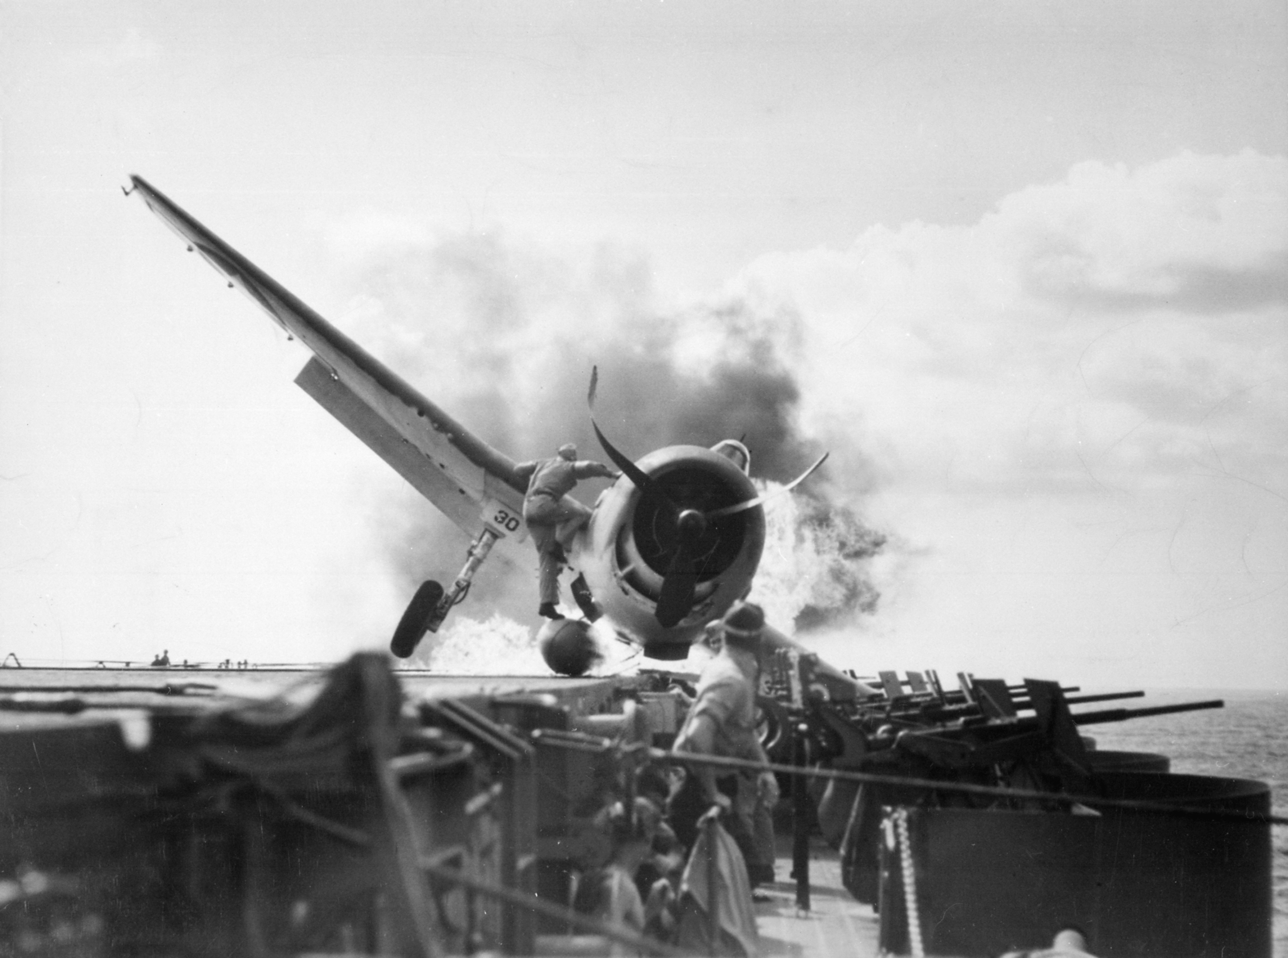
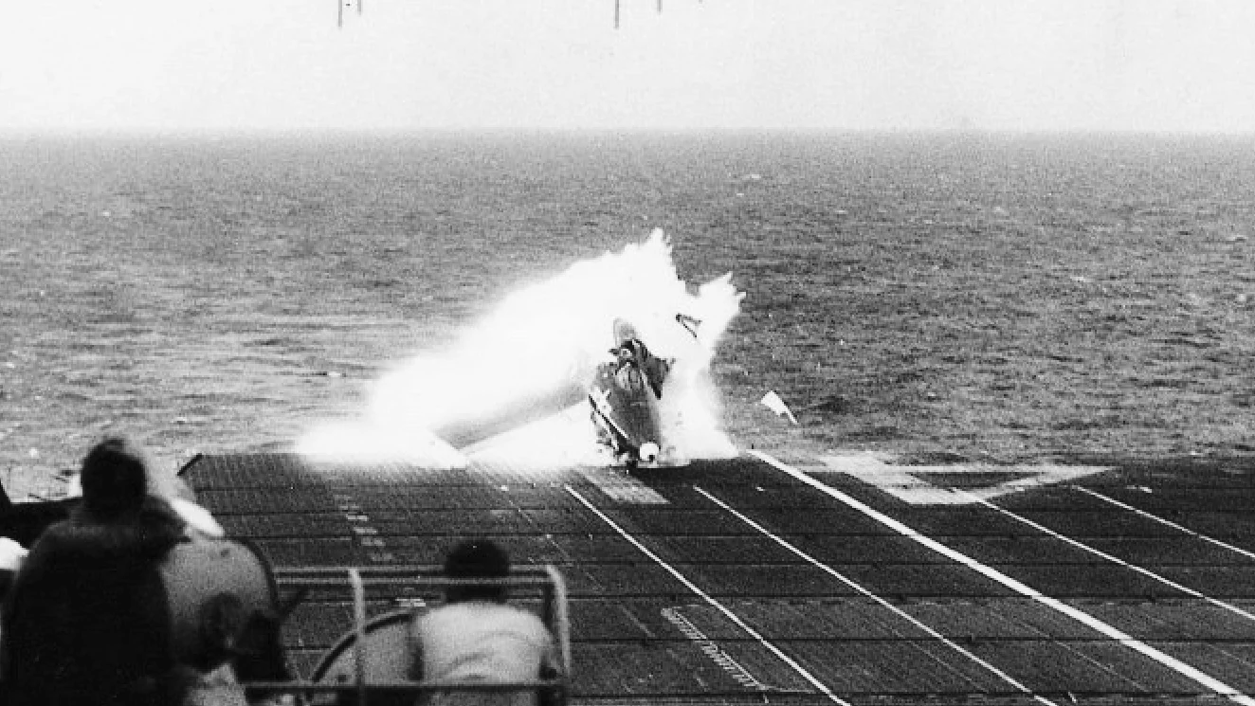
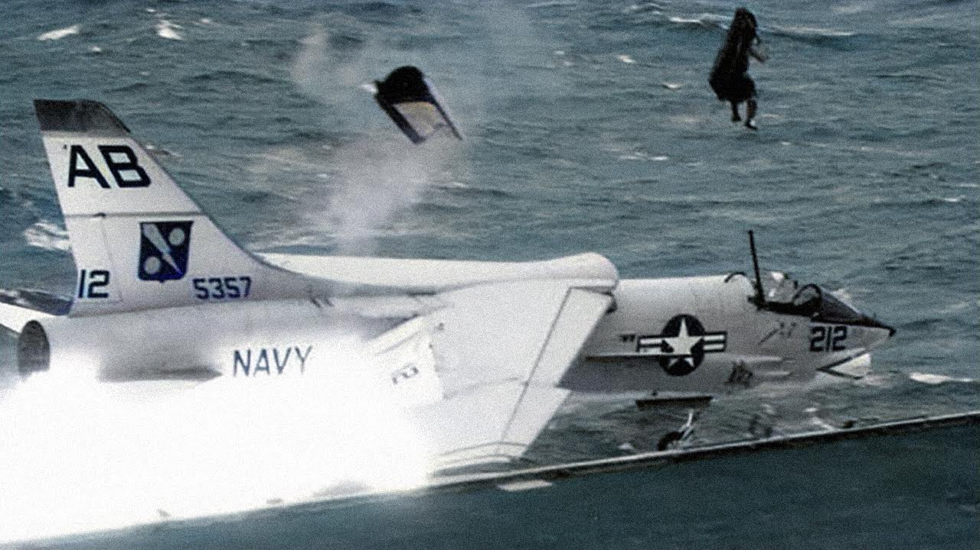
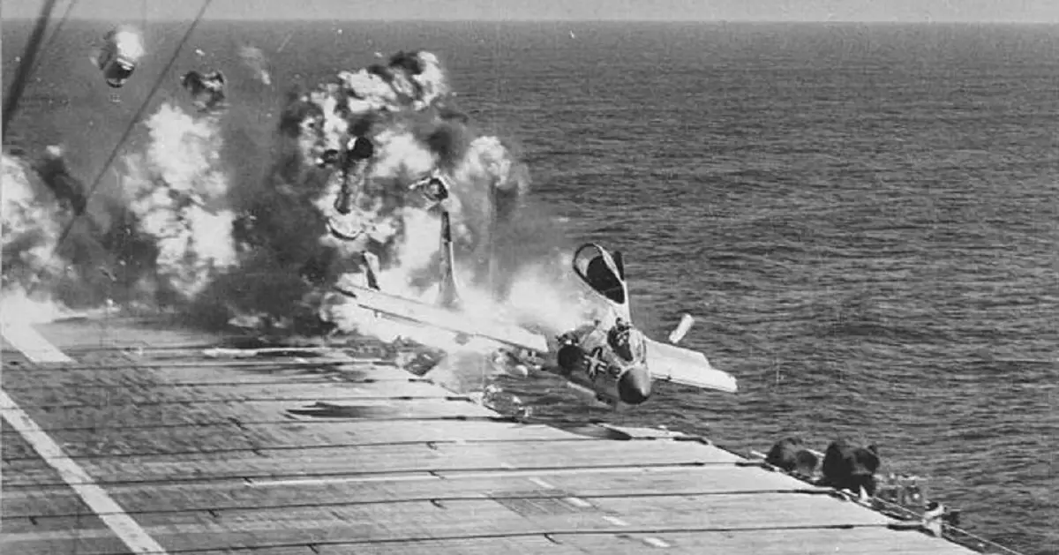

Slide 17
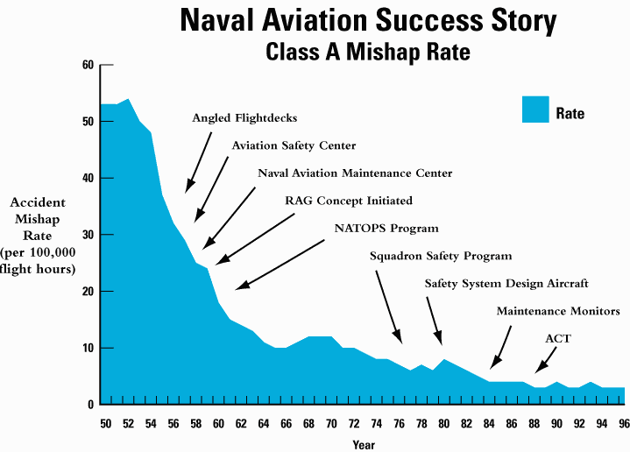

Slide 18
Change before you have to.
- Jack Welch

Slide 19
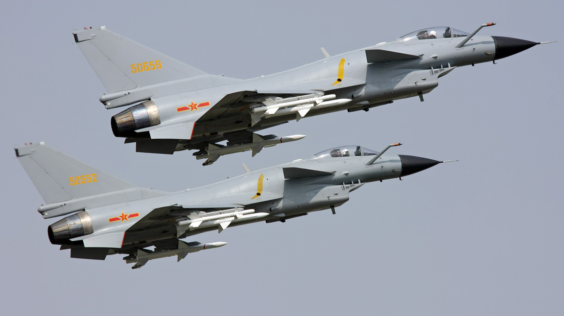

Slide 20
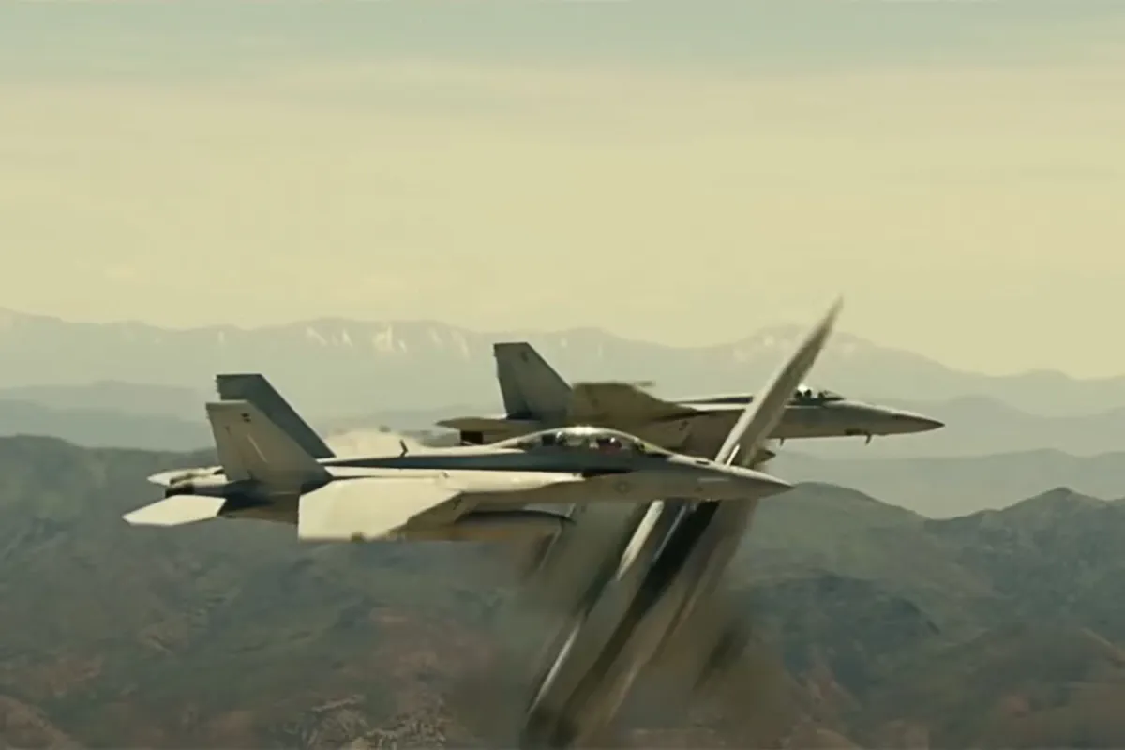

Slide 21
Train Like You Fight, Fight Like You Train
PBED process (plan, brief, execute, debrief) - every day, every mission, everyone
Plan
Mission Planning
Delegation
Brief
Standardized briefing format
Execute
Debrief
Everyone’s performance is scrutinized

Slide 22
Crew Resource Management
MCSALAD
Mission Analysis
Communication
Situational Awareness
Assertiveness
Leadership
Adaptability & Flexiblity
Decision Making

Slide 23
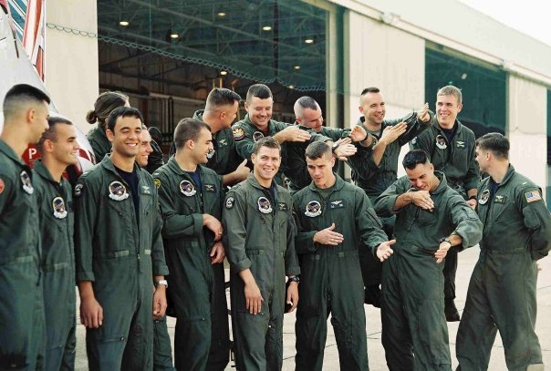
Culture vs. Climate
Culture
Shared beliefs, values, norms, routines, traditions, perspectives
Slow to change
Tailhook ‘91
Climate
Sense, feeling, or atmosphere people get in the organization on a day-to-day basis
Can change quickly
CloudFlare
Connected and feed off each other

Slide 24
Change begins at the end of your comfort zone.
- Roy T. Bennett

Slide 27
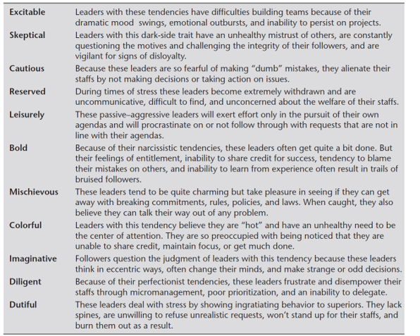
Table15.3: Dark-Side Personality Traits Source: Hogan Assessment Systems, The Hogan Development Survey (Tulsa, OK: 2002).

Slide 28
Driving Change - Kotter

Slide 29
Understanding the Environment
VUCA
Volatile
Uncertain
Complex
Ambiguous
Vision
Understanding
Clarity
Agility

Slide 30
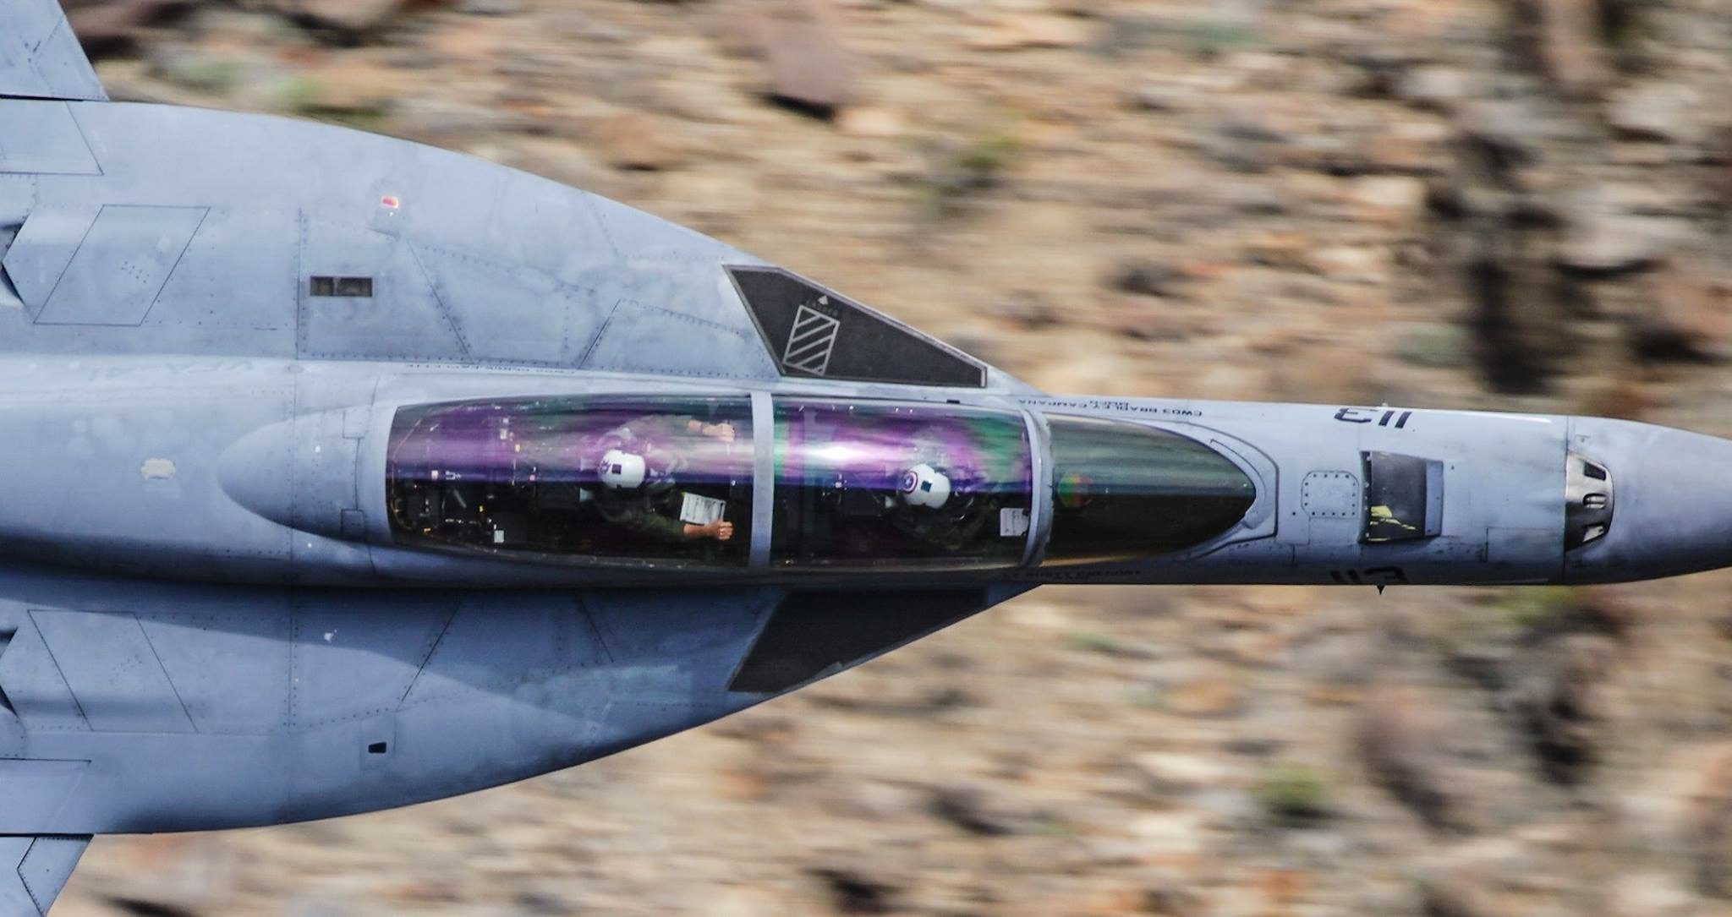
QUESTIONS?

