Slide 1
Michigan Aggregates Association 2024 Annual Conference
National Pollutant Discharge Elimination System (NPDES) and Groundwater (GW) Permits

Slide 2
Do You Need A Wastewater Discharge Permit?
Do you use water to wash/sort aggregate? If yes, then where does the wash/sort water discharge to?
Two Permit Categories for Wastewater Discharge: Groundwater or National Pollutant Discharge Elimination System (NPDES)
Does the water discharge to a surface water as defined by EGLE? - The site requires a NPDES Discharge Permit
Does the water discharge to groundwater through settling ponds or infiltration basin? - The site requires a Groundwater Discharge Permit

Slide 3
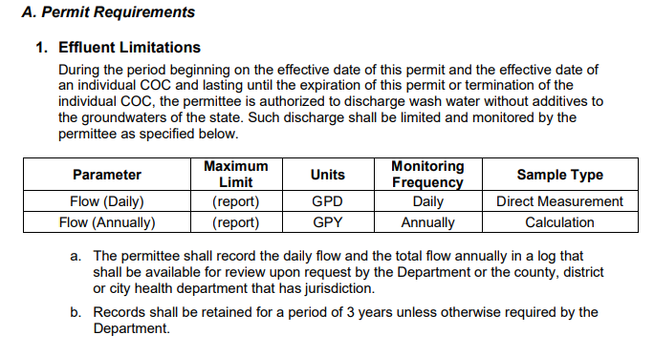
Groundwater Permit
Part 22 Groundwater Rules under Part 31
Unless on-site pond is lined there would be discharge to groundwaters of the state.
General Permit GW1540000
Effluent Limits

Slide 4
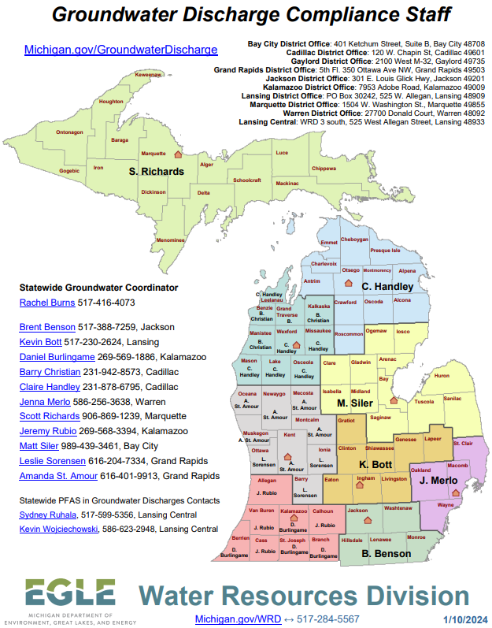

Slide 5
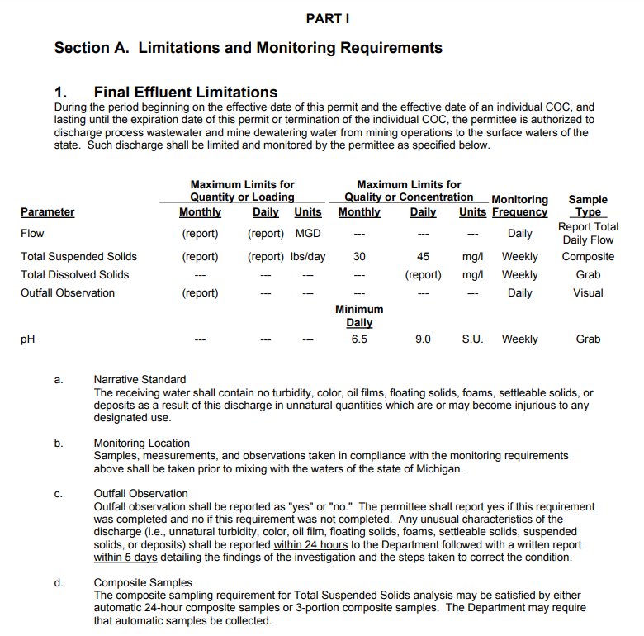
NPDES Permit
Part 31 of National Resource Environmental Protection Act (NREPA)
General Permit MIG490000
Water Quality Limits

Slide 6
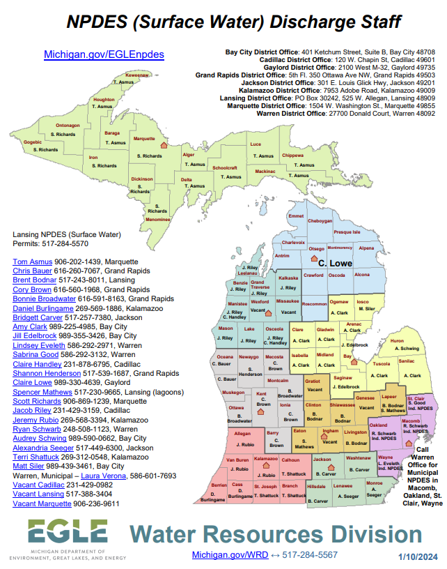

Slide 7
Permit Compliance
Maintain Site Records For 3 Years
If required, submit Discharge Monitoring Reports (DMRs)
Re-apply for Permit reissuance according to Permit instructions
If required, retain a certified operator.
Most only require A-1a (Special Classification)
Some require A-1b, A-1d, or others (Plain Clarification, Impoundment, etc.)

