Slide 1


Slide 2
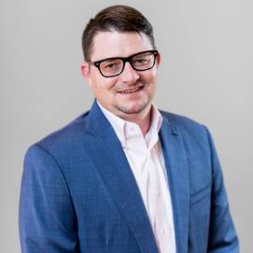

Presenters
Tim Lazich
Kyle Wilson
Business Development Director
Area Manager

Slide 3




Key Industry Trends
Aging Workforce
Turnover
Absenteeism
Bandwidth
Notes:
Key trends
Aging Workforce
Turnover
Absenteeism
Bandwidth
Access to Healthcare

Slide 4

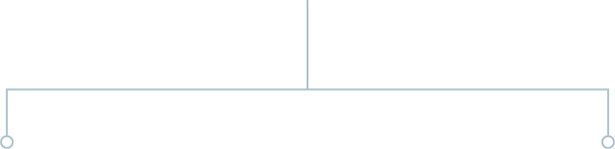




+
Over 30,000 Clients & 2,000+ Employees, Team Members & Experts

Slide 5
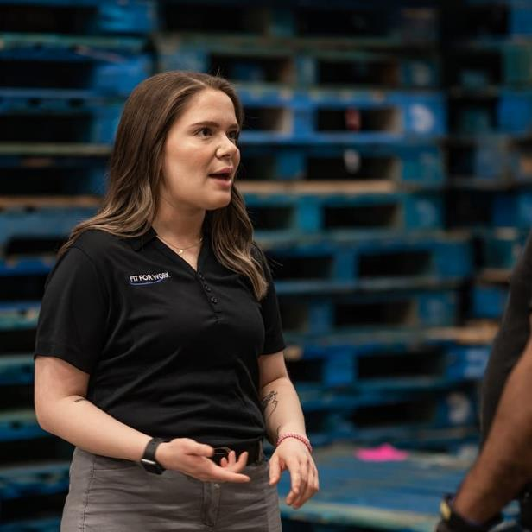
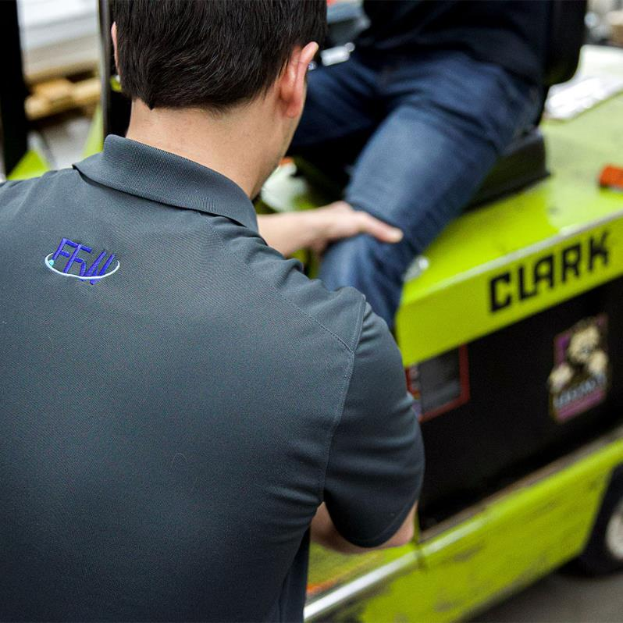
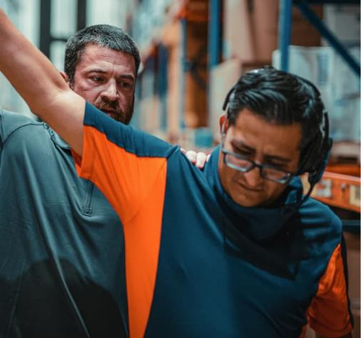
Who We Are
Our highly trained professionals are uniquely focused on injury prevention
Certified Professional Ergonomists
Certified Safety Professionals
Athletic Trainers, Physical Therapists and Occupational Therapists
All our professionals are Fit For Work employees

Slide 6
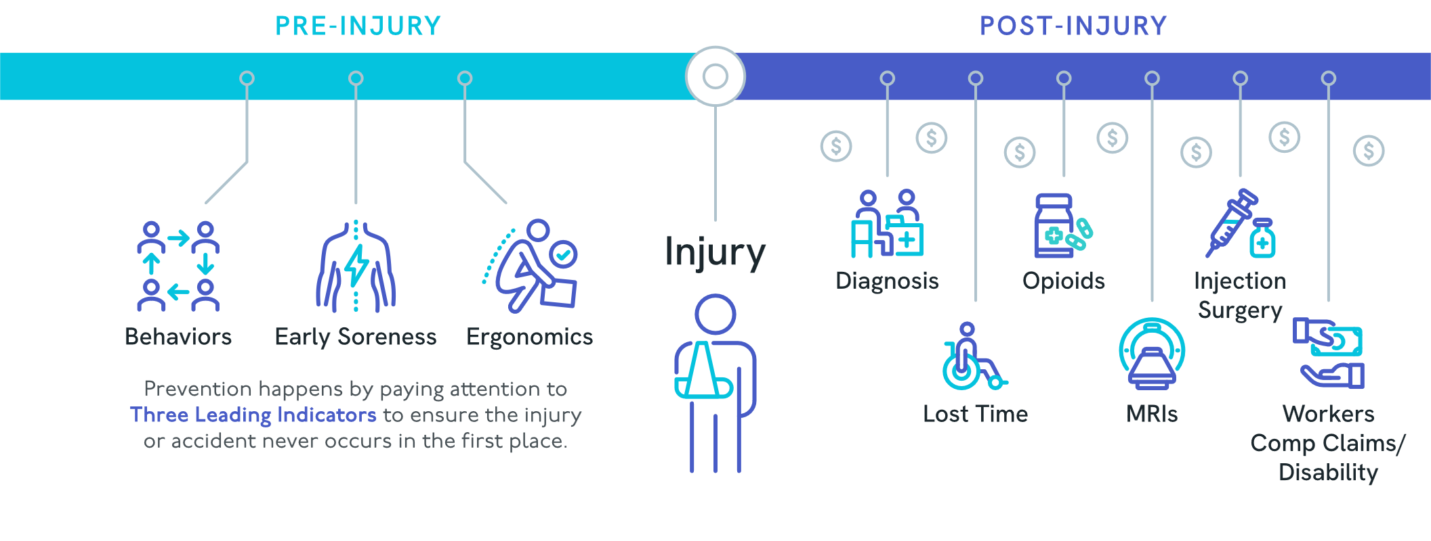
Our Philosophy

Slide 7
Prevent Your Employees from Becoming Patients.
OUR #1 GOAL

Slide 8
Our Clients:

Slide 9
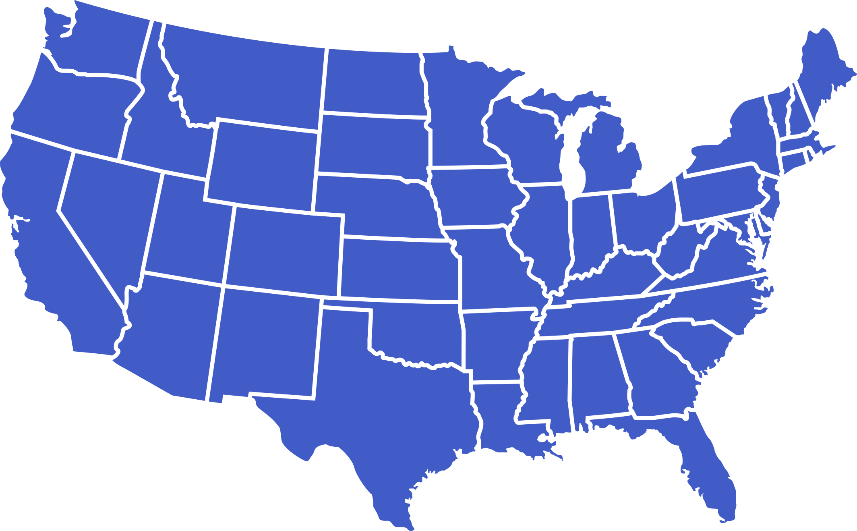

Where We Serve
Nationwide coverage across the lower 48

Slide 10




Early Intervention
Results Across Our Customers Through Proactive Injury Prevention
50%
Reduction in Injuries
Focus on Three Leading Indicators:
50%
Average cost savings
Early Soreness
Ergonomics
Behaviors
30%
Reduction in non-work-related sprain strain costs
Thousands of one-on-one preventative interactions per year – ONSITE

Slide 11


Early Intervention
70% Proactive Care, 30% Reactive Care
Proactive Care
On-floor Ergonomic Observations and Interactions
Pre-shift Warm-ups
Lifting Labs
New-hire Orientation
Reactive Care
1-on-1 OSHA First Aid
Massage/Trigger Release
Hot/Cold Compress
Biofreeze
Kinesiology Tape
Ensuring Your Success
Providing On-Site Proactive Injury Prevention
Delivering Unmatched Expertise
Offering Complete Scalability
Infusing Latest Pain Science Research
Providing Dedicated Customer Experience Contact
Documenting Interactions in HIPAA-Compliant Portal
Sharing Weekly Symptom Reports/Quarterly ROI Reports

Slide 12
Early Intervention: Proven Results
84%
Reduction

Slide 13


Ergonomics
Choose the Right Service for Your Needs
Ensuring Your Success
Industrial Ergonomics
Ergonomic Risk Assessment
Physical Demands Analysis (PDA)
Functional Job Descriptions & Job-Specific Testing
Job Rotation Recommendations
Better Together with
Physical Demands Analysis (PDA)
Return to Work
Industrial Ergonomics
Project-based services are billed per project and ideal for:
Focused projects or needs
Time-sensitive issues
Swift deliverables
Subscription-based services are billed monthly and ideal for:
Various service requirements
Ongoing need for deliverables
On-demand access to an ergonomist
Consistent quarterly deliverables

Slide 14

Employee Testing
1,000+
Testing locations across the United States
Ensuring Your Success
Post-Offer Comprehensive Test
Physical Agility Test (Post-Offer)
Fit For Duty Testing (Post-Employment)
Unmatched Legal Compliance
PAVE™ Validation
40-50%
Reduction in musculoskeletal injuries in the first year following implementation
0
Successful EEOC or ADA challenges in nearly 40 years with millions of completed tests

Slide 15
Calculating Costs / Risk of MSDs

Slide 16
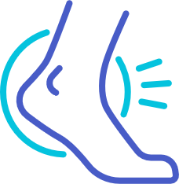

Calculating Cost/Risk of MSDs
Most common causes of workplace injuries
Most common body parts injured
29%
Overexertion
38%
Strains and sprains
12%
Shoulder(s)
13%
Lower back
23%
Slips, trips and falls
13%
Fractures
10%
Knee(s)
13%
Struck by an object
8%
Contusions

Slide 17
Calculating Cost/Risk of MSDs
Total cost of top 10 most disabling workplace injuries in 2023:
$48.15B
Total cost of workplace injuries in 2023:
$58.61B
Source: Liberty Mutual 2023 Workplace Safety Index, Risk Control Services Annual Report

Slide 18
Calculating Cost/Risk of MSDs
Most common causes of injuries by industry
Most common injuries by industry
Estimated Costs of Occupational Injuries
Based on the OSHA $afety Pays Program Cost Calculator
Carpal Tunnel Syndrome:
$30,930
Hernia:
$20,940
Sprains:
$30,487
Strains:
$32,023
Estimated Costs of Occupational Injuries/Illnesses
Based on the OSHA $afety Pays Program Cost Calculator

Slide 19
Industry Case Study

Slide 20
Industry Case Study

Slide 21
Industry Case Study

Slide 22


Adding Value to Business Operations
Assumptions:
Research shows that the indirect benefits of ergonomics on quality, productivity, absenteeism, and turnover are, at a minimum:
Quality
2x that of MSD cost reduction
Absenteeism
0.4x
Productivity
0.7x
Turnover
0.4x

Slide 23
Thank you.
Tim Lazich
Director of Business Development
812-305-0268
tlazich@wellworkforce.com
Any questions? We’re here to help.
Notes:
Fill-in contact info here – add linkedin profile url to “in” icon

