Slide 1
Michigan Aggregates Winter Workshop
Efficiency in Wire Cloth

Slide 2

About Matt
33 years with Hoyt
Covered most of the country
Lived in 3 states
Certified Aggregate Technician
BA – Bowling Green State University
Sales Manager for 12 years
Matt Hurd
Director of Sales

Slide 3




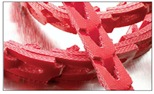
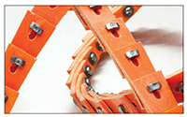
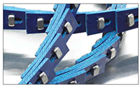
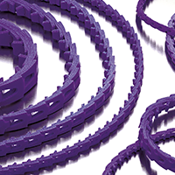
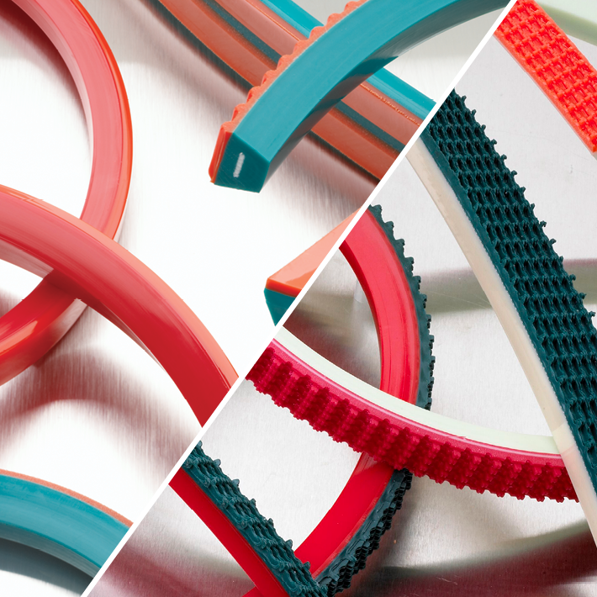

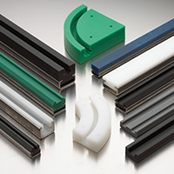
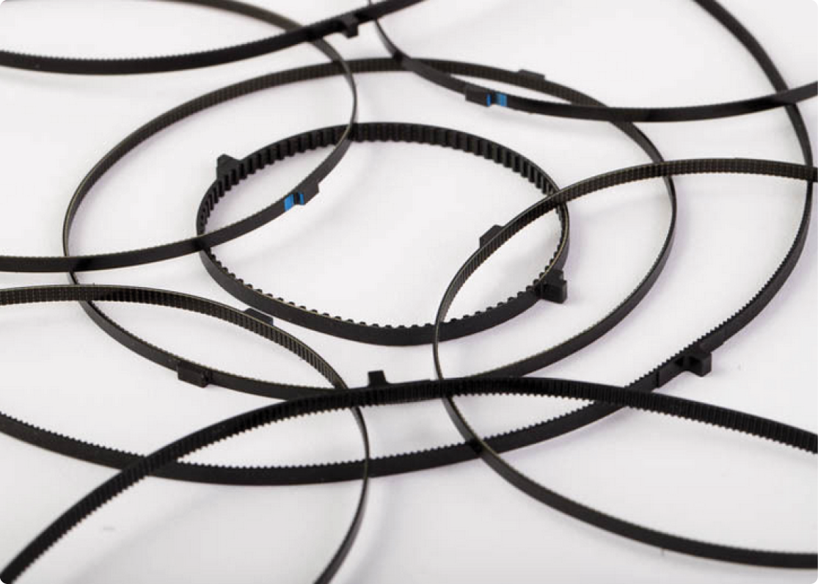
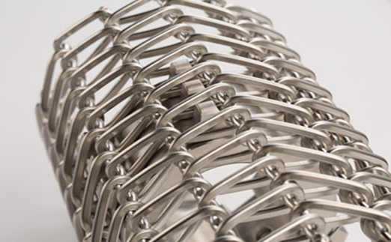
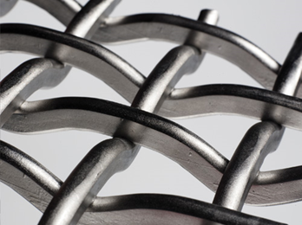
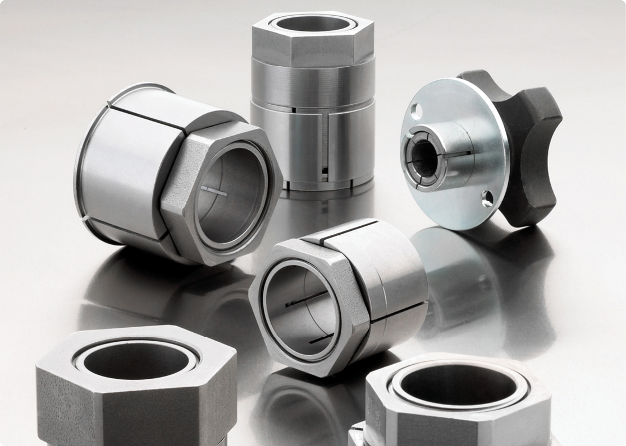


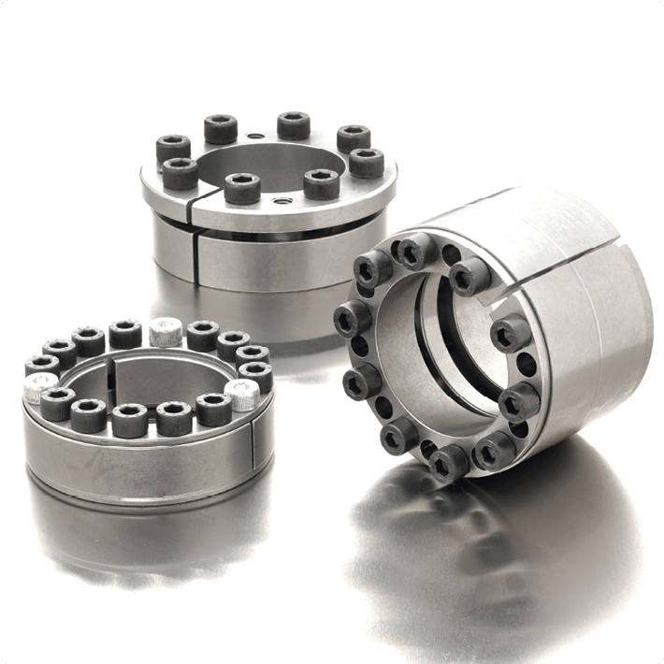
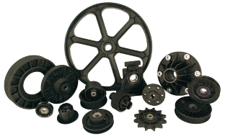
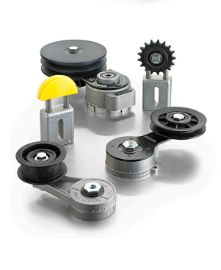
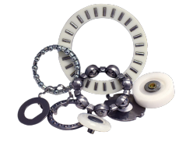
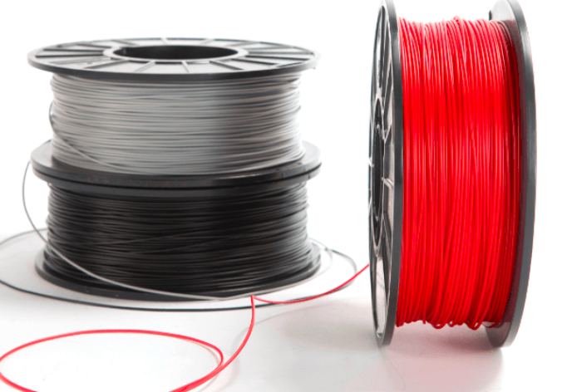
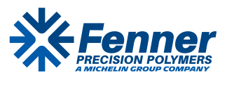
Product Categories
Notes:
I don’t have national bearings, power max, or t max… Should these be included

Slide 4
Efficiency Defined
Percentage of Open Area: This metric represents the ratio of the total area of all openings to the total surface area of the screen panel, typically expressed as a percentage.
Purpose: It determines the material throughput and screening capacity of a deck. A higher percentage of open area allows more material to pass through, increasing production efficiency.
Usable vs. Theoretical Open Area: In practical operations, the "usable" open area is often lower than the manufacturer's specification because parts of the screen are blocked by support structures like bucker bars, crown rubber, or side clamp rails.

Slide 5
Relative Open Area (Theoretical)
1. Relative open area is the geometric percentage of the screen panel that is open, as provided by the manufacturer's technical specifications.
Calculation: It is based strictly on the ratio of the total area of the apertures to the total surface area of a single panel.
Use Case: This value is used to compare different types of media (e.g., woven wire vs. polyurethane) in a controlled environment.
Limitation: It does not account for the installation environment or the machinery it is mounted on.

Slide 6
Effective Open Area (Actual)
Obstructions: It subtracts the surface area covered by structural components such as:
Bucker bars and support frames.
Side clamp rails and center hold-downs.
Dead zones where material does not travel or where the screen is blinded/pegged.
Angle of Incline: A significant factor in 2026 screening efficiency is the deck's angle. As the incline increases, the "effective" opening seen by a falling particle becomes smaller (an ellipse rather than a circle or square), further reducing the effective open area compared to a horizontal deck.

Slide 7
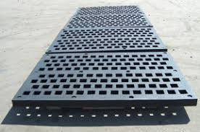
Rubber Panels
Rubber screen panels are durable screening media primarily used in mining and aggregate processing for heavy, abrasive materials. Their open area percentages generally range from approximately 10% to 57.6%, significantly lower than wire mesh due to the thicker material needed for wear life.
Notes:
Protects the frame of the shaker.

Slide 8
Why Use Rubber?
⭐ Key Advantages of Rubber Panels
🔧 Performance Benefits
Wear Life: 6–15× longer in abrasive conditions
Impact Resistance: Absorbs and dissipates heavy impact energy
Blinding/Pegging: Flexible material reduces clogging and near‑size particle retention
🌿 Environmental & Safety Advantages
Noise Reduction: Up to 50% quieter due to natural damping
Corrosion Resistance: Highly resistant to water, rust, and common processing chemicals
Safety & Handling: Lightweight and easier to install, reducing maintenance risks

Slide 9
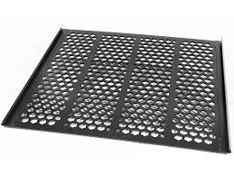
Perforated Plate
⭐ Advantages of Perforated Plate vs. Other Screen Media
🛠️ 1. Extreme Durability & Wear Life
• Made from thick steel plate, often AR steel or stainless.
• Handles very high impact from large, sharp, or heavy feed.
• Ideal for scalping, primary screening, and high‑abrasion environments where wire cloth or synthetic media would fail quickly.
🔧 2. Dimensional Stability
• Holes do not stretch or deform under load.
• Maintains consistent aperture size over time.
• Reduces risk of oversize material slipping through due to media flexing.
🔩 3. High Structural Strength
• Can support heavy bed depths and aggressive feed.
• Performs well in high‑vibration or high‑load applications.
• Less prone to tearing compared to wire cloth.

Slide 10
Perforated Plate
🔥 4. Heat & Chemical Resistance
• Steel plate tolerates high temperatures and harsh environments.
• Useful in applications where rubber or polyurethane would degrade.
🧹 5. Easier to Clean (Depending on Hole Style)
• Smooth steel surfaces shed material better than some synthetic media.
• Certain hole patterns reduce pegging compared to square wire cloth.

Slide 11
🎯 Does Hole Design Affect Open Area?
📌 Key Insight
Hole geometry directly affects open area, which determines:
• Screening efficiency
• Throughput
• Durability
• Pegging resistance
Hole Shape | Typical Open Area | Notes
Round | Low–Moderate | Strongest design; best for impact; lowest open area
Square | Moderate | Higher open area than round; boosts throughput
Slotted (Longitudinal) | High | Ideal for elongated material; reduces pegging
Slotted (Transverse) | Moderate | Balances strength and throughput
Hexagonal / Specialty | High | Maximizes open area while maintaining strength

Slide 12
Wire Cloth
Traditionaly has the most open area of synthetics and plate.
Plate can often have the same as wire cloth if the margins are the same. i.e. 1” x .250 wire cloth or 1” plate with .250 margins should have the same open area.

Slide 13
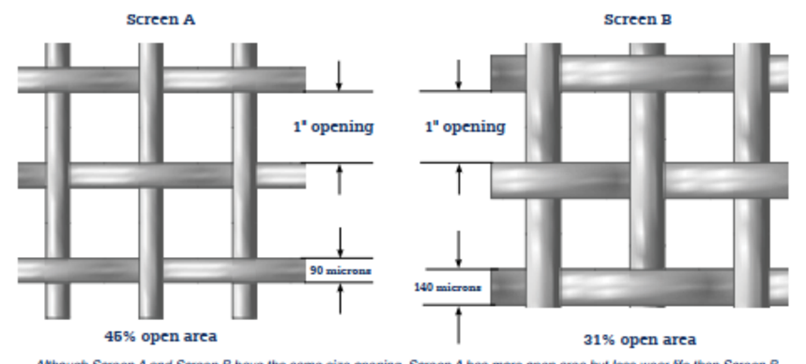
Open Area or Wear Life??
Notes:
Customers try to find a balance for their specific production needs.
As with all of our screens, we can “fine tune” throughput (efficiency) with a change in wire diameter

Slide 14
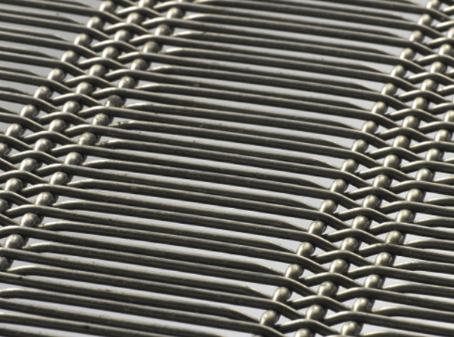
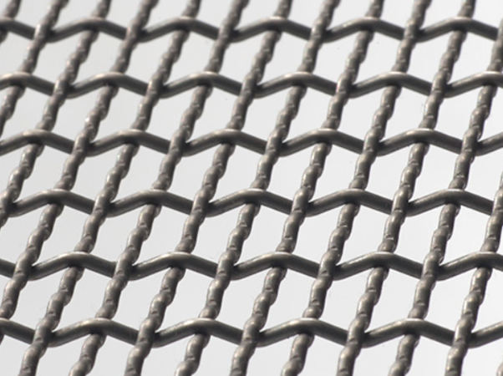
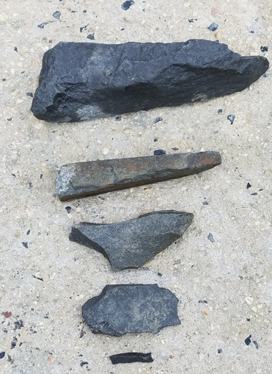
Styles of Screens – Oblong/Longslot Opening
Oblong/Longslot openings were the “first” style of screens to help alleviate plugging and blinding and are still used in a variety of applications today
The rectangular opening helps particles pass more easily through the aperture due to rectangular shape
The rectangular shape can also help “flat, elongated and angular” material that would typically get stuck in a square opening, pass through the screen
Utilizing a rectangular shape, end users can gain open area due to a wider/longer opening
Notes:
Slots and oblongs offer the best open area percentages, need to typically have a waste through product or cubicle and round stone.

Slide 15
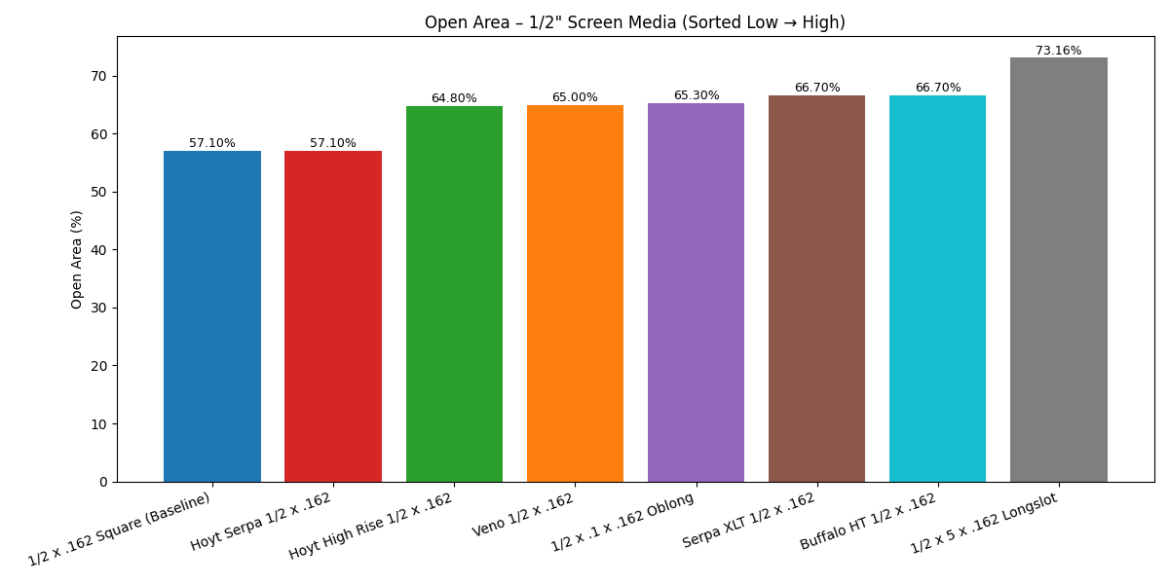

Open area of different products

Slide 16
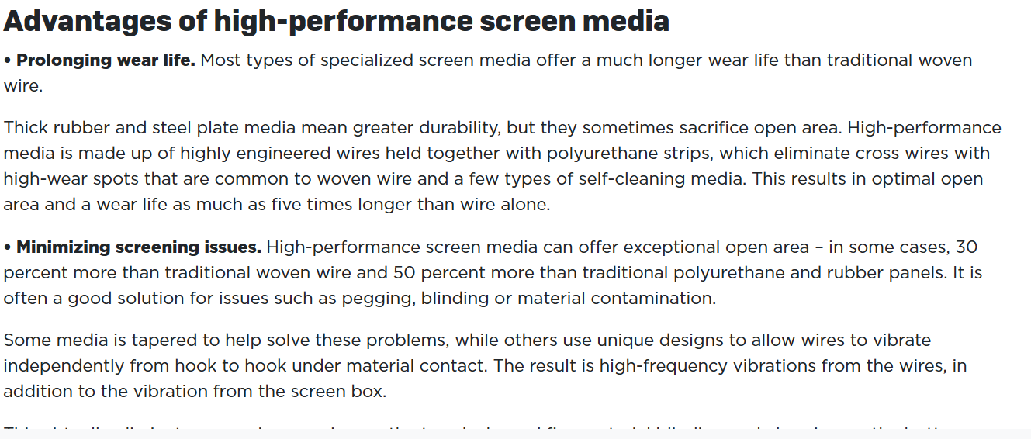
Article from Pit and Quarry on Media

Slide 17
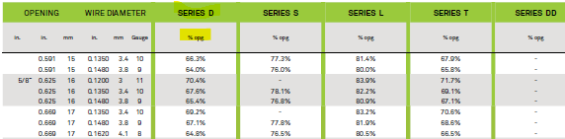
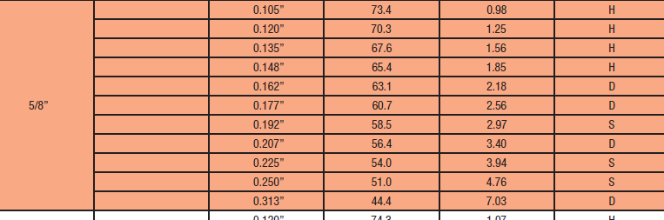

Be Careful When open area is overestimated.

Slide 18
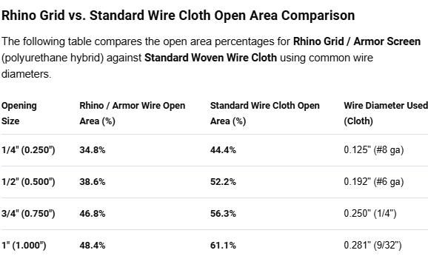
Higher open area polyurethane
Tandem Started this with the Rhino Wire.
It’s wire cloth with urethane poured over it.

Slide 19
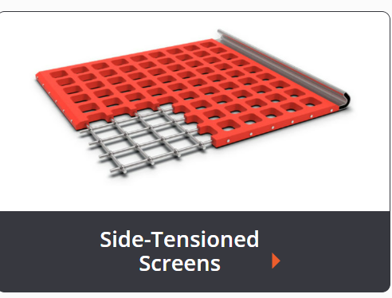
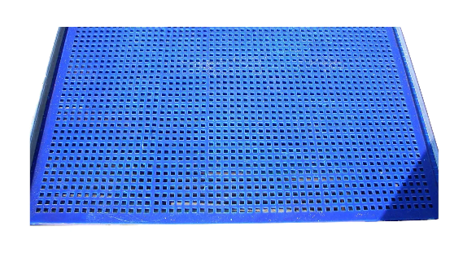
Other Manufactures
Miller Wire uses Urewire and Ureflex.
Unified Superflow
Durex Armor Wire
Tyler Tywire

Slide 20
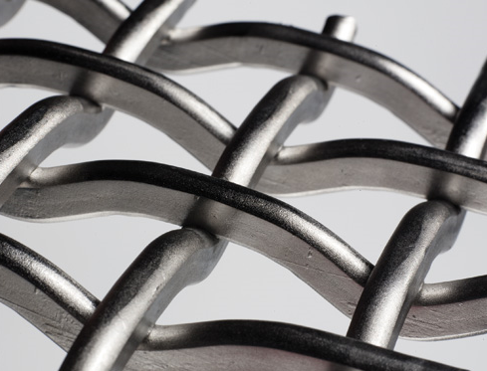
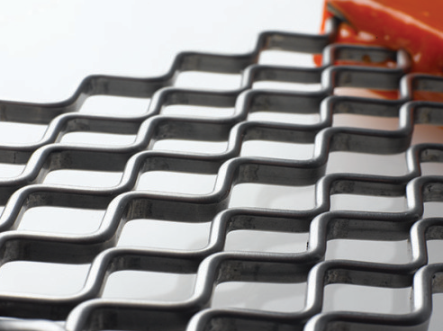
Maximizing Efficiency is KEY!
Hoyt Wire has a Line of Screens
Made of Shaped Wire Instead of Round Wire
HiRise®
Serpa XLT

Slide 21
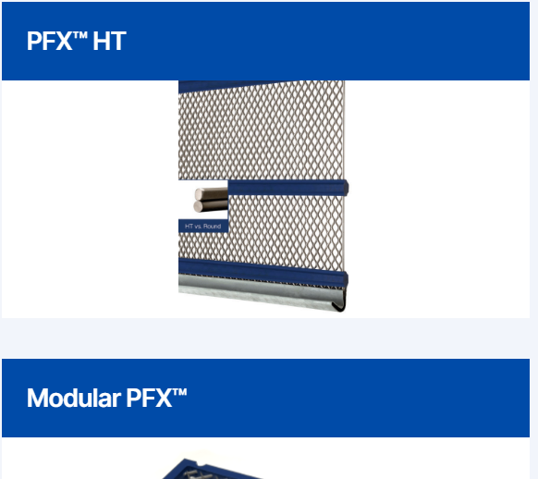
Shaped Wire Has more open area
Buffalo PFX HT

Slide 22
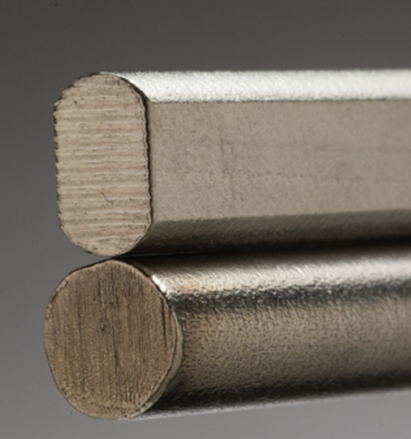
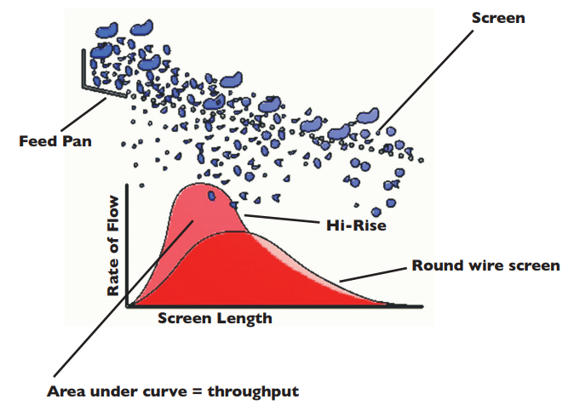
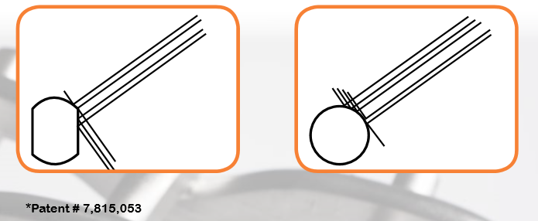
HI-RISE®
Notes:
Patented product – unique screen to increase production by flattening out wire

Slide 23
Advantages of Shaped Wire
INCREASED OPEN AREA – Shaped wire offers an average of 15% open area, increasing production.
EXTENDED WEAR-LIFE – Shaped wire offers greater height and thus presents more wearing surface to the material, resulting in a screen panel that lasts longer.
INCREASED LOAD CAPACITY – The unique shape of our wire provides up to 55% greater strength and load carrying capacity.
LONG-DURATION SIZING ACCURACY – The flat sides of our shaped wire wear more slowly. The result is a screen panel that holds accurate sizing longer.
WHAT MAKES THE DIFFERENCE?
Shaped Wire™ With shaped wire more particles deflect down and through the screen. Fewer particles deflect up and over. Just what you want and Production Increases!
Competitor’s Round Wire Particles are able to deflect up and over more easily causing less production. Material hitting wire at this angle bounces back at the same angle. What a waste..
*Patent # 7,815,053

Slide 24
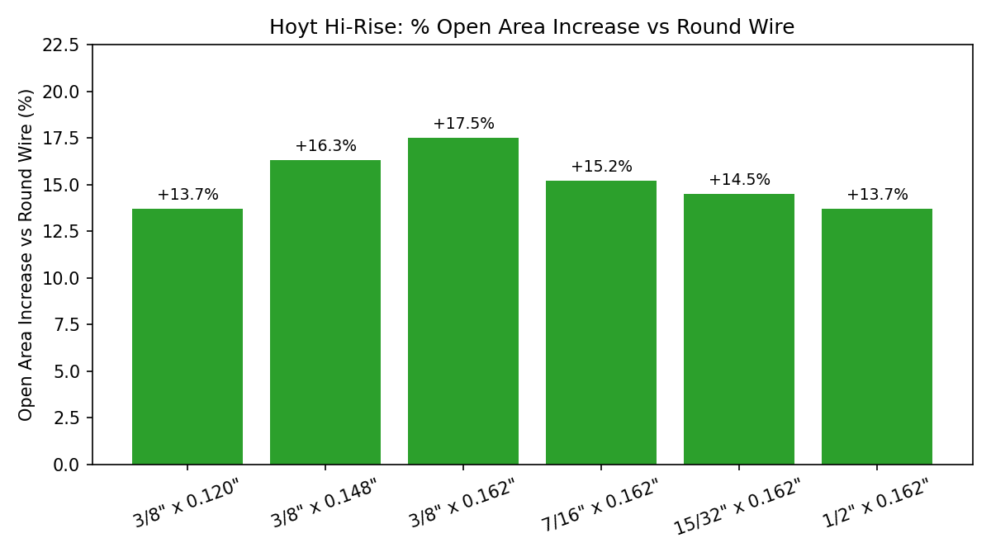
Shaped Wire Vs. Serpa, PFX & Flexmat open area

Slide 25
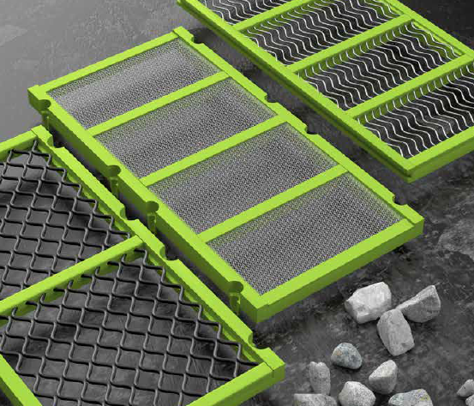
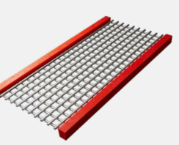
Modular Urethane with wire cloth in it
Polydeck and Major are big in the Market
Durex, Miller, Hoyt and Buffalo also manufacture modular with Wire Cloth.

Slide 26
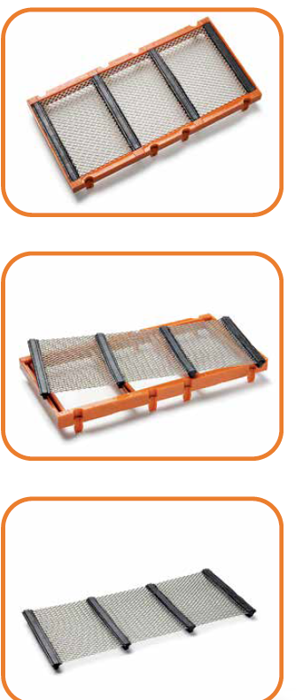
Hoyt’s Version is different

Slide 27
Questions

