Slide 1
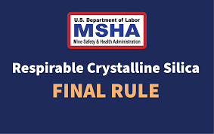
MSHA’s final Rule - Lowering Miners’ Exposure to Respirable Crystalline Silica and Improving Respiratory Protection
A Review of 30 CFR PART 60

Slide 2
Acknowledgement and Disclaimer
UNITED STATES DEPARTMENT OF LABOR Mine Safety and Health Administration (MSHA) Brookwood - Sago Training Grant
24R60BS000013-01-01
This material was produced under an MSHA Brookwood - Sago Mine Safety Grant. It does not necessarily reflect the views or policies of the sponsor; nor does it mention of any trade names, commercial products, or organizations, or imply any endorsement by the U.S. Government. The contents of this presentation is for information and awareness purposes only, and do not replace or substitute for the original MSHA RESPIRABLE CRYSTALLINE SILICA STANDARD (30 CFR part 60)
Notes:
This material was produced under an MSHA Brookwood - Sago Training Grant (24R60BS000013-01-01). It does not necessarily reflect the views or policies of the U.S. Department of Labor; nor does it mention of any trade names, commercial products, or organizations implying endorsement by the U.S. Government. The contents presented is for information and awareness purposes only, and do not replace or substitute for the original MSHA RESPIRABLE CRYSTALLINE SILICA STANDARD (30 CFR part 60). (https://www.ecfr.gov/current/title-30/chapter-I/subchapter-M/part-60)

Slide 3
Background Information on Silica
What is Respirable Crystalline Silica?
Silica exposures and hazards in mining industry
Silica-associated health effects (risks)
Notes:
This presentation is in two segments: The first segment covers background and general information about silica and its health effects and provides a concise overview of MSHA’s new Final Rule (30 CFR Part 60). The second segment gets into details of the individual sections of the standard.

Slide 4
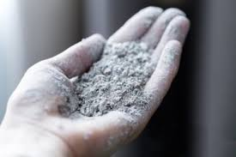
Contents of the Standard
Scope; Compliance Dates – Section 60.1
Definitions -- Section 60.2
Permissible Exposure Limit -- Section 60.10
Methods of Compliance -- Section 60.11
Exposure Monitoring --Section 60.12
Corrective Actions -- Section 60.13
Respiratory Protection -- Section 60.14
Medical Surveillance -- Section 60.15
Recordkeeping -- Section 60.16
Notes:
Please refer to the instructor notes of the previous slide.

Slide 5
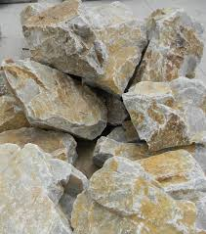
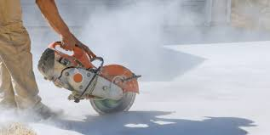
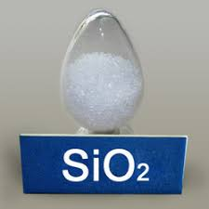
What is Silica?
Silicon Dioxide (SiO₂), also known as Silica, is a mineral commonly found in many naturally occurring and man-made materials used at various work sites –
Examples
Stone / Rock
Sand / Gravel
Soil/Clay
Concrete /Mortar
Notes:
Silica is a mineral and a naturally occurring solid compound with a specific chemical composition, i.e. , silicon dioxide (SiO₂), Mining applications where silica is encountered include stone and rock (solid or fractured), and natural and manufactured aggregates - sand and gravel. Soil composed of silt and clay may also have large silica percentages. Finally, Portland cement concrete, asphalt concrete (incorporating large volumes of aggregates), as well as brick and block, are construction materials that usually contain silica.

Slide 6
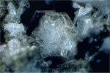
Types of Crystalline Silica
There are three forms of crystalline silica minerals covered by the standard
Quartz - the most common form of silica found in mining sites (various rocks)
Cristobalite - a polymorph of silica; it has the same chemical formula but a different crystal structure (less common)
Tridymite – a different polymorph (less common)
Notes:
There are three forms of crystalline silica minerals covered by the standard
Quartz - the most common form of silica found in mining sites (various rocks)
Cristobalite - a polymorph of silica; it has the same chemical formula but a different crystal structure (less common)
Trydimite – a different polymorph (less common)

Slide 7
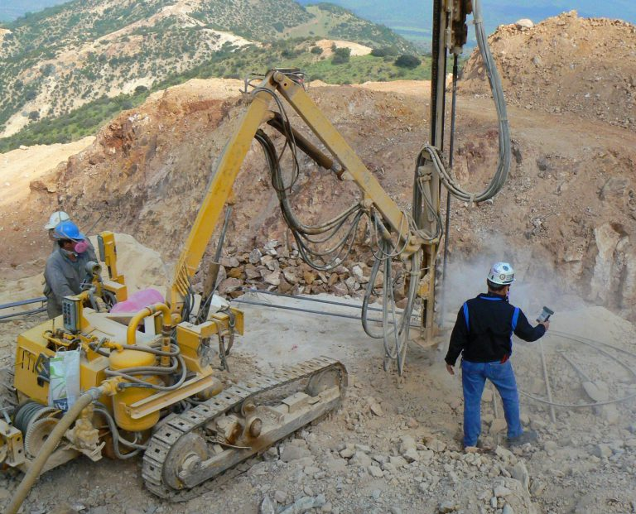
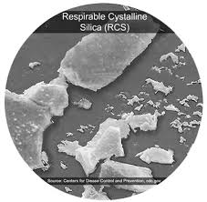
What is Respirable Crystalline Silica?
Respirable crystalline silica – very small particles of silica (1/100 the size of beach sand or smaller), generated by high-energy operations (silica dust), which include
Cutting / Sawing
Grinding / Drilling
Crushing and abrasive blasting (of/with silica containing materials)
Loading/Unloading, hauling
https://blogs.cdc.gov/niosh-science-blog/2023/12/22/silica-metal-nonmetal-mining/
Notes:
When silica containing natural or man-made materials are powdered into silica dust by applying high – energy processes such as cutting, sawing, sanding, grinding, drilling, crushing, scraping, jackhammering, excavating, and blasting (including abrasive blasting), as well as loading , unloading and hauling, very fine respirable silica dust is likely to be generated.
These very small particle sizes ( 1/100 the size of the beach sand or smaller) may also be sharp and angular, and they are not visible individually to the naked eye.

Slide 8
Respirable Crystalline Silica Health Effects
Respirable crystalline silica is classified by the International Agency for Research on Cancer (IARC) as a human carcinogen
Adverse health effects (risks) include
Silicosis
Acute silicosis - Intense exposure to respirable dust of high crystalline silica content for a relatively short period (for few months to less than 2 years)
Accelerated silicosis - Resulting from about 5-15 years of heavy exposure
Chronic silicosis - Most common form; less intense exposure; usually more than 20 years
If one has silicosis, tuberculosis (TB) may also be developed
Notes:
Respirable crystalline silica (also known as silica dust or quartz dust) is a common occupational hazard for coal and metal/nonmetal (MNM) miners.
Respirable crystalline silica is classified by the International Agency for Research on Cancer (IARC) as a human carcinogen.
Its adverse health effects (risks) are led by:
Silicosis – a form of lung cancer that is irreversible and uncurable.
Acute silicosis - Intense exposure to respirable dust of high crystalline silica content for a relatively short period (for few months to less than 2 years)
Accelerated silicosis - Resulting from about 5-15 years of heavy exposure
Chronic silicosis - Most common form; less intense exposure; usually more than20 years
If one has silicosis, tuberculosis (TB) may also be developed.
.

Slide 9
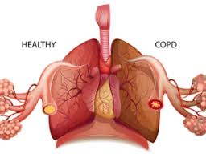
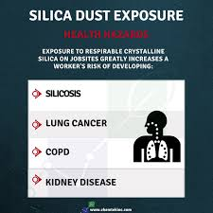
Respirable Crystalline Silica Health Effects – cont’d
Lung cancer- exposure to very high silica concentration
COPD- Chronic Obstructive Pulmonary Disease (e.g. emphysema)
Kidney and immune system disease
All of these illnesses are chronic, irreversible, and potentially
disabling or fatal
Based on the evaluation of these hazards and the new controls, MSHA believes that the rule change will prevent over 1,000 deaths and almost 4,000 cases of silica-related illnesses (lifetime)
MSHA has also estimated that there will be financial benefits exceeding $150 million annually
Notes:
Other silica related diseases are as follows:
Relatively nonmalignant respiratory diseases (e.g., emphysema and chronic bronchitis),
Lung cancer, and
Kidney disease.
Silicosis and these other diseases are chronic, irreversible, and potentially disabling or fatal.
Exposure to mixed coal mine dust containing respirable crystalline silica can lead to the development of coal workers’ pneumoconiosis, progressive massive fibrosis, and multi-dust pneumoconiosis

Slide 10
Respirable Crystalline Silica Health Effects – Cont’d
Silicosis is fatal (respiratory failure) but preventable
Symptoms include
Shortness of breath
Fever
Bluish skin at the ear lobes or lips
Notes:
Silicosis is often fatal (respiratory failure) with limited curing options, but is preventable.
Inhaling silica dust can cause scar tissue to form in the lungs, reducing the lungs’ ability to extract oxygen from the air, making breathing difficult
Silica particles can embed themselves deep in the lungs where they cannot be cleared by mucus or coughing.

Slide 11
Silicosis Mortality Rate
Over time, silicosis-related mortality has diminished in the US, but has not been stopped
A major industry concern was that limited improvements were made in the 1990’s with modest improvements until 2015
Approximately 2.3 million U.S. workers are exposed to silica in the workplace, including 2 million in construction and 300,000 in other industries (current estimates)
Source: American Lung Association, 2024
https://www.lung.org/lung-health-diseases/lung-disease-lookup/silicosis/learn-about-silicosis
Notes:
Silicosis risk has been reduced over the past decades; however, exposures are still a problem that needs to be addressed.

Slide 12
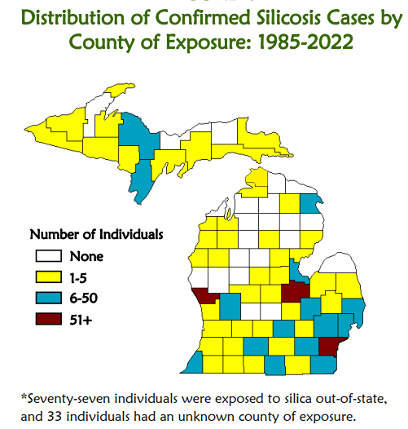
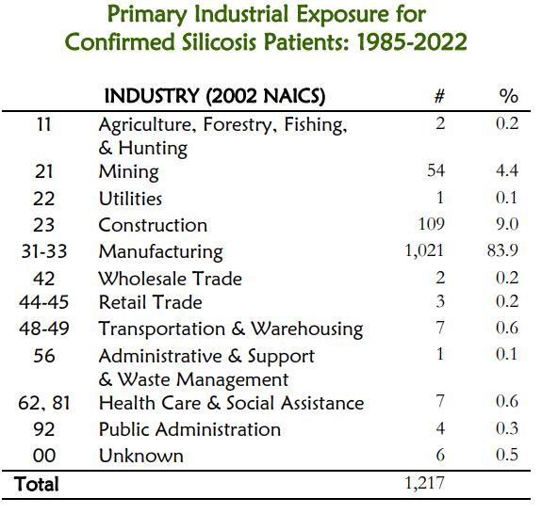
Silicosis Statistics in Michigan (1985- 2022)
The predominant industries were
Manufacturing (84%)
Construction (9%)
Mining (4.4%)
https://oem.msu.edu/images/annual_reports/2022/2022_SandOLDS_AnnualReport.pdf
Notes:
Michigan silicosis statistics (1985- 2022) show that the top three industries suffering from this disease are Manufacturing (84%)
Construction (9%)
Mining (4.4%)
Note that the mining in the state is substantially smaller than the other two industries, and these are based on number of silicosis cases. This is also true in the rest of the country with few exceptions.

Slide 13
Authorities on Silica Regulation
Prevention and elimination of silicosis and silica-related disease in United States are priorities of
National Institute for Occupational Safety and Health (NIOSH)
Occupational Safety and Health Administration (OSHA)
Mine Safety and Health Administration (MSHA)
American Lung Association
Notes:
The Occupational Safety and Health (OSH) Act of 1970 created NIOSH and OSHA.
The Mine Safety and Health Act of 1977 created MSHA.

Slide 14
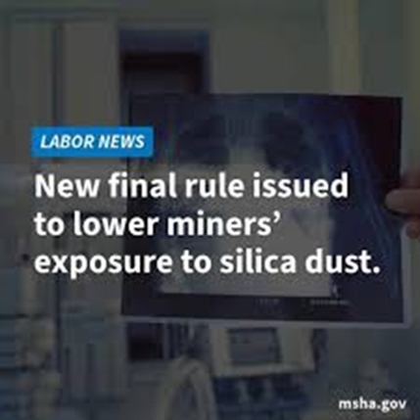
MSHA’S Final Rule on Respirable Crystalline Silica
MSHA’s silica standard was initially promulgated in the early 1970’s
Through its new Final Rule on Respirable Crystalline Silica (RCS)
MSHA is amending its existing standards to better protect miners against occupational exposure to silica and to improve respiratory protection for miners against exposure to all airborne particulates
The new standard
Establishes a uniform permissible exposure limit (PEL) of 50 μg/m³ and introduces an action level (AL) of 25 μg/m³ (averaged over an 8-hr shift) for all mines
Additionally, it includes provisions for methods of compliance, exposure monitoring, corrective actions (when PEL is exceeded), respiratory protection, medical surveillance for metal and nonmetal (MNM) mines, and recordkeeping
Notes:
MSHA’s silica standard was initially promulgated in the early 1970’s. The agency is amending its existing standards to better protect miners against occupational exposure to silica and to improve respiratory protection for miners against exposure to all airborne particulates
The new/revised standard
Establishes a uniform PEL of 50 μg/m3, and introduces an AL of 25 μg/m3 for all mines (averaged over an 8-hr shift).
Additionally, it includes provisions for methods of compliance, exposure monitoring, corrective actions (when PEL is exceeded), respiratory protection, medical surveillance for metal and nonmetal (MNM) mines, and recordkeeping

Slide 15
Section 60.1 – Scope; Compliance Dates
MSHA’s new final rule was
issued on April 18, 2024 and
became effective on June 17, 2024
The rule sets forth mandatory health standards for all surface and underground mines subject to the Federal Mine Safety and Health Act of 1977, as amended
Compliance dates have been set as
April 14, 2025 - for coal mine operators
April 8, 2026 - for MNM mine operators
Note that longer time (2 years from issue date) has been allowed for MNM miners
Notes:
Issue date is when the Rule is first published. Effective date is when mine operators can start applying the procedures and requirements of the standard without any citations for violations. Compliance date is when the standard must be followed and any violations can result in citations.
A period of two years is allowed for MNM operators to complete their preparations for compliance.

Slide 16
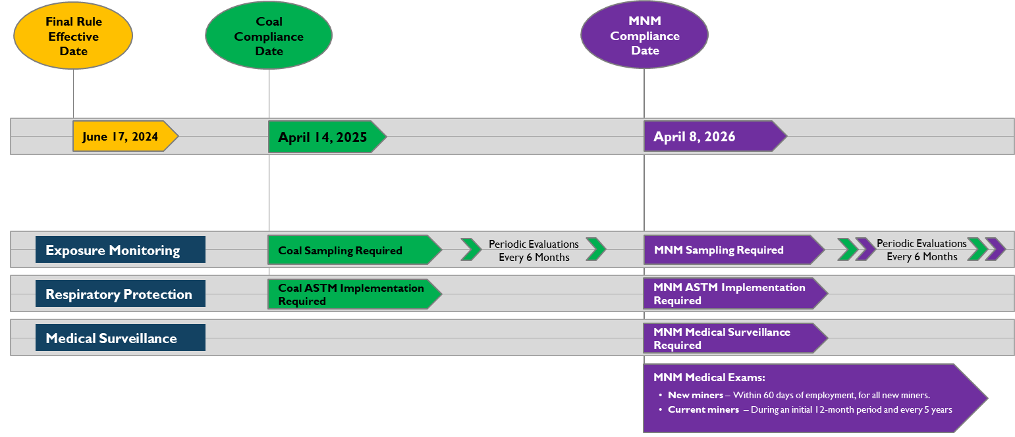
Section 60.1 – Scope; Compliance Dates – Cont’d
SOURCE-https://www.msha.gov/sites/default/files/Regulations/ Silica-Stakeholder-Meeting-Slides-2024-09-06.pdf
Notes:
The above chart shows the effective date and the compliance dates for coal and MNM mines. It indicates that Exposure Monitoring, Respiratory Protection, and Medical Surveillance activities can be initiated before the compliance date, with the understanding that violations of the standard before the compliance date will not be subject to citations. For MNM mines the compliance date is April 8, 2026, and starting from this date sampling, respiratory protection (ASTM F3387-19), and medical surveillance requirements must be met (mandatory). Note that the required sampling must be followed by periodic evaluations every 6 months; and MNM medical exams must be completed within 60 days of employment for all new miners, while for current miners the requirement is during an initial 12-month period and every 5 years.

Slide 17
SECTION 60.2 – DEFINITIONS
Action level (AL) means an airborne concentration of RCS of 25 μg/m³ for a full-shift exposure, calculated as an 8-hour time-weighted average (TWA) – The standard does not apply if the exposure is below the AL Per NIOSH, wherever exposure measurements are above one-half the PEL, employer cannot be reasonably confident that employee is not exposed to levels above the PEL on days with no measurements taken
Further sampling is required when a sampling result is at or above AL
Sampling can be stopped when two consecutive sampling results are at or below AL
Respirable Crystalline Silica (RCS) means quartz, cristobalite, and/or tridymite contained in airborne particles determined to be respirable by a sampling device conforming to the International Organization for Standardization (ISO) 7708:1995: Air Quality—Particle Size Fraction Definitions for Health-Related Sampling
Notes:
Action level (AL) is reached when airborne concentration of RCS is 25 μg/m³ for a full-shift exposure, calculated as an 8-hour time-weighted average (TWA). The standard does not apply if the exposure is below the AL.
Per NIOSH, wherever exposure measurements are above one-half the PEL (which is AL), the employer cannot be reasonably confident that the employee is not exposed to levels above the PEL on days with no measurements taken. This is the rationale behind introducing the AL value for silica concentration. Therefore, further sampling is required when a sampling result is at or above AL, and sampling can be stopped when two consecutive sampling results are at or below AL.
According to the MSHA standard, Respirable Crystalline Silica (RCS) meand quartz, cristobalite, and/or tridymite contained in airborne particles determined to be respirable by a sampling device conforming to the International Organization for Standardization (ISO) 7708:1995: Air Quality—Particle Size Fraction Definitions for Health-Related Sampling

Slide 18
Supplemental Definitions
Permissible Exposure Limit (PEL): The maximum concentration of a chemical that a worker may be exposed to under MSHA regulations
Action Level (AL): Exposures at or above this concentration the Standard applies – used for trigger /threshold determination for exposure assessment
Time Weighted Average (TWA) : Time-weighted average exposure for the work shift (8hours)
Example : (3 hrs x 20 μg/m³ ⁾ ⁺ ⁽3hrs x 40 μg/m³ ⁾ ⁺ (2hrs x 30 μg/m³ ⁾ ⁼ 30 μg/m³ )
8hrs
Concentration is above AL but below PEL; so, the Standard applies (on site)
Notes:
Conceptual definitions for PEL and AL are presented here.
PEL is the maximum concentration of a chemical that a worker may be exposed to under MSHA regulations.
AL signifies the level, of exposure (in terms of the airborne concentration of CRS) at or above which the Standard applies, meaning that sampling must be continued until two consecutive sampling results are at or below AL
Competent Person: Per the Mine Act, Under 30 CFR Part 46, training must be provided to miners by a "competent person." who is designated by the production-operator or independent contractor, who has the ability, training, knowledge, or experience to provide training to miners in his or her area of expertise. Must be able both to effectively communicate the training subjects and to evaluate whether the training is effective.

Slide 19
SECTION 60.10 – PERMISSIBLE EXPOSURE LIMIT (PEL)
Mine operators must ensure that no miner is exposed to a respirable crystalline silica concentration in excess of 50 μg/m³ of air for a full-shift exposure, calculated as an 8-hour TWA
Using a full-shift exposure (including extended shifts)
Note that 50 μg/m³ is the new PEL starting on April 8, 2026 (for MNM mines)
Notes:
This is right from the New Rule. It has been in effect since April 18, 2024. The new PEL of 50 μg/m³ will be enforced (for compliance) starting on April 8, 2026 for MNM mines.

Slide 20
Permissible Exposure Limit and Action Level - Summary
50 μg/m³ TWA₈
in the air
Permissible Exposure Limit (PEL)
8-hour time-weighted average exposure limit (TWA₈)
Action Level
(AL)
25 μg/m³ TWA₈
in the air
Rule-of–thumb for RCS Overexposure
If dust containing respirable silica is visible in the air, there is a higher likelihood that permissible exposure limit (PEL) is exceeded
Notes:
This figure is an illustrative summary. In addition to AL and PEL information, there is a comparative picture of human hair vs. very small particles of fine beach sand and other fine particulate matters.
Also note that as a rule-of–thumb for CRS overexposure, if dust containing respirable silica is visible in the air, there is a higher likelihood that permissible exposure limit (PEL) is exceeded. Realize that this is qualitative and unenforceable for compliance with the standard.

Slide 21
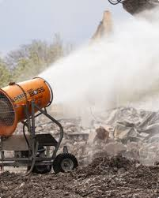
SECTION 60.11 – METHODS OF COMPLIANCE
Mine operators are required to install, use, and maintain feasible engineering controls, supplemented by administrative controls when necessary
Engineering controls are the primary means of control
Examples: ventilation systems; dust suppression devices; enclosed cabs or control booths with filtered breathing air; changes in equipment used or in materials handling methods
Administrative controls to be used as a supplement
Examples: housekeeping procedures; avoiding a dusty process area by walking outside of it rather than through it; and preventing or minimizing contamination of clothing to decrease silica exposure (no air pressure to get dust off clothing…)
Note that rotation of miners is prohibited as an acceptable administrative control for RSC
Training miners on silica safety and health is usually considered an administrative control
Notes:
Methods of compliance embody engineering controls and administrative controls.
Engineering controls are primary
Administrative controls are supplementary
Examples of engineering controls applicable to mining work include ventilation systems; dust suppression devices; enclosed cabs or control booths with filtered breathing air changes in equipment used or in materials handling methods
Examples of housekeeping procedures applicable to mining operations include avoiding a dusty process area by walking outside of it rather than through it; and preventing or minimizing contamination of clothing to decrease silica exposure (no air pressure to get dust off clothing…)
Note that rotation of miners is prohibited as an acceptable administrative control for respirable crystalline silica
Training miners on silica safety and health is usually considered an administrative control

Slide 22
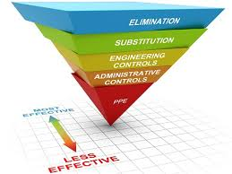
Hierarchy of Controls
The hierarchy of controls identifies a preferred order of actions to best control hazardous workplace exposures
Elimination, substitution, and engineering controls are more effective because they control exposures without significant human interaction
Administrative controls and personal protective equipment (PPE) can also be effective at reducing workers' exposures
Note that PPE alone may not be reliable - to be used as a last resort
Notes:
The Hierarchy of Controls principle refers to a system for ranking workplace safety measures from the most effective to the least effective, prioritizing methods like eliminating hazards completely, then substituting hazardous materials, followed by engineering controls, administrative controls, and finally, personal protective equipment (PPE) as the last resort.
Elimination is physically removing the hazard from the workplace is the most effective and preferred method.
Substitution is replacing a hazardous material or process with a less hazardous alternative (when possible and feasible).
Engineering controls encompass modifying equipment or work processes to reduce exposure to hazards.
Administrative controls incorporate changing work practices or procedures to minimize risk, including training and job rotation.
Personal Protective Equipment (PPE) are a means of providing workers with gear like gloves, goggles, or respirators to protect them from hazards, considered the least effective control method.
Export
Save
The hierarchy of controls is a method of identifying and ranking safeguards to protect workers from hazards. They are arranged from the most to least effective and include elimination, substitution, engineering controls, administrative controls and personal protective equipment.

Slide 23
Hierarchy of Controls - Cont’d
Elimination removes the hazard at the source; e.g. changing the work process to stop using a harmful material or risky process
Preferred solution to protect workers because no exposure occurs
Substitution is using a safer alternative to the source of hazard; e.g. instead of sand-blasting, using a low or zero silica content abrasive material
Most effective in design phases
Engineering controls will reduce or prevent hazards from coming into contact with workers; e.g. ventilation, enclosed cabs
Cost-effective in the long term
Administrative controls establish work practices that reduce the duration, frequency, or intensity of exposure to hazards e.g. limiting access to hazardous areas/machinery; warning signs
PPE is equipment worn to minimize exposure to hazards; e.g. respirators
Training and evaluation can help ensure selected controls are successful
Notes:
Please refer to the previous slide’s instructional notes.

Slide 24
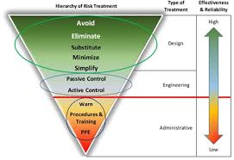
Engineering and Administrative Controls
The following information can be considered among best practices
Engineering and administrative controls for reducing exposures allows for respirator use, in addition to those controls, when feasible engineering controls cannot reduce employee exposures to levels below PEL
Even when employers demonstrate the infeasibility of engineering and administrative controls, they must still use feasible controls to reduce exposures to lowest possible level, and then use respiratory protection along with those controls
Notes:
The following information can be considered among best practices
Engineering and administrative controls for reducing exposures allows for respirator use, in addition to those controls, when feasible engineering controls cannot reduce employee exposures to levels below PEL
Even when employers demonstrate the infeasibility of engineering and workplace controls, they must still use feasible controls to reduce exposures to the lowest possible level, and then use respiratory protection along with those controls
Engineering and administrative controls for silica exposures in mining activities include the following examples:
Engineering controls
Exhaust ventilation
Dry dust collection systems
Water sprays
Wet drilling or suppression
Supply vacuums with high-efficiency particulate air (HEPA) filters
Enclosed cabs / control booths
Administrative controls :
Preventative maintenance
Good housekeeping
Wet cleaning methods
Rotation (not allowed for miners)
Training (mandatory and awareness level)

Slide 25
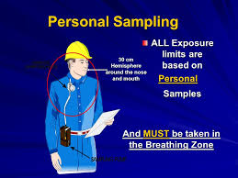
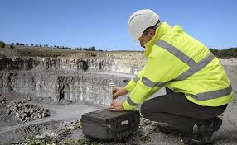
SECTION 60.12 – EXPOSURE MONITORING
Two ways to monitor miners’ exposures to silica
Sampling airborne dust, and
Periodic evaluations of the mining environment
Sampling
Personal breathing-zone air samples for MNM operations, and occupational environmental samples - (For the duration of a miner’s regular full shift, and during typical mining activities, including shaft and slope sinking, and construction and removal of overburden)
May sample a representative fraction of miners (at least two) when multiple miners perform the same tasks on the same shift and in the same work area; must select the miners with highest exposure to silica
Notes:
Two ways to monitor miners’ exposures to silica
Sampling airborne dust, and
Periodic evaluations of the mining environment
Sampling
Personal breathing-zone air samples for MNM operations, and occupational environmental samples for the duration of a miner’s regular full shift, and during typical mining activities, (including shaft and slope sinking, and construction and removal of overburden)
May sample a representative fraction of miners (at least two) when multiple miners perform the same tasks on the same shift and in the same work area; must select the miners with highest exposure to silica.
Mine operators are required to conduct periodic evaluations at least every 6 months or whenever there is a change in production, processes, installation and maintenance of engineering controls, installation and maintenance of equipment, administrative controls, or geological conditions.

Slide 26
ADDITIONAL SAMPLING REQUIREMENTS
Use respirable-particle-size selective samplers that conform to ISO 7708:1995(E)
Several models available in the market for purchase or rental
Have the samples analyzed by a laboratory that:
is an ISO-accredited body, and
analyzes the samples by analytical methods specified by MSHA, NIOSH or OSHA
There are 30 commercial labs in the US for this purpose as of fall 2023
Make a record of sampling date, occupations sampled, and concentrations of respirable crystalline silica dust
Post the record and the lab report on the mine bulletin board, and share them electronically (if applicable) for 31 days upon receipt
Notes:
Additional sampling requirements include the following:
Use respirable-particle-size selective samplers that conform to ISO 7708:1995(E)
Several models available in the market for purchase or rental
Have the samples analyzed by a laboratory that:
is an ISO-accredited body, and
analyzes the samples by analytical methods specified by MSHA, NIOSH or OSHA
There are 30 commercial labs in the US for this purpose as of fall 2023
Make a record of sampling date, occupations sampled, and concentrations of respirable crystalline silica dust
Post the record and the lab report on the mine bulletin board, and share them electronically (if applicable) for 31 days upon receipt

Slide 27
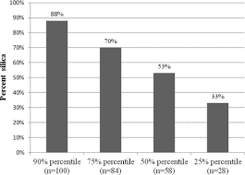
SAMPLING TYPE/SEQUENCE
Initial samplings (first sampling and second sampling) are required for
Any miner who is exposed or may reasonably be expected to be exposed to respirable crystalline silica
Subsequent samplings are required when
Sampling result is at or above AL, but at or below PEL (between 25μg/m³ and 50μg/m³)
Sampling can be stopped when
Two consecutive samplings indicate that miner exposures are below AL
The second sampling must be taken after receiving the results of the prior sampling, but no sooner than 7 days after the prior sampling
Corrective actions sampling is required when
Sampling result is above the PEL
Notes:
Initial samplings (first sampling and second sampling) are required for any miner who is exposed or may reasonably be expected to be exposed to respirable crystalline silica
Subsequent samplings are required when sampling result is at or above AL, but at or below PEL (between 25μg/m³ and 50μg/m³)
Sampling can be stopped when two consecutive samplings indicate that miner exposures are below AL
The second sampling must be taken after receiving the results of the prior sampling, but no sooner than 7 days after prior sampling
Corrective actions sampling is required when sampling result is above PEL

Slide 28
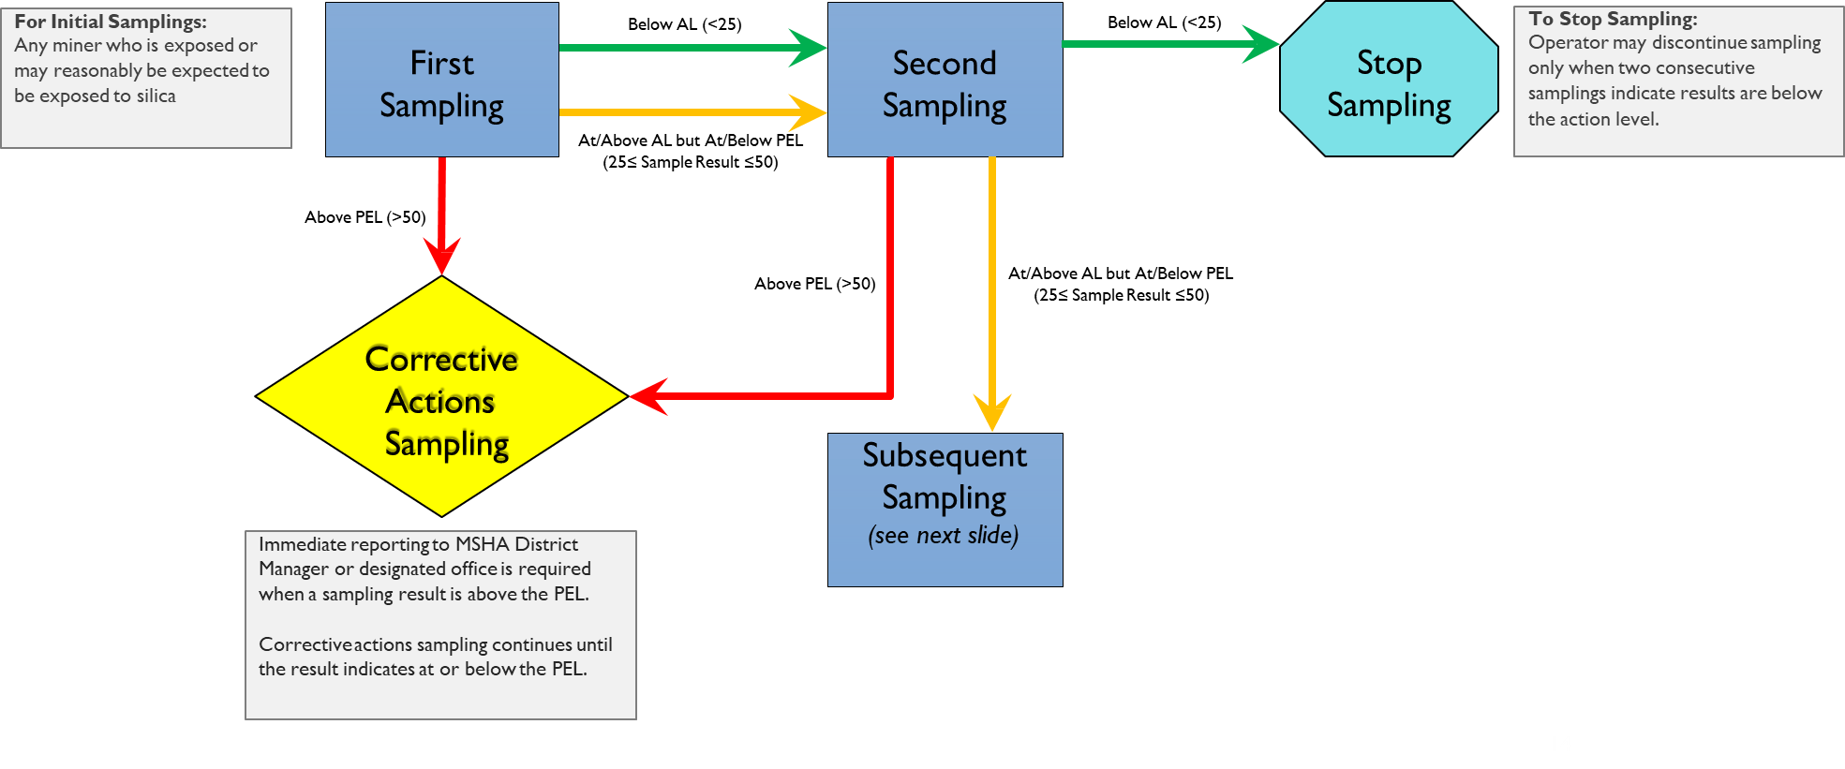
Exposure Monitoring - Initial Samplings
SOURCE - https://www.msha.gov/sites/default/files/Regulations/ Silica-Stakeholder-Meeting-Slides-2024-09-06.pdf
Notes:
This schematic chart illustrates the sequence and flow of the samplings as required by the MSHA silica standard. The First Sampling is used to determine whether the silica concentration is below AL, between AL and PEL., or above PEL. For the first two conditions, a Second Sampling is required, which will create three additional scenarios. If two consecutive trials in the Second Sampling produce results that are still below AL, the sampling can be stopped/discontinued. However, if the results are between AL and PEL, Subsequent Sampling must be performed, as described in the next slide.
If the results of the Second Sampling indicate concentrations that exceed PEL, Corrective Actions Sampling will have to be initiated. In such cases (i.e. when PEL is greater than 50),immediate reporting to MSHA District Manager or designated office is required. Corrective Actions Sampling continues until the results come at/below PEL.

Slide 29
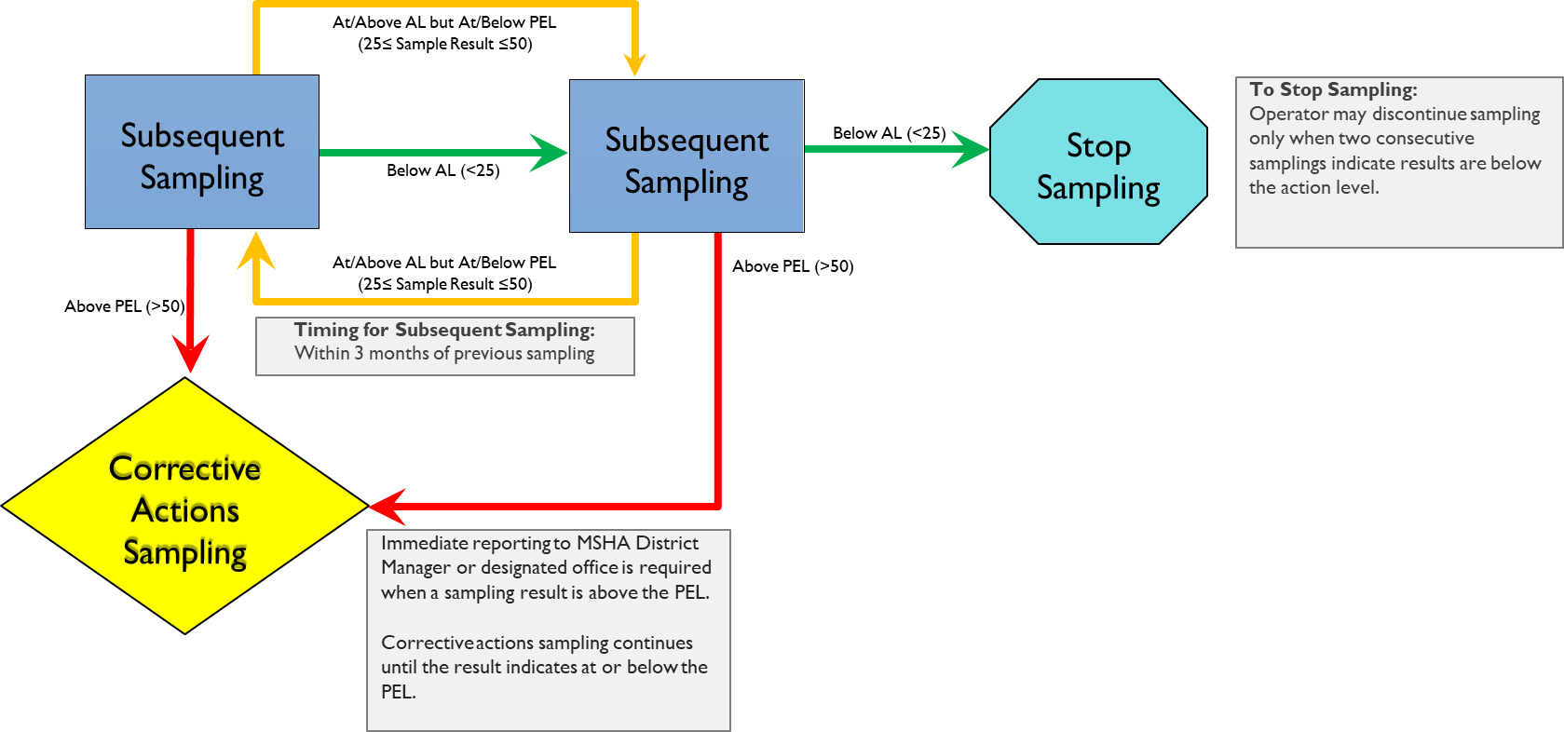
Exposure Monitoring - Subsequent Samplings
SOURCE - https://www.msha.gov/sites/default/files/Regulations/ Silica-Stakeholder-Meeting-Slides-2024-09-06.pdf
Notes:
This schematic chart illustrates the sequence and flow of the Subsequent Samplings as required by the MSHA silica standard. Subsequent Samplings must be initiated within 3 months of the previous sampling, but can be discontinued if the results in two consecutive samplings are below AL. However, If the results are between AL and PEL, sampling continues. If Subsequent Sampling gives results above PEL, then Corrective Actions Sampling must start and proceed in the manner described in the previous slide. immediate reporting to MSHA District Manager or designated office is required when results show values in excess of PEL, and Corrective Actions Sampling continues until the results come at/below PEL.

Slide 30
PERIODIC EVALUATIONS
Evaluate changes in production, processes, equipment, use of engineering controls; administrative controls; or geological conditions
Determine whether the change may reasonably be expected to result in new or increased exposure to respirable crystalline silica
Conduct sampling if the change may result exposure to silica levels above AL
Post-evaluation sampling must be conducted when operator determines that the change may reasonably be expected to result in new or increased exposure levels above AL
Make a record of the evaluation – date, change recorded, impact on silica exposure
Post the record on the mine bulletin board, or by electronic means, for the next 31 days
At least every 6 months or whenever there is a change in production, processes, etc.
Notes:
Periodic evaluations can be performed as follows:
Evaluate changes in production, processes, equipment, use of engineering controls; administrative controls; or geological conditions
Determine whether the change may reasonably be expected to result in new or increased exposure to respirable crystalline silica
Conduct sampling if the change may result exposure to silica levels above AL
Post-evaluation sampling must be conducted when operator determines that the change may reasonably be expected to result in new or increased exposure levels above AL
Make a record of the evaluation – date, change recorded, impact on silica exposure
Post the record on the mine bulletin board, or by electronic means, for the next 31 days
At least every 6 months or whenever there is a change in production, processes, etc.

Slide 31
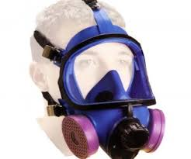
SECTION 60.13 – CORRECTIVE ACTIONS
When miners’ exposures are above PEL, mine operators must
Make NIOSH-approved respirators available to affected miners before the next work shift
Ensure that affected miners wear respirators properly for the full shift or during overexposure period until exposures are below PEL
Immediately take corrective actions to lower silica exposure to below PEL
Once corrective actions have been taken, mine operators must conduct sampling, and implement additional or new corrective action until subsequent sampling indicates exposures below PEL
Notes:
When miners’ exposures are above PEL, mine operators must take corrective actions as follows:
Make NIOSH-approved respirators available to affected miners before the next work shift
Ensure that affected miners wear respirators properly for the full shift or during overexposure period until exposures are below PEL
Immediately take corrective actions to lower silica exposure to below PEL
Once corrective actions have been taken, mine operators must conduct sampling, and implement additional or new corrective action until subsequent sampling indicates exposures below PEL

Slide 32
SECTION 60.14 – RESPIRATORY PROTECTION
At MNM mines, respiratory protection must be used as a temporary measure when silica exposure is above PEL, while
Engineering control measures are being developed and implemented; or
It is necessary by the nature of work for example, occasional entry into hazardous atmospheres to perform maintenance or investigation)
Upon written determination by a Physician or other Licensed Health Care Professional (PLHCP) that an affected miner is unable to wear a respirator, the miner must be temporarily transferred: either to work in a separate area of the same mine; or to an occupation at the same mine, where respiratory protection is not required
Notes:
A respiratory protection program is a comprehensive set of procedures and guidelines designed to protect employees from respiratory hazards by ensuring proper respirator selection, use, maintenance, and training, while a respiratory protection plan is a more specific document outlining the key components of that program, often focusing on the written procedures and protocols for implementing respirator use in a particular workplace setting; essentially, the plan is a detailed part of the larger program.

Slide 33
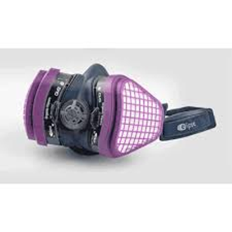
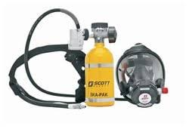
RESPIRATORY PROTECTION – CONT’D
In addition,
Affected miners must be provided with a NIOSH-approved atmosphere-supplying respirator or NIOSH-approved air purifying respirator
Examples: Half mask elastomeric respirator with N,R,P-100 series filtration, or powered air purifying respirators with high efficiency (HE) filter
When approved respirators are used, mine operators must have a written respiratory protection program that meets the requirements of ASTM F3387-19 - Standard Practice for Respiratory Protection, with respect to
Written standard operating procedures
Medical evaluation
Respirator selection
Training
Fit testing
Maintenance, inspection, and storage
Notes:
Also note that,
Affected miners must be provided with a NIOSH-approved atmosphere-supplying respirator or NIOSH-approved air purifying respirator
Examples: Half mask elastomeric respirator with N,R,P-100 series filtration, or powered air purifying respirators with high efficiency (HE) filter
When approved respirators are used, mine operators must have a written respiratory protection program that meets the requirements of ASTM F3387-19 - Standard Practice for Respiratory Protection - with respect to
Written standard operating procedures
Medical evaluation
Respirator selection
Training
Fit testing
Maintenance, inspection, and storage

Slide 34
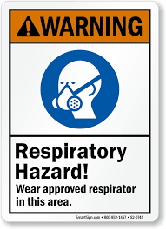
Key Elements of Respiratory Protection Plan – ASTM F3387-19
Program Administration:
Assign a qualified program administrator with direct communication to site managers to oversee the respiratory protection program
Written Standard Operating Procedures (SOPs):
Develop written procedures detailing all aspects of the program
Include hazard assessments, respirator selection, maintenance, training, and program evaluation
Hazard Assessment:
Identify and evaluate workplace respiratory hazards, including oxygen-deficient environments and exposure to harmful contaminants
Medical Evaluation:
Ensure employees are medically evaluated to determine fitness for respirator use
Document medical evaluations and reassess periodically
Notes:
A respiratory protection program is a comprehensive set of procedures and guidelines designed to protect employees from respiratory hazards by ensuring proper respirator selection, use, maintenance, and training, while a "respiratory protection plan" is a more specific document outlining the key components of that program, often focusing on the written procedures and protocols for implementing respirator use in a particular workplace setting; essentially, the plan is a detailed part of the larger program.
To comply with ASTM F3387-19, the key elements recommended for the Respiratory Protection Plan are
Program Administration
Written Standard Operating Procedures (SOPs)
Hazard Assessment
Medical Evaluation
5. Respirator Selection
6. Training and Education
Fit Testing
Use and Maintenance
Inspection
10. Program Evaluation
11. Emergency Preparedness, and
12. Recordkeeping.
Additional details are provided on the above slide, and the two consecutive slides that follow.

Slide 35
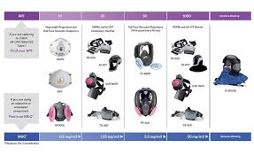
Key Elements of Respiratory Protection Plan – Cont’d
5. Respirator Selection
Choose respirators based on type of hazard and workplace conditions
Consider protection factors, work duration, and environmental factors
6. Training and Education:
Train employees on proper respirator use, limitations, maintenance, and emergency procedures
Conduct training initially and annually
Fit Testing:
Perform qualitative or quantitative fit tests to ensure a proper seal for tight-fitting respirators
Conduct fit tests before initial use and annually or when facial changes occur
Use and Maintenance:
Establish guidelines for proper respirator use and ensure users conduct seal checks
Maintain respirators in clean, operable condition and store them appropriately
Notes:
See the previous slide for instructor notes

Slide 36
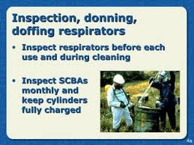
Key Elements of Respiratory Protection Plan- Cont’d
Inspection:
Inspect respirators regularly for wear, damage, and function
Replace components, like filters and cartridges, based on a change schedule or when necessary
10.Program Evaluation:
Regularly review and audit the program to ensure compliance and effectiveness.
Update procedures based on regulatory changes and workplace needs
11.Emergency Preparedness:
Provide training and equipment for emergency use, such as escape respirators.
Maintain sufficient stock and accessibility of emergency respirators
12.Recordkeeping:
Keep detailed records of medical evaluations, training, fit testing, maintenance, and program audits
Notes:
See the two previous slides for instructor notes

Slide 37
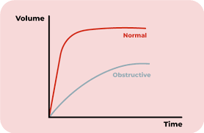
SECTION 60.15 – MEDICAL SURVEILLANCE
MNM Medical Surveillance Program
Mine operators must provide medical exams at no cost to miners
Medical exams by a physician or other licensed health care professional (PLHCP) or specialist must include
Medical and work history
Physical exam with special emphasis on the respiratory system
Chest X-Ray
Occupational history and symptom assessment
Pulmonary function test
Note that a specialist must be American Board-Certified in Pulmonary Disease or Occupational Medicine
Notes:
Medical Surveillance Program is mandatory for MNM miners
Mine operators must provide medical exams at no cost to miners
Medical exams by a physician or other licensed health care professional (PLHCP) or specialist must include
Medical and work history
Physical exam with special emphasis on the respiratory system
Chest X-Ray
Occupational history and symptom assessment
Pulmonary function test
Note that a specialist must be American Board-Certified in Pulmonary Disease or Occupational Medicine

Slide 38
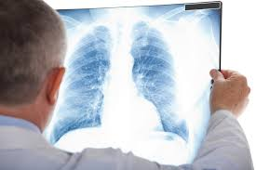
MEDICAL SURVEILLANCE – CONT’D
Timing of MNM Medical Surveillance
Provide medical exams to new miners who start work after April 8, 2026, within 60 days of beginning employment
1st follow-up exam no later than 3 years
2nd follow-up no later than 2 years if the 1st follow-up exam shows evidence of decreased lung function
Provide medical exams to current miners ( who are already employed and working)
During an initial 12-month period and every 5 years thereafter
Notes:
Timing of MNM Medical Surveillance will be as follows:
Provide medical exams to new miners who start work after April 8, 2026, within 60 days of beginning employment
1st follow-up exam no later than 3 years
2nd follow-up no later than 2 years if the 1st follow-up exam shows evidence of decreased lung function
Provide medical exams to current miners (who are already employed and working)
During an initial 12-month period and every 5 years thereafter.
MSHA defines a new miner as a person who has just started working as a miner for a production operator or independent contractor and is not yet experienced, while an experienced miner is a person who has at least 12 months of experience in surface or underground mining.

Slide 39
SECTION 60.16 – RECORDKEEPING
Mine operators must retain
Sampling, periodic evaluations, and corrective actions records; for at least 5 years
Written records of a PLHCP's determination on whether a miner is able or unable to wear a respirator; for the duration of employment plus 6 months
Written records of medical opinions by the PLHCP or specialist that include: date of the medical exam; a statement confirming the exam has met requirements of section 60.15; and any recommended limitations on the miner's use of respirator; for the duration of a miner’s employment plus 6 months
Operators must promptly provide access to any of these records, upon request from an authorized representative of the DOL Secretary, from miners, or from their authorized representative
Notes:
Please refer to the next slide, displaying the type of records mandated to be kept by the Employer and how long the records must be retained.

Slide 40
RECORDKEEPING REQUIREMENTS – CONT’D
Record | Section references | Retention period
1. Evaluation records | § 60.12(c) | At least 5 years from date of each evaluation
2. Sampling records | § 60.12(g) | At least 5 years from sample date
3.Corrective actions records | § 60.13(c) | At least 5 years from date of each corrective action
4. Written determination records received from a PLHCP | § 60.14(b) | Duration of miner's employment plus 6 months
5. Written medical opinion records received from a PLHCP or specialist | § 60.15(f) | Duration of miner's employment plus 6 months
Notes:
The above Table lists the type of records mandated to be kept by the Employer and how long the records must be retained.

Slide 41
SUMMARY
MSHA’s final rule on respirable crystalline silica sets the following standards
Compliance dates: Coal mine operators must comply by April 14, 2025, and MNM mine operators must comply by April 8, 2026
Permissible exposure limit (PEL): 50 µg/m³ of air for a full shift, calculated as an 8-hour time-weighted average (TWA)
Action level: 25 µg/m³ for a full shift, calculated as an 8-hour TWA
Corrective actions: Required if a miner's exposure exceeds PEL
Engineering controls: Required to prevent miners' overexposures
Medical surveillance: Required for MNM mines
Monitoring and control requirements: Uniform requirements for monitoring and controlling silica exposures (for all mines)

Slide 42
SUMMARY – Cont’d
Respiratory protection requirements: Updates the existing respiratory protection requirements to the ASTM F3387-19 Standard
Periodic evaluations: Qualitative evaluations must be repeated at least every six months or whenever there is a change
Medical exams: New miners must be examined within 60 days of beginning employment, and current miners must be examined during the initial 12-month period and every 5 years thereafter
Record keeping: Mine operators must retain records of sampling, periodic evaluations, and corrective actions for at least 5 years

Slide 43
FREQUENTLY ASKED QUESTIONS (FAQ)
MSHA has published a FAQ document which sheds light into the details and interpretations of the New Final Rule on Silica. Refer to the link below
https://www.msha.gov/respirable-crystalline-silica-30-cfr-part-60-frequently-asked questions#:~:text=Part%2060%20establishes%20a% 20uniform,ISO%20sampling%20conventions
This document in its entirety has 34 questions and answers (Q and A). A sampling of these Q and A are presented here
Notes:
The trainees should be aware of this document prepared and published by MSHA ( see the URL above), containing information in the form of Questions and Answers. It sheds light into a lot of key implementation issues pertaining to compliance dates, exposure monitoring, medical surveillance and others for the new MSHA silica standard. The document has 34 questions and answers; a representative sampling of 12 questions and answers are provided in the following seven (7) slides. An attempt has been made to perform some light editing to render the information more concise without changing its meaning and thrust.

Slide 44
ANY QUESTIONS?

Slide 45
Dr. Mumtaz Usmen – musmen@wayne.edu Dr. Emrah Kazan – ekazan@wayne.edu

