Slide 1

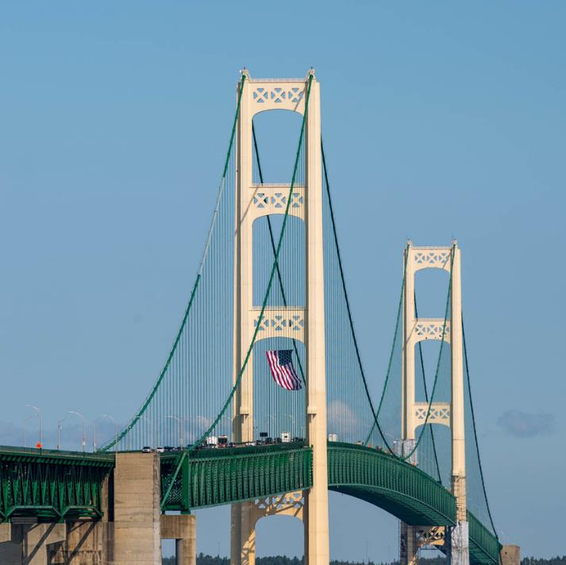

UPDATE
February 12, 2026
Director Bradley C. Wieferich, PE
Michigan Aggregates Association Annual Conference

Slide 2
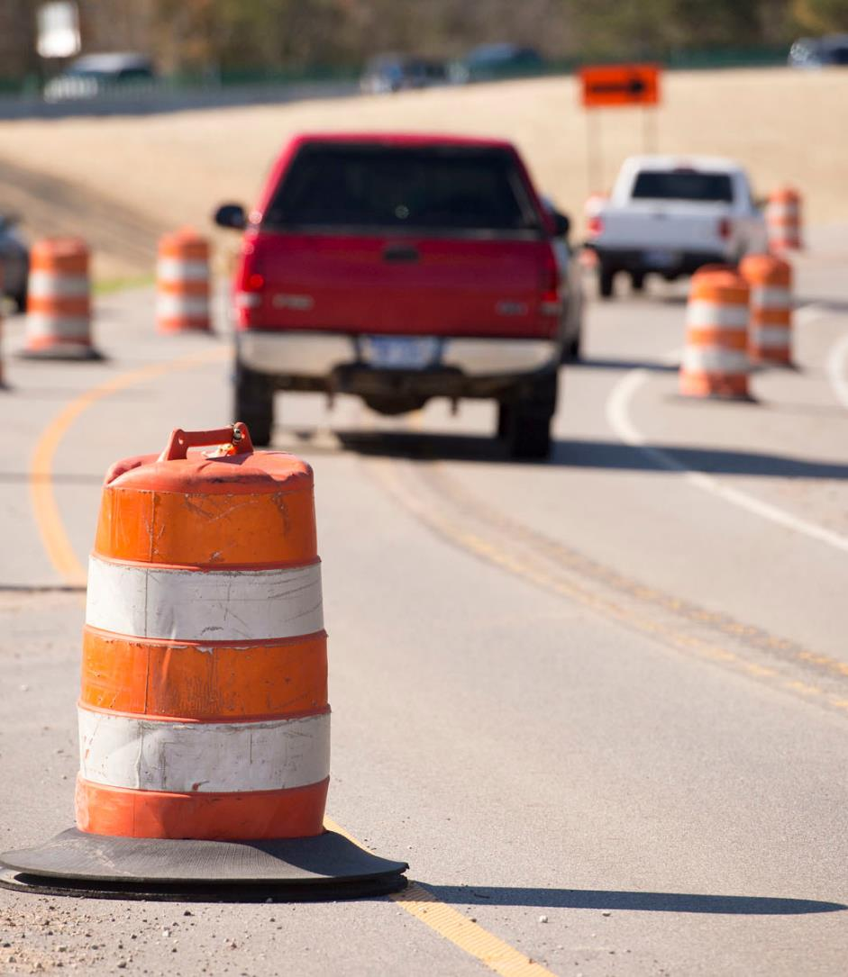




Today’s Topics
Program & Funding
DBE/SBE Program
Gordie Howe International Bridge
Project Updates

Slide 3


Toward Zero Deaths
Michigan Traffic Fatalities as of 12/30/2025
 | 2025 | 2024 | Change | % Change
Total Fatalities** | 1009 | 1022 | -13 | -1%⬇️
Person Types**
Pedestrian | 162 | 158 | 4 | 3%⬆️
Bicycle | 29 | 29 | 0 | 0%⏹️
Crash Types**
Lane Departure | 602 | 726 | -124 | -17%⬇️
Lane Departure on a Curve | 110 | 110 | 0 | 0%⏹️
Speed Limits >45 mph | 587 | 637 | -50 | -8%⬇️
Wrong Way | 10 | 18 | -8 | -44%⬇️
Work Zone | 22 | 24 | -2 | -8%⬇️
Seat Belt Not Used | 264 | 283 | -19 | -7%⬇️
*Data Disclaimer: All crash data pulled from Mi-CAT (Michigan Crash Analysis Tool). Mi-CAT receives up-to-date traffic crash data and statistics for all crashes that have occurred in Michigan.

Slide 4
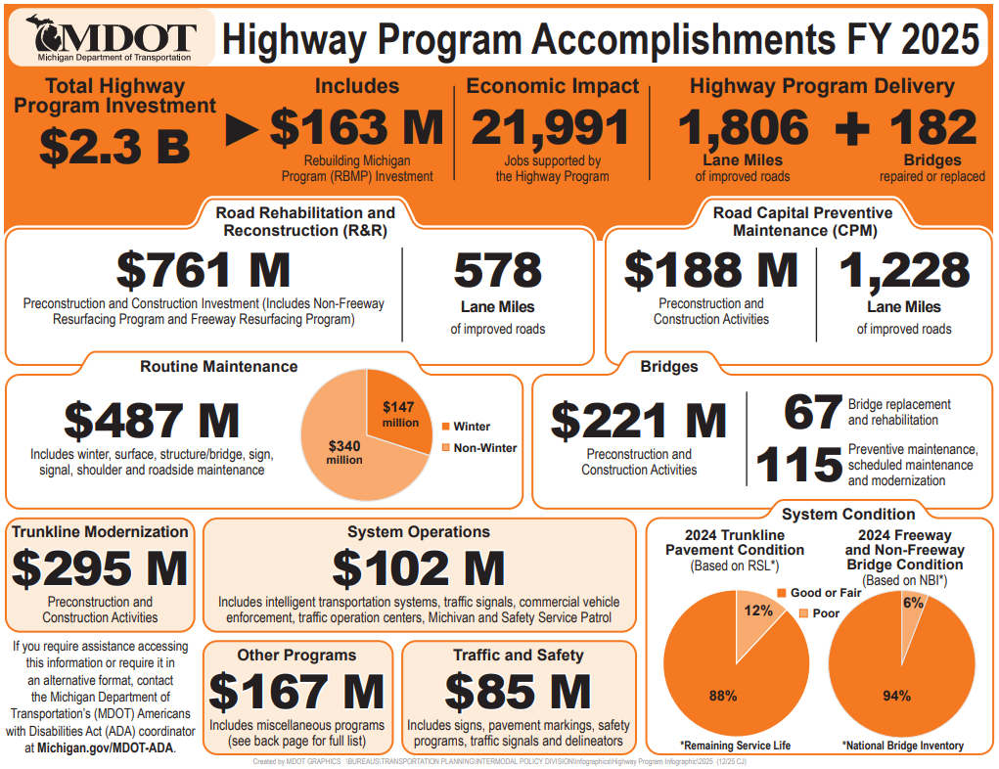

Slide 5
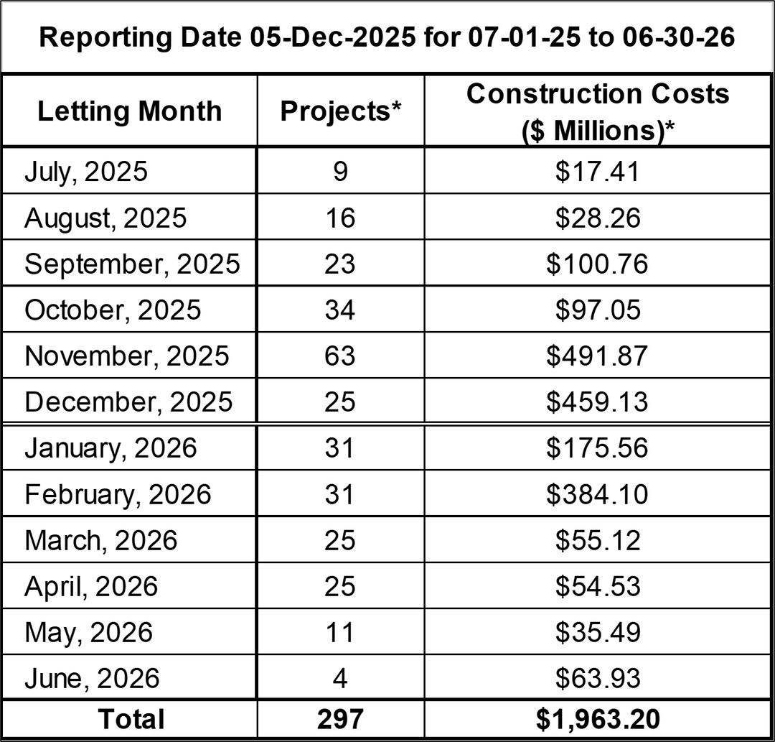
2026
Construction Projects
Trunkline Only
*This Information Represents the Total Number of Projects and Dollars scheduled to be let in each month.
Data does not include CMGC projects.
Therefore, the sum of values will not directly correlate to program year budgets, and this information is always subject to change.

Slide 6
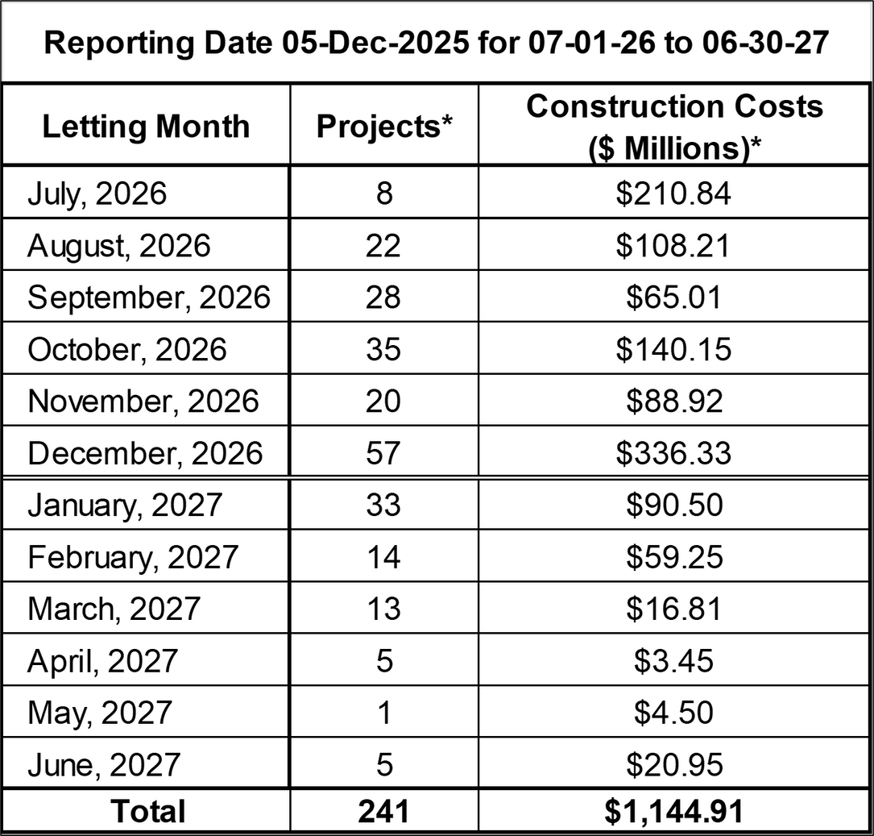
2027
Construction Projects
Trunkline Only
*This Information Represents the Total Number of Projects and Dollars scheduled to be let in each month.
Data does not include CMGC projects.
Therefore, the sum of values will not directly correlate to program year budgets, and this information is always subject to change.

Slide 7
Quantity Values
*This information is draft and may change as the program is developed.
2026 & 2027 amounts are programmed values to date. The 2026 year encompasses data from July 2025 to June 2026 and the 2027 year encompasses data from July 2026 to June 2027 to align with construction year emphasis.
Data does not include CMGC projects.

Slide 8


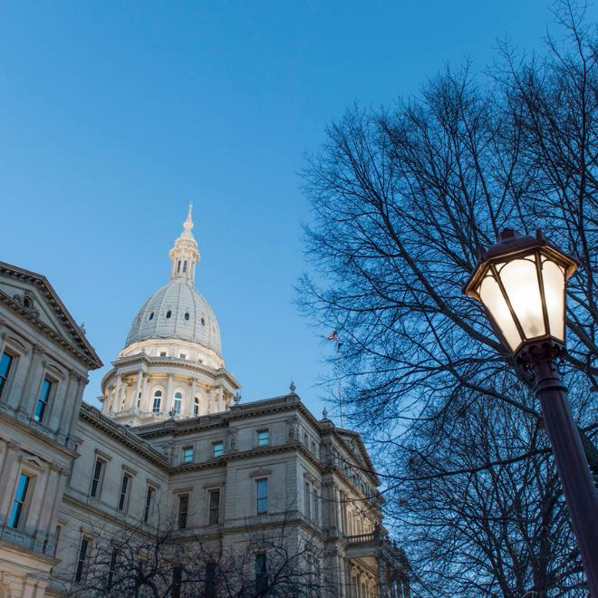
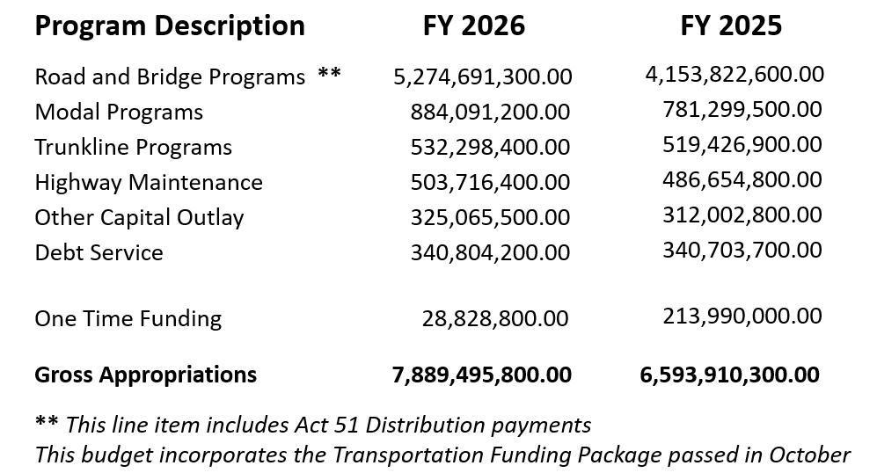
Fiscal Year 26 Budget

Slide 9
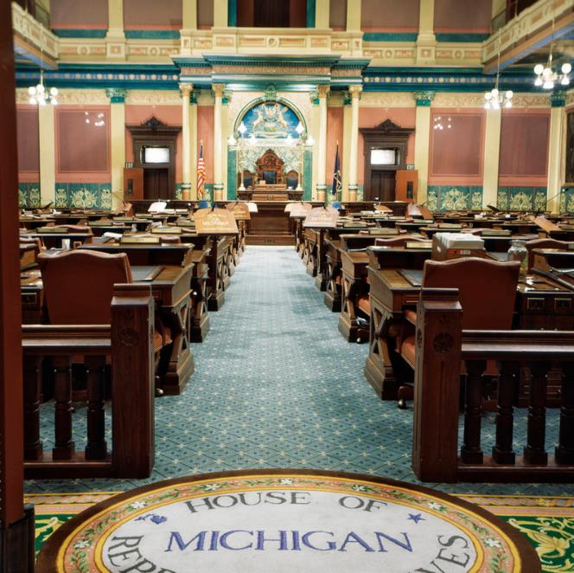
Transportation Funding Package
Legislative Changes
Motor Fuel Tax – increased the fuel tax rate from 31.0 cents per gallon to at least 51.0 cents per gallon (effective January 1, 2026; PA 20 of 2025)
Income Tax – ended the $600 million earmark to the Michigan Transportation Fund
(effective October 1, 2025; PA 24 of 2025)
Corporate Income Tax – established a new earmark to the Neighborhood Roads Fund
$688 million in FY 26; increases by $88 million a year until 2031
Wholesale Excise Tax on certain sales or transfers of marijuana
Expected annual collections $420 million with a set aside for Treasury administration (effective January 1, 2026; PA 23 of 2025)
General Sales Tax and Use Tax – exempted motor fuel sales and use taxes
(effective January 1, 2026; PA 17 and PA 19 of 2025)

Slide 10

Transportation Funding Package Impacts
Due to January 1, 2026, effective dates, partial year impacts for FY 2026 are projected as follows:
Source: House Fiscal Agency analysis, dated November 20, 2025
William E. Hamilton
Motor Fuel Tax Increase - $715.6 million
2% to Recreation Improvement Fund ($11.5 million);
10% to Comprehensive Transportation Fund ($70.4 m)
Income Tax Redirection Decrease - $600 million
Results: Net Distribution to Road Programs $33.7 million
Local Agencies would receive $20.5 million
MDOT would receive $13.2 million

Slide 11
Transportation Funding Package Impacts
Partial Year End Estimates
Neighborhood Roads Fund - $1,000.8 million
Corporate Income Tax capped at $688 million
Wholesale Marijuana Tax (75%) estimated at $312.8 million
Off the top:
Local Bridge Advisory Board - $100 million
Local (Rail) Grade Separation Fund - $40 million
Public Transportation - $100 million
Leaving $760.8 million to be distributed to Road Programs
Local Agencies would receive $608.6 million
MDOT would receive $152.2 million

Slide 12
Transportation Funding Package Impacts
Initial 12-month estimates
Motor Fuel Tax Increase - $1,073.4 million
Subtotal to Road Programs, net of income tax decrease, $350.5 million
Amount to be distributed to Local Road Agencies - $213.5 million
Amount to be distributed to MDOT - $137.0 million
Corporate Income Tax - $688 million
Wholesale Marijuana Tax - $417 million
Set Asides for Bridge, Rail, Public Transportation - $240 million
Amount to be distributed to Local Road Agencies - $692 million
Amount to be distributed to MDOT - $173 million
Total Transportation Impacts: $1,455.5 million

Slide 13
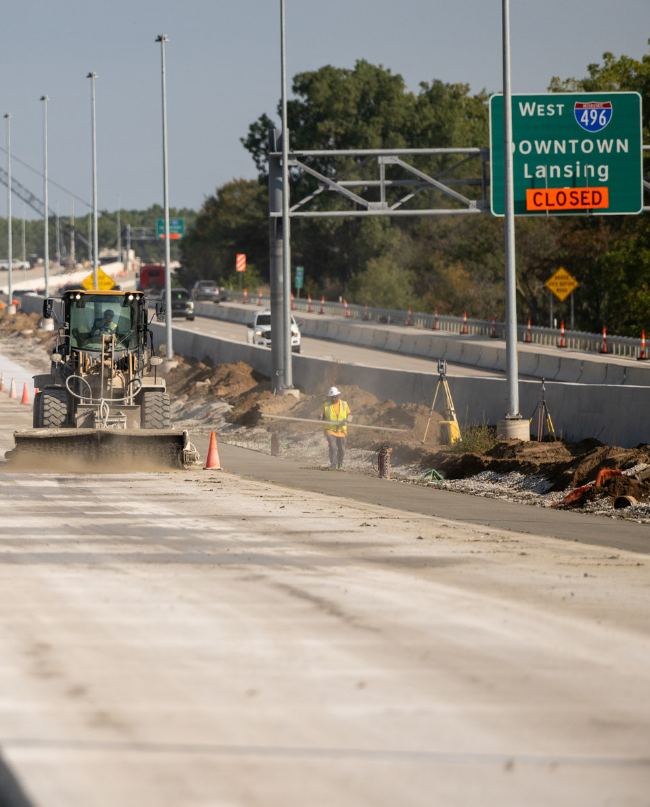

Rebuilding Michigan Program Update
“Financing not Funding”
$706M Bonds remaining to be issued in 2026
Additional Projects with remaining bond funds must be approved by STC
Debt Services
$200M currently for approximately 27 years
Projected $250M if remaining tranche is issued
GARVEE bonds issued 15+ years ago to be fully paid off in 2027

Slide 14
Road Usage Charging (RUC)
The need to replace the existing fuel tax charged at the pump is becoming necessary as vehicles become more fuel efficient and transition to alternate methods of propulsion (EVs) which do not generate revenue at the pump.
MDOT’s FY26 budget includes funding ($7.65M) and authorization to conduct a study and pilot on RUC.
RUC Technical Advisory Committee met for the first time 1/27/26. Members of the TAC come from MDOT, Treasury, State, DTMB, ACEC, MITA, CRA, MSU and Industry.
An RFP to hire a consultant to support the RUC Pilot was approved by the TAC and will be advertised as soon as practical.
The study and pilot will focus on education and outreach statewide with a goal of reducing confusion and misunderstanding related to road user charges.
That focus will include our citizens and policy makers to address their questions and concerns.

Slide 15

Reauthorization Update
AASHTO Policy Priorities
Prioritize Formula-Based Funding: Increase formula program share to 95%and reserve discretionary grants for projects of highest federal interest.
Streamline Project Delivery: Reduce regulatory burdens, modernize NEPA, and support states assuming federal responsibilities to accelerate reviews and improve efficiency.
Advance Safety, Resilience & Innovation: Expand funding eligibility for technology, sustain research and development, and promote standards for connected infrastructure and vehicles.

Slide 16




Disadvantaged &
Small Business Enterprise
DBE/SBE Program Update

Slide 17
DBE/ACDBE Program
Interim Final Rule (IFR) 10/3/25
Changes how “social disadvantage” is evaluated. Requires owners to produce an “individual social disadvantage narrative”
Requires MDOT to re-evaluate certified DBEs under the new criteria
DBE goals were removed beginning with the October letting and MDOT will not be able to establishing new DBE goals until re-evaluation process is complete
MDOT cannot report on DBE goals to FHWA, FAA or FTA until the process is complete

Slide 18
SBE Program
MDOT’s Small Business Program (SBP) certifies firms based upon business size, owner(s) personal wealth and independence
MDOT has piloted Small Business goals on Construction projects beginning with the November 2025 letting
MDOT is anticipating piloting Small Business goals on Consultant/Engineering projects by early April

Slide 19
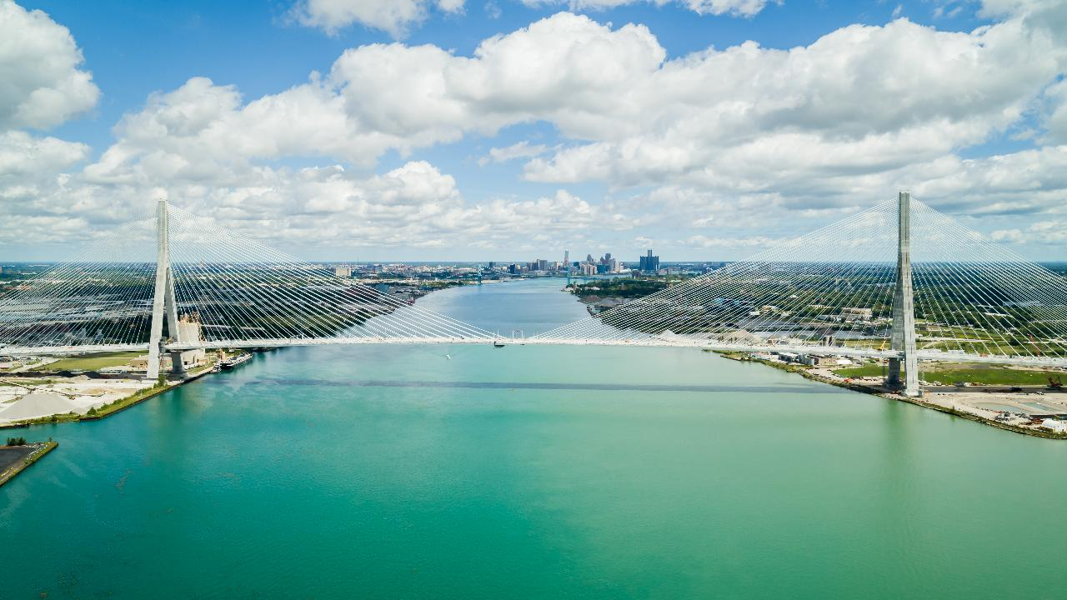

Gordie Howe International Bridge

Slide 20
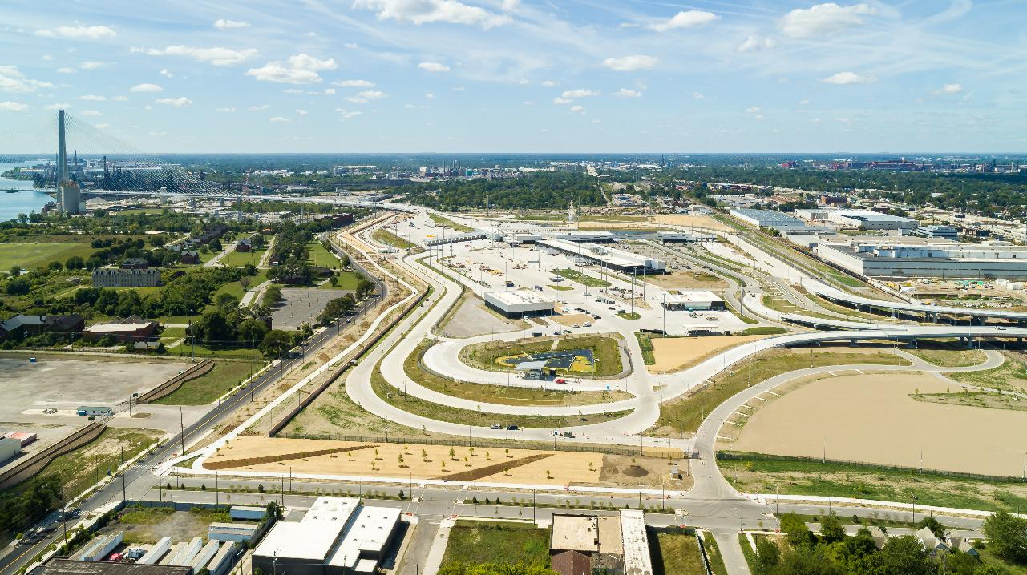
US Port of Entry

Slide 21
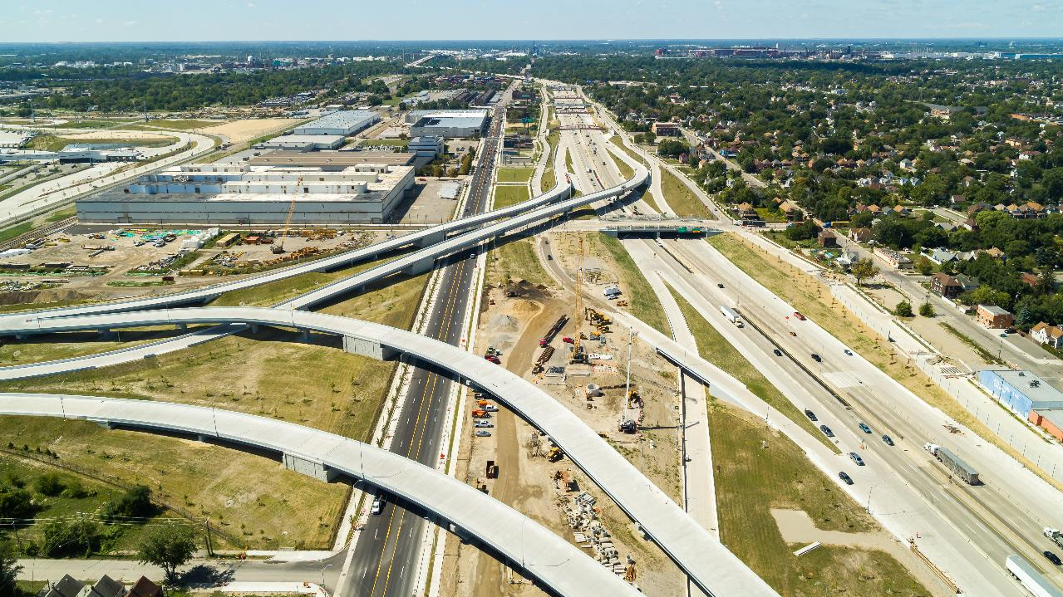
Michigan Interchange (I-75)

Slide 22
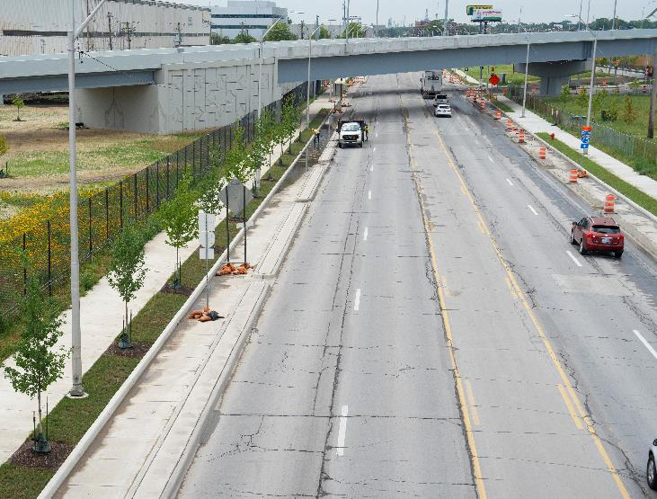
Local Road Improvements
Reconstruction and realignment of:
Green Street (in progress)
Campbell Street (complete)
Livernois Avenue (complete)
Reconstruction and reconfiguration of the following intersections:
West End Street and Fort Street (complete)
West End Street and W. Jefferson Avenue (complete)
Dearborn Street and W. Jefferson Avenue (in progress)
Clark Street and Fort Street (complete)
Clark Street and W. Jefferson Avenue (complete)
Road resurfacing will take place on:
North and southbound I-75 Service Drives (in progress)
Fort Street (in progress)
Cavalry Street (complete)
W. Jefferson Avenue (in progress)

Slide 23
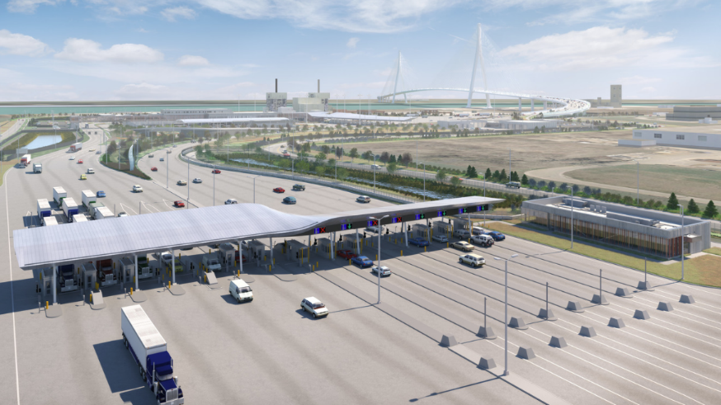
Tolling and Accounts
Rate based on vehicle classification, axle of vehicles and height
Tolls can be paid in Canadian and US dollars
Combination of manual, automatic and electronic toll collection
Prepaid and post-paid accounts
Customer service call centre
Bilingual English/French services

Slide 24
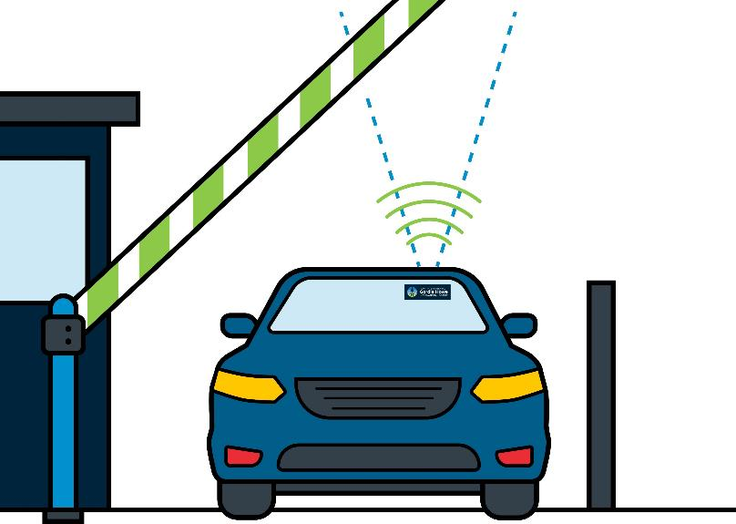
Customer Accounts
Benefits to travelers:
Discounted Rates
Pre- And Post-paid Accounts
Time Efficiency
How it works:
Account Holders Provided With Branded RFID Tag
Tag Read In Electronic Toll Collection Lanes
How to open an account:
Customer Service Webpages on Gordiehoweinternationalbridge.com
A Mobile Unit
Through Customer Service Centre

Slide 25





Workforce Development and Participation Strategy
Community Benefits Plan
Cumulative Totals from September 2018 – August 2025
15,090+
individuals oriented to the project in Canada and the US
41% are local
850+
apprentices/pre-apprentices assigned to the project
435+
co-operative learning experiences have been provided on the project
290+
local businesses engaged on the project

Slide 26
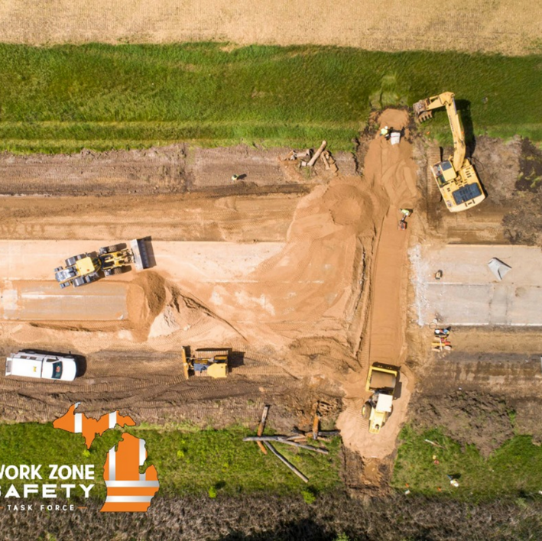

Project Updates

Slide 27
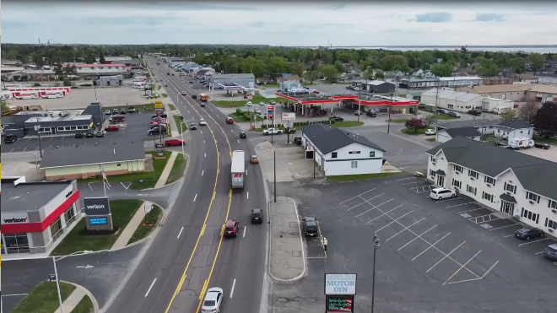
Superior Region
Route: US-2
Location: North 30th Street to Danforth Road, Escanaba
Scope of Work:
Full pavement removal and replacement
New storm sewer and municipal utilities
New subbase layer, aggregate base layer, and hot mixed asphalt layers
Replacing CN railroad bridge with a longer span
Letting Dates: Oct. 2026, Oct. 2027 (Phase 2)
Duration of Construction: Spring 2027- Fall 2029
Construction Cost: $37 million
Benefits: Pedestrian/non-motorized improvements, drainage upgrades, safety/operational improvements, aesthetic opportunities

Slide 28
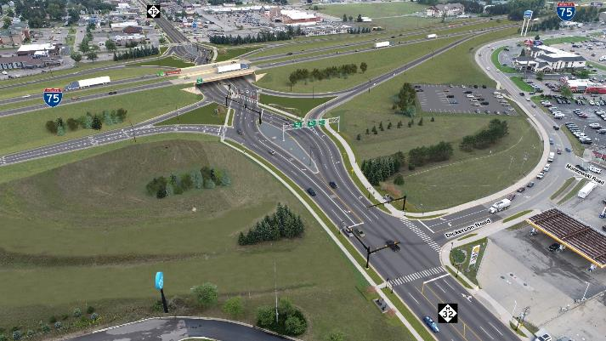
North Region
Route: I-75/M-32 Interchange
Location: Townline Road to Wilkinson Road in the City of Gaylord
County: Otsego
Scope of Work:
Reconfiguration to a Diverging Diamond Interchange (DDI)
Sidewalk/Pathway construction (5.4 miles)
Replacement of two poor-rated structures
Carpool Parking Lot
Letting Date: June 2026
Duration of Construction: Fall 2026 – November 2029
Construction Cost: $66.2 million dollars
Benefits: Improved traffic flow, active transportation improvements, pedestrian safety and lighting improvements, aesthetic improvements

Slide 29
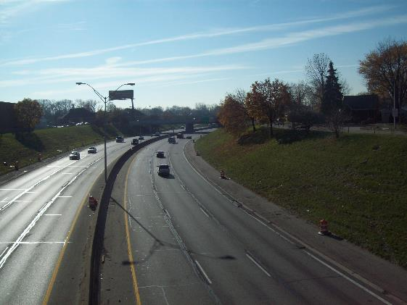
Metro Region
Route: I-94
Location: 8 Mile Rd to 11 Mile Rd
County: Macomb
Scope of Work:
Road Reconstruction
Storm sewer replacement, barrier walls, lighting replacement
Bridge
Work on 13 Structures
Rehabilitations
Letting Date: January 2027
Duration of Construction: March 2027-Oct 2029
Construction Cost: $116 million dollars
Benefits: Drainage improvements, modern signals at intersections, ADA compliant ramps and sidewalks, new LED lighting, new signs and pavement markings

Slide 30
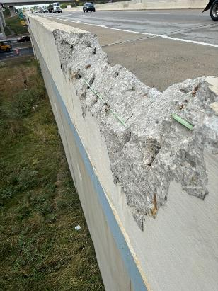
Metro Region
Route: I-94
Location: Wayne Rd. to Schaefer Rd. (10.5 miles)
County: Wayne
Scope of Work:
Road
Realign I-94 and build a new interchange at Ecorse, reconstruction, inlay, pavement repairs, lighting replacement
Bridge
Work on 24 Structures
Scope ranges from new structures to rehab
Letting Date: November 2026
Duration of Construction: February 2025-September 2029
Construction Cost: $342 million dollars
Benefits: New fully functioning interchange at Ecorse, drainage improvements, modern signals at intersections, ADA compliant ramps and sidewalks, new LED lighting, new signs and pavement markings

Slide 31
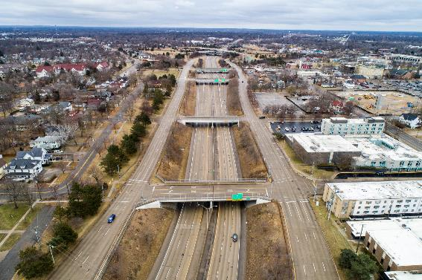
Bay Region
Route: I-475
Location: Bristol Road to Flint River
County: Genesee
Scope of Work:
Road Reconstruction
Storm sewer replacement, noise wall replacement, lighting replacement
Bridge
Work on 36 Structures
Bridge Replacements
Bridge Removals
Deck Replacements
Letting Date: August 2026
Duration of Construction: Fall 2026 to Summer 2029 (work allowed during winter)
Construction Cost: $280 million dollars
Benefits: Upgrading and adding non-motorized facilities and right-sizing roadways to meet current and future needs of the surrounding communities

Slide 32
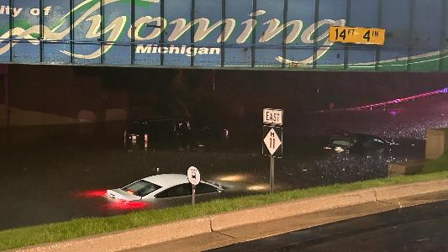
Grand Region
Route: M-11 (28th Street)
Location: Division Avenue to Kalamazoo Avenue
County: Kent
ADT: 36,000 to 42,000
Scope of Work:
Road reconstruction (west half)
Pavement Inlay (east half)
Pump Station and stormwater drainage improvements
Federal PROTECT grant
Pedestrian crossings with HAWK signals
Letting Date: Summer 2026
Duration of Construction: April – Nov. 2027, pre-construction work in fall 2026.
Construction Cost: $31 million
Benefits:
Reconstruction of major highways connecting several large communities, industries, and services
Remove poor-condition pavement
Improved stormwater drainage and less likelihood of road flooding by Division Ave.

Slide 33
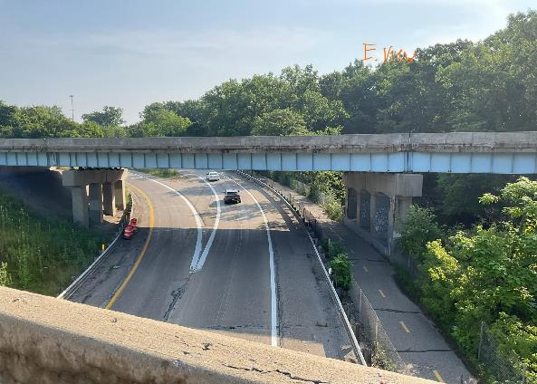
University Region
Route: US-127
Location: I-496 to Lake Lansing Road
County: Ingham
Scope of Work:
Road
Reconstruction/Inlay
Storm sewer replacement
County Drain work
Upgraded lighting
Bridge
2 Replacements
Work on 12 Structures
Deck Replacements
Railing Replacements
Letting Date: December 2026
Duration of Construction: Spring 2027 to Fall 2028
Construction Cost: $108.7 million dollars
Benefits: Improved pavement and bridge condition, geometric improvements (NB and NB exit at M-43), pedestrian upgrades, ITS upgrades, lighting upgrades, guardrail upgrades

Slide 34
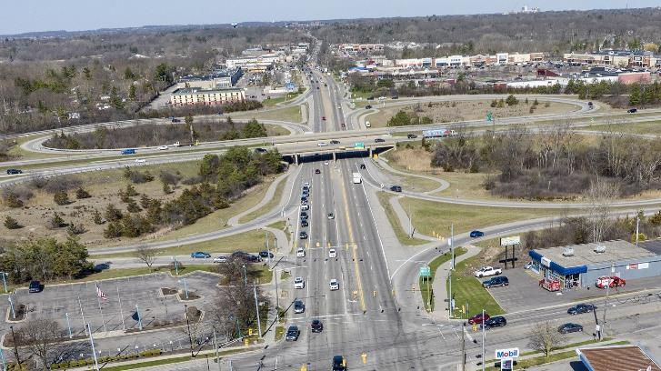
University Region
Letting Date: December 2026 (CMGC)
Duration of Construction: Spring 2027 – Fall 2029
Construction Cost: $320 million dollars
Benefits: Update aging infrastructure of roadways & bridges, modernize geometric elements & provide connectivity & mobility along & across the corridor
Route: US-23
Location: I-94 to Earhart Road
County: Washtenaw
Scope of Work:
Road Reconstruction
Drainage, Safety & Operational Improvements
Bridge Replacement
9 - Removals and Replacements
Bridge Rehabilitation
4 - Deck Patching & Epoxy Overlays

Slide 35
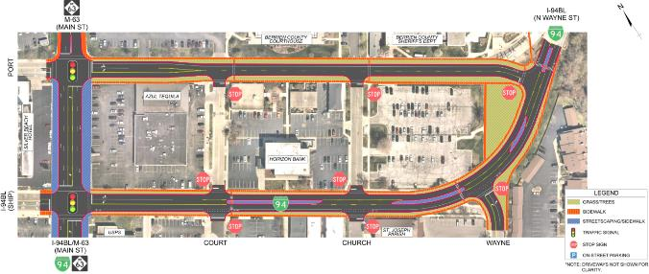
Southwest Region
Route: M-63 / I-94 BL
Location: Main, Port and Ship Streets in the City of St. Joseph
County: Berrien
Scope of Work:
Road Reconstruction
Storm sewer and municipal utility replacements, traffic signal upgrades, traffic operational upgrades, non-motorized improvements, streetscaping including lighting.
Letting Date: CMGC ~ December 2026
Duration of Construction: June 2027 – November 2028
Construction Cost: $25.4M plus $4.9M City Trans. Alternatives Program (TAP) Grant
Benefits: Replacing 1950’s concrete and underlying utilities, Port/Ship 1-way to 2-way conversion, sidewalk/bike/transit upgrades, ped refuge islands, traffic signal connectivity to lift bridges.

Slide 36
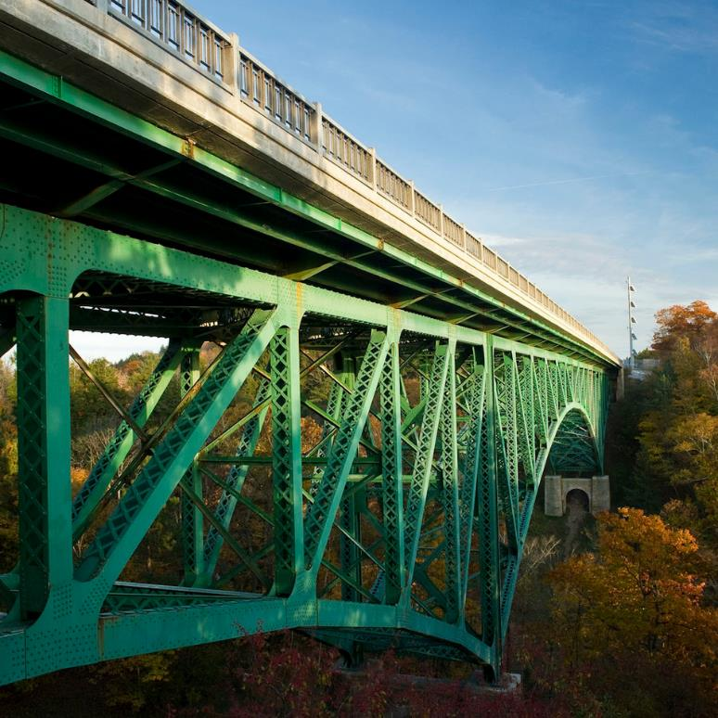
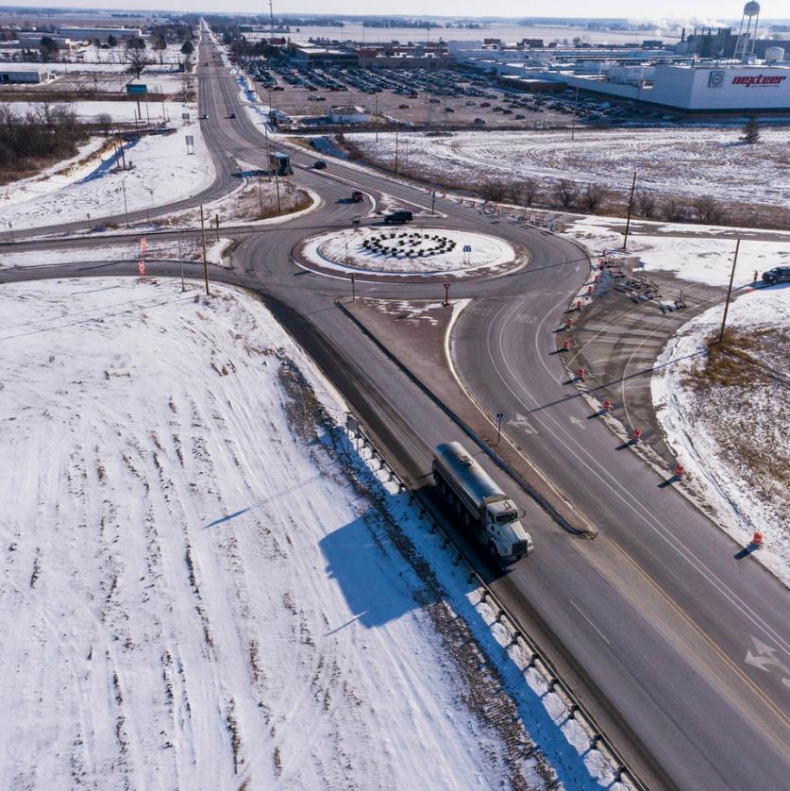
THANK YOU
Questions?

