Slide 1
BUILDING A CHAMPIONSHIP ECONOMY: A QUEST FOR GREATNESS
Quentin L. Messer, Jr.
February 8, 2023
Notes:
INTRO:
Thank them for having you.

Slide 2





TRANSFORMATIONAL PROJECTS MATTER –
BUT ECONOMIC DEVELOPMENT IS MUCH MORE THAN THAT
Supporting placemaking investments
Providing buyer/supplier matchmaking opportunities
Expanding into international markets
Accelerating startup opportunities
Helping small businesses grow
Promoting Michigan as a best-in-class destination for travel and tourism
Protects and rehabilitate Michigan’s historic places
Notes:
DEFINING ECONOMIC DEVELOPMENT
Important to level-set what we mean when we talk about economic development – because it’s a big tent!
Yes, it means the projects we read about in the papers – the transformational projects from Ford, GM, Our Next Energy and Gotion.
But it’s also so much more – it’s about:
Supporting placemaking investments in communities across the state to make them places where talent wants to live and businesses want to be
Providing buyer/supplier matchmaking opportunities to help our great Michigan companies secure new business
Expanding into international markets for Michigan risktakers and businesses to grow their customers
Accelerating startup opportunities for researchers in universities and throughout the state
Helping small businesses grow with implementing Industry 4.0 technologies and accessing federal resources that are available
Promoting Michigan as a place to visit and explore through Pure Michigan
Protect and rehabilitate our historic places that bring us so much pride to call ourselves Michiganders and foster so much appreciation for our towns and communities
Beyond our robust programs, we also have a strong internal team at MEDC to provide and prioritize excellence in customer service support.
Committed to making sure everyone sees themselves in the work we do at MEDC.

Slide 3

CELEBRATING MICHIGAN’S
HISTORIC 2022
Regional Impact of MEDC across Michigan’s 83 counties
Special Utility Rates for High-Volume Customers
$600M
121
$5.2B
Consumers Energy Competitive
Rate on Incremental Electric
Load with minimum
DTE Electric large-volume
customers adding incremental electric load with minimum
In Private Investment Leveraged for Placemaking Projects
New Businesses Started through State Support
In Revenue for Small Businesses through State Support
35 MW
50 MW
For at least 15 years
For at least 15 years
As a result of the signed SOAR Fund Legislation
$13.5B
+12,900
In Private
Investment
Jobs Created
and Retained
Notes:
Highlighting accomplishments that we have achieved
Achieved so much together in the past year that has positioned us today to create even more long-term opportunities and success for the people and businesses who call our state home.
MEDC continued to drive home its regional relevancy across Michigan’s 83 counties:
Leveraged $600 million in private investment to support placemaking projects
Helped start 121 new businesses
Helped small businesses generate $5.2 billion in revenue through our state support
At the close of 2021, legislative leaders took bold votes to approve legislation that puts Michigan in a position of strength and certainty as we work to secure transformational projects that will create economic opportunity for families and workers for generations.
Throughout 2022, the SOAR Fund helped Michigan secure more than $13.5 billion in private investment in Michigan communities and create and retain nearly 13,000 jobs in the EV, battery manufacturing and semiconductor industries.
Michigan’s two largest electric utilities, Consumers Energy and DTE Electric, will now offer special rates for high-volume industrial customers thanks to an approval by the Michigan Public Service Commission.
Helps MI compete with other states when companies look for sites to build facilities for producing electric vehicles, related components including batteries and semiconductors, and other advanced manufacturing.

Slide 4




THE WORLD IS DIFFERENT NOW THAN IT WAS PRE-COVID
Symbol or
Number
Symbol or
Number
Workers
Small business
Supply chain
Rural shifts
Persistent COVID impacts require response
Labor force participation (59%) remains lower than peers and pre-COVID levels (62-63%), and employment remained 5% (238K) below the pre-pandemic level as of September 2021, exacerbating the challenges of an already shrinking population
Small businesses need recovery support
Small businesses hit hard by the pandemic recession need support as they recover and endure ongoing market changes
Emphasis on resiliency provides opportunity
New emphasis—and significant investment—in more resilient supply chains provides and opportunity for Michigan, particularly in semiconductors
Moves to rural areas demonstrate potential
While Michigan’s most distressed rural regions saw a 14% population decline before the pandemic, they saw a 2% increase during the pandemic—and other regions also slowed declines
Notes:
4
OUR WORLD HAS CHANGED SINCE COVID
The world is different now than it was pre-COVID, impacting our workforce, small businesses, and the supply chain.
Persistent COVID impacts require response. Labor force participation remains lower than our peers and pre-COVID levels, and employment remained 5% below the pre-pandemic level as of September 2021, exacerbating the challenges of an already shrinking population. Know this is especially relevant here in Barry County.
Small businesses hit hard by the pandemic recession need support as they recover and endure ongoing market changes
The new emphasis and significant investment in more resilient supply chains provides an opportunity for Michigan, particularly in semiconductors
Moves to rural areas demonstrate potential: While Michigan’s most distressed rural regions saw a 14% population decline pre-pandemic, they saw a 2% increase during the pandemic. Other regions also slowed declines.

Slide 5
MICHIGAN’S PATH FORWARD:
CONSISTENCY
WINNING IN OUR OWN BACKYARD
PHYSICAL AND KNOWLEDGE INFRASTRUCTURE
MARKET THE STATE
Notes:
OUR PATH FORWARD
While these challenges are big, we are up for the fight on Team Michigan.
By working together across the state, we can continue to achieve greatness for our 10 million-plus friends and neighbors.

Slide 6
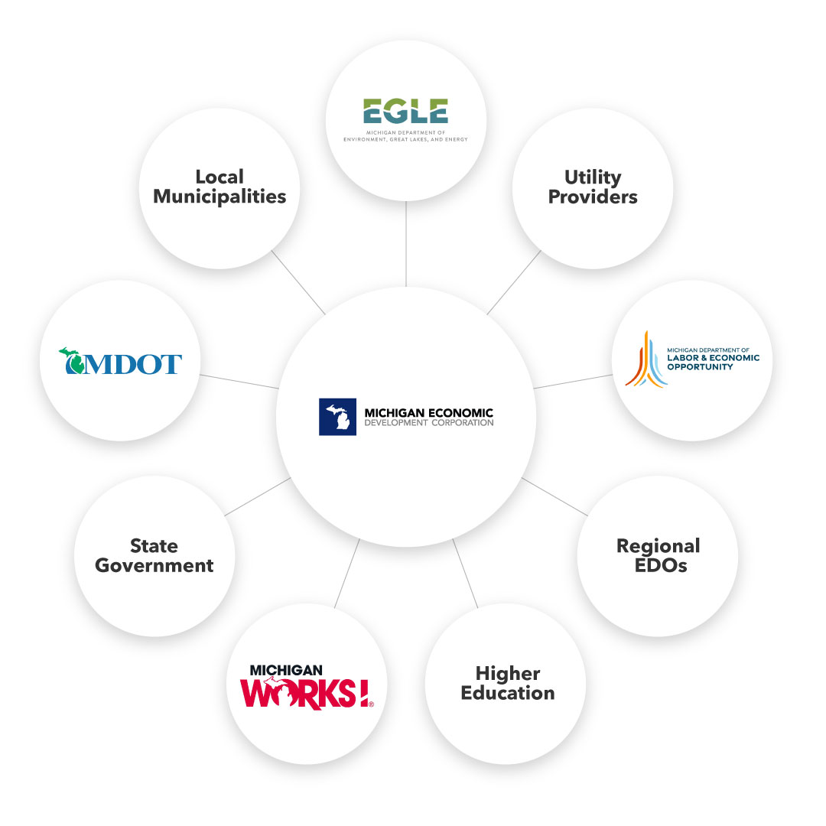
CONSISTENCY:
TEAM MICHIGAN APPROACH
Notes:
CONSISTENCY
Embrace a Team Michigan, whole of government approach to ensure our support is streamlined and simplified for customers every step of the way.
We have a robust network of partners joining us in the work we’re doing.

Slide 7
MEDC & Core Partners, Steering Committee
EDO’s
CDFI’s, Banks & Credit Unions
DDA / Community Organizations
Professional Service Firms
Business Service Organizations
SmartZones
WINNING IN OUR
OWN BACKYARD: SUPPORTING SMALL BUSINESS
Supporting micro, early-stage, second-stage and growth-stage companies to find capital, help to implement systems and technology, establish and diversify customer base and help find the talent needed.
Notes:
WINNING IN OUR OWN BACKYARD: SUPPORTING SMALL BUSINESSES
Made supporting small business a key focus area of our MEDC strategic plan to demonstrate our commitment to helping businesses of all sizes
Working with a broad group of partners to ensure risk takers and small businesses have the resources they need to be successful – whether it’s:
Federal funding through the State Small Business Credit Initiative
Working with our Small Business Service and Support team at MEDC
Or tapping into our service providers like the Small Business Development Centers around the state.
We’re focused on enabling regions, institutions and small businesses to thrive with distinct regional identities.
IF NEEDED: Utilizing State Small Business Credit Initiative
Another tool in our toolbox to support Michigan’s small businesses and tech-based startups is the State Small Business Credit Initiative (SSBCI) 2.0 funding from the U.S. Department of Treasury.
In August 2022, Michigan began deploying funds from the first round of SSBCI 2.0 funding, with up to $72 million available to support loans to small businesses through MEDC’s Access to Capital programs, including:
Collateral Support
Loan Participation
Loan Guarantee
Capital Access Programs
Equity investments for early-stage, technology-based businesses in Michigan as part of the Small Business Venture Capital Program.
Michigan was one of only five states to be approved for funding through this round of SSBCI awards, intended to increase access to capital and promote entrepreneurship, especially in traditionally underserved communities as they emerge from the pandemic
SSBCI funding is expected to catalyze up to $10 of private investment for every $1 of SSBCI capital funding
We are committed to deploying every federal and state resource available to spark additional innovation and economic opportunity here in Michigan
$72 million to support loans to small businesses intended to increase access to capital and promote entrepreneurship, especially in traditionally underserved communities as they emerge from the pandemic

Slide 8
WINNING IN OUR OWN BACKYARD: OFFICE OF RURAL DEVELOPMENT
FOCUSING ON THE STRATEGIC
NEEDS OF RURAL MICHIGAN
Economic and Workforce Development
Infrastructure
High-speed Internet
Public Health
Environmental Sustainability
Notes:
WINNING IN OUR OWN BACKYARD: OFFICE OF RURAL DEVELOPMENT
We are laser-focused on connecting risk-takers, small businesses and startups throughout urban, suburban and rural areas with the resources and support they need.
We’re also building on our work to encourage economic growth throughout the state through our support of the newly created Michigan Office of Rural Development, working in partnership with Director McDowell – who I have monthly meetings with to collaborate and share opportunities – along with others to create greater equity in economic opportunities in all Michigan communities.
At the MEDC, we are committed to doing everything we can to make sure our impact is felt by rural, urban and suburban communities alike, because we know that economic development only matters because people matter.

Slide 9




WINNING IN OUR OWN BACKYARD: REGIONAL PROSPERITY
Transformational
Customer-focused
Ingenuity and Innovation
Notes:
WINNING IN OUR OWN BACKYARD: REGIONAL PROSPERITY
Our efforts remain guided by our strategic plan to enable upward economic mobility for all our 10 million-plus friends and neighbors.
MEDC Team lives, works and plays in every region of the state. Our staff is intentionally spread out among every prosperity region to make sure we are on the ground and supporting the local needs of each community every step of the way.
In doing so, we support Michiganders and communities across every single corner of the state.
From high-tech entrepreneurs and startups to small businesses, Michigan’s tourism industry workforce and more – we are committed to making sure everyone sees themselves in Michigan’s economic success.
New Regional Prosperity Team and SVP of Regional Prosperity Matt McCauley working with communities across the state to provide dedicated and personalized support.
Together, we may be two peninsulas but we have one shared destiny on Team Michigan.
I brought in visuals from how QLM talked about it per Matt on the slide maggie did. Including the tps here:
REGIONAL IMPACT
As we work to achieve these goals, our efforts remain guided by our strategic plan to enable upward economic mobility for all our 10 million-plus friends and neighbors.
As we work to realign our strategic plan, we are doing so with a focus on being transformational (how we are driving impact statewide and supporting regional strategies); customer-focused (being consistent, streamlined approach, timely in decision making, proactive, and stronger individual accountability); and embracing an approach that’s defined by ingenuity and innovation (focusing on collaboration and creative thinking and approaches). Throughout this process, we are prioritizing four key areas that will drive our ultimate impact and success both operationally and organizationally.
People: Take a team cross-collaborative approach focused on serving customers rather than being driven by programs. Eliminate silos and engage more directly and effectively with our customers. Align with implementation of the strategic plan while driving regional impact statewide. Serve as concierges to our customers, stakeholders and partners. Determine how we can support a culture that creates an environment for engagement, inclusion, and support.
Process: Streamline our efforts with customer responsiveness in mind. Focus on mitigating, not eliminating risk, and clearly identify ownership and accountability for execution.
Tools: Ensure programs are designed to impact the strategic plan. Shift to flexibility within programs so we can more effectively problem solve. Focus on what is needed from a local and regional level rather than top down while maintaining alignment with the strategic plan.
Metrics: Ensure our efforts are driving toward the outcomes we aim to achieve. Focus on whether our efforts are driving individual behavior and overall culture of the organization in a way that helps employees feel empowered to make an impact across the state.
Notably around our focus on being regionally relevant to every community throughout the state.
CD and BD Process Improvements/Alignment
Relationships- not a series of transactions
Be more demand driven than before
Positive, “Can Do” Attitude
Northern Michigan Contacts- Tino Breithaupt, Dan Leonard, Jessie Mitchell, Jen Tucker….Matt McCauley locally based, but oversees state team

Slide 10
WINNING IN OUR OWN BACKYARD: OFFICE OF HIGH-SPEED INTERNET
RELIABLE HIGH-SPEED INTERNET IS IMPREATIVE ON BOTH PENINSULAS.
Connecting Michigan Taskforce
Broadband Expansion Act
Connecting Michigan Communities Grant Program
Notes:
WINNING IN OUR OWN BACKYARD: OFFICE OF HIGH-SPEED INTERNET
In June, Gov. Whitmer signed an Executive Directive to expand high-speed internet access for people in Michigan, creating the Michigan High-Speed Internet Office (MIHI) to ensure that "every home and business in Michigan will have access to an affordable, reliable high-speed internet connection that meets their needs."
High-speed internet is becoming more of a necessity than ever before in citizens' educational, professional and personal lives played a key factor in the creation of MIHI, especially since the COVID-19 pandemic hit.
MEDC works to support efforts being led by Eric Frederick in this office, acknowledging that businesses and talent alike make decisions about where to locate and grow based on their ability to access necessities like high-speed internet
Gov. Whitmer signed into law the Broadband Expansion Act of Michigan in June, which codified the Connecting Michigan Communities (CMIC) grant program.
Connecting MI Communities Grant Program: The Michigan Department of Technology, Management, and Budget (DTMB) is providing a grant opportunity to extend broadband service into unserved areas in Michigan. The grant funds are available to projects that demonstrate collaboration to achieve community investment and economic development goals of the area impacted.

Slide 11






PHYSICAL AND KNOWLEDGE INFRASTRUCTURE: BARRIERS WE MUST ADDRESS TO WIN ON TALENT
Trouble finding talent
Shortage of high-skill workers in advanced manufacturing and healthcare
Workforce shortages
Labor force participation lagging
Challenges retaining, recruiting and upskilling talent
Population growth declining
Notes:
PHYSICAL AND KNOWLEDGE INFRASTRUCTURE: TALENT
The MEDC is developing the talent for Michigan’s tomorrow.
Every state faces a universal challenge of how to attract, keep and grow their workforce to meet employer needs.
Here in Michigan, we’re no exception; what we hear most from employers is that they are having trouble finding talent.
We need to be honest about the challenges we’re facing if we’re going to be effective in addressing them:
We are experiencing challenges in retaining and recruiting talent, and upskilling/reskilling workers.
In advanced manufacturing and healthcare, there is a significant shortfall of high-skill workers
Labor force participation rates are lagging.
Need to grow diversity in talent across priority sectors
Must strengthen the link between education and employers
Also – I said it before, and I know it’s grim, but it’s also the truth: Our population growth is trending towards decline.
Come 2028, deaths will outpace births in Michigan.
By investing in tailored solutions for employers, expanding educational opportunities to build competitive, cross-industry talent for the future, and investing in education/employment partnerships that create early career exposure and better feedback between educators and employers, Michigan’s talent pool can help build upon our state’s economic competitiveness and allow us to continue winning in the years to come.

Slide 12




PHYSICAL AND KNOWLEDGE INFRASTUCTURE: MEDC’S TALENT ACTION TEAM
Serving as a concierge service for talent solutions
Sourcing and training talent to give Michigan companies an advantage in the semiconductor, EV and mobility markets
Leveraging existing programs, like Going PRO, MI Reconnect, and more
Developing strategic labor and skill forecasts in partnership with companies so we know their top talent priorities
Promoting auto industry as great place to work, offering highly purposeful and rewarding career
Recruiting widely – via a network of community partners – to deepen diverse pools of talent
Partnering with training providers to develop tailored, accelerated, flexible programs
Notes:
PHYSICAL AND KNOWLEDGE INFRASTRUCTURE: TALENT ACTION TEAM
Building on our commitment to providing concierge-level support to businesses looking to grow and expand, the MEDC convened two Talent Action Teams to launch the first focused effort on supporting the talent transition in the EV and mobility sectors as well as the semiconductor industry.
In the future, we’ll also launch similar Talent Action Teams specific to other focus industries in the state.
The EV and mobility Talent Action Team’s goal is to train thousands of workers in the first year by delivering professional development programs that engage workers in improving their skills and competencies in line with in-demand roles.
This new model of workforce development aims to reshape a once fragmented and dispersed landscape of resources and programs into a hub of innovation and collaboration, all centered on the people that have made Michigan a powerhouse of the auto industry for over a century.
The Team acts as a concierge service for talent solutions, including leveraging existing programs such as Going Pro and MI Reconnect.
The work being led by the Talent Action Team will serve to inform other industry-specific initiatives, as well, like the state’s EV Academy, to proactively prepare the talent needed for automotive mobility and electrification current, emerging, future jobs and career pathways.

Slide 13
PHYSICAL AND KNOWLEDGE INFRASTUCTURE:
STRATEGIC SITE READINESS
Site
Qualitative Considerations
Energy
Two initial drivers in the site section process include the site and talent availability.
Additional factors include energy, community, incentives and qualitative considerations such as the cohesiveness of the team and eagerness to secure projects, DEI initiatives, environmental sustainability goals, personal interaction.
Site Selection
Community
Incentives
Talent
Notes:
PHYSICAL AND KNOWLEDGE INFRASTRUCTURE: STRATEGIC SITE READINESS
Michigan is years, and even decades, behind competitor and other states in site readiness efforts.
Michigan is being noticed and is experiencing an unprecedented level of interest as a site selection option.
Being site-ready means having the talent, incentives, energy connectivity, DEI initiatives and support systems in place to welcome a global company and its employees on Day One.
With the additional $350 million MEDC received to support strategic site readiness, we are:
Identifying and preparing multiple megasites throughout the state
Growing our Build Ready Sites Program to prepare sites of all sizes in communities across Michigan
Identifying innovative ways to address company site concerns in real time as our pipeline faces historic demand
IF NEEDED: KEY DEFINITIONS
Site Selection is the process of analyzing all factors impacting the likelihood of project success.
There are two initial drivers in the site selection process: site and talent.
Site is the physical property and attributes, including all factors related to the viability of site development and operations.
Energy is the availability and cost of service.
Incentives are financial and other resources applied to project costs, which vary by project and may be a significant factor.
Talent is workforce availability and initiatives designed to secure workforce requirements.
Community is the supporting position of the local unit of government; quality of life attributes such as housing availability and schools, and vibrant communities.
Qualitative Considerations are the non-measurable aspects that companies and consultants respond to emotionally – the cohesiveness of the team and eagerness to secure projects, DEI initiatives, environmental sustainability goals, personal interaction.

Slide 14
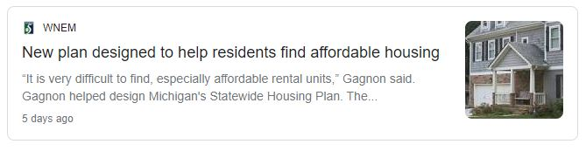
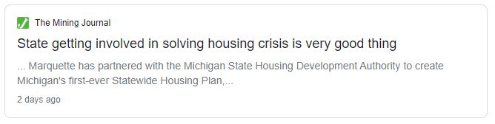
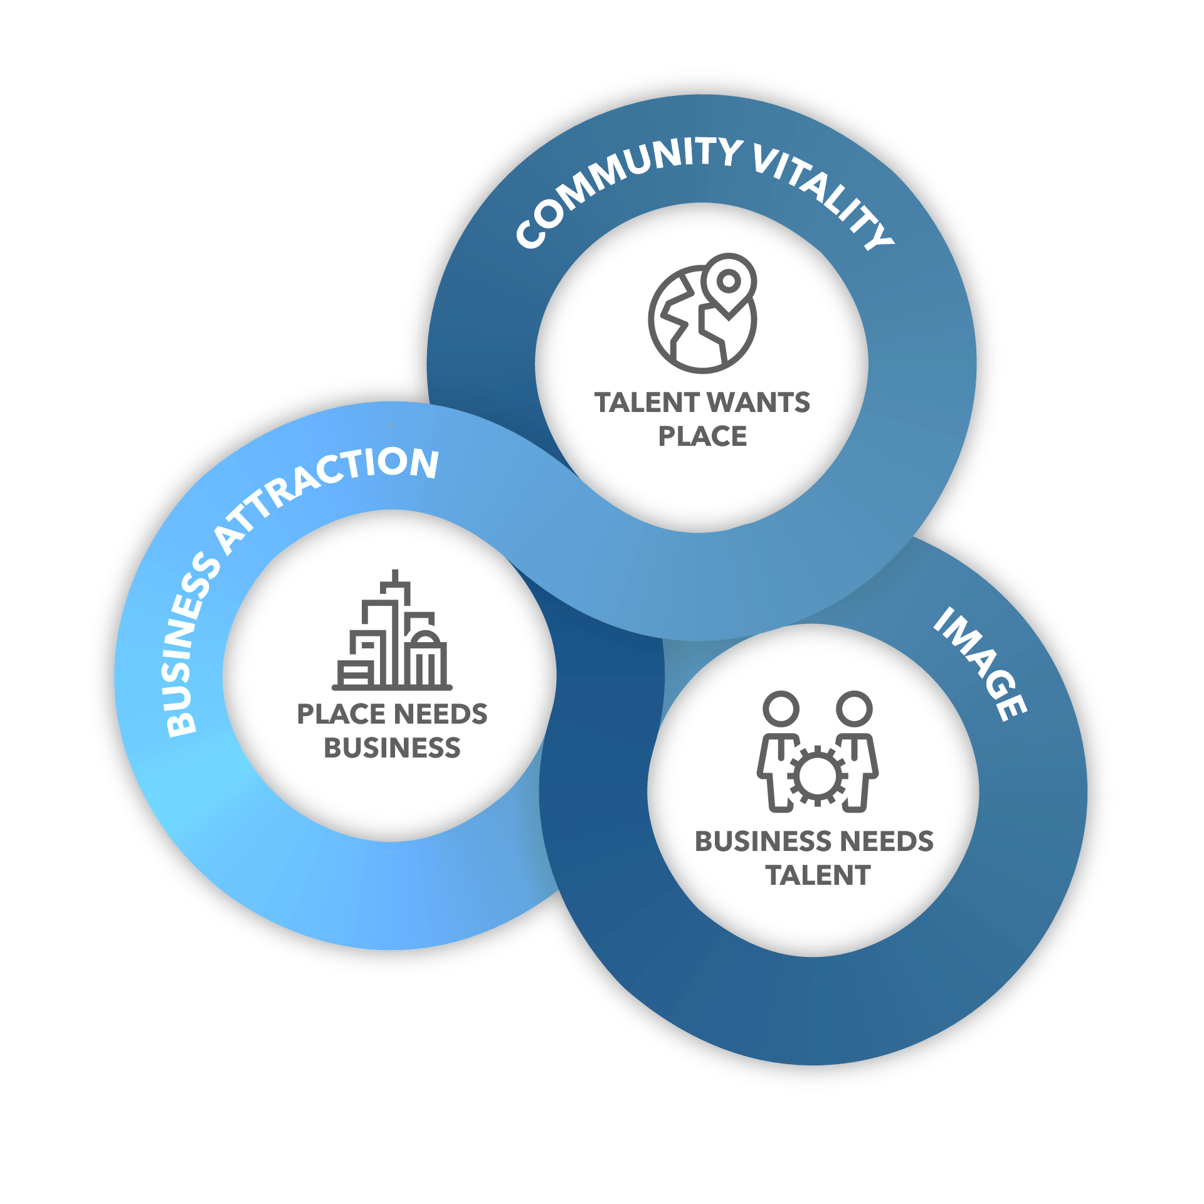
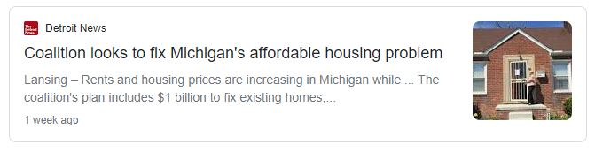
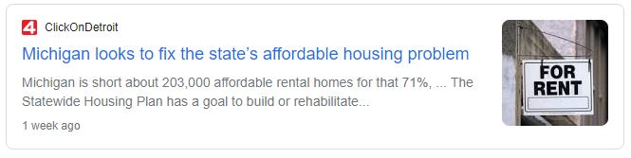
PHYSICAL AND KNOWLEDGE INFRASTRUCTURE:
PLACE AND HOUSING MATTER IN MICHIGAN’S ECONOMIC FUTURE
Notes:
IMPORTANCE OF PLACE IN OUR ECONOMIC FUTURE: HOUSING
Last summer, Governor Whitmer proposed a significant $100 million investment in affordable, attainable housing to create 2,000 units, create 1,600 good-paying jobs and give 6,000 Michiganders a place to call home.
We’re working with the Administration and MSHDA to support greater access to affordable housing to make sure all our communities are a great place to live, work and play.
We know that workers want safe, attractive and affordable housing options with access to businesses, public services, cultural amenities and community assets – and yet, here in Michigan there is a housing shortage being felt across many housing types and price points.
MEDC specifically targets housing for households with incomes between 80% and 120% of the area median income (AMI) in growing the inventory of housing for Michigan’s workforce.
We work closely with the Michigan State House Development Authority, who in turn supports low-income housing.
Pleased to support the first-ever statewide housing plan introduced by the Governor this year, which works to make investments in affordable, accessible housing that will give us a competitive edge in attracting and retaining talent.
We can make bold investments to support our business community and create better jobs for Michigan workers, with a laser-focus on creating and growing more Main Street businesses that make up the heart and soul of our local communities.
Build MI Community Grant: provides access to real estate development gap financing for small scale, incremental redevelopment projects.
The Build MI Community Initiative has been established to re-activate underutilized or vacant space into vibrant areas by promoting capital investment into redevelopment projects being taken on by developers and property owners with limited real estate development experience and familiarizing them with the development process in order to position them to potentially undertake more complex projects in the future.
Revitalization and Placemaking Program: awarded $83.8 million in grant funding across 22 statewide community development projects around Michigan
And of course, this means that we need to build stronger communities across our state, because Michiganders deserve to live in vibrant places with the kinds of services and amenities that can create a high quality of life, from affordable and attainable housing to high-speed internet access.
At the end of the day, the true measure of success and impact within our economy won’t be based on rosy economic statistics or reports. It will be measured by the conversations taking place at kitchen tables every night across our state.

Slide 15
To support these efforts, MEDC works to provide resources for real estate professionals and emerging developers to:
Eliminate barriers to accessing and utilizing MEDC programs and services
Ensure equal access to the MEDC community development programs and services.
Provide the tools and network for coordinated communication regarding opportunities.
Identify and establish regional networking opportunities to assist developers in creating a development team, forming networks, and improving access to capital and other resources.
Establish initiative to introduce individuals to development and assist with putting them in position to take the next steps in development.
PHYSICAL AND KNOWLEDGE INFRASTRUCTURE:
SUPPORTING OPPORTUNITIES FOR EMERGING DEVELOPERS
Notes:
IMPORTANCE OF PLACE IN OUR ECONOMIC FUTURE: EMERGING DEVELOPER SUPPORT
Also making a commitment to supporting opportunities for community members to get involved in development projects to be part of the change they want to see in their communities – even if they don’t have traditional developer experience or access.
MEDC created our Emerging Developers program – and a Developers Toolkit – to help break down barriers for new developers to engage in opportunities to grow and invest in their communities.
And of course, this means that we need to build stronger communities across our state, because Michiganders deserve to live in vibrant places with the kinds of services and amenities that can create a high quality of life, from affordable and attainable housing to high-speed internet access.
At the end of the day, the true measure of success and impact within our economy won’t be based on rosy economic statistics or reports. It will be measured by the conversations taking place at kitchen tables every night across our state.

Slide 16


MARKET THE STATE:
PROMOTE MICHIGAN’S IMAGE AS A WORLD-CLASS BUSINESS LOCATION AND TRAVEL DESTINATION
Notes:
MARKETING THE STATE
In addition to our work to attract and retain companies, support small businesses, accelerate high-tech innovation and develop attractive communities – is our proactive work to market the state by promoting Michigan’s image as a world-class business location and travel destination.
Pure Michigan is no doubt the best-known campaign, and while it is no doubt first and foremost a consumer-facing leisure travel campaign effort, we also very much consider Pure Michigan as part of our economic development efforts as well – particularly when it comes to conversations around talent retention and attraction.
Ultimately, we are working to increase both the awareness and consideration of Michigan – whether it’s a site selector looking for the best site for an expansion, a CEO in Michigan looking to grow business opportunities in the state, talent considering where they should live and work, or a traveler planning their next vacation.
We are also working over the coming year to build a talent campaign to continue growing awareness and consideration of Michigan among key talent looking for a place to build a career and a life for themselves.

Slide 17
THE JOURNEY TO GREATNESS:
MEETING TODAY’S REALITY AND PREPARING FOR TOMORROWS
Developing a “Moat” around Michigan Businesses
Continuously Operating as Best-in-Class
Aggressively Telling our Story
Enhancing our Regional Relevancy
Moving Mountains for our Customers
Notes:
WHAT WE ARE DOING AS AN ORGANIZATION TO MEET TODAY’S REALITY
As we move forward, we’re laser-focused on making sure we as MEDC are preparing to respond to today’s reality while forging a path toward greatness for all of Michigan.
This is the exact effort that I committed to spearheading when I was brought on as the leader of this incredible team.
Grateful to continue working with all of you to make our vision of greatness a reality in Michigan.
MEDC is evolving to meet today’s reality while staying laser-focused on building and maintaining a moat around our in-state businesses, making strategic bets on the future.
MEDC needs to be recognized by our peers across the country as the best economic development organization in the nation.
By working together, being creative and staying focused on the people who we serve, we will make sure MEDC – and all of Michigan – sets the standard of excellence for economic development across our country.
Continuing to be our own best advocates and tell the most compelling Michigan story.
By working collaboratively with every single one of you as partners in making a strong case for Michigan, we are going to put the world on notice that Michigan is a top destination for both business and travel.
Making sure that no matter where our customers are – whether they’re in urban, suburban or rural communities of the state – our work is regionally relevant to every single Michigander we serve.
Staying laser-focused on expanding and growing our orientation to customer service and a partner-centric approach to economic development.
We wouldn’t be successful without our strong partnerships and our dedicated and loyal customers in businesses, communities and regions across the state.
Focused on not only winning but making sure we offer the highest quality of customer service and support every step of the way.

Slide 18
THANK YOU
Quentin L. Messer, Jr.
Messerq@michigan.org
Personal Mobile
225.235.4830
Work Mobile
517.881.5861
Notes:
CLOSING SLIDE:
Thank them for inviting you; open up to questions if time allows.

