Slide 1
NSSGA Update From DC
February 13, 2025
Evan H. Bender
Director, Government Affairs

Slide 2
Agenda
NSSGA Introduction
New Landscape in DC
Federal Priorities NSSGA is Advocating for
ROCKPAC Update
Questions?

Slide 3


NSSGA
Our members are stone, sand and gravel producers, as well as those who provide equipment and services to support them. They are responsible for producing the essential raw materials found in homes, buildings, roads, bridges and public works projects across the country.
NSSGA represents 90 percent of the crushed stone and 70 percent of the sand and gravel produced annually in America.

Slide 4

Our Mission
NSSGA advocates for the priorities of the aggregates industry to positively impact federal public policy in legislation and regulation.
NSSGA provides the venue for members to come together to learn, collaborate and network.
NSSGA arms and informs our members to engage in public policy, making our collective voice greater.

Slide 5
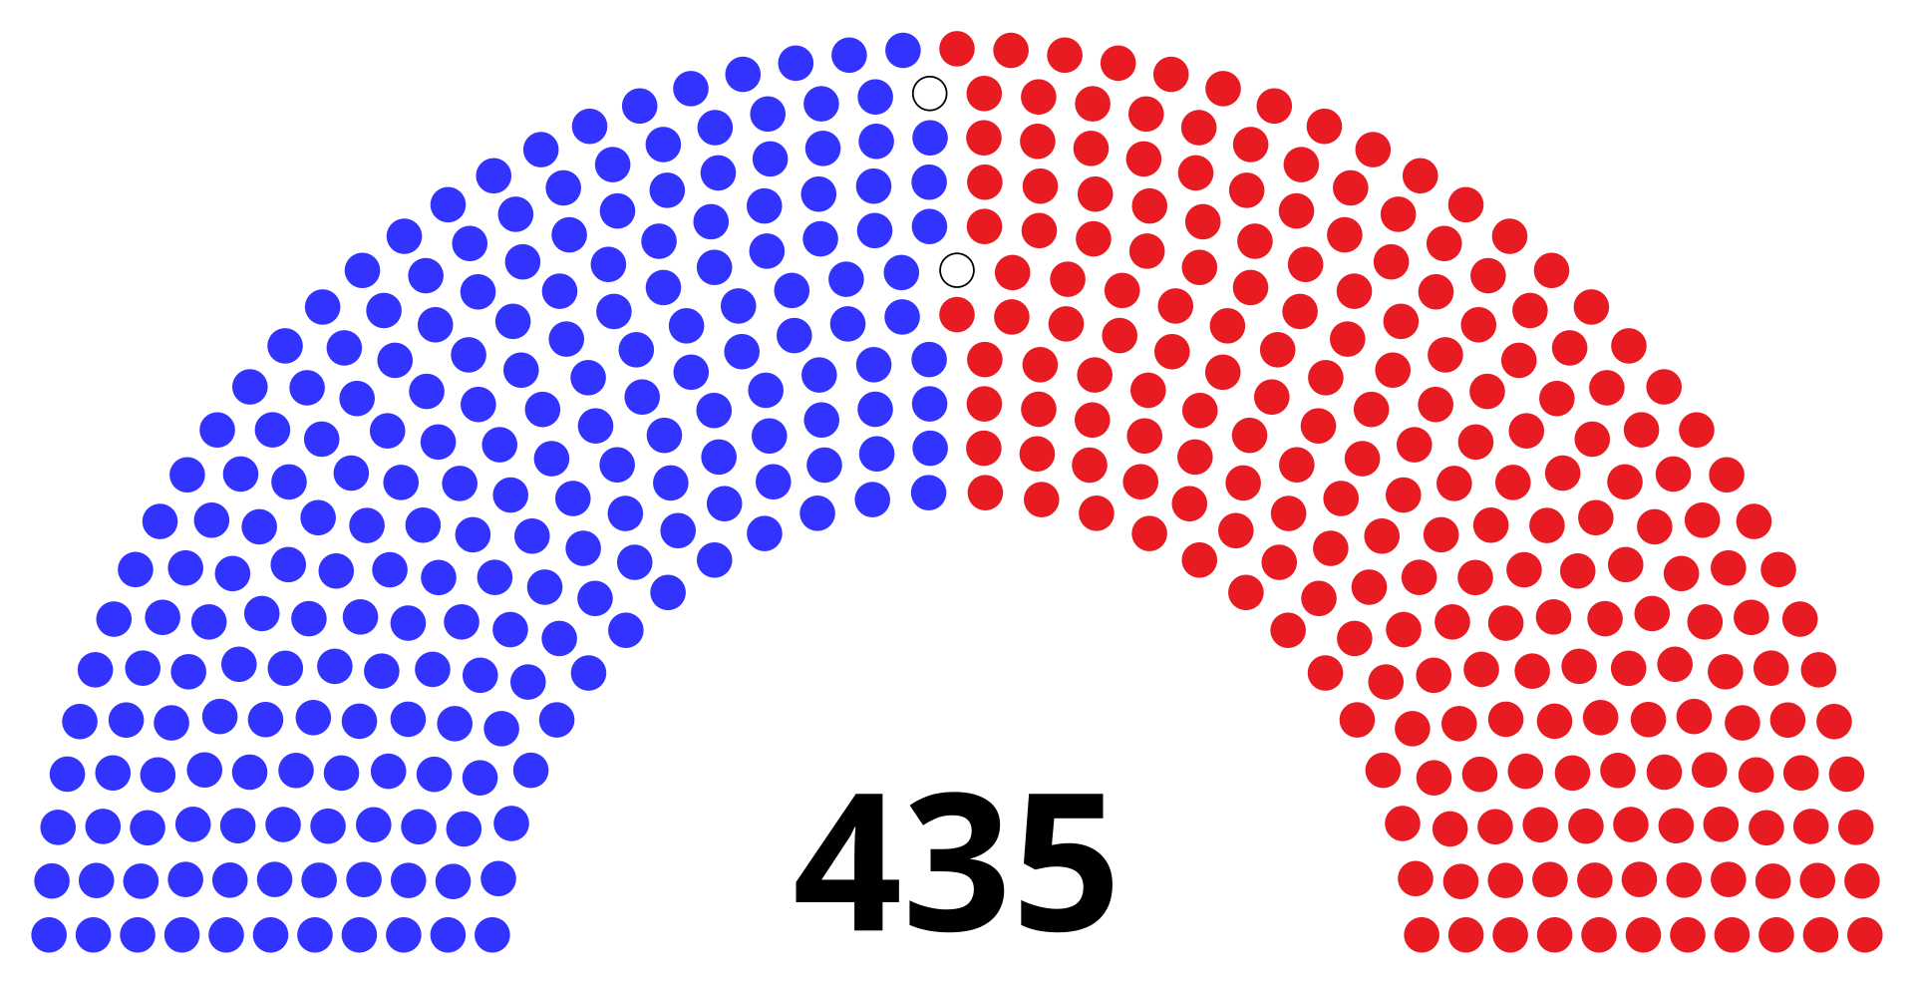
U.S. House
GOP Majority 218-215

Slide 6

U.S. Senate
GOP Majority 53-47

Slide 7
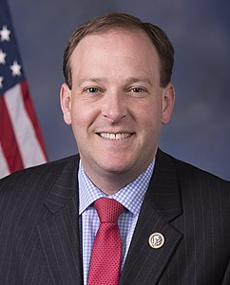
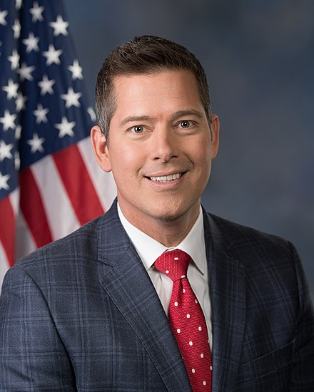
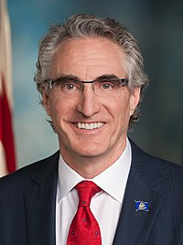
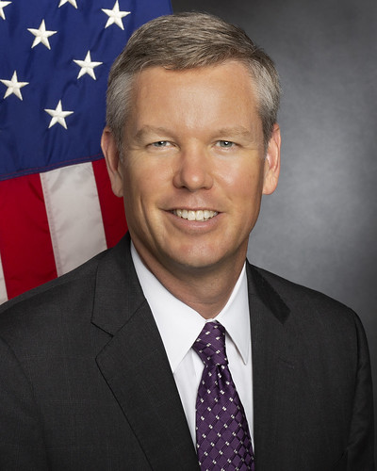
Key Members of Trump Administration
Lee Zeldin, EPA
Sean Duffy, DOT
Doug Burgum, DOI
Chris Wright, DOE

Slide 8
Actions Coming out of DC
Executive Orders:
  25% Tariffs on Canada and Mexico (30 day pause)
    Lower tariff (10%) on Canadian energy sources
  Federal Aid Freeze (paused)
  Freeze on Payments to Federal Contractors w/DEI policies
Key Legislation in 119th Congress:
  TCJA Reauthorization
  Surface Transportation Reauthorization
  FY25/FY26 Government Funding
  Debt ceiling

Slide 9
Federal Rules Update
Proposals and final rules not yet published are now paused by executive order​
Final & proposed rules undergoing WH review now removed (including AERR)​
Proposals never finalized can be withdrawn and revised or left to languish​
Final rules need to be repealed or replaced or Congressional Review Act applied.

Slide 10
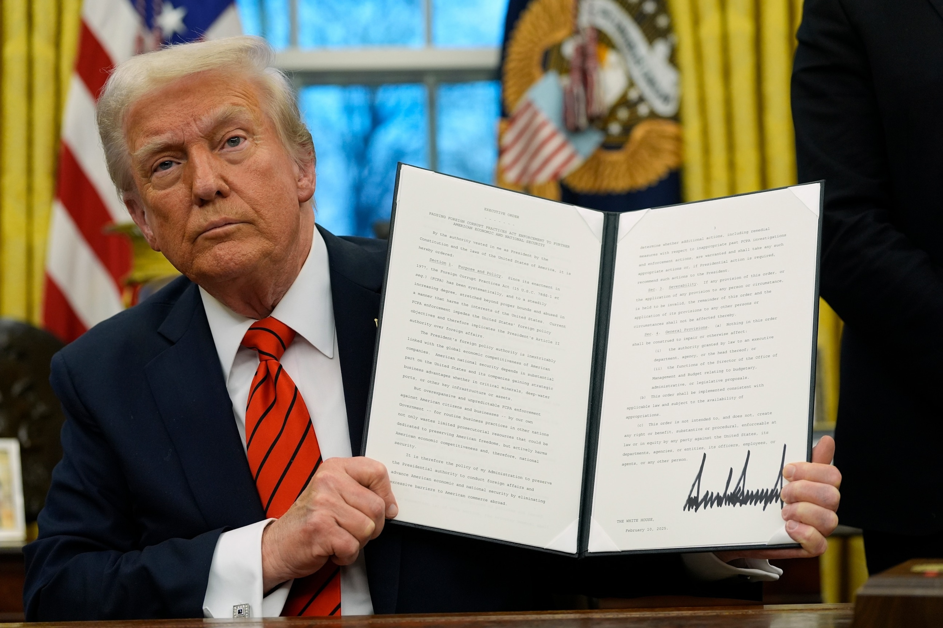
President Trump’s Priorities
Border Security
Domestic Energy Production
Tax Cuts
Where does infrastructure fall?

Slide 11
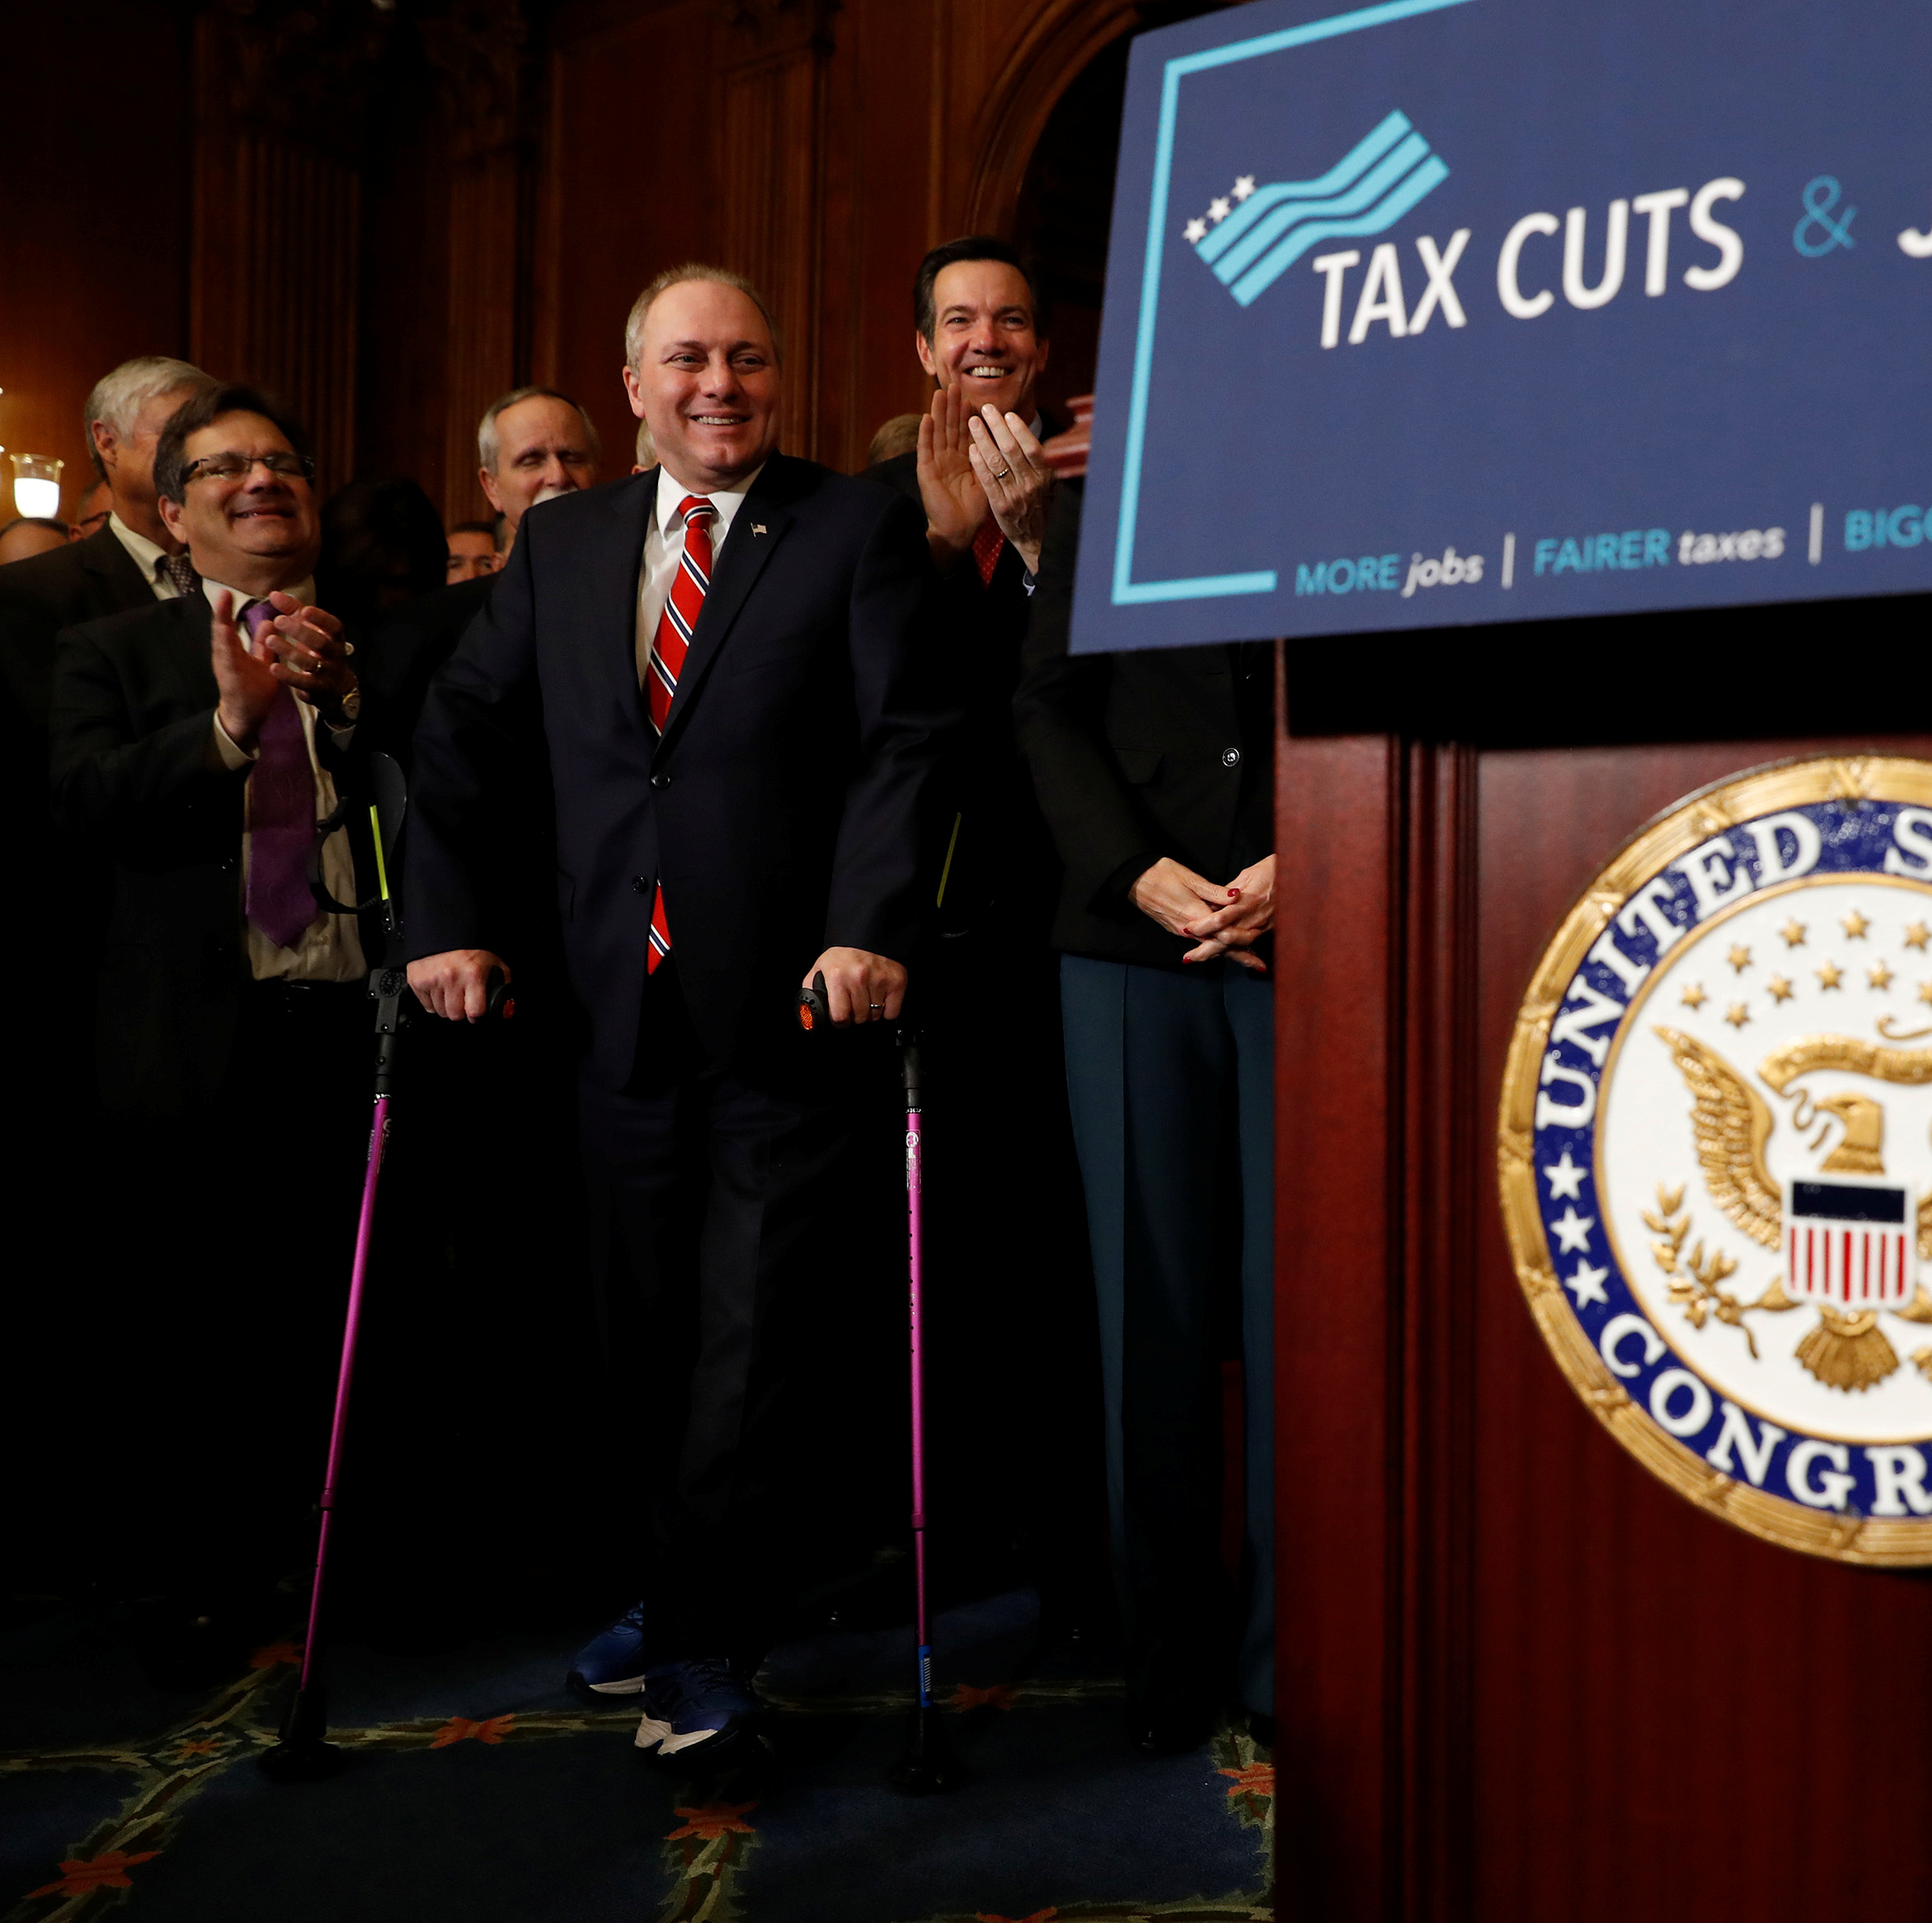
TCJA Expirations Will Force Congress to Act on Taxes
At the end of 2025:
  Reduction of individual tax rates will expire.
  The increase in the standard deduction, elimination of the personal exemption, and doubling of the child tax credit will expire.
  Reduction of the alternative minimum tax will expire.
  Pass-through deduction will expire
  Reduction of estate tax will expire.
Notes:
Passed house on suspension but senate wants to amend
Has lot of good things in it for industry including 100% deduction for R&D, 100% bonus depreciation and EBIT

Slide 12
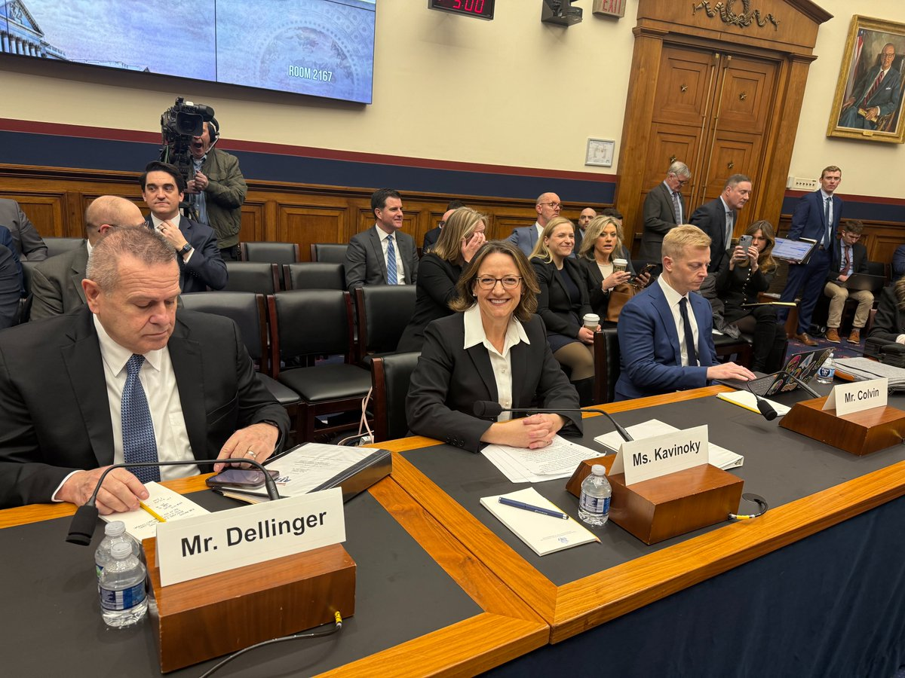
Highways & Transit Hearing
Held on January 22nd, 2025
NSSGA was represented by Janet Kavinoky, Vulcan Materials Company
Focused on industry priorities in next surface transportation reauthorization

Slide 13
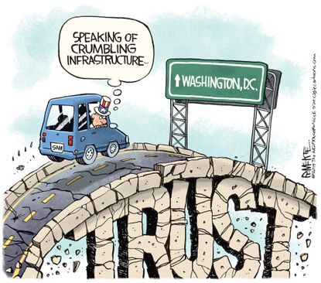
Highway Trust Fund
The next reauthorization bill must incorporate visionary and evolutionary revenue increases. NSSGA supports revenue options to sustain the HTF and create financial certainty, including:
  National registration fee
  Vehicle-miles-traveled (VMTs)
  public-private partnerships (P3s)
  bonding measures
  raising and indexing of the federal gas tax

Slide 14
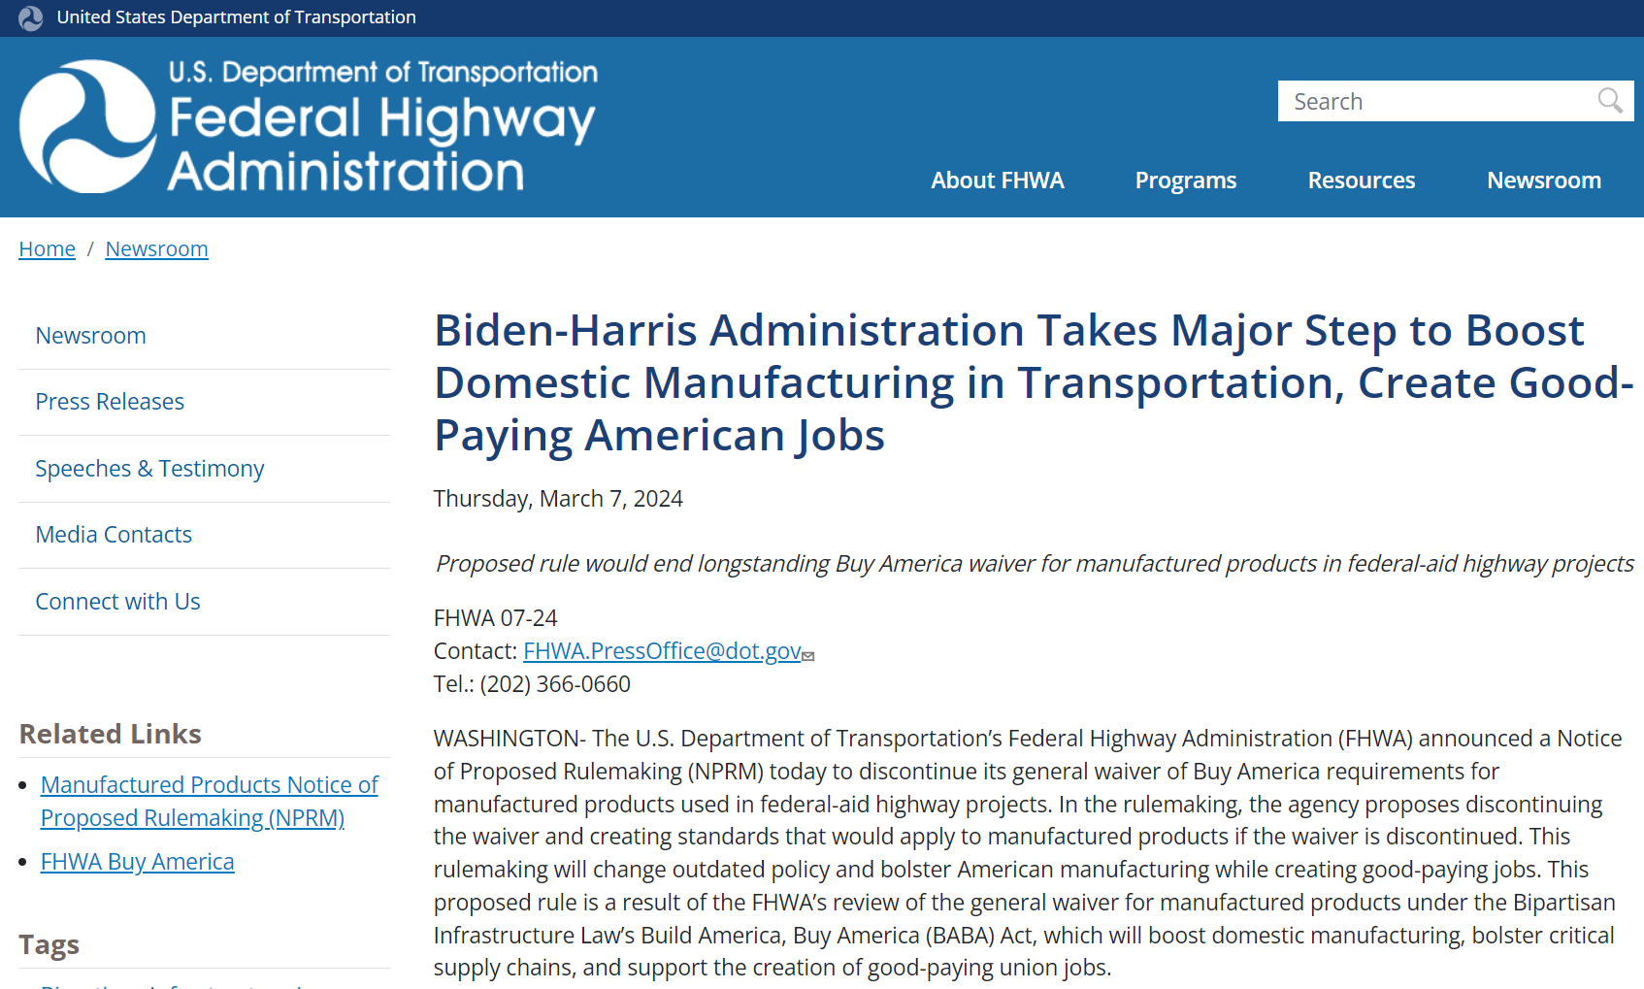
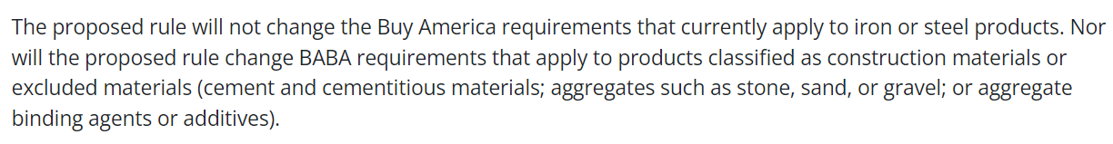
Buy America Exclusion

Slide 15

Material Neutrality
Numerous bills have directives to mandate federal buildings be made with mass timber
Also fighting "open competition" language
Construction programs and directives should be material neutral. Engineers and construction professionals should decide which construction materials to use; Congress should not be directing or influencing materials decisions.

Slide 16
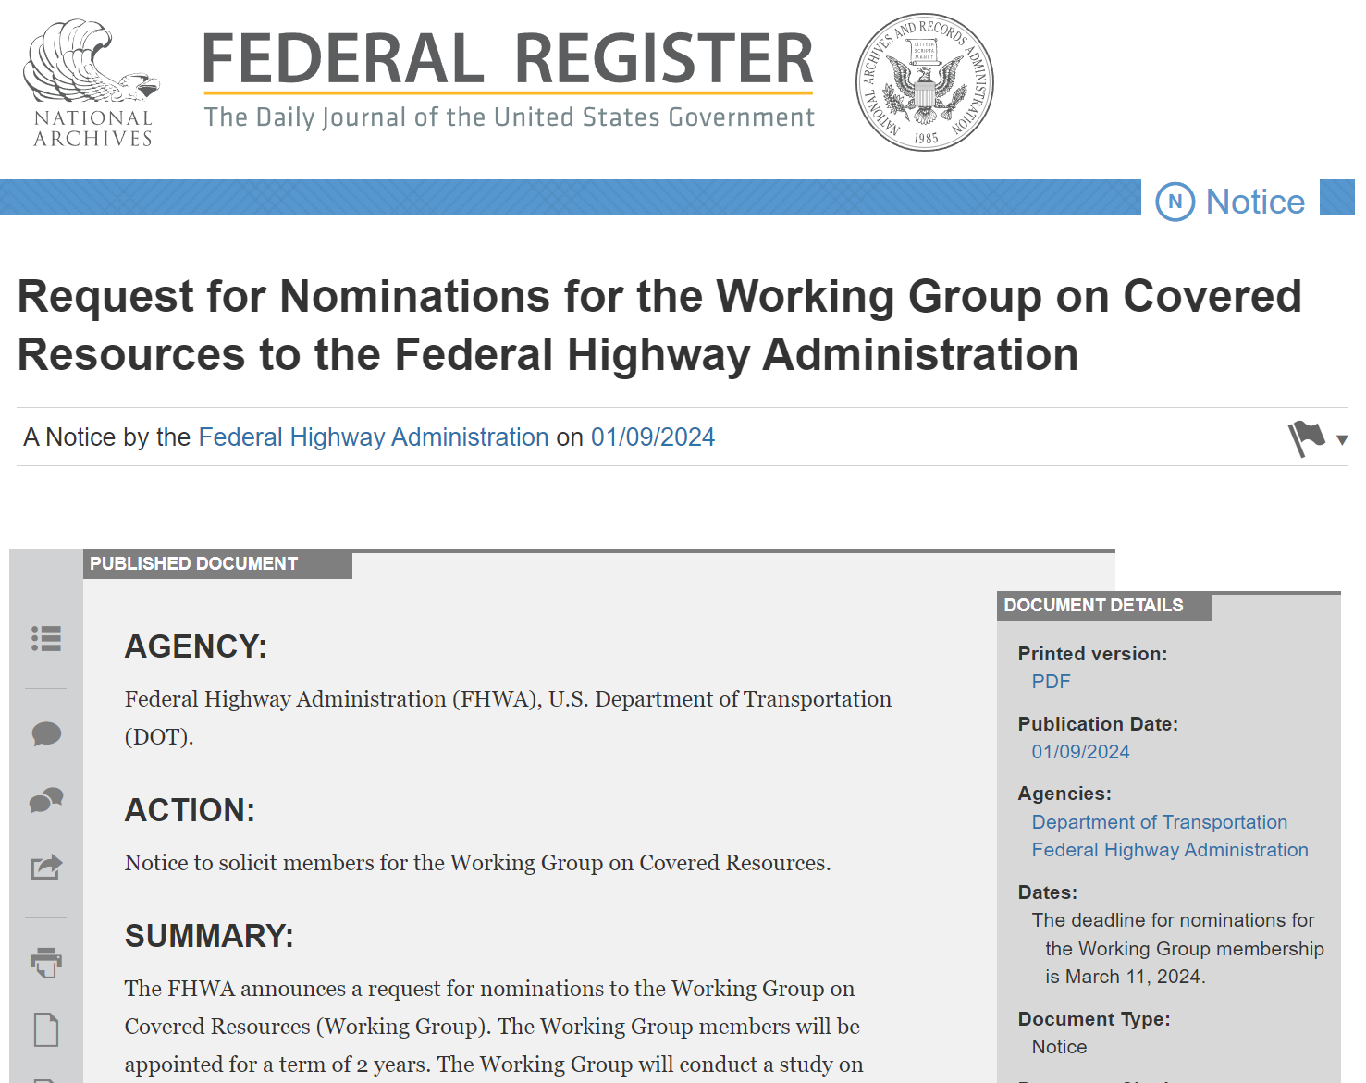
ROCKS ACT Working Group
The ROCKS Act establishes a working group of federal, state and local stakeholders to examine the use of aggregates and institute a federal policy to ensure continued access to these essential materials.
Appointments have been made. First meeting date TBD.

Slide 17
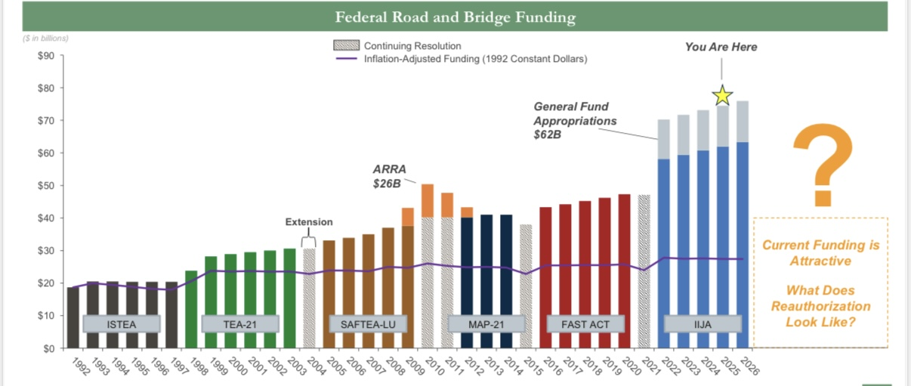
Federal Road and Bridge Funding

Slide 18
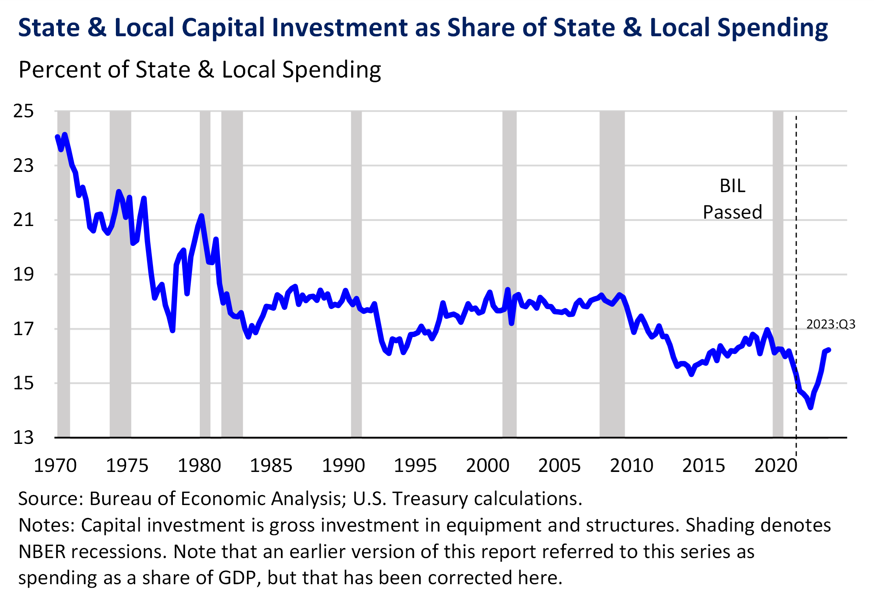
IIJA Impact at State and Local Level

Slide 19
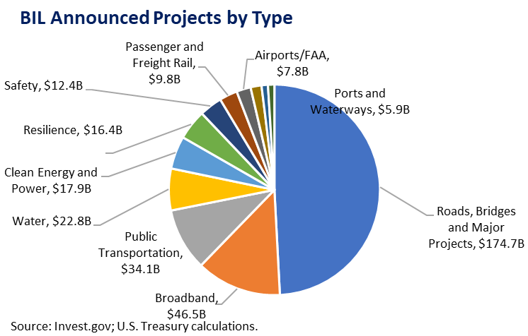
IIJA Infrastructure Investment

Slide 20
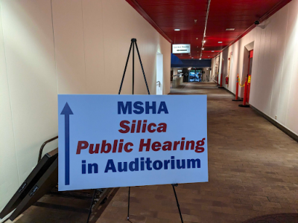
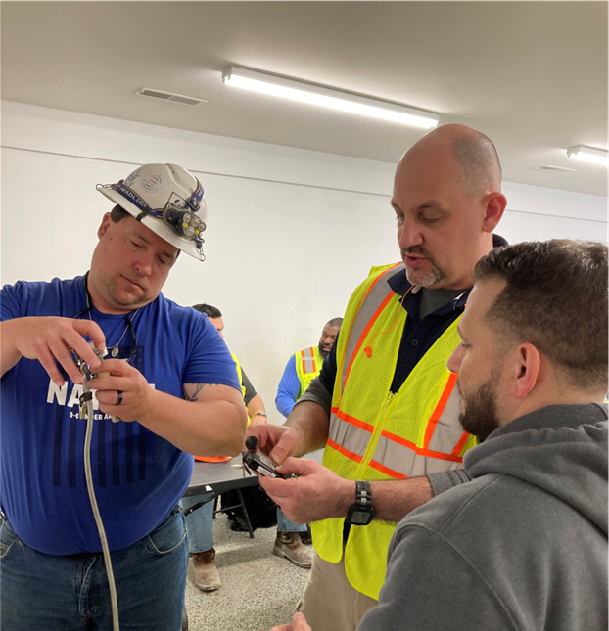
MSHA Silica Rule
Notes:
In 2019, MSHA continued its decades-long effort toward an updated rule on respirable crystalline silica (RCS) with a Request for Information (RFI) to which NSSGA submitted comments. On July 13, 2023, MSHA published its proposed rule and provided only a 45-day comment period. The rule did not follow OSHA’s silica rule, was overly prescriptive, and not based on sound industrial hygiene practices. NSSGA submitted extensive comments with numerous attachments focused on the need for MSHA to align with OSHA, the separation of MNM and coal, and urged the agency to adopt industrial hygiene best practices. NSSGA also met with almost a dozen Hill offices on the proposed rule, reached out to unions to garner support for our position, and silica was a talking point on Hill Day. In January 2024, MSHA sent its final rule to the Office of Management and Budget (OMB), the rule’s final stop before publication. NSSGA met with OMB in February and reviewed key talking points. Publication of the final rule is anticipated in April, according to the Fall Regulatory Agenda.
NSSGA is planning 2 noise and dust workshops in 2024 targeting summer in the Chicago area and in the northeast late summer or early fall.

Slide 21
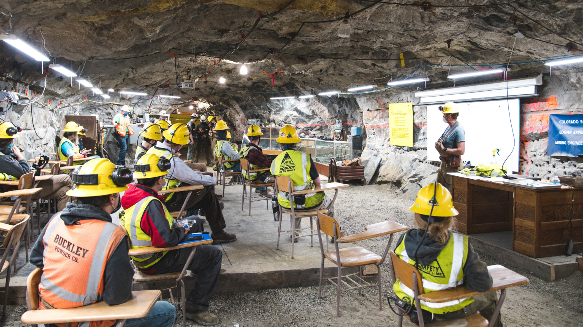

Addressing Workforce Challenges
Supporting mining schools, technical programs, junior colleges
Attracting new talent
Lori Chavez-DeRemer to be DOL Secretary
Notes:
We support legislation that seeks to expand mine engineering and related fields at colleges and universities and develop vocational education programs supporting the mining industry – such as the Mining Schools Act. We also encourage Congress and the administration to continue its bipartisan support for programs that work with America’s veterans, active and reserve service members, and their families to find meaningful careers and employment opportunities.
Finally, we urge Congress to examine and update our immigration laws and provide new opportunities to increase the legal workforce in the United States. The NSSGA workforce development task force is forming partnerships with agencies across the country that help place refugees and our team is creating resources for members who want to learn more about attracting and hiring refugees. The first resource is a panel of experts speaking on this during Convention.

Slide 22
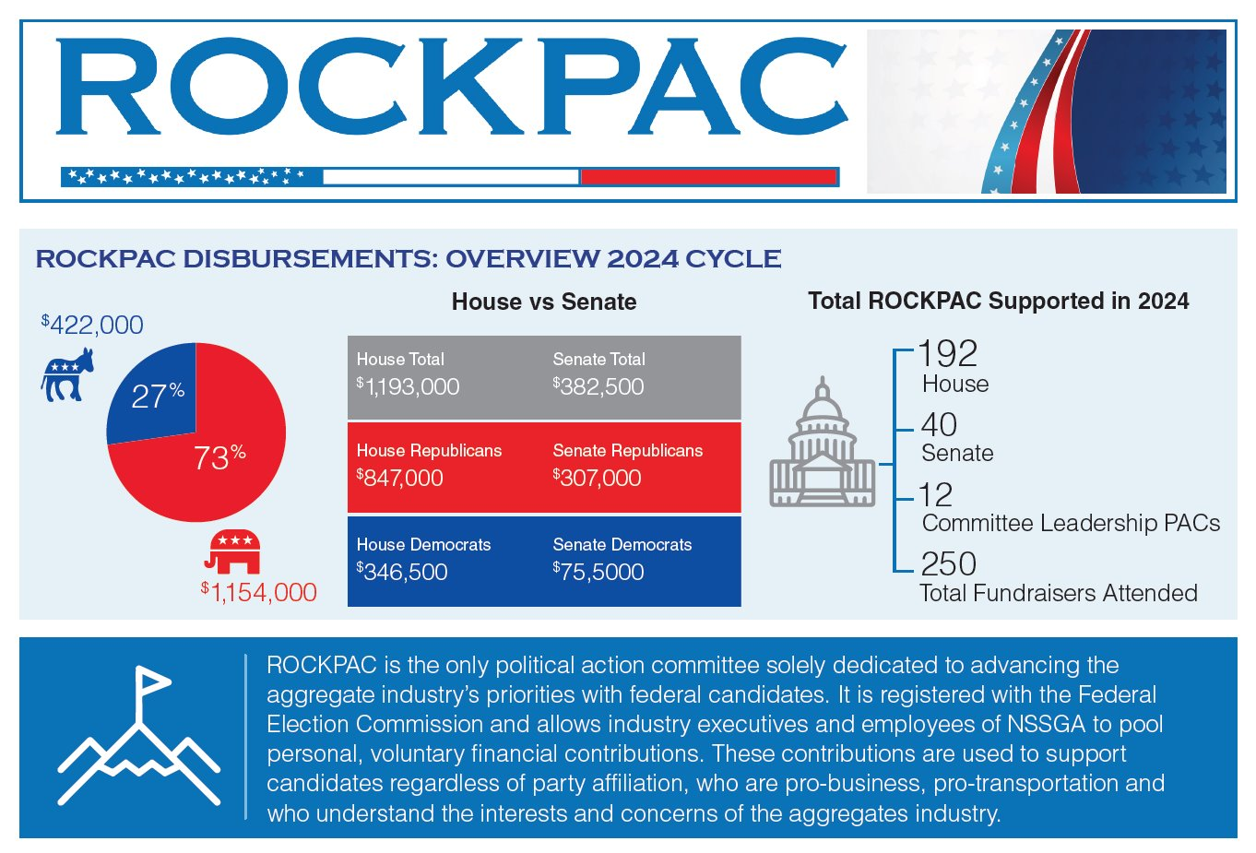
ROCKPAC

Slide 23
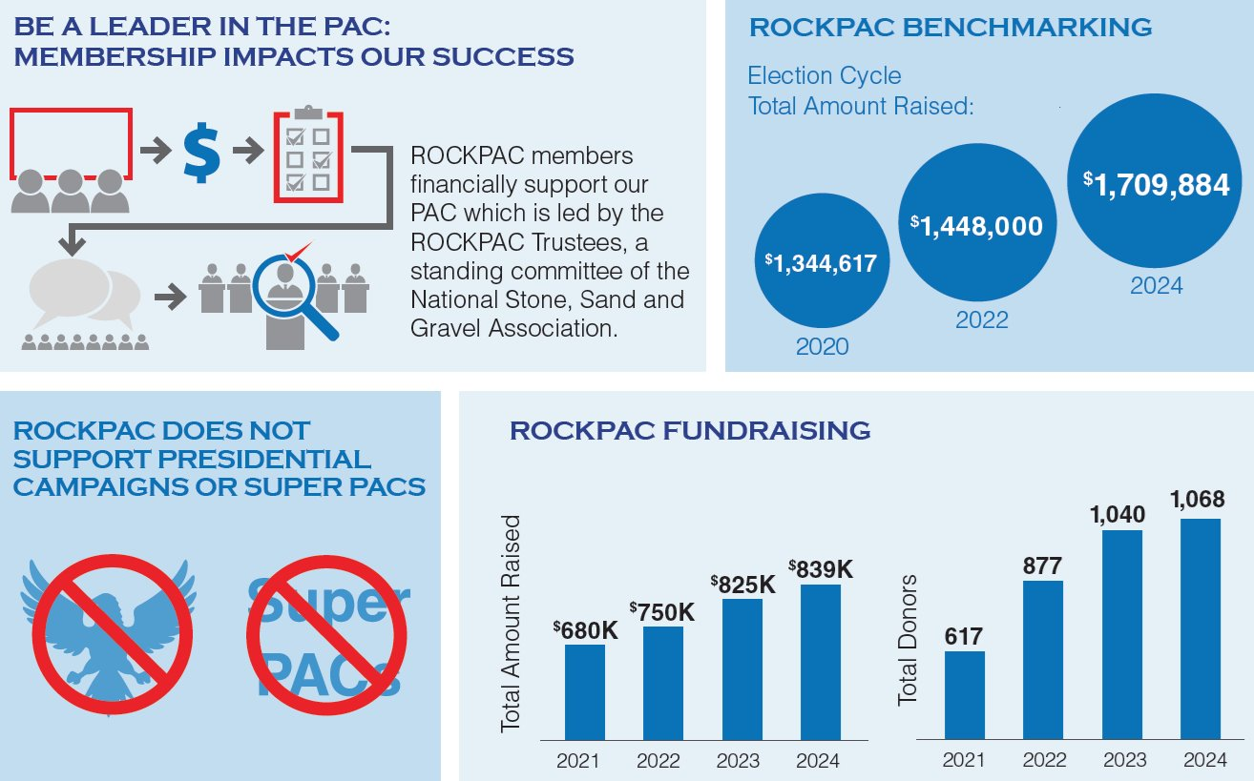
ROCKPAC

Slide 24
Questions?
Evan Bender ebender@nssga.org

