Slide 1
BEARING LUBRICATION Best Practices 2/14/2024
Presents:
Presenter – Dean Burcroff

Slide 2
BEARING LUBRICATION
Primary role
Insert a oil film between all surfaces that are in rolling or sliding contact
Effects of Lubrication
Reduces friction and wear
Extends life of components
Takes away heat from bearing
Helps prevent contamination and guards against corrosion

Slide 3
BEARING LUBRICATION Grease
Bearing grease is lubricating oil suspended in a thickening agent or base
Color is not a good indicator of grease type
Never mix greases with different bases
See compatibility chart
PolyRex EM is the latest preferred Polyurea grease for electric motor bearings
Shielded/sealed bearings are lubed for life

Slide 4
BEARING LUBRICATION Grease
Advantages
Economical
Overall cleanliness of the machinery
Can act as a protective barrier
Facilitates mountings
Facilitates handling
No external systems
Simple, provides protection from contamination

Slide 5
BEARING LUBRICATION Grease
Disadvantages
Slower speeds than oil
Friction torque higher than oil
Lower cooling characteristics than oil
Difficult to control volume of grease
Not as easy to replace as oil
Cannot remove particles from grease

Slide 6
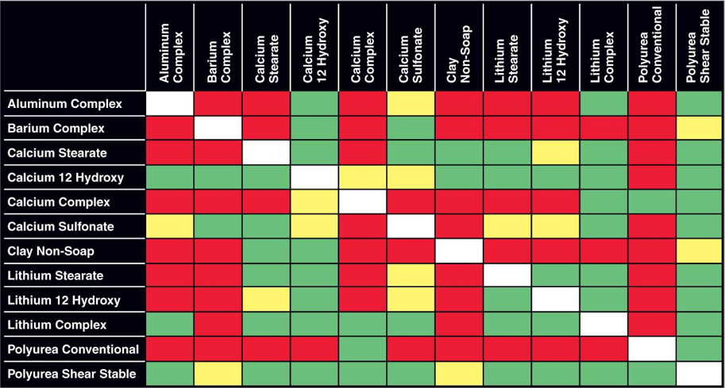
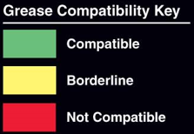
GREASE COMPATIBILITY CHART

Slide 7
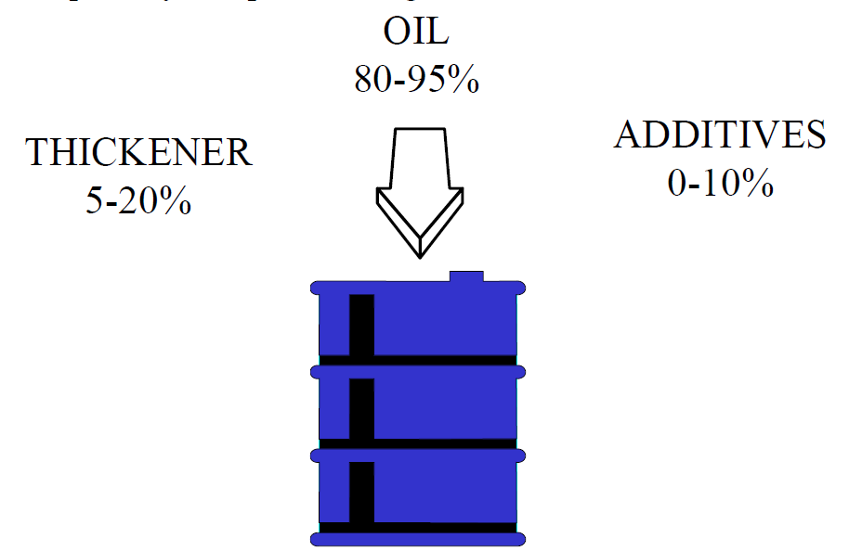
GREASE
Base oil in the grease provides the lubrication needed in an application
The thickener base of a grease is one of the most important factors when considering the mixing of grease
Common Additives
Rust inhibitors
EP agents
Oxidation inhibitors
Anti-wear agents

Slide 8
BEARING LUBRICATION Grease Terminology
NLGI Rating published in 1938, adopted in 1941
Consistency of lubricant
#000 to #6
#2 very common, consistency of Peanut Butter
Melting Point
The point at which the grease is fluid enough to run
Operable temperature is 100º F below melting point
Shear Stability
Ability to withstand repeated working with a minimum change to consistency

Slide 9
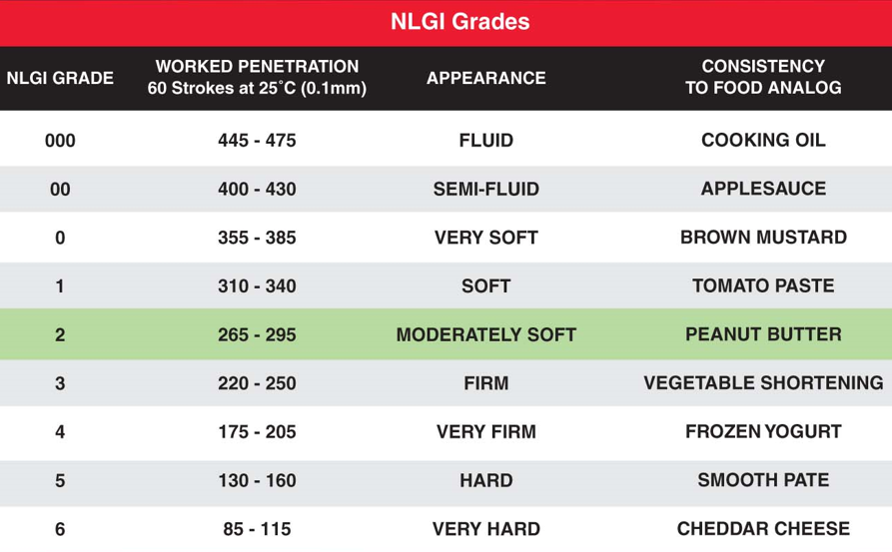
NLGI NUMBERING SYSTEM

Slide 10
BEARING LUBRICATION Grease
Factors Affecting Grease Selection
Operating speed
Operating temperature
Pressure
Water Conditions
Lubricating requirements of the other components in the system

Slide 11
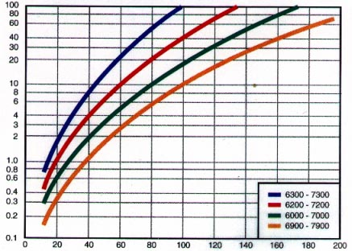
BEARING LUBRICATION Grease Fill
Ball bearings, 25-40%
Cylindrical roller, 20-30%
Mounted bearings, 50-100%
Lubricate while running
Tapered roller bearings, 100%
IMPORTANT: Over-lubrication is as harmful as under lubricating
Do not add extra grease to quiet a bearing
Allow grease time to evenly distribute throughout bearing
Volume of Grease - cm3
Ball Bearing Bore - mm

Slide 12
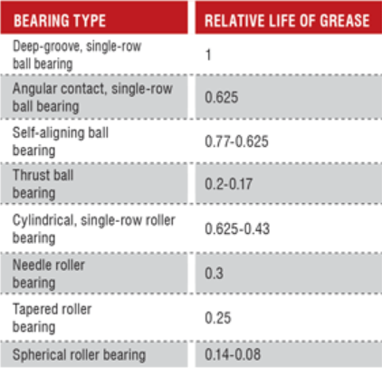
BEARING LUBRICATION
Grease intervals will be different for different types of bearings
Self contained ball bearings are sealed for life and shouldn’t need re-lubrication (Most electric motors)
As load increases or less free space in a bearing, need for re-lubrication is more frequent

Slide 13
BEARING LUBRICATION Grease Fill
Under Lubrication
Boundary friction
Lubricant starvation
Increased wear
Over Lubrication, major cause of bearing failure
Increase fluid friction
Increase heat, which will oxidize grease
Shorter operational life

Slide 14
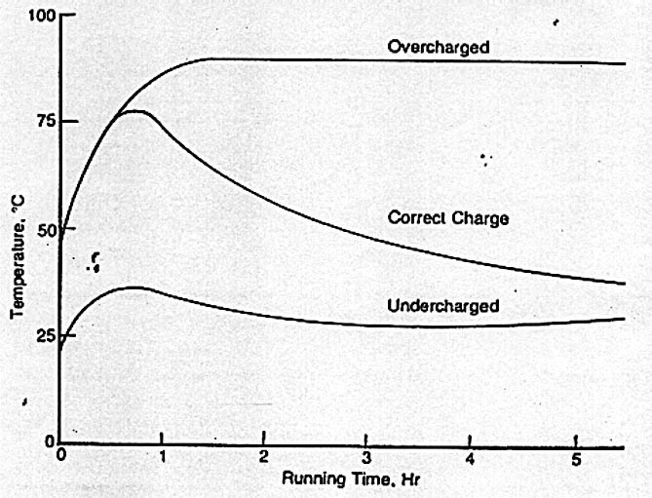
BEARING LUBRICATION
Effect of Fill Rate on Operating Temperature

Slide 15
BEARING LUBRICATION
Properly packing a bearing with grease
Hand packing requires clean hands or gloves
Gauge proper fill based on fill charts
Generally smaller bearings contain higher fill rates than larger bearings when shipped by the manufacturer
Fill rate depends on speed, load, frequency of relubrication

Slide 16
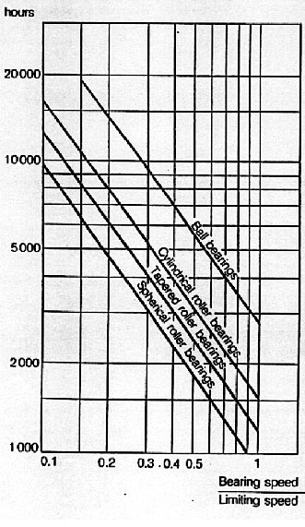
BEARING LUBRICATION
Lubrication Interval
Example: Ball bearing operating speed is 1,800 RPM. Limiting speed is 6,000 RPM
Ratio 1800/6000 = 0.3
Ball Bearing is 9,500 hrs
Roller bearings have lower limiting speed ratings than same sized ball bearings and require more frequent lubrication

Slide 17
COMMON GREASES
Electric Motor greases
PolyRex EM
Temp range -20 F to 350 F
Polyurea
More shear stable
PolyRex EP-2
Temp range -20 F to 350 F
Extreme Pressure
Cylindrical Roller Bearings
Shell Alvania 2
Temp range -30 F to 230 F
Lithium base
Chevron SRI-2
Temp range -20 F to 350 F
Polyurea
“Old standard” EM grease
No need to grease most electric motors

Slide 18
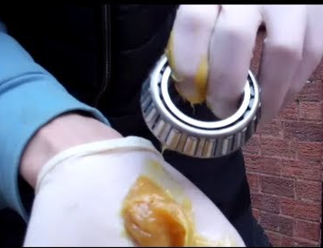
TAPER ROLLER Grease Packing
When greasing bearing, pack either by hand or with mechanical bearing packer
100% fill

Slide 19
MOUNTED BEARINGS Lubrication Instructions
Most mounted units have a lithium base NLGI#2 grease as standard (Timken uses PolyRex EM=)
Compatibility of grease must be assured
Follow recommended lubrication intervals
If safe, grease while running
Pump in grease slowly until slight bead forms around seal
A slight rise in temperature usually occurs
10ºF to 30ºF is normal, temporary temp rise

Slide 20
MOUNTED BEARINGS Lubrication Chart

Slide 21
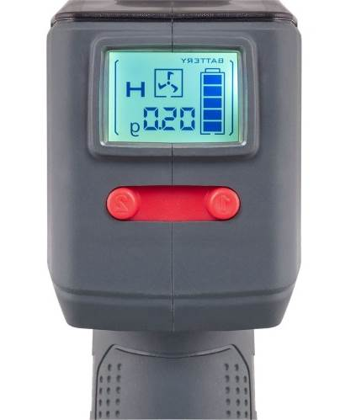
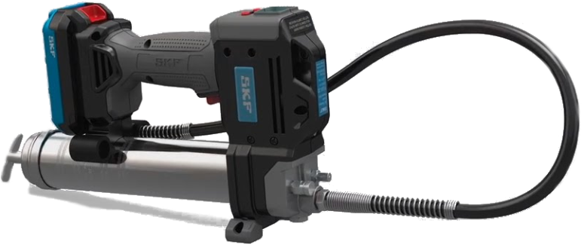
BEARING LUBRICATION Motorized Grease Gun
SKF TLGB 20/110V, battery powered
Follow all safety warnings and instructions
20V DC lithium-ion rechargeable battery
Battery and 110-120 v charger included
LED light helps locate lubrication fittings
LCD display shows battery charge, pump speed, and grease output
Two grease output speeds 3.5oz/min or 5.5oz/min
Grease capacity is 14.5oz
Max pressure 10,000 psi
6.5 lbs, 15 cartridges/charge

Slide 22
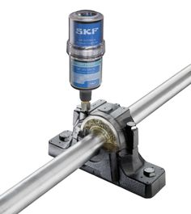
BEARING LUBRICATION Automatic Lubricators
Advantages
Proper metering of grease flow
Stricter control over grease type
Less waste
Ensures continual lubrication
Ensures hard-to-reach areas receive lube
Reduces labor cost

Slide 23
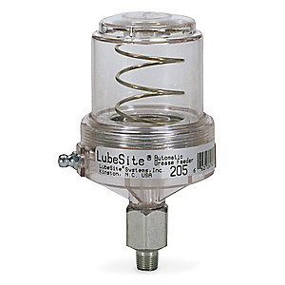
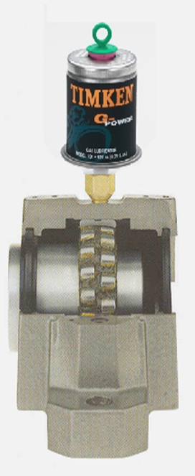
BEARING LUBRICATION Automatic Lubricators
Types
Spring Operated
Changing spring alters dispensing rate
Reusable, refillable by grease gun
Gas Operated
Nitrogen or Hydrazine gas cartridge
Allows for flow adjustment - 1 month to 2 years, based on plug used
Throw away units

Slide 24
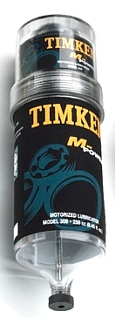
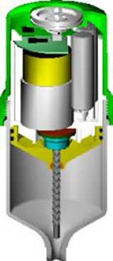
BEARING LUBRICATION Automatic Lubricators
Types continued
Battery / Motorized
Dispenses at rate set by user
Rates vary by unit and manufacturer
Many have replaceable grease cartridges/batteries
Multi-lubrication point units available
Accessories available from most suppliers
Lines, fittings, brushes, brackets, clamps, etc.

Slide 25
TEMPERATURE OF BEARINGS
Most electric motors operate from 140-160 F
Measure housing at bearing location to take temperature reading and add 15-20 F to estimate bearing temperature
Fan bearings may experience wide temperature variations because of environmental/season changes
In general, when grease is introduced, there will be a spike in temperature as the rolling elements push grease out of the way
This could take 30 minutes to several hours

Slide 26
IS THERE MOISTURE IN THE GREASE?

Slide 27
WATER CONTAMINATION IN GREASE

Slide 28
BEARING FAILURES

Slide 29
CAUSES OF BEARING FAILURES
Based on a study by an independent German insurance company, they found that only 0.5% of bearings actually fail due to overstressing of the steel.
B 20%
A
20%
C 15%
I <1%
H 10%
D 20%
E 5%
G 5%
}
F 5%
}
A
Aged lubricant
F
Mounting faults
B
Unsuitable lubricant
G
Secondary damages
C
Insufficient lubricant
80% !
H
Unsuitable choice of bearing
20%
D
Solid contamination
(design, size, load carrying capacitiy)
E
Liquid contamination
I
Material and production faults
Source: Antriebstechnik 18 (1979) No. 3,

Slide 30
PREMATURE BEARING FAILURES
Miscellaneous
Electric current
Design problem
Material quality
Sealing deficiency
Contamination
Moisture
Corrosion
Inadequate lubrication
Lubricant shortage
Improper lubricant
Improper Mounting
Shaft or housing defect
Misalignment
Incorrect fits
Excessive clearances
Rough mounting
Axial looseness
Radial or thrust overload
False Brinelling
Contact corrosion
Seal/Shield damage

Slide 31
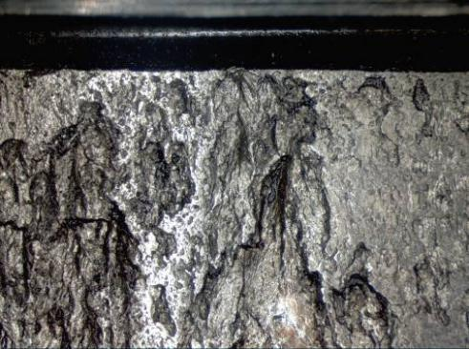
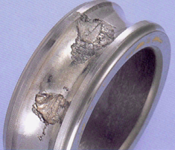
FLAKING OR SPALLING
Flaking at intervals on raceway
Caused by impact load
Deep “Potholes” in outer ring raceway
Spalling in a ball bearing inner race

Slide 32
BRINELLING
Is a sudden force that leaves dents or marks from the rolling element into a raceway
Bearing with brinelling will fail because of the damage
Causes
Incorrect mounting forces
Dropping bearing

Slide 33
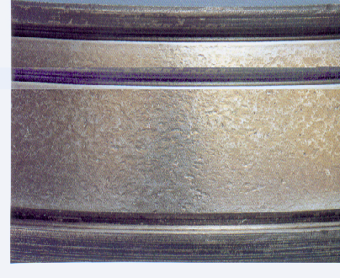
CONTAMINATION
Contaminants get into bearing from improper sealing, failure of seals, contaminated grease
Can leave scoring, pitting, scratching
Water is another threat that will rust bearings
CONTAMINATION DAMAGE

Slide 34
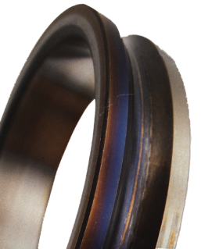
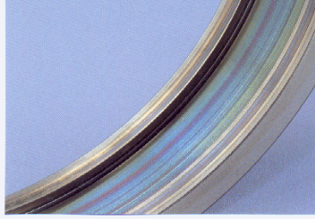
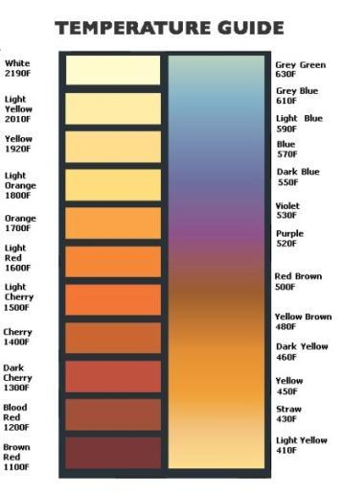
FAILURE BY HEAT EXPOSURE
Improper lubrication method or inappropriate lubricant
Can be preload, reverse loading, process heat or other causes
Look for blue/black and silver/gold discoloration.
Balls will usually be blue/black.

Slide 35
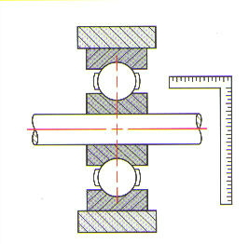
MISALIGNMENT FAILURE
Caused by bent shafts
Shaft and housing not square
Shaft misalignment transferred through shaft into bearing
Can cause broken cage

Slide 36
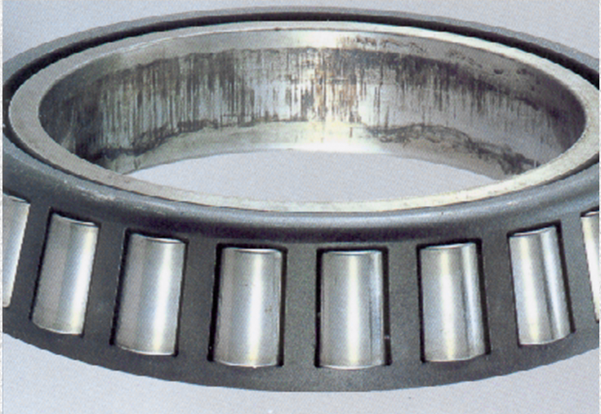
FRETTING CORROSION
Insufficient interference
Happens often in mounted bearings between the inner race and shaft

Slide 37
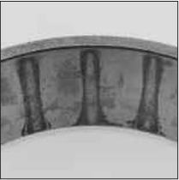
WATER ETCHING
Water etch is when water is exposed to bearing and stains rolling surface
If left too long it will turn into pits and cause failure of bearing

Slide 38
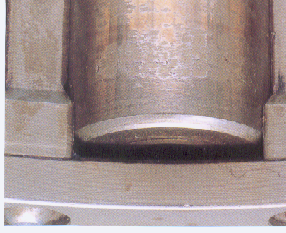
SMEARING
Surface initiated damage from excessive sliding or skewing between contact surfaces
Smearing wear on roller caused by contaminated lubricant

Slide 39
CREEPING
Motion between the bearing ring and the mating part
May appear as highly polished surface or discoloration
Insufficient interference
Fitting selection should be reviewed and/or mating parts checked for wear

Slide 40
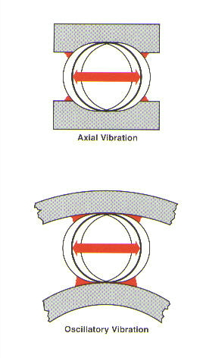
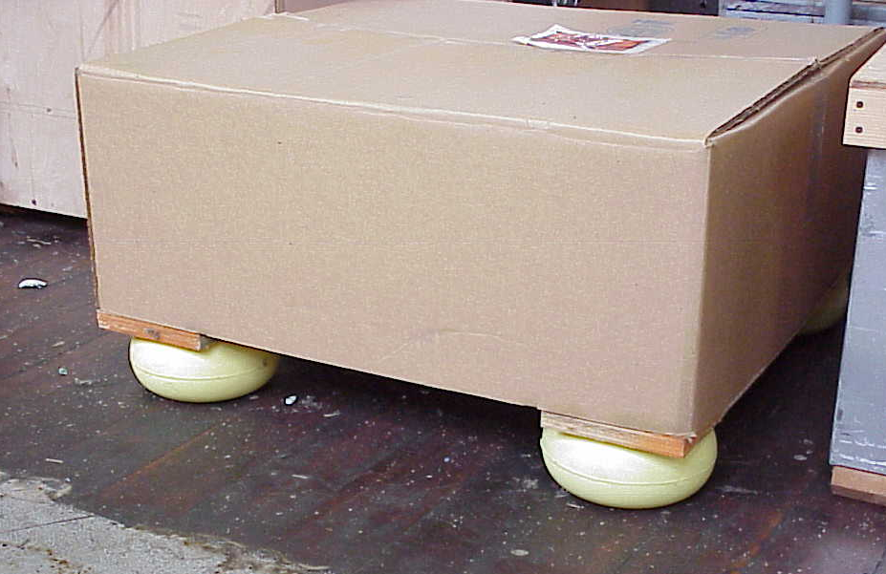
FALSE BRINELLING
Vibration causes wearing while bearing is stationary
In storage, make sure bearings are not subject to vibration or isolate on vibration absorbent material

Slide 41
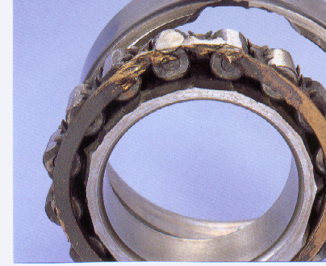
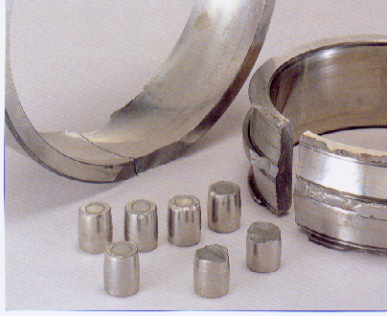
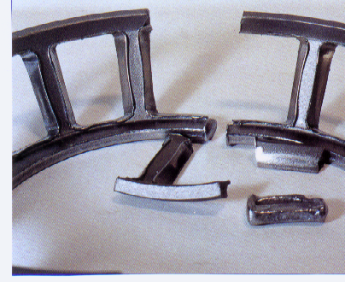
CATASTROPHIC FAILURE
Seizure caused by chips on ribs
Cause is excessive axial impact load
Cracks and chips
Excessive axial impact load
Broken retainer
Lubrication failure most likely cause

Slide 42
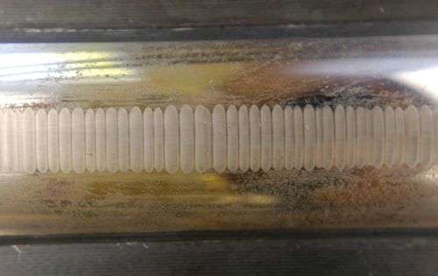
BEARING DAMAGE FROM ELECTRICAL CURRENT
Electrical discharge machining (EDM)
Electrical fluting / wash boarding
Often found when VFD used on equipment

Slide 43
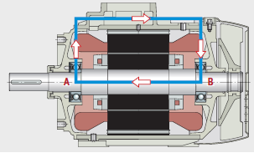
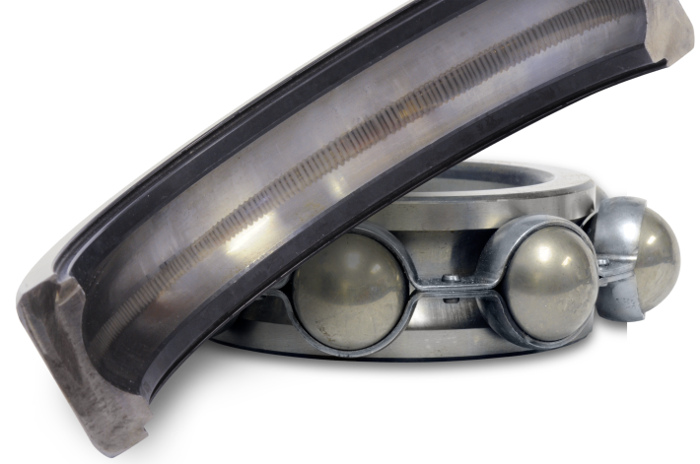
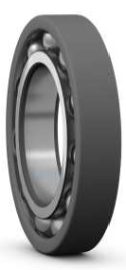
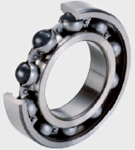
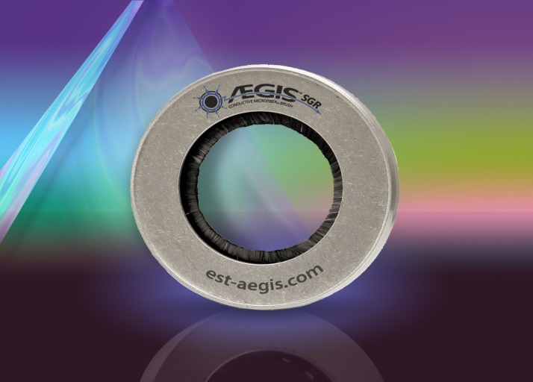
BEARING PROTECTION FROM ELECTRICAL CURRENTS
=
Fixes: Aegis ring, ceramic coated ring, or ceramic ball

Slide 44
BEARING SERVICE Premium Service, Expert Solutions
Thank You for your time!

