Slide 1
National Aggregates Update
Michele Stanley, IOM
President and CEO
National Stone, Sand & Gravel Association

Slide 2
Agenda
Who is NSSGA?
My vision
NSSGA 2025 Accomplishments
2026 Opportunities and Threats
Political Update

Slide 3
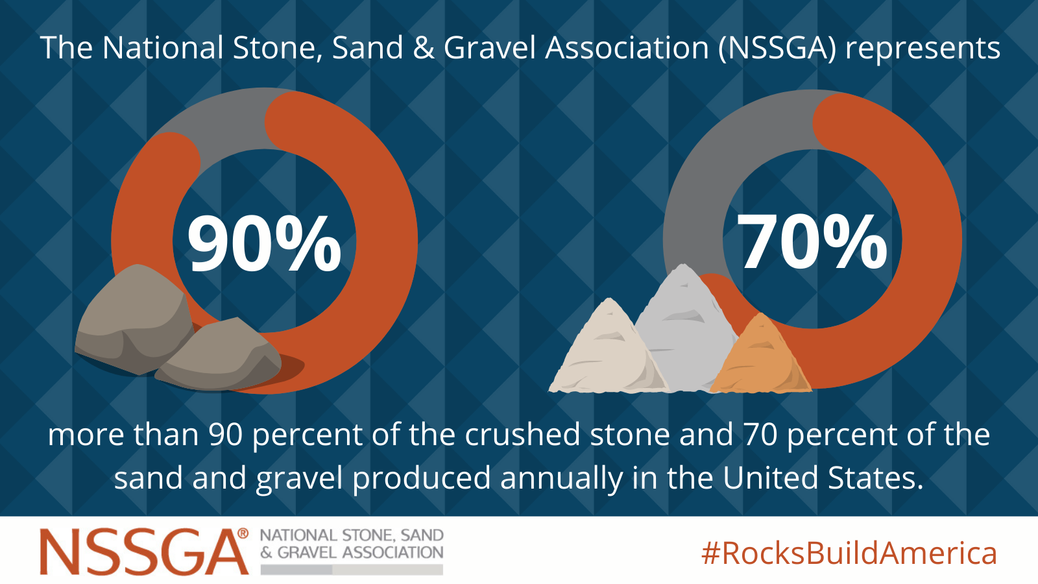
NSSGA Representation
Notes:
127 Producer members
Industry has 9000 quarries in the US

Slide 4
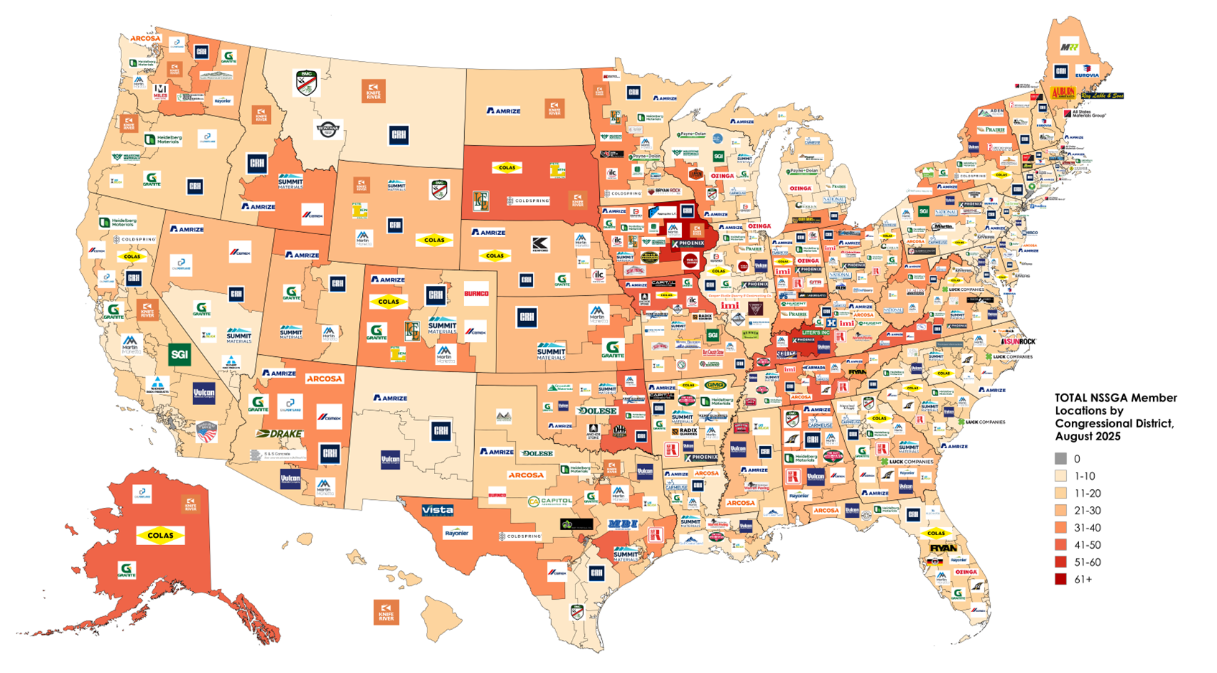
NSSGA Producer Member Locations

Slide 5

2025 By the Numbers
Production increased 5% in Q3 2025 – 703 Mt
1.76 Bt of construction aggregates sold or used
in first three quarters of 2025 ( 1% )
1.10 billion metric tons crushed stone ( 1.8%)
657 million metric tons of sand and gravel ( 2%)
Notes:
Third quarter of 2025 saw a 5% increase of construction aggregates sold or used at 703 million metric tons
The first 9 months of 2025 saw a 1% decrease of construction aggregates sold or used to 1.76 billion metric tons from 1.78 billion metric tons in the same period of 2024, according to USGS.

Slide 6
Factors for Production Decrease
Portland Cement down 2 %
Residential Market Weakness
Inflation and Cost Moderation
Federal Funding Timeline
Shipments down
Notes:
Nothing you don’t already know, but….
Residential market weakness: Continued high interest rates are dampening demand for new housing, which significantly impacts aggregates consumption.
Inflation and cost moderation: While producers maintain pricing power, softening demand in residential and commercial sectors is influencing the market.
Federal funding timeline: While the Infrastructure Investment and Jobs Act is expected to boost future demand, aggregate production in the first half of 2025 had not yet seen a major turnaround.
Aggregates shipments down: but turning a corner. Inclement weather was a deterring factor

Slide 7
Key Industry Trends
Strategic Mergers and Acquisitions
Technological Investment
Mega Projects
Workforce Challenges
Notes:
Strategic Mergers & Acquisitions:
Companies are acquiring smaller producers to expand market reach and secure resources, a trend that saw increased activity in the summer of 2025.
Technological Investment:
Producers are investing in technologies to improve efficiency, reduce environmental impact, and enhance product quality.
Mega Projects:
Although residential construction leaves something to be desired, producers are supplementing aggregate demand related to infrastructure with expanded opportunities in nonresidential construction. Data centers in 2025 are what warehouse were just a few years ago.
Workforce Challenges:
The industry continues to grapple with workforce shortages, with technology being used as a partial solution to address labor gaps

Slide 8

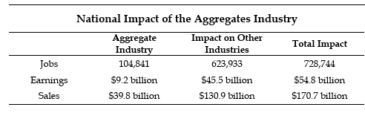
Economic Impact
Notes:
In 2025, the Phoenix Center for Advanced Legal & Economic Public Policy Studies did a study that found the aggregates industry is a significant contributor to the economic wellbeing of the United States, generating nearly $40 billion in sales annually.
105,000 direct jobs
Each job in the aggregates industry supports an additional 5.95 jobs throughout the economy or nearly 729,000 jobs across a wide range of occupations and industries
Each dollar of earnings creates another $4.95 of earnings in other sectors
Each dollar of sales in the industry produces another $3.29 of sales in other industries

Slide 9
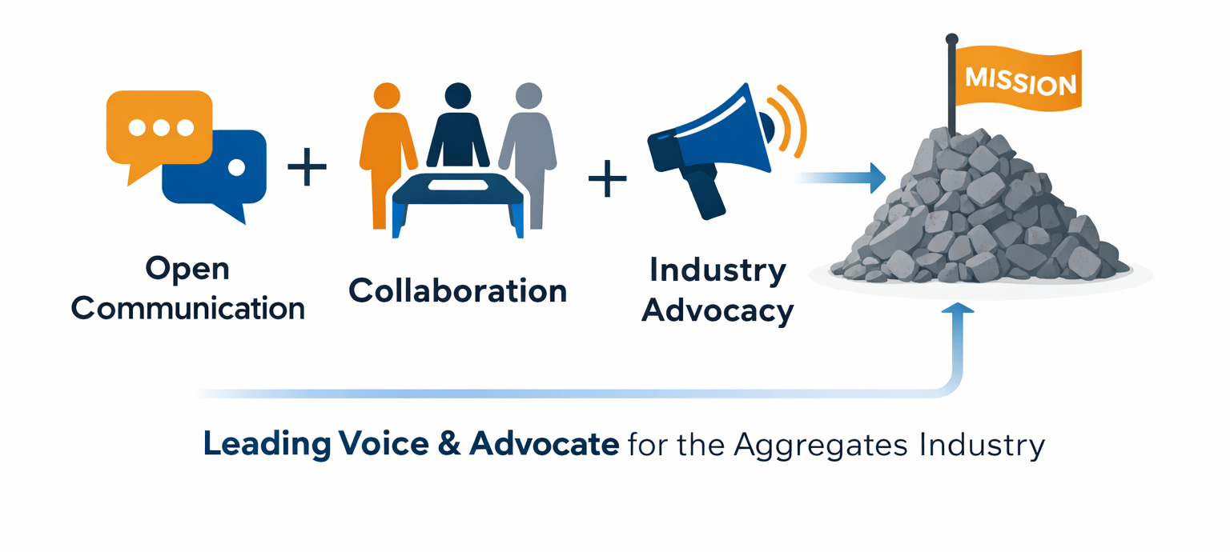
New Vision at NSSGA
Notes:
Joining this incredible organization—more than 10 years ago—has been both humbling and energizing. My commitment to the industry is simple--open communication, robust collaboration and a relentless focus on our mission to be the leading voice and advocate for the aggregates industry.
The first item of business for me was to embark on the strategic planning process. It will focus on qualitative and quantitative research to surface future trends and drivers of market success. We will also confirm our “north star” or how we will deliver the new and different outcomes for the industry. The new value imperative and strategic initiatives will come from member surveys and interviews. This was an important component for me and I look forward to hearing from all our members.
We are standing at a pivotal moment for our industry — one where collaboration, innovation, and advocacy will define the next decade. My vision is for our association to be the driving force behind that transformation.
The path ahead is full of opportunity, and I’m excited to navigate it together. I’m here to learn from you, support you and build on the strong foundation we have.

Slide 10



Communications Accomplishments
Open rates on emails increased to 42 percent across communications sent to all NSSGA members. The highest open rates came from emails on advocacy and news, safety, and general association info.
NSSGA received more than 110 earned media clips that were published in a range of publications, including Politico, NPR and Bloomberg Law.
Notes:
We’ve increased our member communications engagement by 9.65 percent, reaching an open rate across all email communications of 41.67 percent.
We earned mention in over 110 media clips during the year, focused primarily on DC and Hill-based media.
Our social media following grew again for the fifth straight year. LinkedIn has proven to be a valuable channel to engage with members. Where five years ago that was our lowest followed channel, it is now far and away our greatest, with nearly 11,000 followers.
All year, we’ve promoted NSSGA’s 25th Anniversary. The year began with launch of our 25th Anniversary video and release of our 25-year timeline on our website and signage at events. We solicited and gathered member testimonials throughout the year on the impact NSSGA has made on their professional careers. Those member testimonials have been shared on social media and in compilation ‘person on the street’ videos on our YouTube channel.

Slide 11
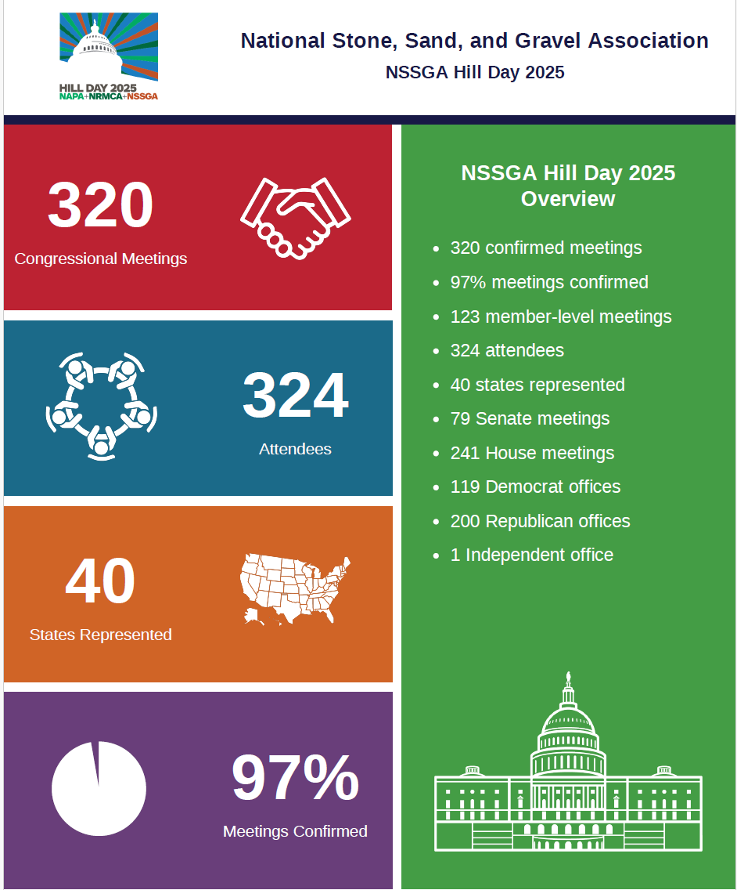
Meetings and Membership Accomplishments
Record number of attendees
Record membership at 536
Joint Fly In with 3 Michiganders who met with 7 Members of Congress
Notes:
Record number of attendees for Young Leaders, Leadership Summit and Legislative & Policy Forum
Record membership numbers – 536 in 2025, largest in NSSGA history.
7 Hill meetings
Gary Peters
Elissa Slotkin
Jack Bergman (with him)
Bill Huizenga
Tom Barrett (with him)
Kristen McDonald River
Lisa McClain

Slide 12
Technical Accomplishments
Standards and specifications engagement
Efforts to secure funding for research
Launch of new ASR exposure site
Development of new data platform
Downstream PCR Committees
Assumed program operator role for Construction Aggregates PCR
Notes:
Stayed engaged on the standards and specifications, representing and advocating for the industry
Continued efforts on securing funding for research on industry priorities
Launch of the new ASR exposure site in PA for long-term support of ASR research
Development of a new data platform to centralize industry data
Increased sustainability member resources and participation
Participated in and provided comments to downstream PCR Committees (Asphalt Mixtures, Precast Concrete, Lime Materials, and Ready-Mix Concrete)
Assumed program operator role for Construction Aggregates product category and developed appropriate program instructions
Anticipate PCR Committee application process will begin in early 2026
Participated in state, national, and international meetings and forums related to construction material sustainability and carbon neutrality goals

Slide 13
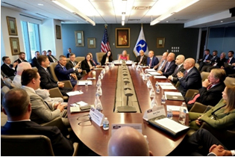
Policy Accomplishments
Witnesses at two Congressional hearings
Hill Staff quarry tour
One Big Beautiful Bill
Surface Roundtable at DOT
CLEAR Waters Act and PERMIT Act
SPEED Act
Aggregates Caucus
Average 40 touch points per month
Notes:
In July, President Trump signed into law the One Big Beautiful Bill Act that included several rock-solid tax provisions for the aggregates industry.
The law makes several of our key tax priorities permanent:
Bonus depreciation
Expensing for research and development
Section 199A for S-Corps
Estate and gift tax limits
Percentage depletion
The aggregates industry can confidently plan for future investments, hire and retain skilled workers and promote growth across the construction supply chain.
Getting the PERMIT Act and CLEAR Waters Act introduced (clean water act). Also secured specific provisions within the SPEED Act (NEPA) around federal money no longer triggering NEPA.
Averaging over 40 touch points a month with members of the House and Senate to advocate for the aggregates industry
Educated Congress on the need for permitting reform & encouraged the introduction of several bills to reform CWA, ESA and NEPA
Engaged with federal agencies by submitting public comments on rulemakings ranging from environmental issues to trade to small business reporting requirements
You may have seen Golden's announcement to not run again in 2026 - so if the SPEED Act doesn't pass this Congress, we will need a new D lead in 2027.

Slide 14

One Big Beautiful Bill Act
In July, President Trump signed into law the One Big Beautiful Bill Act that included several rock-solid tax provisions for the aggregates industry.
The law makes several of our key tax priorities permanent
Bonus depreciation
Expensing for research and development
Section 199A for S-Corps
Estate and gift tax limits
Percentage depletion
The aggregates industry can confidently plan for future investments, hire and retain skilled workers and promote growth across the construction supply chain.

Slide 15


2026 Opportunities
New WOTUS proposal
Permitting Reform
Surface Transportation Reauthorization
MSHA Silica Rule
MSHA collaboration
Notes:
Expect new WOTUS proposal soon and that it is expected to more faithfully adhere to limits from the Supreme Court, ie must be direct, flowing surface water connection to navigable waters or tributaries to be jurisdictional (this won’t matter all the much to them since they have very strict state rules). WOTUS has finally left the White House and OMB. It is currently pending final review with the EPA and the Army Corps. We are hearing it will have a 45-day comment period.
Permitting reform proposed solutions include setting firm review timelines, increasing transparency and improving government efficiency while balancing environmental protection with economic development. Must be bipartisan so that its durable and project neutral which will probably mean legislative guardrails. Surface reauthorization may be the vehicle for most of this. However, using it as the vehicle limits what permitting reform can be done.
From the aggregates' point of view, we need permitting reform to extend beyond NEPA and encompass the Clean Water Act and the Endangered Species Act. We believe it should also address the Clean Air Act. We would encourage a standalone bill that gets to 60 and 218 so it can span different committees in both chambers. EPW and ENR in the Senate and T&I, Nat Resources and E&C in the House. According to House leadership, this is the first time the committees have truly worked together rather than focused on their individual silos. (opinion here - the Senate is still operating in its silos).
Surface:
House T&I will mark up some time in early 2026 with the goal of having it to the House floor by spring 2026. Senate is committed but no timeline yet. Will be EV and hybrid fee
Silica Rule Status
No new substantive updates
8th Circuit stay of implementation still in place. The stay applies to both coal and MNM. MSHA cannot implement/enforce the rule until the Court reaches a decision on the merits.
The plaintiffs’ coalition has been talking with MSHA to try to reach settlement, but all discussions have stopped during the government shutdown.
The Court agreed to pause the litigation during these settlement discussions. At the end of October, MSHA asked, and the Court agreed to, a request to continue to hold the case in abeyance (paused). The parties will have 14 days after the end of the shutdown to file another status report.
MSHA Collaboration
Golden Age of Collaboration” and wants to work with industry on a wide variety of issues.
Data is really important. Want to ensure MSHA data is accurate and available. MSHA wants to make sure industry and miners have access to data to help drive improvements.
MSHA Information Hub – done significant improvements to the MSHA.gov website. Much more user friendly. MSHA is looking for additional input on ways to improve the information hub, so if you have ideas about additional information you want on the landing page, you should share with MSHA directly or feel free to share thoughts with NSSGA
They have rebranded the compliance assistance program as the CASH or Compliance Assistance in Safety and Health. The CASH website has training resources, toolkits and information on how to contact a compliance assistance specialist.

Slide 16
Deregulation – 10:1 Goal
Launched a 10:1 deregulatory initiative
Environmental and land management agencies are making progress
Safety-focused agencies are facing challenges
Focus on industry input
Notes:
President Trump launched a 10:1 deregulatory initiative for his administration.
Environmental and land management agencies are making progress to meet this goal.
Safety-focused agencies are facing challenges, hesitant to roll back 10 regulations to introduce a new one, even if the industry is requesting something new.
The Trump administration frequently solicits our input on which regulations it should target to roll back.
In July, MSHA published several proposed rules eliminating or updating standards they deem outdated, unnecessary or overly burdensome standards. For example,
they are trying to eliminate standards regulations blacksmith shops and trolleys because they are no longer needed.
They are updating the HazCom standard to allow operators to provide materials electronically instead of just in paper form.
Then there are some looking to limit District Managers’ authority related to ventilation, roof control, and training plans.
MSHA took public comments on the proposed rules and now we wait and see how they decide to move forward.
Much of what happens will be dictated by budget and staffing. MSHA lost a significant amount of staff to the early retirement offers – including people in the solicitor’s office and the office of standards, regulation and variances who are all necessary to do the regulatory/deregulatory work.
No new updates on the NIOSH mining program

Slide 17
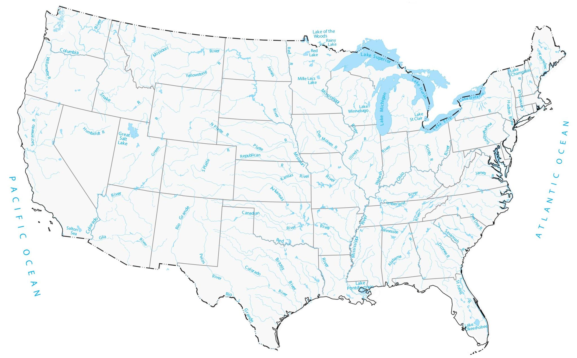
Clean Water Act
Support new WOTUS rule as durable
Adheres to Sackett
Increases clarity to reduce permit times
Final rule expected soon
Exempt dry & isolated areas
water treatment
ditches
Pits
stormwater control
groundwater
Notes:
After nearly 15 years of back and forth rulemaking which is confusing for the industry as well as regulators, we support the new WOTUS durable rule
The rule adheres to the unanimous Sackett opinion where SCOTUS limited federal control of wetlands to only those in direct, flowing contact with jurisdictional waters.
This increased clarity will reduce permit time and complexity for the industry.
A final rule is expected in the first half of 2026.
NSSGA has strongly supported the PERMIT Act to reform the Clean Water Act. This bill provides clear exclusions for Clean Water Act jurisdiction, it limits state reviews to only federally-regulated discharges and enforces a strict timeline, the bill extends general permits to 10 years and clears the backlog of pending approved jurisdictional determinations and permit applications.

Slide 18

2026 Threats
Uncertainty
Economic factors
Congressional Oversight on Trump
Continued polarization
Notes:
Uncertainty over everything: trade, immigration, executive orders, government funding on all levels
And how the economy reacts to all of that
Republicans are starting to say publicly that they will begin to do some oversight in 2026. They appreciate that it's easy to look back at Biden's term; however, they are noticing a need for it in the trade space. With the Supreme Court's hearing on tariffs playing a pivotal role in this, will pit MAGA versus free-market Rs

Slide 19


Permitting Challenges & Opportunities
Environmental delays
The National Environmental Policy Act (NEPA)
Endangered Species Act (ESA)
Clean Water Act (CWA)
Reform the permitting system
Notes:
Environmental delays are among the most significant barriers to timely infrastructure development.
The National Environmental Policy Act (NEPA) reviews often exceed federal timelines.
Under the Endangered Species Act (ESA), multiple agencies often offer conflicting guidance or redundant steps to reduce harm to a species.
Clean Water Act (CWA) jurisdiction has been subject to ongoing litigation for over ten years.
Congress is working to reform the permitting system to support domestic manufacturing and economic growth. Proposed solutions include setting firm review timelines, increasing transparency and improving government efficiency while balancing environmental protection with economic development.
NSSGA strongly supported the SPEED Act that clarifies the analysis required under the National Environmental Policy Act. This bill enables agencies to better balance environmental protection with economic development.
Importantly, the bill is project neutral and is meant to advance projects all of sorts. This is critically important to NSSGA as it provides all industries the certainty that once their project is permitted, it can be built!
Notably, the SPEED Act clarifies that the simple receipt of federal funding is not a trigger for NEPA. This will allow infrastructure projects authorized under the upcoming surface transportation efforts to be quickly built and not caught up in bureaucratic redtape.
NSSGA submitted comments in support of common sense streamlining of implementation of the endangered species act.
The comments include member examples of how suggested improvements will positively impact the industry and reduce delays.
NSSGA endorsed the ESA Amendments Act that were introduced in early 2025. This bill would prioritizes science-based conservation efforts, improves regulatory transparency and streamlines permitting processes essential to economic growth and infrastructure development.

Slide 20

MSHA Silica Rule Update
Rule review
8th Circuit Court of Appeals challenge
MSHA revisiting portions of the rule
Levels will not change
How operators can comply/demonstrate compliance will
Expecting NPRM this spring/summer
MSHA will not begin implementation April 2026
Notes:
NSSGA continues to advocate for changes to the 2024 MSHA Silica Rule.
To recap, the 2024 Rule lowered the Permissive Exposure Limit (PEL) to 50 μg/m³ (micrograms per cubic meter) and established an Action Level of 25 μg/m³. Additionally, among other things, it added significant sampling requirements and established an extensive and complicated medical surveillance requirement.
NSSGA and a group of National and State associations challenged the rule in the 8th Circuit Court of Appeals. That case is still pending but has been held in abeyance (paused) since August 2025, while the parties try to negotiate a settlement.
NSSGA is pleased with MSHA’s decision to revisit portions of the Respirable Crystalline Silica Rule.
The 50 μg/m³ and 25 μg/m³.50 levels will not change, but we hope to see changes how operators can comply/demonstrate compliance – for example, changes to sampling protocols, addressing respirator use in certain circumstances, etc.
We anticipate we will see the new Notice of Proposed Rulemaking later this spring or early summer and look forward to reviewing a rule that is highly protective of miners, grounded in sound science, and feasible for operators to implement.
In the meantime, while the 2024 Rule set an April 2026 implementation date for metal and nonmetal mines, MSHA will not begin implementation or enforcement this April. All implementation has been stayed pending a decision by the court.
Given the PEL and AL will not change, operators should continue to make sure they are prepared to protect miners at those levels.

Slide 21
Secretary of Labor, MSHA v. Consol Pennsylvania Coal Co.
FMSHRC modify S&S violation
Moved away from that multi-factor framework and embraced what it claims is a simpler, more direct statutory formulation: an S&S violation exists if the condition “is of such nature as could significantly and substantially contribute to the cause and effect of a coal or other mine safety or health hazard.”
Potential to lower the burden for establishing S&S designations
Notes:
(PENN 2021-0084) (The S&S Test issue)
This past fall, the Federal Mine Safety and Health Review Commission (the Commission) sua sponte (on its own accord) decided to modify the long-standing test for determining MSHA Significant & Substantial (S&S) violations.
Historically, the Commission applied a structured four-part test (originating in Mathies Coal Co.) that required MSHA to prove: (1) a mandatory standard violation, (2) a discrete hazard contributed to by the violation, (3) a reasonable likelihood that the hazard would lead to injury, and (4) that any resulting injury would be of a reasonably serious nature.
In this decision, the Commission moved away from that multi-factor framework and embraced what it claims is a simpler, more direct statutory formulation: an S&S violation exists if the condition “is of such nature as could significantly and substantially contribute to the cause and effect of a coal or other mine safety or health hazard.”
The Commissioners suggested the reframing aligns more closely with the Mine Act’s text and de-emphasizes the previous emphasis on reasonable likelihood of injury.
This ruling has the potential to lower the burden for establishing S&S designations going forward, making it easier for MSHA to uphold such findings in enforcement proceeding.
Consol filed an appeal to the U.S. Court of Appeals for the 3rd Circuit and NSSGA is joining with the Essential Minerals Association to file an amicus brief in support of Consol, and specifically regarding the change in the S&S test.
There is no need to take any action right now and your operations should not be seeing any change to how inspectors are issuing S&S citations.
Briefs in the case are due at the end of February and we will continue to monitor and provide updates as they become available.

Slide 22






2026 Priorities
Surface Transportation Reauthorization
Fair access to materials research, development and deployment
Promote workforce development
Permit Reform
Restore NIOSH mining program
Remain engaged with Administration
Notes:
Secure a strong surface transportation reauthorization bill that addresses the Highway Trust Fund solvency and maintains support for highways
Maintain the construction materials exemption from Federal Buy America requirements
Ensure fair access to materials research, development and deployment
Promote workforce development through career and technical education, workforce Pell grants, supporting our Veterans, apprenticeships, and expanding the eligible workforce
Fix a broken permitting system to build smarter and faster
Restore the NIOSH mining program
Remain engaged with the Trump administration to advance the aggregates industry's priorities through regulatory efforts

Slide 23
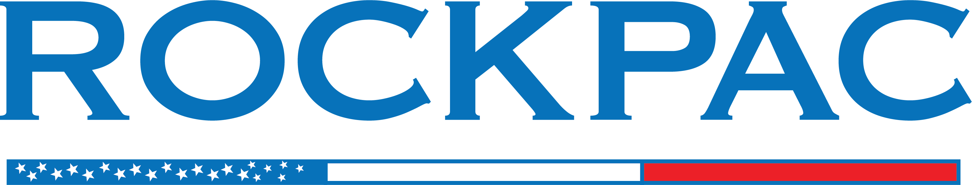
ROCKPAC Mission
ROCKPAC is the only political action committee solely dedicated to advancing the aggregate industry’s priorities with federal candidates. It is registered with the Federal Election Commission and allows industry executives and employees of NSSGA to pool personal, voluntary financial contributions. These contributions are used to support candidates regardless of party affiliation, who are pro-business, pro-transportation and who understand the interests and concerns of the aggregates industry.
ROCKPAC Goal
Raise $1M in a calendar year
Raise political visibility of the Aggregates Industry

Slide 24
Supported Candidates
Sen. Gary Peters
Cong. Haley Stevens
Cong. John James
Cong. Tim Wahlberg
Cong. Bill Huizinga
Cong. Kristin Scholten
Cong. Jack Bergman
Cong. Dan Kildee
Cong. Lisa McClain

Slide 25
2025 Financial Wrap Up
Cash on Hand Start of 2025: $30,003.02
Total Amount Raised: $ 844,188.65
Total Amount Disbursed: $ 842,946.42
Cash on Hand Start of 2026: $ 31,245.25

Slide 26
Top PACS Jan 1 – June 30, 2025
Top Trade Assn PACs:
Top Corporate PACs:
NATIONAL BEER WHOLESALERS | $1,442,128
AMERICA'S CREDIT UNIONS | $1,339,258
NATIONAL AUTOMOBILE DEALERS | $1,307,359
ASSOCIATED BUILDERS AND CONTRACTORS, INC. | $1,230,474
NATIONAL RURAL ELECTRIC COOPERATIVE | $1,155,918
AMERICAN SOCIETY OF ANESTHESIOLOGISTS | $1,136,455
AMERICAN HOSPITAL ASSOCIATION PAC | $1,128,314
MORTGAGE BANKERS ASSOCIATION (MORPAC) | $854,731
NATIONAL ASSOCIATION OF HOME BUILDERS (BUILDPAC) | $797,802
NATIONAL MULTIFAMILY HOUSING COUNCIL(NMHC PAC) | $797,664
NATIONAL STONE, SAND & GRAVEL ASSOCIATION ROCKPAC | $795,974
AMERICAN COUNCIL OF ENGINEERING COMPANIES (ACEC/PAC) | $794,132
CALIFORNIA ASSOCIATION OF REALTORS | $781,414
INDEPENDENT INSURANCE AGENTS & BROKERS (INSURPAC) | $731,891
NATIONAL ASSOCIATION OF BROADCASTERS (NABPAC) | $706,037
HONEYWELL INTERNATIONAL | $2,028,975
PRICEWATERHOUSECOOPERS | $1,579,765
THE BOEING COMPANY | $1,111,027
KOCH, INC. POLITICAL | $1,108,744
THE HOME DEPOT INC. | $1,108,275
DEMOCRACY ENGINE, INC., PAC | $1,028,619
EMPLOYEES OF NORTHROP GRUMMAN | $978,702
LOCKHEED MARTIN CORPORATION | $973,297
UNITED PARCEL SERVICE, INC. PAC (UPSPAC) | $972,552
COMCAST CORPORATION & NBCUNIVERSAL | $938,240
SPACE EXPLORATION TECHNOLOGIES CORP. | $916,964
ENTERPRISE HOLDINGS, INC. / ENTERPRISE MOBILITY | $902,644
WALMART INC. PAC FOR RESPONSIBLE GOVERNMENT | $823,317
CHARTER COMMUNICATIONS INC. | $808,818
DIRECT SUPPLY, INC. PARTNERS PAC (DSI PARTNERS PAC) | $802,531

Slide 27
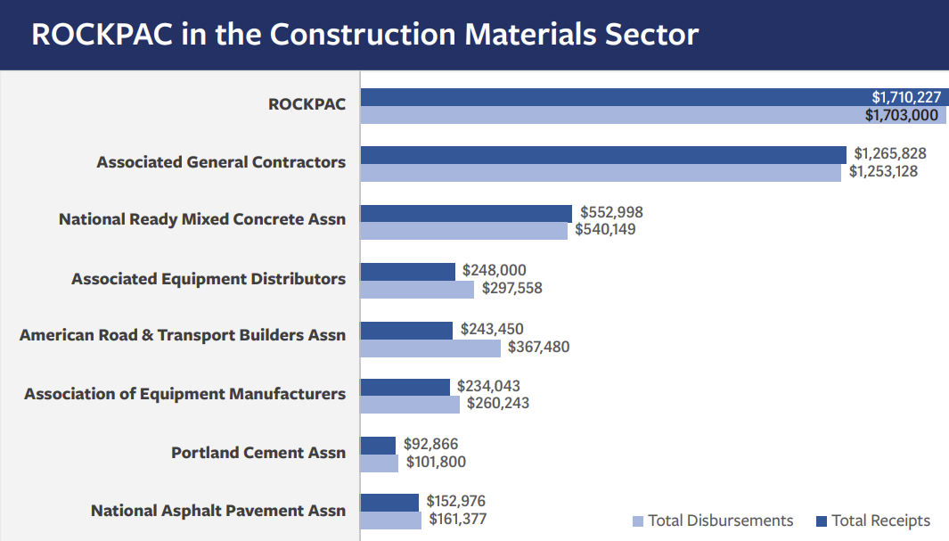
Fighting Above our Weight Class
Notes:
There will be $2.5 BILLION spent this election cycle from PACs, Super PACs and campaigns

Slide 28
ROCKPAC Fundraising – Lets Go!

Slide 29





Ballot in 2026
THE MAJORITY
Continued Trifecta?
SENATE
53-45 Republican majority in jeopardy?
HOUSE
18 toss up seats
GOVERNORS
36 governors’ mansions up for grabs
STATE LEGISLATURE
88 of the 99 state legislative chambers up
Notes:
The Republican party aims to maintain its trifecta while Democrats will fight to claim a majority. Midterm elections often favor the party not in the White House, but Democrats will need to gain seats in historically Republican areas. GOP members who voted against Trump’s agenda might face primary challenges by Trump-backed candidates.
Senate
Republicans currently hold a 53-45 majority in the Senate; 22 of the 35 Senate seats up for election are Republican-held, giving Democrats an opportunity to flip the chamber
House
Republicans hold a slim 219-213 majority in the House; The Cook Political Report rates 18 seats as toss-up, giving Democrats an opportunity to flip the chamber. And redistricting still leaves a lot questions.
Governors
36 states will hold gubernatorial elections in 2026, and two did in 2025. Not all current governors have announced their intentions for the 2026 election
State Legislatures
88 of the 99 state legislative chambers in the US will hold elections in 2026, with Republicans currently controlling 55.42% of seats nationally

Slide 30
Why ROCKPAC – Education Matters
RETIREMENTS FROM CONGRESS BY ELECTION CYCLE
■ Democrats ■ Republicans ■ Independent/Libertarian
*Data includes retirements and members of Congress seeking a different office; does not include members of Congress who resigned from or otherwise vacated their seat before their term ended
SOURCE Ballotpedia, NPR
PRESENTATION CENTER 1/20/26
Notes:
Sources:
“List of U.S. Congress incumbents who are not running for re-election in 2026,” Ballotpedia, accessed August 26, 2025, https://ballotpedia.org/List_of_U.S._Congress_incumbents_who_are_not_running_for_re-election_in_2026 Stephen Fowler, “A record number of congressional lawmakers aren't running for reelection in 2026. Here's the list,” NPR, January 6, 2026, https://www.npr.org/2025/09/15/nx-s1-5534254/house-senate-retirement-tracker-2026

Slide 31
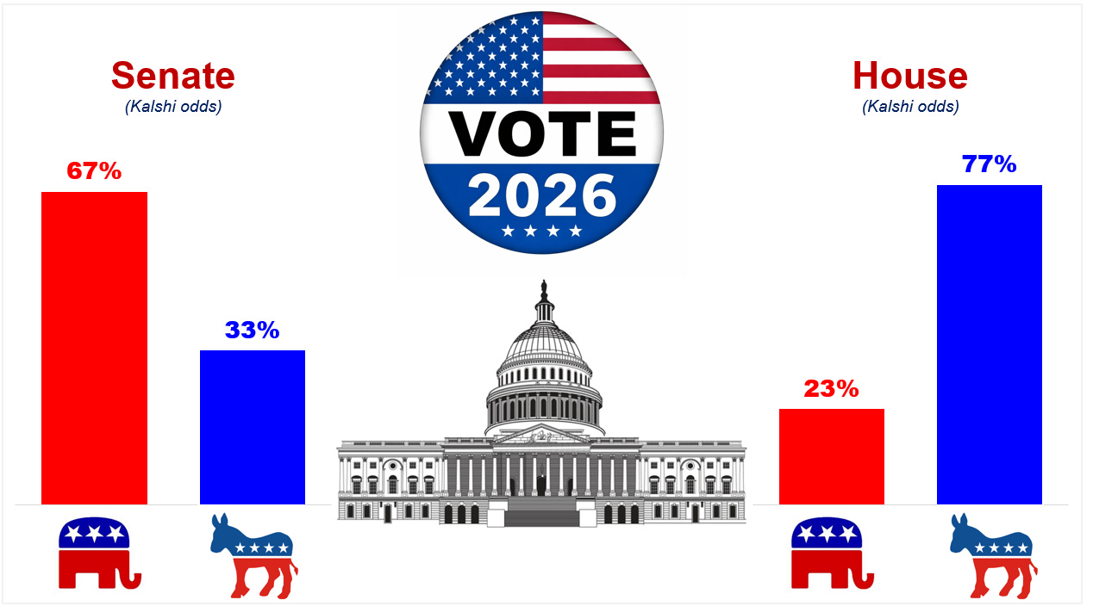
Why ROCKPAC – Elections Matter

Slide 32
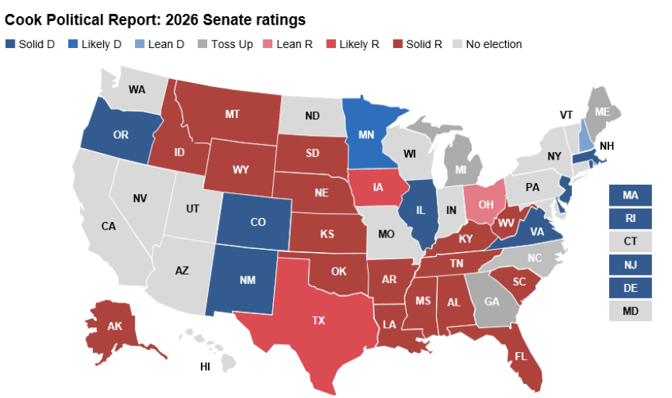
Senate Toss Up Seats

Slide 33
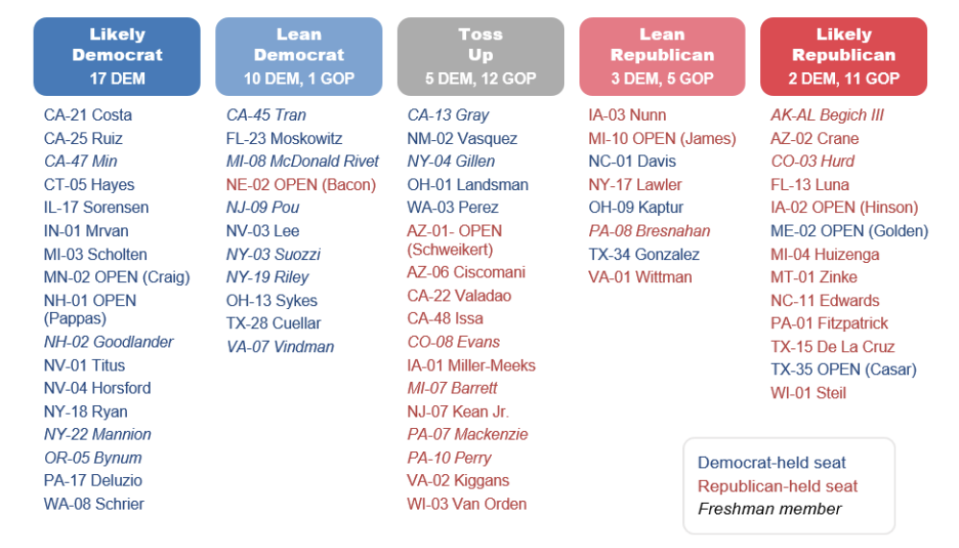
House Toss Up Seats

Slide 34
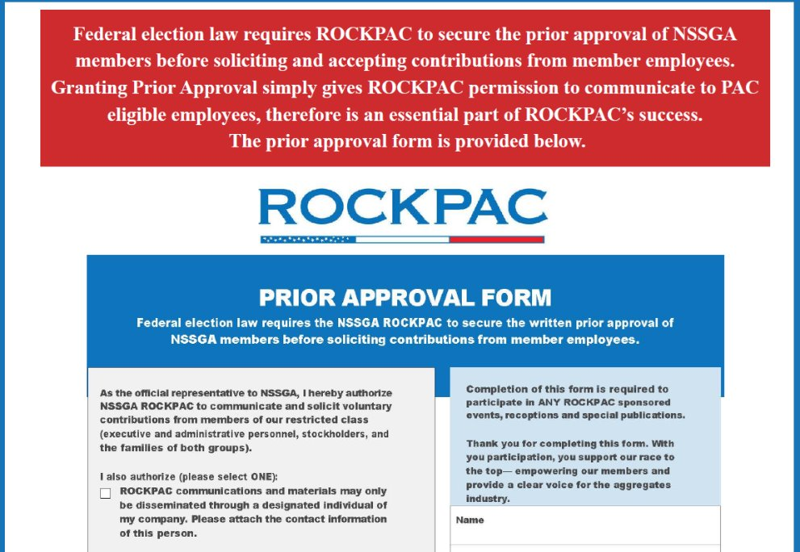
Prior Approval​
Ashley Taylor is reaching out to every member –if you have any questions, please email her ataylor@nssga.org​

Slide 35

LIVe from Las Vegas

Slide 36
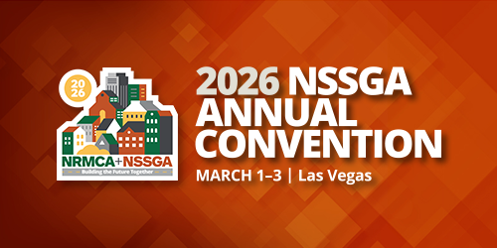
See you in Las Vegas!

Slide 37
Questions?

