Slide 1
What to do about material contamination
The easy material is gone
21st July 2023
Mark Krause | North America Managing Director

Slide 2
As we continue to grow and expands two things are happening
Deposits with lignite, coal and other contaminants must be processed
Recycle Aggregates are coming into play
  In larger cities where material is now a larger haul distance to usage.

Slide 3
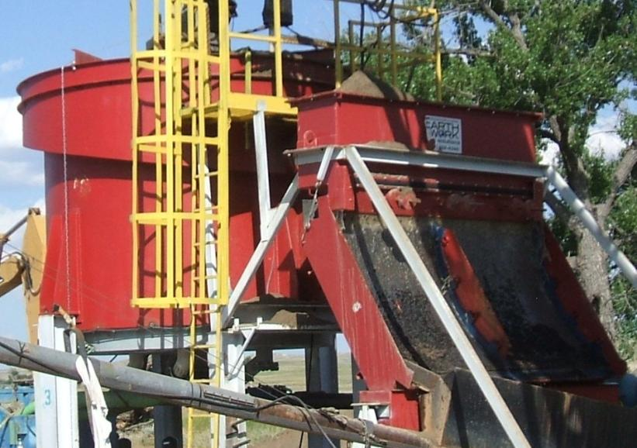
Contaminant Removal

Slide 4
General Process Flow Diagram for Removal
of Lignite and Coal from Sand -- Conveyable Discharge
Process Water
Cy-101
4
3
FT-101
To Ponds or
Water Treatment
12
2
5
Cy-102
Feed (-4mm )
Scrn-101
10
1
6
11
Lignite / Coal
Free Sand
Scrn-102
13
Tk-101
8
8
P-101
Lignite, Coal,
Light Materials, etc.
Tk-102
P-102
7

Slide 5
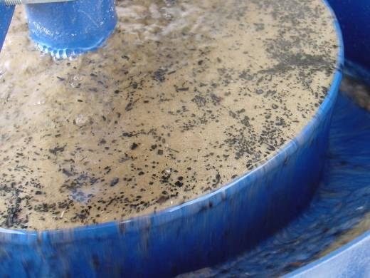
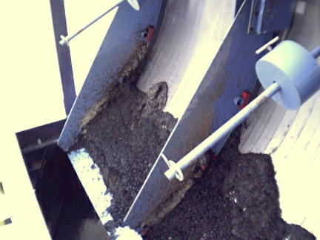
Lignite in overflow is
removed by the sieve
bend.

Slide 6
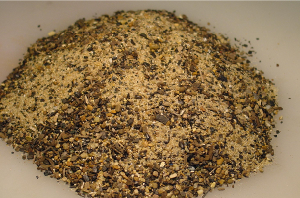
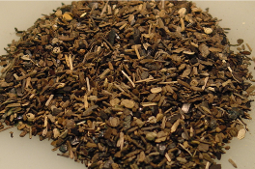
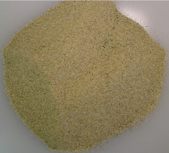
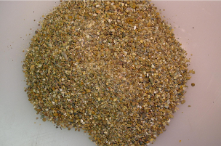
Flat Bottom Classifier: The “Heart”
of the System
Organics
FBC
Classifier
Feed
Sieve
Bend
Coarse Sand
Fine
Sand

Slide 7
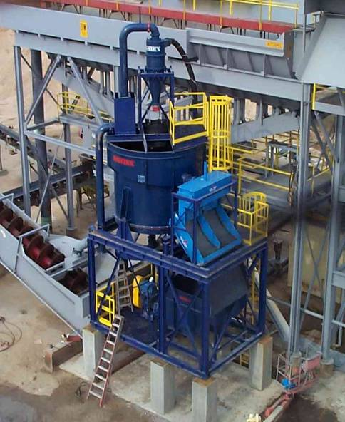
Lignite Removal From
Concrete Sand
Classifier underflow and sieve bend underflow report to sand screw for dewatering
Lignite will drop into
catch basin

Slide 8
Classification by Size
Feed topsize - 3/8”
Cut between 200 mesh & 35 mesh

Slide 9
Separation by Density
Must be at least 0.7 SG difference in minerals
Can be problem if lighter mineral has much larger particle size

Slide 10
Removal of Organics
Common case of density separation
- lignite SG 1.4 & Silica SG 2.7
difference = 1.3
Use with Sieve Bend on overflow to recover fine sand

Slide 11
Parts of a FBC
Level Probe
Air Cylinders
Weir
O/F Launder
Feedwell
Tank
Plungers
Plate with
Nozzles
Plenum
Chamber
Outlet Ports

Slide 12
Operation
Feed enters –
50 to 65% w/w
Teeter Bed Forms
Teeter Water gives
a rising current

Slide 13
Operation
When the Level Probe detects that the sand bed level reaches the setpoint
Fines Overflow Weir…
Teeter bed segregates
Fines to top
Coarse to bottom
..& exit Launder
The Plungers open for ½ second to let out some coarse material
Teeter Water gives
a rising current

Slide 14
Rules of Thumb
The finer the cut size, the lower tph capacity for a given size of Classifier.
For size classification at 35 Mesh
capacity is 35 to 40 TPH of dry solids per m².
For size classification at 140 Mesh
capacity is 10 to 15 MTPH of dry solids per m².

Slide 15
Common Questions
What happens if the recommended loading rate is exceeded?
  Efficiency of size separation decreases
How much lignite is removed?
  Approximately 95% with a 50 mesh size separation

Slide 16
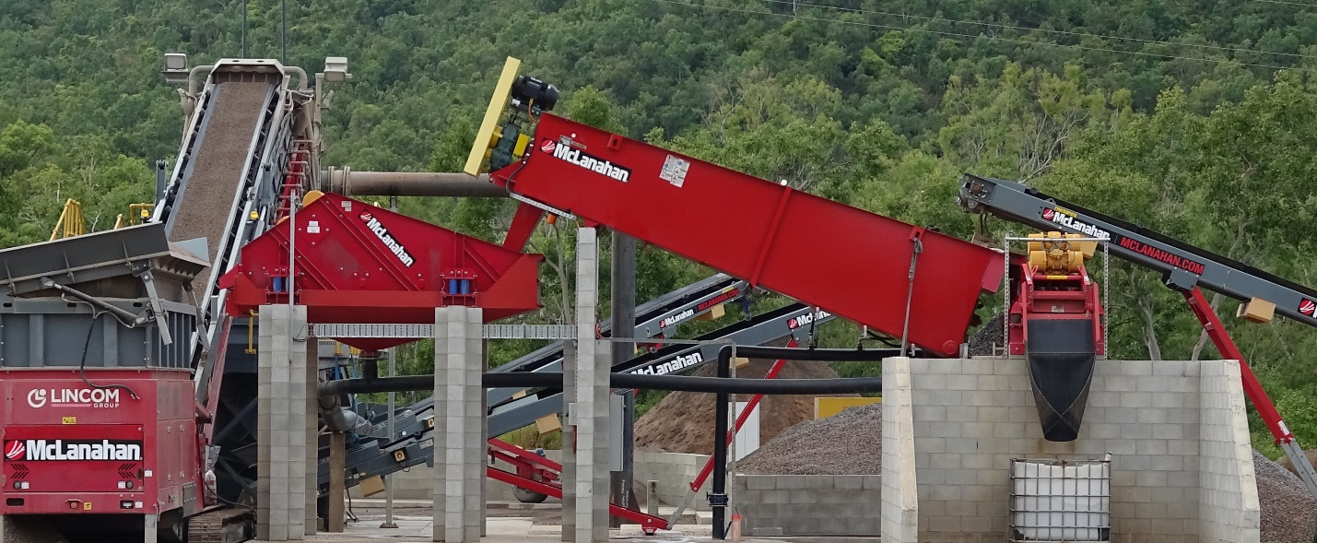
Wet Recycling: EQUIPMENT LOOKS SIMILAR BUT PROCESS FLOW IS DIFFERENT

Slide 17
DEFINITION OF AGGREGATES
Primary aggregates are naturally occurring deposits of minerals that come in the form of crushed rocks, sand and gravel
Recycled aggregates are the product of processing inert construction, demolition and excavation waste, asphalt millings and used railway ballasts into construction aggregates.
Secondary materials are derived from other industrial processes including: China clay / Fly Ash / Incinerator Bottom Ash / Blast furnace slag
Source MPA

Slide 18
DEFINITION
WHAT ARE THE ENVIRONMENTAL DIFFERENCES?
The biggest difference between virgin and recycled aggregate is the impact on the environment. Virgin material needs to be mined, and this requires digging up land, using a variety of tools and equipment, and then processing the material for use. All of this can use valuable natural resources, cause pollution, and consume energy.
Since recycled aggregates are already coming from a previously existing product, they do not need to be mined for use. This allows companies to conserve the natural resources while also eliminating the need for products to take up space in a landfill.

Slide 19
DEFINITION
WHAT ARE THE COST DIFFERENCES?
There are many factors that determine the cost of aggregate, and when comparing recycled vs. virgin aggregate, recycled is generally the more cost-effective option. Since companies don’t have to mine or produce new material, they can price the recycled material lower than the virgin material. Since recycled producers already have the raw material at their facility, costs are generally lower, and savings are passed on to the consumer.
In some instances, you may actually get more recycled material than virgin material for the same or a lower price. For example, recycled CA6 is 15% lighter than virgin CA6, so you receive 15% more volume per ton. All of this adds up to a significant cost savings.

Slide 20
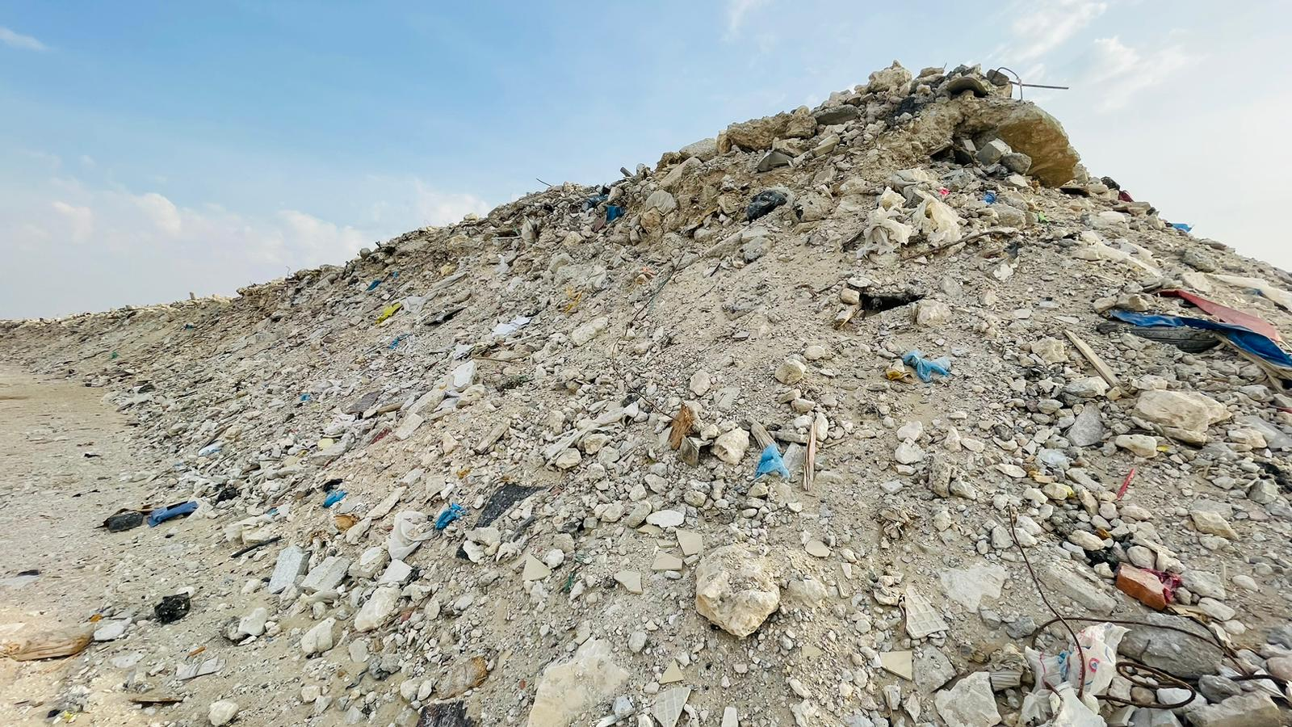
GENERAL MIX MATERIAL
General mix material contain of excavation, concrete, wood, plastic, etc.…

Slide 21
RECYCLE FACTS
An average new home building project generates about four tons of debris, according to Yost. That includes two tons of wood debris, a ton of drywall, 1,000 pounds of masonry, 600 pounds of cardboard, 150 pounds vinyl and 150 pounds of metals.

Slide 22
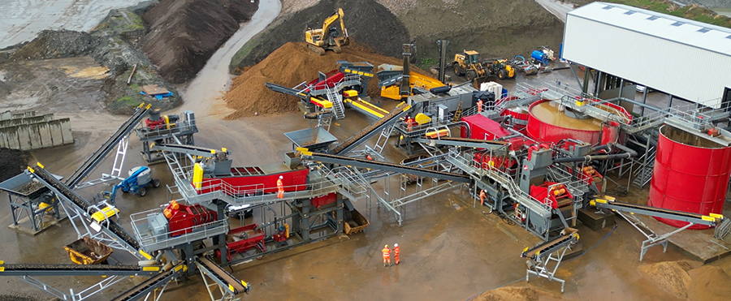
EQUIPMENT LOOKS SIMILAR BUT PROCESS FLOW IS DIFFERENT

Slide 23
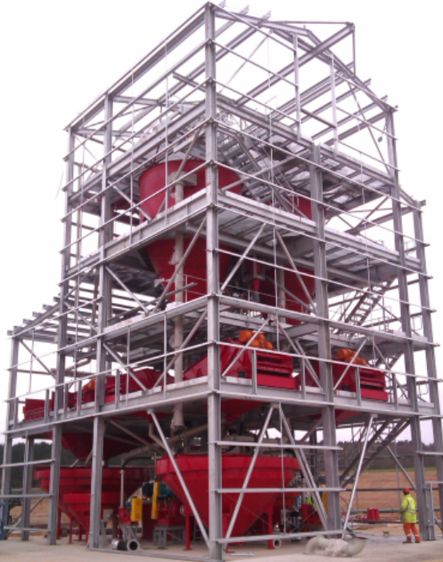
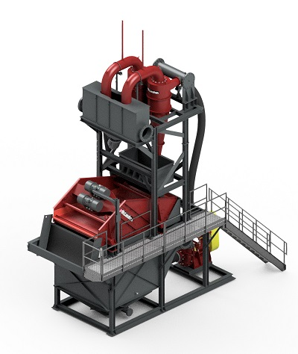
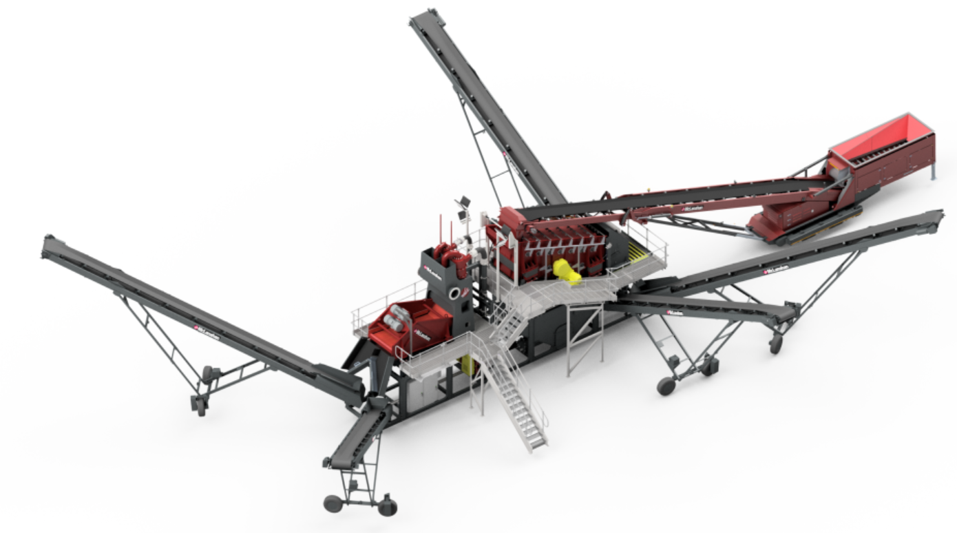
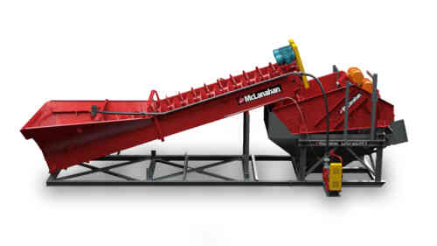
WASH PLANT CONFIGURATIONS FOR RECYCLED AGGREGATES
Wash plants for recycled aggregates are available in a variety of configurations from simple to extremely complex.
Tonnage
Products

Slide 24
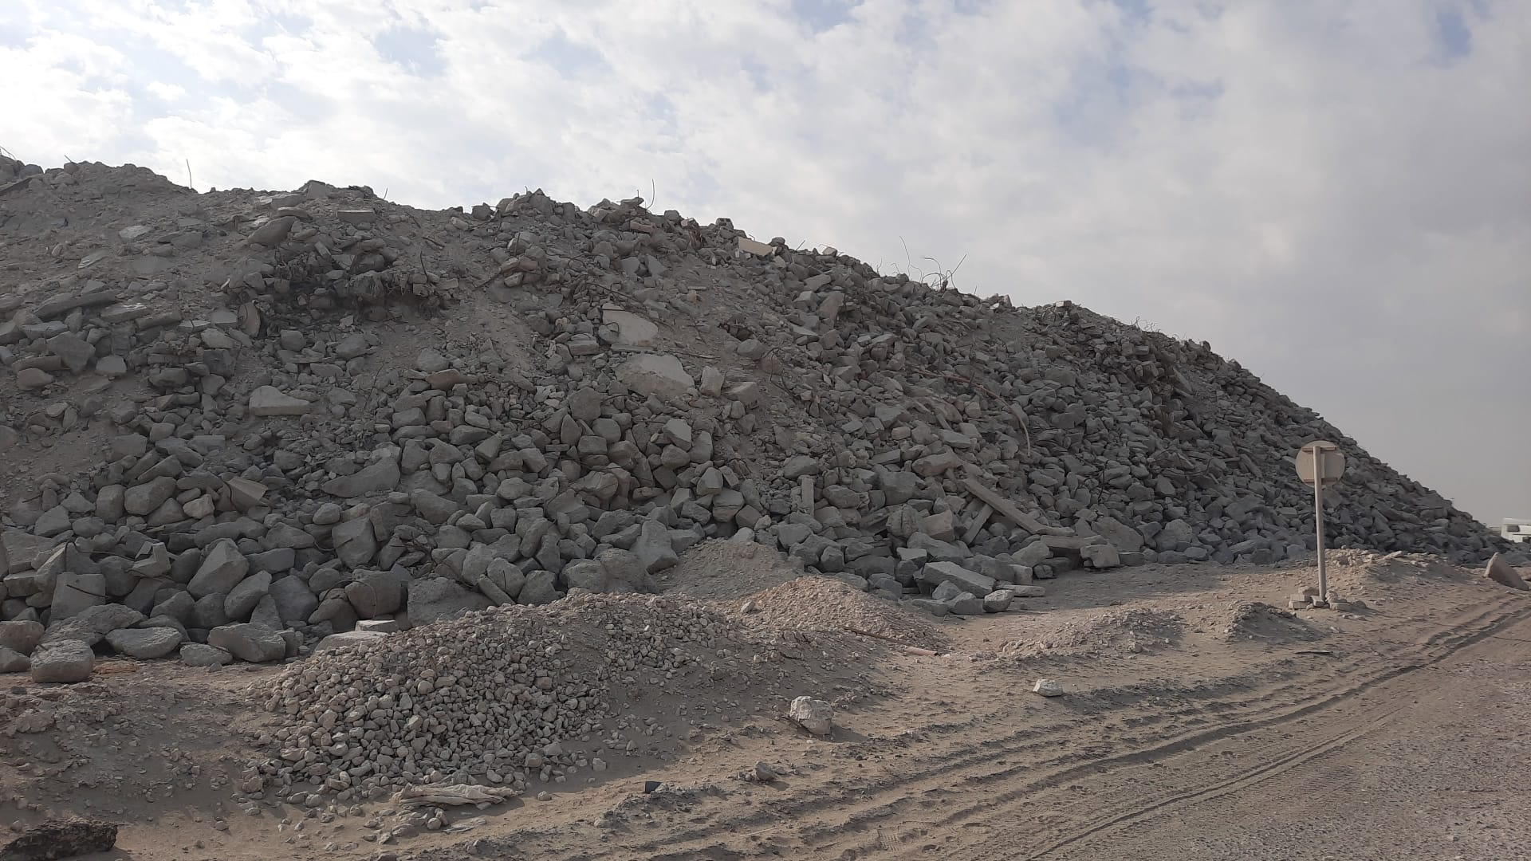
RECYCLED CONCRETE
Advantages of Recycled Concrete:
Delivers a low cost alternative to exhausting local natural raw aggregates.
Concrete constructed with crushed recycled concrete has a lower carbon footprint
Slows down depreasion of natural aggregates
Uses less energy than natural aggregates
Lowers construction cost.

Slide 25
RECYCLED CONCRETE
Disadvantages of Recycled Concrete:
Produces a lower grade of concrete than all natural. Less durable
Workability of concrete can be affected
It has less compressive strength
Has not been spec’ed in all areas as of yet.

Slide 26
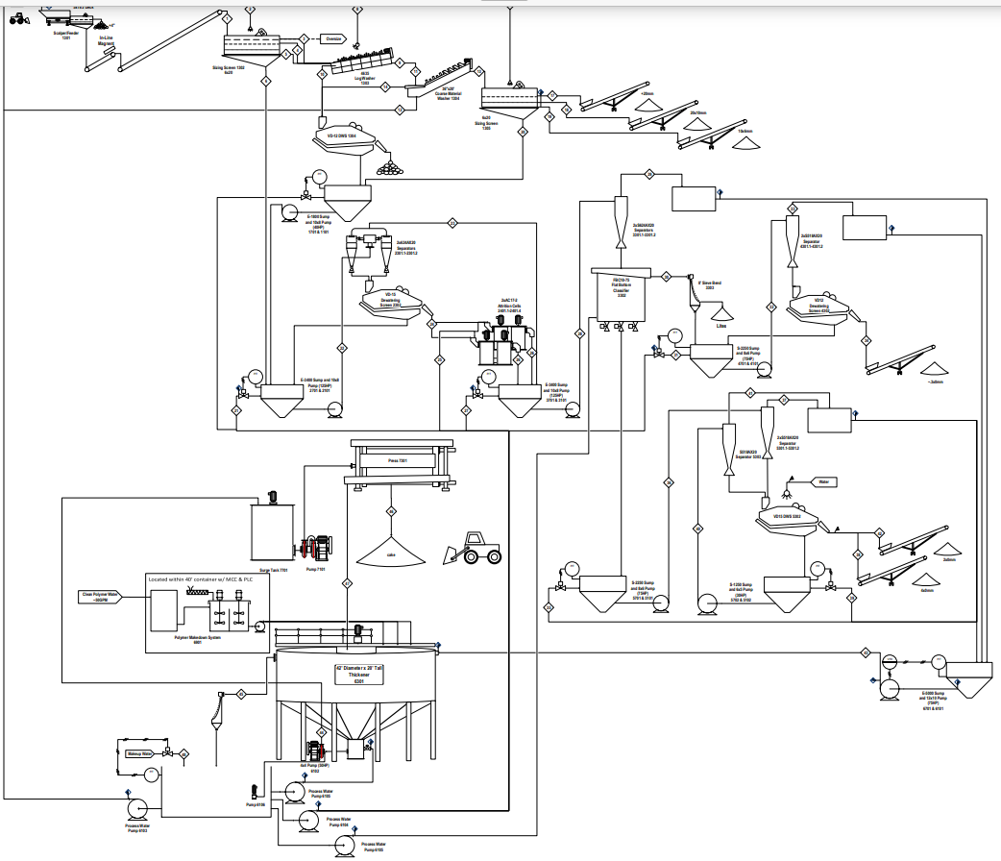
Where can I find more information?

Slide 27
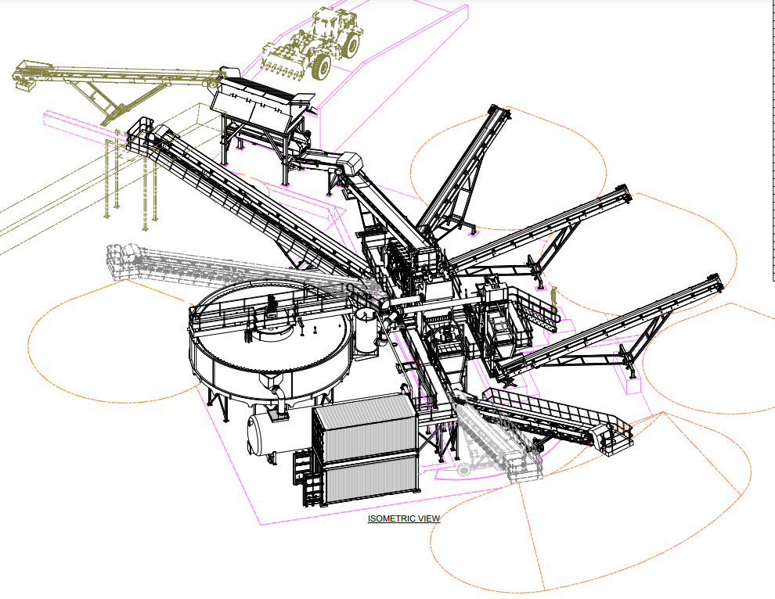
Where can I find more information?

Slide 28
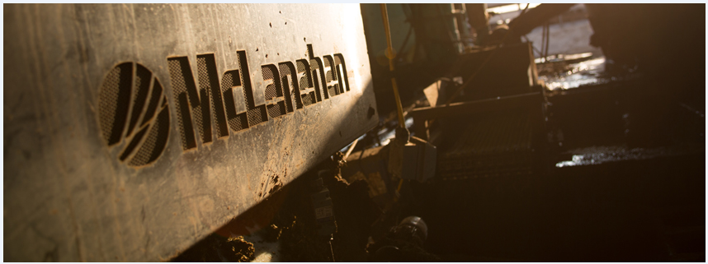
THANK YOU

