Slide 1
Economic Update Presented to the Michigan Aggregates Association July 21, 2023
By:
Pierre G. Villere
Senior Managing Partner
Allen-Villere Partners

Slide 2
Antitrust Statement
This meeting is conducted in accordance with the MAA Antitrust Policy Statement
The Michigan Aggregates Association assigns the highest priority to full compliance with both the letter and the spirit of the antitrust laws. Agreements among competitors that unreasonably limit competition are unlawful under federal and state antitrust laws, and violators are subject to criminal fines and incarceration, civil fines and private treble-damage actions. Even the successful defense of antitrust litigation or an investigation can be very costly and disruptive. It is thus vital that all meetings and activities of the Association be conducted in a manner consistent with the Association’s antitrust policy.
Examples of illegal competitor agreements are those that attempt to fix or stabilize prices, to allocate territories or customers, to limit production or sales, or to limit product quality and service competition. Accordingly, it is inherently risky and potentially illegal for competitors to discuss under Association auspices, or elsewhere, the subjects of prices, pricing policies, other terms and conditions of sale, individual company costs (including planned employee compensation), the commercial suitability of individual suppliers or customers, or other factors that might adversely affect competition.
It is important to bear in mind that those in attendance at Association meetings and activities may include competitors, as well as potential competitors. Any discussion of sensitive antitrust subjects with one’s competitors should be avoided at all times before, during, and after any Association meeting or other activity. This is particularly important because a future adversary may assert that such discussions were circumstantial evidence of an illegal agreement, when viewed in light of subsequent marketplace developments, even though there was, in fact, no agreement at all.
If at any time during the course of a meeting or other activity, Association staff believes that a sensitive topic under the antitrust laws is being discussed, or is about to be discussed, they will so advise and halt further discussion for the protection of all participants. Member attendees at any meeting or activity should likewise not hesitate to voice any concerns or questions that they may have in this regard.

Slide 3
Economic Update: Discussion Points
Economic Outlook
Recession on the Horizon?
GDP
Consumer Sentiment
AVP Pulse Index
Industry Data
Construction Aggregates Demand

Slide 4
Economic Outlook
Let’s Start with America’s Biggest Industry
What is the biggest industry in the country?
Can you guess?

Slide 5
Economic Outlook
Let’s Start with America’s Biggest Industry
It is the shopper pushing the grocery cart through Wal-Mart
The American consumer!
He (or she) represents 70% of America’s entire GDP

Slide 6
Economic Outlook
Recession on the Horizon?
Consumer sentiment, or confidence, is the KEY driver to the entire U.S. economy
“Sentiment is self-fulfilling” is a very true statement in understanding what moves the economy
With the American consumer representing 70% of GDP, mood swings can have a huge impact, albeit sometime temporarily, on the economy

Slide 7
Economic Outlook
"Willing Us Into Recession”
By: Pierre G. Villere
I was driving to the airport at 5:15 a.m. one very recent morning to catch an early flight, and tuned into one of my favorite business radio channels for my usual dose of early news and data, and the outlook for the markets. Some financial pundit was being interviewed, giving all the reasons why the recent spate of good economic news was just wrong, and that we were headed to recession. He cited ever-rising interest rates and diminishing consumer savings that will soon run out, therefore stopping the flow of consumer spending. And he predicted housing prices will start to descend and then plunge, and added all manner of other reasons why the current reporting of strength in our economy will be short-lived.
Good Lord. Talk about Chicken Little.

Slide 8
Economic Outlook
Source: U.S. Bureau of Economic Analysis

Slide 9
Economic Outlook
Recession on the Horizon?
Consumer Sentiment
The Conference Board: Consumer Confidence Index
University of Michigan: Consumer Sentiment Index

Slide 10
Economic Outlook
June: 109.7

Slide 11
Economic Outlook
72.6

Slide 12
Economic Outlook

Slide 13
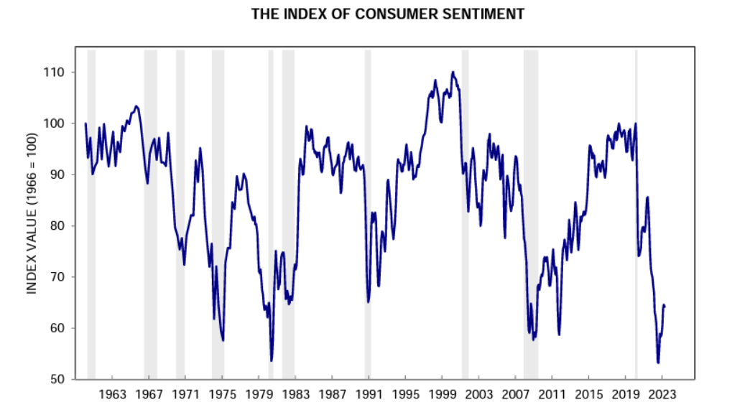
Economic Outlook
Sentiment begins to fall prior to most recessions
Source: University of Michigan

Slide 14
Economic Outlook
AVP Pulse Index in Partnership with Rock Products
Rock Products has recently introduced “The Pulse,” a new construction industry economic report; and the AVP Pulse Index, a joint effort with our firm

Slide 15
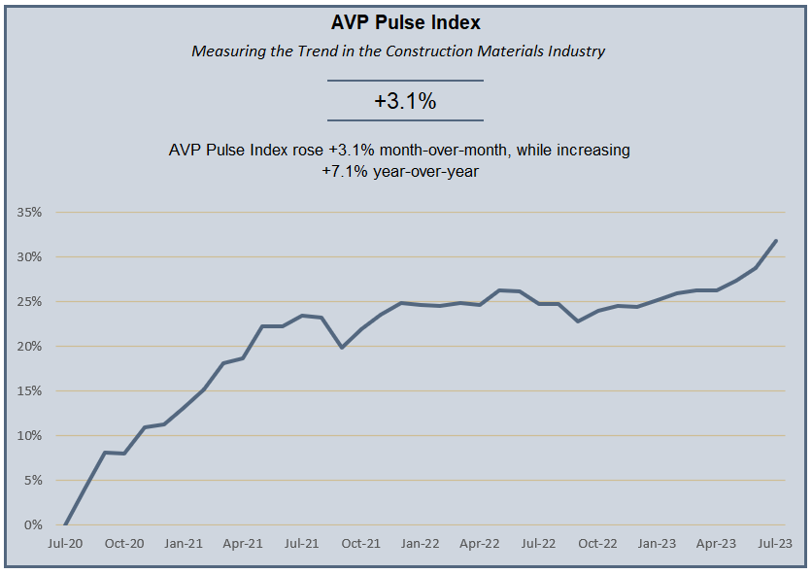
Economic Outlook
AVP Pulse Index
 |  | Measuring the Trend in the Construction Materials Industry
 |  |  |  | +0.9%
 |  | AVP Pulse Index rose +0.9% month-over-month, while increasing +1.8% year-over-year
The previously flattened curve of the Index turned up this month, much sooner than I expected, rising 3.1% month-over month, and 7.1% year-over year. Key drivers include privately‐owned housing starts in May that were at a seasonally adjusted annual rate of 1,631,000. This is 21.7% (±14.8%) above the revised April estimate of 1,340,000, and is 5.7% (±10.8%) above the May 2022 rate of 1,543,000. Single‐family housing starts in May were at a rate of 997,000; this is 18.5 percent (±14.1 percent) above the revised April figure of 841,000. And once again, Industry Stocks Average Price rose 7.5% from last month’s reading, which was already at a 52-week high, and reflects a stunning 59.2% increase year-over-year. That is now two consecutive months of our Industry Stocks Average Price setting a new 52-week high. Finally, economists across the board are rolling back predictions of a recession, with Goldman Sachs now revising previous expectations down to a 20% chance in the next 12 months.

Slide 16
Industry Data
Dodge Data & Analytics Forecasts for Michigan
Construction Aggregates

Slide 17
Construction Aggregates – Michigan Forecast
Source: Dodge Data & Analytics

Slide 18
Construction Aggregates – Michigan Forecast
Source: Dodge Data & Analytics

Slide 19
Construction Aggregates – Michigan Forecast
Source: Dodge Data & Analytics

Slide 20
Construction Aggregates – Michigan Forecast
Source: Dodge Data & Analytics

Slide 21
Construction Aggregates – Michigan Forecast
Source: Dodge Data & Analytics

Slide 22
Economic Outlook
We expect rates to cap out near 5.5% by the end of 2023
2001 was the last time rates reached 5.5%

Slide 23
Summary
THE IIJA WILL BE A BOON TO OUR INDUSTRY, AND WILL LIKEWISE SOFTEN THE BLOW OF ANY ECONOMIC OR SENTIMENT IMPACTS BROUGHT ABOUT BY UKRAINE, INFLATION, OR INTEREST RATES
When the current threats abate, and the economy returns to pre-pandemic stability, get ready for a long, multi-year economic expansion

Slide 24
My Final Thoughts
The prospect exists for a slowing economy generally, and possibly a minor dip into negative GDP for a couple of quarters – THAT IS OUR WORST CASE SCENARIO
Construction generally, and ready mixed concrete in particular, will thrive for the foreseeable future
Housing will slowly recover through this year and next, adding to the only soft demand area in our industry
Materials, especially cement, will continue to be suffer spotty shortages and could be a drag on total volume potential
Watch out for Black Swans events!

Slide 25
So with that….
Thank you!!

