Slide 1
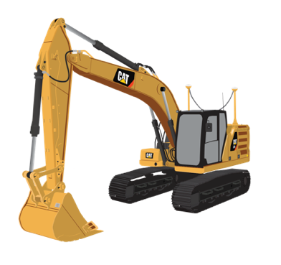
REMOTE SERVICES TECHNOLOGY

Slide 3
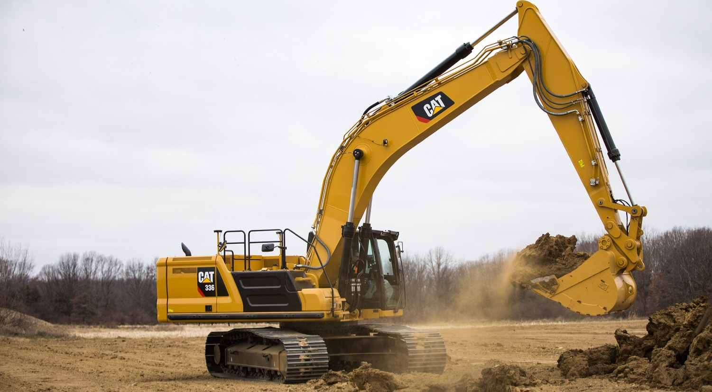
THIS PRESENTATION
Introducing Remote Services Technology
What this technology delivers for customers
Remote Troubleshoot
Remote Flash

Slide 4
INTRODUCING REMOTE SERVICES TECHNOLOGY
Remote Services is a suite of cutting-edge technologies that significantly improve
jobsite efficiency.
- REDUCE DOWNTIME
- INCREASE JOBSITE EFFICIENCY
- SAVE TIME AND MONEY
Two of its key functions are:
Remote Troubleshoot and Remote Flash.

Slide 5
WHAT THIS TECHNOLOGY DELIVERS FOR CUSTOMERS
Boost jobsite efficiency
RUN A MORE
EFFICIENT JOBSITE
WITH REMOTE SERVICES
Minimize machine downtime by
as much as 50%
Diagnose fault codes remotely
Optimize machine performance
with latest software
Save time and money

Slide 6
REMOTE TROUBLESHOOT
Enables real time remote diagnostics on connected machines
Reduces service calls
Minimizes machine downtime

Slide 7
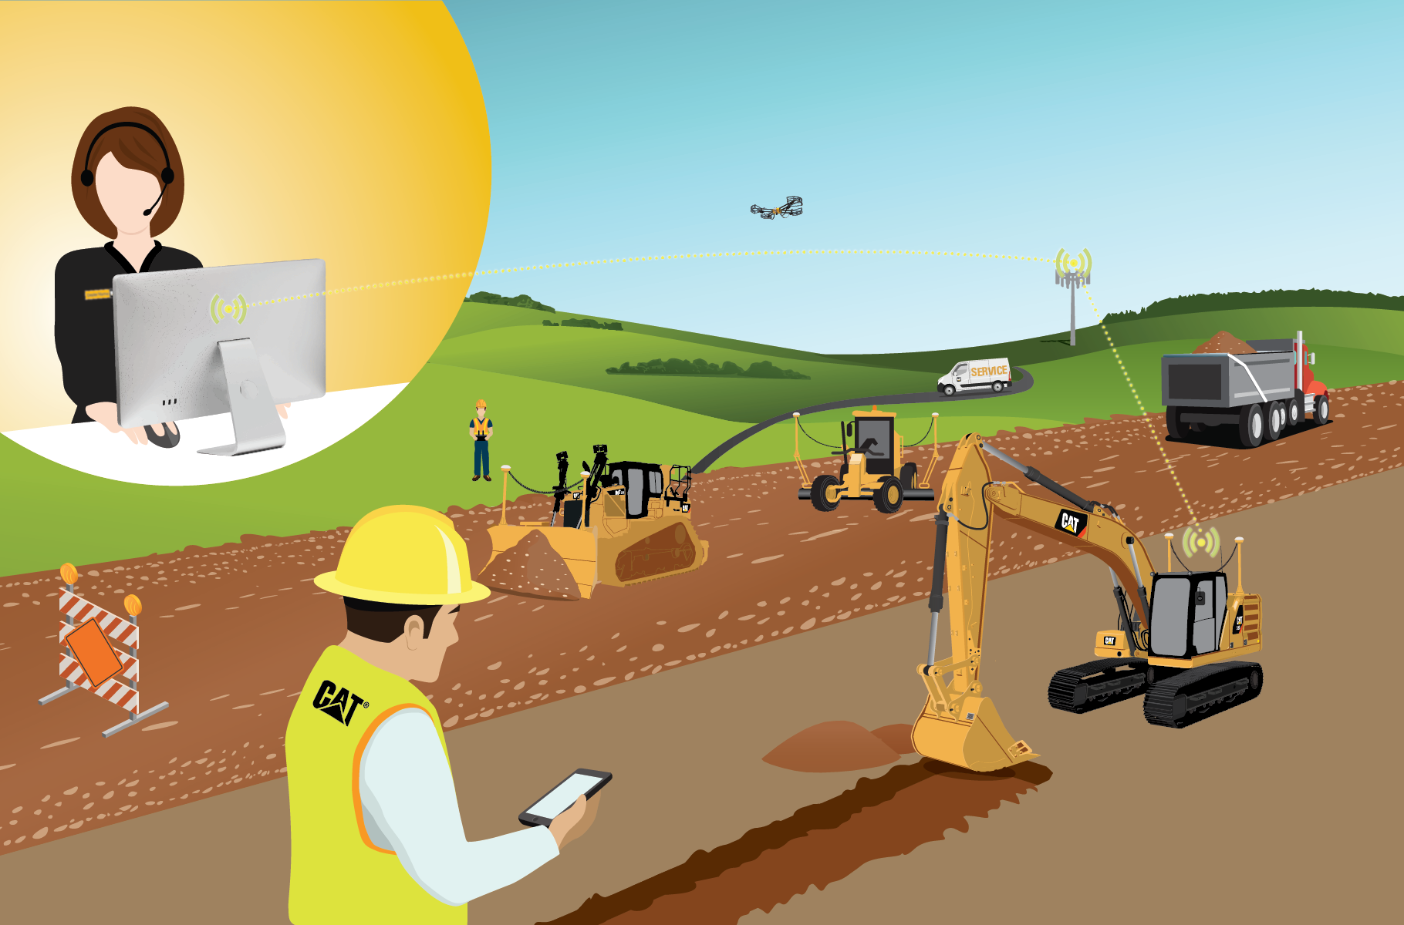
REMOTE TROUBLESHOOT PROCESS
2
3
Customer calls the dealer to report an issue with the machine.
1
4
2
The dealer technician initiates a Remote Troubleshoot session, accessing live machine diagnostics information, and remotely identifies problems.
3
Dealer identifies any software updates required on the machine, and downloads latest version of software to the machine using Remote Flash.
4
If required, the technician arrives on site to carry out the repair, with the correct parts in hand.
1
5
5
Machine is operating at full efficiency with minimal downtime

Slide 8
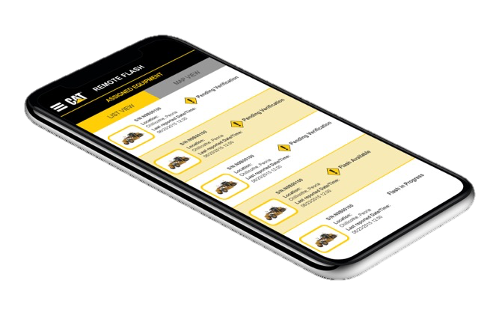
REMOTE FLASH
Optimizes machine performance with the latest software features and upgrades
Maximizes uptime with remote software updates

Slide 9
REMOTE FLASH
1
2
The dealer determines when new software is required and authorizes Remote Flash.
1
2
Software is downloaded to the machine while it’s still in operation.
3
The customer then initiates the software to be installed on the individual machine control modules.
4
The customer is notified and the Install complete.
4
3

Slide 10
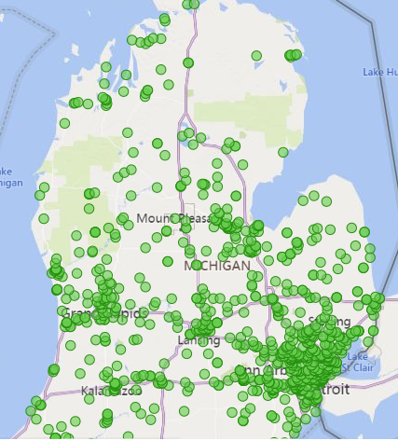
Remote Flash
Capable Machines
that need an update
Notes:
These are the machines in the Lower Peninsula of Michigan that are Remote Capable and need to be updated.

Slide 11
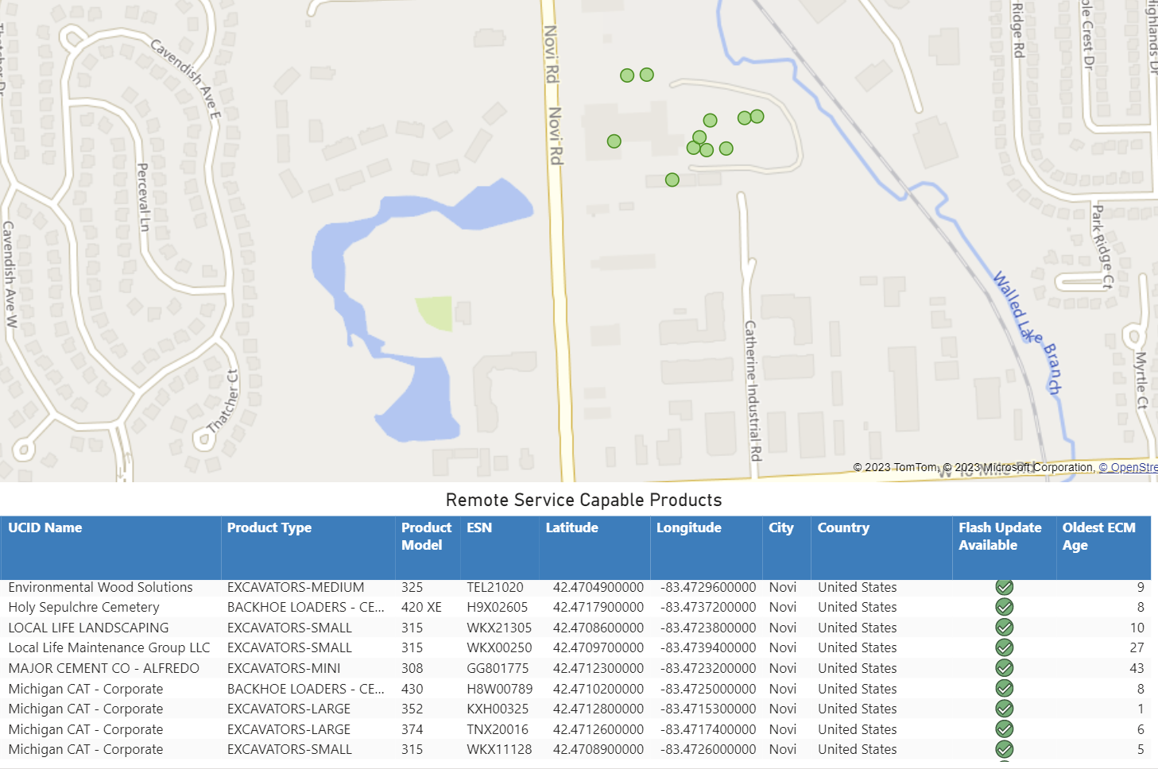
Machines in Novi Yard
Notes:
Weekly we send out updates to each of our stores, here is an example of our Novi Yard.
We have equipped lead men to be able to push Remote Flash. They power up the machines, whether themselves or by a yard man, lock out the cab with a tag that says, “Flash in Progress”. Then they can push the flashes through on all machines at the same time.
If each one was done individually with a comm adapter, it would take at least 12 hours to update these machines.
We are also working with CAT on the API to have a notification pop up every time a work order is opened.
We have flashed ******** machines remotely this year, and we haven’t even begun to start working with customers.
Now let’s take a look into the capabilities of Remote Troubleshoot.

Slide 12
Remote Troubleshoot
Notes:
To begin we’ll have to start a Remote Troubleshoot Session

Slide 13
Remote Troubleshoot
NAVIGATION – ICONS
ECM Status
Active Diagnostic Codes
Logged Diagnostic Codes
Active Events
Logged Events
ECM Summary
ECM Configuration
Disconnect Session
Generate PSR
Help
Very Similar to ET
Notes:
Once connected you’ll notice that the Dashboard Icons look very similar to ET

Slide 14
Remote Troubleshoot: CURRENT
Modify Parameters, including SEA and FPS
Real Time Graphing- Datalog
ECM Product Replacement Files
PSR- Product Status Report real time
Notes:
To begin we’ll have to start a Remote Troubleshoot Session

Slide 15
Remote Troubleshoot: FUTURE
2024 Release A
Aftertreatment Functional Test
Solenoid Test
Calibration Menu
Notes:
You can see there are a lot more things planned that will greatly expand the capabilities of Remote Troubleshoot.
And now I’d like to ask Steve to come talk about the Organization of Remote Services and what it might look like.

Slide 16
Remote Troubleshoot: FUTURE
2024 Release B
Cylinder cutout test
Injector Calibration
2024 Release C
Wiggle Test
2025 Release
Datalog trigger
Notes:
You can see there are a lot more things planned that will greatly expand the capabilities of Remote Troubleshoot.
And now I’d like to ask Steve to come talk about the Organization of Remote Services and what it might look like.

Slide 17
Questions

