Slide 1
Deeper Dive Into the Green Energy Law
Ashley Chrysler
Warner Norcross + Judd LLP
February 12, 2025

Slide 2
Overview of 2023 Energy Legislation
PA 229, 231, 233, 234, and 235 were passed on November 8, 2023 and signed by Governor Whitmer on November 28, 2023
PA 235
  Establishes new clean energy standard and updates the renewable portfolio standard
  Effective as of February 27, 2024
PA 233
  Creates the siting process for renewable energy and energy storage projects at the MPSC
  Effective as of November 29, 2024

Slide 3
How did we get here?
Prior to passage of these laws, local governments were responsible for permitting renewable energy projects under ZEA like most other land uses
Many local governments adopted exclusionary standards or other tactics to prevent renewable energy development
  Lengthy moratoria
  Amended ordinances before property interest vested
  Impossible sound, glare, or other standards or conditions
  Legal challenges
Goal of PA 233 was to ensure state goals could be met by preempting local regulation of facilities where standards exceeded the statutory requirements

Slide 4
PA 235 of 2023
Requires electric providers to establish 100% clean energy portfolio by 2040 (80% by 2035)
  Clean energy = all sources that generate electricity or steam without emitting greenhouse gas
  Electric providers must file plans with Commission by 2028
Amends the renewable energy standard for electric providers
  50% by 2030 (previously 15%)
  60% by 2035
  Electric providers must file amended plans with Commission by Feb. 27, 2025

Slide 5
PA 235 of 2023 (continued)
Establishes a statewide energy storage target of 2,500MW
  By December 31, 2029:
    Investor-Owned Utilities need to file petitions for approvals related to the storage target
    Alternative Electric Suppliers will need to file plans for how they will comply with the target
Increases distributed generation program cap from 1% to 10%

Slide 6
PA 233 of 2023
Solar
50 MW
Energy Storage
50 MW nameplate + energy discharge capability of 200+MWh
Wind
100 MW
Took effect on November 29, 2024
Gives developers the option to go to MPSC for a siting certificate
  Developer is not required to go to MPSC; can choose to stay local if workable ordinance
However, if local unit has a CREO, must go through local process set forth in PA 233 before going to MPSC

Slide 7
PA 233 of 2023 (continued)
Pre-application meetings
  With MPSC staff
  With ALU chief elected officials
  Public meeting in ALUs
  Consultations with MDARD, EGLE, DNR, drain commissioner, tribes, SHPO, etc. required (some of these parties are new to the process)
Very detailed application/site plan requirements
  More formal than local process
  Contested case
    Must be supported by written/expert testimony
    Written direct/rebuttal testimony/live cross-examination

Slide 8
PA 233 of 2023 (continued)
Host community agreement with ALU
  $2,000 per megawatt
Must make a one-time $150,000 intervenor grant when application is filed
Pay up to $250,000 in assessed fees for processing application
MPSC must approve within 1 year of complete application

Slide 9
PA 233 – Section 226(8)
Solar
300 foot setback from occupied nonparticipating dwellings
Max height of 25 feet
Wind
2.1 times blade height setback from occupied nonparticipating dwellings
1.1 times blade height setback from nonparticipating property line, right-of-way, participating structures, and transmission lines
Energy Storage
300 foot setback from occupied nonparticipating dwellings
50 foot setback from nonparticipating property line and right-of-way
55 dBA Leq
50 foot setback from nonparticipating property line and right-of-way
Dark-sky friendly lighting
Max 30 hours of shadow flicker per year
55 dBA Leq
Light-mitigating technology
55 dBA Leq
Complies with NFPA 855 “Standard for the Installation of Stationary Energy Storage Systems”
Dark-sky friendly lighting

Slide 10
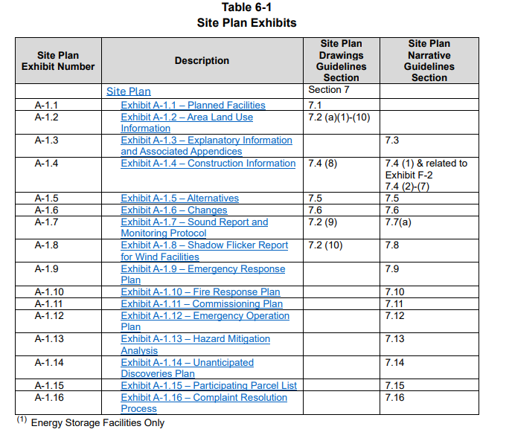
MPSC Guidelines - Site Plan Requirements

Slide 11
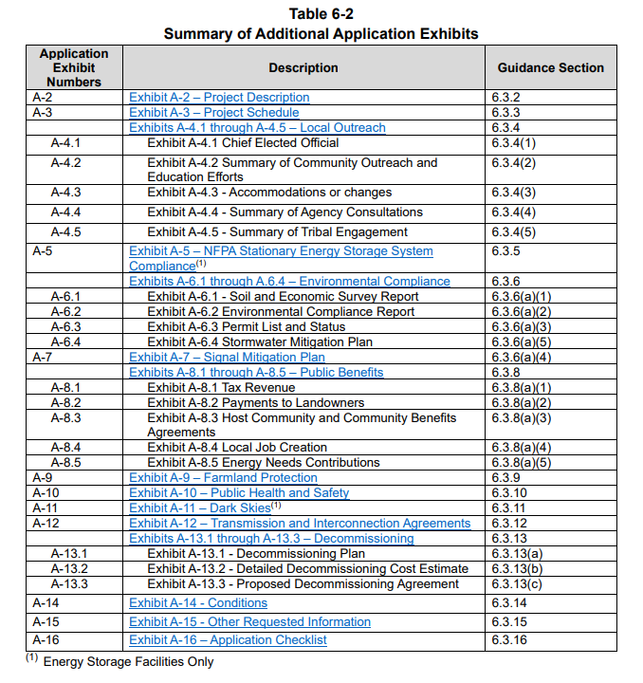
MPSC Guidelines – Application Requirements

Slide 12
Challenges to Energy Laws
November 8, 2024 – 76 townships and counties appealed MPSC guidance to Court of Appeals
  Procedural challenge to the guidance not being adopted through rulemaking
  Substantive challenges to:
    CREO definition
    ALU definition
    Hybrid facility definition
January 28, 2025 - House Bills 4027-28 introduced to repeal PA 233 and amend PA 235

Slide 13
Thank you!
Ashley Chrysler
wnj.com

