Slide 1
Washington: New Year, Same Congress
Reid Dagul
Director, Government and Regulatory Affairs

Slide 2
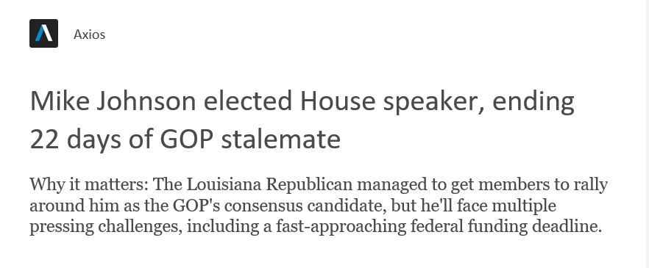
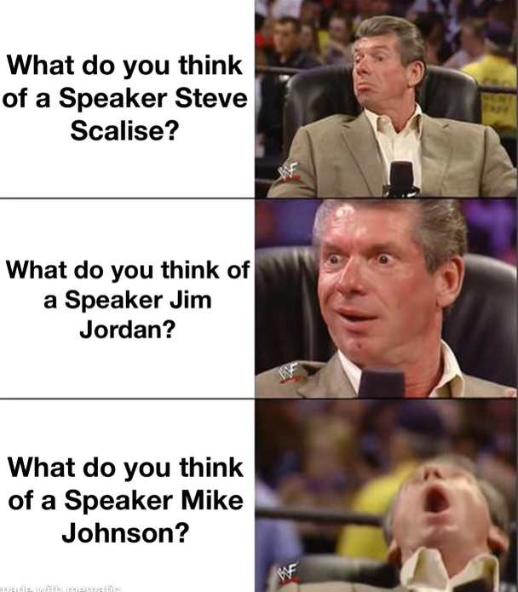
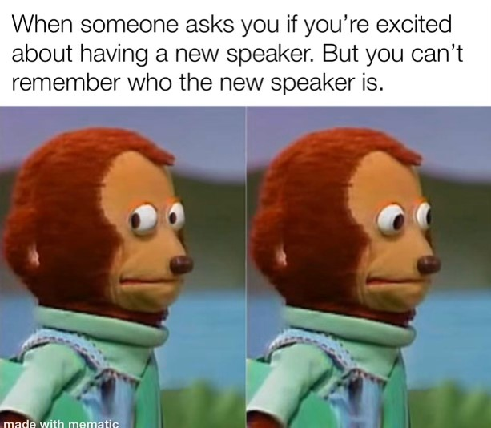
And we have a Speaker!

Slide 3
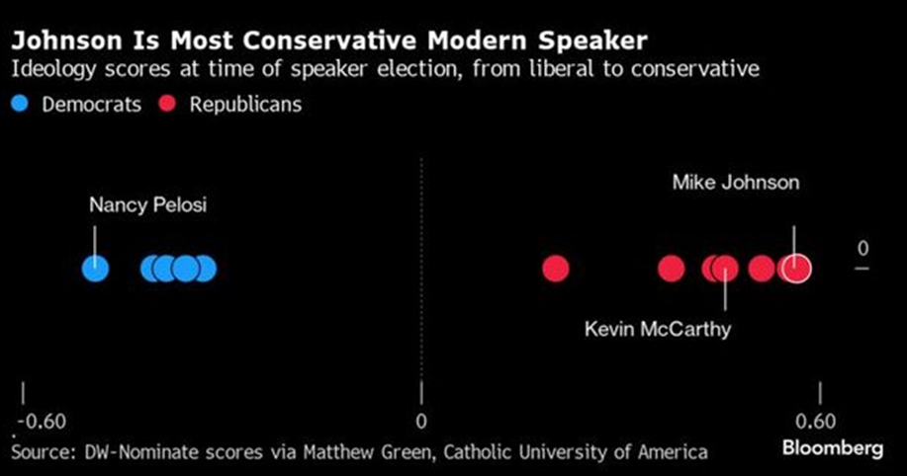
Who is Mike Johnson?
Notes:
Elected in 2016 to LA-4
116th Congress – Republican Study Committee Chair
2020 – Vice Chair Republican Conference
Staunch advocate for religious freedoms and deregulation
Constitutional lawyer

Slide 4
Can Johnson Control Congress?
Speaker Kevin McCarthy – Retires
Rep. Bill Johnson – Retires
Rep. George Santos – Expelled
Whip Steve Scalise – Out Until Feb
House Republicans have a 218 Seat Majority

Slide 5
Appropriations Priorities
NSSGA Wins
FAA technology research
OMB
FHWA
DOL

Slide 6
The small House GOP majority will continue to shrink into 2024
118th HOUSE COMPOSITION:
JANUARY 2023
The 118th Congress began with a slim majority and heavy contention, with Rep. McCarthy ascending to the speakership after 15 votes and concessions to the House Freedom Caucus
118th HOUSE COMPOSITION:
JANUARY 2024
Rep. McCarthy’s upcoming resignation at the end of 2023 and Rep. George Santos’ controversial expulsion will see the House GOP kicking off 2024 with a razor-thin majority
Several other seats in the House are in flux in early 2024
February 13, 2024: Special election to replace expelled Rep. George Santos (R-NY-3) will be held; Cook Political Report rates this race as a Toss Up
February 2024: Rep. Brian Higgins (D-NY-26) is resigning to take over Shea’s Performing Arts Center
March 2024: Rep. Bill Johnson (R-OH-6) is resigning to become president of Youngstown State University
Notes:
Sources:
Republicans fret about shrinking majority as McCarthy plans exit - axios. Accessed December 11, 2023. https://www.axios.com/2023/12/06/republicans-house-majority-mccarthy.
Schnell, Mychael, and Mike Lillis. “GOP’s Tiny House Majority Risks Getting Smaller Post-Santos.” The Hill, December 2, 2023. https://thehill.com/homenews/house/4338035-gop-house-majority-risks-getting-smaller-post-santos/.
Jimison, Robert. “McCarthy’s Exit May Create Even More Headaches for the Tiny G.O.P. Majority.” The New York Times, December 7, 2023. https://www.nytimes.com/2023/12/07/us/politics/mccarthy-republicans-house-majority.html.
Karni, Annie. “McCarthy Wins Speakership on 15th Vote after Concessions to Hard Right.” The New York Times, January 6, 2023. https://www.nytimes.com/2023/01/06/us/politics/house-speaker-vote-mccarthy.html.

Slide 7
Lawmakers have until early 2024 to pass appropriations and avoid a government shutdown
RISK OF GOVERNMENT SHUTDOWN
Lawmakers passed a second bipartisan short-term funding bill prior to the November 17 deadline; the deal gives them until early 2024 to pass appropriations bills to avoid a lapse in federal funding and a government shutdown
If Congress has passed some, but not all, of the 12 necessary appropriations bills, a partial government shutdown can result
3 WAYS TO AVOID A GOVERNMENT SHUTDOWN
Continuing resolution
Provides budget authority for federal agencies and programs to operate until regular appropriations are enacted
Omnibus bill
Package of appropriations bills passed together, rather than in the traditional separate manner
Cromnibus bill
Combination of long-term omnibus spending bills and short-term continuing resolution for some programs
1
2
3
For more Presentation Center coverage on government shutdowns:
Government shutdown primer - An overview of government shutdowns
Appropriations 101 – A guide to the federal appropriations process
House Speaker nomination tracker – Tracking the latest developments on efforts to secure a Speaker of the House
Notes:
Sources:
James Saturno, Bill Heniff, Megan S. Lynch, “The Congressional Appropriations Process: An Introduction,” Congressional Research Service, November 30, 2016, https://www.senate.gov/CRSpubs/8013e37d-4a09-46f0-b1e2-c14915d498a6.pdf.
“Appropriations 101,” Committee for a Responsible Federal Budget, May 30, 3018, https://www.crfb.org/papers/appropriations-101.
James Saturno, Brian Yeh, “Authorization of Appropriations: Procedural and Legal Issues, “ Congressional Research Service, November 30, 2016, https://fas.org/sgp/crs/misc/R42098.pdf.
“Cromnibus,” The District Policy Group, accessed May 31, 2019, http://www.districtpolicygroup.com/dewonkify-detail/cromnibus.
“Continuing Resolution/Continuing Appropriations,” United States Senate, accessed May 31, 2019, https://www.senate.gov/reference/glossary_term/continuing_resolution.htm.
Kathryn Watson, “President Biden signs short-term funding bill to keep the government open ahead of deadline,” CBS News, November 17, 2023, https://www.cbsnews.com/news/biden-signs-short-term-funding-bill-averting-government-shutdown/

Slide 8
Gov Shutdown: To be or not to be
Notes:
House Speaker Mike Johnson (R-LA-4) reveal plans for a CR Friday to abide by the House GOP 72-hour rule and vote by Tuesday
Johnson was forced to pull two appropriations bills from the floor this week after in-party fighting threatened their passage; Johnson had hoped to demonstrate progress in the appropriations process ahead of unveiling plans for a CR to extend the government shutdown deadline

Slide 9
Gov Shutdown Disruptions
SNAP, WIC, Head Start
Federal government contractors
NIH, TANF
National Parks
IRS and tax returns
Public health and safety
Notes:
Those not affected: Medicare/Medicaid, Border enforcement, student loan payments, US postal service, passports and travel like TSA and FAA, Social Security checks, military and veterans benefits and HTF funded projects

Slide 10
The shrinking GOP majority impacts the passage of critical legislation
The impact of a shrinking majority
The Republican majority in the 118th House now stands at 221, meaning the House GOP only has room for three defections in party-line votes
Rep. McCarthy’s exit and Democrats’ push to flip expelled Rep. Santos’ seat could shrink the GOP majority to two votes by February 2024
Some lawmakers worry that the shrinking majority will encourage others to halt legislation movement based on individual and/or caucus demands
Others believe that a shrinking majority will have no impact on what has already been a highly contentious Congressional body; more exits are expected
OUTLOOK
House Speaker Johnson faces an increased threat of another uprising from the House Freedom Caucus, impeding the passage of critical appropriations legislation ahead of January deadlines
Notes:
Sources:
Republicans fret about shrinking majority as McCarthy plans exit - axios. Accessed December 11, 2023. https://www.axios.com/2023/12/06/republicans-house-majority-mccarthy.
Schnell, Mychael, and Mike Lillis. “GOP’s Tiny House Majority Risks Getting Smaller Post-Santos.” The Hill, December 2, 2023. https://thehill.com/homenews/house/4338035-gop-house-majority-risks-getting-smaller-post-santos/.
Jimison, Robert. “McCarthy’s Exit May Create Even More Headaches for the Tiny G.O.P. Majority.” The New York Times, December 7, 2023. https://www.nytimes.com/2023/12/07/us/politics/mccarthy-republicans-house-majority.html.
Karni, Annie. “McCarthy Wins Speakership on 15th Vote after Concessions to Hard Right.” The New York Times, January 6, 2023. https://www.nytimes.com/2023/01/06/us/politics/house-speaker-vote-mccarthy.html.

Slide 11
FAA Reauthorization
Airport Pavement Research and Technology
Increased AIP Funding
Notes:
On Dec. 12, the House and Senate passed another extension of the Federal Aviation Administration (FAA) programs until March 8, 2024.
• The House originally passed its FAA bill in July, but the Senate bill had been held up due to a few controversial issues unrelated to the aggregates industry.
• NSSGA will continue to advocate for the passage of a new FAA bill that includes the hard-fought increase to Airport Improvement Program funding and support for the Airfield Pavements Research Program.
:
Air traffic controllers, transportation security officers, and TSA personnel will have to work without pay
In some instances, controllers may not show up to work, and TSA officers are not at checkpoints, so lines for travel and customs may be longer
The 2,500+ controllers in training will be forced to halt programs
Grant money for safety improvements and some regulations processes, such as passenger protection measures, will halt entirely
The government will not receive revenue from fuel and fare taxes
The US Travel Association estimates that a partial shutdown would cost the US travel economy up to $140M a day
House version passed the House but Senate hasn’t moved out of committee – talk that it will be extended again
AIP from 3.35B to 4B to modernize airport infrastructure

Slide 12
Regulatory Hurdles
Waters of the United States
Particulate Matter (PM) 2.5
MSHA Silica Rule
And 7 Other DOL Rulemakings
NEPA Phase 2
OMB Ecosystem Guidance
Reciprocal Switching
Endangered Species Act
FWS Dunes Sagebrush Lizard listing
EPA AERR Reporting Rule
Corps Ordinary High Water Mark Manual
Notes:
Expanding Davis-Bacon
Expanding Project Labor Agreements
Significant Changes to Exempt and Hourly Employees
OSHA Heat and Illness Rules
Enhanced OSHA Reporting Requirements
OSHA Walk Around Rule
Independent Contractor Rule

Slide 13
2024 congressional calendar
■ Both chambers in session ■ House only in session ■ Senate only in session ■ Federal holiday
January
February
March
April
 | 1 | 2 | 3 | 4 | 5 | 6
7 | 8 | 9 | 10 | 11 | 12 | 13
14 | 15 | 16 | 17 | 18 | 19 | 20
21 | 22 | 23 | 24 | 25 | 26 | 27
28 | 29 | 30 | 31
 |  |  |  | 1 | 2 | 3
4 | 5 | 6 | 7 | 8 | 9 | 10
11 | 12 | 13 | 14 | 15 | 16 | 17
18 | 19 | 20 | 21 | 22 | 23 | 24
25 | 26 | 27 | 28 | 29
 |  |  |  |  | 1 | 2
3 | 4 | 5 | 6 | 7 | 8 | 9
10 | 11 | 12 | 13 | 14 | 15 | 16
17 | 18 | 19 | 20 | 21 | 22 | 23
24 | 25 | 26 | 27 | 28 | 29 | 30
31
 | 1 | 2 | 3 | 4 | 5 | 6
7 | 8 | 9 | 10 | 11 | 12 | 13
14 | 15 | 16 | 17 | 18 | 19 | 20
21 | 22 | 23 | 24 | 25 | 26 | 27
28 | 29 | 30
May
June
July
August
 |  |  | 1 | 2 | 3 | 4
5 | 6 | 7 | 8 | 9 | 10 | 11
12 | 13 | 14 | 15 | 16 | 17 | 18
19 | 20 | 21 | 22 | 23 | 24 | 25
26 | 27 | 28 | 29 | 30 | 31
 |  |  |  |  |  | 1
2 | 3 | 4 | 5 | 6 | 7 | 8
9 | 10 | 11 | 12 | 13 | 14 | 15
16 | 17 | 18 | 19 | 20 | 21 | 22
23 | 24 | 25 | 26 | 27 | 28 | 29
30
 | 1 | 2 | 3 | 4 | 5 | 6
7 | 8 | 9 | 10 | 11 | 12 | 13
14 | 15 | 16 | 17 | 18 | 19 | 20
21 | 22 | 23 | 24 | 25 | 26 | 27
28 | 29 | 30 | 31
 |  |  |  | 1 | 2 | 3
4 | 5 | 6 | 7 | 8 | 9 | 10
11 | 12 | 13 | 14 | 15 | 16 | 17
18 | 19 | 20 | 21 | 22 | 23 | 24
25 | 26 | 27 | 28 | 29 | 30 | 31
September
October
November
December
1 | 2 | 3 | 4 | 5 | 6 | 7
8 | 9 | 10 | 11 | 12 | 13 | 14
15 | 16 | 17 | 18 | 19 | 20 | 21
22 | 23 | 24 | 25 | 26 | 27 | 28
29 | 30
 |  | 1 | 2 | 3 | 4 | 5
6 | 7 | 8 | 9 | 10 | 11 | 12
13 | 14 | 15 | 16 | 17 | 18 | 19
20 | 21 | 22 | 23 | 24 | 25 | 26
27 | 28 | 29 | 30 | 31
 |  |  |  |  | 1 | 2
3 | 4 | 5 | 6 | 7 | 8 | 9
10 | 11 | 12 | 13 | 14 | 15 | 16
17 | 18 | 19 | 20 | 21 | 22 | 23
24 | 25 | 26 | 27 | 28 | 29 | 30
1 | 2 | 3 | 4 | 5 | 6 | 7
8 | 9 | 10 | 11 | 12 | 13 | 14
15 | 16 | 17 | 18 | 19 | 20 | 21
22 | 23 | 24 | 25 | 26 | 27 | 28
29 | 30 | 31
Notes:
Sources:
“2024 Combined Congressional Calendar,” Rational 360, December 4, 2023, https://rational360.com/wp-content/uploads/2023/11/2024-Congressional-Calendar.pdf

Slide 14
2024 congressional priorities
118th Congress instability
2023 has been a record year for Congressional retirements and resignations; so far, 31 Democrats and 16 Republicans are leaving their offices, some before the term ends
The exits and expulsion have the potential to cut into an already slim House GOP majority
2024 special elections will play a key role in Congress’s ability to pass legislation and meet deadlines in the new year
FY2024 appropriations
Lawmakers passed a second bipartisan short-term funding bill to give them until early 2024 to pass appropriations bills and avoid a government shutdown
If Congress has passed some, but not all, of the 12 necessary appropriations bills, a partial government shutdown can result
House Speaker Johnson will be facing an uphill battle as he tries to pass appropriations with a slim House GOP majority that could shrink further
1
2
Ukraine aid and immigration
Democratic and Republican Senate negotiators continue to work on a deal to provide Ukraine with additional aid
The White House’s $61B aid request came with a warning that the US will run out of money to support Ukraine at the end of the year
Provisions to bolster US border security have become a contentious negotiation point; the two sides will resume discussions in early 2024
Farm Bill
The continuing resolution passed on November 17 included a one-year extension of the 2018 Farm Bill, setting up negotiations for the next farm bill to occur throughout 2024
So far, neither the House nor Senate have released drafts of the bill due to partisan fighting over appropriations
If the next farm bill is not passed by the end of 2024, a new Congress (119th) will drastically change the negotiation landscape
3
4
Notes:
Sources:
Republicans fret about shrinking majority as McCarthy plans exit - axios. Accessed December 11, 2023. https://www.axios.com/2023/12/06/republicans-house-majority-mccarthy.
Schnell, Mychael, and Mike Lillis. “GOP’s Tiny House Majority Risks Getting Smaller Post-Santos.” The Hill, December 2, 2023. https://thehill.com/homenews/house/4338035-gop-house-majority-risks-getting-smaller-post-santos/.
Jimison, Robert. “McCarthy’s Exit May Create Even More Headaches for the Tiny G.O.P. Majority.” The New York Times, December 7, 2023. https://www.nytimes.com/2023/12/07/us/politics/mccarthy-republicans-house-majority.html.
“List of U.S. Congress incumbents who are not running for re-election in 2024,” Ballotpedia, accessed August 7, 2023, https://ballotpedia.org/List_of_U.S._Congress_incumbents_who_are_not_running_for_re-election_in_2024
Kathryn Watson, “President Biden signs short-term funding bill to keep the government open ahead of deadline,” CBS News, November 17, 2023, https://www.cbsnews.com/news/biden-signs-short-term-funding-bill-averting-government-shutdown/
Phillip Brasher, “Extension buys time, but farm bill faces multiple hurdles in 2024,” Agri-Pulse, November 22, 2023, https://www.agri-pulse.com/articles/20304-extension-buys-time-but-farm-bill-faces-multiple-hurdles-in-2024
US Senate Leaders Say Ukraine, border deal not likely soon. (n.d.-o). https://www.reuters.com/world/us/us-senate-leaders-say-ukraine-border-deal-not-likely-soon-2023-12-19/

Slide 15
2024 legislative look-ahead: Transportation and infrastructure
BACKGROUND
The deadline for the FAA reauthorization bill has been extended a couple times throughout the year due to in-house fighting
On December 12, the House approved a bill extending the funding until March 8 2024
WHAT TO WATCH
While the House has already introduced a long-term reauthorization bill (H.R. 3935), the Senate has yet to approve or create a similar draft
In early 2024, both chambers must agree upon a long-term solution for FAA funding in order to ensure the efficiency and safety of aircraft operations
BACKGROUND
The Biden Administration announced $8B in high speed rail system funding, allocating grants to
The grants will go towards both creating and updating corridor sections
WHAT TO WATCH
Two key projects to watch include the creation of a system connecting Nevada and California in addition to completing upgrades in Virginia
Ahead of the 2028 Olympics hosted by Los Angelos, the Department of Transportation is hoping to establish safe, efficient public transportation that can meet increasing demand
BACKGROUND
Throughout December, Congress has led several hearings for evaluating priorities in addressing water resource needs through the Water Resources Development Acts for 2024
WHAT TO WATCH
Reliable navigation systems depend on having well-functioning water resources
Major considerations for the 2024 legislative package will include prioritizing flood control, investing in river navigation structures, and driving coastal restoration and nourishment projects
1
FAA deadline extended
2
High speed rail
3
WRDA 2024
Notes:
Sources:
“FAA funding extended through March 2024”, General Aviation News, December 12 2023, https://generalaviationnews.com/2023/12/12/faa-funding-extended-through-march-2024/#:~:text=The%20House%20of%20Representatives%20has%20approved%20H.R.%206503%2C,long-term%20FAA%20reauthorization%20bill%20by%20Dec.%2031%2C%202023.
“President Biden Announces $8.2 Billion in New Grants for High-Speed Rail and Pipeline of Projects Nationwide”, DOT, December 8 2023, https://www.transportation.gov/briefing-room/president-biden-announces-82-billion-new-grants-high-speed-rail-and-pipeline-projects
Alex Gangitano. “Biden to announce $8B in funding for high-speed passenger rail projects”, The Hill, December 8 2023, https://thehill.com/homenews/administration/4348523-biden-to-announce-8b-in-funding-for-high-speed-passenger-rail-projects/
“Graves & Rouzer Statements from Hearing on Stakeholder Priorities for WRDA 2024”, Committee on Transportation and Infrastructure, December 13 2023, https://transportation.house.gov/news/documentsingle.aspx?DocumentID=407083

Slide 16
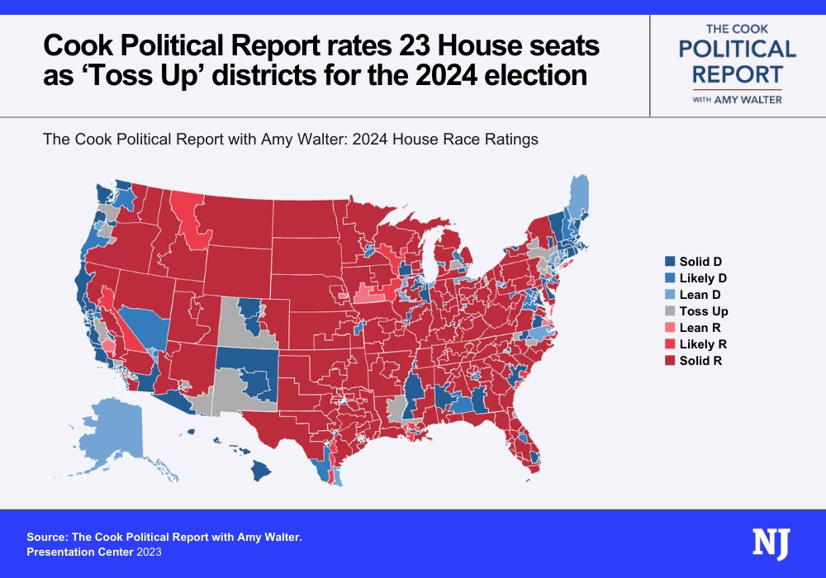
2024 Election Outlook - House
Notes:
Retirements – 31 as of today (22 Ds and 9 Rs)
18 Rs in Biden districts, 23 Toss up seats –

Slide 17
2024 Election Outlook - Senate
Notes:
Senate with Manchin retiring Republicans only need to flip one more D seat when they have 23 up

Slide 18
Questions?
Reid Dagul
rdagul@nssga.org

