Slide 1

Stockpile Management & Best Practices for Operators
Presented by:
Keith Childress – Great Lakes Aggregates Nathan Gates – Verplank Trucking

Slide 2
What We’ll Cover
Segregation
Stockpile Types
Production Stockpiling (conveyor)
Truck/Loader built Stockpiling
Shipping
Sampling
QC/QA
Data

Slide 3
Segregation
What is it? Why is it important?
Particle separation
Ratio of the largest size to smallest size exceeds 2:1
#1 cause of material failures
Can lead to rejection or costly penalties
Inaccurate & inconsistent test data
Influences strength and durability of concrete
Multiple causes
Notes:
Separation of particles caused by gravity, vibration, wind, particle size, momentum
Front-to-back or roll-down segregation

Slide 4
Segregation
Begins at source (shot, bank, pile)
Screening/particle sizing
Conveyor belt
Natural vs crushed
Moisture content
Loading/unloading

Slide 5
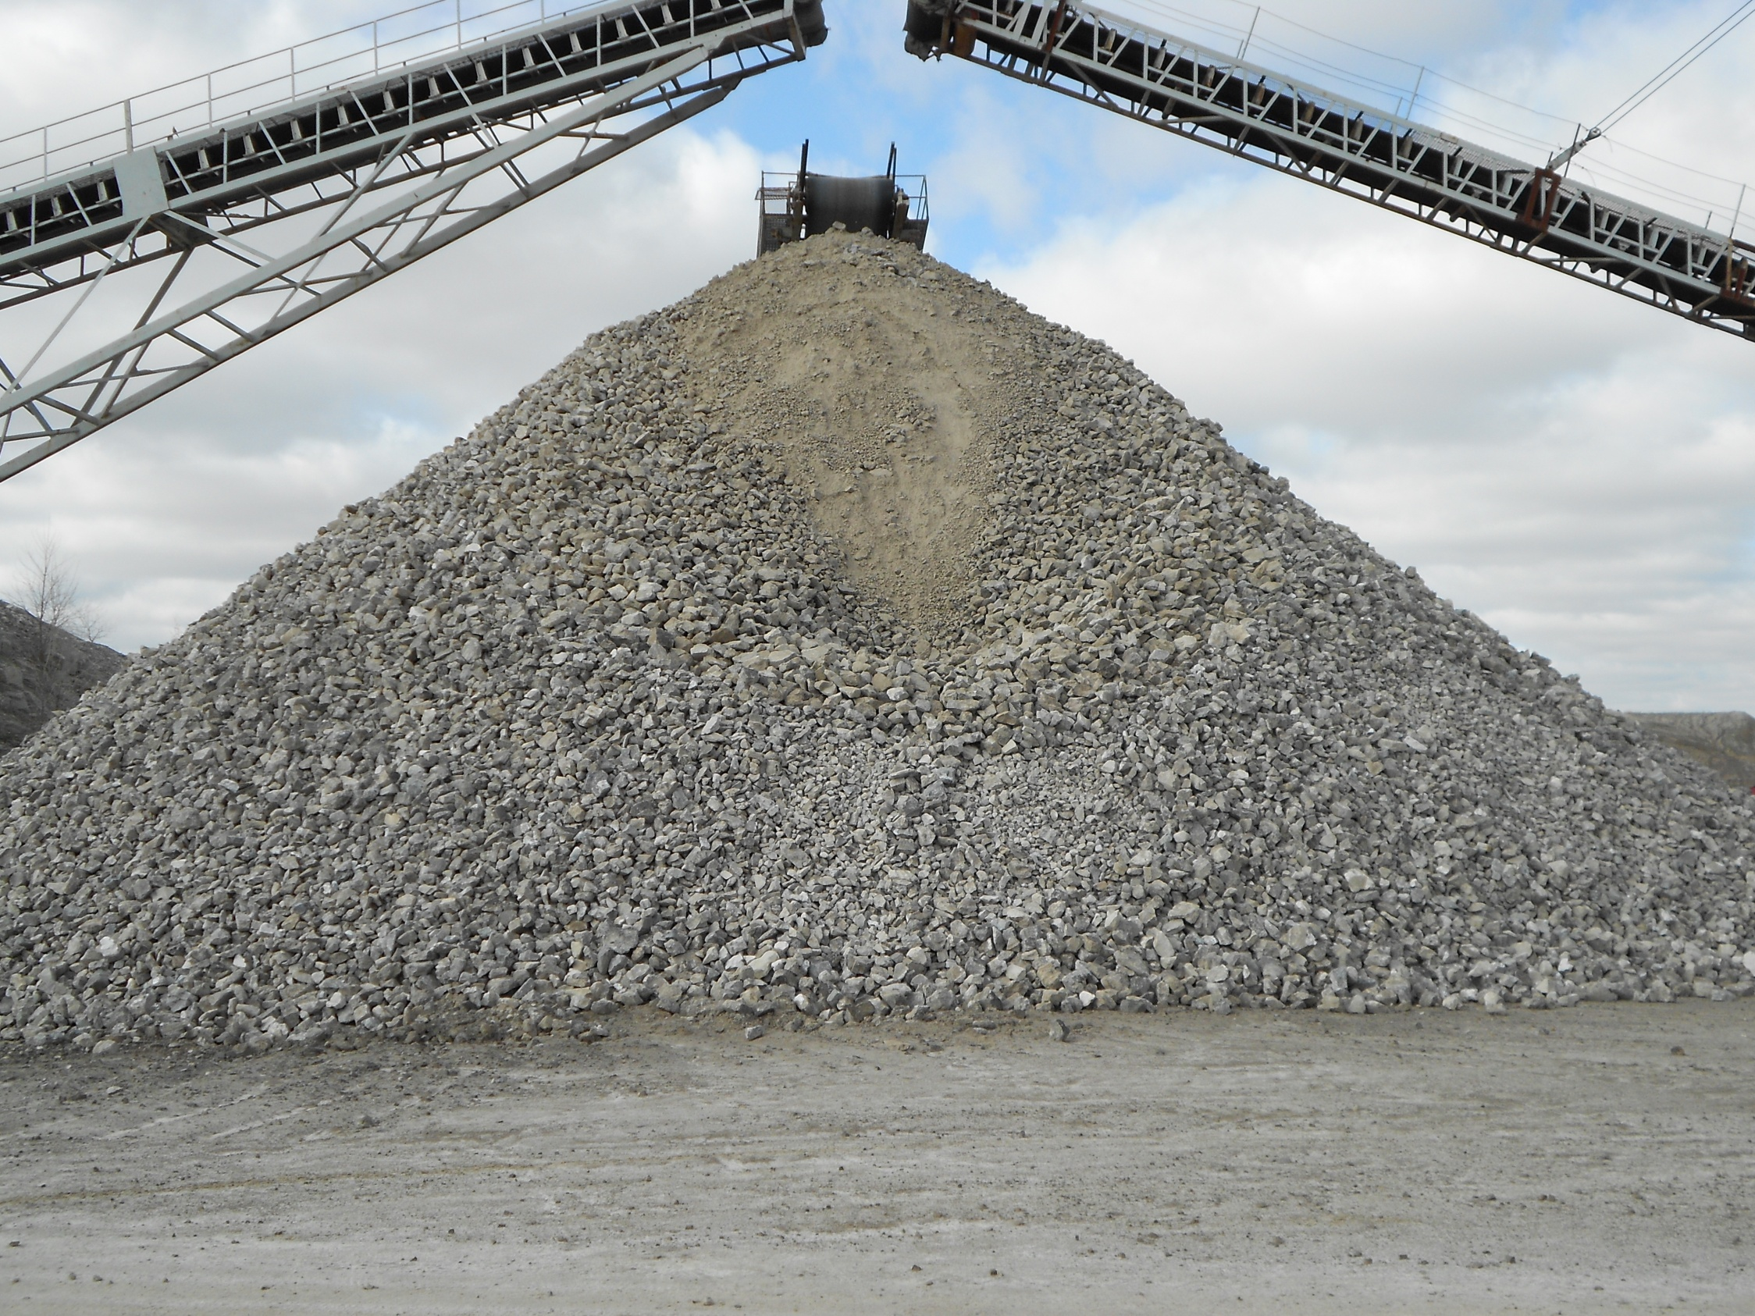
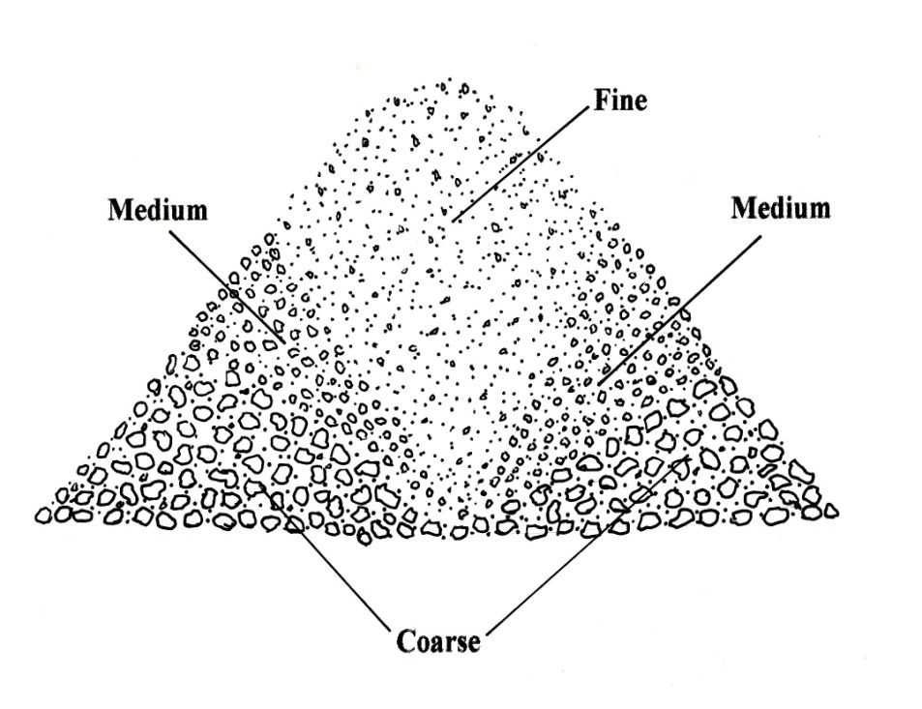
Segregation
Must understand the anatomy of a stockpile to understand how and why segregation occurs
Fines collect in center
Medium size in outside middle half
Coarse at bottom due to gravity
Notes:
Not 100% preventable
Able to reduce & manage

Slide 6


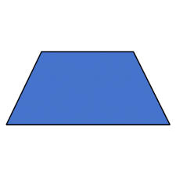
Stockpile Types
Conical (cone shaped)
Windrow (kidney, rail, tent-shaped)
Single-lift (trapezoid or tear drop shaped)
Multi-lift or layered (trapezoid or tear drop shaped)
Notes:
Cone – highest risk of segregation, most re-blending
Windrow – least re-blending, layered windrow lowest risk of segregation
Lift – well blended, some blending may be warranted

Slide 7
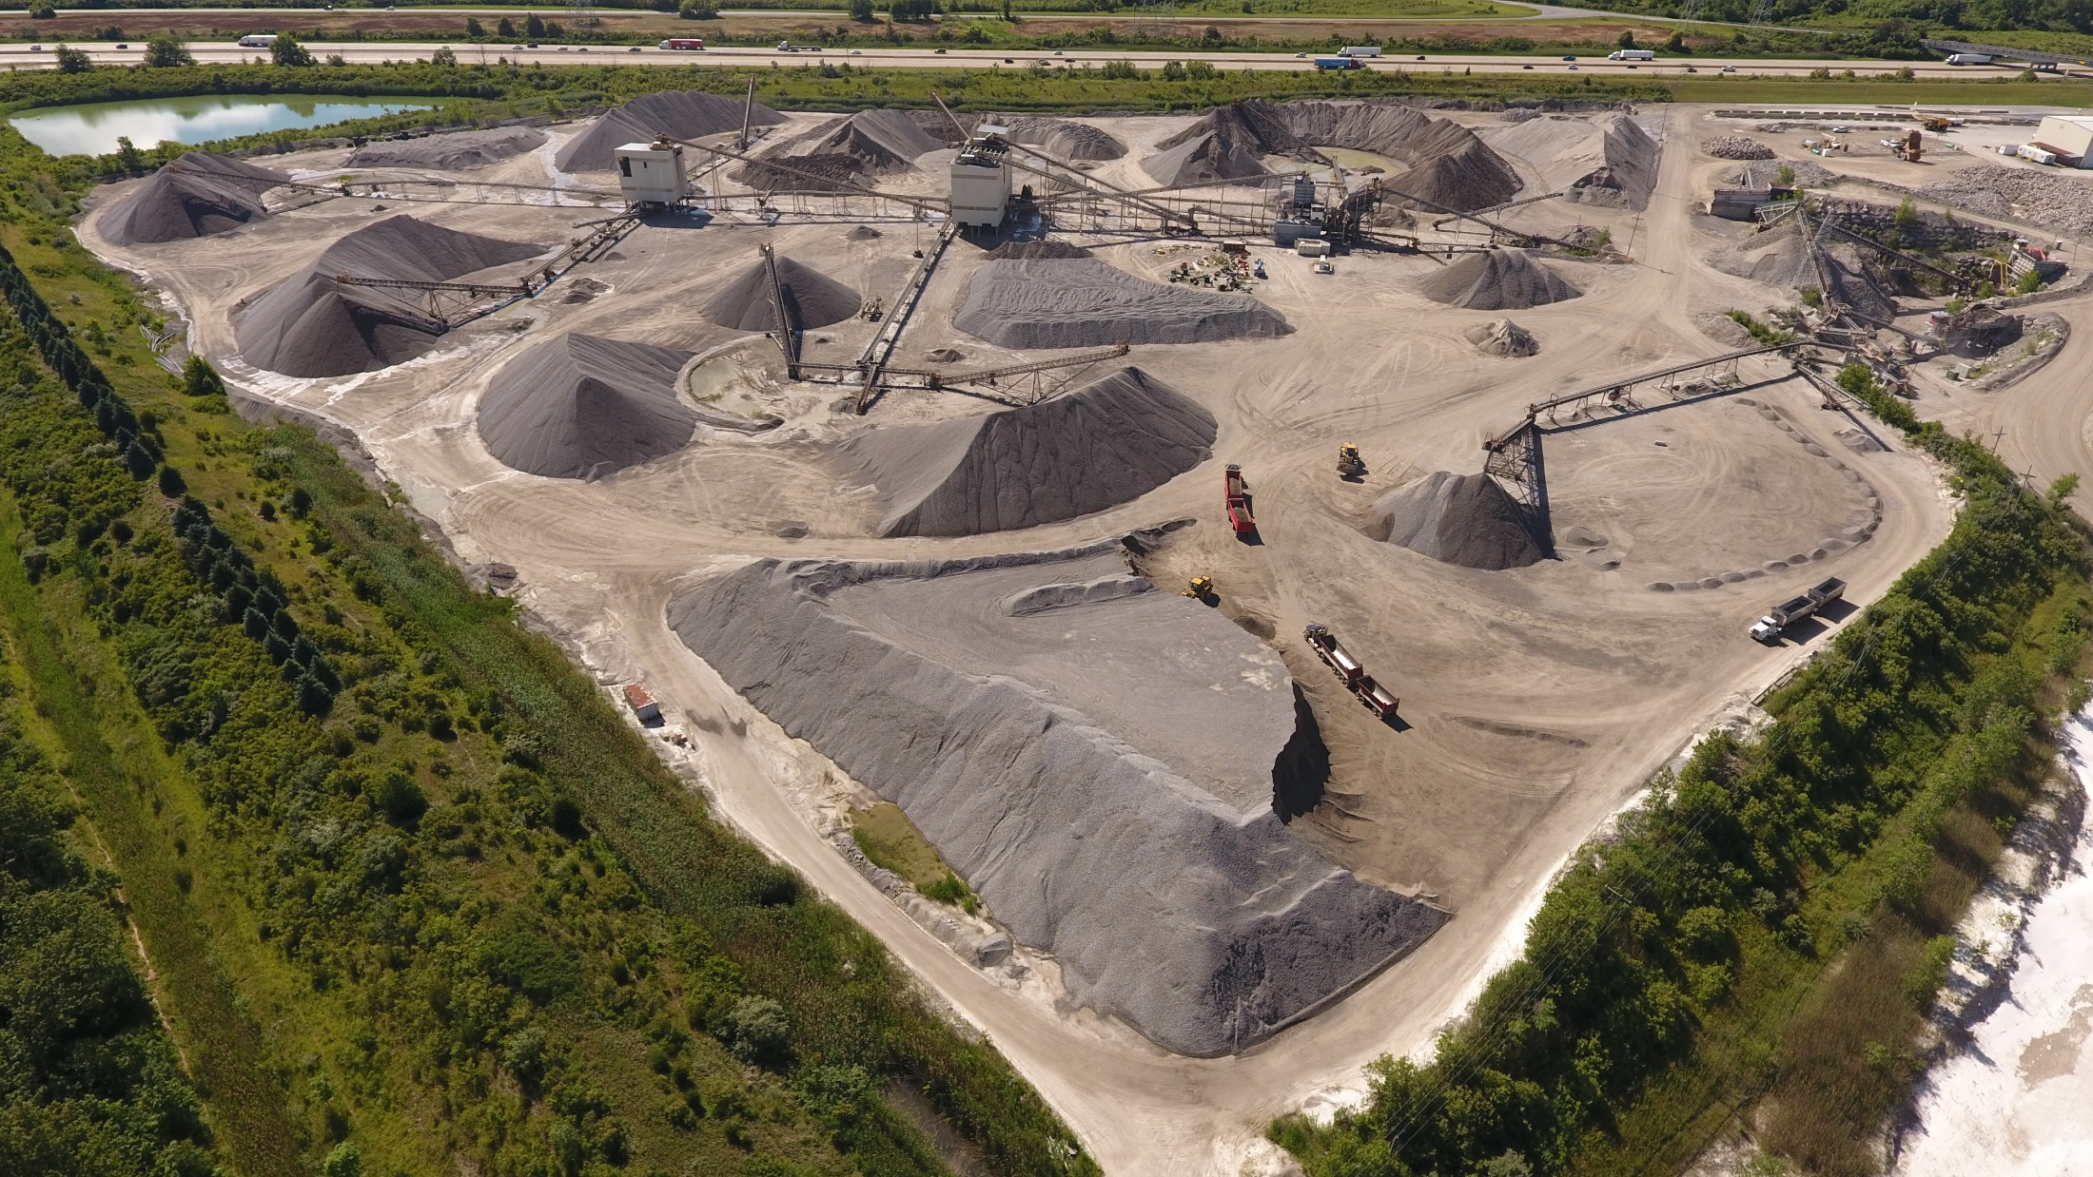
Windrow
Single-lift
Conical
Shipping face
Guide berm
Multi-lift
Notes:
Guide/safety berms, stockpile types, proper shipping face

Slide 8
Stockpile Types
Conical (cone shaped)
Windrow (kidney, rail, tent-shaped)
Single-lift (trapezoid or tear drop shaped)
Multi-lift or layered (trapezoid or tear drop shaped)
Notes:
Cone – highest risk of segregation, most re-blending
Windrow – least re-blending, layered windrow lowest risk of segregation
Lift – well blended, some blending may be warranted

Slide 9
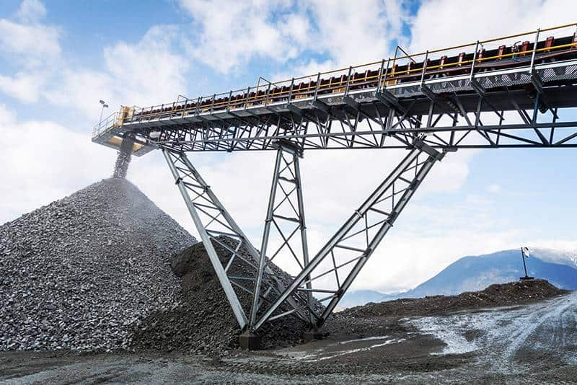
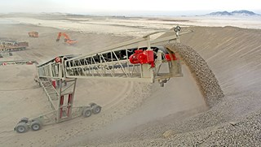
Stationary, Fixed height - Conical Stockpiles - more prone to roll down segregation & degradation
Adjustable Height – minimizes drop distance, less risk for degredation
Radial (fixed & adjustable height) -
Production Stockpiling
Notes:
Radial stacker creates tent-shape stockpile which reduces segregation and degradation

Slide 10
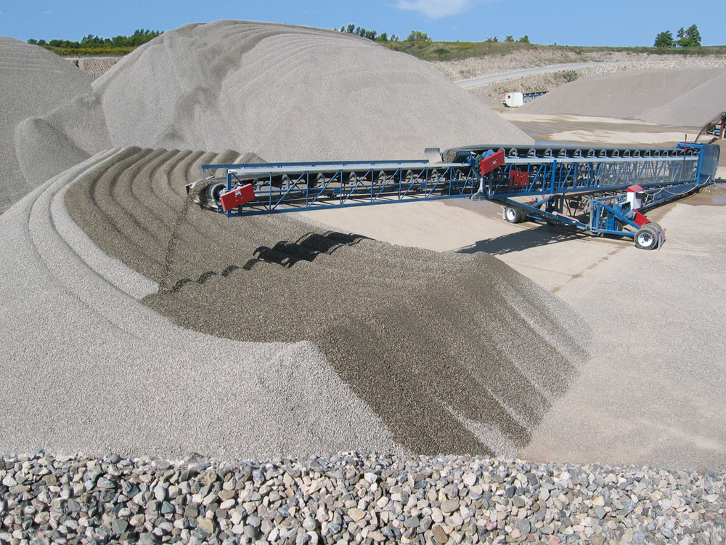
Production Stockpiling
Telescoping radial conveyor
Most simple and economical way to create and keep stockpiles in spec
Moves side to side, stinger moves in and out
Minimal segregation
Material is re-blended with loader as it is loaded out
Can be reclaimed from front or back, instead of the ends if property dictates

Slide 11
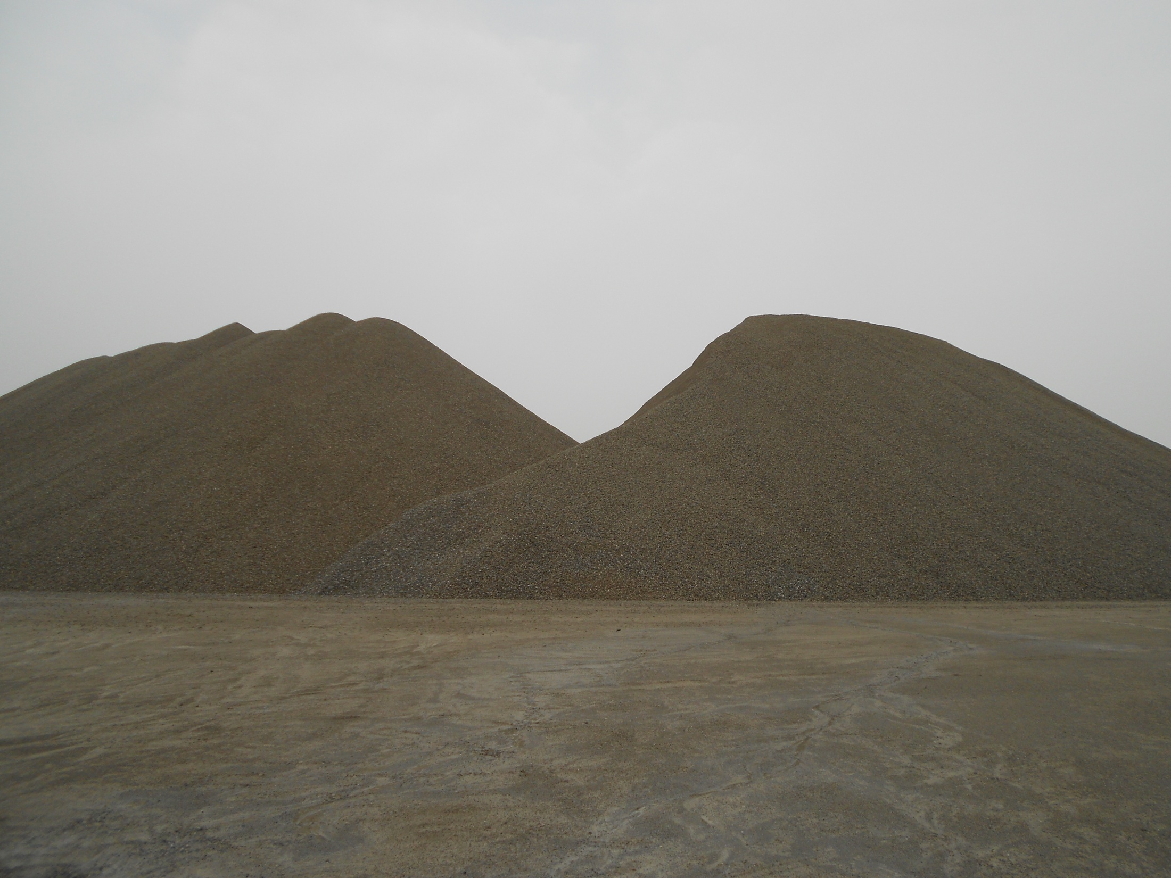

Stockpiling Management
Great Lakes Aggregates, LLC
Comingled stockpiles
Notes:
Planning is key

Slide 12
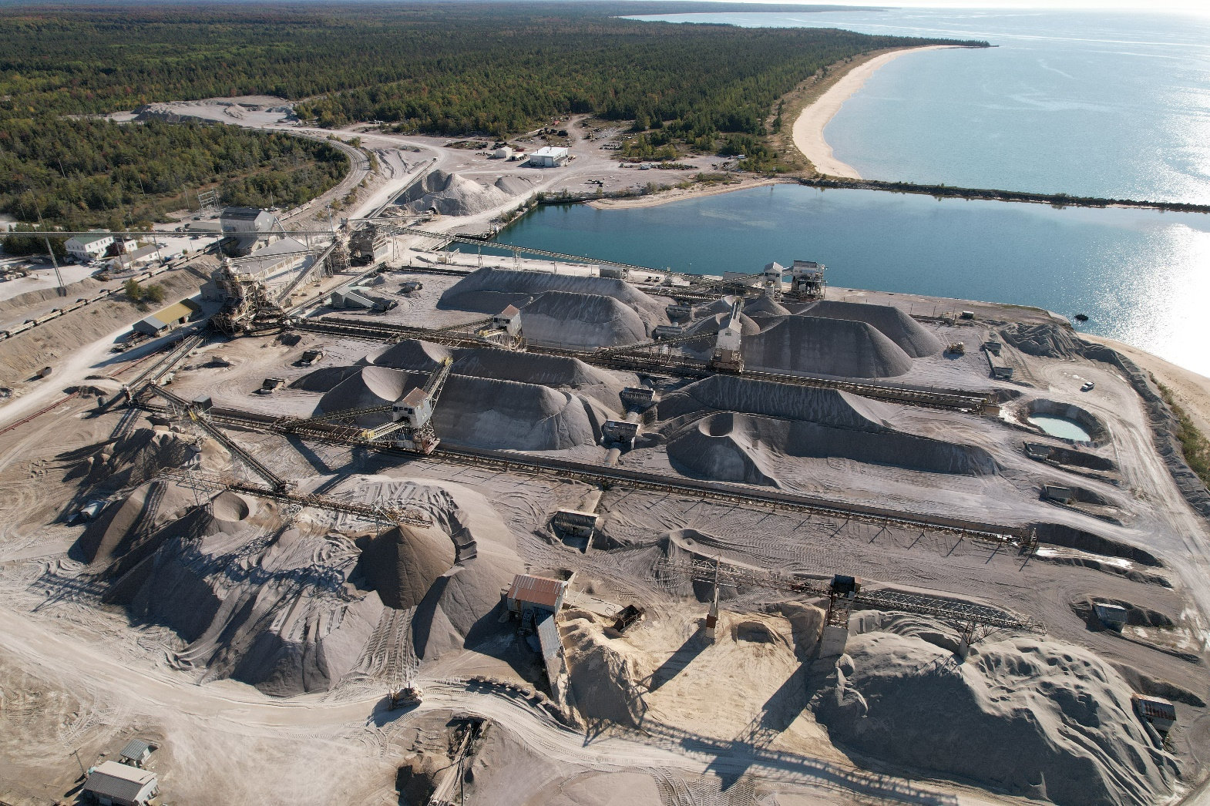
Dock Stockpiling (Lake Vessel)
Fractionated particle sizes
Blended to specified gradation on lake vessel

Slide 13
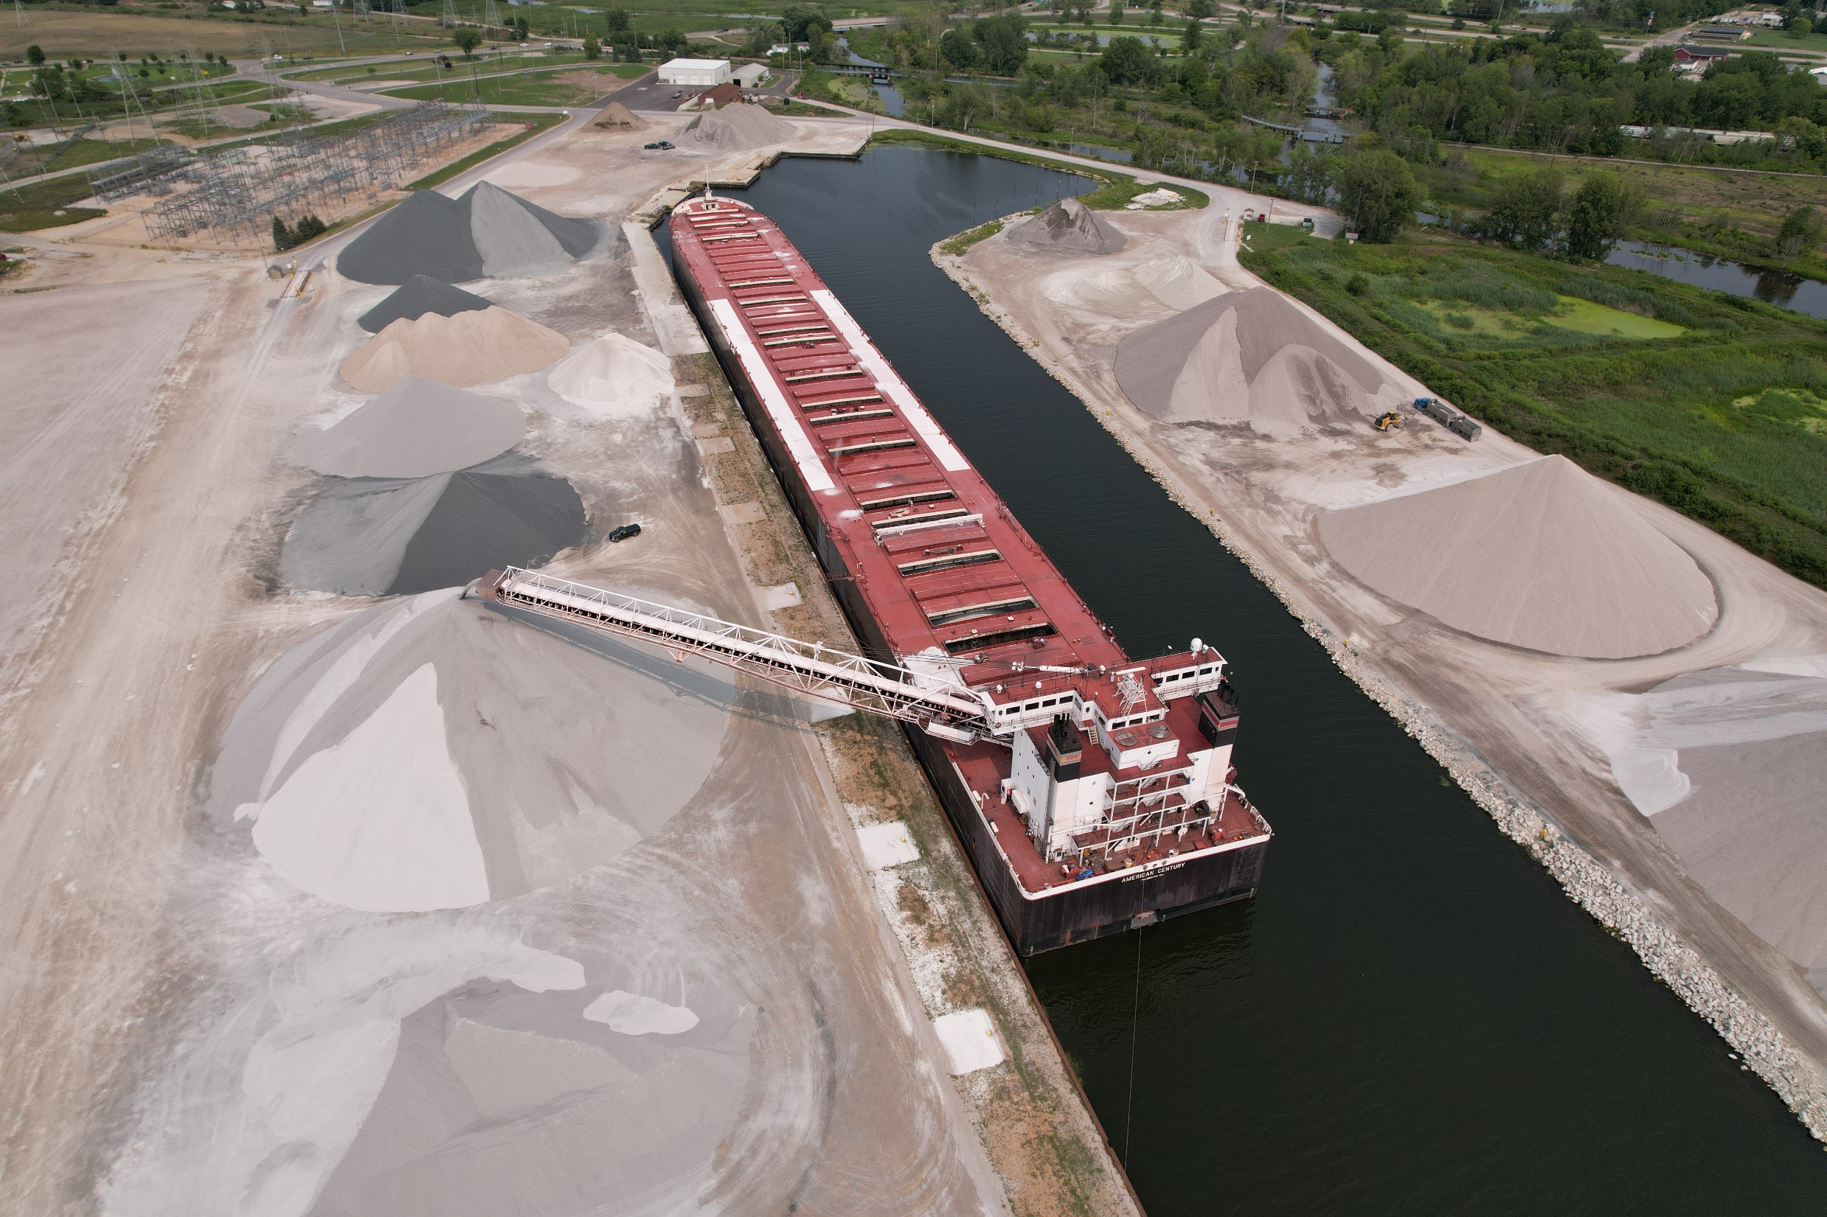

Slide 14
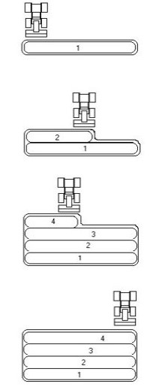
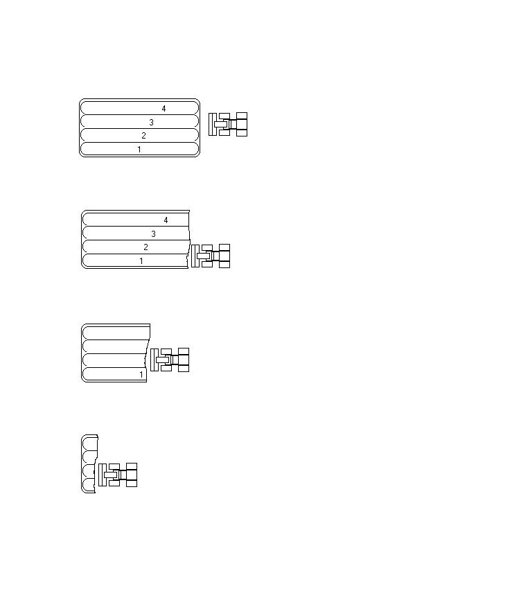
Truck/Loader Built Stockpiles
Relatively flat area preferred
Do not stockpile against berms, leave room for access
Prep floor, remove any debris
Use same size or smaller material to prep
Provide adequate drainage
Reclaim material from source stockpile utilizing the entire face

Slide 15
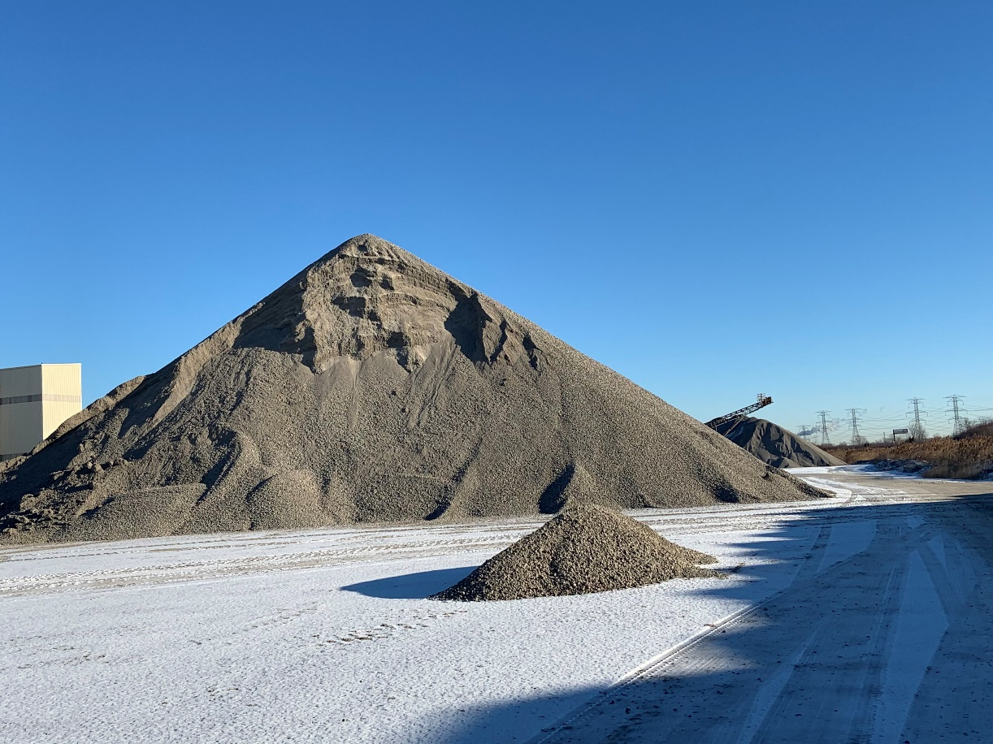
Prepare for Shipping
Planning is key
Never load current production
Establish shipping face the right way – remove coarse and blend in later
Perpendicular to pile
Confirm material meets spec
Construct guide berms

Slide 16
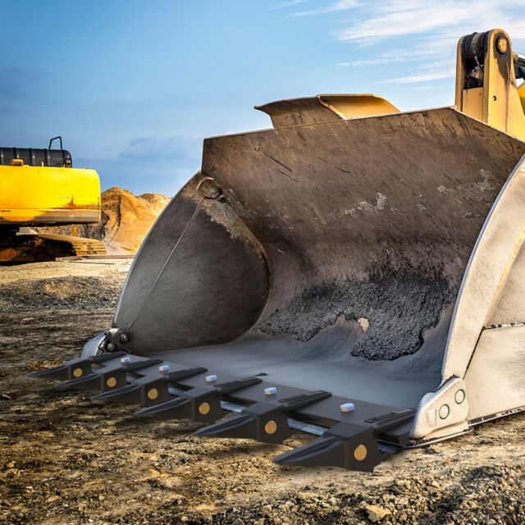
Shipping
Things to consider:
Keep loading area clean (snow, mud, water, etc.)
Periodically inspect bucket for contamination (ask a driver)
Customer truck trailers
Trash
Plant debris (blast wire, metal, silicone, etc.)
Plant start-up after maintenance or mode change
Visually inspect stockpiles - Isolate oversize material

Slide 17
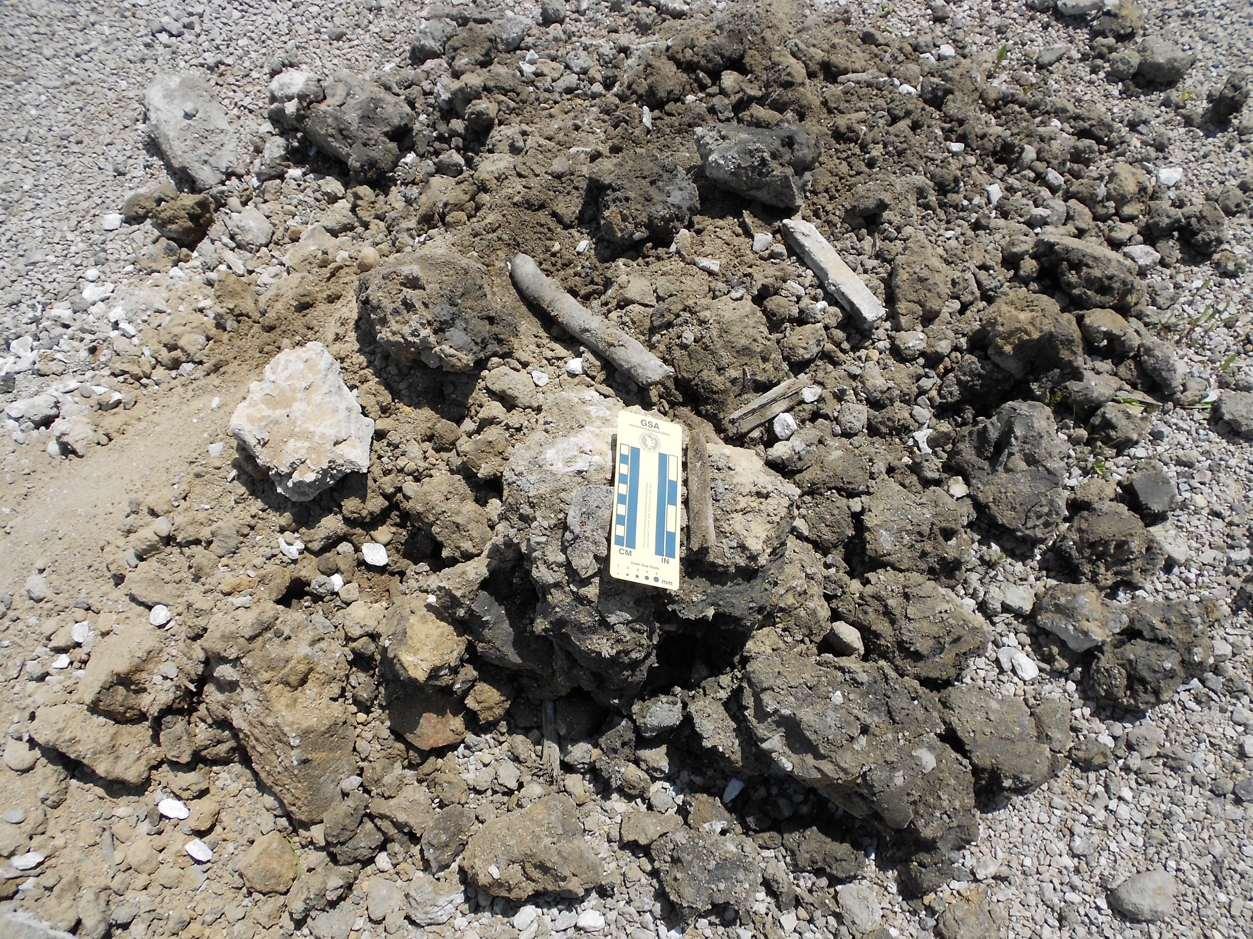
Notes:
Contamination in Coarse Agg – Customer trailer

Slide 18
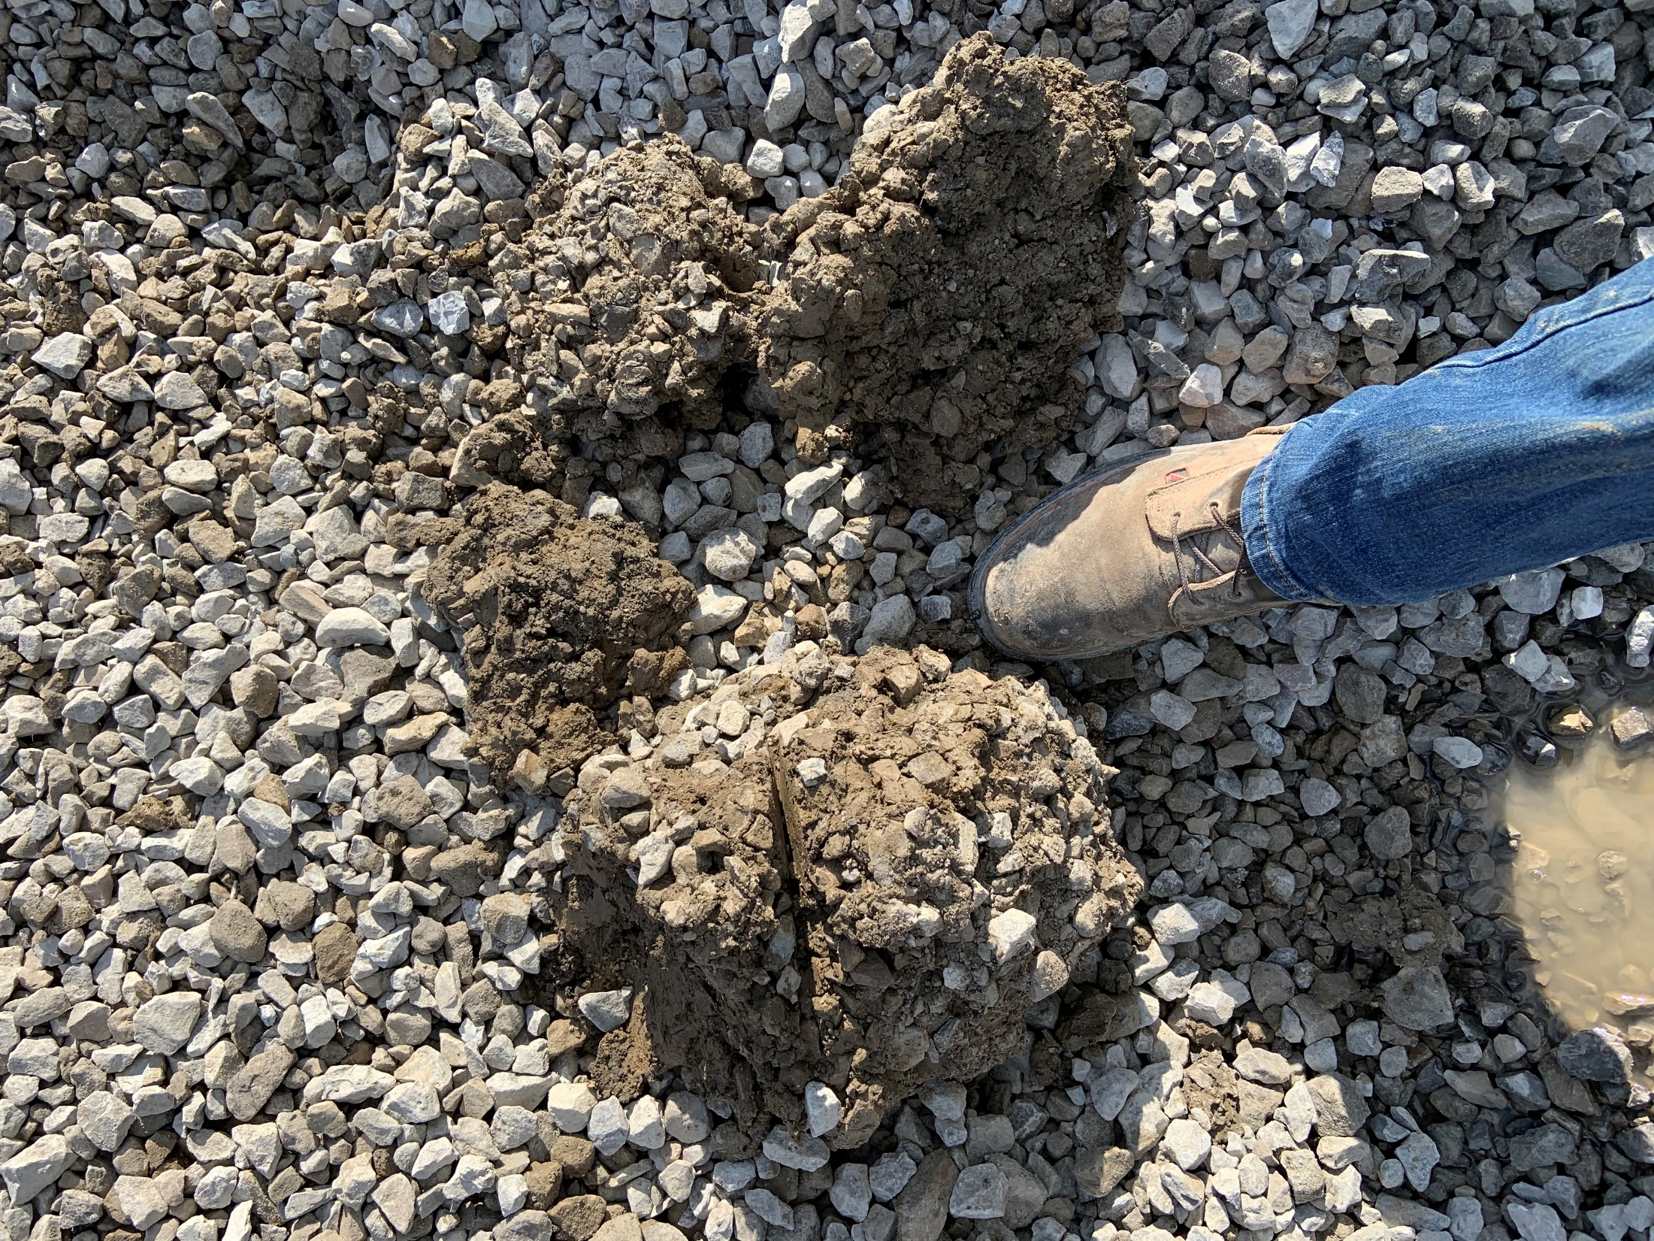
Notes:
Clay contamination – 6AA

Slide 19
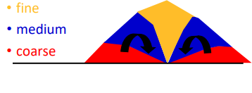
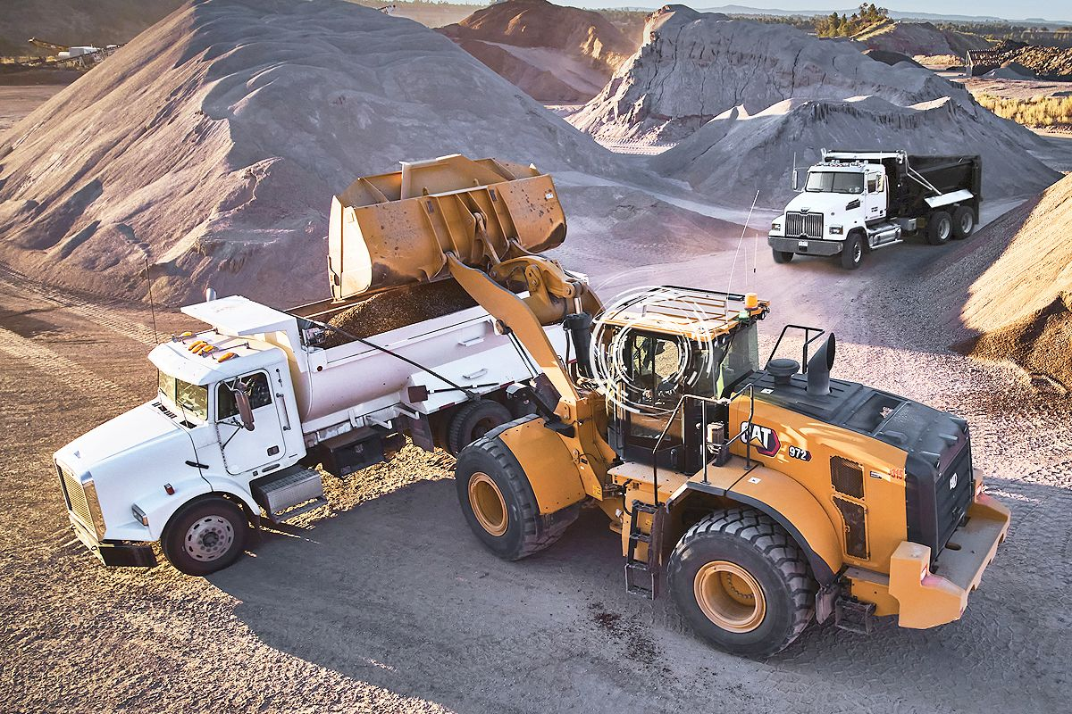
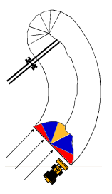
Shipping
Clear bucket
Confirm product with driver
Position truck perpendicular to face – use guide berm
Consider bucket position – avoid contamination
Every pile is different – moisture, particle type, size, method of construction
Trailer type – size, train, flow boy
Utilize entire face for each load– coarse, medium, fine
Maintain shipping face & elevation - blend in edges or toes as you go
BE CONSISTENT!
Notes:
Takes years to build a good reputation, takes seconds to lose it
Poor material handling can be extremely costly and potentially dangerous

Slide 20
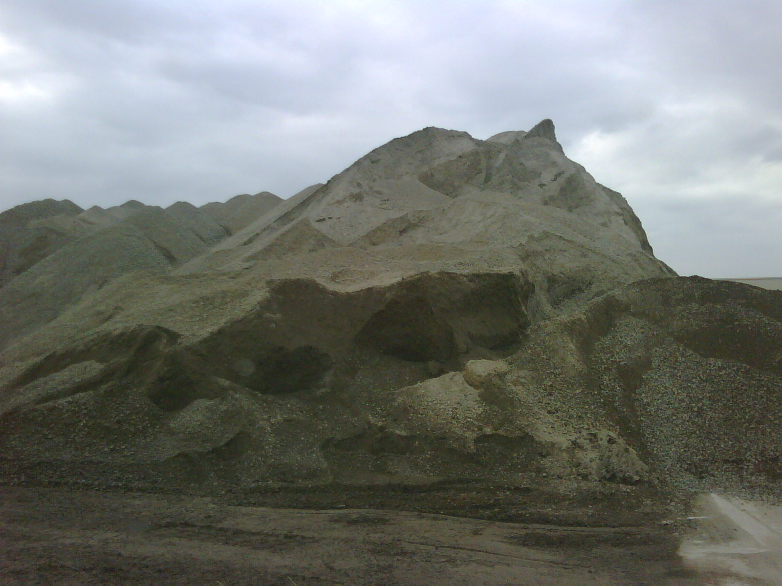
Excavator reclaiming from here
Location of excavator
Stockpiling where trucks were loaded
Notes:
Example of poor stockpile management and inexperience

Slide 21
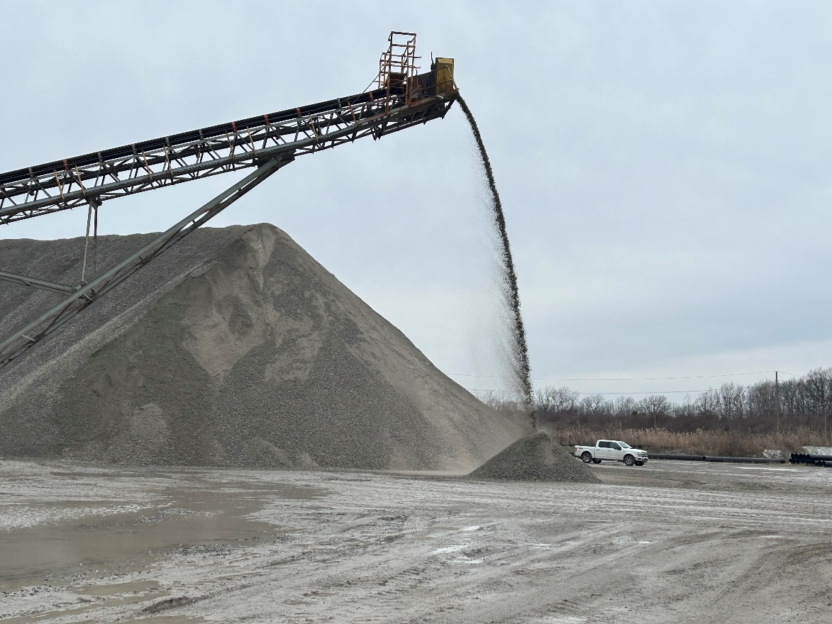
Sampling (Production)
Check with plant operator to verify plant is running at normal speed before obtaining a sample.
Stacker-built mini-stockpile
  Move stacker far enough from the stockpile where it can be mixed properly.
  Lower height
  Build a mini-stockpile that is approximately equal to a semi load.
Production Cone
  Remove enough material from pile to expose fines (roughly half of cone?
  Remove three buckets of material across the newly established face and place in one pile
Notes:
Too close to the pile is unsafe for the technician, more difficult to mix properly.

Slide 22
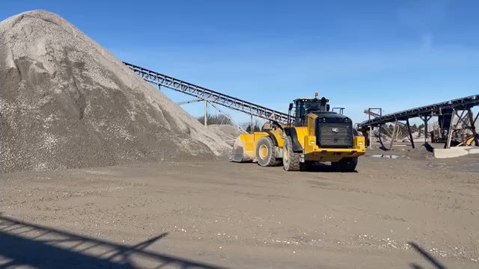
Sampling (Production)
Blend mini-stockpile thoroughly using a front-end loader to “roll” the stockpile from at least two different directions as many times as needed to blend the pile
Back blade with the bucket curled in a downward position. Pull the material straight back slowly
Observe the stockpile - re-mix if segregated or coarse/fine pockets are visible

Slide 23
Sampling (Shipping Face)
Obtain a minimum of three buckets across the shipping face (coarse, medium, fine) or (left, right, center) and combine into one pile
Blend pile thoroughly using a front-end loader to “roll” the stockpile from at least two different directions as many times as needed to blend the pile
Back blade with the bucket curled in a downward position. Pull the material straight back slowly
Observe the stockpile - re-mix if segregated or coarse/fine pockets are visible
Notes:
Monitor during shipping, investigative, customer complaints, material failures

Slide 24
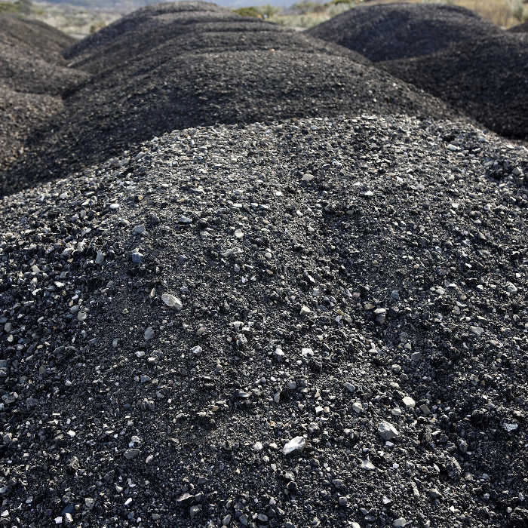
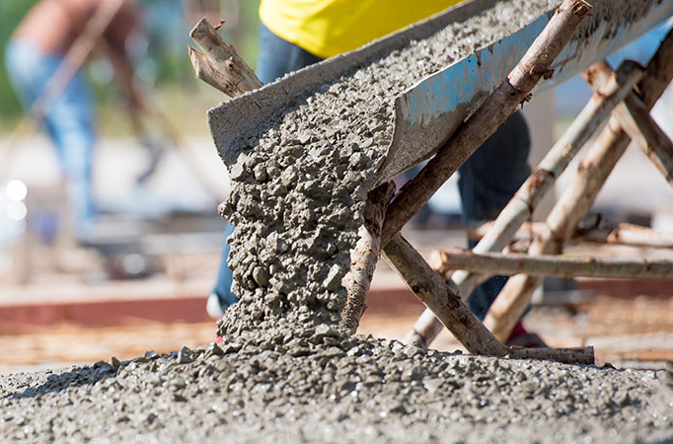
Consistency
Asphalt mixes are 95% aggregate
Concrete is about 85% aggregate
Properties of asphalt and concrete mixes are based on the properties of the aggregate
Changes in the aggregate properties will impact the asphalt and concrete properties
Customer may get penalized
Materials will prematurely fail!

Slide 25
Sampling – QC/QA
Only qualified technicians should obtain samples
Certify operators in Sampling (MDOT)
Proper sampling tools must be used to obtain samples
Required to monitor quality at specific frequencies
Incorrect sampling can cause erroneous data, increased testing costs, delayed projects and penalties.

Slide 26
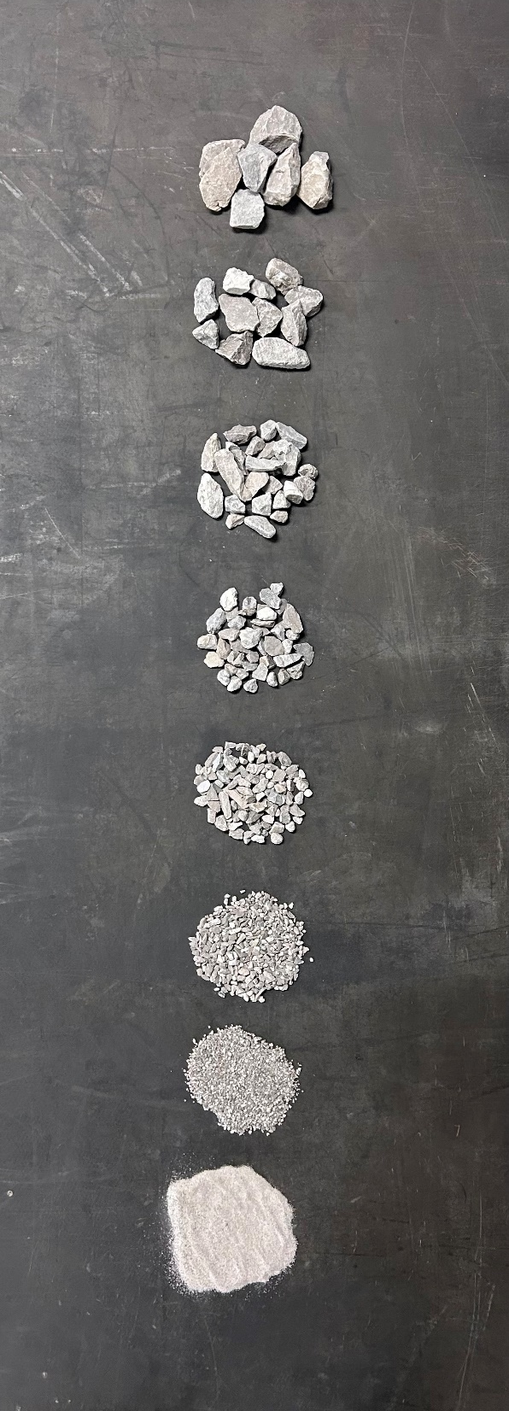
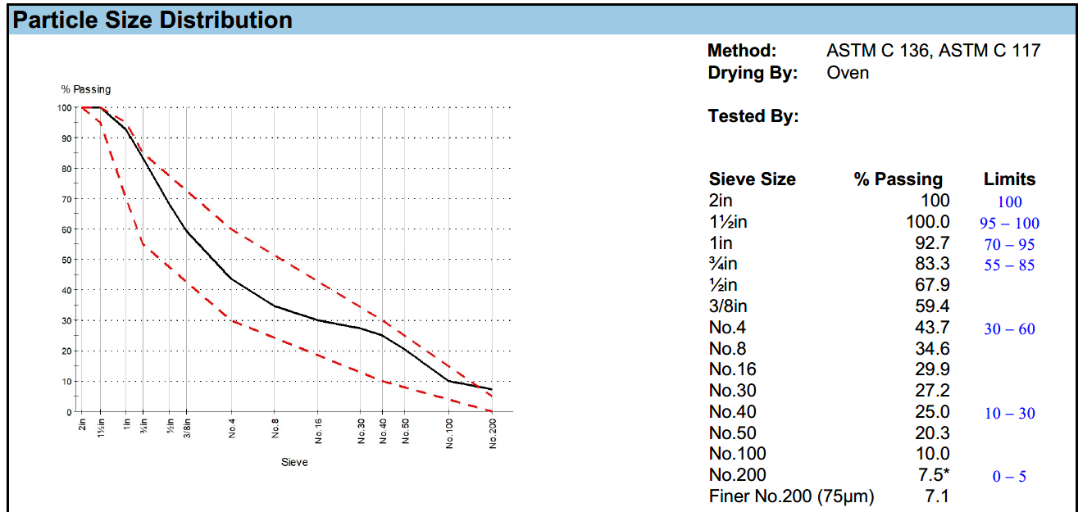
Interpret the Data
Fine vs coarse
Dirty vs clean
Percent passing
Percent deleterious

Slide 27
Contact us if you have any questions or need further information
Keith Childress @ 810-217-4044 kchildress@greatlakesagg.com
Nathan Gates @ 231-206-5404 nate@verplanktrucking.com
Notes:
Ask audience for feedback or missed topics

