Slide 1

Understanding the MDOT Budget and Funding Formula
Laura Mester and Patrick McCarthy (MDOT)

Slide 2
FY 2025 Enacted Budget
Appropriations
Total: $6,807,900,300

Slide 3
FY 2025 Enacted Budget

Slide 4
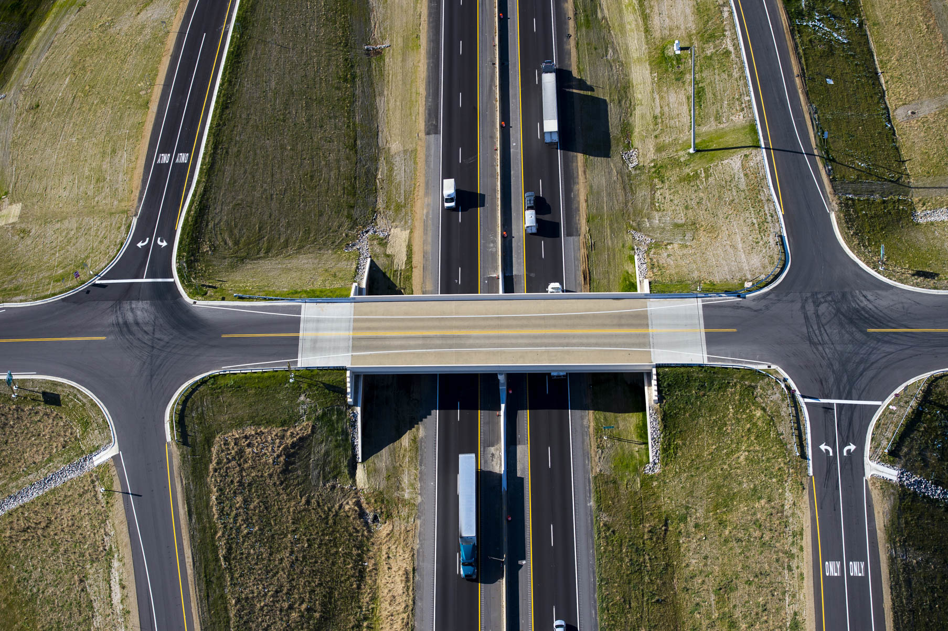
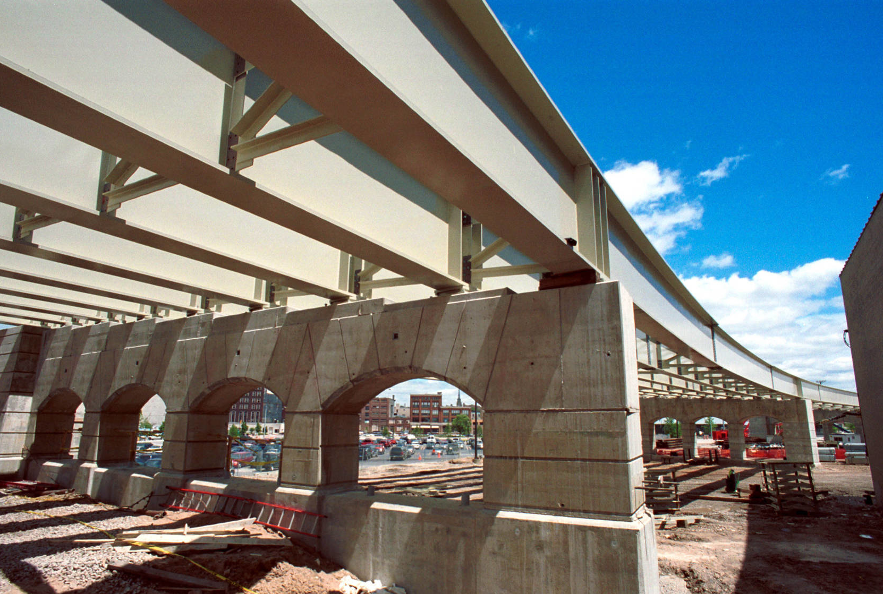
FY 2025 Enacted Budget
Road and Bridge Program Highlights
Road and Bridge Programs increased by $250.2 million
    State R&B increase by $123.4 million
    (Federal & STF increases)
  Local federal aid increased by $26.2 million
  Counties increased by $64.8 million
  Cities and Villages increased by $36.2 million
  Local Bridge Fund decreased by $483,800
  Moveable Bridge Program increased by $150,500 (inflation)
  Blue Water Bridge decreased by $1.6 million

Slide 5

FY 2025 Enacted Budget
Other Budget Highlights
Recreational Marijuana excise tax (2/7/24 ORTA Est) - $113.6 million
One-Time Appropriations - $213.99 million
    One-Time General Funds - $193.0 million
          Federal Match - $76.0 million
          Critical Infrastructure Projects - $74.5 million
          New Technology & Mobility - $23.95 million
          MI Contracting Opportunity - $5.0 million
          Air Service/Airport Revitalization - $6.0 million
          Other - $7.55 million
    One-Time BWB Funds (Equipment & Facilities) - $990,000
    One-Time Coronavirus Fiscal Recovery Fund – ARP Local Bus Operating - $20 million

Slide 6
FY 2025 Federal Funding Total $2,273,675,100

Slide 7
FY 2025 State Funding Total $4,427,976,700

Slide 8
FY 2025 Michigan Transportation Fund (MTF) Revenue $3,939,603,000

Slide 9
FY 2025 State Trunkline Fund (STF) Revenue $1,588,542,600

Slide 11
FY 2025 State Aeronautics Fund (SAF) Revenue $46,810,300

Slide 13
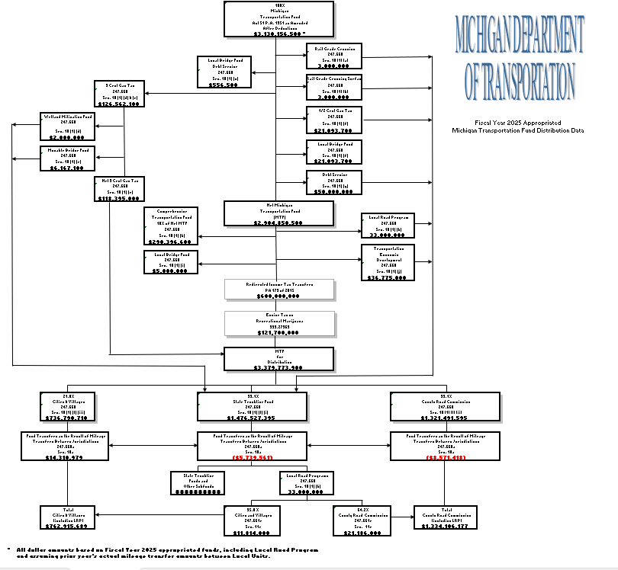


Slide 14
FY 2025 State Trunkline Fund (STF) Use of Resources $1,584,677,400

Slide 15
FY 2025 Comprehensive Transportation Fund (CTF) Use of Resources $512,938,700

Slide 18
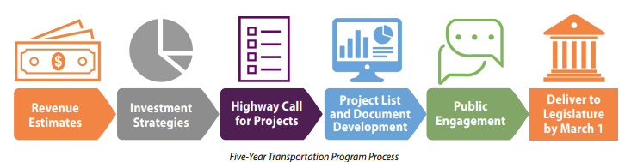
Call for Projects & 5-Year Transportation Program - High Level Process

Slide 19
Program Performance & Condition Goals
Road Program – Based on Remaining Service Life (RSL)
  95% good/fair condition of freeway pavements
  85% good/fair condition of non-freeway pavements
Bridge Program - Based on National Bridge Inventory Rating Scale
  95% good/fair condition of Interstate bridges
  85% good/fair condition of the non-Interstate Bridges
Transportation System Management & Operations (TSMO)
  Intelligent Transportation Systems: Improve safety and mobility for all users
  Operations: Reduce delay, reduce crashes, improve reliability
  Safety: Reduce fatalities and serious injuries to zero
  Traffic Signal Modernization: Replace signals that reach end of service life and maintain safe intersection control.
Carpool Parking: Maintain condition, improve safety, improve connectivity to transit

Slide 20

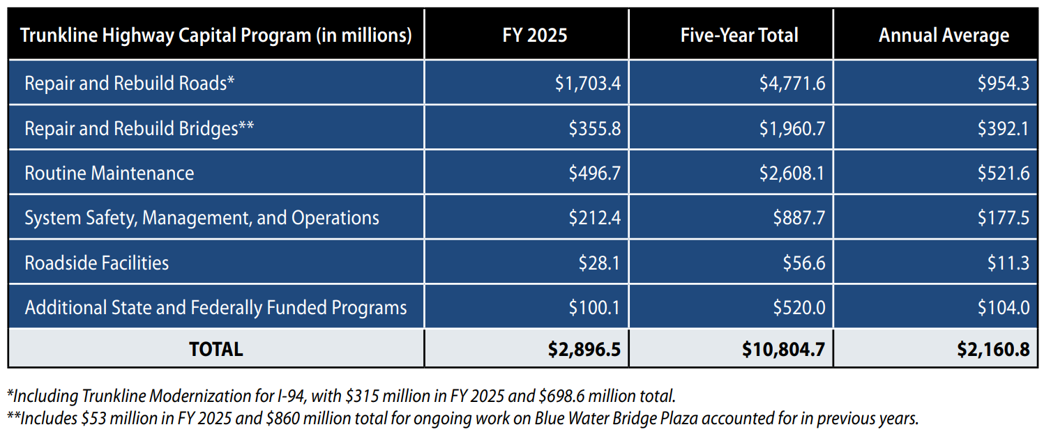

2025-2029 Five-Year Transportation Program Investment

Slide 21
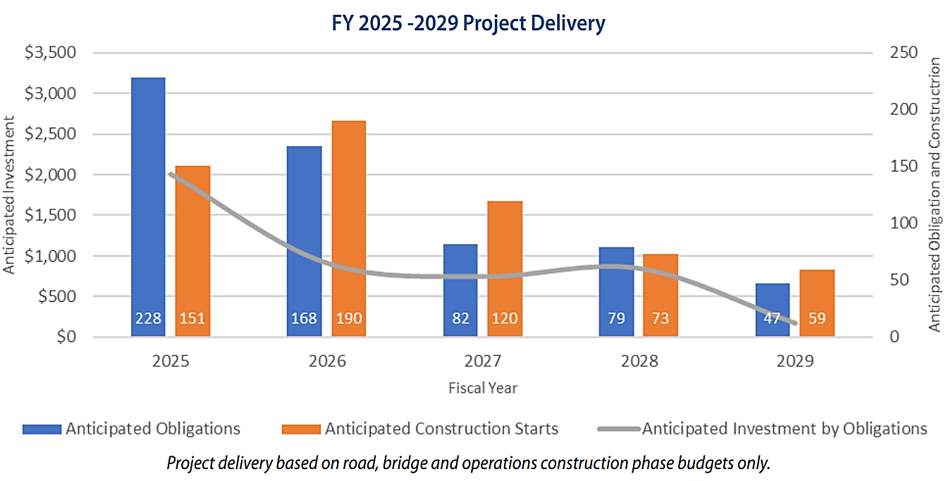
Fiscal Year 2025-2029 Project Delivery

