Slide 1
Vibration Analysis and Thermography
Presented by: Alta Mine Services
Michigan Aggregates Annual Meeting 2025

Slide 2


MEET THE TEAM
Brice Jacobs
  Reliability Program Manager, Midwest Mine Services
  15 years experience in the reliability field
Tim Meighan
  Mining Engineer, Midwest Mine Services
  15+ years industry experience

Slide 3
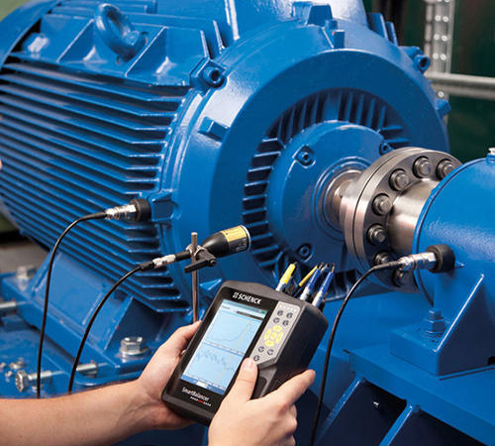
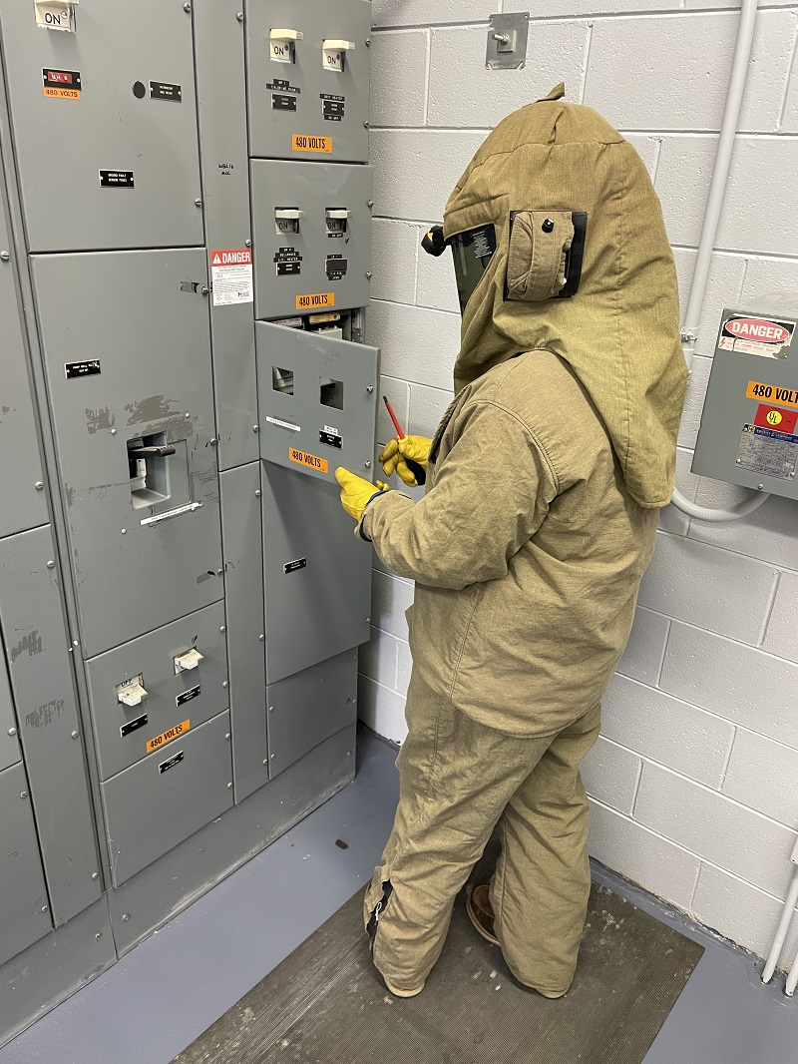
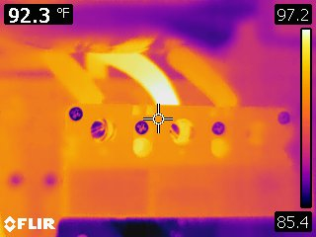
Vibration and Infrared Thermography– What is it?
Vibration Analysis
  A method of utilizing vibration measurements taken from an asset to identify possible machine performance issues
Infrared Thermography
  A non-contact means of measuring thermal energy emitted by an object to be used in assessing the condition of the object

Slide 4

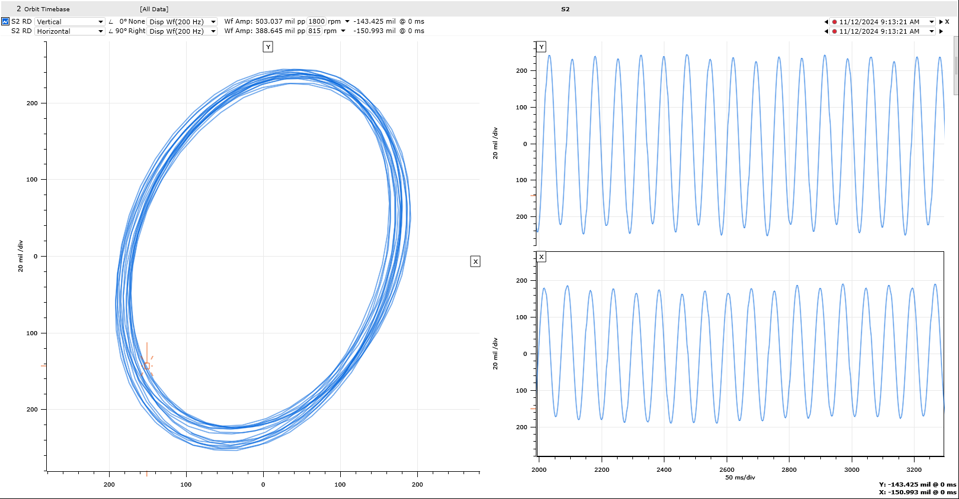
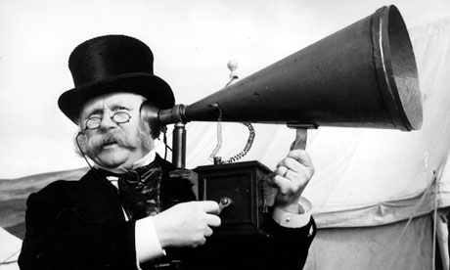
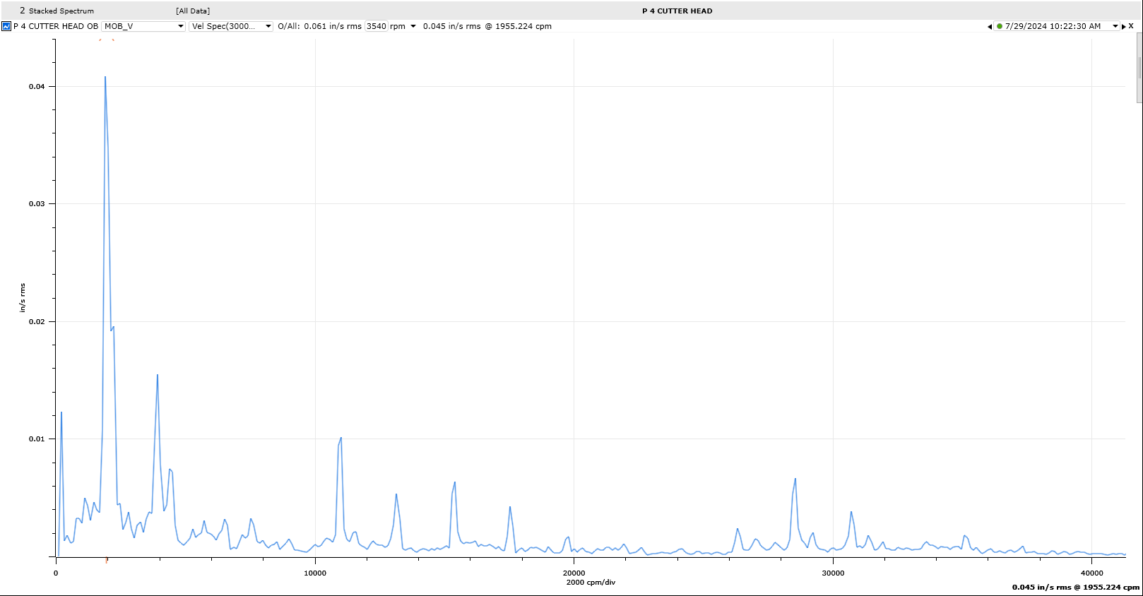
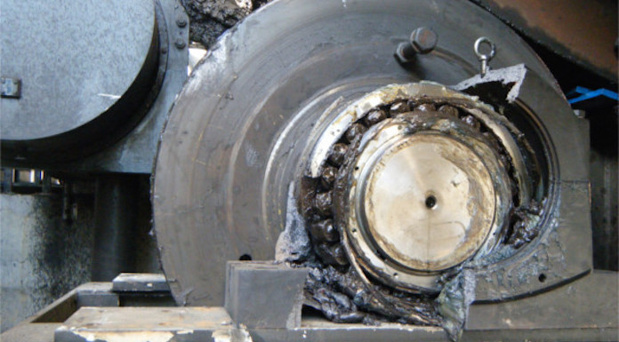
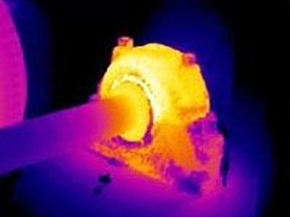
The Evolution of Vibration and Thermal Analysis
From pencil and paper for screen orbits to the modern digital versions
Old timer approach using stethoscope or amplification cone to the current FFT analysis
Going from “when its on fire, its too hot” to Infrared Thermography

Slide 5
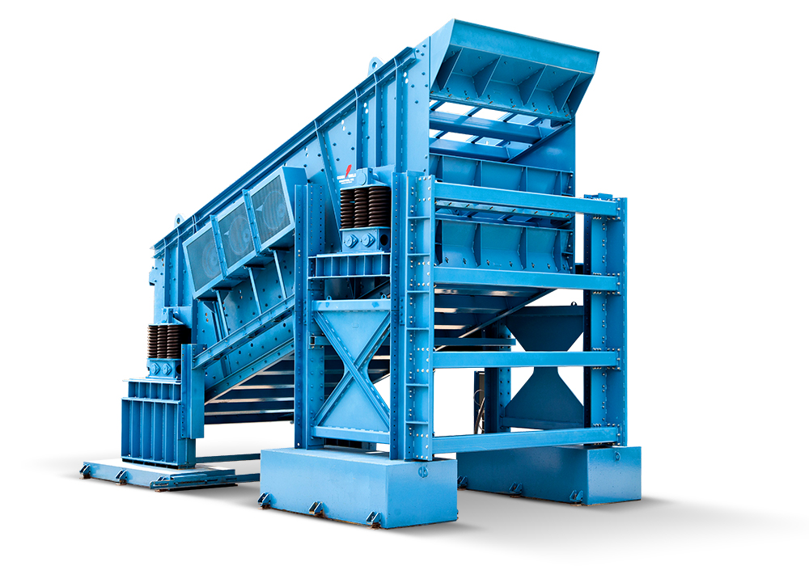
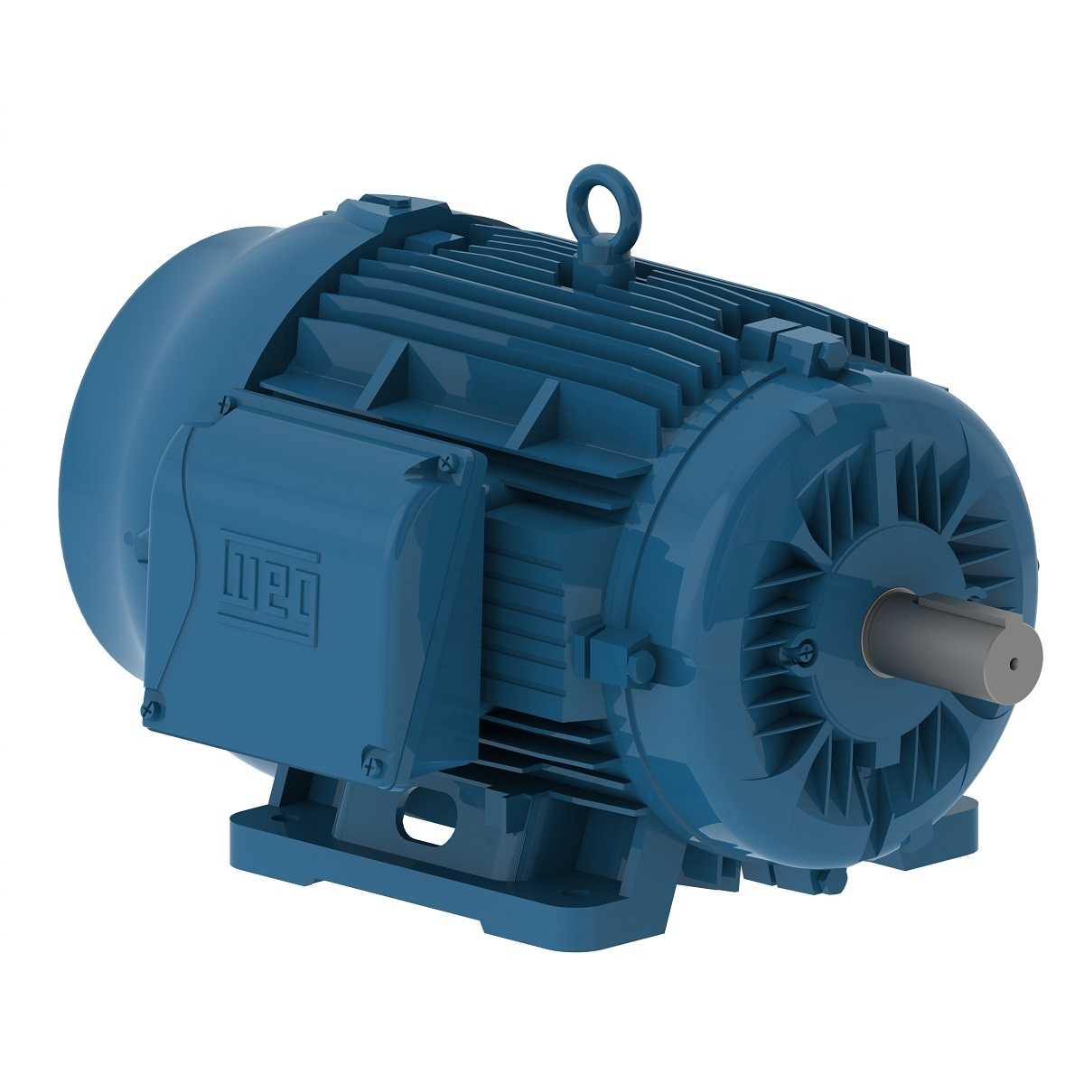
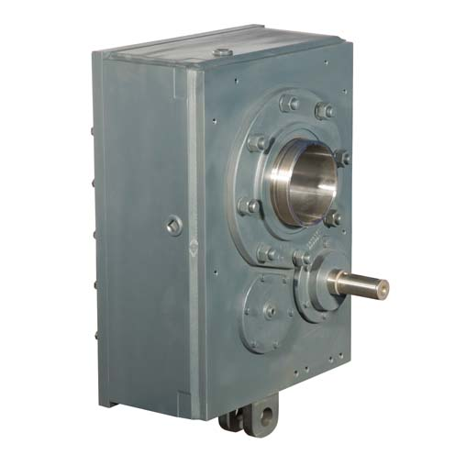
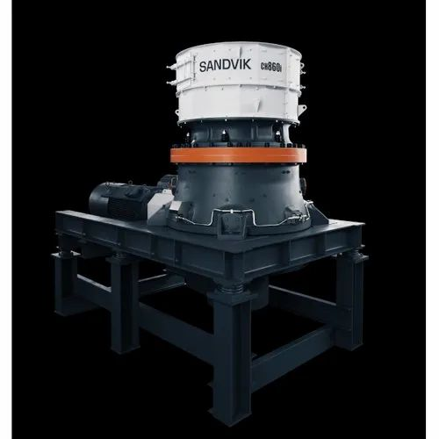
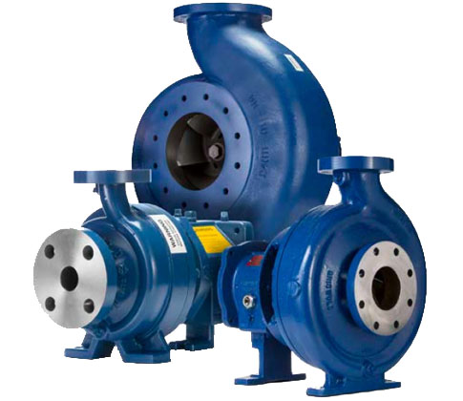
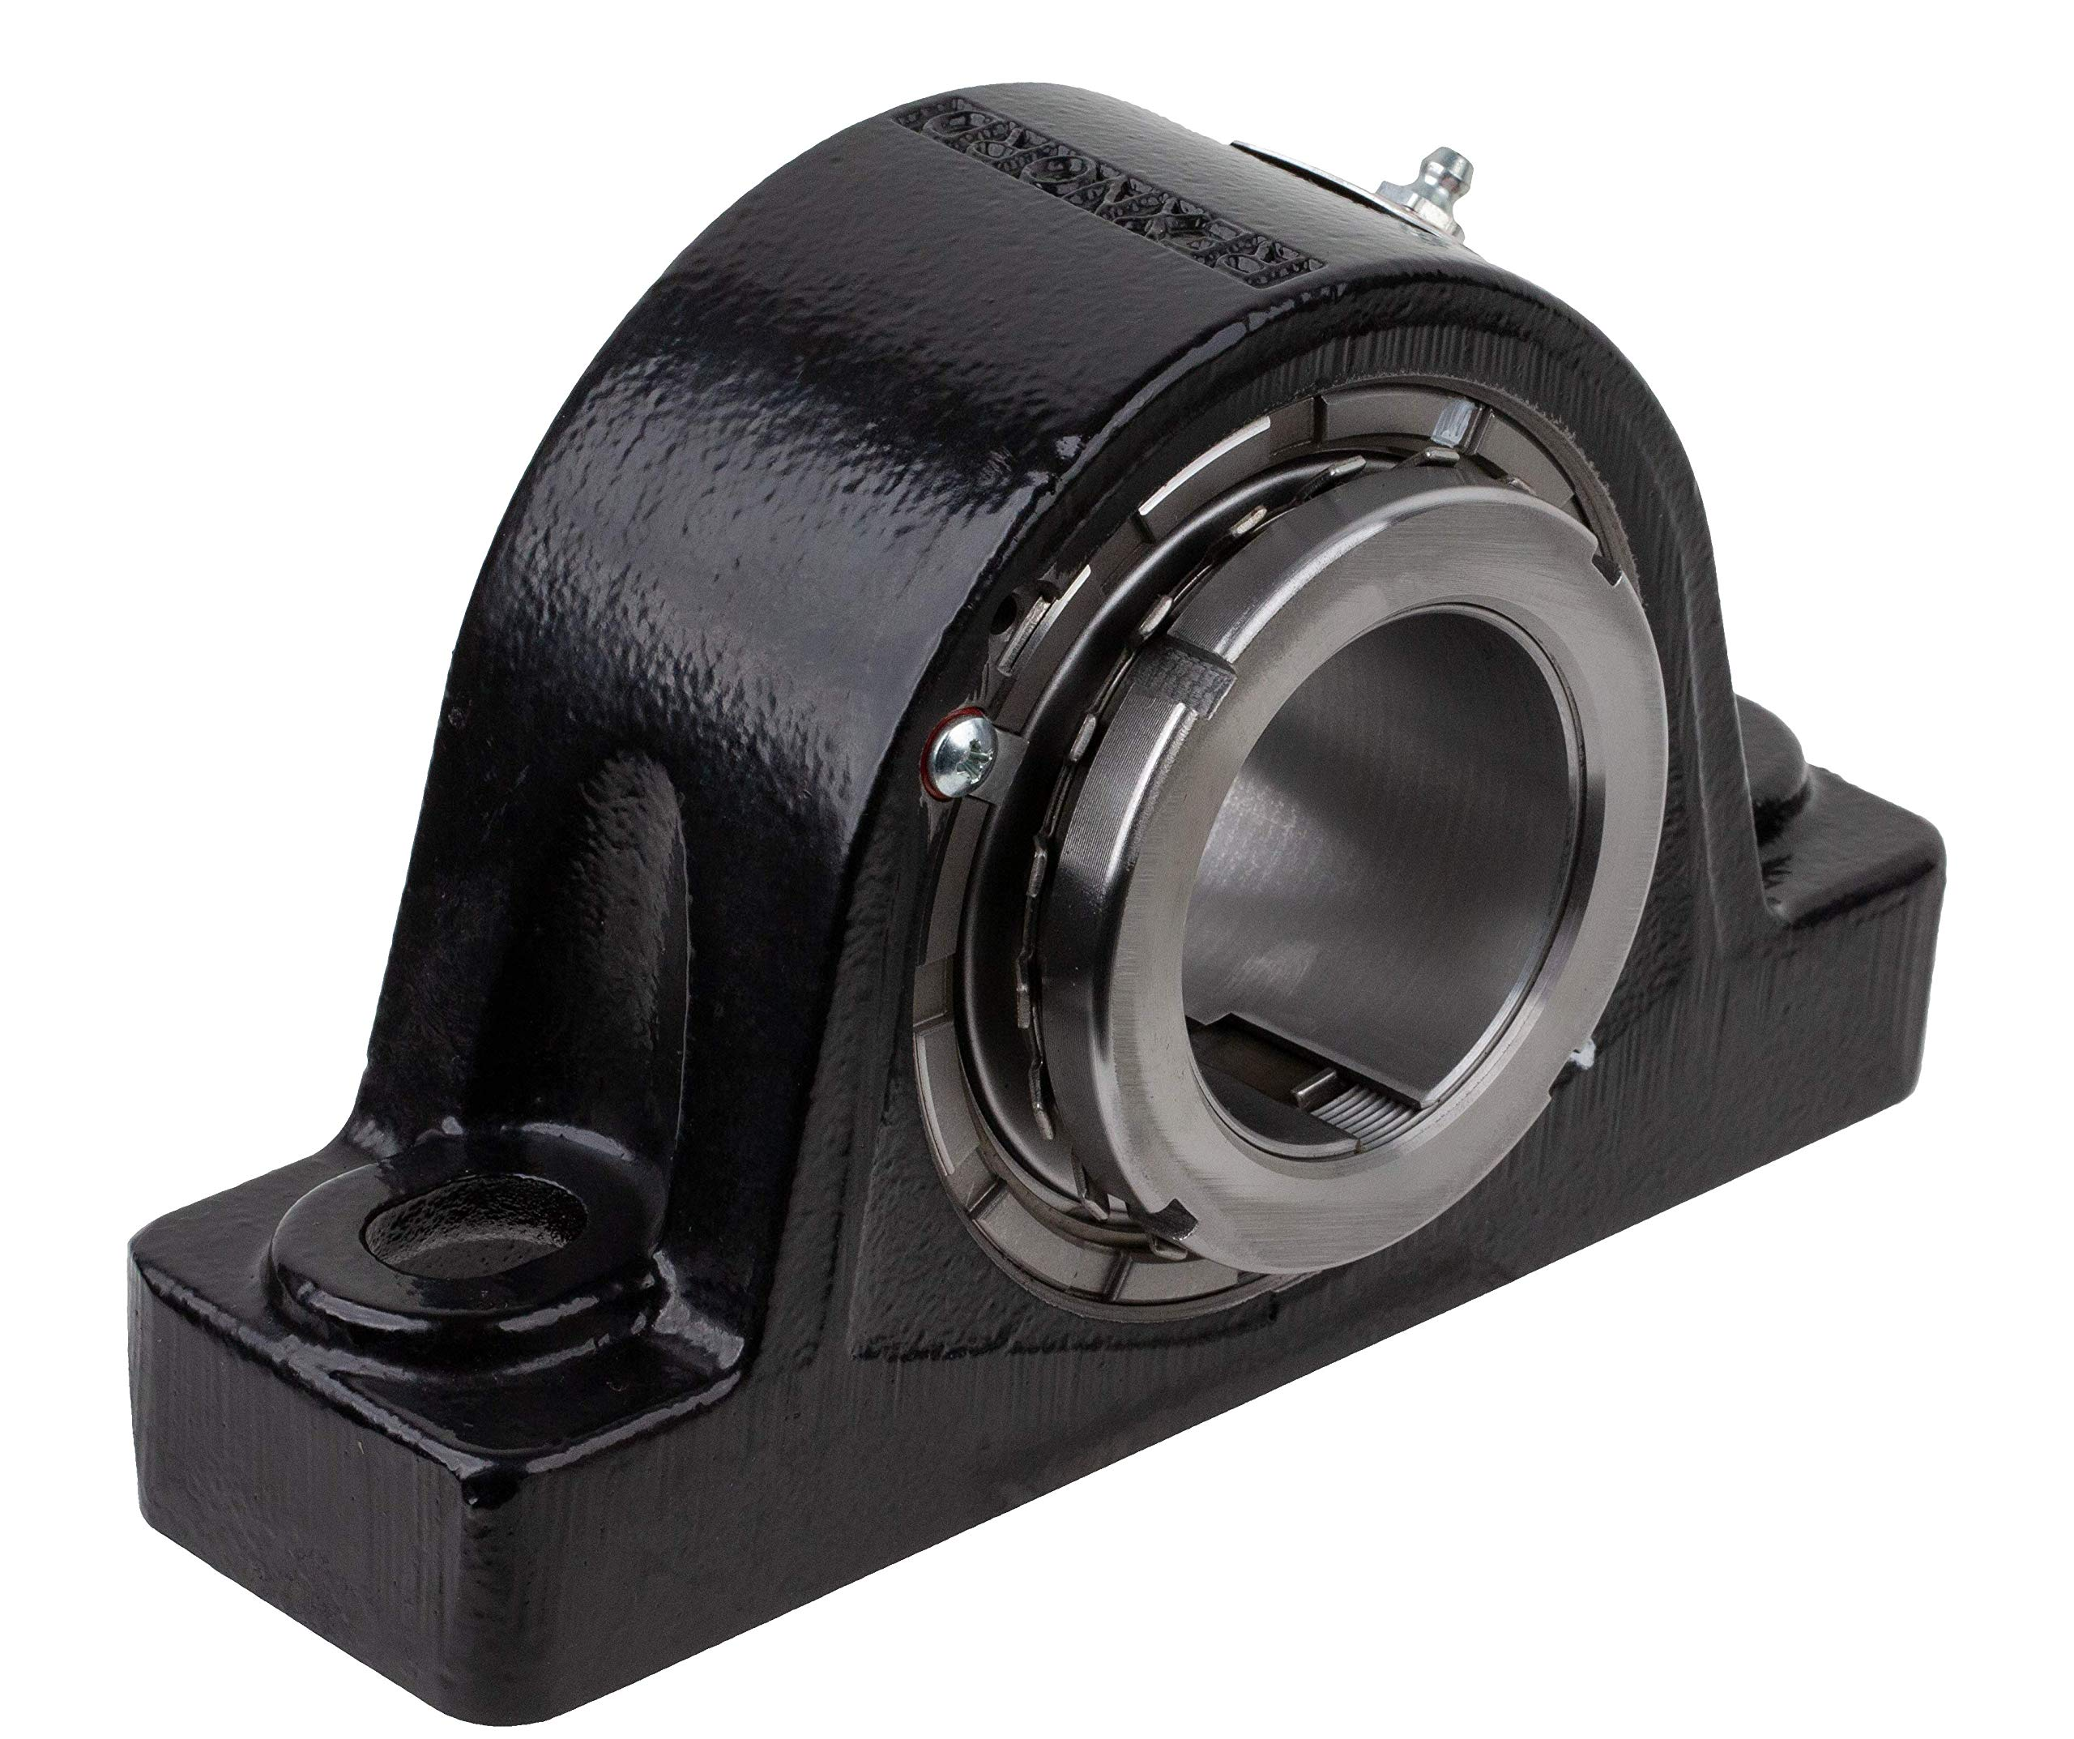
Vibration Analysis– Aggregate industry applications
Bearings
Motors
Gearboxes
Screens
Pumps
Fans
Crushers

Slide 6
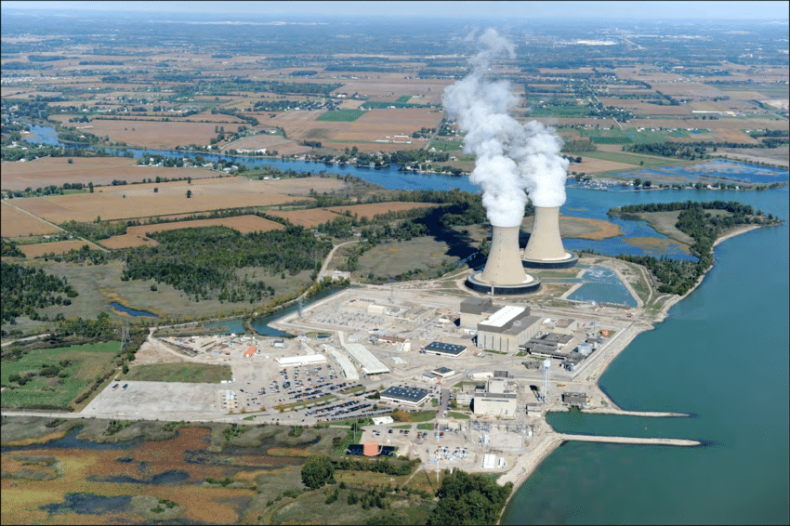
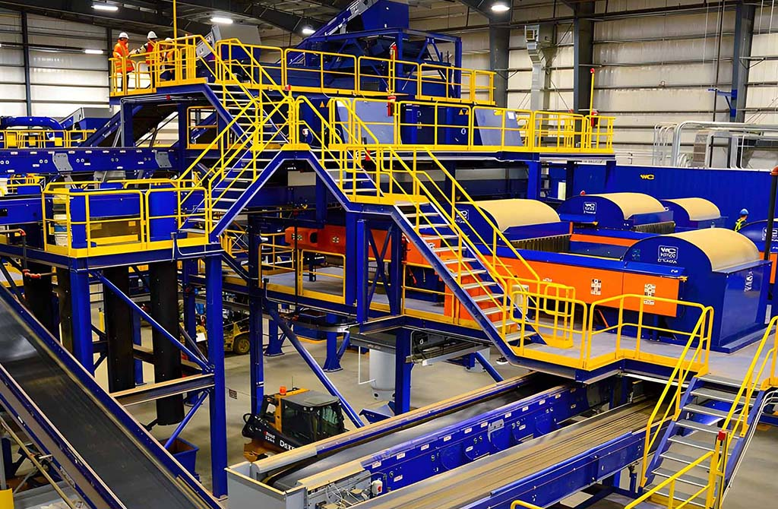
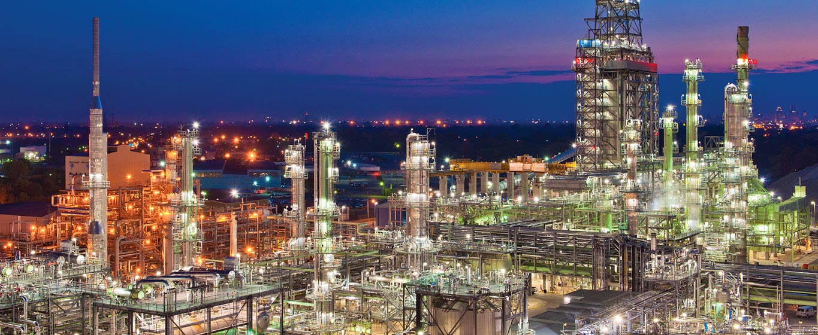
Vibration Analysis– Other Industrial Applications
Power Generation
Aerospace
Refineries
Agricultural
Plastics
Recycling
Construction/Engineering

Slide 7
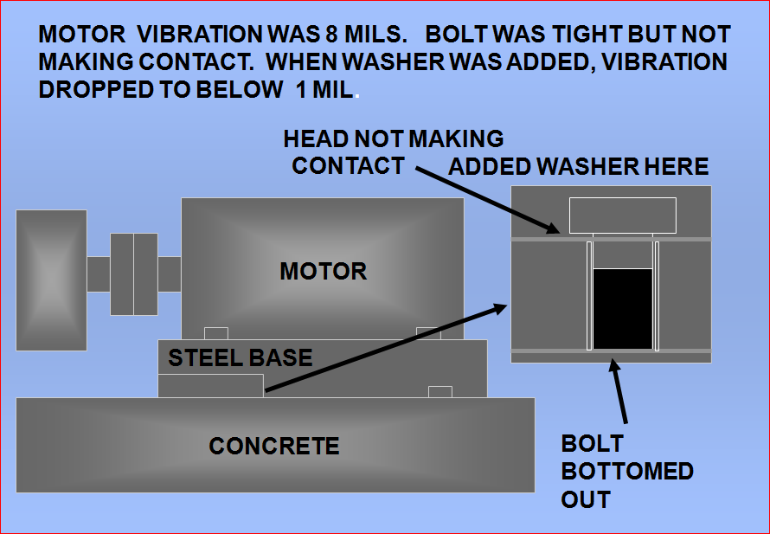
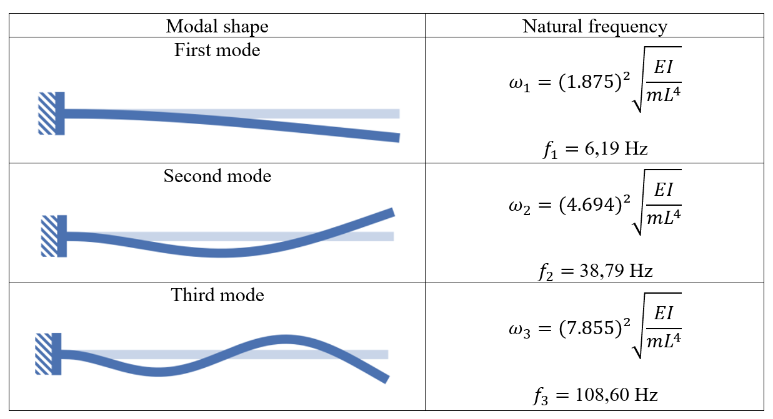
Vibration Analysis– Special Applications
Finding resonances within structures
Finding unintended physical movement of assets
Assessing natural frequencies within components
Beating (typically with large moving assets like screens)

Slide 8

Vibration Analysis – What is the process?
Vibration Analysis
  This is a system of actions used to diagnose and provide predictive maintenance recommendations for a myriad of industries
  The process can vary depending on the industry, but the most commonly used process is a route-based data collection, followed by an analysis of the data collected, then a report of the findings and recommendations.

Slide 9
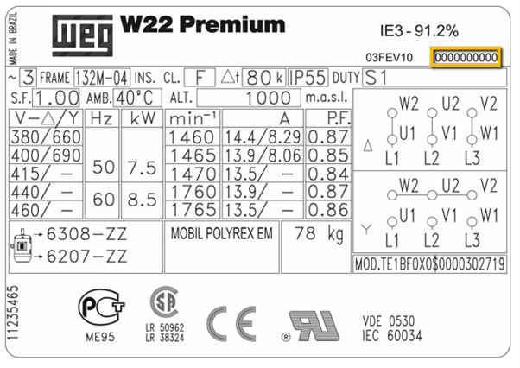
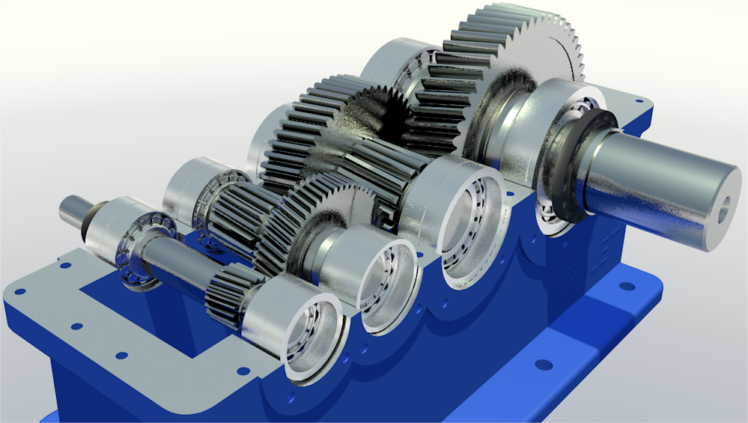
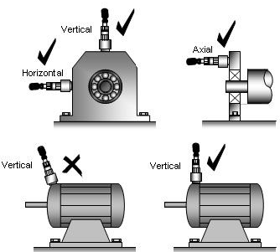
Vibration Analysis– Choosing the right assets
Setting up the data base
  Walk through of the assets to be collected
  Collect all speed and load data for each asset
    VFD or process forced speed changes
    Motor speed and bearing numbers
    Gearbox ratios, tooth counts, and bearing numbers
    Driven asset bearing numbers
  Determine data collection points for each asset
  Lastly, determining what faults are possible for this asset will aid in setting the data collection specifications correctly

Slide 10
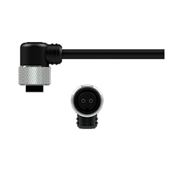
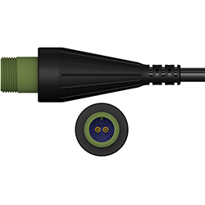
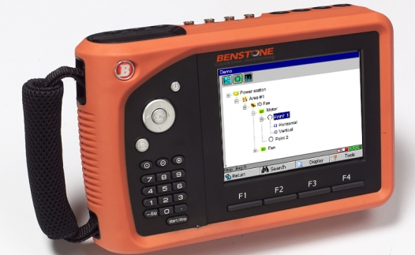
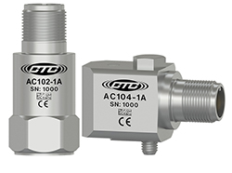
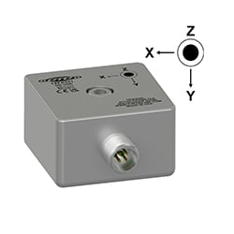
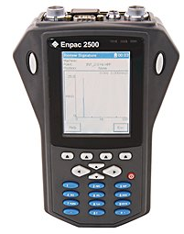
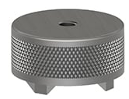
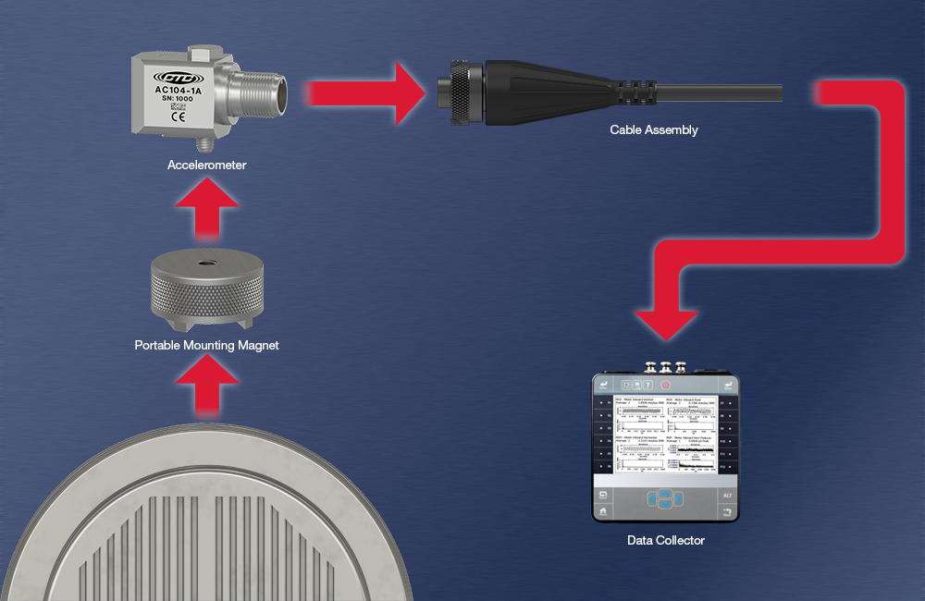
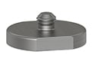
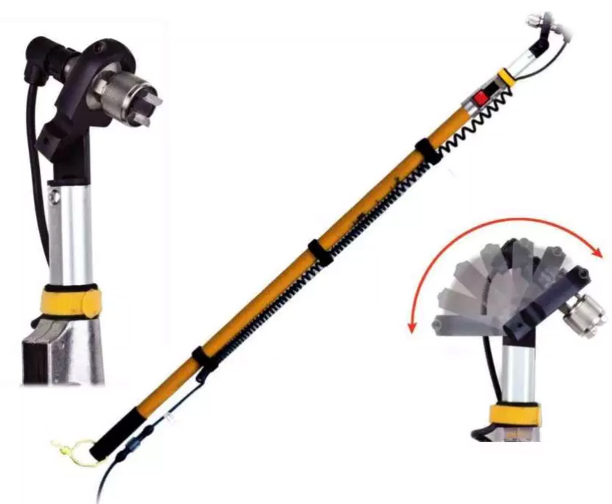
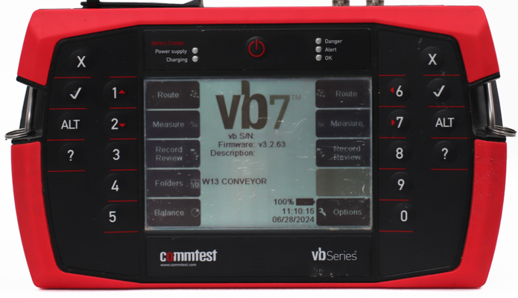
Vibration Analysis– Tools of the Trade

Slide 11
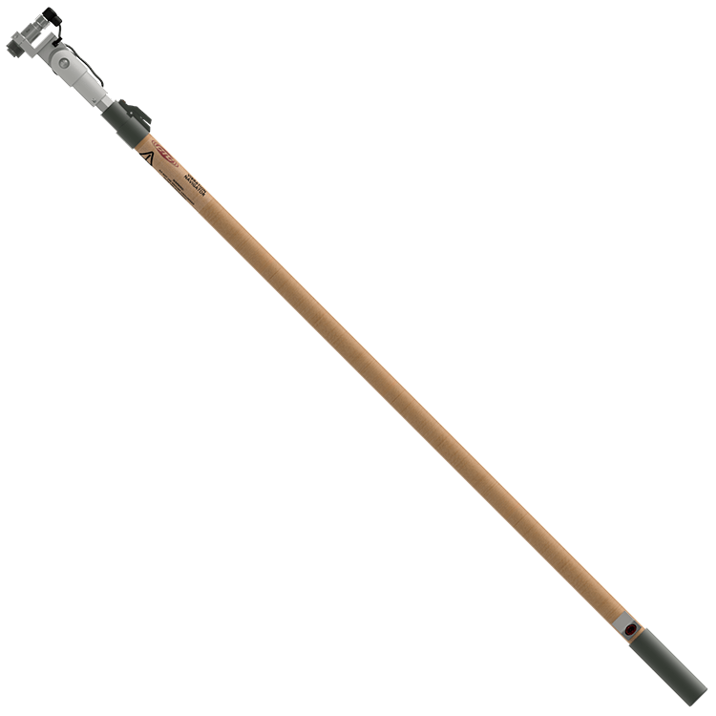
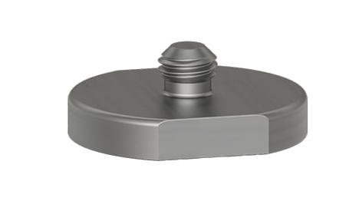

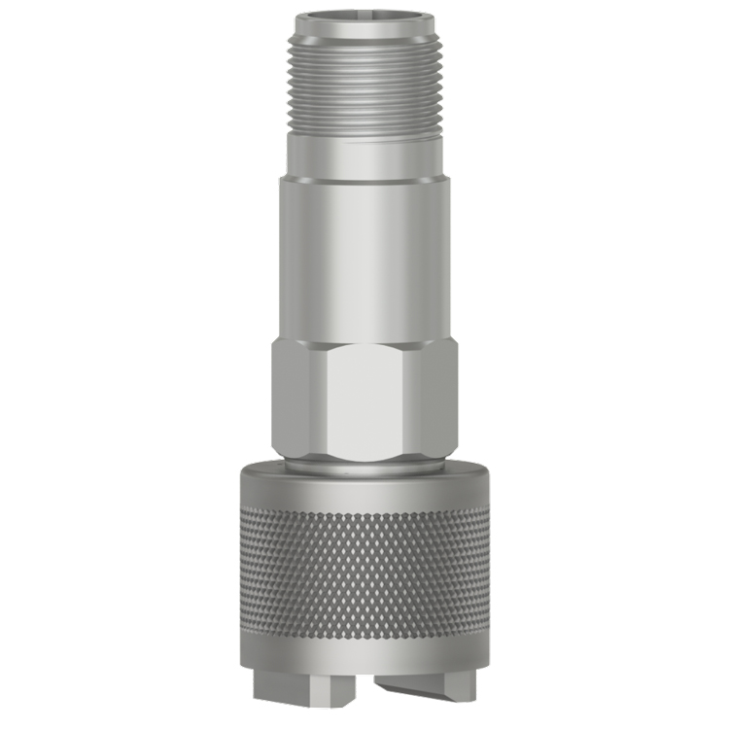
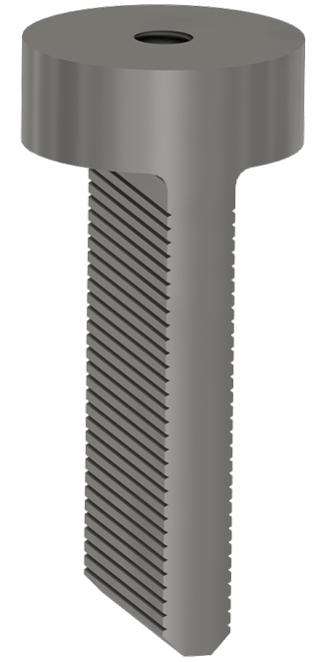
Vibration Analysis– Data Collection
Collecting the data
  Physically
    Walking up to each asset and attaching the accelerometers to each of the predetermined data collection locations
      Magnet mounted (most common)
      Stud mounted
      Probe
      Pole accessible
  Wireless
    This method typically sends more frequent , less detailed readings directly to a data storage site or directly imports into the database

Slide 12
Vibration Analysis– Fault types
More Common Faults
  V-Belt issues
  Bearing issues
  Imbalance
  Gear Issues
  Looseness
  Misalignment
Less Common Faults
  Electrical issues in motors
  Turbulence
  Cavitation
  Resonance
  Beating
  Vane/Blade issues

Slide 13
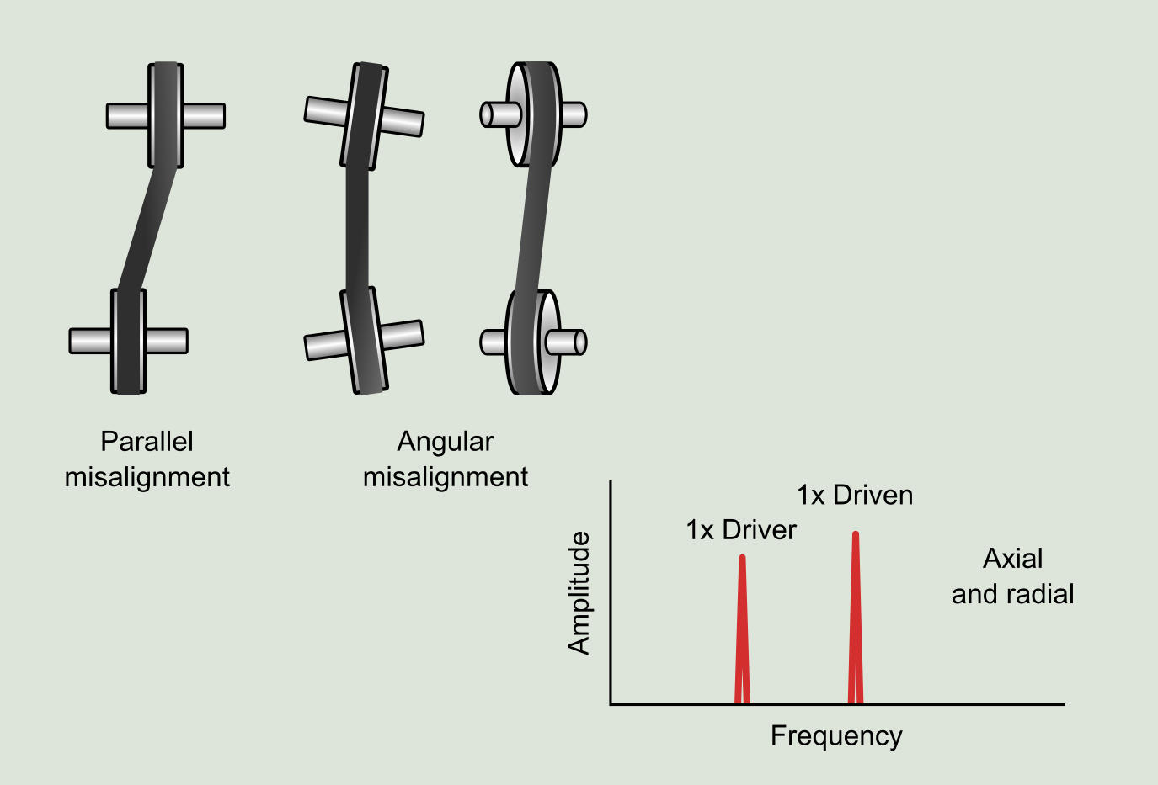
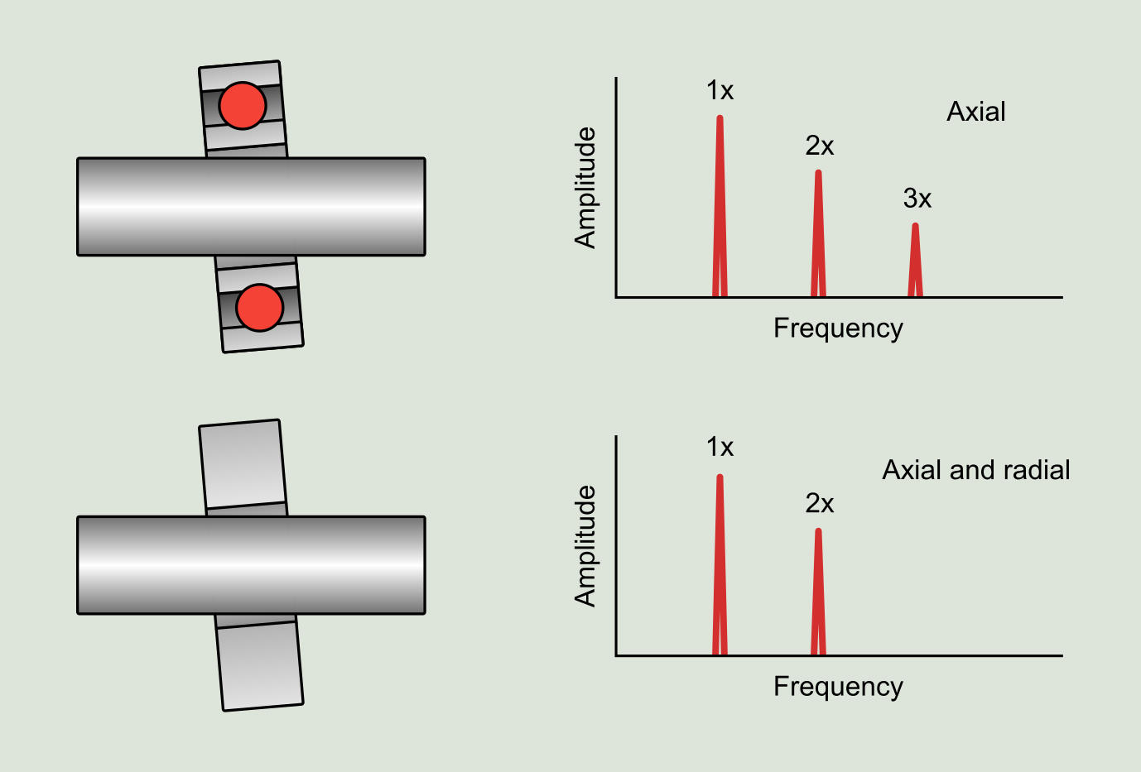
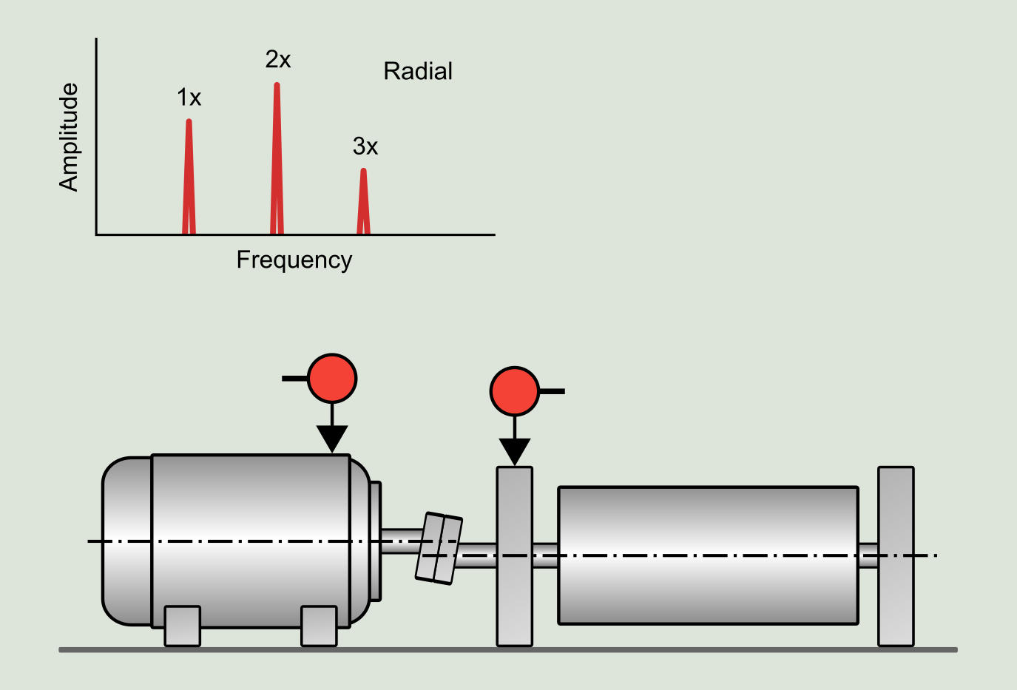
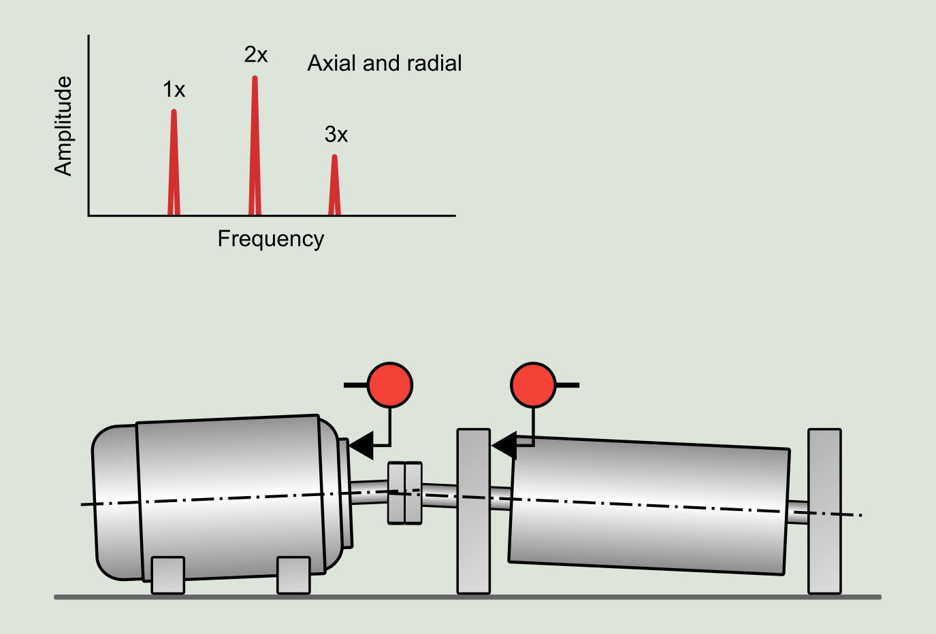
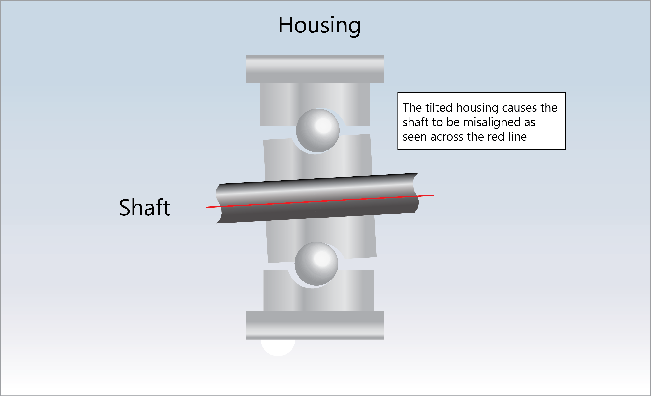
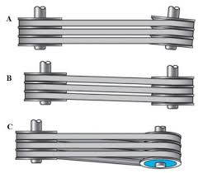
Vibration Analysis–Misalignments
Possible asset damage
  Sheave wear or breakage
  Wearing and breaking belts
  Coupler degradation and premature failure
  Bearing damage
  Significant shaking of all mounting components

Slide 14
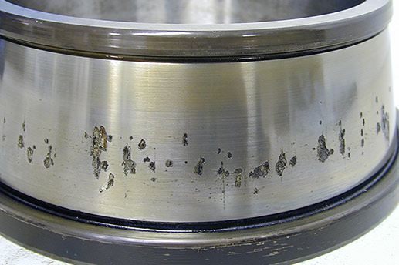
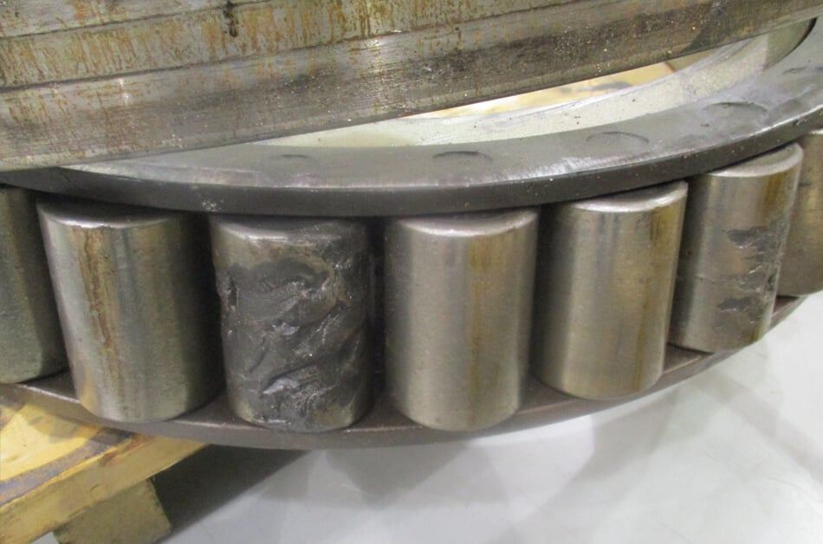
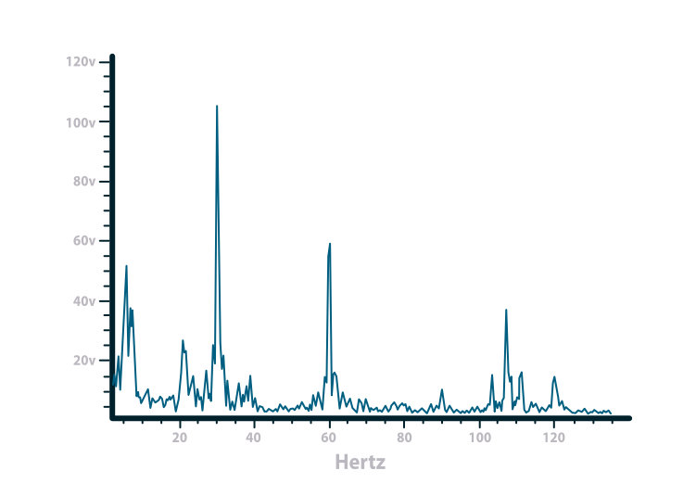
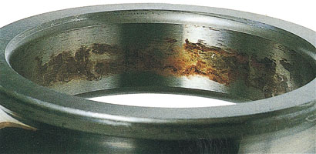
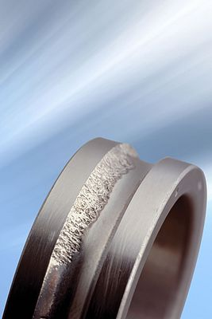
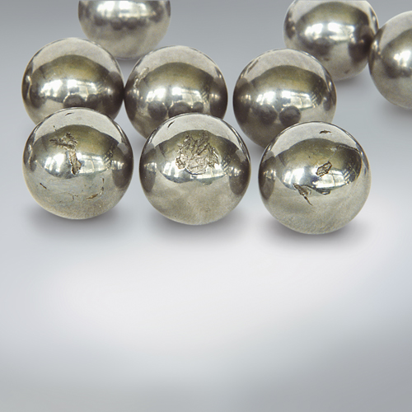
Vibration Analysis–Bearing Faults
Possible asset damage
  Fire
  Shaft damage
  Extended downtime due to ancillary damage of housing
  Gear damage if in a gearbox
  Significant damage to motor internal components

Slide 15
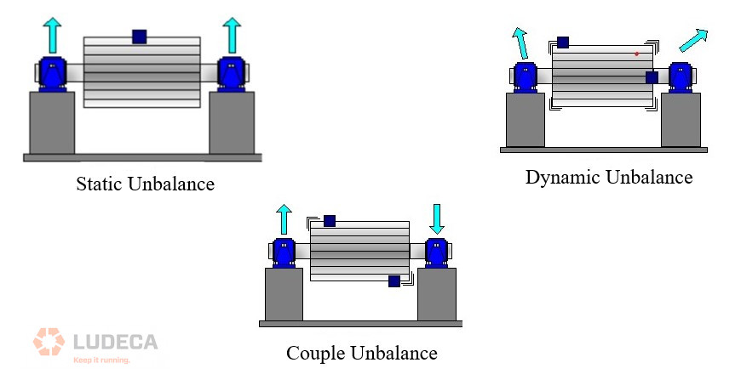



Vibration Analysis–Imbalance
Possible asset damage
  Housing damage
  Bearing life significantly shortened
  Structural damage
  Shorts in electric motors due to constant change in airgap

Slide 16






Vibration Analysis–Gear Issues
Possible asset damage
  Complete self destruction gears
  Housing damage
  Bearing failures
  Shaft binding/fracturing
  “Snowball” effect on all gearbox components

Slide 17



Vibration Analysis–Screen Orbits
Possible asset damage
  Spring Damage
  Loose Media
  Mistimed shaft(s)
  Speed issues
  Material distribution issues
  Broken crossmembers

Slide 18






Vibration Analysis– Screen Orbits
Orbits are plotted using two accelerometers fixed 90° apart
The readings are taken simultaneously, and the resulting displacement and acceleration differences are graphed concurrently, resulting in an orbital shape
This measurement also reads the speed(RPM) and stroke of the screen

Slide 19


Vibration Analysis– Reviewing the Data
Analysis
  What needs manually reviewed
    Raw Data
    % of change comparison
    Location and direction of change
      Increase or decrease
    Manual analysis of the remaining data
      Fault determination
      Compare data point to data point for fault confirmation
      Review asset history vs current readings

Slide 20

Vibration Analysis– Fault Diagnosis
Analysis
  Provide technical insight to the fault identified by the analyst
Comments
  Include environmental, asset history, common failures for the fault in question
Recommendations
  This section should have possible solutions to reduce or remove the fault

Slide 21
Vibration Analysis– Reporting
What information should be included
  General condition for each asset
  Notable issues found
  A detailed description for each notable issue
  Physical, environmental, audible or other noticeable items possibly related to the issue
  A predetermined priority or ranking system for the findings

Slide 22




Vibration Analysis– Asset Condition
List the fault(s) for each asset
Utilize the data to provide a visual aid to the fault diagnosis
Explain the fault and possible causes
Recommend possible solutions

Slide 23




Vibration Analysis– Asset Environment
Environmental notes should include
  Smells- burnt belts, oil or grease
  Sounds- Bearing noise, rattling, excessive noise, whining
  Sights- Loose bolts, worn liners, potential safety issues, production conditions at time of data collection, excessive grease
  Feels- thumping, shaking, wobbling

Slide 24
Vibration Analysis– Prioritization
The Asset list is designed to be user friendly
Color coded items are of a higher priority
  1 Critical Fault
  2 Severe Fault
  3 Advanced Fault
  4 Early Fault
  5 No Action Required, will begin to trend fault
The priority column can help prioritize your maintenance efforts
The previously reported column can help develop a history on a “bad actor”
Priority may be based on visual and safety notes from the data collection route

Slide 25



Infrared Thermography

Slide 26







Infrared Thermography
Tools of the trade

Slide 27




Infrared Thermography-Safety and PPE
Extra Safety Concerns
  Assets are typically live and loaded during collection
  ARC Flash hazards
  Electrocution possibilities
PPE
  Arc Flash Suits
  Arc Flash Rated Gloves
  Insulated Tools

Slide 28



Infrared Thermography – Common Industry Applications
Electrical
  Most commonly this is done in the MCC (Motor Control Center)
  Can also be performed at switches, breaker panels, motor peckerhead, and transformers
Mechanical
  Motors, fans, pumps, gearboxes

Slide 29




Infrared Thermography – Other Industries
Home inspections
Vehicle Repair
HVAC Repair
Hunting
Healthcare
Insulation inspections

Slide 30




Infrared Thermography– Data Collection
  Inspecting MCC Buckets
    Checking for the proper Arc Flash safety rating
    Opening the bucket safely
    Ensuring asset is under load
    Inspecting from a safe distance with the proper PPE
  Mechanical Assets
    Identify the correct assets for data collection
    Ensure asset is loaded and safe to access

Slide 31
Infrared Thermography– Fault types
More Common Faults
  Loose terminals
  Corroded components
  Phase inequality
  Overheated wiring/insulators
  Mechanical issues
Less Common Faults
  Rodent issues
  Moisture intrusion
  Overloading of electrical componentry
  Fuses nearing the end of life

Slide 32




Infrared Thermography–Loose/Corroded Components
Possible asset damage
  Fire
  Arc Flash
  Melting of components
  Loss of system function

Slide 33




Infrared Thermography–Overheating
Possible asset damage
  Fire
  Arc Flash
  Significant ancillary damage to the MCC, wiring, ETC.
  Melting of components
  Loss of system function

Slide 34


Infrared Thermography–Mechanical Issues
Possible asset damage
  Bearing failure
  Coupling issues
  Rubbing
  Poor air circulation
  Pump vane clearance issues
  Warped casings

Slide 35

Infrared Thermography–Reporting
A good report should include
  Plant or Location
  Image(s) of the Thermogram and raw photo
  Analysis of the fault
  Priority or severity of the fault
  Recommendations for possible remedies
  Photo of the exterior of the box (to aid technician)

Slide 36





Building a complete report
A complete report should include
  Plant or Location
  Explanation of Predictive terminology
  Findings of the applied technologies
  Details of the significant findings
  Recommendations

Slide 37




What to do with the Report
  Prioritize
  Plan
  Review
  Execute

Slide 38
Prioritizing the data
Which work orders take priority?
How bad is it, and what will it effect if it were to fail?
Which work orders have all the parts on site?
What is the lead time on components if this asset fails?
When can we shut down for this repair to be made?
Can we do this in house?
Do we need a vendor or additional expertise?
Do we have the right equipment for the proper repair?

Slide 39
Planning
Write work orders
Coordinate work orders with all involved parties
Stage equipment
Stage parts for repair/replacement
Schedule manpower/ Contractor
Build stockpile to meet customer demand before outage
Select when and where
Project the duration

Slide 40
Execution
Perform the work per the plan
Document the progress and anything needed “off plan”
Include time spent on all activities related to each individual work order

Slide 41
Review
Walk the work area
Review the documentation to ensure congruity
Double check quantities and part numbers
Ensure the wellbeing and safety of the technician and the completed job
Track successes and areas for improvement to make the next job easier

Slide 42




How Does This Add Value?
Reduce unplanned downtime
Reduced replacement costs
Reduced inventory cost
Identifying criticality of all assets

Slide 43
How Does This Add Value?
Reduce unplanned downtime
  Replacing something before catastrophically failing greatly reduces the likelihood of it going down unplanned
  Replacing components before it can cause ancillary damage

Slide 44
How Does This Add Value?
Reduced replacement costs
  Plan for maintenance activities during regular paid hours(not overtime)
  Stage materials and manpower
  Stage tooling and prep the work area
  Not expediting parts
  Combine this outage with other planned maintenance to best utilize manpower

Slide 45
How Does This Add Value?
Reduced inventory cost
  Shared inventories within certain geographic areas (centralized warehousing)
  Unification of the parts for common assets
  Only stocking for highly critical assets instead of every asset

Slide 46
How Does This Add Value?
Identify Criticality
  Is what you're working on worth your time?
  Identify “bad actors”
  Identify costs associated with each repair for better long-term planning
  Unification of parts for future project planning
  Reduced “rework”

Slide 47
Analyzing Value
  Situation: A conveyor keeps going through belts every three weeks, but shows no physical sign of an issue, The vibration analysis shows a gear mesh issue and a bearing issue within the gearbox and recommends a replacement.
Potential solution #1
Potential Solution #2
The gearbox is replaced at a cost of $5000 for the total project during already scheduled downtime and takes the technicians 3 hours to perform
Potential Total Cost: <$6000
The belts are replaced 8 times in 6 months for a cost of less than $1000 But each event caused an hour of unplanned downtime for the plant of 8 employees and one hour lost production. The gearbox finally gave out and seized to the shaft. The gearbox is then replaced at a cost of $5000 and the shaft and head bearings were also replaced for a cost of $2000 and an additional 8 hours of unscheduled downtime and takes 8 hours to perform
Potential total cost: $8000 + 16 hours unscheduled downtime and 128 hours of downtime man hours without production

Slide 48
Thank you!
Questions?

