Slide 2
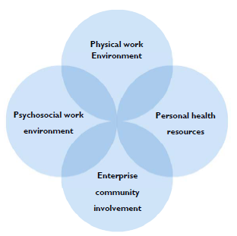
World Health Organization
Workplace Mental Health Framework

Slide 3
Policies
Procedures
Work/Life Balance
Trauma-Poverty, Racism, ACE’s
Societal pressures/events
Work/Life Balance
Parity
Environment for Growth
Tools/Resources

Slide 4
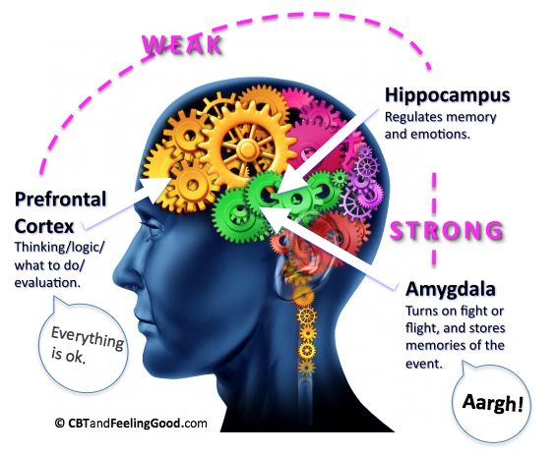

Slide 5
THE BRAIN ON TOXIC STRESS AND TRAUMA Normal responses to abnormal experiences
Abnormal experiences:
Adverse Childhood Experiences (ACEs)
Chronic work stress
Climate change trauma
COVID-19 pandemic
Poverty
Racial trauma, violence and reckoning
War
Fight
Flight
Freeze
Fawn
Normal automatic bodily responses:
Anger
Anxiety
Body aches
Brain fog
Confusion
Depression
Fatigue
Fearful
Fed up
Feeling physically older
Irritated
Numb
Untrusting

Slide 6
THE IMPACT OF TOXIC AND CHRONIC STRESS
Chronic stress is linked to other conditions, both psychological and physical. These can include:
Diseases such as hypertension, heart disease, obesity and metabolic syndrome, Type II diabetes and arthritis.
Addiction to alcohol, nicotine and/or prescription drugs, and behavioral-related activities such as addiction to the internet, food or gambling.
Mood disorders and anxiety disorders, which are common secondary diagnoses for people with chronic stress.

Slide 7
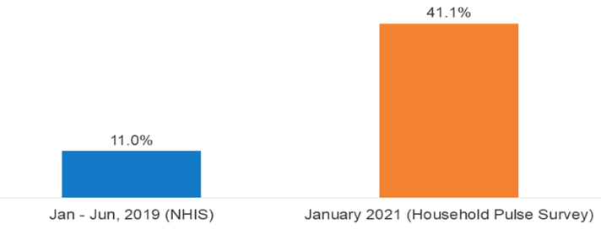
Average Share of Adults Reporting Symptoms of Anxiety Disorder and/or Depressive Disorder January – June 2019 Vs. January 2021
The Impact of the Pandemic
With the COVID-19 pandemic, Americans experienced toxic and chronic stress, and many have experienced significant trauma.
This has increased symptoms of anxiety and depression in a large way.

Slide 8
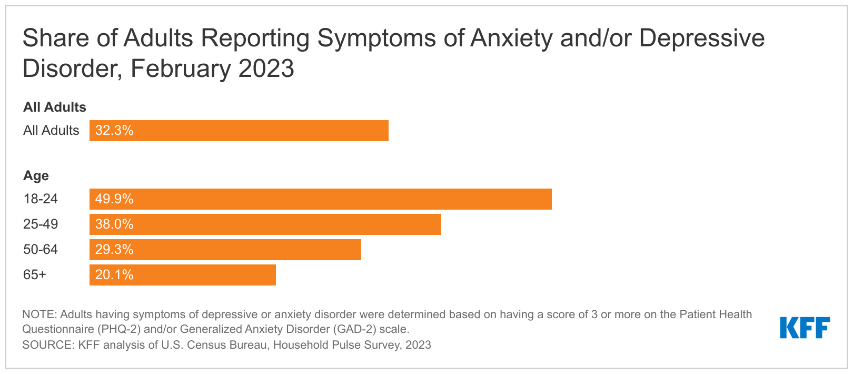
https://www.kff.org/mental-health/press-release/latest-federal-data-show-that-young-people-are-more-likely-than-older-adults-to-be-experiencing-symptoms-of-anxiety-or-depression/

Slide 9
In 2020, roughly 48M people suffered from an anxiety disorder,
While 21M suffered from a major depressive episode.
However, less than half, 46.2%, received treatment for a mental illness in 2020.
Overall, 21% of the U.S. adult population will have a mental illness in any given year.
48M
21M
46%
21%

Slide 10
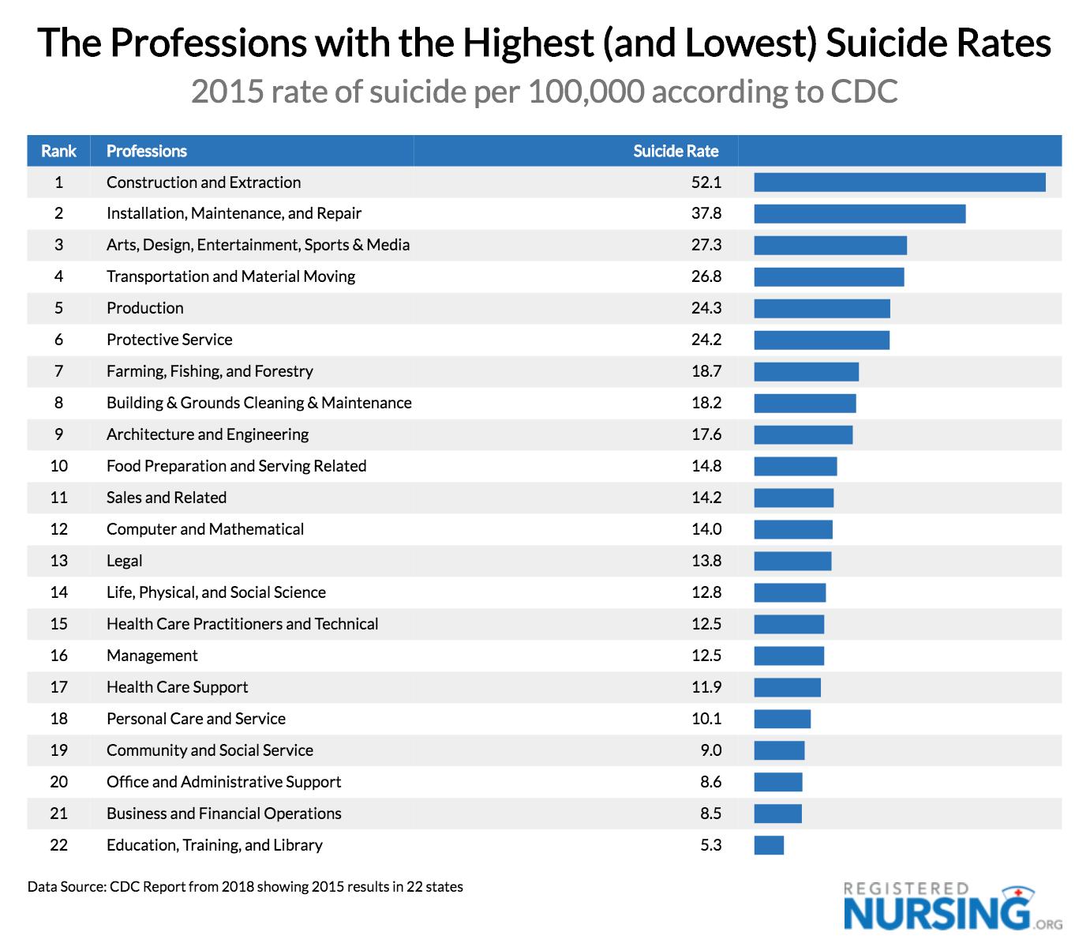
Industry Impacts
https://www.registerednursing.org/articles/suicide-rates-profession/

Slide 11
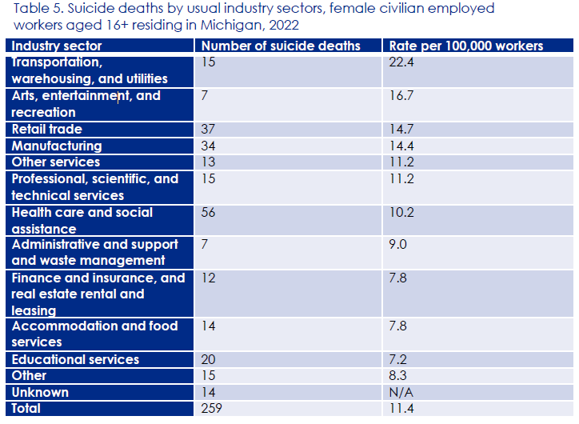
Michigan Industry Specific 2022
https://www.michigan.gov/mdhhs/-/media/Project/Websites/mdhhs/Doing-Business-with-MDHHS/Boards-and-Commissions/MSPC/Reports/2024-Suicide-Prevention-Commission-Report-Final.pdf?rev=9ab650d524bd44eeab0c3a0997f7e415&hash=C62786801DFE143274BFD31C105B3DE1

Slide 12
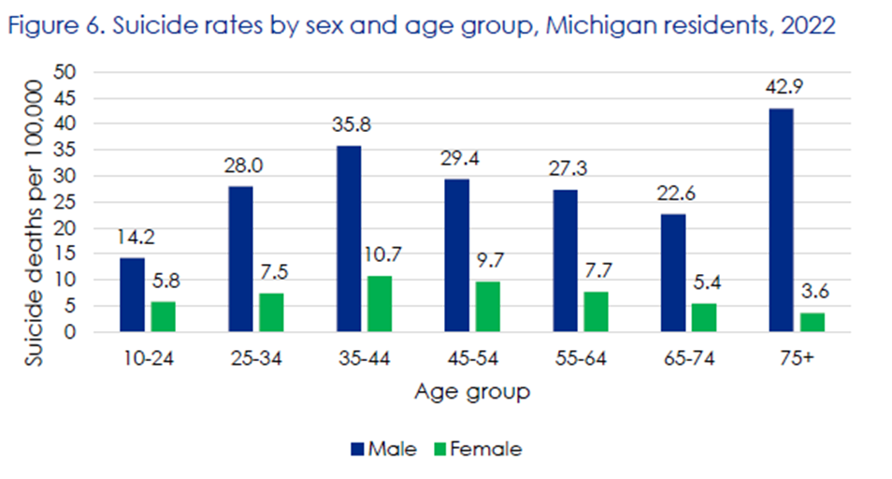
https://www.michigan.gov/mdhhs/-/media/Project/Websites/mdhhs/Doing-Business-with-MDHHS/Boards-and-Commissions/MSPC/Reports/2024-Suicide-Prevention-Commission-Report-Final.pdf?rev=9ab650d524bd44eeab0c3a0997f7e415&hash=C62786801DFE143274BFD31C105B3DE1

Slide 13
Industry Impacts-Substance Abuse
Figure 1. Past month heavy alcohol use among adults aged 18 to 64 employed full time, by industry category: combined 2008 to 2012
https://www.samhsa.gov/data/report/substance-use-and-substance-use-disorder-industry

Slide 14
Industry Impacts-Illicit Drugs
Figure 2. Past month illicit drug use among adults aged 18 to 64 employed full time, by industry category: combined 2008 to 2012
https://www.samhsa.gov/data/report/substance-use-and-substance-use-disorder-industry

Slide 15
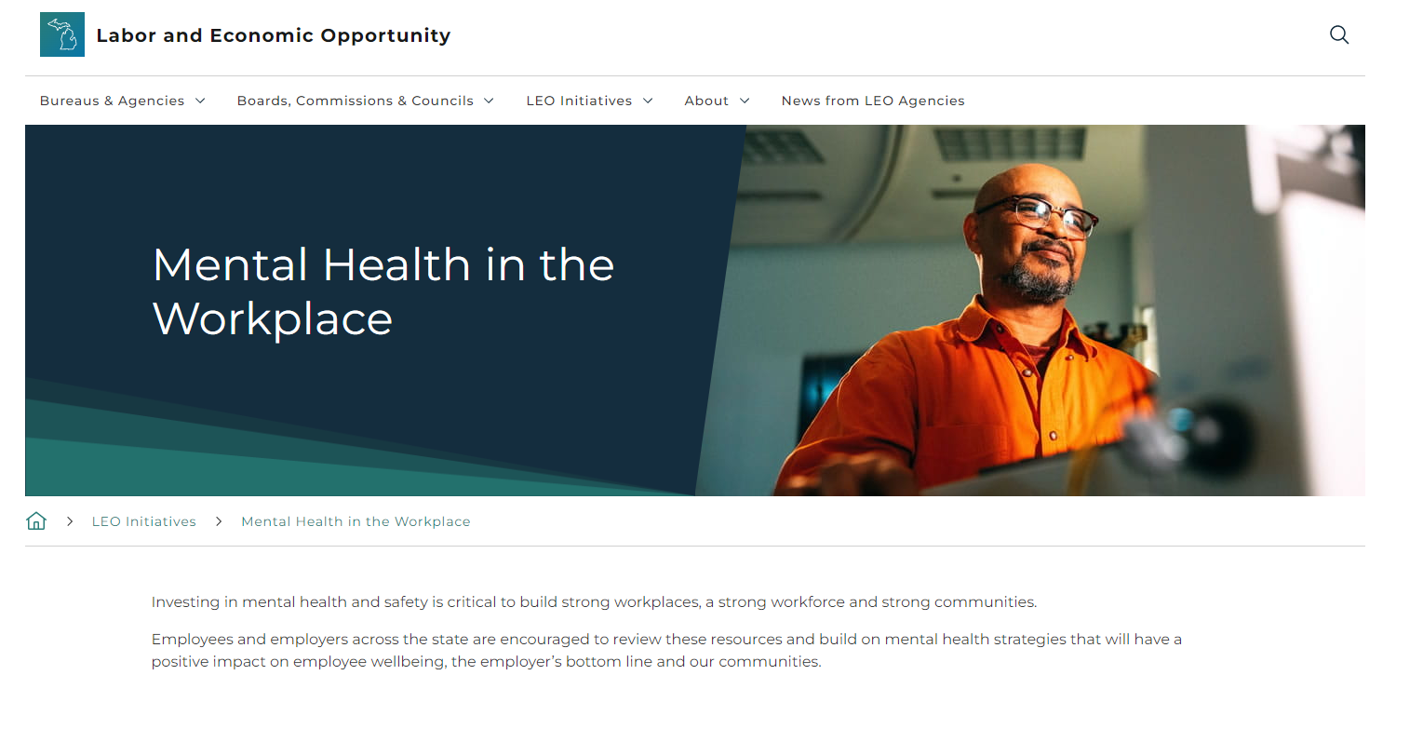

Slide 16
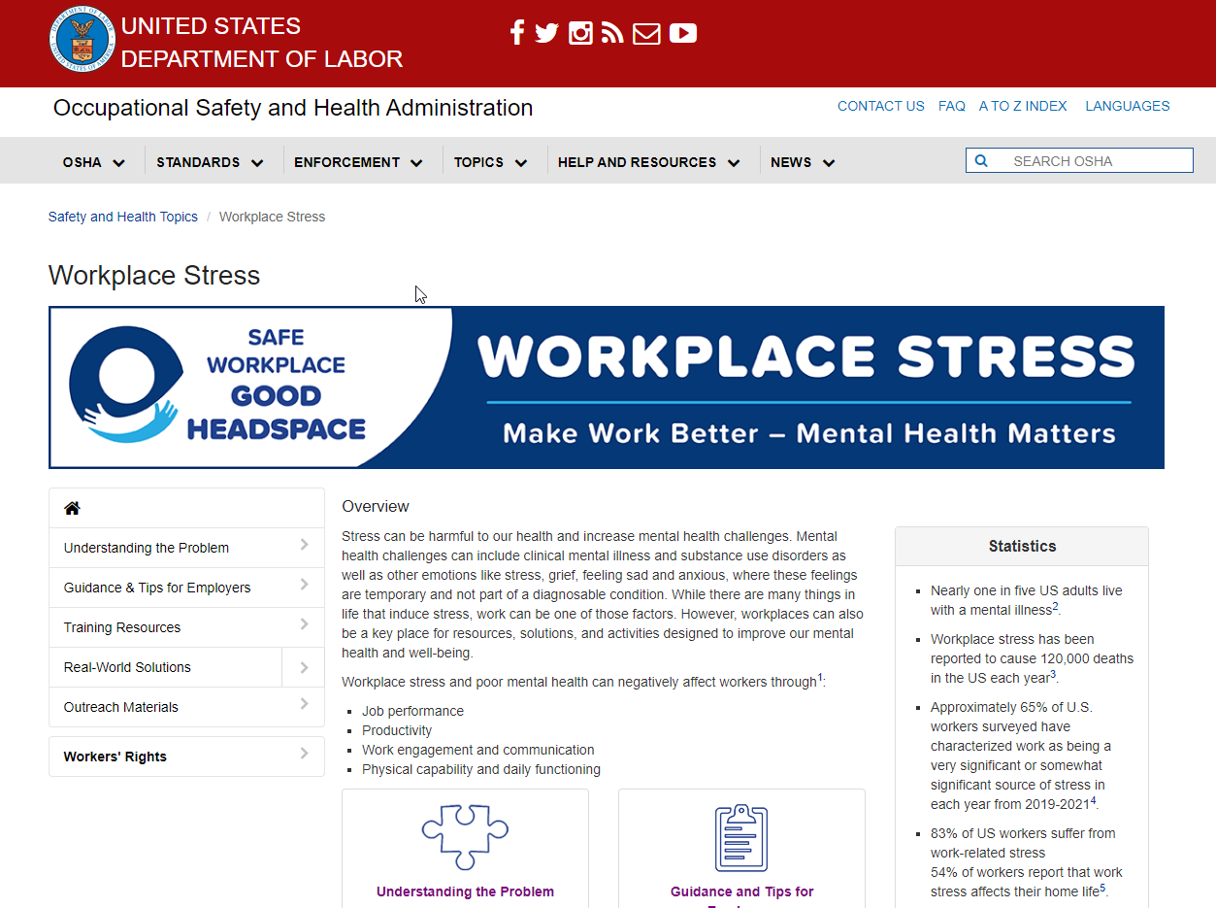

Slide 17
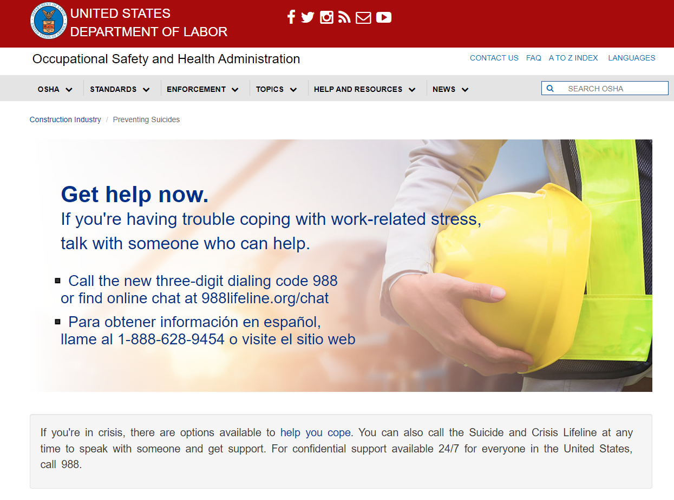
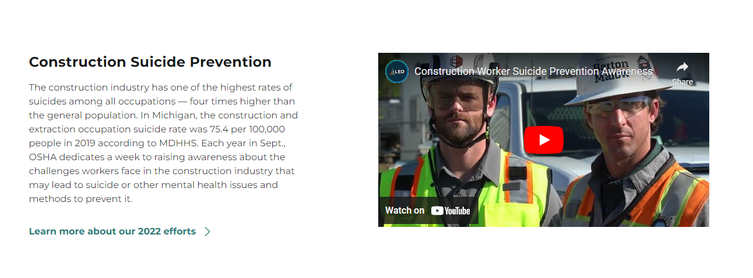

Slide 18
Building the Business Case
WHY THE WORKPLACE?
Working people spend most of their waking hours at work.
65% of Employees surveyed identified their job as the #1 stress in their lives.
Workplaces are already bearing the brunt of these costs of toxic and chronic stress, trauma, and unsafe mental health challenges.
Workplaces are most likely the best place to offer education, support and the ability to impact good outcomes.

Slide 19
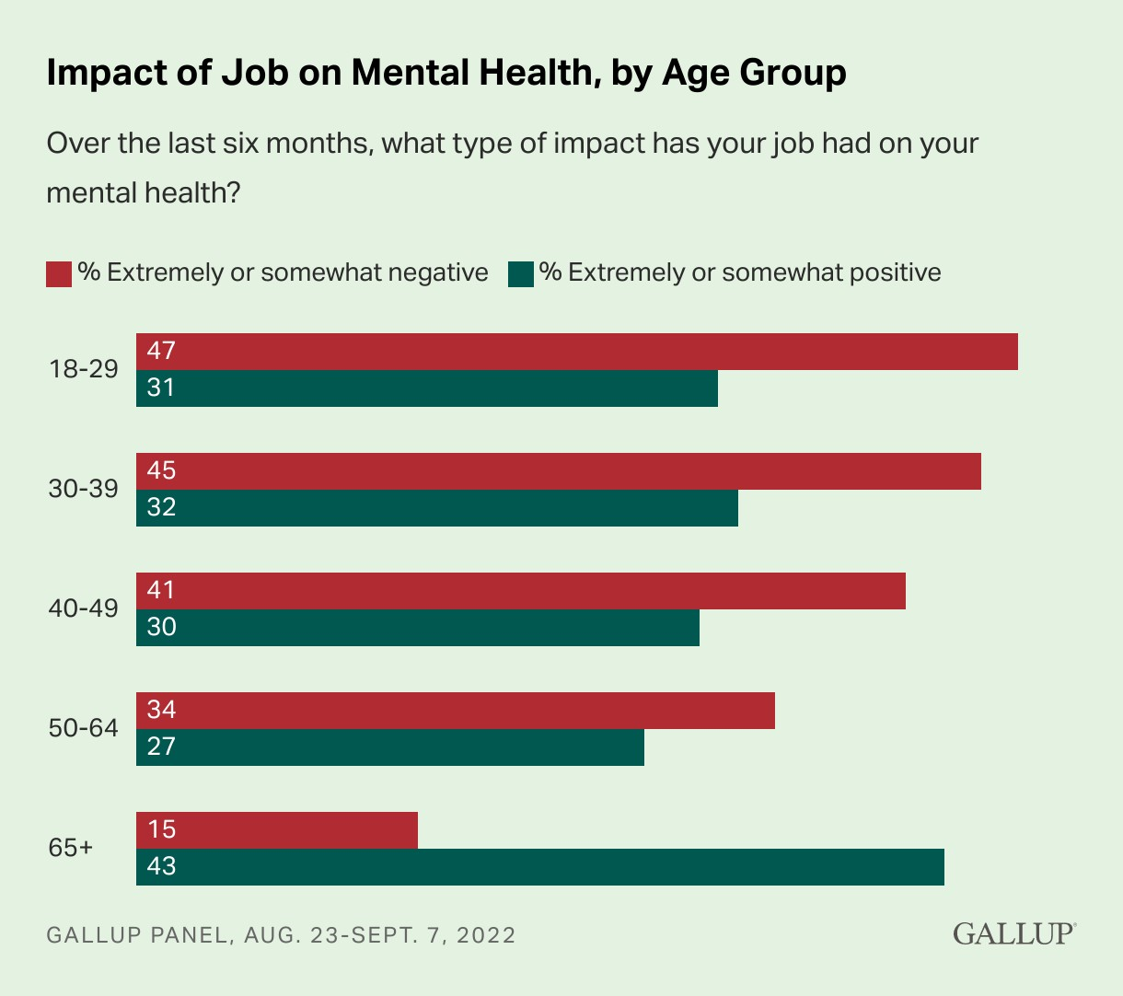
https://www.gallup.com/workplace/404174/economic-cost-poor-employee-mental-health.aspx

Slide 20
The Chicago Resiliency Network found a $4 return for each dollar invested in mental health treatment. Similar numbers are found in other research on mental health, which can vary a bit by condition. However, overall, the return on investment appears significant.
Typically, Invisible Costs:
Absenteeism because of major depressive disorder and anxiety alone account for 27 or more lost workdays annually per person experiencing these conditions, and cost roughly $250B annually.
Presenteeism occurs when workers are in the workplace, but due to depression are unable to fully function. A study from Tufts University found that depression accounted for 37% of all presenteeism losses for the top 10 most expensive chronic conditions at roughly $109 per all employees with or without the condition.
Based on prevalence data of depressive conditions, it is likely that an employer with 10,000 employees has 1,000 that are experiencing depression. These same multiples apply to smaller employers as well, meaning that the costs associated are already occurring.
Adding in job stress, research suggests that stress alone costs American companies over $300B in health care costs, absenteeism and poor performance. Further, roughly 40% of turnover is due to job stress.
IGNORING IS EXPENSIVE

Slide 21
Employer Impact: Control, Influence, Common Interests
Employers have control over several factors that can greatly impact overall employee health and wellbeing. Among these are:
Medical and other benefit programs
Workplace Rules
Employers also have a great deal of influence establishing the right culture and commitment to influence employee behaviors. Among these are:
Building trust
Employees and employers share many common interests in the workplace. Among these include:
Workplace safety and health
Processes and Procedures
Distribution of Work and Training
Supervisory Training
Employee Training
Response to Customer Interactions
Expectations for suppliers/contractors
Internal Data Gathering
Company Culture
Employer Communications and Messaging
Employer Commitment
Enhancing employee engagement through more opportunities and control
Ensuring transparency and ability for employees to speak up
Creating a safe space for employees to share challenges and opportunities focused on mental health
Recognizing all as Human Beings
Building a positive, welcoming culture
Enhancing and integrating diversity, equity and inclusion
Showing empathy
Job quality and engaging work
Personal and professional development
Employee ownership of job responsibilities
Opportunities for growth
Training
Transparency
Conflict resolution
Continued success of the business
Impacts job security, Impacts profitability

Slide 22
Employers who invest in their employees’ mental health and safety see a significant return on investment including improved employee satisfaction, increased productivity and reduced absenteeism and turnover.

Slide 23
71%
less likely to report experiencing a lot of burnout
5x
more likely to advocate for their employer as a place to work
THE GOOD NEWS
Employees who strongly agree that their employer cares about their overall wellbeing, including mental health, are:
69%
less likely to search for a new job
3x
more likely to be engaged at work
36%
more likely to be thriving in their lives

Slide 24
What is Resilience?
The ability, capacities, and relationships to manage and overcome adversity.
Resilience is not binary; it can be built, particularly through recovering from toxic stress and trauma.
By understanding toxic stress and trauma and their effects on the brain, we can transform them into resilience to fuel healing and success.
Notes:
TRISH
CSW is very intentional in our approach to this work and focus on trauma-informed AND resilience-building strategies.
Toxic stress and trauma are often hidden barriers to success for staff and clients, however, the brain has neuroplasticity, meaning that it is adaptable and can be rehabilitated to overcome the effects of trauma and emerge stronger on the other side, and this is resilience.
Resilience: Is a psychological and physiological strength
It can help us adapt & grow from challenges
It is NOT a fixed state
Can be developed & enhanced in multiple layers (personal, organizational, & community)
Practical strategies and flexible thinking can be helpful
Important to hold onto “multiple truths”

Slide 25
Five Steps to Start Building a Resilient Workplace
01
02
03
04
05
Assess Your Workplace and Culture
Consider Workplace Policies, Practices and Procedures
Recommit to Employee Assistance Programs (EAPs)
Develop Ways to Engage and Empower Employees
Consider Adding Mental Health to Joint Employer/ Employee Safety Committees

Slide 26
MiLEADS On Workplace Mental Health
Learning
Resources
Educate
Chronic Stress
Action
Deploy
Study/Stats
Surveys
Work Groups
Trauma
Stigma
Bias
Employee Empowerment
Evaluate Work Processes
Update Work as Necessary
Update/Add Supports
Train Managers and Employees
Set Expectations
Evaluate
Survey
Adjust
Resiliency
Policy Review/Updates

Slide 27
Investing in mental health and safety is critical to building strong workplaces, a strong workforce and strong communities.

Slide 28
